Slide 1
CUSTOMER SEGMENTATION USING K – MEANS CLUSTERING

Slide 2
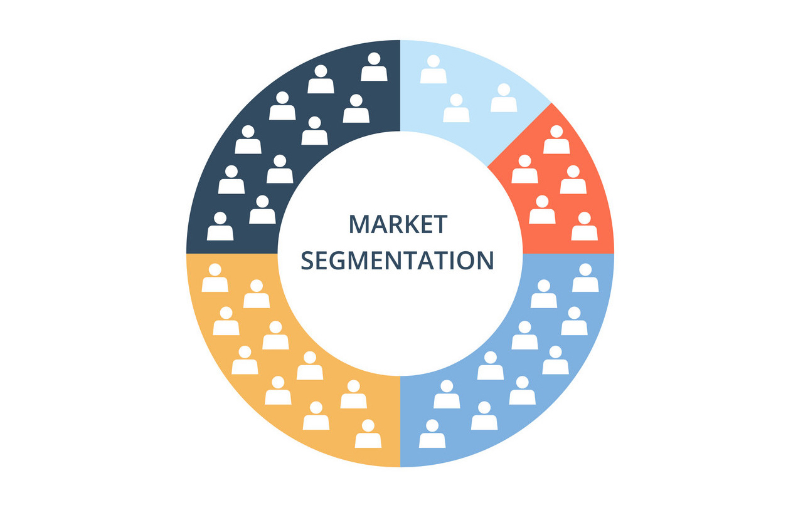
What is Customer Segmentation?
Customer segmentation (also known as market segmentation) is the division of potential customers in a given market into discrete groups.
That division is based on customers having similar enough:
Needs, i.e., so that a single whole product can satisfy them.
Buying characteristics, i.e., responses to messaging, marketing channels, and sales channels, that a single go-to-market approach can be used to sell to them competitively and economically.

Slide 3
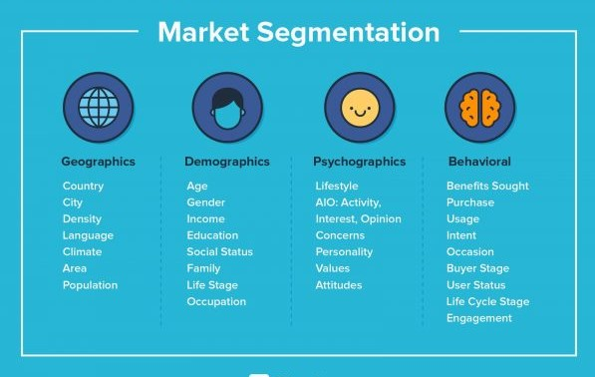
Types of Customer Segmentation?

Slide 4
The Algorithm?
K – Means Clustering

Slide 5
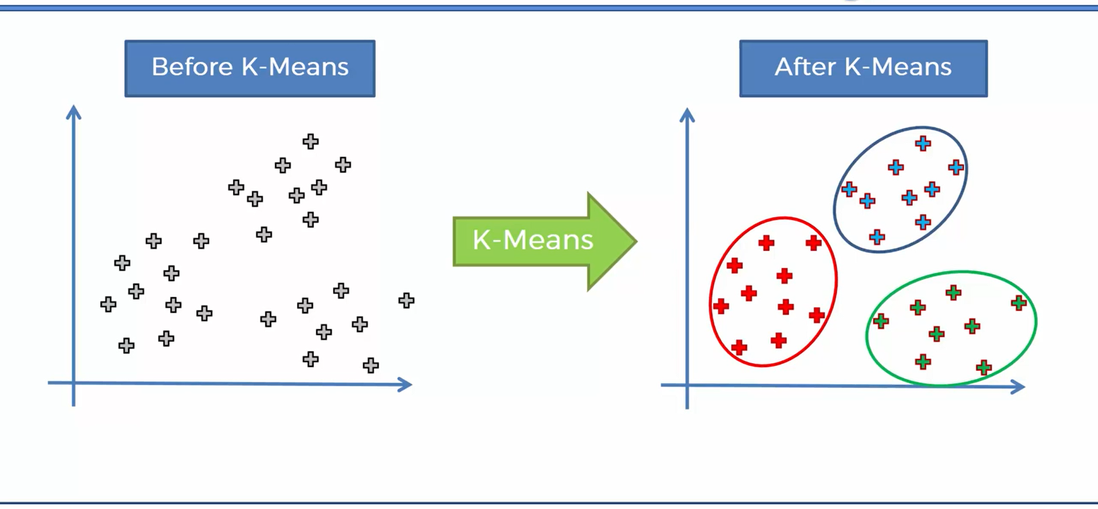
What K – Means does for you?

Slide 6
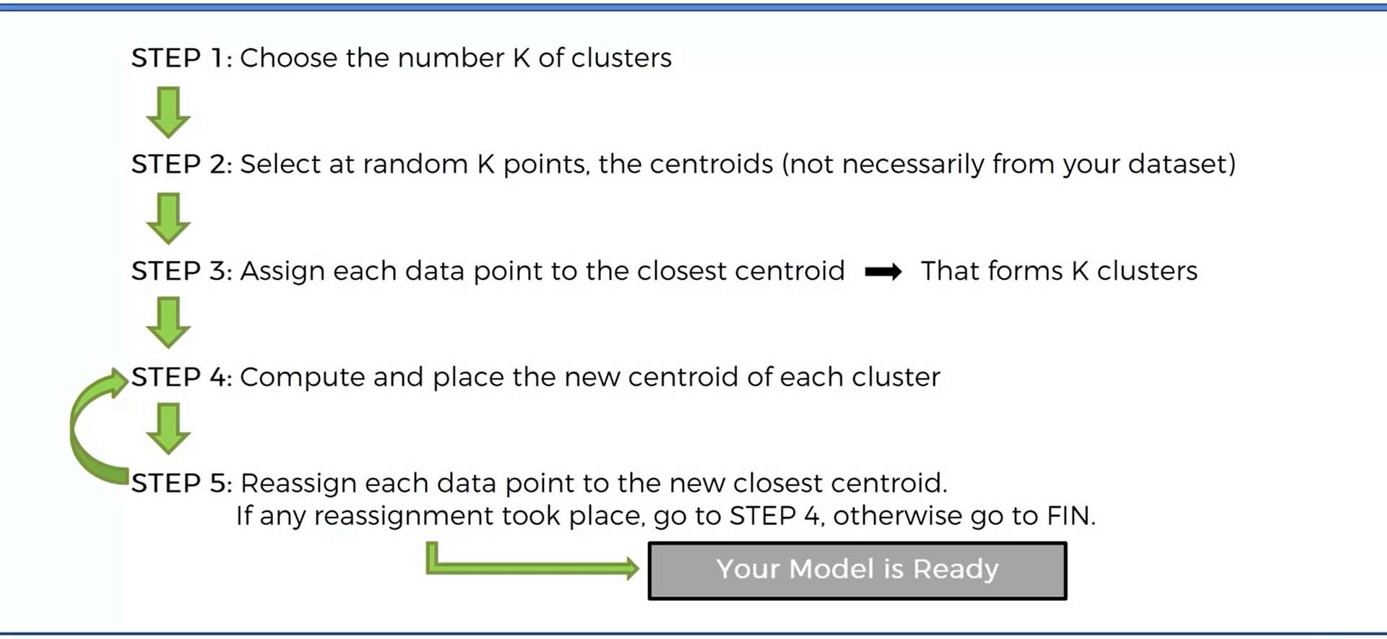
How did it do that?

Slide 7
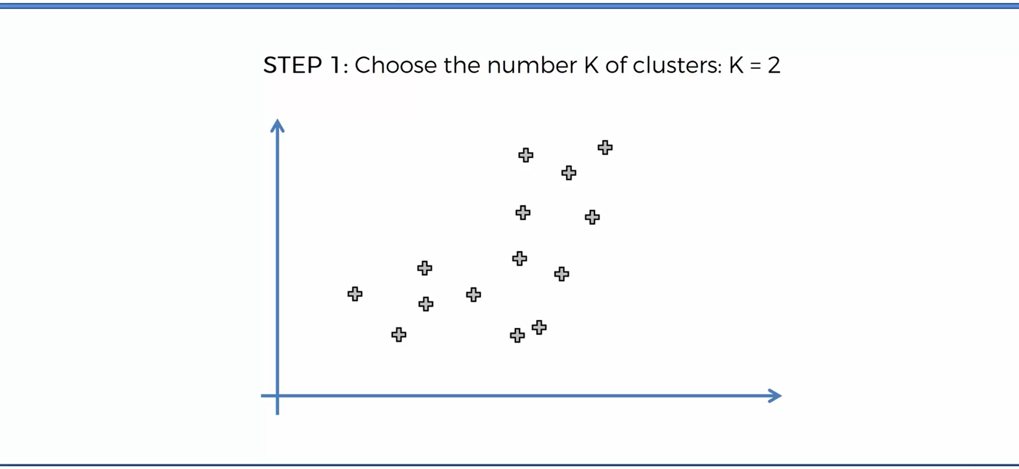
K – Means Algorithm

Slide 8
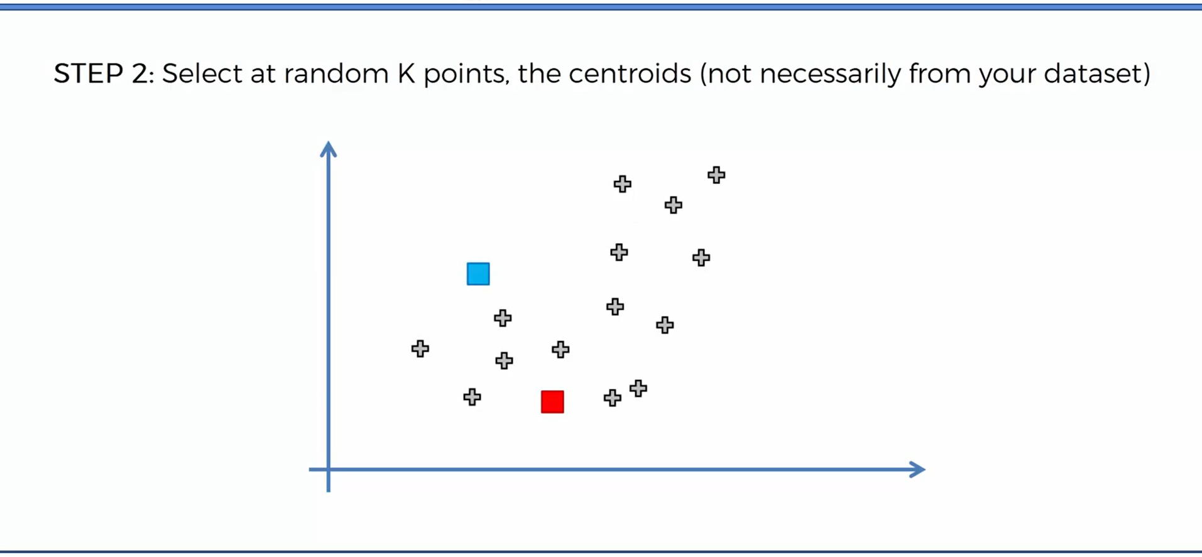
K – Means Algorithm

Slide 9
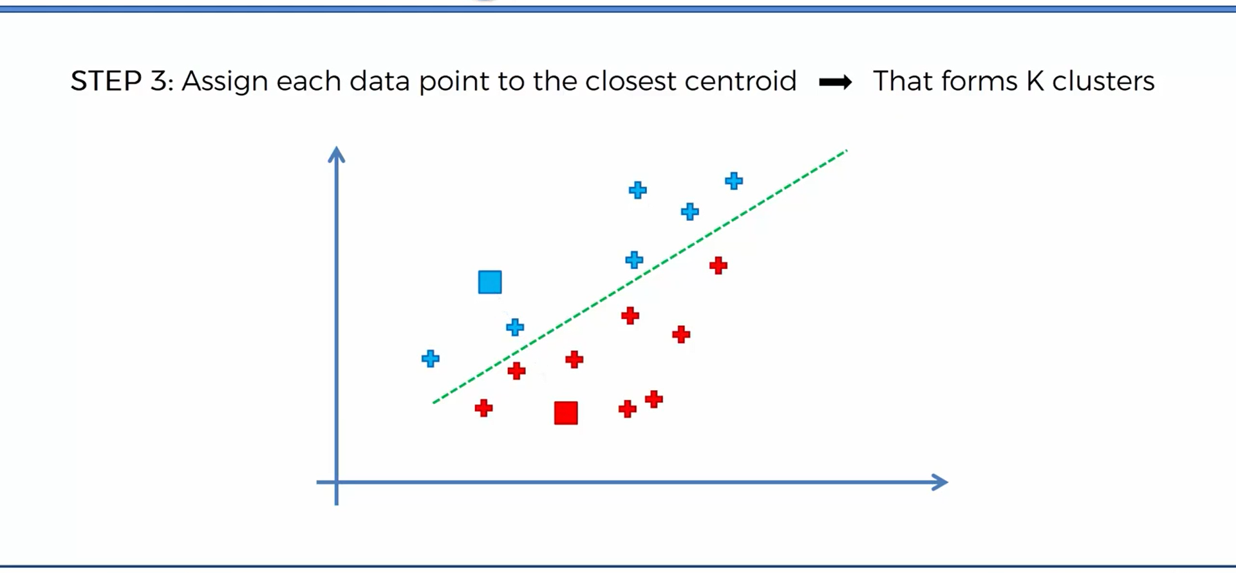
K – Means Algorithm

Slide 10
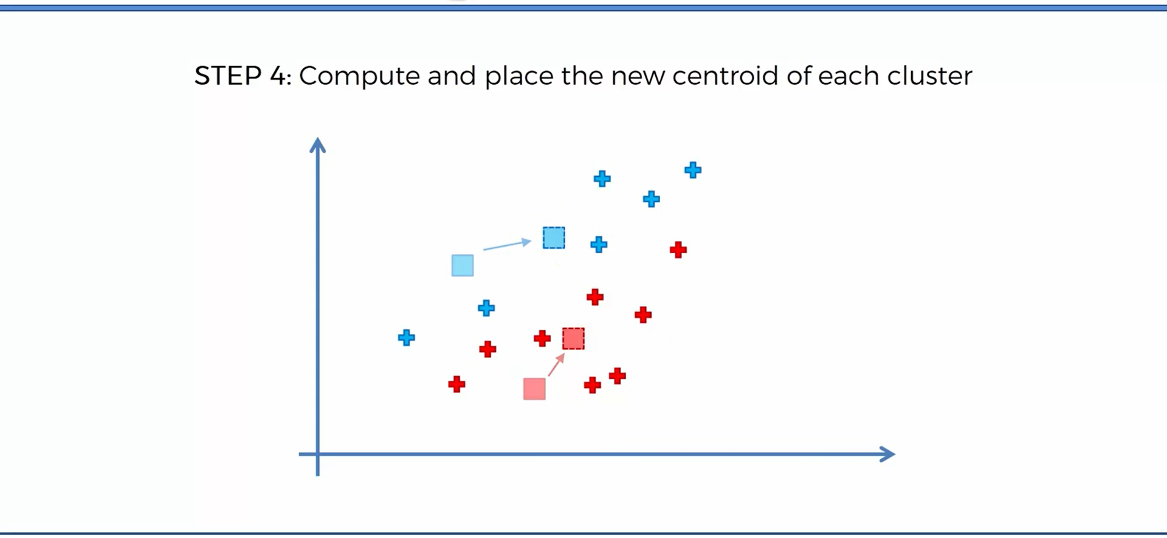
K – Means Algorithm

Slide 11
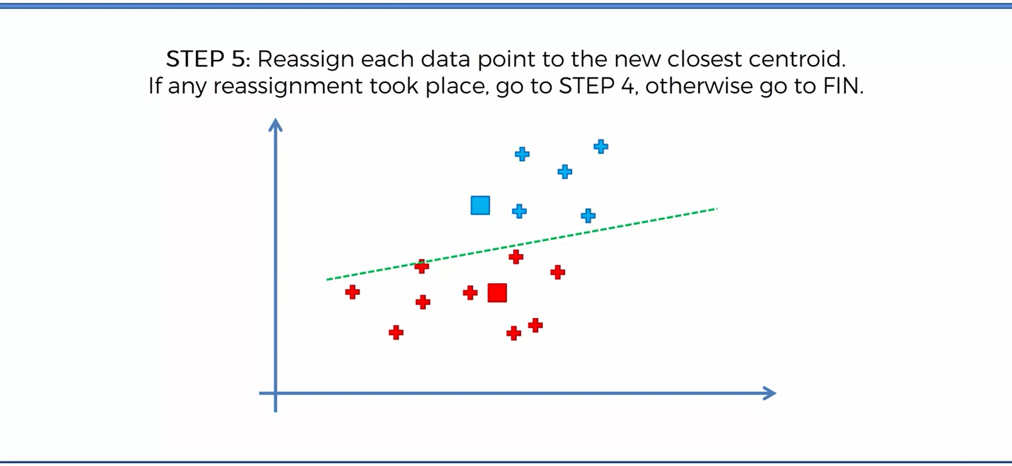
K – Means Algorithm

Slide 12
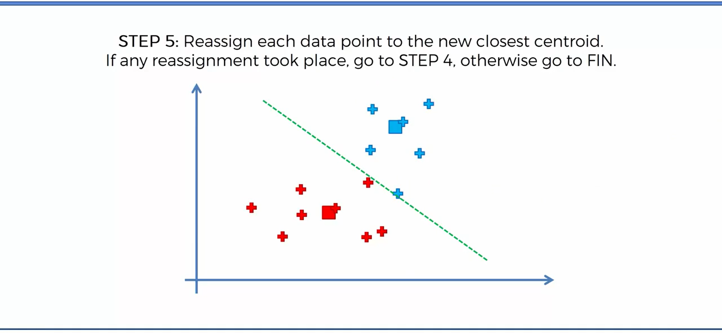
K – Means Algorithm

Slide 13
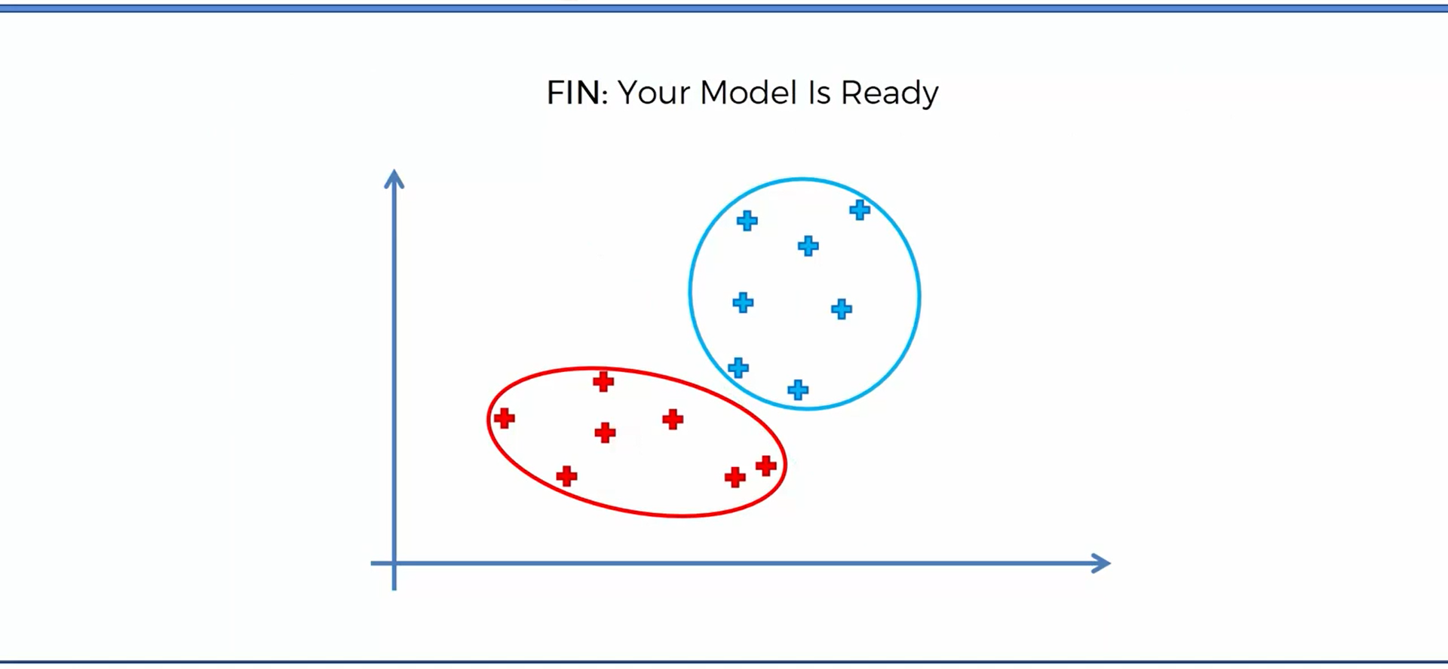
K – Means Algorithm

Slide 14
THANK YOU!
- Made by Tanay Mayee

