Slide 1
E0-271 Graphics & Visualization A Real-Time Framework For Eddy Visualization and Analysis
Group 2:
Tanay Narshana
Tushar Pandurang Kadam

Slide 2
Background
No one definition for eddies
1

Slide 3



Background
Ocean mesoscale eddies: Energetic, swirling, time-dependent circulations about 10- 100 km in width, found in large water bodies.
1

Slide 4
Background
Ocean mesoscale eddies: Energetic, swirling, time-dependent circulations about 10- 100 km in width, found in large water bodies.
Transformations in eddies aren’t very abrupt
1

Slide 5
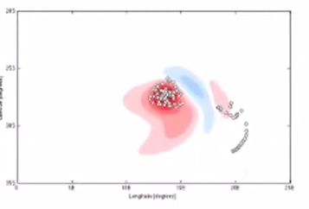
Why Visualize Eddies?
Transport Salt, Carbon, Nutrients around the oceans
2

Slide 6
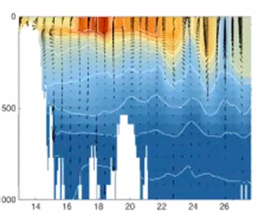
Why Visualize Eddies?
Transport Salt, Carbon, Nutrients around the oceans
Bring Nutrients onto the surface of the sea
2

Slide 7
Why Visualize Eddies?
Transport Salt, Carbon, Nutrients around the oceans
Bring Nutrients onto the surface of the sea
Affect Weather across Earth (air-sea interactions)
2

Slide 8
Why Visualize Eddies?
Transport Salt, Carbon, Nutrients around the oceans
Bring Nutrients onto the surface of the sea
Affect Weather across Earth (air-sea interactions)
Have Contained Oil Spills!
2

Slide 9
Why Visualize Eddies?
Transport Salt, Carbon, Nutrients around the oceans
Bring Nutrients onto the surface of the sea
Affect Weather across Earth (air-sea interactions)
Have Contained Oil Spills! And maybe a reason of their cause too!
2

Slide 10
Why Visualize Eddies?
Transport Salt, Carbon, Nutrients around the oceans
Bring Nutrients onto the surface of the sea
Affect Weather across Earth (air-sea interactions)
Have Contained Oil Spills! And maybe a reason of their cause too!
Let’s Detect Eddies in the Read Sea & the Gulf of Aden!
2

Slide 11
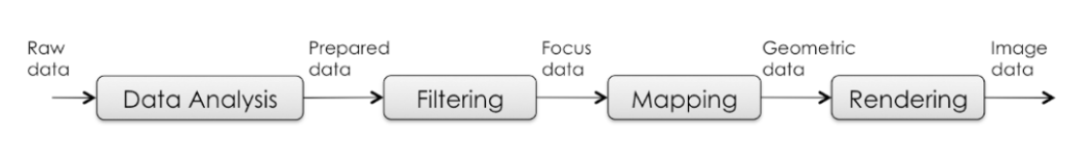
Our Work
3

Slide 12
Our Work
Courtesy: Red Sea Modelling and Prediction Group, H. Toye et al. Ensemble data assimilation in the Red Sea
3

Slide 13


Our Work
OW = $S_{n}^{2}+S_{S}^{2}−⍵^{2}$
3

Slide 14

Our Work
OW = $S_{n}^{2}+S_{S}^{2}−⍵^{2}$
$$S_{n}=u_{x} −v_{y}$$
Normal Component of Strain
3

Slide 15

Our Work
OW = $S_{n}^{2}+S_{S}^{2}−⍵^{2}$
$$S_{n}=u_{x} −v_{y}$$
$$S_{s}=u_{y}+v_{x}$$
Shear Component of Strain
3

Slide 16

Our Work
OW = $S_{n}^{2}+S_{S}^{2}−⍵^{2}$
$$S_{n}=u_{x} −v_{y}$$
$$S_{s}=u_{y}+v_{x}$$
$$⍵= v_{x} − u_{y}$$
Relative Vorticity of the Flow
3

Slide 17
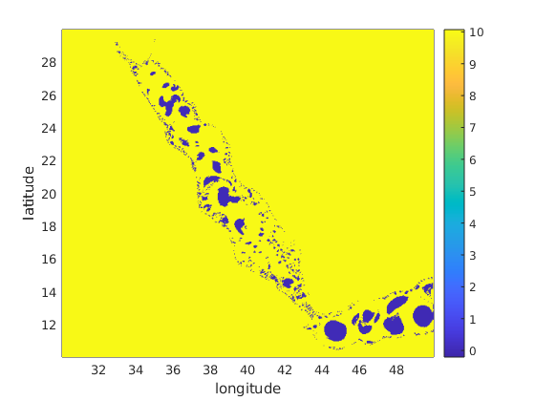

Our Work
OW = $S_{n}^{2}+S_{S}^{2}−⍵^{2}$
$$S_{n}=u_{x} −v_{y}$$
$$S_{s}=u_{y}+v_{x}$$
$$⍵= v_{x} − u_{y}$$
$$OW<−0.2 σ_{OW}$$
Okubo ['70], Weiss ['91]
3

Slide 18
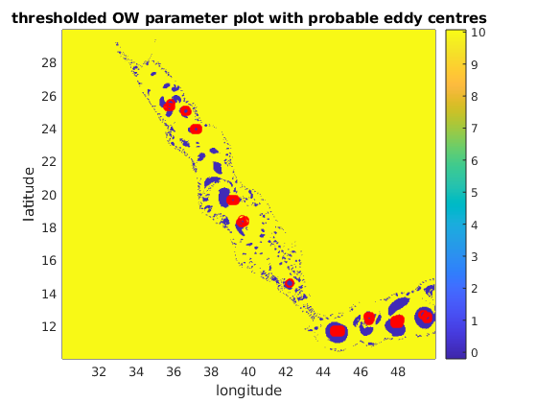
Our Work
OW = $S_{n}^{2}+S_{S}^{2}−⍵^{2}$
$$S_{n}=u_{x} −v_{y}$$
$$S_{s}=u_{y}+v_{x}$$
Kang et al. (2013)
$$⍵= v_{x} − u_{y}$$
$$OW<−0.2 σ_{OW}$$
3

Slide 19
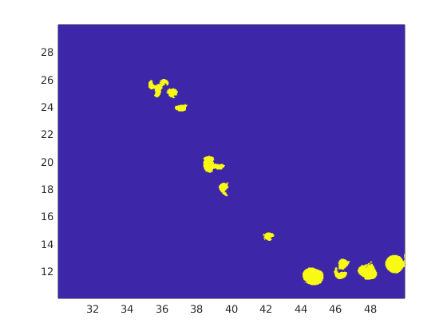
Our Work
OW = $S_{n}^{2}+S_{S}^{2}−⍵^{2}$
$$S_{n}=u_{x} −v_{y}$$
$$S_{s}=u_{y}+v_{x}$$
$$⍵= v_{x} − u_{y}$$
$$OW<−0.2 σ_{OW}$$
3

Slide 20
Our Work
Isocontours
3

Slide 21
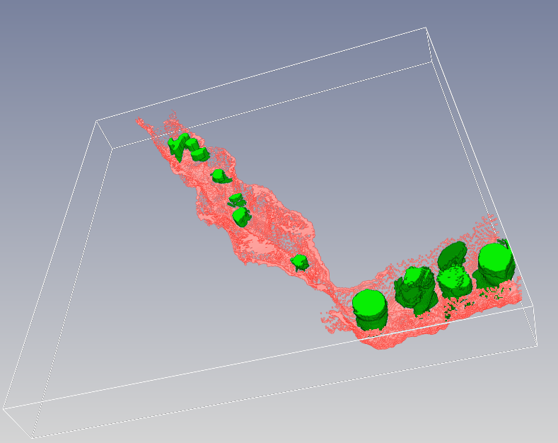
Our Work
Inviwo
3

Slide 22
Our Work
Sea Surface Data
Algorithms for
Sea Surface
4

Slide 23
Our Work
Sea Surface Data
Algorithms for
Sea Surface
Rendering
Image Data
4

Slide 24
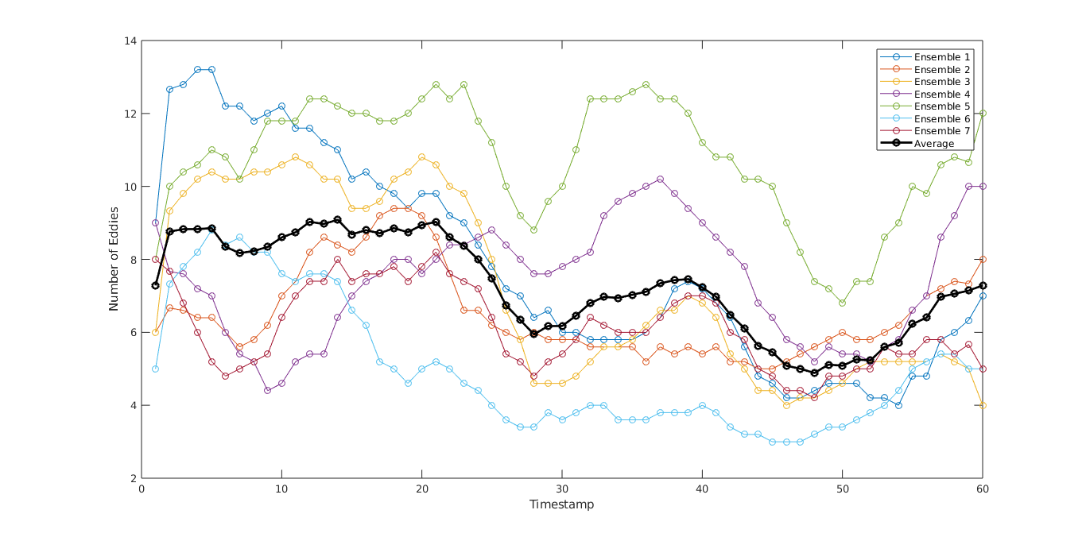
Our Work
4

Slide 25
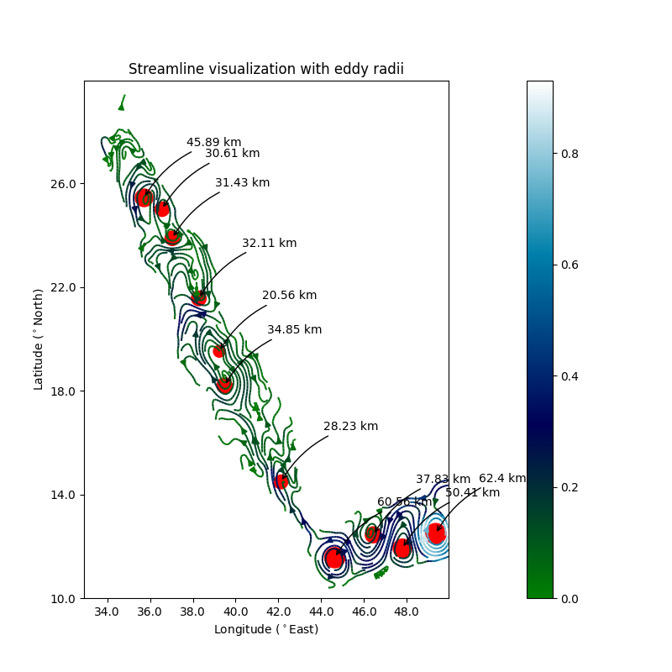
Our Work
4

Slide 26



Our Work
Split
4

Slide 27



Our Work
Split
Merge
4

Slide 28

Our Work
Split
Merge
Birth
4

Slide 29

Our Work
Split
Merge
Birth
Death
4

Slide 30
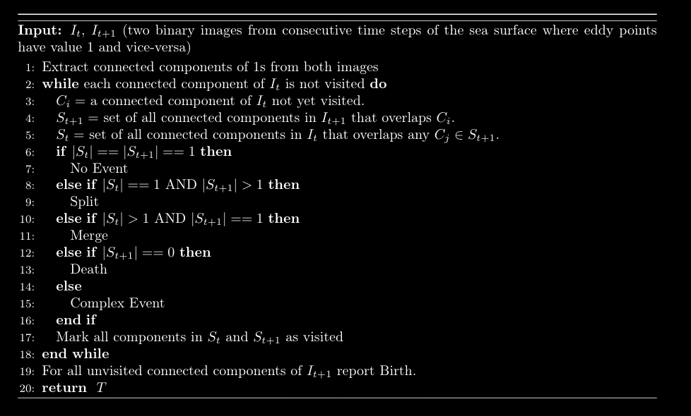

Our Work
5

Slide 31


Our Work
No Event!
5

Slide 32



Our Work
Split!
5

Slide 33



Our Work
Merge!
5

Slide 34




Our Work
Complex Event!
5

Slide 35

Our Work
Birth!
5

Slide 36
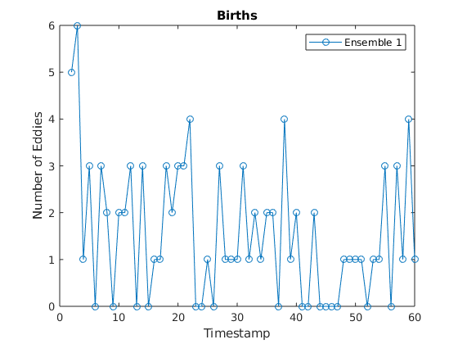
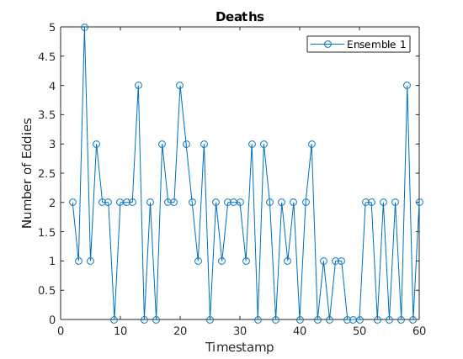
Our Work
(Something is wrong)
5

Slide 37
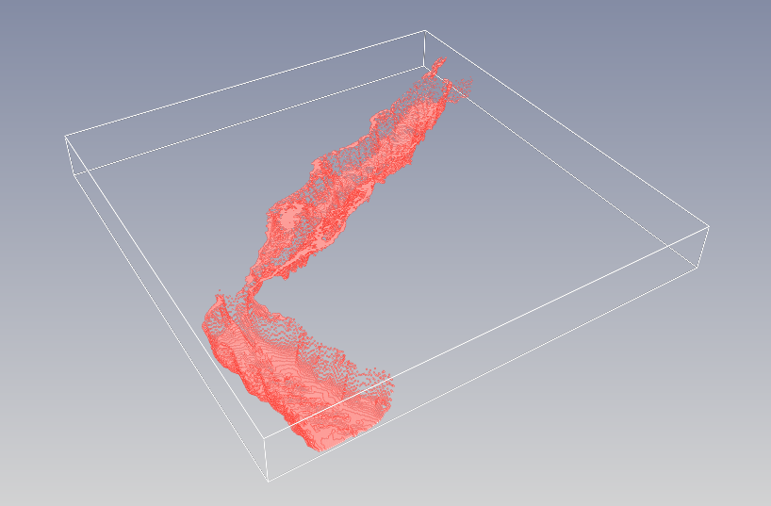
Demo
Interactive Visualisation of Eddies in red sea using Inviwo
Sea bed from bathymetry data

Slide 38
Demo
Interactive Visualisation of Eddies in red sea using Inviwo
Sea bed from bathymetry data
Eddies with sea bed

Slide 39
Results : Streamline Plot
To verify the results of our eddy detection we compared results with streamline plot of vector field and Color coded with magnitude of surface velocity

Slide 40
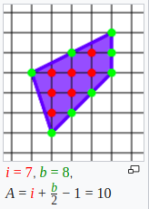
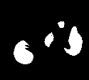
Results : Streamline Plot
To verify the results of our eddy detection we compared results with streamline plot of vector field and Color coded with magnitude of surface velocity
Calculated Effective Radius of each mesoscale eddy using Picks theorem on each of
Shapes of Detected eddies
Pick's Theorem PC :Wikipedia

Slide 41
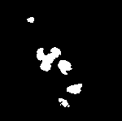

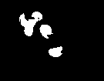
Challenges in Eddy Tracking
Appear / Disappear nature of eddies
Timestep 12
Timestep 13
Timestep 14

Slide 42
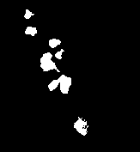
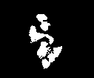
Challenges in Eddy Tracking
Appear / Disappear nature of eddies
Timestep 12
Timestep 13
Timestep 14
Clutter of small eddies which are close to each other
Timestep 04
Timestep 06

Slide 43
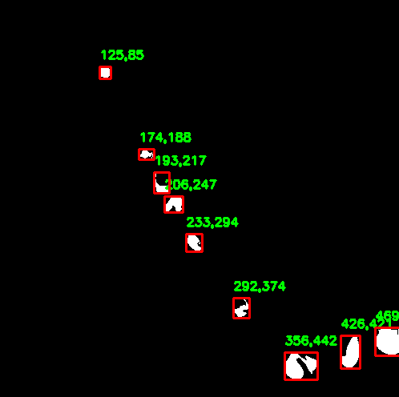
Eddy Tracking : Using Image Processing
Applied object detection algorithms on images of eddies (Contour Detection)

Slide 44
Eddy Tracking : Using Image Processing
Applied object detection algorithms on images of eddies (Contour Detection)
For each detected objects we can assign features like centroid of eddy, shape of contours, area of contours.

Slide 45
Eddy Tracking : Using Image Processing
Applied object detection algorithms on images of eddies (Contour Detection)
For each detected objects we can assign features like centroid of eddy, shape of contours, area of contours.
After that we can search for these eddies in next few timesteps with similar features.

Slide 46
Eddy Tracking : Using Image Processing
Applied object detection algorithms on images of eddies (Contour Detection)
For each detected objects we can assign features like centroid of eddy, shape of contours, area of contours.
After that we can search for these eddies in next few timesteps with similar features.
Using this is better than volume overlap technique because here along with spatial features like volume we are also using positional features

Slide 47
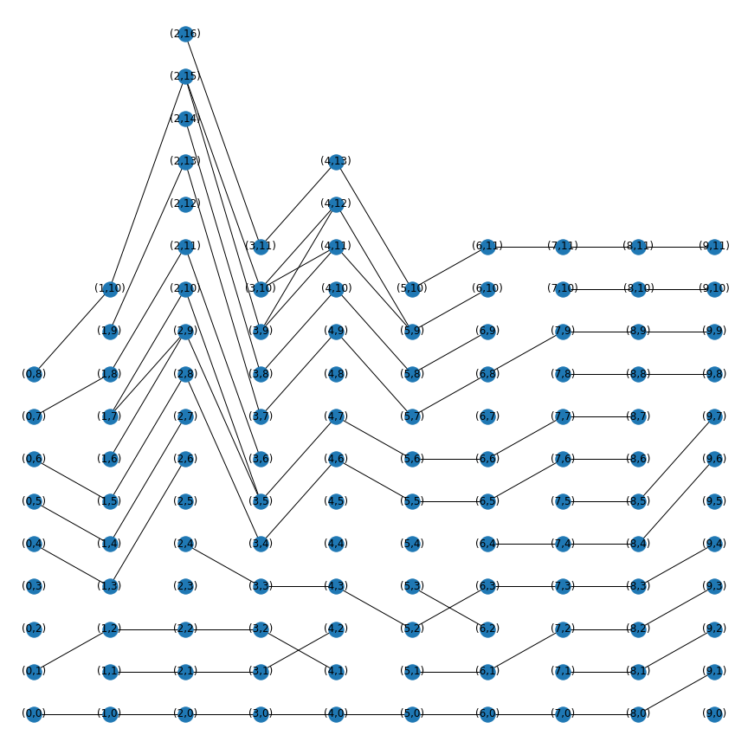
Eddy Tracking : Using Image Processing
Life cycle of eddies for ensemble 1 using Graph Visualization .

Slide 48
Eddy Tracking : Using Image Processing
Life cycle of eddies for ensemble 1 using Graph Visualization .
Each node is numbered like (A,B) where : A is timestamp (columns) and B is eddy identifer.

Slide 49
Eddy Tracking : Using Image Processing
Life cycle of eddies for ensemble 1 using Graph Visualization .
We can visualise life of eddy using this graph.

Slide 50
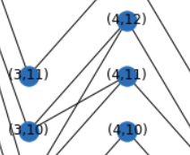
Eddy Tracking : Using Image Processing
Life cycle of eddies for ensemble 1 using Graph Visualization .
Splits / merges of eddies can be determined by incoming and outgoing edges
Split at (3,10)

Slide 51
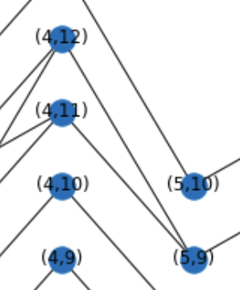
Eddy Tracking : Using Image Processing
Life cycle of eddies for ensemble 1 using Graph Visualization .
Splits / merges of eddies can be determined by incoming and outgoing edges
Merge

Slide 52
Eddy Tracking : Using Image Processing
Life cycle of eddies for ensemble 1 using Graph Visualization .
Births vs Deaths can be identified using vertex connectivity of vertex.

Slide 53
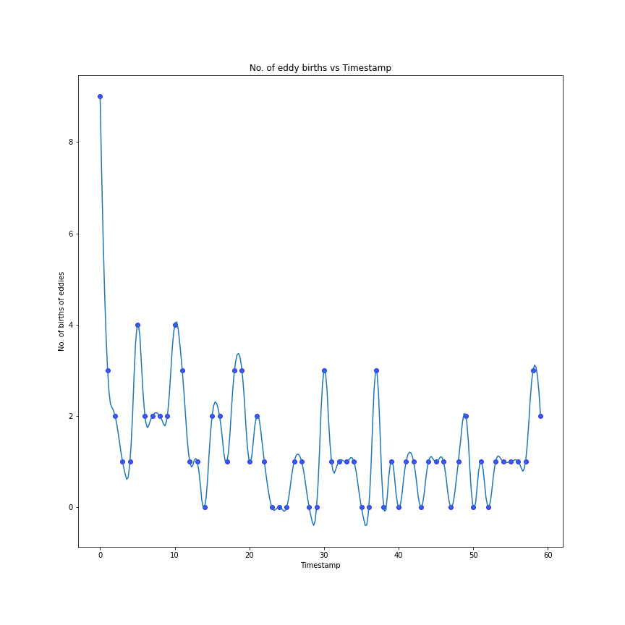
Eddy Tracking : Plots (Births and deaths)

Slide 54
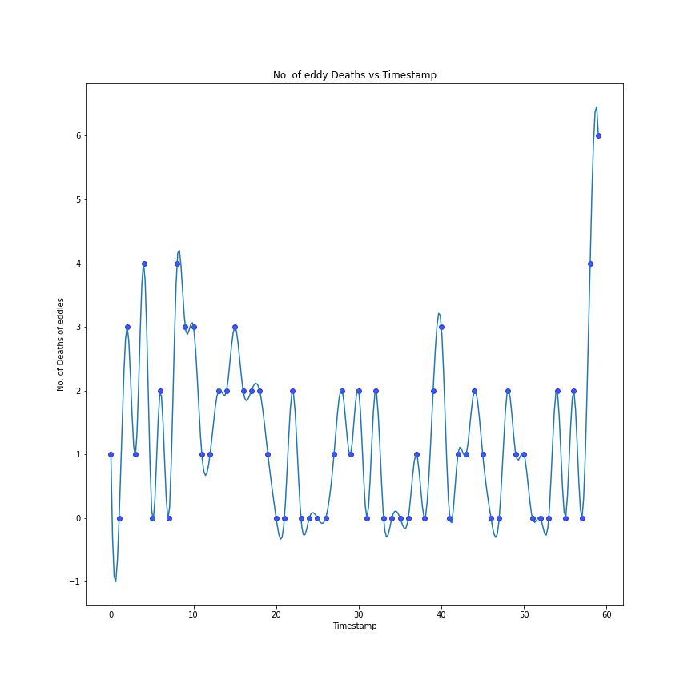
Eddy Tracking : Plots (Births and deaths)

Slide 55
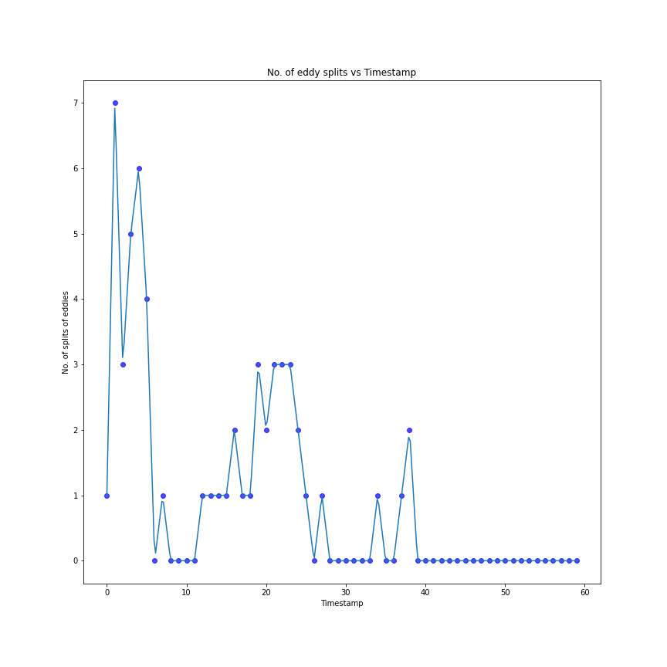
Eddy Tracking : Plots (Splits and Merges)

Slide 56
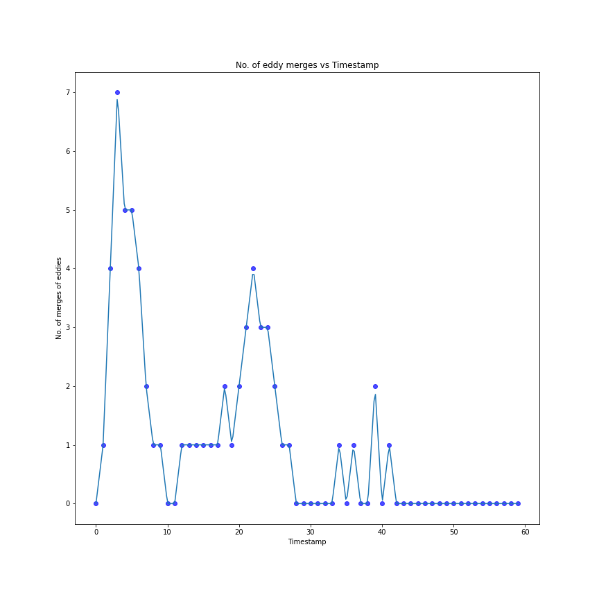
Eddy Tracking : Plots (Splits and Merges)

Slide 57
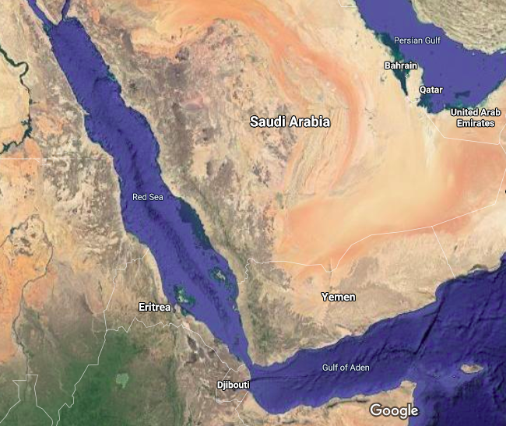
Conclusions
Around 3-4 dominant mesoscale eddies are present at Gulf of Aden
Position of dominant eddies
Google maps image

Slide 58
Conclusions
3-4 dominant mesoscale eddies are present at Gulf of Aden.

Slide 59
Conclusions
3-4 dominant mesoscale eddies are present at Gulf of Aden.
Magnitude of Velocities near Eddie center is more than other places. (From Stream plots)

Slide 60
Conclusions
3-4 dominant mesoscale eddies are present at Gulf of Aden.
Magnitude of Velocities near Eddie center is more than other places. (From Stream plots)
As the times passes number of births of eddies decreases as well as number of deaths also increases which shows only few dominant eddies (Eddies near gulf of aden) are contributing for transportation of nutrients.

Slide 61
Conclusions
3-4 dominant mesoscale eddies are present at Gulf of Aden.
Magnitude of Velocities near Eddie center is more than other places. (From Stream plots)
As the times passes number of births of eddies decreases as well as number of deaths also increases which shows only few dominant eddies (Eddies near gulf of aden) are contributing for transportation of nutrients.
Image processing techniques though gives better results are not 100% accurate.

Slide 62
Conclusions
3-4 dominant mesoscale eddies are present at Gulf of Aden.
Magnitude of Velocities near Eddie center is more than other places. (From Stream plots)
As the times passes number of births of eddies decreases as well as number of deaths also increases which shows only few dominant eddies (Eddies near gulf of aden) are contributing for transportation of nutrients.
Image processing techniques though gives better results are not 100% accurate.
Even though size of dataset is enormous (~500 MB/timestep) our script for eddy detection took around 3.8 secs/timestep to completely process data.

Slide 63
Conclusions
3-4 dominant mesoscale eddies are present at Gulf of Aden.
Magnitude of Velocities near Eddie center is more than other places. (From Stream plots)
As the times passes number of births of eddies decreases as well as number of deaths also increases which shows only few dominant eddies (Eddies near gulf of aden) are contributing for transportation of nutrients.
Image processing techniques though gives better results are not 100% accurate.
Even though size of dataset is enormous (~500 MB/timestep) our script for eddy detection took around 3.8 secs/timestep to completely process data.
Once eddy detection step is done only around 2MB of data transfer is required for further visualisations.

Slide 64
Conclusions
3-4 dominant mesoscale eddies are present at Gulf of Aden.
Magnitude of Velocities near Eddie center is more than other places. (From Stream plots)
As the times passes number of births of eddies decreases as well as number of deaths also increases which shows only few dominant eddies (Eddies near gulf of aden) are contributing for transportation of nutrients.
Image processing techniques though gives better results are not 100% accurate.
Even though size of dataset is enormous (~500 MB/timestep) our script for eddy detection took around 3.8 secs/timestep to completely process data.
Once eddy detection step is done only around 2MB of data transfer is required for further visualisations.
Proposed methods of visualisations can be used in real-time from data obtained from geo-stationary satellites.

Slide 65
Conclusions
3-4 dominant mesoscale eddies are present at Gulf of Aden.
Magnitude of Velocities near Eddie center is more than other places. (From Stream plots)
As the times passes number of births of eddies decreases as well as number of deaths also increases which shows only few dominant eddies (Eddies near gulf of aden) are contributing for transportation of nutrients.
Image processing techniques though gives better results are not 100% accurate.
Even though size of dataset is enormous (~500 MB/timestep) our script for eddy detection took around 3.8 secs/timestep to completely process data.
Once eddy detection step is done only around 2MB of data transfer is required for further visualisations.
Proposed methods of visualisations can be used in real-time from data obtained from geo-stationary satellites.
When integrated with pipelined framework the rate of updating of the framework would be the maximum of the eddy detection script and the time to fetch and pre-process data.

Slide 66
Conclusions
3-4 dominant mesoscale eddies are present at Gulf of Aden.
Magnitude of Velocities near Eddie center is more than other places. (From Stream plots)
As the times passes number of births of eddies decreases as well as number of deaths also increases which shows only few dominant eddies (Eddies near gulf of aden) are contributing for transportation of nutrients.
Image processing techniques though gives better results are not 100% accurate.
Even though size of dataset is enormous (~500 MB/timestep) our script for eddy detection took around 3.8 secs/timestep to completely process data.
Once eddy detection step is done only around 2MB of data transfer is required for further visualisations.
Proposed methods of visualisations can be used in real-time from data obtained from geo-stationary satellites.
When integrated with pipelined framework the rate of updating of the framework would be the maximum of the eddy detection script and the time to fetch and pre-process data.
Global parameters like vorticity per eddy can be easily passed.

Slide 67
References
Vijay Natarajan. Scientific Visualization: From Data to Insight
Daniel Jönsson, et al. Inviwo - a visualization system with usage abstraction levels. IEEE Transactionson Visualization and Computer Graphics, 26(11):3241–3254, 2019.
Google Images
SciVis 2020 Presentation Video

Slide 68
Thank You!
Curious about something?

