Slide 1
Classes and Objects

Slide 2
Mrs. K.V.Bhatt
Lecturer, Information Technology,
SBMP

Slide 3
Learning Outcomes
Students will be able to:
Define class and object.
Declare a class and instantiate an object
Write a sample program to test functionality of a class and an object

Slide 4
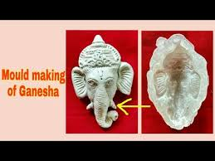
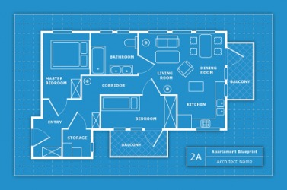
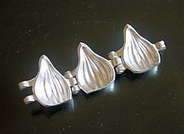
Class
A “Template” or “Blue Print” or “mould” which declares data and code(function) inside it.
We can create a user defined data type in C++ using class
It is a logical reality from which we can create n no. of instances i.e. from a mould, we can create so many idols, from a blue print (plan/design/pattern), we can construct so many buildings physically, etc.
A class is a collection of objects of similar types.

Slide 5
Class Declaration
class class_name
{
private:
variable declarations;
function declarations;
public:
variable declarations;
function declarations;
};

Slide 6
Class Declaration
class body -> declaration of variables and functions
class members->variables and functions declared inside a class
private, public -> visibility labels.
data members->variables declared inside a class.
function members-> functions declared inside a class.
Encapsulation: The binding of data and functions together into a single class type variable.

Slide 7
By default, the members of a class are private. (i.e. when both the labels private and public are missing)

Slide 8
Only public member functions can have access to the private data members and private functions
Public members (both data and functions) can be accessed from outside the class i.e. main()

Slide 9
Class Example
class product
{
private:
int code, qty;
char name[15];
float price;
public:
void get_data(int c, char n[15], int q, float p);
void put_data();
};

Slide 10

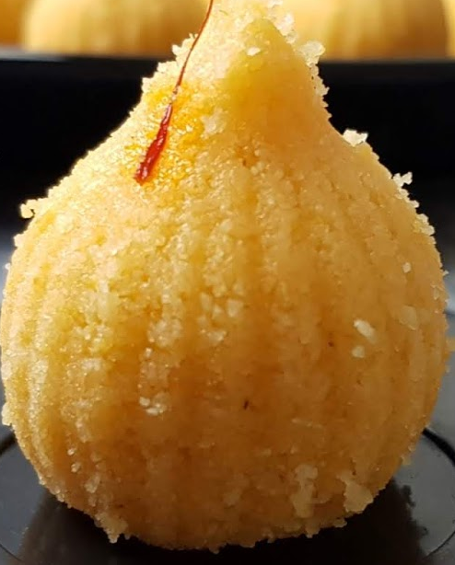
Object
An instance of a class. A physical reality. (has a room/place in the RAM)
Each object contains it’s own separate data and common code(function) to manipulate this data
Are instances (variables) of type class
Objects interact with each other by sending messages. i.e. a customer object can request an account object for the bank balance.

Slide 11
Creating Objects
Syntax: class_name obj_name;
Example: product p1;

Slide 12
Accessing class members
Class members can be accessed with object name only. (They can not be accessed alone )
Usually, we call public member functions in the main()
Syntax: obj_name.fun_name(actual-arguments);
Example: p1.getdata(1,”prncil”, 50, 5);

Slide 13
Defining Member Functions outside the class
A member function incorporates a membership ‘identity label’ (::) in the header . It tells the compiler which class the function belongs to.
ret_type class_name :: fun_name(argument declaration)
{
// function body
}

Slide 14
Defining Member Functions outside the class
Example:
void product::get_data(int c, char n[15], int q, float p)
{
code=c;
strcpy(name,n);
qty=q;
price = p;
}

Slide 15
While passing arguments inside a member function of a class, formal argument name and class data member names should have separate names.
i.e. c, n, q, p for code, name, qty and price.
Reason: Both local and global variables are in scope and in this case local variable wins.

Slide 16
Defining Member Functions outside the class
Example:
void product::put_data()
{
cout<<“Code=”<<code<<endl;
cout<<“Name=”<<name<<endl;
cout<<“Quantity=”<<qty<<endl;
cout<<“Price=”<<price<<endl;
}

Slide 17
Writing main() function
#include<iostream.h>
#include<math.h>
void main()
{
product p1;
p1.get_data(1,”Pencil”,50,5);
p1.put_data();
}

Slide 18
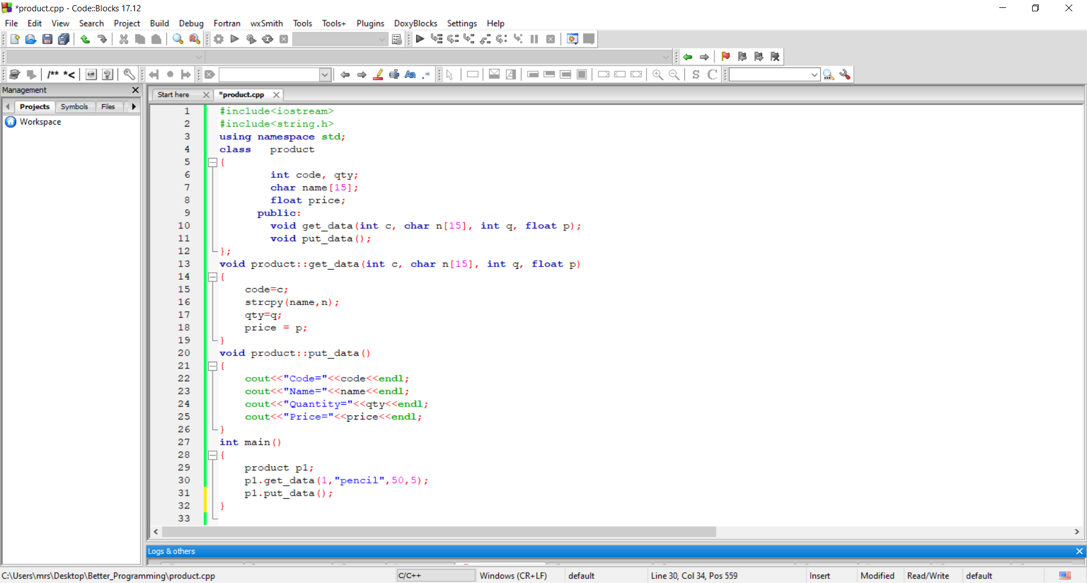
Example Program

Slide 19
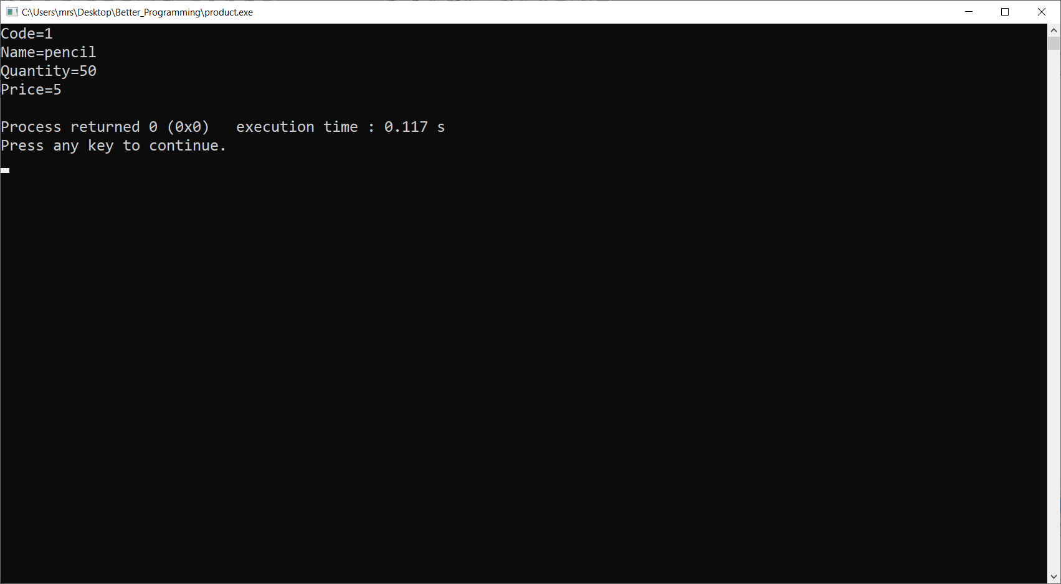
Example Program

Slide 20
A class with Inline functions

Slide 21
Defining Member Functions inside the class
We can define the member functions inside the class at the time of declaration as shown below: declaration+ definition
ret_type fun_name(argument declaration)
{
// function body
}
void put_data()
{
cout<<“Code=”<<code<<endl;
cout<<“Name=”<<name<<endl;
cout<<“Quantity=”<<qty<<endl;
cout<<“Price=”<<price<<endl;
}

Slide 22
Defining Member Functions inside the class
Such function is called an “automatic inline” function.(No need to write inline keyword)
We can do it only for small functions. (limitations!)
The member function defined outside the class is made inline by preceding it with inline keyword.
Inline void product::put_data()
{
cout<<“Code=”<<code<<endl;
cout<<“Name=”<<name<<endl;
cout<<“Quantity=”<<qty<<endl;
cout<<“Price=”<<price<<endl;
}

Slide 23
Taking User Input inside a Function

Slide 24
User Inut inside the Function
class product
{
private:
int code, qty;
char name[15];
float price;
public:
void get_data();
void put_data();
};

Slide 25
User Inut inside the Function
void product::get_data()
{
cout<<“Enter the code, name, quantity and price of a product”<<endl;
cin>>code>>name>>qty>>price;
}

Slide 26
Every class contains input() and output() functions.

Slide 27
Introducing a function which performs some logic

Slide 28
Problem Statement
Define a class named “product”, having code, name, quantity and price as data members. Provide setter()(input) and getter() (output) functions. Develop a function to calculate the total valuation or investment made for a particular product.
Write a C++ program to create instance(object) of a product class and test the functionality of the same class.

Slide 29
Implementing Logic
class product
{
private:
int code, qty;
char name[15];
float price;
public:
void get_data();
void put_data();
float valuation();
};

Slide 30
Implementing Logic
float product::valuation()
{
return (price*qty);
}

Slide 31
Writing main() function
#include<iostream.h>
#include<math.h>
void main()
{
product p1;
p1.get_data();
float val= p1.valuation();
cout<<“The details for product1 are:”
p1.put_data();
cout<<“Valuation=”<<val;
}

Slide 32
Practice Questions

Slide 33
Problem Statement#`1
Define a class named “Employee”, having code, level and basic salary as data members. Provide setter()(input) and getter() (output) functions. Develop a function to calculate the gross salary of the employee. HRA of 50%, DA of 95% and EA of 5% is given to the employee on his basic salary.
Write a C++ program to create instance(object) of Employee class and test the functionality of the same class.

Slide 34
Problem Statement#`2
Define a class named “ElecBill”, having consumer code, name and number of units as data members. Provide setter()(input) and getter() (output) functions. Develop a function to calculate the total electric bill for the consumer. (Problem is given in the next slide)
Write a C++ program to create instance(object) of ElecBill class and test the functionality of the same class.

Slide 35
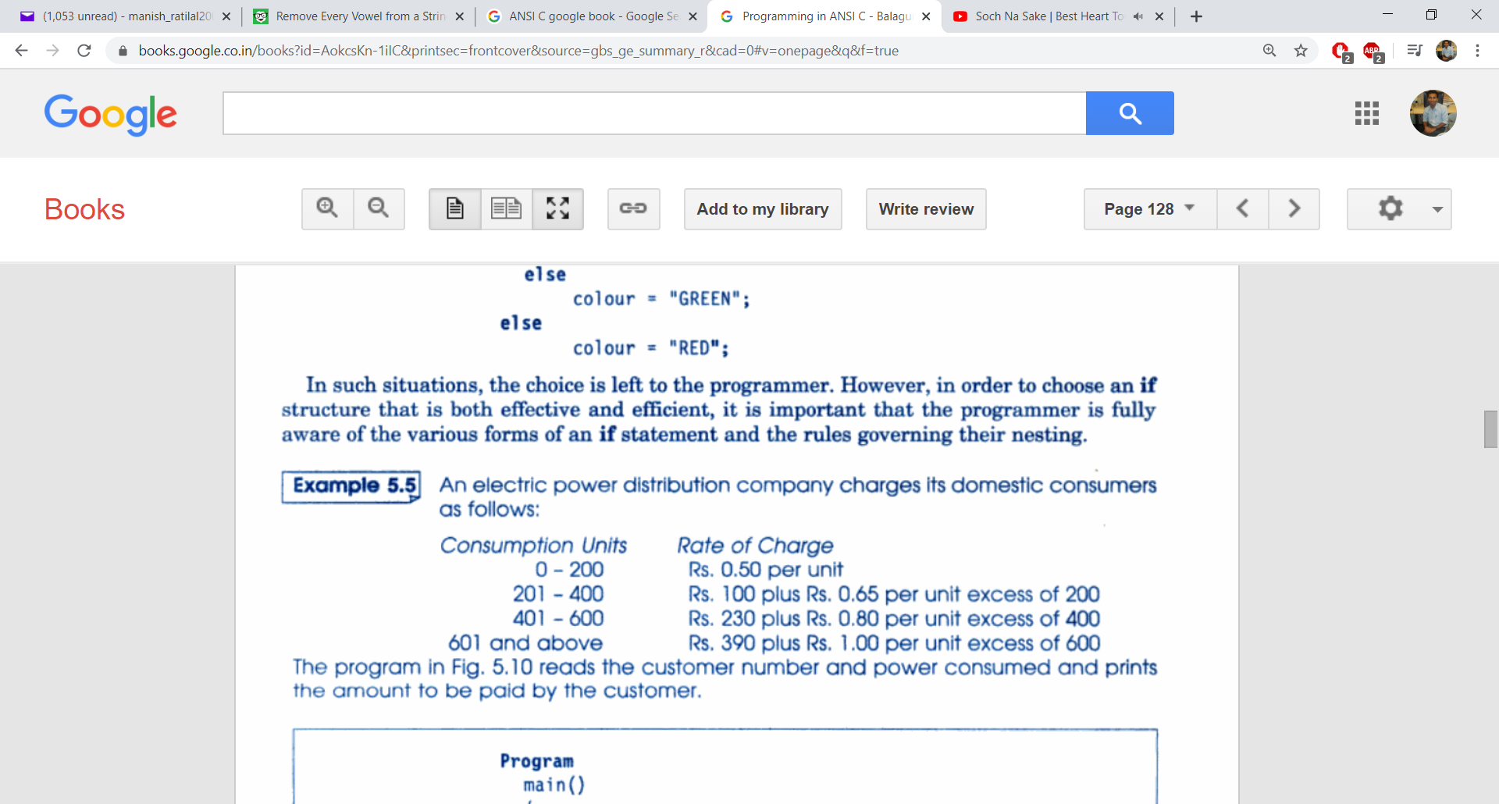
Problem Statement#`2
State Govt. has imposed 4% of bill and Central Govt. has imposed 3% of bill. So calculate the total bill amount which includes state and central govt. tax.

Slide 36
Problem Statement#`1.1
Define a class named “Employee”, having code, name, level and basic salary as data members. Provide setter()(input) and getter() (output) functions. Develop a function to calculate the net salary of an employee. (See the next slide for the employee allowances and taxes)
Write a C++ program to create instance(object) of Employee class and test the functionality of the same class.

Slide 37
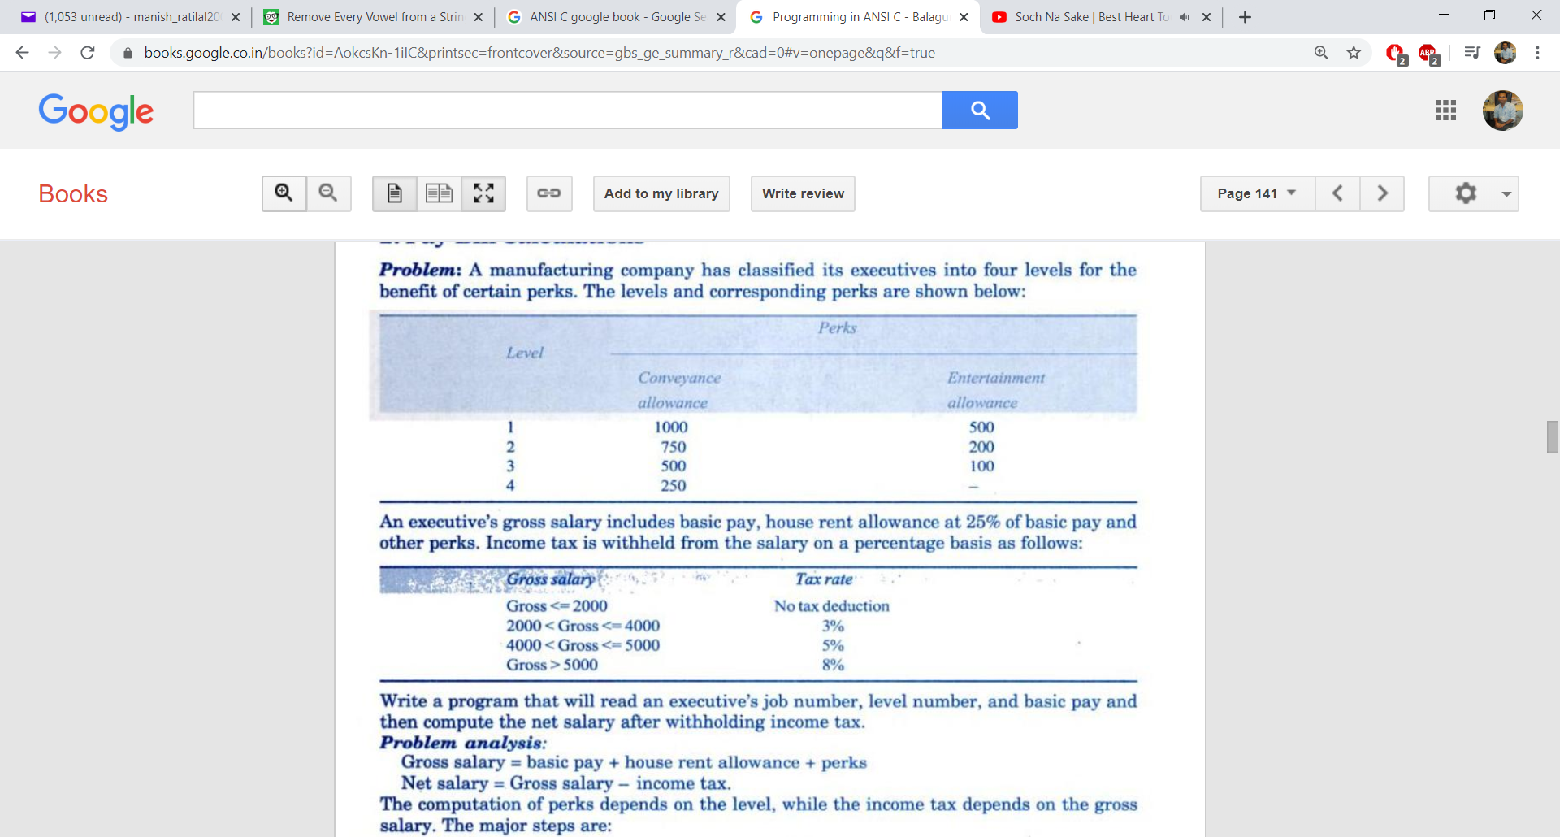
Problem Statement

Slide 38
Arrays within a class

Slide 39
Problem Statement
Define a class named “Student”, having id number, name and marks of 5 subjects as data members. Provide setter()(input) and getter() (output) functions. Develop a member function to calculate the average marks of a student.
Write a C++ program to create instance(object) of Student class and test the functionality of the same class.

Slide 40
Array of objects

Slide 41
Array of objects
We can create an array of objects in the similar manner as we create array of primary types.
Syntax: class_name obj[size];
Example: product p[3];
The above statement will create 3 objects of class product physically in the RAM

Slide 42
Problem Statement
Define a class named “product”, having code, name, quantity and price as data members. Provide setter()(input) and getter() (output) functions. Develop a function to calculate the total valuation or investment made for a particular product.
Write a C++ program to create some instances of a product class(using array of objects) and test the functionality of the same class. Also calculate total investment made for all products by the shopkeeper.

Slide 43
Passing object as an argument

Slide 44
Object as an argument
We can pass object as an argument like any other primary data types.
To achieve this, the formal argument data type must be the class type of which the object is being passed.

Slide 45
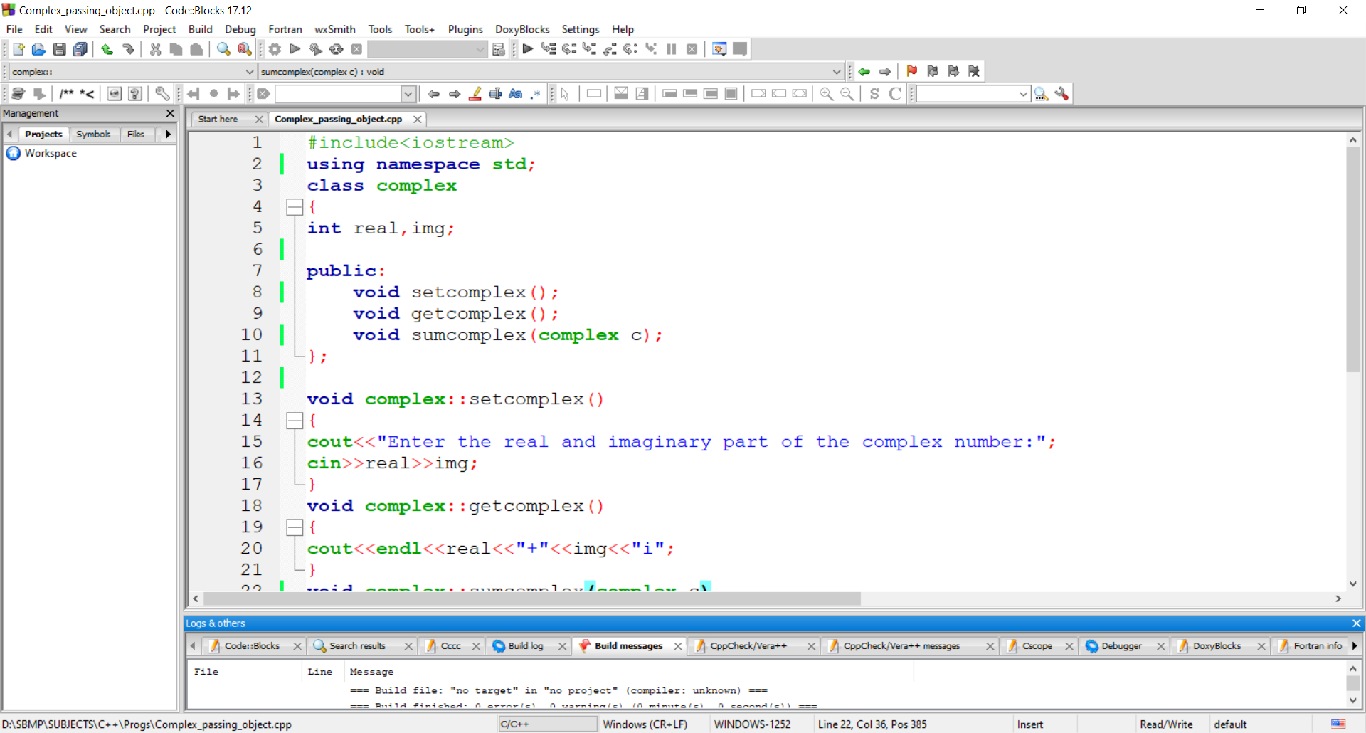
Object as an argument

Slide 46
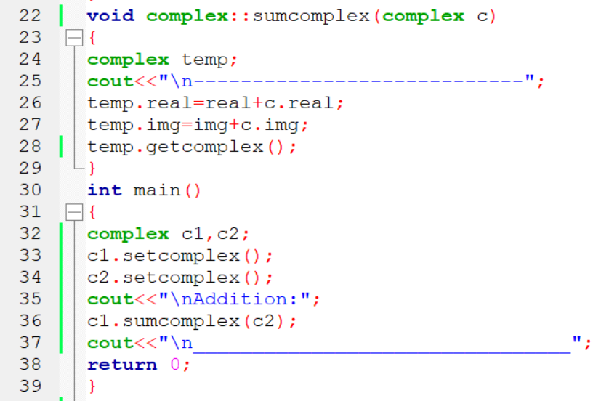
Object as an argument

Slide 47
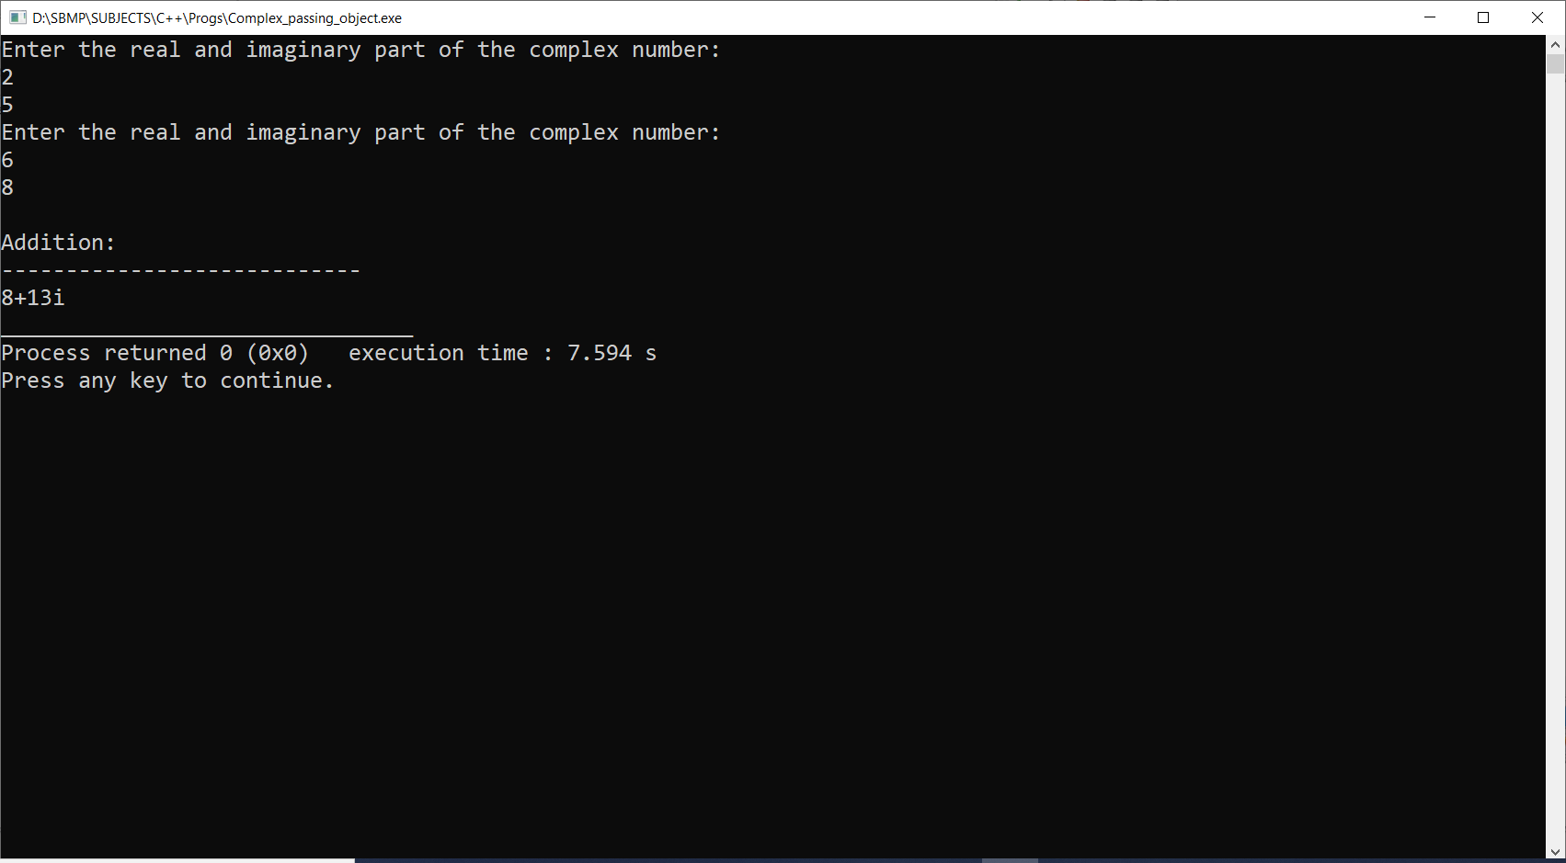
Output

Slide 48
Returning object from the function

Slide 49
Returning an object
We can an object from the function similar to othe primary data types.
To achieve this, the return type of the function must be the type of the class.
Inside the caller, the variable which receives this object must be of same class type.

Slide 50

Returning an object

Slide 51
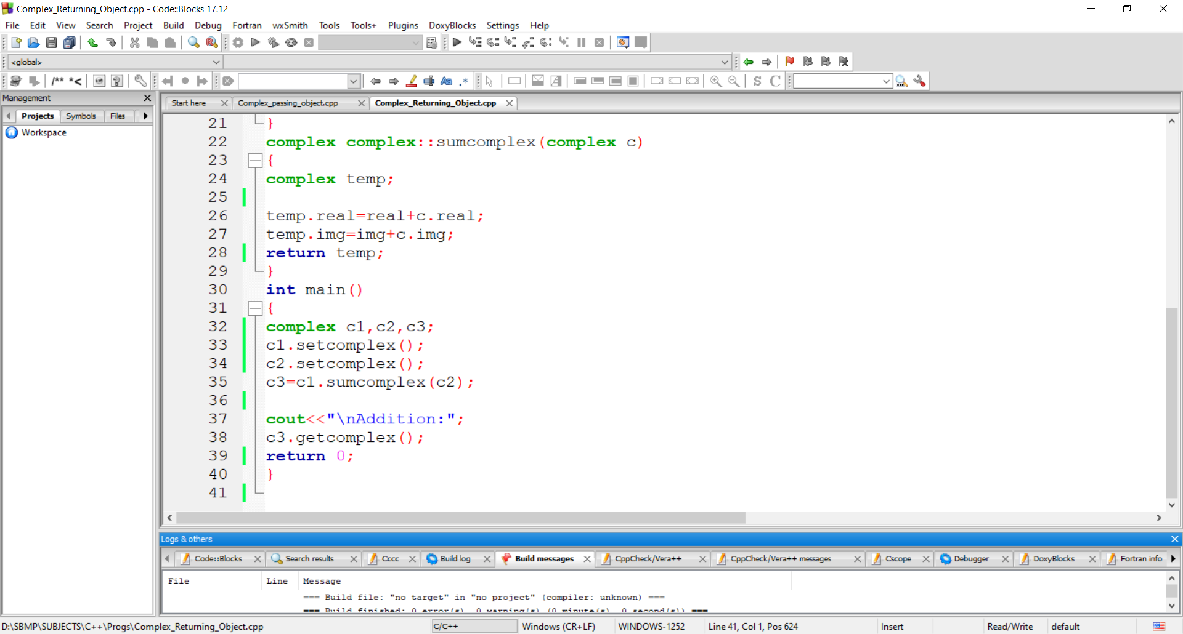
Returning an object

Slide 52
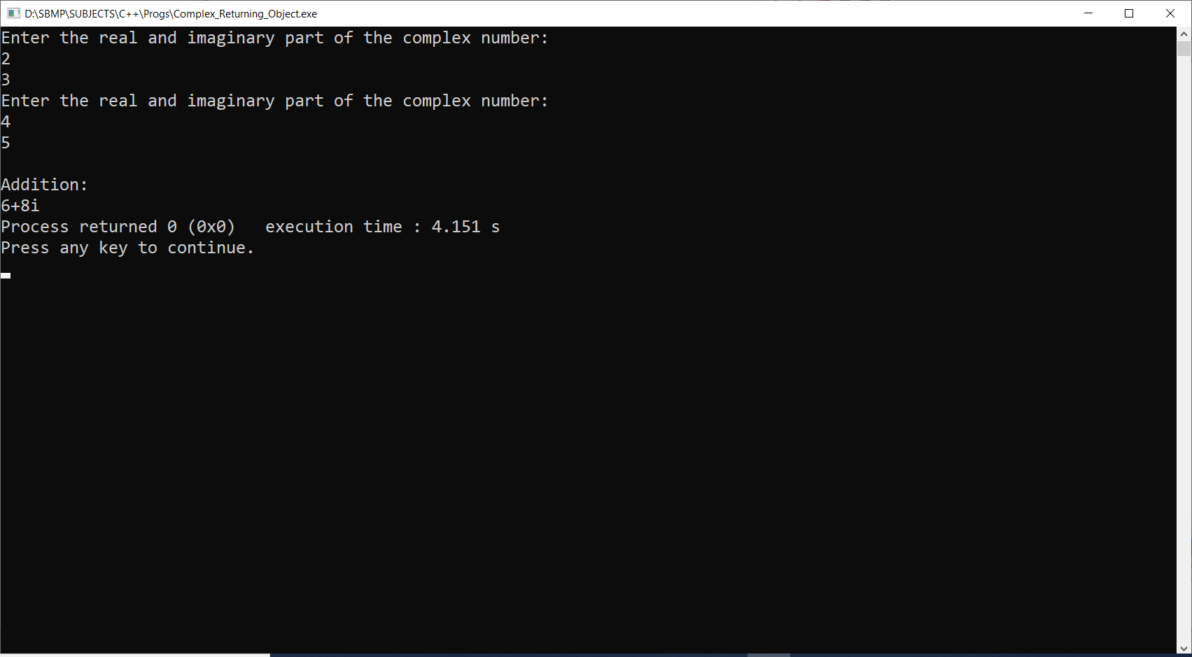
Returning an object

Slide 53
Thanks!
Any questions?
You can find me at:
manish_ratilal2002@yahoo.com

Slide 54
Credits
Object oriented programming with C++, E Balagurusamy, Tata McGraw-Hill Publishing Company Limited, New Delhi

