Slide 1
10. File Handling
M.R.Solanki,
Lecturer,
Information Technology Department,
SBMP

Slide 2
File Handling
Many real-life scenarios are there that handle a large number of data, and in such situations, you need to use some secondary storage to store the data.
The data are stored in the secondary device using the concept of files.
Files are the collection of related data stored in a particular area on the disk.
Programs can be written to perform read and write operations on these files.

Slide 3
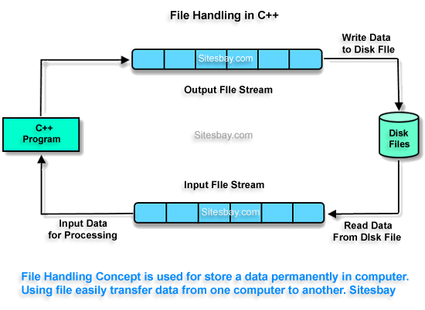
File Handling
https://www.sitesbay.com/cpp/cpp-file-handling

Slide 4
File Handling
C++ provides the following stream classes to handle files:
ofstream: Stream class to write on files
ifstream: Stream class to read from files
fstream: Stream class to both read and write from/to files

Slide 5
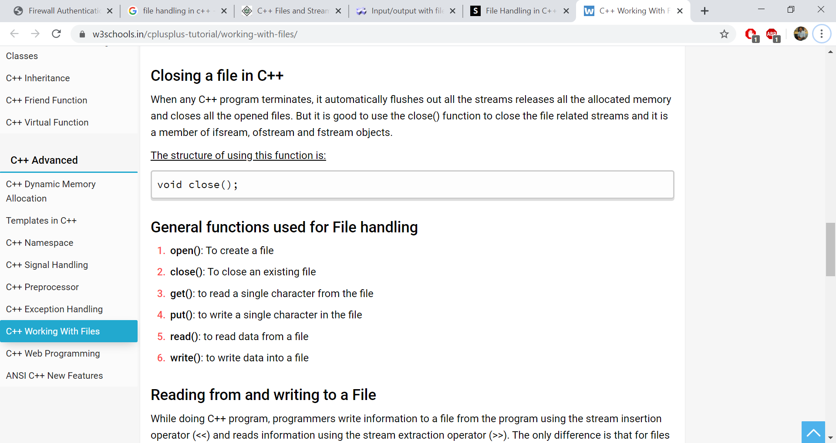
File Handling Functions

Slide 6
Defining a File object
We have to include <fstream.h> in turbo C/C++ and <fstream> in code blocks.
Defining a file object:
file-stream-class stream-object;
ofstream fileout;

Slide 7
Opening a File
The first operation is generally opening a file.
An open file is represented within a program by a stream.
Any input or output task performed on this stream will be applied to the physical file associated with it.
Syntax:
file_stream_object.open (filename, mode);
filename: name or a path of a file with or without extension. i.e. demo.txt or d:\\mrs\\demo.txt

Slide 8
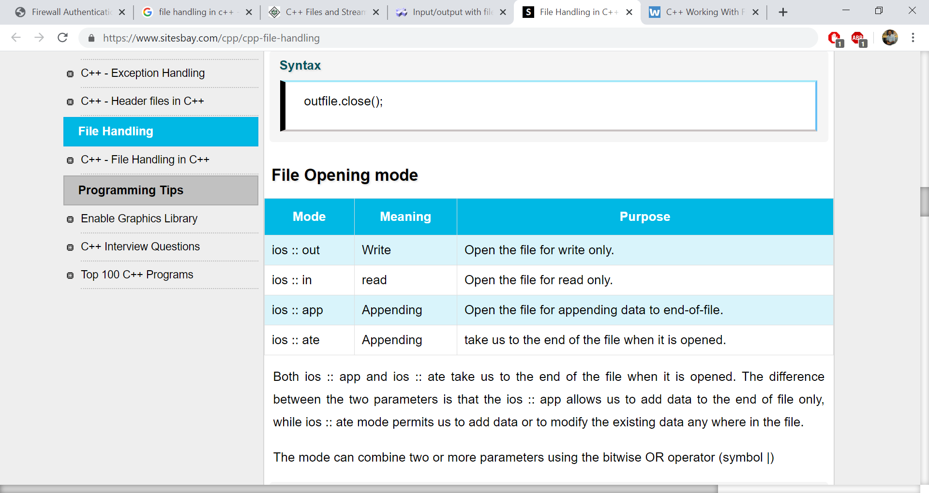
Opening a File
mode: Opening modes are of some types as shown below:
https://www.sitesbay.com/cpp/cpp-file-handling

Slide 9
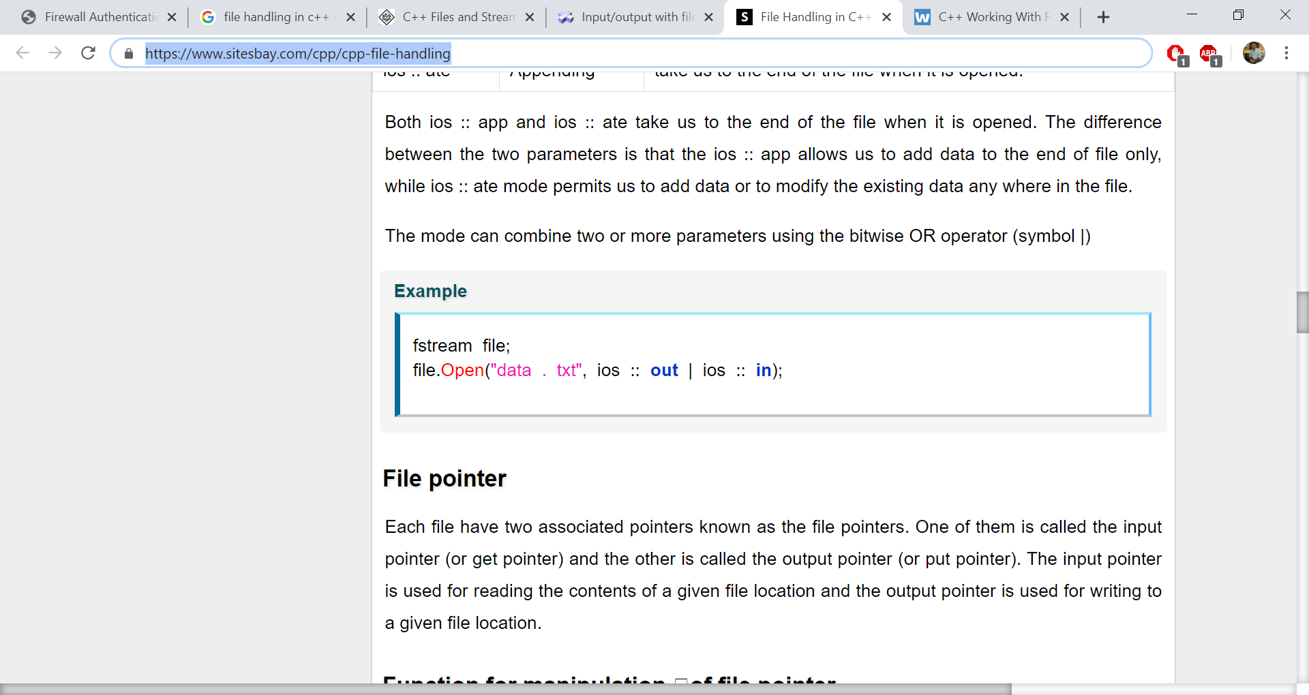
Opening a File
mode: Opening modes are of some types as shown below:
https://www.sitesbay.com/cpp/cpp-file-handling

Slide 10
Closing a File
To close a file, close() function is used.
A file should be closed after competing operation i.e. reading/writing with file.
i.e. fout.close();

Slide 11
Reading from and Writing to a File
Programmers write information to a file from the program using the stream insertion operator (<<) and reads information using the stream extraction operator (>>).
The only difference is that for files programmers need to use an ofstream or fstream object instead of the cout object and ifstream or fstream object instead of the cin object.

Slide 12
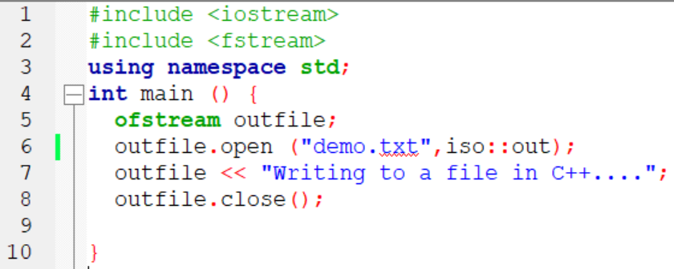
Program to write data to a File
This program will create demo.txt file in the present working directory (where your program resides) and write one line into it.
To write something inside file is same as we write on the console i.e. << operator

Slide 13
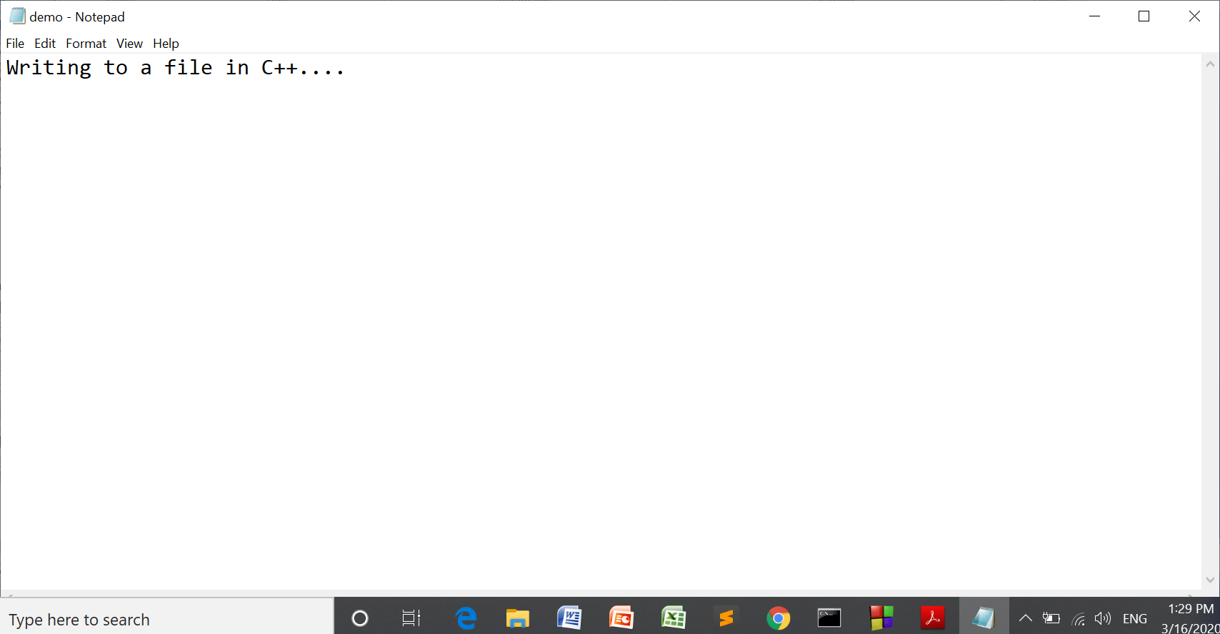
Program to write data to a File

Slide 14
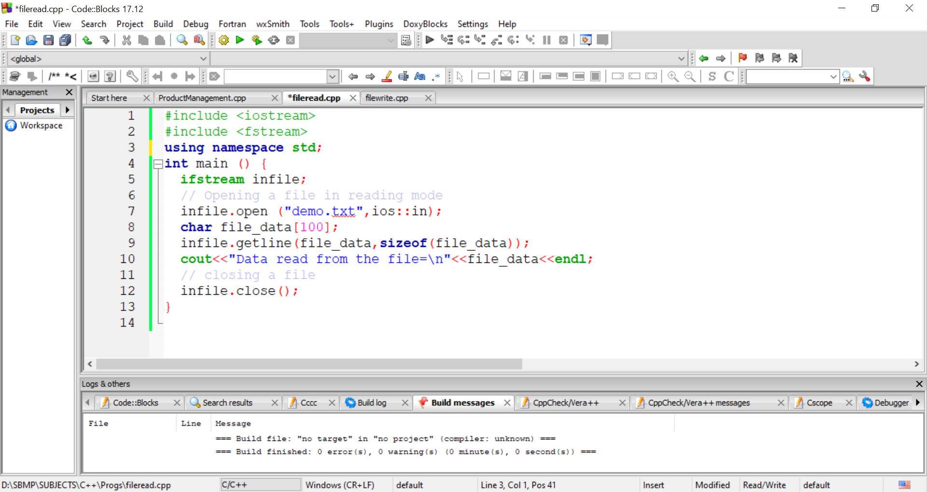
Program to read data from a File
This program will read the line from demo.txt file and displays on the screen.

Slide 15
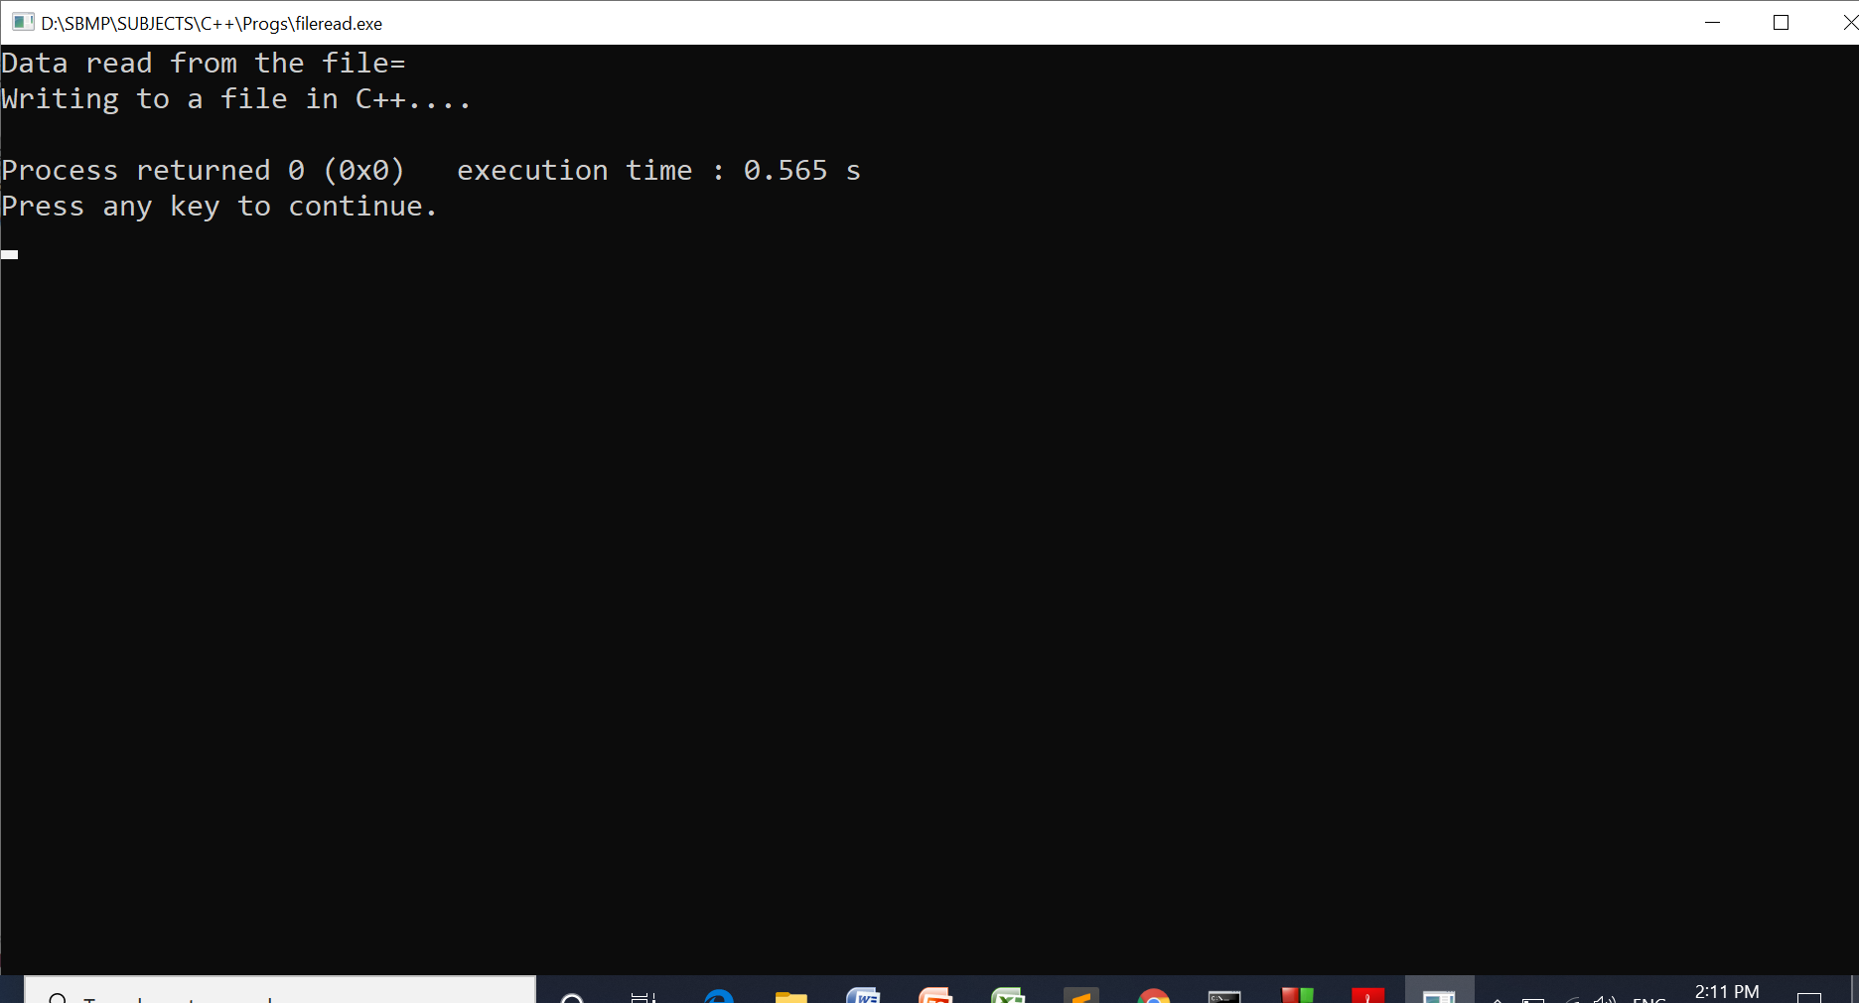
Program to read data from a File

Slide 16
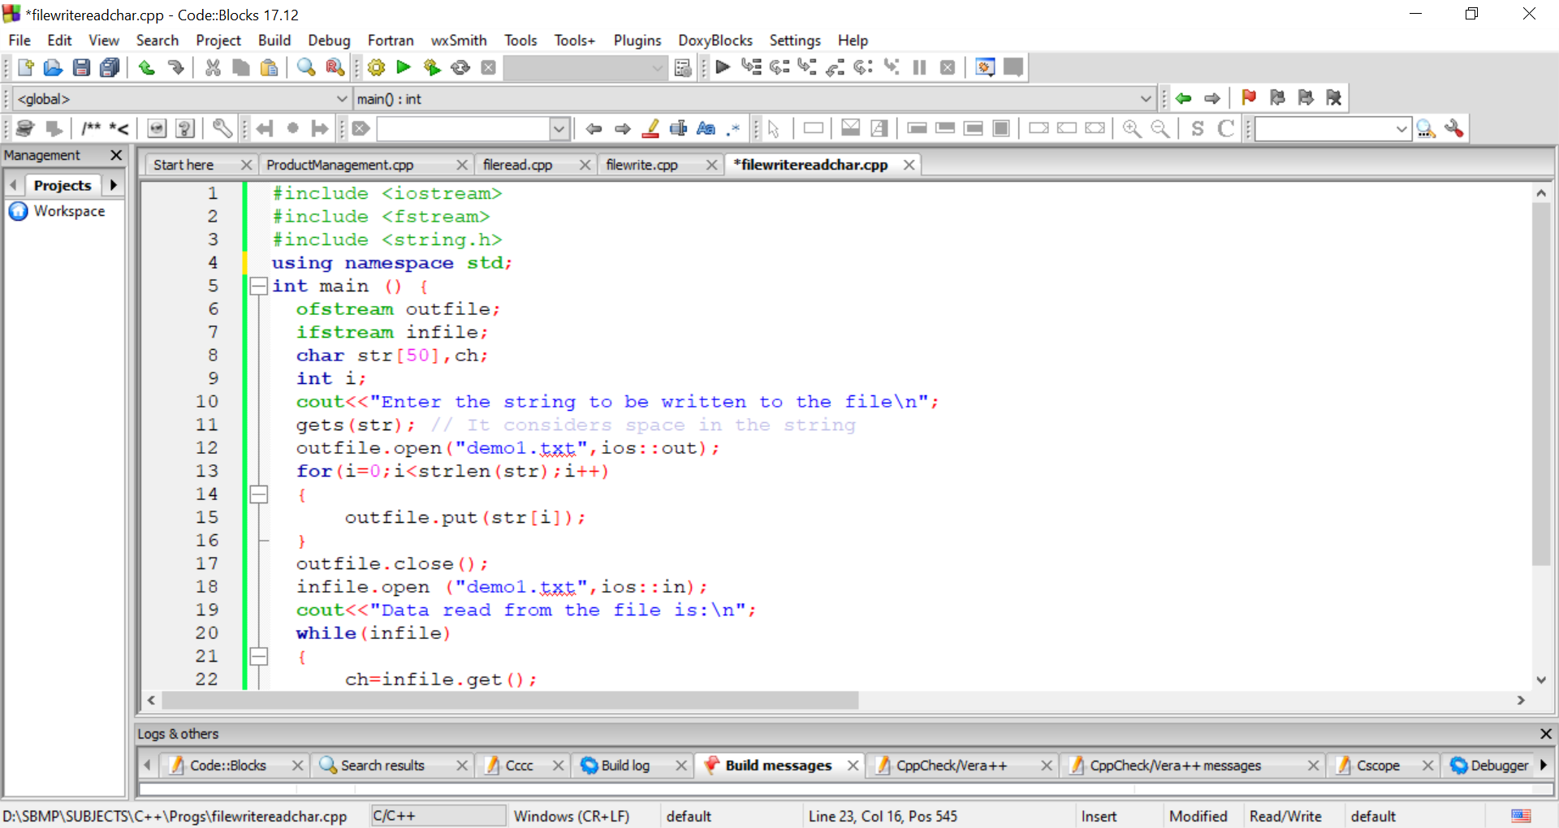
Use of put() and get()

Slide 17
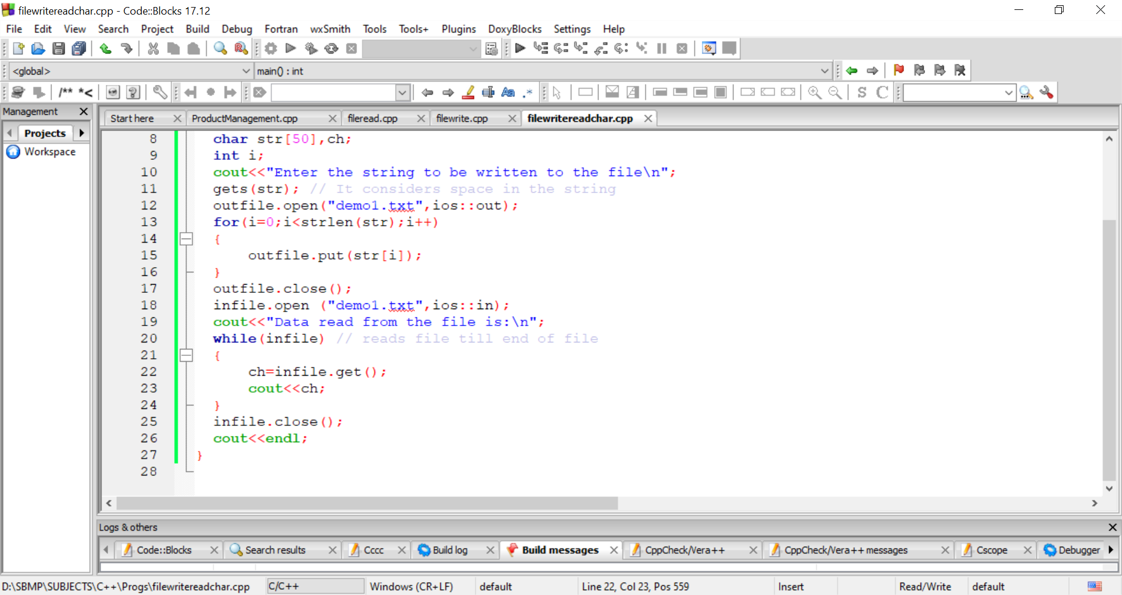
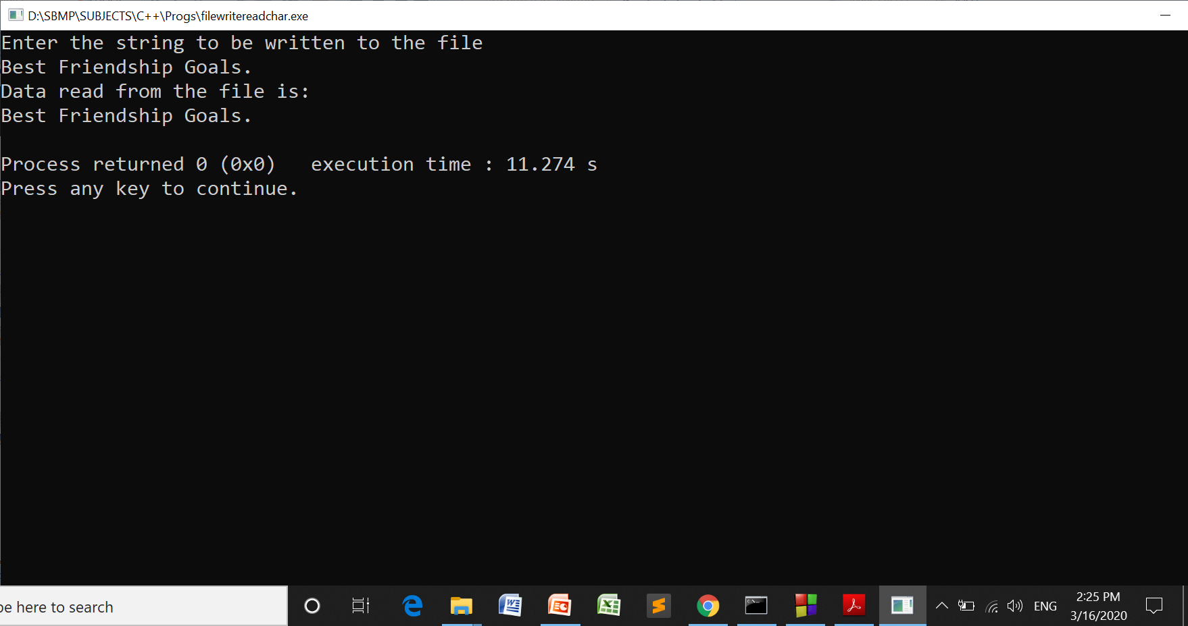
Use of put() and get()

Slide 18
Use of write() and read() Program
write() and read() functions are used to work with binary data. So content of file will not be visible in the form of proper characters.
write() is used to write an object to the file and read() is used to read a file data into an object.
file_obj.write((char*)&class_obj,sizeof(class_obj)); file_obj.read((char *) &class_obj, sizeof(class_obj));

Slide 19
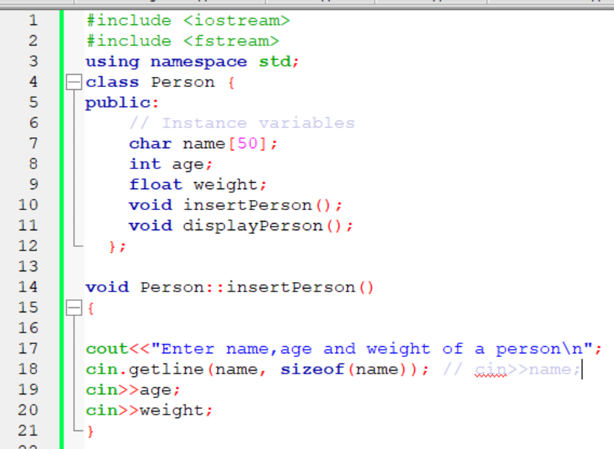
Use of write() and read() Program

Slide 20
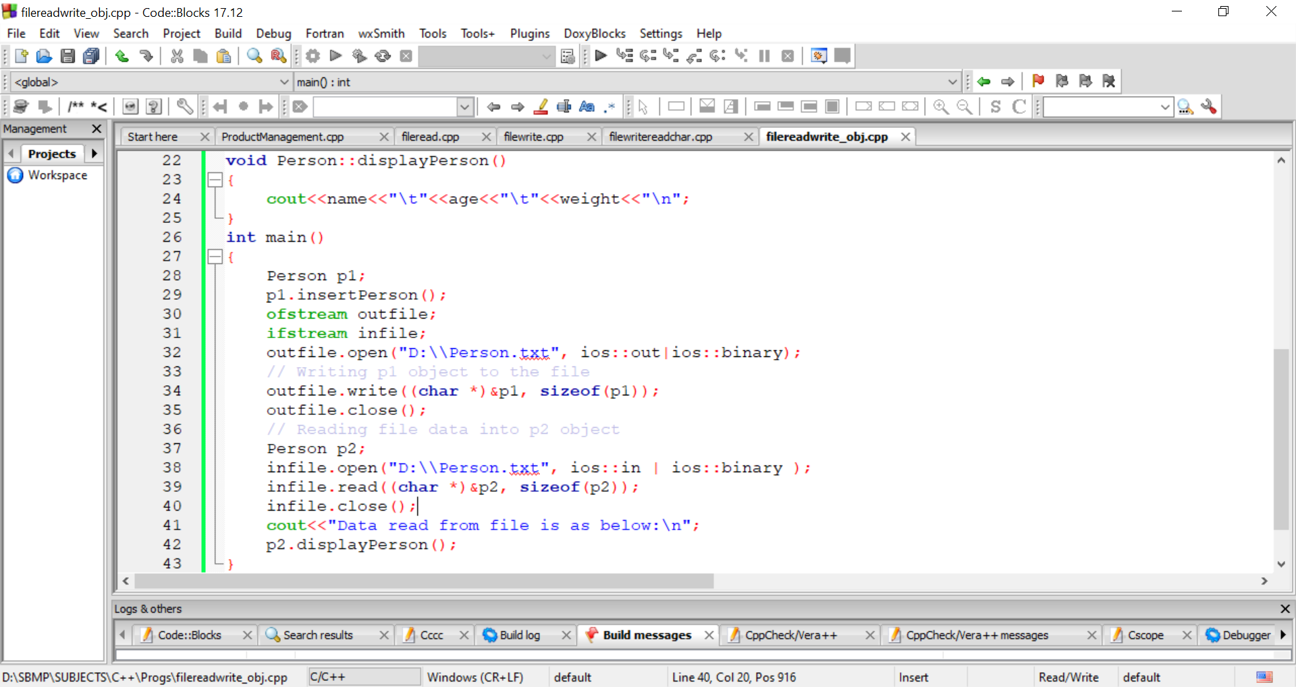
Use of write() and read() Program

Slide 21
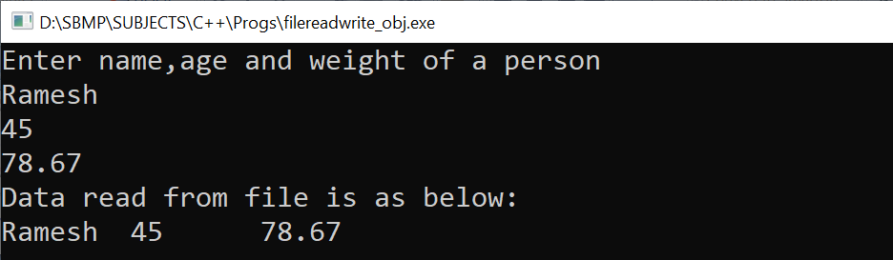
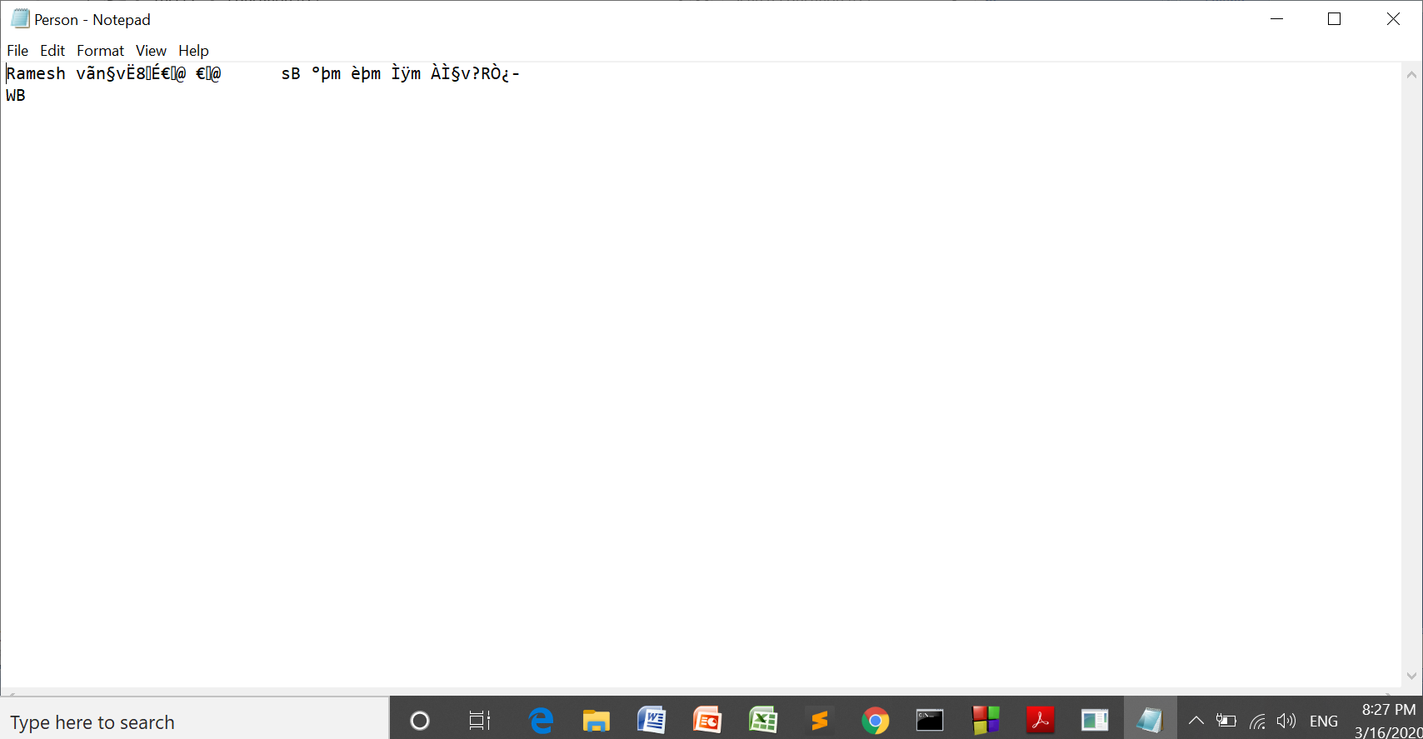
Use of write() and read() Program
Person.txt data will be visible as follows:

Slide 22
References
https://www.w3schools.in/cplusplus-tutorial/working-with-files/
One Program:
https://www.includehelp.com/cpp-programs/write-read-text-in-file.aspx

