Slide 1
3. Functions in C++

Slide 2
Learning Outcomes
Students will be able to:
Define the function and state advantages its advantages
Write the prototype of a function
Describe categories of functions with example programs.
Develop functions for given problem statements
Explain default argument functions
Explain overloaded functions
Describe inline functions

Slide 3
User Defined Function

Slide 4
Definition
We can write any program in C++ with only main() function
When a program becomes too large and complex, it becomes difficult to debug, test and maintain the function
If a program is divided into functional parts then each part can be coded independently and later combined together into a single unit.
These sub programs are called functions which are easy to understand, debug and test.

Slide 5
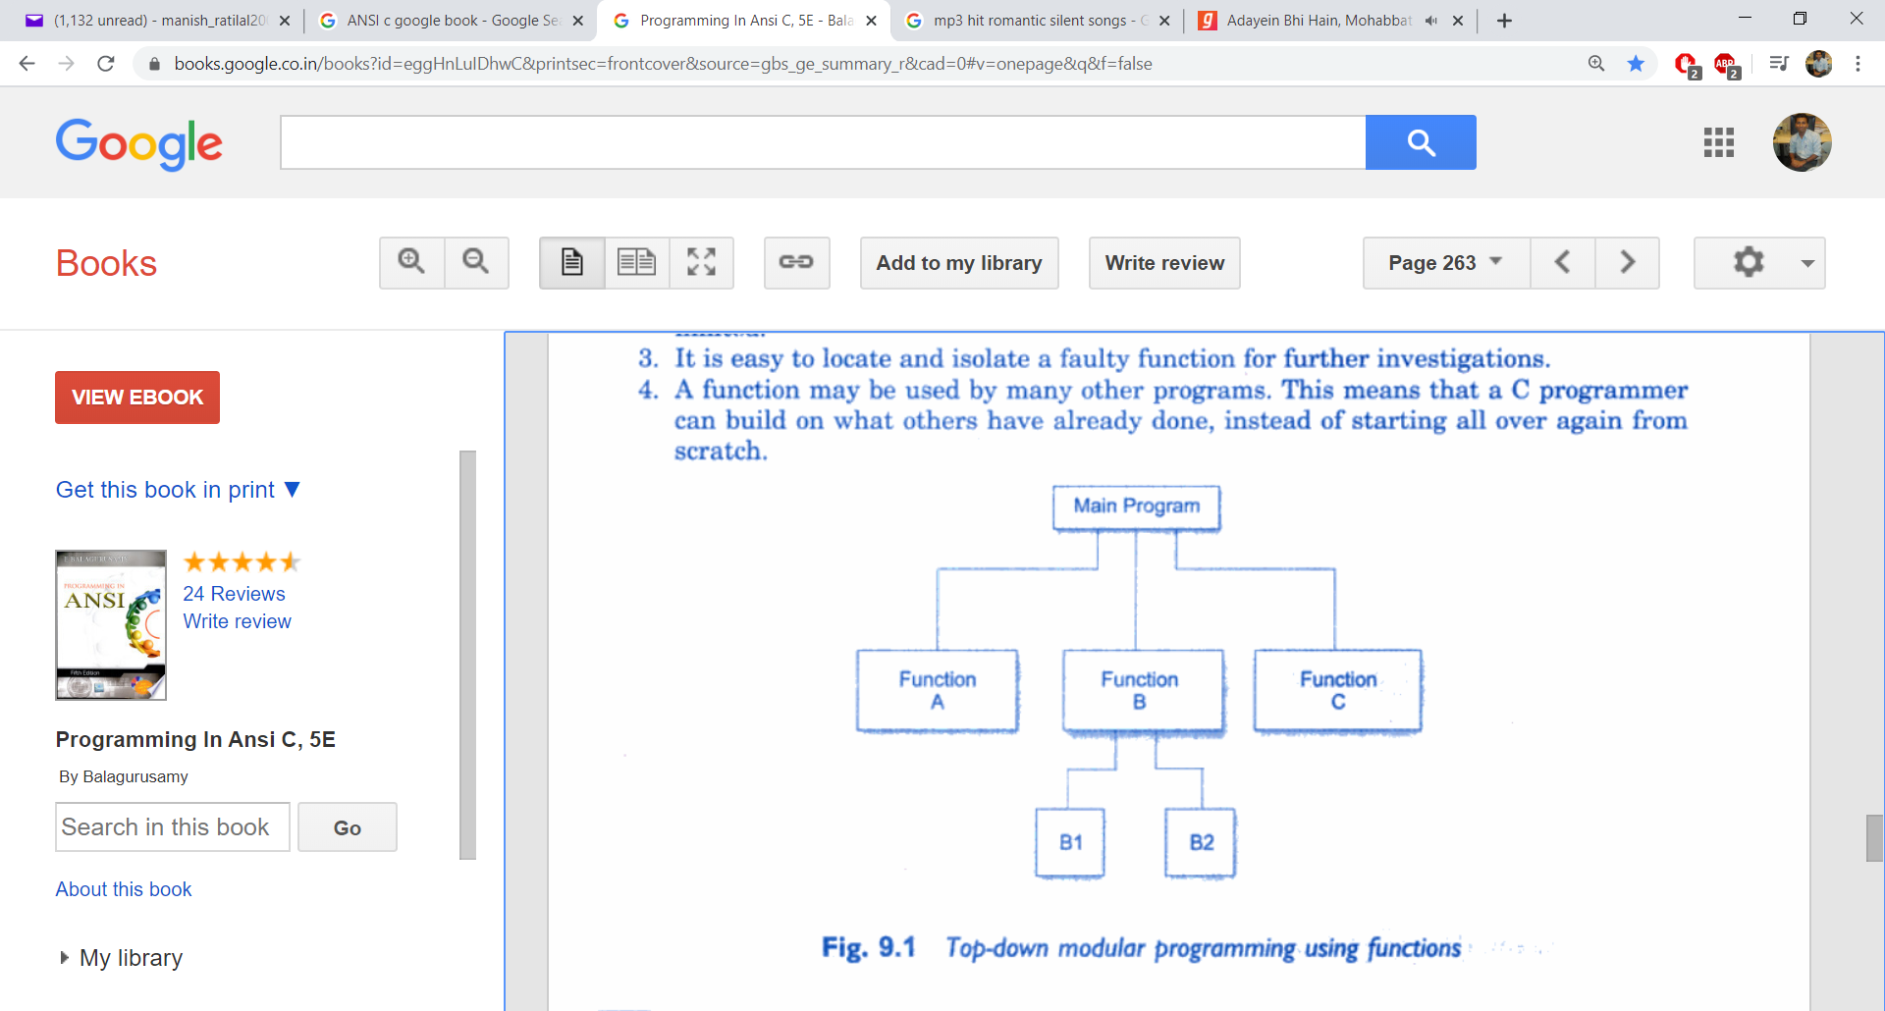
Advantages of Functions
Provides top-down modular program: A Complex program is getting divided into parts:
Reduces the length of a source code (when it is repeatedly called)

Slide 6
Advantages of Functions
It is easy to isolate a faulty function for further investigations
A function can be used by more than one programs.
i.e. sqrt(), pow(), etc.

Slide 7
Working with Functions

Slide 8
Function parts
Prototype: Syntax/signature/declaration of a function to be informed to the compiler
return-type function_name(parameter-list);
2. Function Definition: Body of a function inside which logic of function is written – { }
3. Function call: A function is called by another function. Here, the function which calls another function is termed as “caller” and the function which is being called is termed as “callee”.

Slide 9
To use any function, we must know three things:
Function name
Number and types of arguments
Return value
Example: sqrt() and pow()

Slide 10
Function Categories
No parameters, No return values: i/p + logic + o/p resides inside the function.
With parameters but No return value:
i/p – inside main()
logic + o/p – inside the function
With parameters and With return value:
i/p + o/p – inside main()
logic – inside the function
Q: Develop a user defined function to perform addition of 2 numbers.

Slide 11
If we want to define the body of the function after main() then it must be declared before main()
If we want to define function before main() then we can directly write the definition of the function.

Slide 12
No parameters, No return values
void add()
{
int a,b, c;
cout<<“Enter two numbers”<<endl;
cin>>a>>b;
c = a+b;
cout<<“Addition of ”<<a<<“and ”<<b<<“=”<<c<<endl;
}
void main()
{
add();
}

Slide 13
With parameters, No return values
void add(int x, int y)
{
int z;
z=x+y;
cout<<“Addition of ”<<x<<“ and ”<<y<<“=”<<z<<endl;
}
void main()
{
int a,b;
cout<<“Enter two numbers”<<endl;
cin>>a>>b;
add(a,b);
}
Formal/Dummy arguments
Actual arguments

Slide 14
With parameters, With return values
int add(int x, int y)
{
int z;
z=x+y;
return (z);
}
void main()
{
int a,b,c;
cout<<“Enter two numbers”<<endl;
cin>>a>>b;
c=add(a,b);
cout<<“Addition of ”<<a<<“ and ”<<b<<“=”<<c<<endl;
}

Slide 15
The return type of a function is the same as the data type of variable it returns
The recipient variable of the return value inside the caller function should have same data type as return value of a variable in the callee.
i.e. c = add(a,b) ;
// Here, type of c should be same as z inside add()

Slide 16
Syntax of calling a function
No parameter & No return value:
func_name();
With parameters & No return value:
func_name (actual parameters) ;
With parameters & with return value:
var = func_name (actual parameters) ;

Slide 17
Exercise Qiestions

Slide 18
Function Questions
1. Develop a function to find gross salary of an employee.
2. Develop a function to find average of 3 numbers.
3. Write a choice based program to find area of a circle, rectangle and triangle by developing user defined functions.
4. Write a program to find factorial of a given number using a function.
5. Calculate BMI using UDF.
6. Write a program to enter code, name, quantity and price of a product. Develop a UDF to find total valuation of this product. Display all the details of this product.
7. Write a program to count numbers which are divisible by 7 between 1 to 200 using UDF.

Slide 19
Default Arguments

Slide 20
Function with default argument
C++ allows us to call a function without specifying all its arguments.
In such cases, the function assigns the default value to the parameter which does not have a matching argument in the function call.
Default values are specified when a function is declared.
Function Declaration:
float simple_int(float principal, int period, float rate=0.15);
Function Call:
si = simple_int(5000, 7);
Here, value 5000 is passed to principal, value 7 to period and rate is assigned a default value of 0.15

Slide 21
Function with default argument
The call,
si = simple_int(5000, 7,0.12);
passes an explicit value of 0.12 to rate.
Points to remember:
Default arguments are checked for type at the time of declaration and evaluated at the time of call
We must specify default arguments from right to left ( no other order is permited)

Slide 22
Function Overloading

Slide 23
Function Overloading
Overloading = use of same thing for different purposes
In C++, we can use the same function name to write functions that perform a variety of different tasks. This is known as function overloading or function polymorphism.
Working:
We can design a family of functions with one function name but with different argument lists.
The function would perform different operation depending on the argument list in the function call.
The correct function to be invoked is determined by checking the number and type of the arguments but not on the function return type.

Slide 24
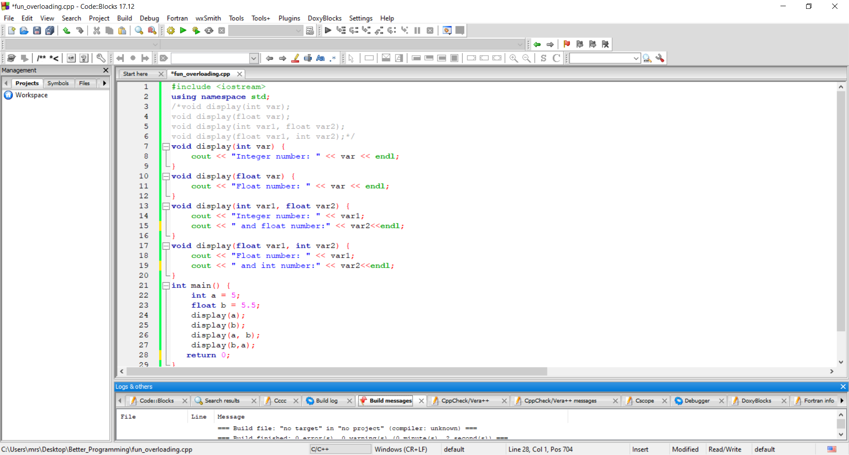
Function Overloading
Example:

Slide 25
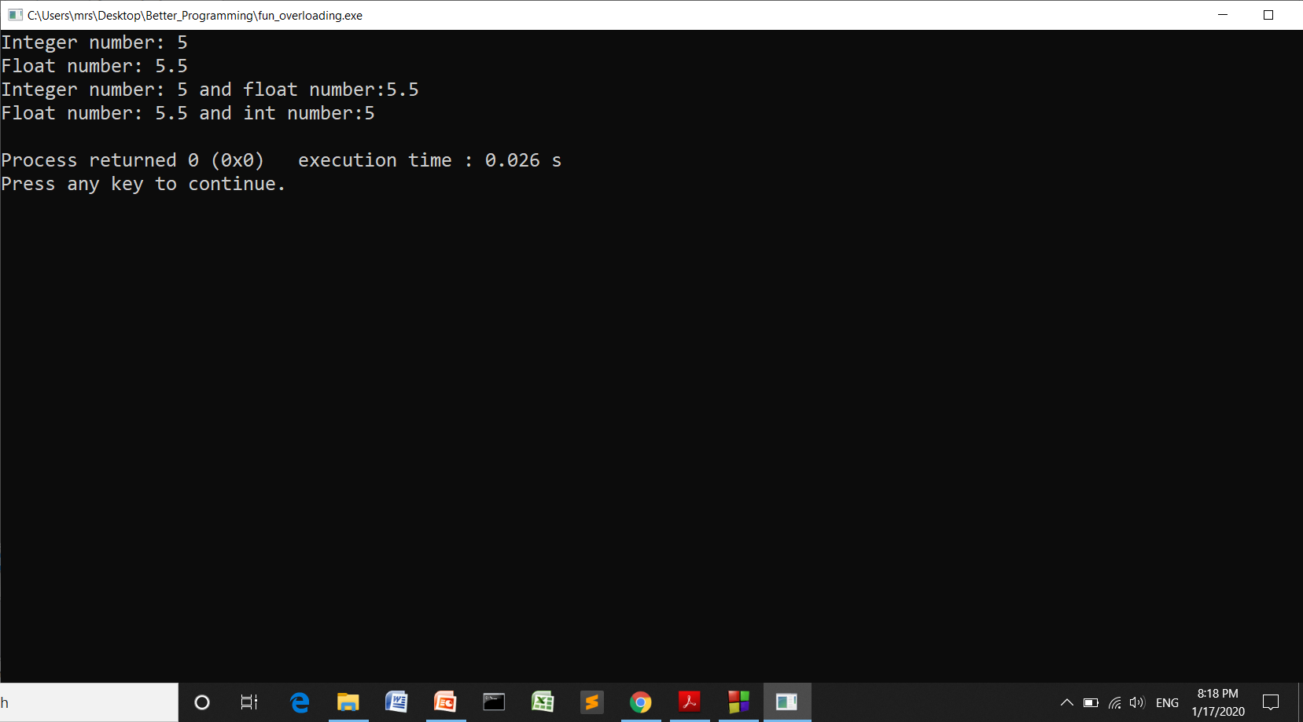
Function Overloading
Example: Output
Q:1 W.A.P. to find area of a circle, triangle and rectangle using function overloading.
Q:2 W.A.P. to find volume of a box, cube and cylinder using function overloading.

Slide 26
Inline Functions

Slide 27
Inline Functions
Whenever a function is called, activities jumping to the function, saving registers, pushing arguments onto the stack and returning to the calling function are taking place.
Such activities takes a considerable CPU time which is costly specially when we write small functions.
To save this overhead time, C++ provide “inline functions”
An inline function is expanded in line when it is invoked. That is the compiler replaces the function call with the corresponding function call.
Syntax:
inline function_header
{
// function body
}

Slide 28
Inline Functions
Example:
inline float area(int r)
{
return (3.14 * r *r);
}
Note:
As the function grows in size, the speed benefits of inline functions diminish. (At some point overhead of function call becomes small compared to execution of the function)

Slide 29
Inline Functions: Limitations
#Inline expansion may not work for the following:
A loop, a goto or switch statements exists.
If a function contains static variables.
If function is recursive.

Slide 30
Credits
Object Oriented Programming with C++, E Balagurusamy, TMH

