Slide 1
Static & Friend Function
K.V.Bhatt,
Lecturer,
Information Technology Department,
SBMP

Slide 2
Static data members
Static data members are also called as “class variables” and declared with static keyword.
Characteristics:
Initialized with value 0.
Only one copy of static data members are being created (irrespective of number of objects)
Accessible only inside the class but lifetime is entire program,
Note: The scope of the static data member must be defined outside the class as follows:
class_name::data_member;

Slide 3
Static data members
#include<iostream>
#include<string>
using namespace std;
class Demo
{
int num;
static int count;
public:
void set_num();
void get_num();
static void staticf();
};
int Demo::count;
void Demo::set_num()
{
cout<<"Enter the num"<<endl;
cin>>num;
count++;
}

Slide 4
Static data members
void Demo::get_num()
{
cout<<"Num= "<<num<<endl<<"Count= "<<count;
}
void Demo::staticf()
{
cout<<"Count= "<<count<<endl;
}
int main()
{
Demo ob1,ob2;
ob1.set_num();
ob2.set_num();
Demo::staticf();
return 0;
}

Slide 5
Static data members
count
ob1
ob2
static variable count is being shared by objects ob1 and ob2

Slide 6
Static function
A static function can access only other static members i.e. data or functions of the same class.
A static member function can be called using the class name.
class_name::function_name();

Slide 7
Static data members
WAP to track number of objects created and destroyed in a program.

Slide 8
Friend Function
A non member function cannot have access to the private data of a class.
However, there could be a situation where classes to share a particular function. For example, Consider a case where two classes, manager and scientist have been defined. We would like to use a function income_tax() to operate on the objects of both these classes.
In such situations, C++ allows the common function to be made friendly with both the classes, thereby allowing the function to have access to the private data of these classes.
Such a function need not be a member of any of these classes.

Slide 9
Features of Friend Function
It is not in the scope of the class to which it has been declared as friend.
It cannot be called using the object of the class to whom it is a friend.
Invoked like a normal function (without object.)
It can access all private and protected members of the class.
To declare a friend function, include its prototype within the class, preceding it with the keyword friend.

Slide 10
Features of Friend Function
Friends are not member functions of a class.
It has to use object name to access the data member of a class.(i.e. ob.x)
Can be declared either in the public or the private part of a class.
Usually, it has the objects as arguments.

Slide 11
Friend Function Syntax
class className
{
... .. ...
friend return_type functionName(arguments);
... .. ...
};
return_type functionName(arguments)
{
// data member access with object
}

Slide 12
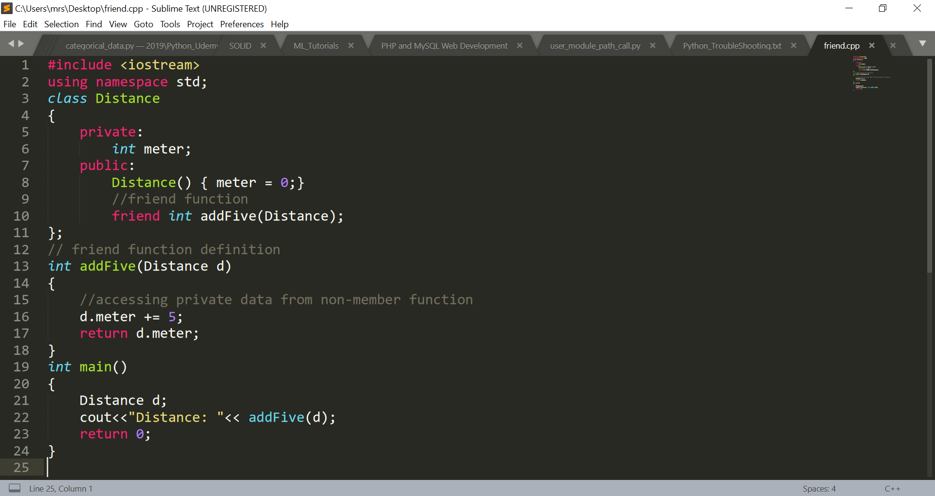
Friend Function Example

Slide 13
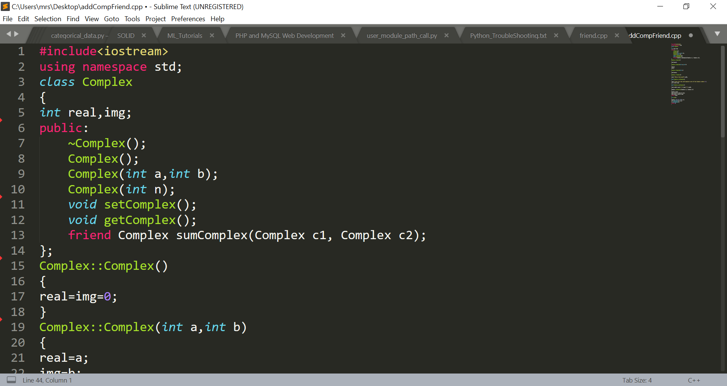
Adding 2 Complex Numbers

Slide 14
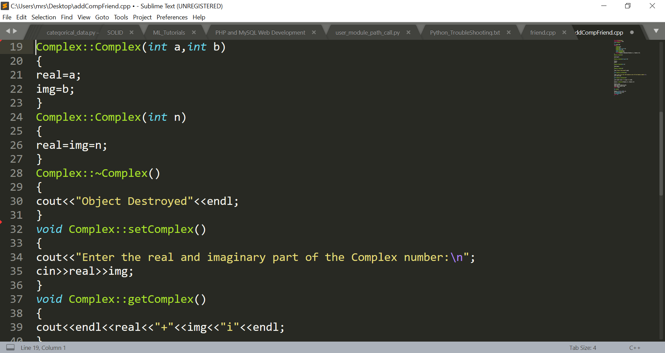
Adding 2 Complex Numbers

Slide 15
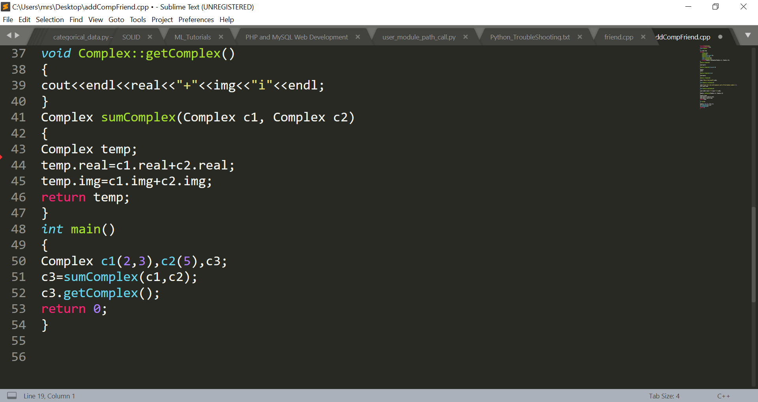
Adding 2 Complex Numbers

Slide 16
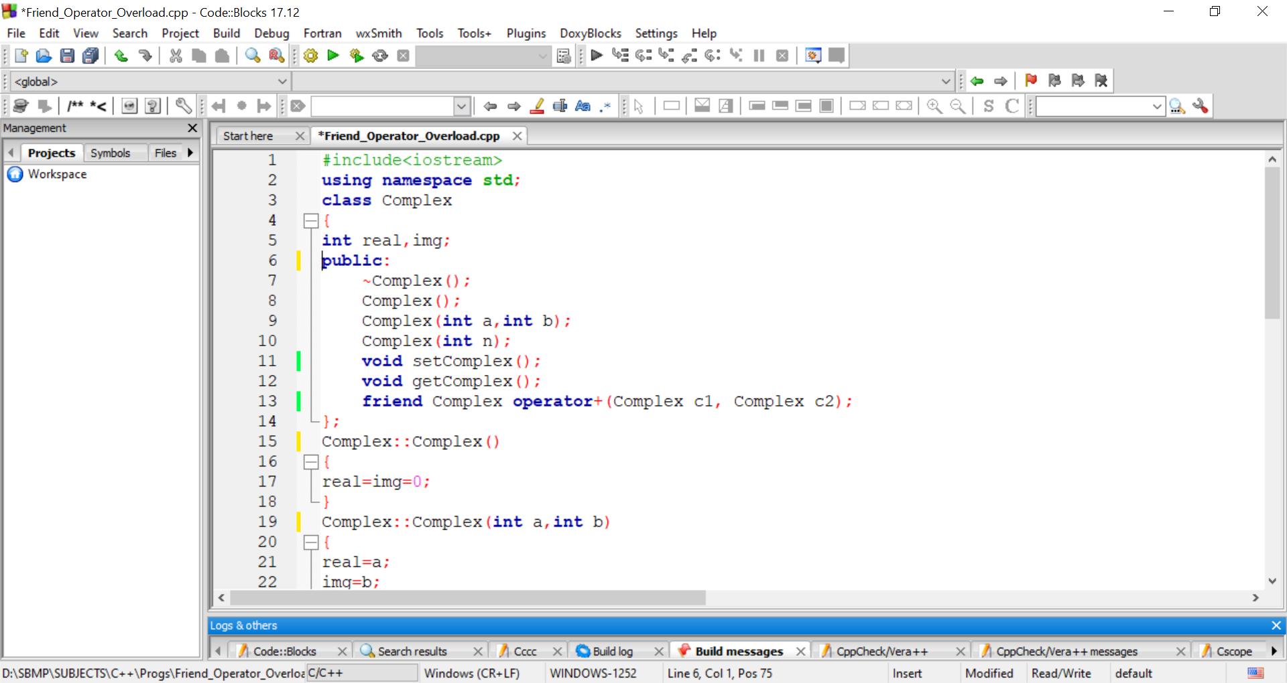
operator overloading using friend

Slide 17
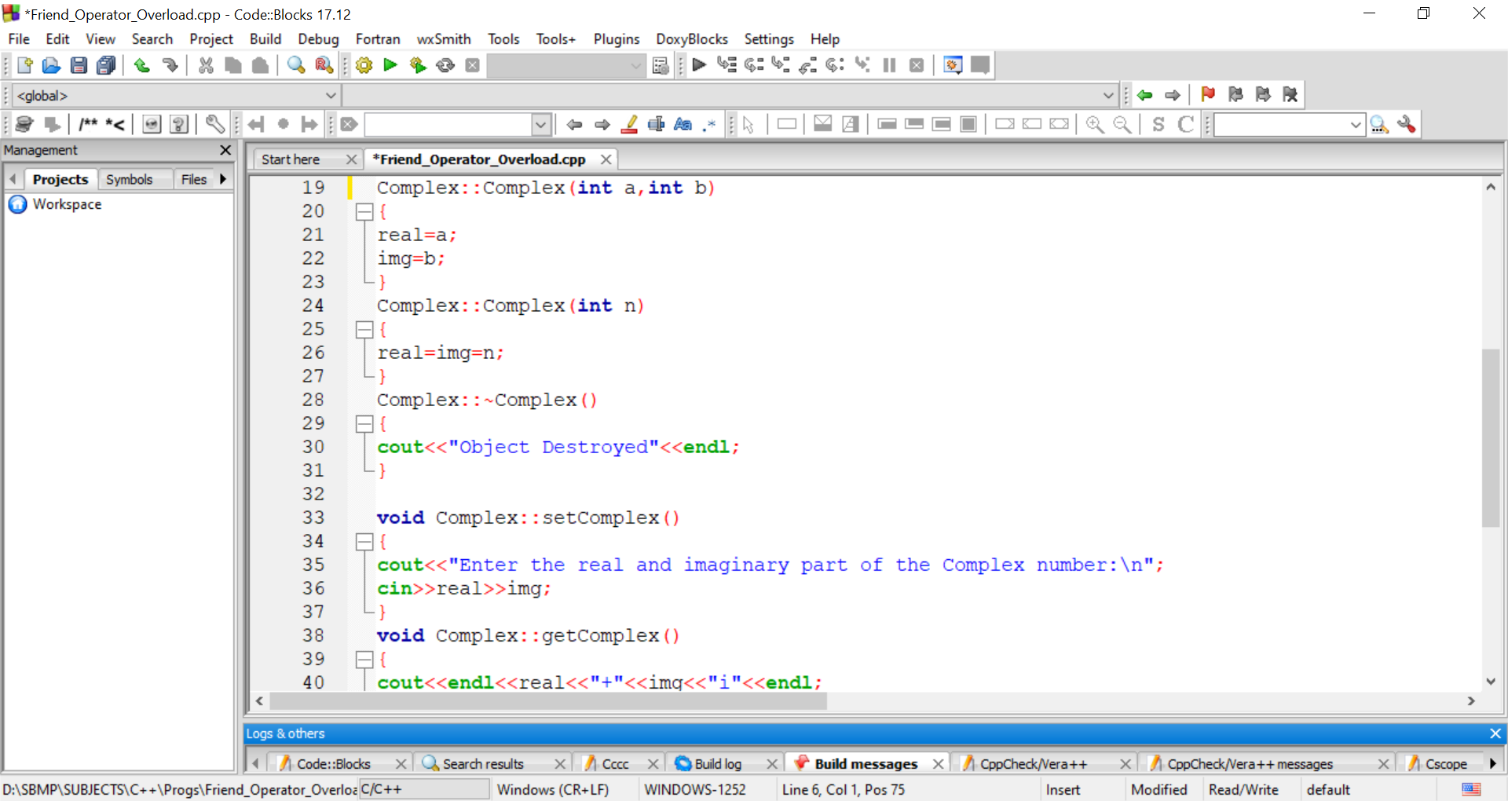
operator overloading using friend

Slide 18
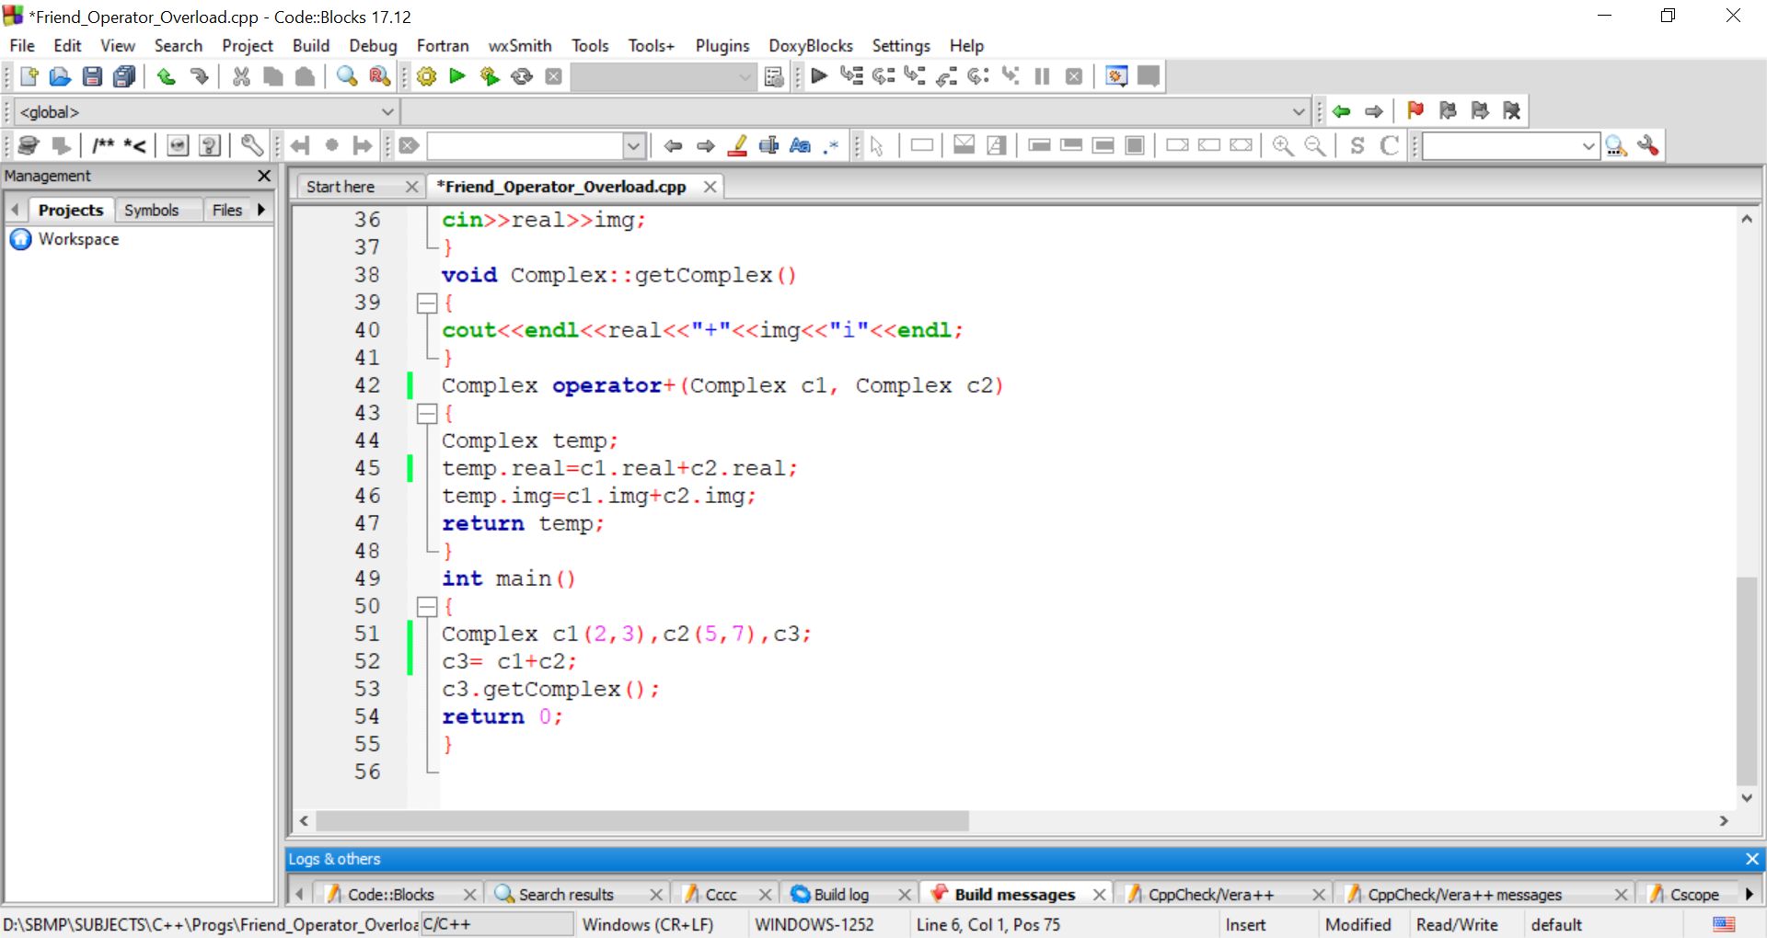
operator overloading using friend

