Slide 1
MULTITHREADING
By
Manishkumar R Solanki
Sr. Lecturer (Information Technology)
SBMP

Slide 2
Learning Outcomes
Students will be able to learn:
Differentiate between a process and a thread
Create a thread using Thread class and Runnable interface
Create multiple user defined threads
Apply the methods isAlive() and join()
Achieve synchronization between threads
Observe the Producer – Consumer problem

Slide 3
Concept of a Thread
A multithreaded program contains two or more parts that can run concurrently
Each part of such a program is called a thread, and each thread defines a separate path of execution
Multithreading is a specialized form of multitasking
There are two distinct types of multitasking i.e. process based and thread-based

Slide 4
Process Vs Threads
Process | Thread
Program/Task is in execution | Part of a Process/Program in execution
Two or more programs are running simultaneously i.e. Java Compiler and Text Editor running parallely Media Player is playing a song and user prepares power point presentation Video player is playing movies while some data is getting downloaded in the background | Two or more sub parts of a program are running simultaneously i.e. 1. A user types text in a MS Word and prints the pages parallely 2. multiple tabs in a single browser window 3. Home Screen of a cell phone displays picture, battery level, signal strength, location, time, etc. 4. In a Video Game, objects are coming and music is played in the background
Smallest unit to be dispatched for OS | Smallest unit to be dispatched by a Process
Execution of more than one processes form multitasking | A specialized form of multitasking.

Slide 5
Process Vs Threads
Process | Thread
4.Each process has its own memory address space | 4.Each thread shares the memory address space allocated to the process of which they are subparts
5.Context Switching is costly | 5.Context Switching is cheaper
6.Heavy Weight Resource so Interprocess communication is expensive | 6.Light Weight Resource so inter thread communication is not expensive

Slide 6
The Main Thread
When a Java program starts up, one thread begins running immediately
This is usually called the main thread of your program, because it is the one that is executed when your program begins
The main thread is important because:
It is the thread from which other “child” threads will be spawned (started)
It must be the last thread to finish execution because it performs various shutdown actions
We can obtain the reference of this running thread using following Thread class method:
static Thread currentThread()
Now, we can control this thread as we like.

Slide 7
The Main Thread
class CurrentThreadDemo {
public static void main(String args[]) {
Thread t = Thread.currentThread();
System.out.println("Current thread: " + t);
// change the name of the thread
t.setName("My Thread");
System.out.println("After name change: " + t);
try {
for(int n = 5; n > 0; n--)
{
System.out.println(n);
Thread.sleep(1000);
} // end of for
} // end of try
catch (InterruptedException e)
{
System.out.println("Main thread interrupted");
}
} }

Slide 8
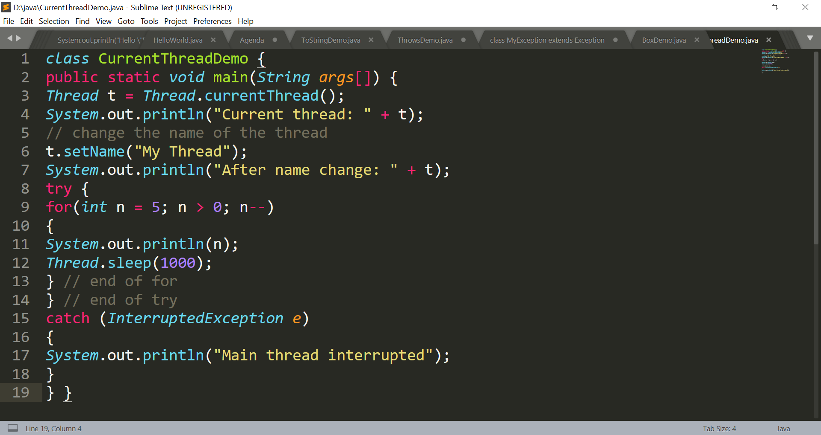
The Main Thread

Slide 9
The Main Thread
Output:
Current thread: Thread[main,5,main]
After name change: Thread[My Thread,5,main]
5
4
3
2
1

Slide 10
Creating a Thread
Java defines two ways in which a thread can be created:
You can extend the Thread class, itself
You can implement the Runnable interface

Slide 11
THREAD class member methods
We can set the name of a thread by using setName( ) and can can obtain the name of a thread by calling getName( )
final void setName(String threadName)
final String getName( )
After creating a thread we have to start its’ execution which is achieved by calling start() method:
void start()
The execution logic of a thread is to be written inside the run() method(we have to override it). run() can not be invoked explicitly but start() method calls it implicitly.
void run()

Slide 12
THREAD class member methods
The sleep( ) method causes the thread to suspend execution for the specified period of milliseconds.
Its general form is shown here:
static void sleep(long milliseconds) throws InterruptedException
The number of milliseconds to suspend is specified in milliseconds.
This method may throw an InterruptedException

Slide 13
Extending a THREAD class
class NewThread extends Thread {
NewThread() {
super("Demo Thread");
System.out.println("Child thread: " + this);
start(); // Start the thread
}
public void run() {
try {
for(int i = 5; i > 0; i--) {
System.out.println("Child Thread: " + i);
Thread.sleep(500);
}
} catch (InterruptedException e) {
System.out.println("Child interrupted.");
}
System.out.println("Exiting child thread.");
} // end of run( )
} // end of class

Slide 14
Extending a THREAD class
class ExtendThread {
public static void main(String args[]) {
new NewThread(); // create a new thread
try {
for(int i = 5; i > 0; i--) {
System.out.println("Main Thread: " + i);
Thread.sleep(1000);
}
} catch (InterruptedException e) {
System.out.println("Main thread interrupted.");
}
System.out.println("Main thread exiting.");
} // end of main( )
} // end of class

Slide 15
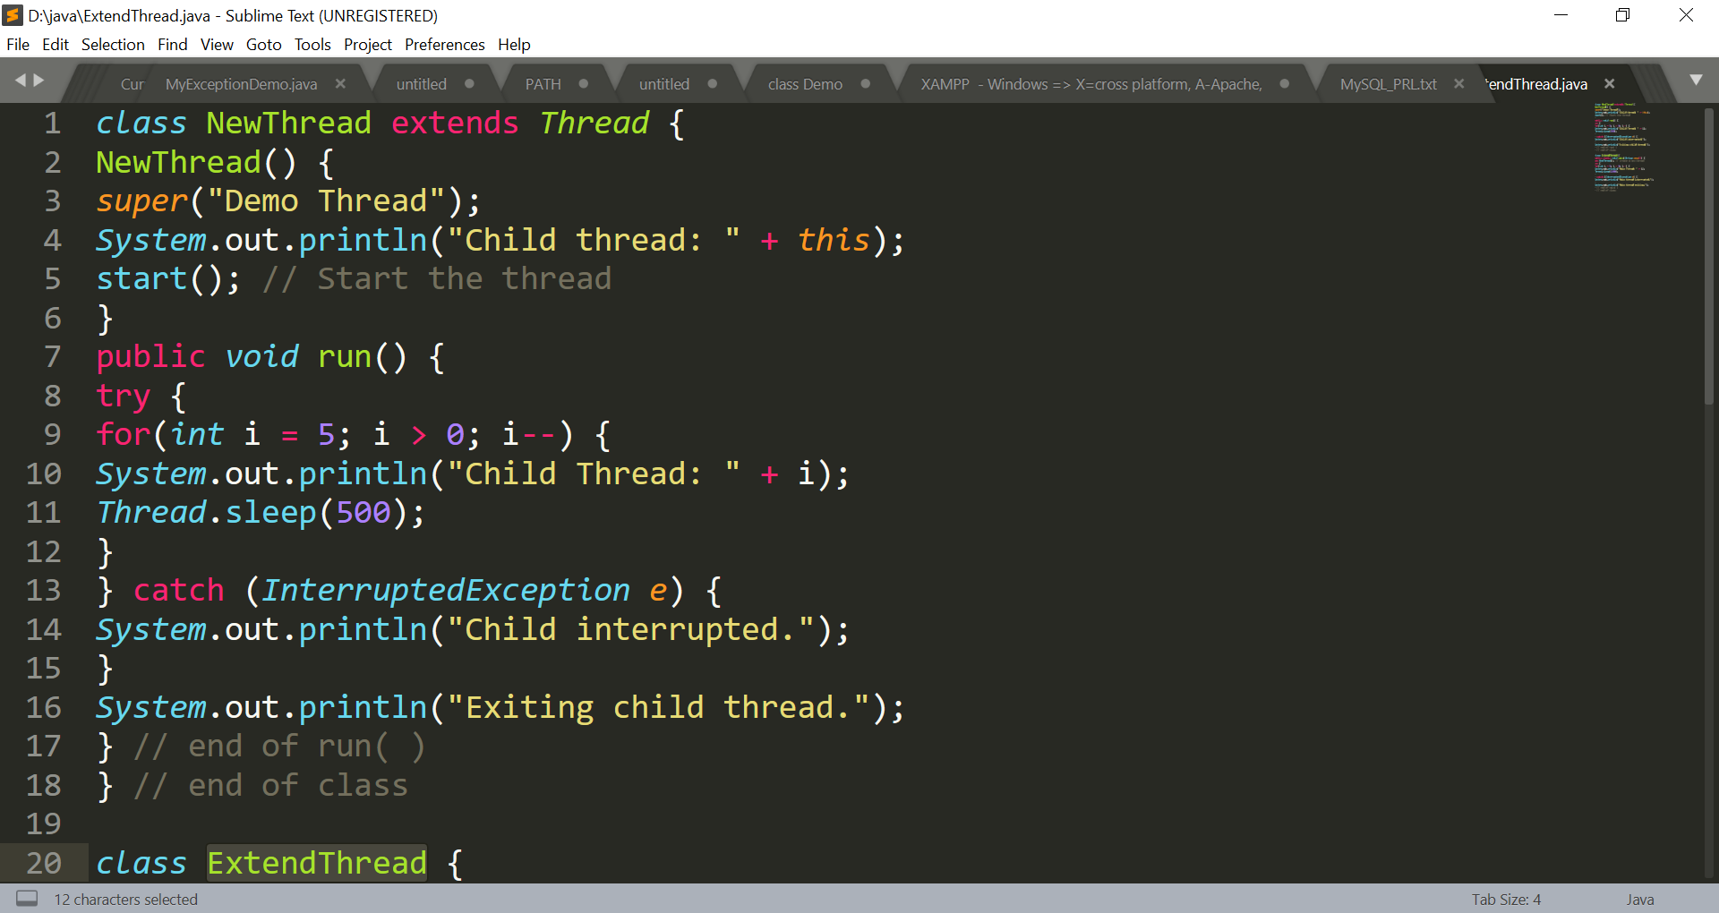
Extending a THREAD class

Slide 16
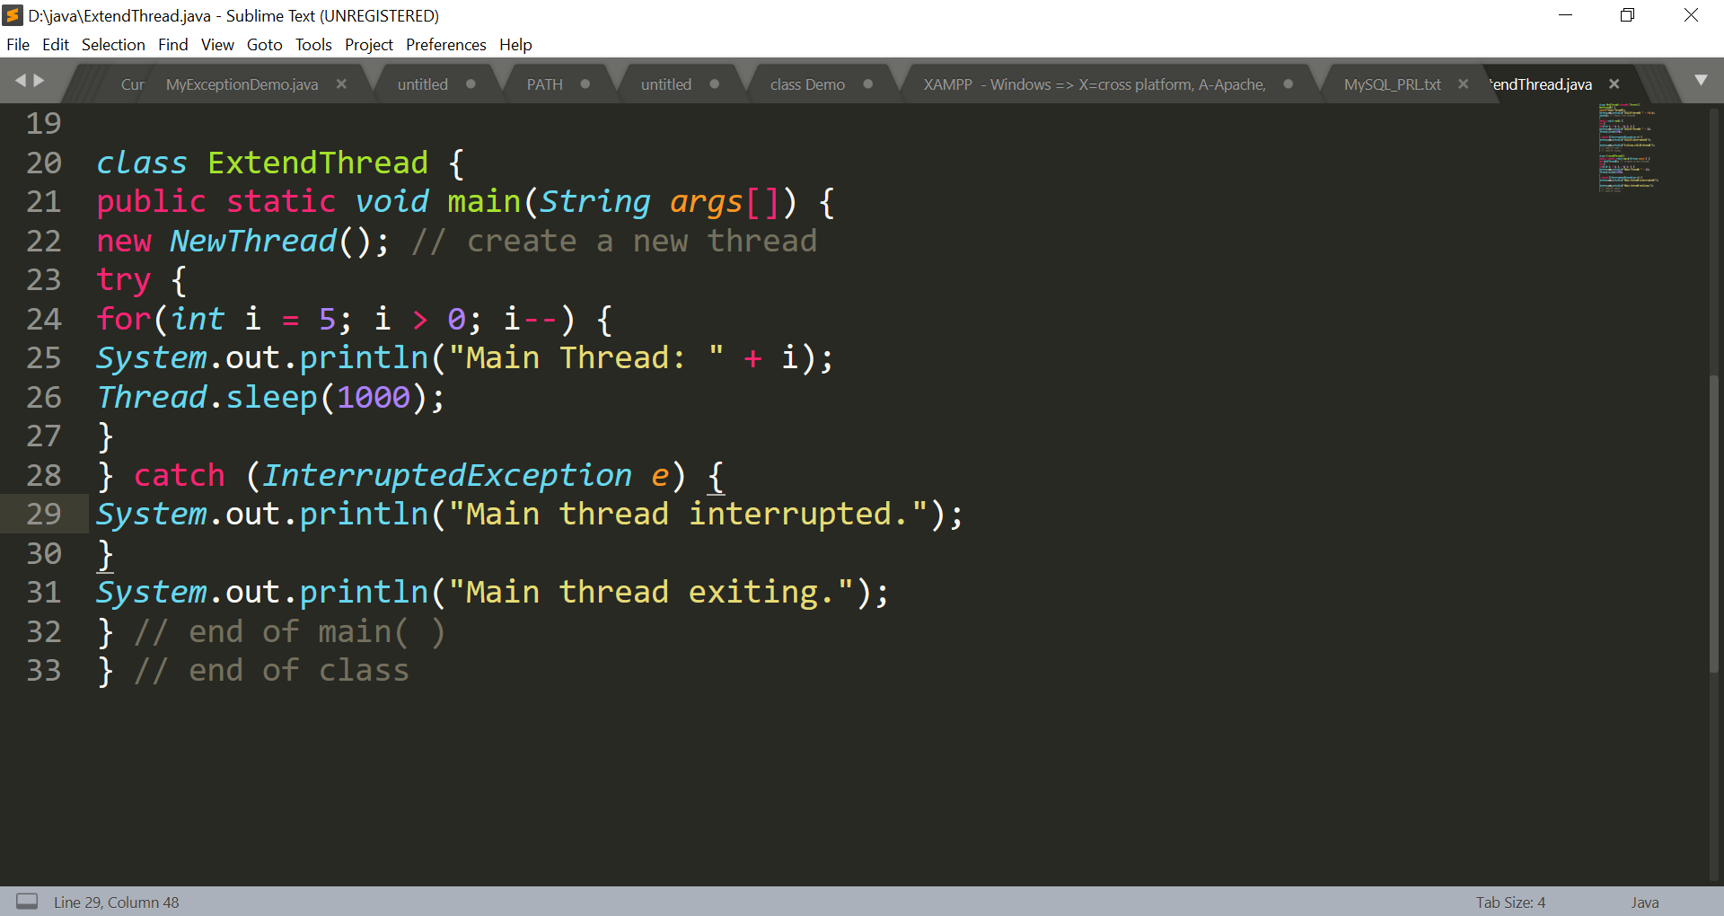
Extending a THREAD class

Slide 17
Extending a THREAD class
Output:
Child thread: Thread[Demo Thread,5,main]
Main Thread: 5
Child Thread: 5
Child Thread: 4
Main Thread: 4
Child Thread: 3
Child Thread: 2
Main Thread: 3
Child Thread: 1
Exiting child thread.
Main Thread: 2
Main Thread: 1
Main thread exiting.

Slide 18
Runnable interface member methods
To implement Runnable, a class need only implement a single method called run( ):
public void run( )
The run( ), contains the execution logic for a thread
The run( ) can call other methods, use other classes, and declare variables, just like the main thread can.
The run( ) method establishes the entry point for another, concurrent thread of execution within your program
The thread will end when run( ) returns(ends)

Slide 19
Runnable interface member methods
Thread class defines several constructors. The one that we will use is shown here:
Thread(Runnable threadOb, String threadName)
In this constructor, threadOb is an instance of a class that implements the Runnable interface
(defines where execution of the thread will begin)
The name of the new thread is specified by threadName

Slide 20
Implementing Runnable
class NewThread implements Runnable {
Thread t;
NewThread() {
t = new Thread(this, "Demo Thread");
System.out.println("Child thread: " + t);
t.start(); // Start the thread
}
public void run() {
try {
for(int i = 5; i > 0; i--) {
System.out.println("Child Thread: " + i);
Thread.sleep(500);
}
} catch (InterruptedException e) {
System.out.println("Child interrupted.");
}
System.out.println("Exiting child thread.");
} }

Slide 21
Implementing Runnable
class ThreadDemo {
public static void main(String args[]) {
new NewThread(); // create a new thread
try {
for(int i = 5; i > 0; i--) {
System.out.println("Main Thread: " + i);
Thread.sleep(1000);
}
} catch (InterruptedException e) {
System.out.println("Main thread interrupted.");
}
System.out.println("Main thread exiting.");
}
}
Note: Output will be same as in extending Thread

Slide 22
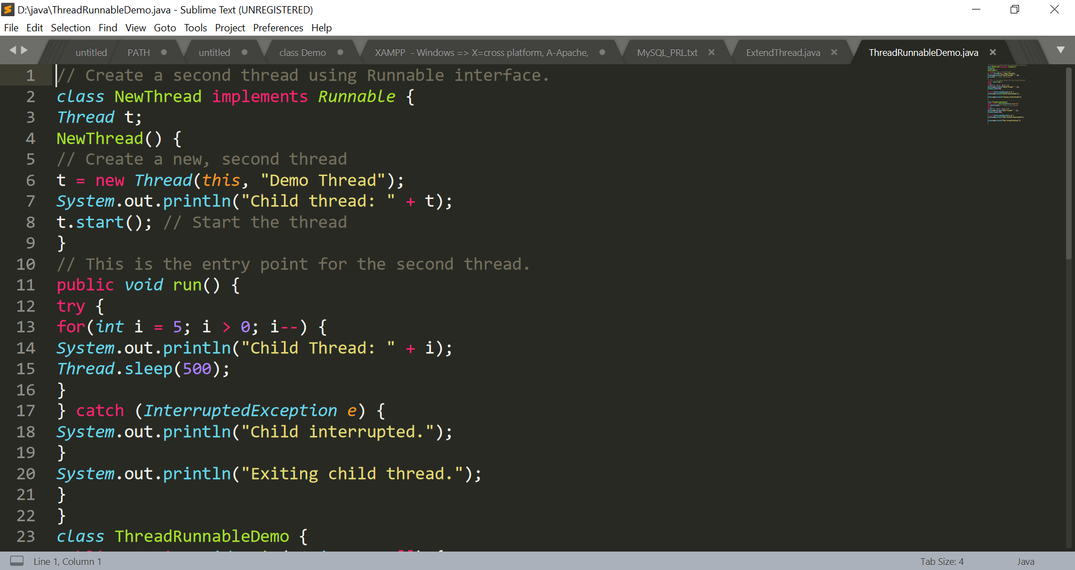
Implementing Runnable

Slide 23
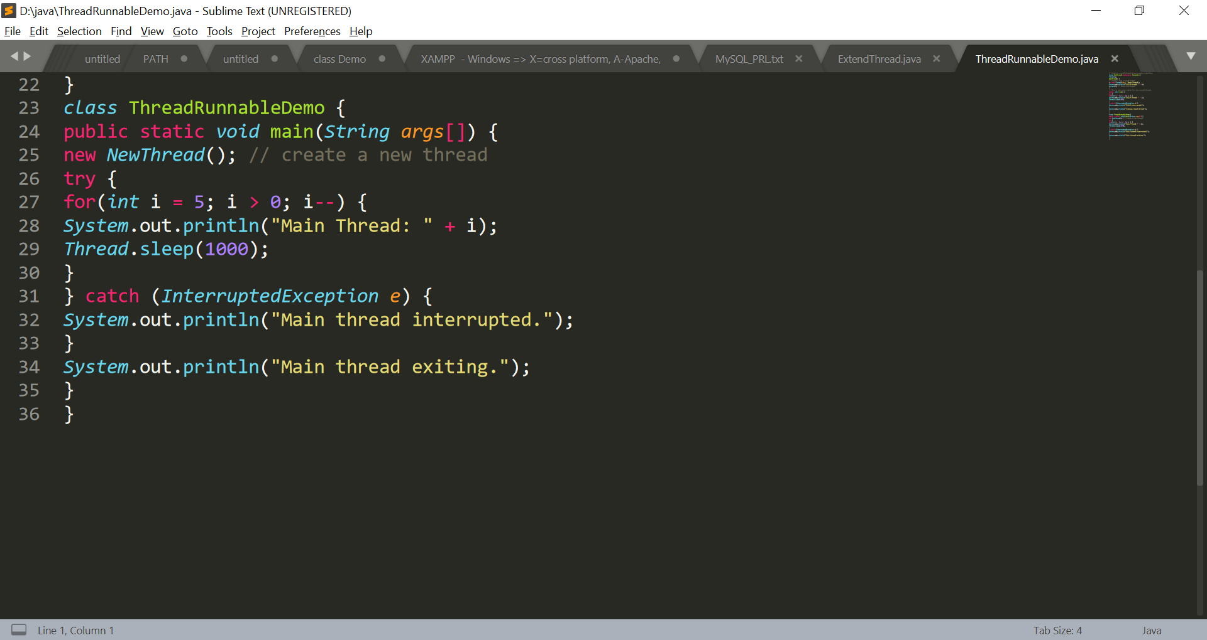
Implementing Runnable

Slide 24
Choosing an Approach for thread creation
The class which extends Thread, overrides only one method run()
Classes should be extended only when they are being enhanced or modified in some way. We do not do this while extending Thread class. So, we should simply implement Runnable.
Another Reason: We can extend at most one class in Java so Runnable will help us here to achieve for thread execution.

Slide 25
Creation of multiple threads
class NewThread implements Runnable {
String name; // name of thread
Thread t;
NewThread(String threadname) {
name = threadname;
t = new Thread(this, name);
System.out.println("New thread: " + t);
t.start(); // Start the thread
}
// This is the entry point for thread.
public void run() {
try {
for(int i = 5; i > 0; i--) {
System.out.println(name + ": " + i);
Thread.sleep(1000);
}
} catch (InterruptedException e) {
System.out.println(name + "Interrupted");
}
System.out.println(name + " exiting.");
} }

Slide 26
Creation of multiple threads
class MultiThreadDemo
{
public static void main(String args[]) {
new NewThread("One"); // start threads
new NewThread("Two");
new NewThread("Three");
try {
// wait for other threads to end
Thread.sleep(10000);
} catch (InterruptedException e) {
System.out.println("Main thread Interrupted");
}
System.out.println("Main thread exiting.");
}
}

Slide 27
Creation of multiple threads
class MultiThreadDemo
{
public static void main(String args[]) {
new NewThread("One"); // start threads
new NewThread("Two");
new NewThread("Three");
try {
// wait for other threads to end
Thread.sleep(10000);
} catch (InterruptedException e) {
System.out.println("Main thread Interrupted");
}
System.out.println("Main thread exiting.");
}
}

Slide 28
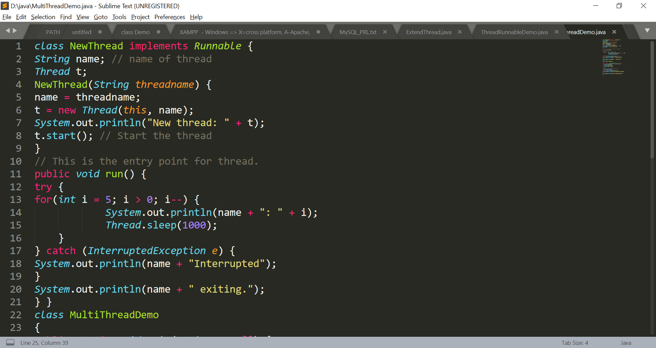
Creation of multiple threads

Slide 29
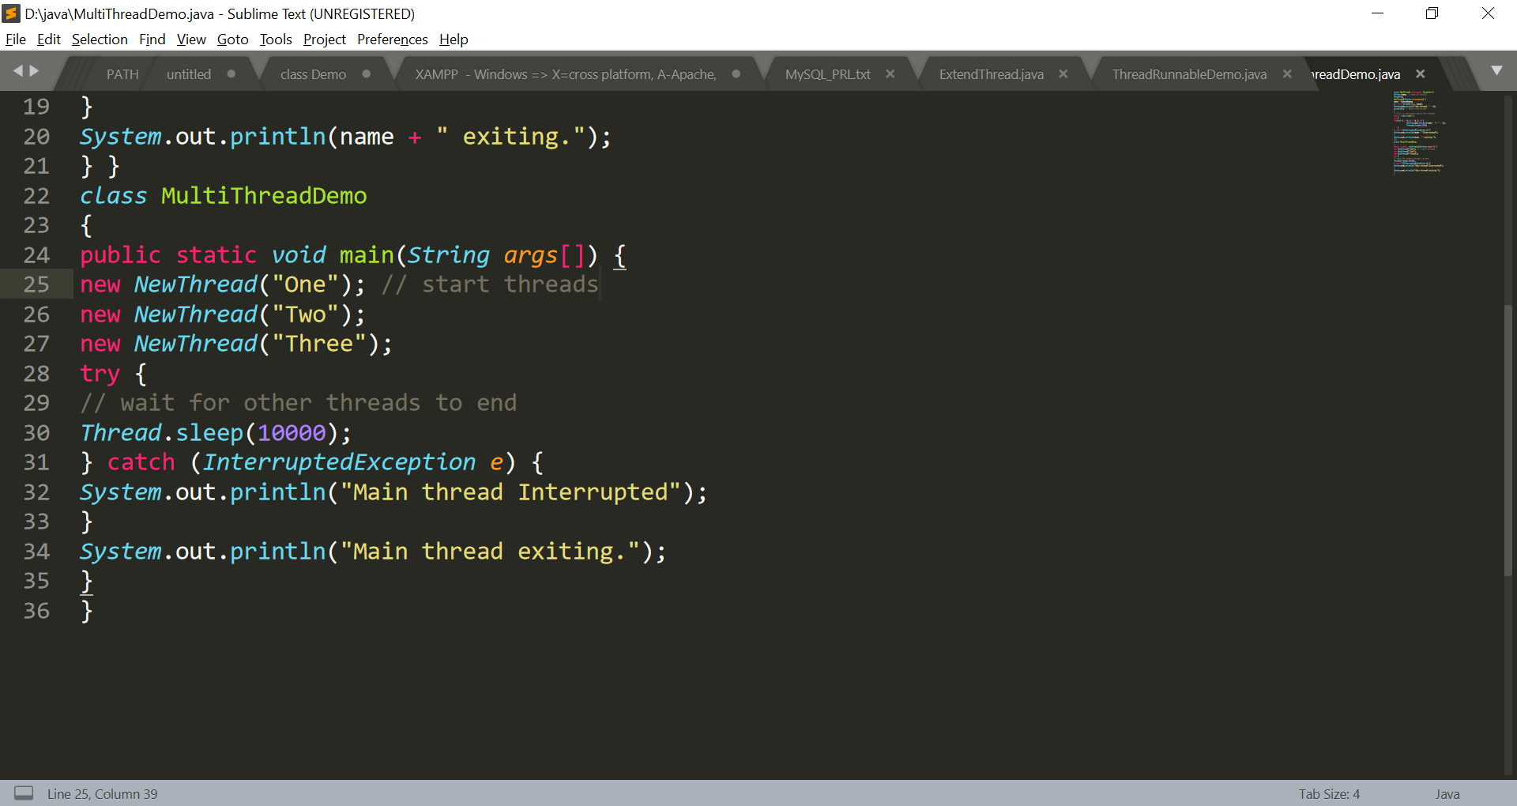
Creation of multiple threads

Slide 30
The output from this program
New thread: Thread[One,5,main]
New thread: Thread[Two,5,main]
New thread: Thread[Three,5,main]
One: 5
Two: 5
Three: 5
One: 4
Two: 4
Three: 4
One: 3
Three: 3
Two: 3
One: 2
Three: 2
Two: 2
One: 1
Three: 1
Two: 1
One exiting.
Two exiting.
Three exiting.
Main thread exiting.

Slide 31
Using isAlive( )
The main tread should be the last to finish, this is accomplished by calling sleep( ) within main( ) with a long enough delay.
How can one thread know when another thread has ended?
Two ways exist to determine whether a thread has finished.
First, you can call isAlive( ) on the thread.
This method is defined by Thread, and its general form is shown here:
final boolean isAlive( )
The isAlive( ) method returns true if the thread upon which it is called is still running. It returns false otherwise.

Slide 32
Using join( )
The method that will be used to wait for a thread to finish is called join( )
final void join( ) throws InterruptedException
This method waits until the thread on which it is called terminates. Its name comes from the concept of the calling thread waiting until the specified thread joins it.

Slide 33
Using isAlive( ) and join( )
class DemoJoin
{
public static void main(String args[]) {
NewThread ob1 = new NewThread("One");
NewThread ob2 = new NewThread("Two");
NewThread ob3 = new NewThread("Three");
// checking status of threads
System.out.println("Thread One is alive: “ + ob1.t.isAlive());
System.out.println("Thread Two is alive: “ + ob2.t.isAlive());
System.out.println("Thread Three is alive: “ + ob3.t.isAlive());

Slide 34
Using isAlive( ) and join( )
try {
System.out.println("Waiting for threads to finish.");
ob1.t.join();
ob2.t.join();
ob3.t.join();
} catch (InterruptedException e) {
System.out.println("Main thread Interrupted");
}
// checking status of threads again
System.out.println("Thread One is alive: “ + ob1.t.isAlive());
System.out.println("Thread Two is alive: “ + ob2.t.isAlive());
System.out.println("Thread Three is alive: “ + ob3.t.isAlive());
System.out.println("Main thread exiting.");
}}

Slide 35
The output from this program
New thread: Thread[One,5,main]
New thread: Thread[Two,5,main]
New thread: Thread[Three,5,main]
Thread One is alive: true
Thread Two is alive: true
Thread Three is alive: true
Waiting for threads to finish.
One: 5
Two: 5
Three: 5
One: 4
Two: 4
Three: 4

Slide 36
The output from this program
One: 3
Two: 3
Three: 3
One: 2
Two: 2
Three: 2
One: 1
Two: 1
Three: 1
Two exiting.
Three exiting.
One exiting.
Thread One is alive: false
Thread Two is alive: false
Thread Three is alive: false
Main thread exiting.

Slide 37
Thread Priorities
Thread priorities are used by the thread scheduler to decide when each thread should be allowed to run.
higher-priority threads get more CPU time than lower-priority threads.
A higher-priority thread can also preempt a lower-priority one. For instance, when a lower-priority thread is running and a higher-priority thread resumes (from sleeping or waiting on I/O, for example), it will preempt the lower priority thread.

Slide 38
Thread Priorities
To set a thread’s priority, use the setPriority( ) method, which is a member of Thread.
final void setPriority(int level)
level specifies the new priority setting for the calling thread. The value of level must be
within the range MIN_PRIORITY and MAX_PRIORITY. Currently, these values are 1 and 10, respectively. To return a thread to default priority, specify NORM_PRIORITY, which is currently 5.
You can obtain the current priority setting by calling the getPriority( ) method of Thread, shown here:
final int getPriority( )

Slide 39
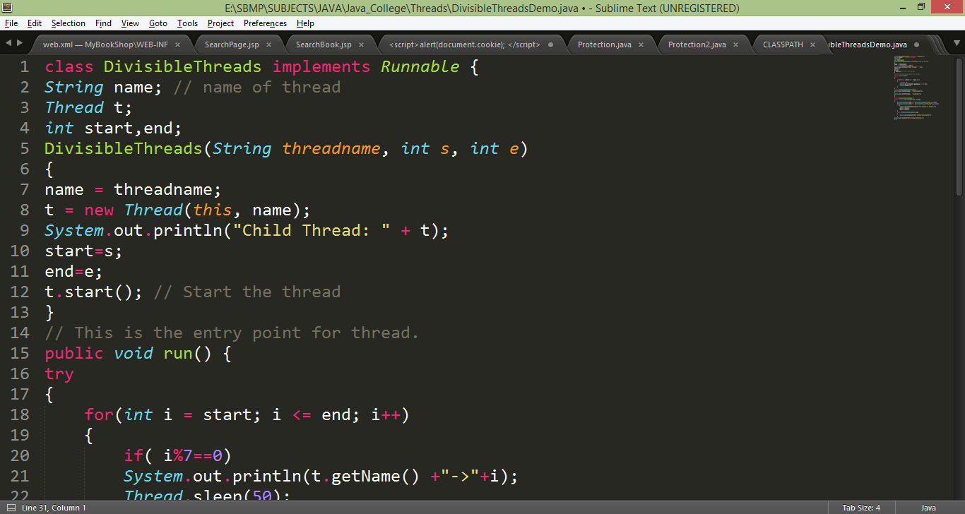
Real World Example
Create two threads to find out numbers which are divisible by 7 between 1 to 200 numbers. Each thread should look after 100 numbers in the given range.

Slide 40
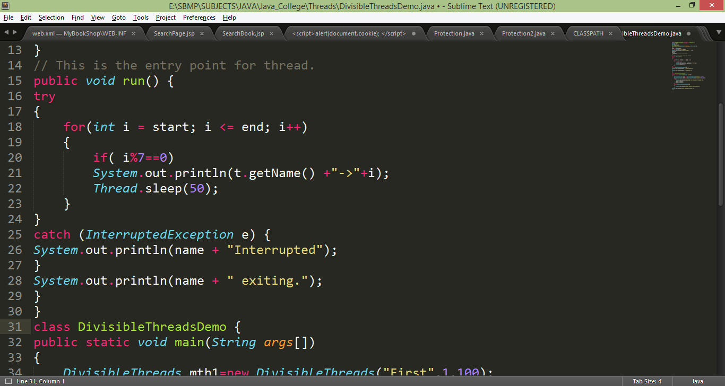
Real World Example

Slide 41
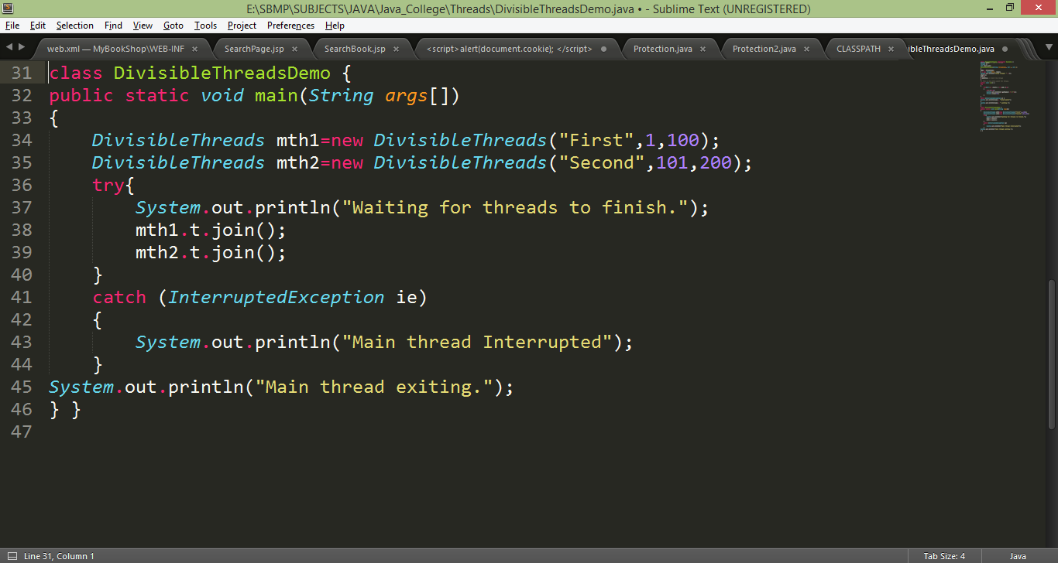
Real World Example

Slide 42
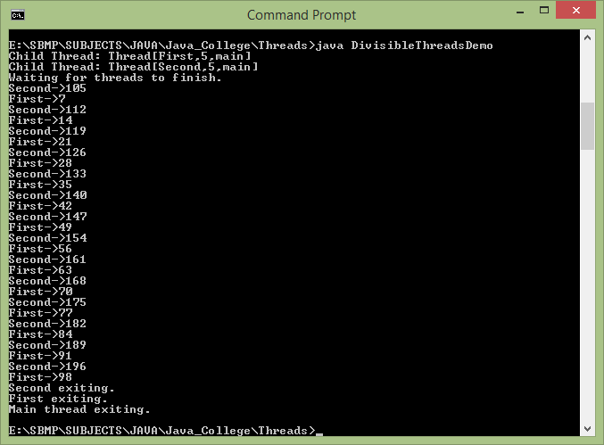
Real World Example

Slide 43
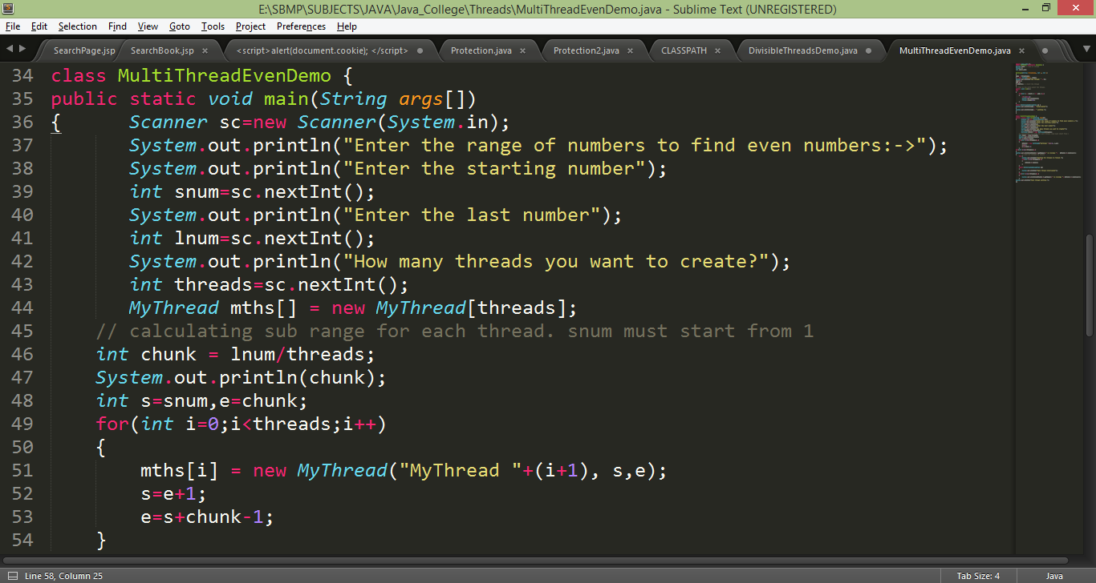
Real World Example
Write an interactive multithreaded Java program to find even numbers from the given range of numbers. The program should ask the user about range and number of threads to be created.

Slide 44
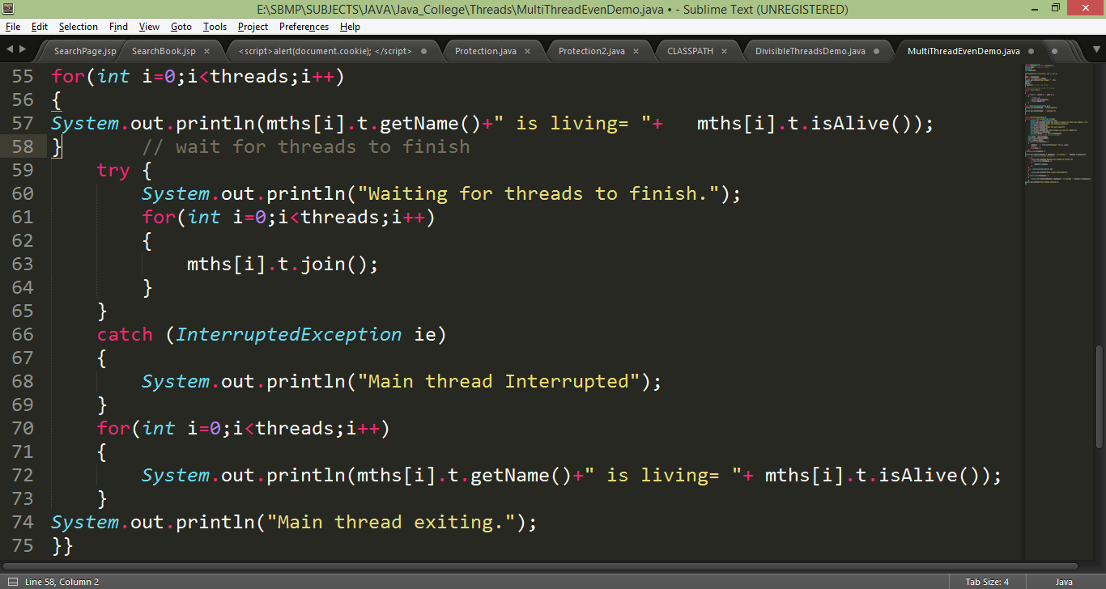
Real World Example

Slide 45
Real World Example
Note: If range is in between i.e. 10 to 100
Then,
chunk = (lnum – snum) / threads;
// Outside the loop
s=snum;
e= s+chunk
// Inside the loop
s=e+1;
e= s+chunk-1;

Slide 46
Thread Synchronization
When two or more threads need access to a shared resource, they need some way to ensure that the resource will be used by only one thread at a time. The process by which this is achieved is called synchronization.
Key to synchronization is the concept of the monitor (also called a semaphore).
A monitor is an object that is used as a mutually exclusive lock, or mutex.
Only one thread can own a monitor at a given time. When a thread acquires a lock, it is said to have entered the monitor.
All other threads attempting to enter the locked monitor will be suspended until the first thread exits the monitor. These other threads are said to be waiting for the monitor.
A thread that owns a monitor can reenter the same monitor if it so desires

Slide 47
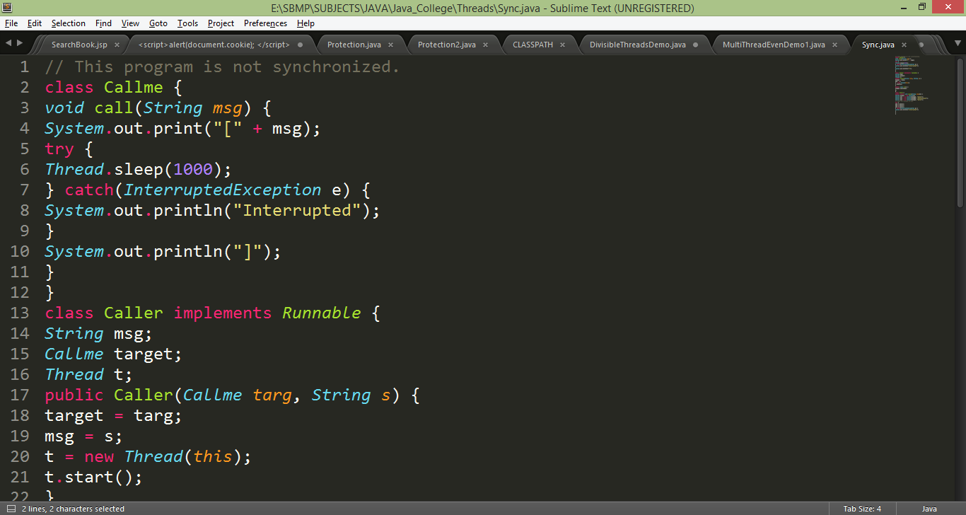
Thread Synchronization

Slide 48
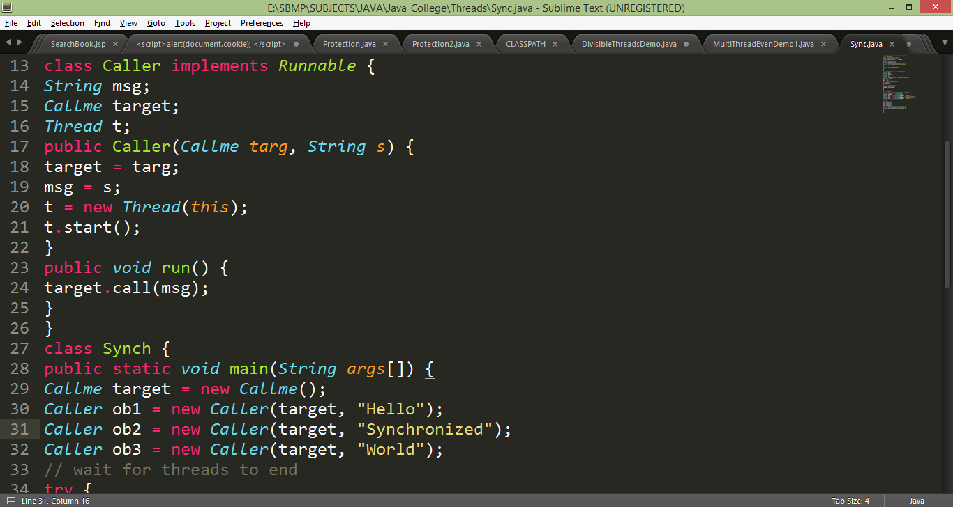
Thread Synchronization

Slide 49
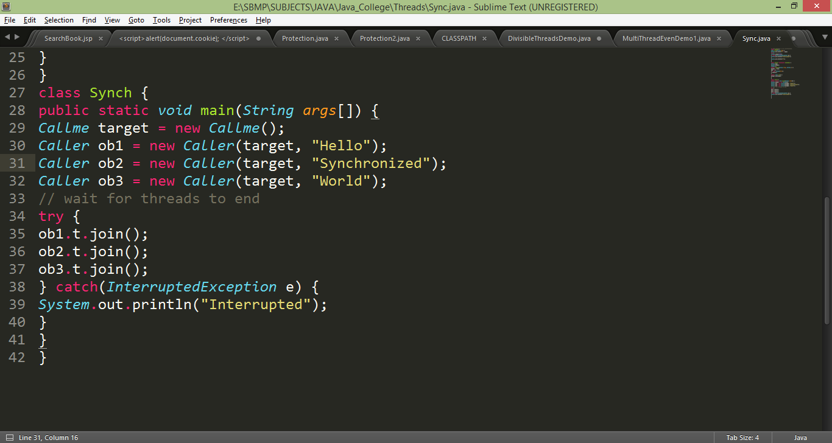
Thread Synchronization

Slide 50
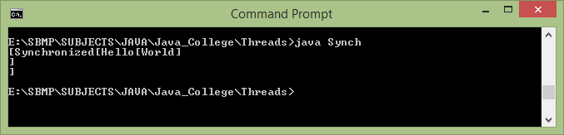
Thread Synchronization

Slide 51
Thread Synchronization
To fix the preceding program, you must serialize access to call( ).
That is, you must restrict its access to only one thread at a time.
To do this, you simply need to precede call( )’s definition with the keyword synchronized, as shown here:
class Callme {
synchronized void call(String msg) {
The output of the program is as follows:
[Hello]
[Synchronized]
[World]
Once a thread enters any synchronized method on an instance, no other thread can enter any other synchronized method on the same instance.

Slide 52
Thread Synchronization
Creating synchronized methods within classes that you create is an easy and effective solution to achieve synchronization
But it is not applicable in all cases
Imagine that you want to synchronize access to objects of a class that was not designed for multithreaded access. That is, the class does not use synchronized methods.
Further, this class was not created by you, but by a third party, and you do not have access to the source code.
Thus, you can’t add synchronized to the appropriate methods within the class. How can access to an object of this class be synchronized?
The solution to this problem is quite easy: You simply put calls to the methods defined by this class inside a synchronized block.
synchronized(object) {
// statements to be synchronized
}

Slide 53
Thread Synchronization
The program code should be written as follows:
// synchronize calls to call()
public void run()
{
synchronized(target) { // synchronized block
target.call(msg);
}
}

Slide 54
Interthread Communication
The preceding examples unconditionally blocked other threads from asynchronous access to certain methods. This use of the implicit monitors in Java objects is powerful, but you can achieve a more subtle level of control through interprocess communication.
Producer Consumer Problem: One thread is producing some
data and another is consuming it. To make the problem more interesting, suppose that the producer has to wait until the consumer is finished before it generates more data.
In a polling system, the consumer would waste many CPU cycles while it waited for the producer to produce. Once the producer was finished, it would start polling, wasting more CPU cycles waiting for the consumer to finish, and so on. Clearly, this situation is undesirable.

Slide 55
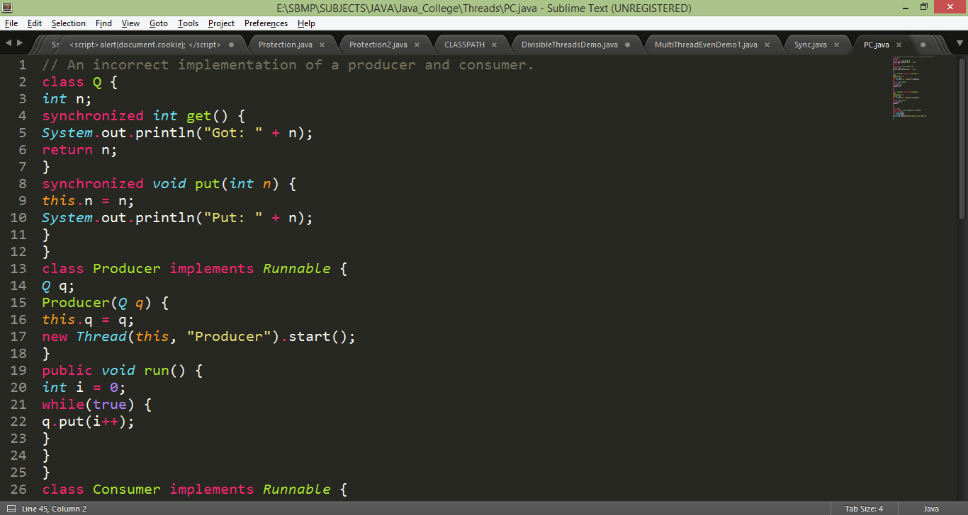
Producer Consumer Problem with only Synchronization

Slide 56
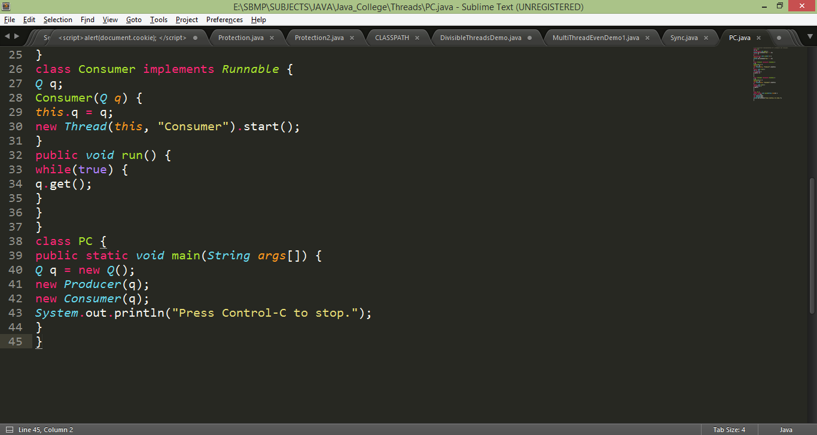
Producer Consumer Problem with only Synchronization

Slide 57
Producer Consumer Problem with only Synchronization
Output
Put: 1
Got: 1
Got: 1
Got: 1
Got: 1
Got: 1
Put: 2
Put: 3
Put: 4
Put: 5
Put: 6
Put: 7
Got: 7

Slide 58
Interthread Communication
To avoid polling, Java includes an elegant inter process communication mechanism via the wait( ), notify( ), and notifyAll( ) methods.
These methods are implemented as final methods in Object, so all classes have them. All three methods can be called only from within a synchronized context.
wait( ) tells the calling thread to give up the monitor and go to sleep until some other thread enters the same monitor and calls notify( ).
notify( ) wakes up a thread that called wait( ) on the same object.
notifyAll( ) wakes up all the threads that called wait( ) on the same object. One of the threads will be granted access.
These methods are declared within Object, as shown here:
final void wait( ) throws InterruptedException
final void notify( )
final void notifyAll( ).

Slide 59
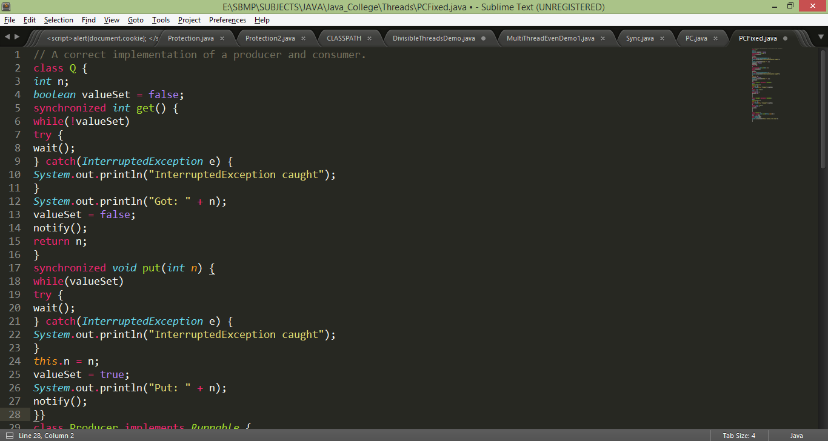
Producer Consumer Problem with only Synchronization

Slide 60
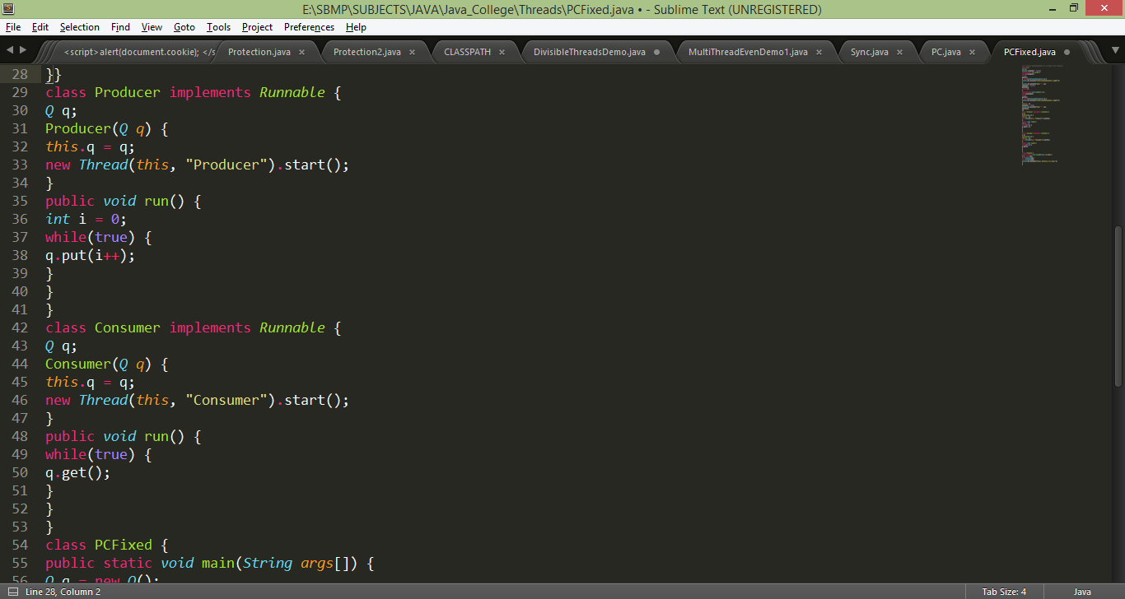
Producer Consumer Problem with only Synchronization

Slide 61
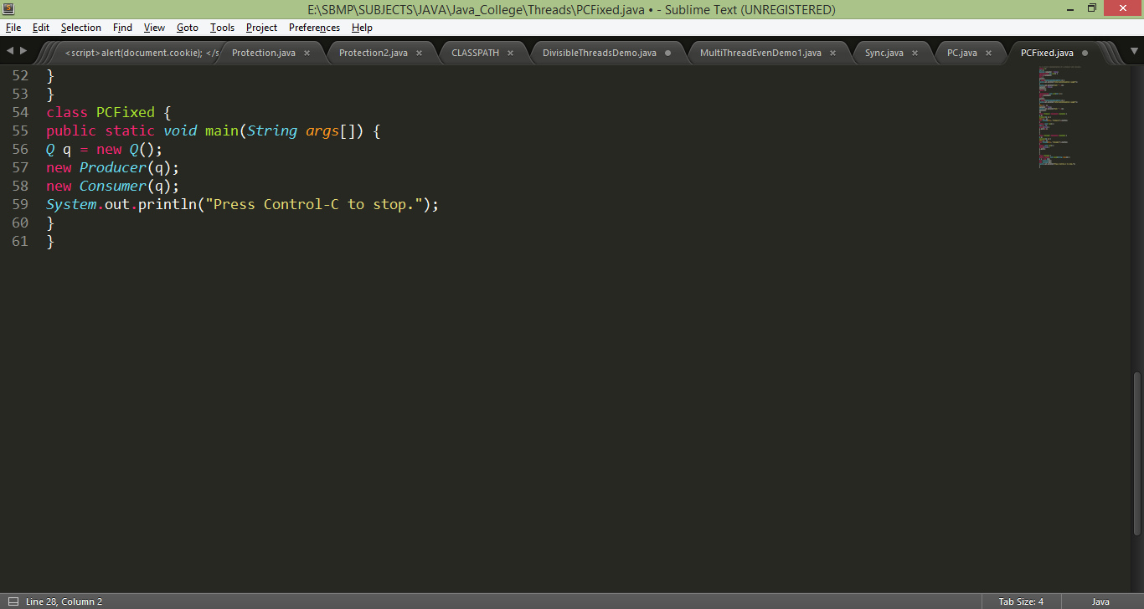
Producer Consumer Problem with only Synchronization

Slide 62
References:
Java The Complete Reference,TMH

