Slide 1
Graphics with Applet
M.R.Solanki, SBMP

Slide 2
Graphics Class
The origin of each window is at the top-left corner and is 0,0.
Coordinates are specified in pixels. All output to a window takes place through a graphics context.
Agraphics context is encapsulated by the Graphics class and is obtained in two ways:
1. It is passed to an applet when one of its various methods, such as paint( ) or update( ), is called.
2.It is returned by the getGraphics( ) method of Component.

Slide 3
Graphics Class
The Graphics class defines a number of drawing functions.
Each shape can be drawn edge-only or filled. Objects are drawn and filled in the currently selected graphics color, which is black by default.
When a graphics object is drawn that exceeds the dimensions of the window, output is automatically clipped.

Slide 4
Drawing Geometric Figures
Drawing Lines
Drawing Rectangles
Drawing Ovals
Drawing Arcs
Drawing Polygons

Slide 5
Drawing Lines
void drawLine(int startX, int startY, int endX, int endY);
drawLine( ) displays a line in the current drawing color that begins at startX,startY and ends at endX, endY
public class Lines extends Applet {
public void paint(Graphics g) {
g.setColor(Color.red);
g.drawLine(0, 0, 100, 100);
g.drawLine(0, 100, 100, 0);
g.setColor(Color.green);
g.drawLine(40, 25, 250, 180);
g.drawLine(75, 90, 400, 400);
g.drawLine(20, 150, 400, 40);
g.drawLine(5, 290, 80, 19);
} }

Slide 6
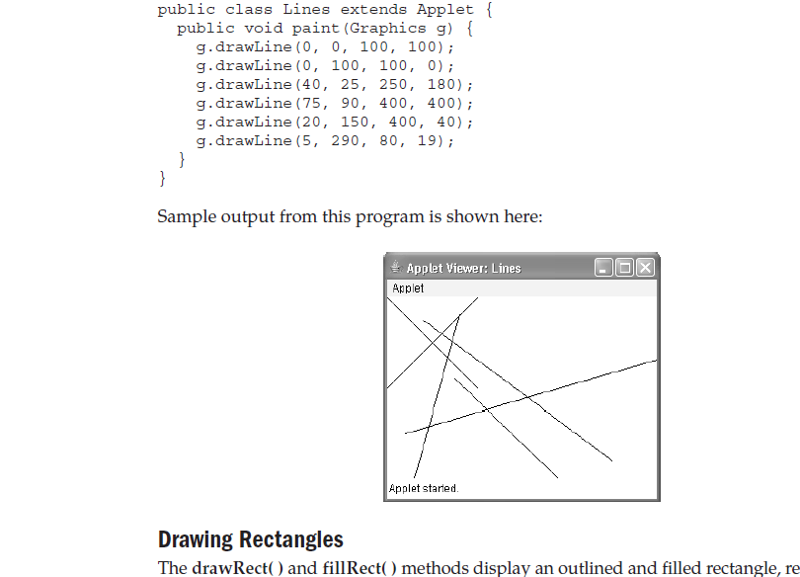
Drawing Lines
6

Slide 7
Drawing Rectangles
drawRect(int x, int y, int w, int h);
fillRect(int x, int y, int w, int h);
The upper-left corner of the rectangle is at top, left. The dimensions of the rectangle are specified by width and height.
void drawRoundRect(int top, int left, int width, int height,
int xDiam, int yDiam)
void fillRoundRect(int top, int left, int width, int height,
int xDiam, int yDiam)
A rounded rectangle has rounded corners. The upper-left corner of the rectangle is at top,left.
The dimensions of the rectangle are specified by width and height.
The diameter of the rounding arc along the X axis is specified by xDiam. The diameter of the rounding arc along the Y axis is specified by yDiam.

Slide 8
Drawing Rectangles
public class Rectangles extends Applet
{
public void paint(Graphics g)
{
g.drawRect(10, 10, 60, 50);
g.fillRect(100, 10, 60, 50);
g.drawRoundRect(190, 10, 60, 50, 15, 15);
g.fillRoundRect(70, 90, 140, 100, 30, 40);
}
}

Slide 9
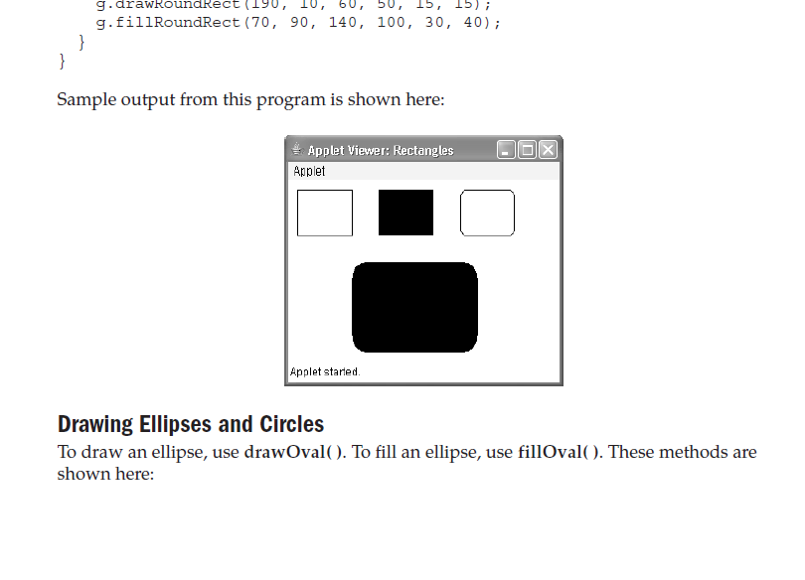
Drawing Rectangles

Slide 10
Drawing Ellipse(Oval) and Circle
drawOval(int x, int y, int w, int h);
fillOval(int x, int y, int w, int h);
The ellipse is drawn within a bounding rectangle whose upper-left corner is specified by top, left and whose width and height are specified by width and height.
To draw a circle, specify a square as the bounding rectangle.

Slide 11
Drawing Ellipse(Oval) and Circle
public class Ellipses extends Applet {
public void paint(Graphics g) {
g.drawOval(10, 10, 50, 50);
g.fillOval(100, 10, 75, 50);
g.drawOval(190, 10, 90, 30);
g.fillOval(70, 90, 140, 100);
}
}

Slide 12
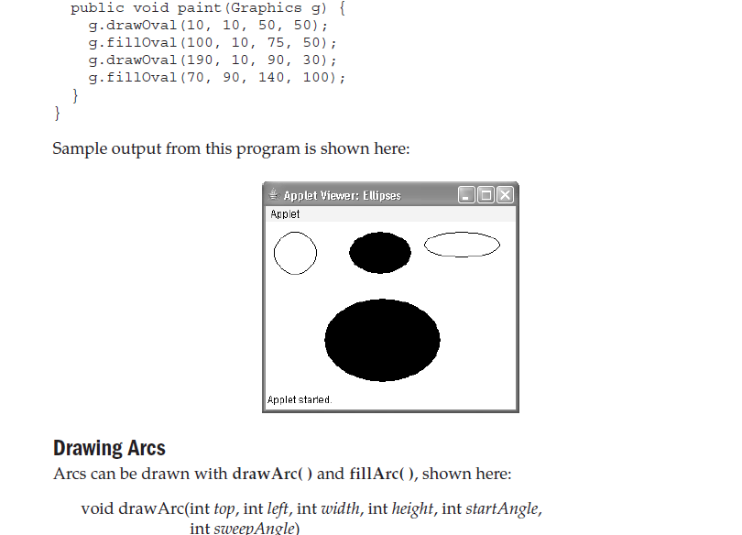
Drawing Ellipse(Oval) and Circle

Slide 13
Drawing Arcs
void drawArc(int top, int left, int width, int height, int startAngle, int sweepAngle)
void fillArc(int top, int left, int width, int height, int startAngle, int sweepAngle)
The arc is bounded by the rectangle whose upper-left corner is specified by top,left and whose width and height are specified by width and height.
The arc is drawn from startAngle through the angular distance specified by sweepAngle.
Angles are specified in degrees.
Zero degrees is on the horizontal, at the three o’clock position.
The arc is drawn counterclockwise if sweepAngle is positive, and clockwise if sweepAngle is negative

Slide 14
Drawing Arcs
public class Arcs extends Applet {
public void paint(Graphics g) {
g.drawArc(10, 40, 70, 70, 0, 75);
g.fillArc(100, 40, 70, 70, 0, 75);
g.drawArc(10, 100, 70, 80, 0, 175);
g.fillArc(100, 100, 70, 90, 0, 270);
g.drawArc(200, 80, 80, 80, 0, 180);
}
}

Slide 15
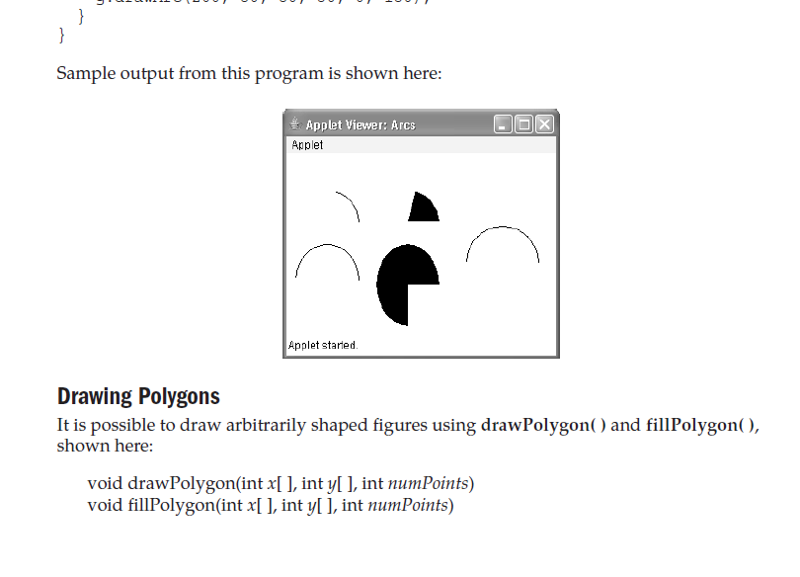
Drawing Arcs

Slide 16
Drawing Polygons
void drawPolygon(int x[ ], int y[ ], int numPoints)
void fillPolygon(int x[ ], int y[ ], int numPoints)
The polygon’s endpoints are specified by the coordinate pairs contained within the x and y arrays. The number of points defined by x and y is specified by numPoints.
public class HourGlass extends Applet {
public void paint(Graphics g) {
int xpoints[] = {30, 200, 30, 200, 30};
int ypoints[] = {30, 30, 200, 200, 30};
int num = 5;
g.drawPolygon(xpoints, ypoints, num);
} }

Slide 17
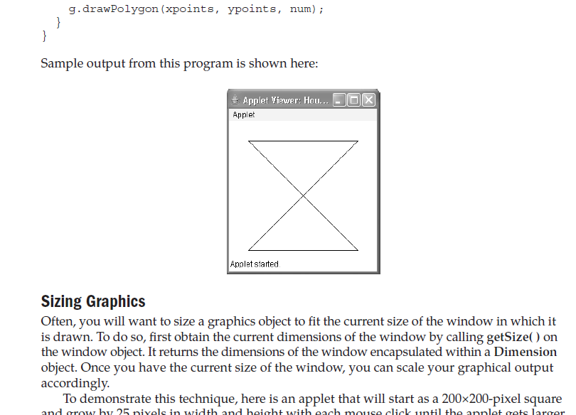
Drawing Polygons

Slide 18
Color class
The class Color defines the constants shown here that can be used to specify colors
Available colors are as below
Color.black
Color.magenta
Color.blue
Color.orange
Color.cyan
Color.pink
Color.darkGray
Color.red
Color.gray
Color.white
Color.green
Color.yellow
Color.lightGray

Slide 19
Color class
The following example sets the background color to green and the text color to red:
setBackground(Color.green);
setForeground(Color.red);
Setting the Current Graphics Color
By default, graphics objects are drawn in the current foreground color. You can change this color by calling the Graphics method setColor( ):
void setColor(Color newColor)
Example: Color c1 = new Color(255, 100, 100);
Color c2 = new Color(100, 255, 100);
Color c3 = new Color(100, 100, 255);
g.setColor(c1);
g.drawLine(0, 0, 100, 100);
g.setColor(c2);
g.drawLine(40, 25, 250, 180);

Slide 20
Color class
An Applet Example:
public class Sample extends Applet{
String msg;
public void init() {
setBackground(Color.cyan);
setForeground(Color.red);
msg = "Inside init( ) --";
}
public void start() {
msg += " Inside start( ) --";
}
public void paint(Graphics g) {
msg += " Inside paint( ).";
g.drawString(msg, 10, 30);
}}

Slide 21
Ref.
The Java Complete Reference

