Slide 1
Abstract Window Toolkit (AWT)
The AWT contains numerous classes and methods that allow you to create and manage windows.
It is also the foundation upon which Swing is built
The AWT classes are contained in the java.awt package

Slide 2
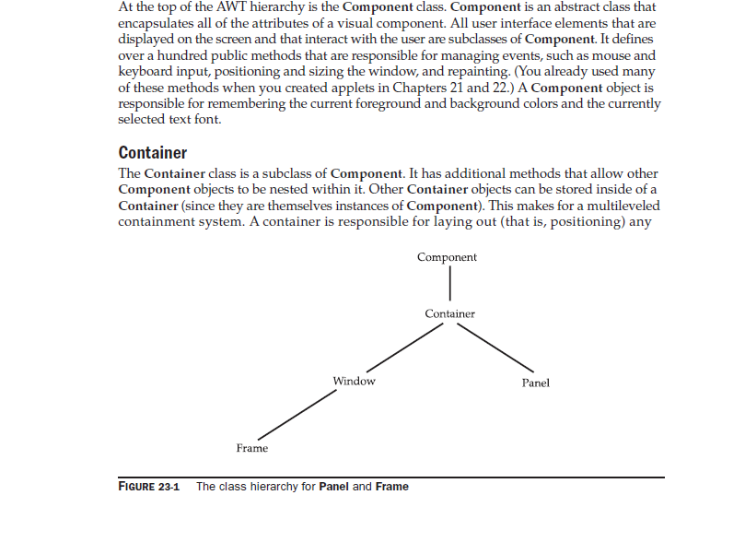
Abstract Window Toolkit (AWT)
The AWT defines windows according to a class hierarchy that adds functionality and specificity with each level.
The two most common windows are those derived from Panel, which is used by applets, and those derived from Window, which is used by Frame.

Slide 3
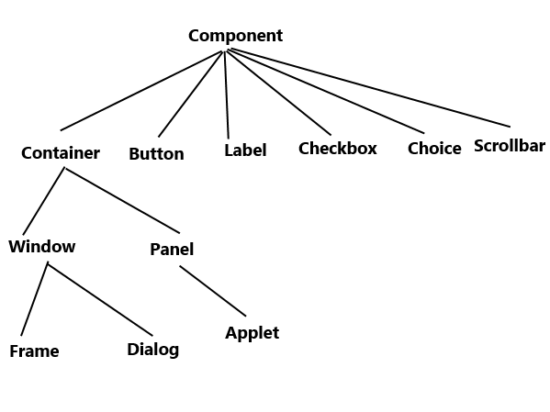
Abstract Window Toolkit (AWT)

Slide 4
Abstract Window Toolkit (AWT)
Component Class:
At the top in AWT class hierarchy
An abstract class that encapsulates all of the attributes of a visual component.
All user interface elements that are displayed on the screen and that interact with the user are subclasses of Component.
Defines over a hundred public methods that are responsible for managing events, such as mouse and keyboard input, positioning and sizing the window, and repainting.
A Component object is responsible for remembering the current foreground and background colors and the currently
selected text font.

Slide 5
Abstract Window Toolkit (AWT)
Container Class:
A subclass of Component.
Has additional methods that allow other Component objects to be nested within it. Other Container objects can be stored inside of a Container. This makes for a multileveled containment system.
Is responsible for laying out (that is, positioning) any components that it contains through the use of various layout managers

Slide 6
Abstract Window Toolkit (AWT)
Panel Class:
A concrete subclass of Container.
It doesn’t add any new methods; it simply implements Container.
A Panel may be thought of as a recursively nestable, concrete screen component.
Panel is the superclass for Applet. When screen output is directed to an applet, it is drawn on the surface of a Panel object.

Slide 7
Abstract Window Toolkit (AWT)
Panel Class:
A Panel is a window that does not contain a title bar, menu bar, or border. This is why you don’t see these items when an applet is run inside a browser. When you run an applet using an applet viewer, the applet viewer provides the title and border.
Other components can be added to a Panel object by its add( ) method (inherited from Container). Once these components have been added, you can position and resize them manually using the setLocation( ), setSize( ), setPreferredSize( ), or setBounds( ) methods defined by Component.

Slide 8
Abstract Window Toolkit (AWT)
Window Class:
The Window class creates a top-level window.
Atop-level window is not contained within any other object; it sits directly on the desktop. Generally, you won’t create Window objects directly. Instead, you will use a subclass of Window called Frame.

Slide 9
Abstract Window Toolkit (AWT)
Frame Class:
It is a subclass of Window class and has a title bar, menu bar, borders, and resizing corners.
If you create a Frame object from within an applet, it will contain a warning message, such as “Java Applet Window,” to the user that an applet window has been created. This message warns users that the window they see was started by an applet and not by software running on their computer.
When a Frame window is created by a stand-alone application rather than an applet, a normal window is created.

Slide 10
Event Handling Mechanism
Event Delegation Model:
Defines standard and consistent mechanisms to generate and process events.
A source generates an event and sends it to one or more listeners.
The listener simply waits until it receives an event. Once received, the listener processes the event and then returns.
The advantage of this design is that the application logic that processes events is cleanly separated from the user interface logic that generates those events.
A user interface element is able to “delegate” the processing of an event to a separate piece of code.

Slide 11
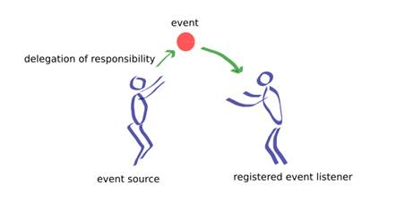
Event Handling Mechanism
Event Delegation Model:
In the delegation event model, listeners must register with a source in order to receive an event notification.
This provides an important benefit: notifications are sent only to listeners that want to receive them.
http://www.developer.com/java/data/understanding-and-using-the-java-delegation-event-model.html

Slide 12
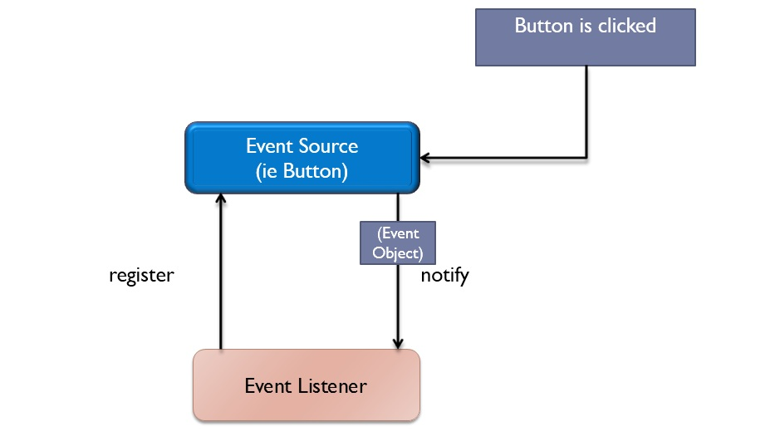
Event Handling Mechanism
Event Delegation Model:
http://www.jgyan.com/java-questions1.php?id=10

Slide 13
Event Handling Mechanism
Event :
An event is an object that describes a state change in a source.
Can be generated as a consequence of a person interacting with the elements in a graphical user interface. Some of the activities that cause events to be generated are pressing a button, entering a character via the keyboard, selecting an item in a list, and clicking the mouse.
Events may also occur that are not directly caused by interactions with a user interface. For example, an event may be generated when a timer expires, a counter exceeds a value, software or hardware failure occurs, or an operation is completed.

Slide 14
Event Handling Mechanism
Event Sources :
A source is an object that generates an event. i.e. button, option button, checkbox, menu item, etc.
This occurs when the internal state of that object changes in some way.
Sources may generate more than one type of event.
A source must register listeners in order for the listeners to receive notifications about a specific type of event. Each type of event has its own registration method.
The general form:
public void addTypeListener(TypeListener el)
Here, Type is the name of the event and el is a reference to the event listener. For example, the method that registers a keyboard event listener is called addKeyListener( ). The method that registers a mouse motion listener is called addMouseMotionListener( ).

Slide 15
Event Handling Mechanism
Event Sources :
When an event occurs, all registered listeners are notified and receive a copy of the event object. This is known as multicasting the event. In all cases, notifications are sent only to listeners that register to receive them.
Some sources may allow only one listener to register.
A source must also provide a method that allows a listener to unregister an interest in a specific type of event. The general form of such a method is this:
public void removeTypeListener(TypeListener el)

Slide 16
Event Handling Mechanism
Event Sources : Some Event Sources
Button | Generates action events when the button is pressed
Checkbox | Generates item events when the check box is selected or deselected
Choice | Generates item events when the choice is changed.
List | Generates action events when an item is double-clicked; generates item events when an item is selected or deselected.
MenuItem | Generates action events when a menu item is selected; generates item events when a checkable menu item is selected or deselected
Scrollbar | Generates adjustment events when the scroll bar is manipulated
Text Components | Generates text events when the user enters a character.
Window | Generates window events when a window is activated, closed, deactivated, deiconified, iconified, opened, or quit.

Slide 17
Event Handling Mechanism
Event Listeners :
A listener is an object that is notified when an event occurs.
It has two major requirements.
(1) It must have been registered with one or more sources to receive notifications about specific types of events.
(2) It must implement methods to receive and process these notifications.
The methods that receive and process events are defined in a set of interfaces found in java.awt.event. For example, the MouseMotionListener interface defines two methods to receive notifications when the mouse is dragged or moved.

Slide 18
Event Handling Mechanism
Event Listeners : Some Event Listeners
ActionListener | Defines one method to receive action events.
KeyListener | Defines three methods to recognize when a key is pressed, released, or typed
MouseListener | Defines five methods to recognize when the mouse is clicked, enters a component, exits a component, is pressed, or is released.
MouseMotionListener | Defines two methods to recognize when the mouse is dragged or moved.
TextListener | Defines one method to recognize when a text value changes
WindowListener | Defines seven methods to recognize when a window is activated, closed, deactivated, deiconified, iconified, opened, or quit.

Slide 19
Event Handling Mechanism
Event Listeners Interfaces :
The ActionListener Interface
This interface defines the actionPerformed( ) method that is invoked when an action event occurs. Its general form is shown here:
void actionPerformed(ActionEvent ae)
The ItemListener Interface
This interface defines the itemStateChanged( ) method that is invoked when the state of an item changes. Its general form is shown here:
void itemStateChanged(ItemEvent ie)

Slide 20
Event Handling Mechanism
Event Listeners Interfaces :
The KeyListener Interface
This interface defines three methods. The keyPressed( ) and keyReleased( ) methods are invoked when a key is pressed and released, respectively. The keyTyped( ) method is invoked when a character has been entered.
For example, if a user presses and releases the A key, three events are generated in sequence: key pressed, typed, and released. If a user presses and releases the HOME key, two key events are generated in sequence: key pressed and released.
The general forms of these methods are shown here:
void keyPressed(KeyEvent ke)
void keyReleased(KeyEvent ke)
void keyTyped(KeyEvent ke)

Slide 21
Event Handling Mechanism
Event Listeners Interfaces :
The MouseListener Interface
This interface defines five methods. If the mouse is pressed and released at the same point, mouseClicked( ) is invoked. When the mouse enters a component, the mouseEntered( ) method is called. When it leaves, mouseExited( ) is called. The mousePressed( ) and mouseReleased( ) methods are invoked when the mouse is pressed and released, respectively.
The general forms of these methods are shown here:
void mouseClicked(MouseEvent me)
void mouseEntered(MouseEvent me)
void mouseExited(MouseEvent me)
void mousePressed(MouseEvent me)
void mouseReleased(MouseEvent me)

Slide 22
Event Handling Mechanism
Event Listeners Interfaces :
The MouseMotionListener Interface
This interface defines two methods. The mouseDragged( ) method is called multiple times as the mouse is dragged. The mouseMoved( ) method is called multiple times as the mouse is moved.
Their general forms are shown here:
void mouseDragged(MouseEvent me)
void mouseMoved(MouseEvent me)
The TextListener Interface
This interface defines the textChanged( ) method that is invoked when a change occurs in a text area or text field. Its general form is shown here:
void textChanged(TextEvent te)

Slide 23
Event Handling Mechanism
Event Listeners Interfaces :
The WindowListener Interface
This interface defines seven methods. The windowActivated( ) and windowDeactivated( ) methods are invoked when a window is activated or deactivated, respectively. If a window is iconified, the windowIconified( ) method is called. When a window is deiconified, the windowDeiconified( ) method is called. When a window is opened or closed, the windowOpened( ) or windowClosed( ) methods are called, respectively. The windowClosing( ) method is called when a window is being closed. The general forms of these methods are:
void windowActivated(WindowEvent we)
void windowClosed(WindowEvent we)
void windowClosing(WindowEvent we)
void windowDeactivated(WindowEvent we)
void windowDeiconified(WindowEvent we)
void windowIconified(WindowEvent we)
void windowOpened(WindowEvent we)

Slide 24
Event Handling Mechanism
Event Classes :
Event Classes
At the root of the Java event class hierarchy is EventObject, which is in java.util. It is the superclass for all events. Its one constructor is shown here:
EventObject(Object src)
Here, src is the object that generates this event.
EventObject contains two methods: getSource( ) and toString( ). The getSource( ) method returns the source of the event. Its general form is shown here:
Object getSource( )
As expected, toString( ) returns the string equivalent of the event.
The class AWTEvent, defined within the java.awt package, is a subclass of EventObject. It is the superclass (either directly or indirectly) of all AWT-based events used by the delegation event model

Slide 25
Event Handling Mechanism
Event Classes : Some Event Classes
ActionEvent | Generated when a button is pressed, a list item is double-clicked, or a menu item is selected
KeyEvent | Generated when input is received from the keyboard
MouseEvent | Generated when the mouse is dragged, moved, clicked,pressed, or released; also generated when the mouse enters or exits a component
ItemEvent | Generated when a check box or list item is clicked; also occurs when a choice selection is made or a checkable menu item is selected or deselected
TextEvent | Generated when the value of a text area or text field is changed.
WindowEvent | Generated when a window is activated, closed, deactivated, deiconified, iconified, opened, or quit.

Slide 26
GUI Basics and Programs
Frame Class :
Constructors:
Frame()
Frame(String title) // sets the title of a frame
Methods:
void setTitle(String title) //sets the title of a frame
void setSize(int width, int height) // sets size of a frame
void setVisible(boolean state) // true – to make a frame visible

Slide 27
GUI Basics and Programs
Creating a frame by extending (“is-a” relationship) Frame class :
import java.awt.Frame;
public class MyFrame1 extends Frame
{
MyFrame1(String title)
{
//call the superclass constructor
super(title); // This will set the title of frame can be done by setTitle() also
setSize(300,300);
this.setVisible(true);
}
public static void main(String args[])
{
MyFrame1 window = new MyFrame1(“Hello My First Frame");
} }

Slide 28
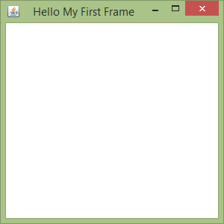
GUI Basics and Programs
Creating a frame by extending Frame class :

Slide 29
GUI Basics and Programs
Creating a frame by using “has-a” relationship :
import java.awt.Frame;
public class MyFrameHasARelation {
Frame f;
MyFrameHasARelation(String title) {
//call the superclass constructor
f = new Frame(title);
f.setSize(300,300);
f.setVisible(true);
}
public static void main(String args[]) {
MyFrameHasARelation window = new MyFrameHasARelation("Hello My First Frame");
/* frame creation
window.f = new Frame("Hello My First Frame");
window.f.setSize(300,300);
window.f.setVisible(true);*/
} }

Slide 30
GUI Basics and Programs
Event Handling Example : Mouse Events
import java.awt.event.*;
import java.awt.*;
public class MyEventsFrame extends Frame implements MouseListener,MouseMotionListener {
public MyEventsFrame() {
setTitle("My Event Frame");
addMouseListener(this);
addMouseMotionListener(this);
}
public void mouseClicked(MouseEvent e) {
int x = e.getX();
int y = e.getY();
System.out.println("Mouse Clicked at X: " + x + " - Y: " + y);
}

Slide 31
GUI Basics and Programs
Event Handling Example : Mouse Events
public void mouseEntered(MouseEvent e) {
int x = e.getX();
int y = e.getY();
System.out.println("Mouse Entered frame at X: " + x + " - Y: " + y);
}
public void mouseExited(MouseEvent e) {
int x = e.getX();
int y = e.getY();
System.out.println("Mouse Exited frame at X: " + x + " - Y: " + y);
}
public void mousePressed(MouseEvent e) {
int x = e.getX();
int y = e.getY();
System.out.println("Mouse Pressed at X: " + x + " - Y: " + y);
}

Slide 32
GUI Basics and Programs
Event Handling Example : Mouse Events
public void mouseReleased(MouseEvent e) {
int x = e.getX();
int y = e.getY();
System.out.println("Mouse Released at X: " + x + " - Y: " + y);
}
public void mouseDragged(MouseEvent me)
{
// save coordinates
int x = me.getX();
int y = me.getY();
System.out.println("Dragging mouse at " + x + ", " + y);
}

Slide 33
GUI Basics and Programs
Event Handling Example : Mouse Events
public void mouseMoved(MouseEvent me)
{
// show status
System.out.println("Moving mouse at " + me.getX() + ", " + me.getY());
}
public static void main(String[] args)
{
MyEventsFrame frame = new MyEventsFrame();
//Display the window.
frame.setSize(400,350);
frame.setVisible(true);
}
} // end of class

Slide 34
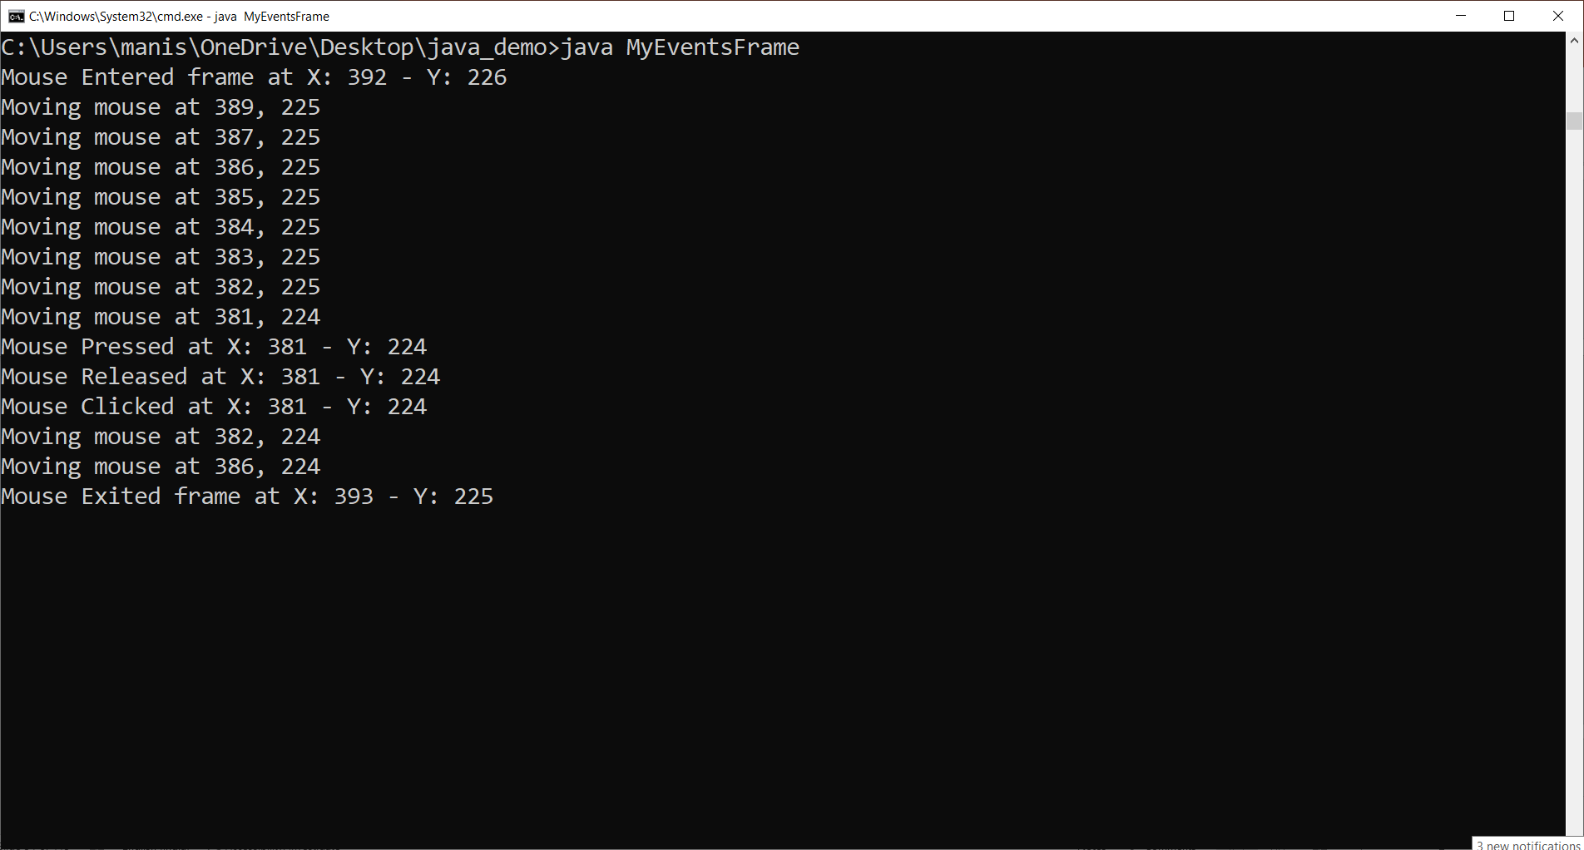
GUI Basics and Programs
Event Handling Example : Mouse Events

Slide 35
GUI Basics and Programs
Event Handling Example : Key Events
import java.awt.*;
import java.awt.event.*;
import java.applet.*;
public class KeyEventsFrame extends Frame
implements KeyListener {
String msg = "";
//int X = 10, Y = 20; // output coordinates
public KeyEventsFrame()
{
addKeyListener(this);
}
public void display()
{
System.out.println(msg);
}

Slide 36
GUI Basics and Programs
Event Handling Example : Key Events
public void keyPressed(KeyEvent ke) {
System.out.println("Key Down");
int key = ke.getKeyCode();
switch(key) {
case KeyEvent.VK_F1:
msg += "<F1>";
break;
case KeyEvent.VK_F2:
msg += "<F2>";
break;
case KeyEvent.VK_F3:
msg += "<F3>";
break;

Slide 37
GUI Basics and Programs
Event Handling Example : Key Events
case KeyEvent.VK_PAGE_DOWN:
msg += "<PgDn>";
break;
case KeyEvent.VK_PAGE_UP:
msg += "<PgUp>";
break;
case KeyEvent.VK_LEFT:
msg += "<Left Arrow>";
break;
case KeyEvent.VK_RIGHT:
msg += "<Right Arrow>";
break;
}
display(); }

Slide 38
GUI Basics and Programs
Event Handling Example : Key Events
public void keyReleased(KeyEvent ke) {
System.out.println("Key Up");
}
public void keyTyped(KeyEvent ke) {
msg += ke.getKeyChar();
display();
}
// Display keystrokes.
public static void main(String args[])
{
KeyEventsFrame frame = new KeyEventsFrame();
//Display the window.
frame.setSize(400,400);
frame.setVisible(true);
}
}// end of class

Slide 39
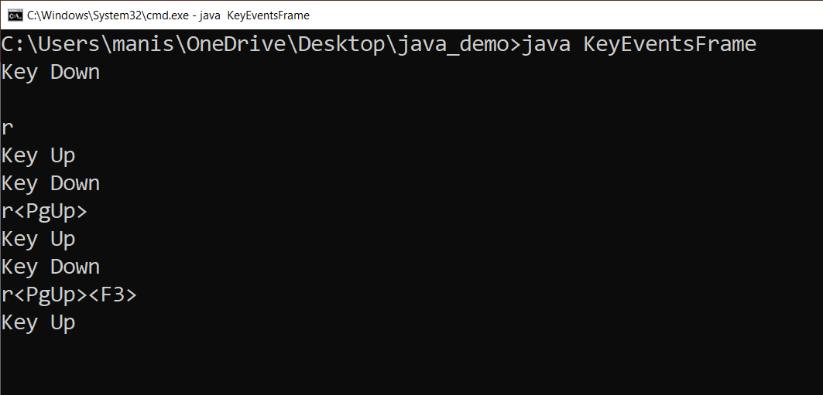
GUI Basics and Programs
Event Handling Example : Key Events

Slide 40
GUI Basics and Programs
Handling Window based events : windowClosing()
A frame window can not be closed by default.
We have to handle the window close event using windowClosing() method of WindowListener interface
import java.awt.Frame;
import java.awt.event.*;
public class MyFrameWindowClose extends Frame implements WindowListener{
MyFrameWindowClose(String title)
{
//Register the Listeners
addWindowListener(this); // frame object has to register itself to listener
//set window title using setTitle method
this.setTitle(title);
setSize(300,300);
this.setVisible(true);
}

Slide 41
GUI Basics and Programs
Handling Window based events : windowClosing()
public void windowClosing(WindowEvent e) {
//hide the window when window's close button is clicked
System.out.println("Frame Closed");
this.setVisible(false);
dispose();
//System.exit(0);
}
public void windowActivated(WindowEvent we){}
public void windowClosed(WindowEvent we){}
public void windowDeactivated(WindowEvent we){}
public void windowDeiconified(WindowEvent we){}
public void windowIconified(WindowEvent we){}
public void windowOpened(WindowEvent we){}
public static void main(String args[])
{
MyFrameWindowClose window = new MyFrameWindowClose("My First Frame");
} }

Slide 42
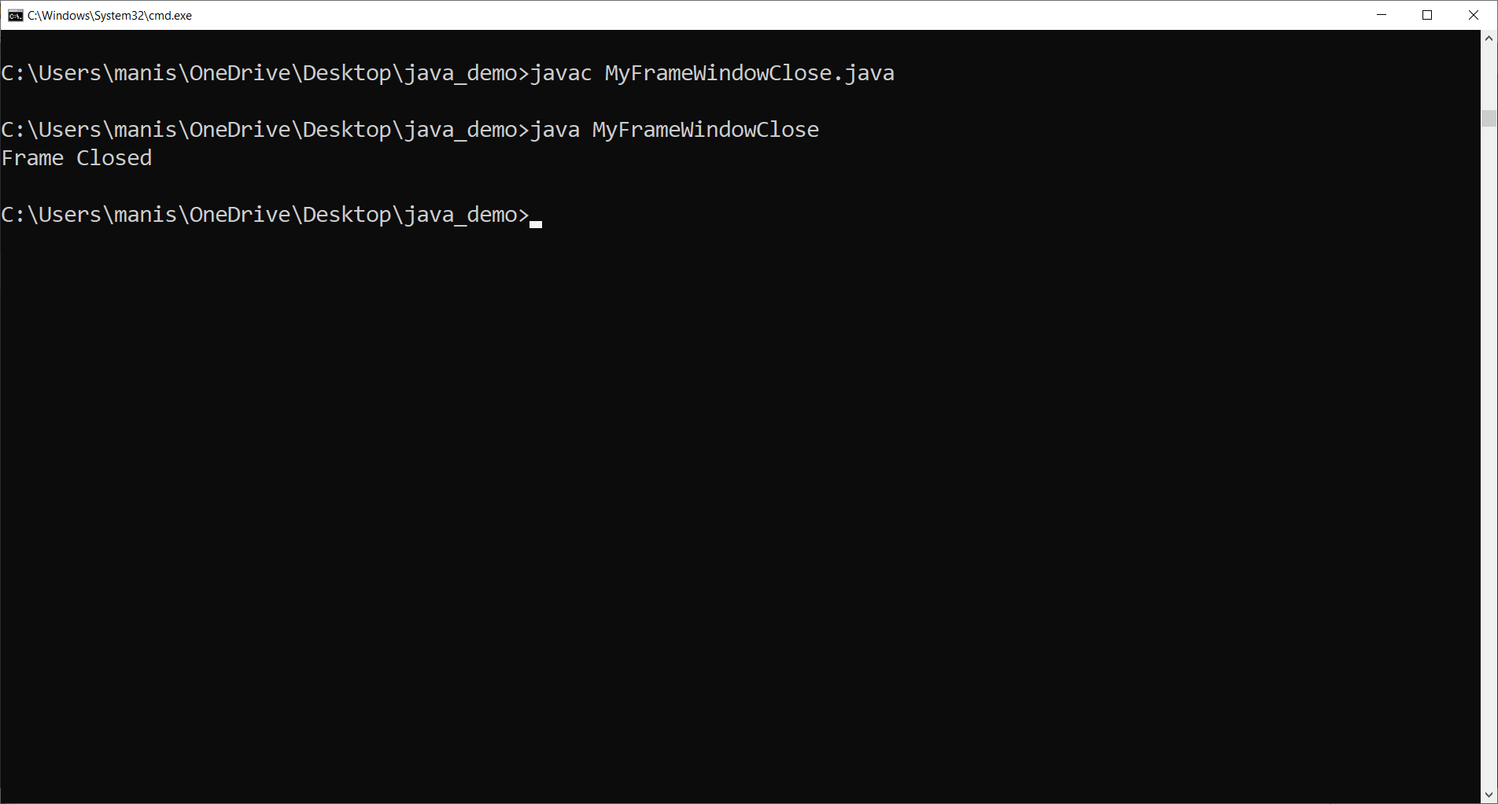
GUI Basics and Programs
Handling Window based events : windowClosing()

Slide 43
GUI Basics and Programs
AWT Components
The AWT supports the following types of controls:
Labels
Push buttons
Check boxes
Choice lists
Lists
Scroll bars
Text editing

Slide 44
GUI Basics and Programs
Adding and Removing Controls
To include a control in a window, you must add it to the window.
To do this, you must first create an instance of the desired control and then add it to a window by calling add( ), which is defined by Container.
The add( ) method has several forms.
void add(Component compObj)
Here, compObj is an instance of the control that you want to add.
Once a control has been added, it will automatically be visible whenever its parent window is displayed.
Sometimes you will want to remove a control from a window when the control is no longer needed. To do this, call remove( ). This method is also defined by Container. It has this general form:
void remove(Component obj)
Here, obj is a reference to the control you want to remove.
You can remove all controls by calling removeAll( )

Slide 45
GUI Basics and Programs
Labels:
A label is an object of type Label, and it contains a string, which it displays.
Labels are passive controls that do not support any interaction with the user.
Label defines the following constructors:
Label( ) throws HeadlessException
Label(String str) throws HeadlessException
Label(String str, int how) throws HeadlessException
The first version creates a blank label.
The second version creates a label that contains the string specified by str. This string is left-justified.
The third version creates a label that contains the string specified by str using the alignment specified by how. The value of how must be one of these three constants: Label.LEFT, Label.RIGHT, or Label.CENTER.

Slide 46
GUI Basics and Programs
Label:
You can set or change the text in a label by using the setText( ) method. You can obtain the current label text by calling getText( ) as shown below:
void setText(String str)
String getText( )
For setText( ), str specifies the new label. For getText( ), the current label text is returned.
You can set the alignment of the string within the label by calling setAlignment( ). To obtain the current alignment, call getAlignment( ) as follows:
void setAlignment(int how)
int getAlignment( )
Here, how must be one of the alignment constants shown earlier.

Slide 47
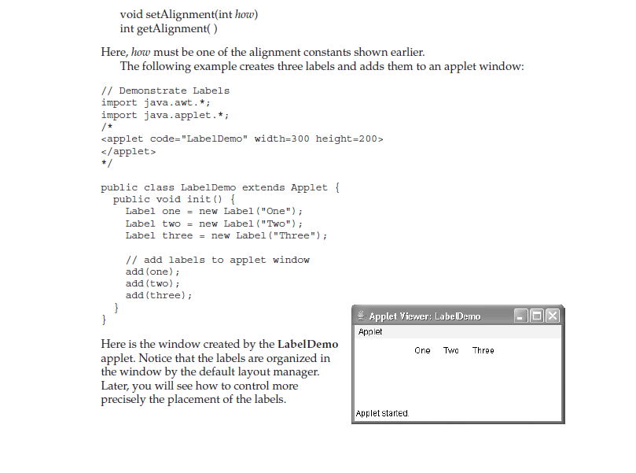
GUI Basics and Programs
Label:
public class LabelDemo extends Applet {
public void init() {
Label one = new Label("One");
Label two = new Label("Two");
Label three = new Label("Three");
// add labels to applet window
add(one);
add(two);
add(three);
}
}

Slide 48
GUI Basics and Programs
Buttons:
A push button is a component that contains a label and that generates an event when it is pressed.
Push buttons are objects of type Button.
Button defines these two constructors:
Button( ) throws HeadlessException
Button(String str) throws HeadlessException
The first version creates an empty button. The second creates a button that contains str as a label.
After a button has been created, you can set its label by calling setLabel( ). You can retrieve its label by calling getLabel( )
void setLabel(String str)
String getLabel( )
Here, str becomes the new label for the button.

Slide 49
GUI Basics and Programs
Handling Buttons:
Each time a button is pressed, an action event is generated.
The ActionListener interface defines the actionPerformed() method, which is called when an event occurs.
An ActionEvent object is supplied as the argument to this method.
It contains both
(1) a reference to the button that generated the event and
Object getSource()
(2) a reference to the action command string associated with the button label.
String getActionCommand()

Slide 50
GUI Basics and Programs
Handling Buttons:
public class ButtonDemo extends Applet implements ActionListener {
String msg = "";
Button yes, no, maybe;
public void init() {
yes = new Button("Yes");
no = new Button("No");
maybe = new Button("Undecided");
add(yes);
add(no);
add(maybe);
yes.addActionListener(this);
no.addActionListener(this);
maybe.addActionListener(this);
}

Slide 51
GUI Basics and Programs
Handling Buttons:
public void actionPerformed(ActionEvent ae) {
String str = ae.getActionCommand();
if(str.equals("Yes")) {
msg = "You pressed Yes.";
}
else if(str.equals("No")) {
msg = "You pressed No.";
}
else {
msg = "You pressed Undecided.";
}
repaint();
}
public void paint(Graphics g) {
g.drawString(msg, 6, 100); } }

Slide 52
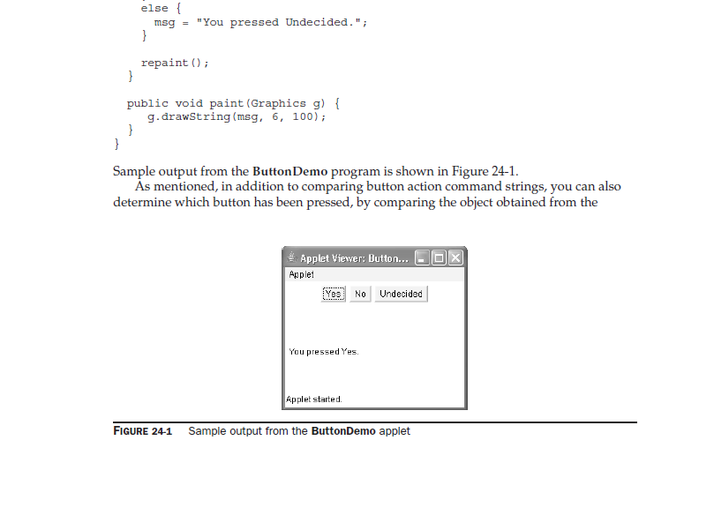
GUI Basics and Programs
Handling Buttons:

Slide 53
GUI Basics and Programs
TextField:
The TextField class implements a single-line text-entry area, usually called an edit control.
Text fields allow the user to enter strings and to edit the text using the arrow keys, cut and paste keys, and mouse selections.
TextField is a subclass of TextComponent.
TextField defines the following constructors:
TextField( ) throws HeadlessException
TextField(int numChars) throws HeadlessException
TextField(String str) throws HeadlessException
TextField(String str, int numChars) throws HeadlessException
The first version creates a default text field.
The second form creates a text field that is numChars characters wide.
The third form initializes the text field with the string contained in str.
The fourth form initializes a text field and sets its width.

Slide 54
GUI Basics and Programs
TextField Methods:
To obtain the string currently contained in the text field, call getText( ). To set the text, call setText( ). These methods are as follows:
String getText( )
void setText(String str)
Here, str is the new string.
You can control whether the contents of a text field may be modified by the user by calling setEditable( ). You can determine editability by calling isEditable( ).
boolean isEditable( )
void setEditable(boolean canEdit)

Slide 55
GUI Basics and Programs
TextField Methods:
There may be times when you will want the user to enter text that is not displayed, such as a password.
You can disable the echoing of the characters as they are typed by calling setEchoChar( )
void setEchoChar(char ch) //Sets an echo char
boolean echoCharIsSet( ) //Checks whether echo char is set
char getEchoChar( ) // Returns echo char
Here, ch specifies the character to be echoed.

Slide 56
GUI Basics and Programs
Simple Calculator with Frame:
import java.awt.*;
import java.awt.event.*;
public class ArithmeticFrame extends Frame implements ActionListener
{
// reference variables
TextField tf1, tf2, tf3; // 3 text fields
Button pb, mb1, mulb2, rmb3, db, eb; // 6 buttons
public ArithmeticFrame ( )
{
// setting the layout
setLayout(new GridLayout(6, 2, 25, 25));
setBackground(Color.cyan);

Slide 57
GUI Basics and Programs
Simple Calculator with Frame:
// creating objects
tf1 = new TextField(10);
tf2 = new TextField(10);
tf3 = new TextField(10);
pb = new Button("+");
mb1 = new Button("-");
mulb2 = new Button("*");
rmb3 = new Button("%");
db = new Button("/");
eb = new Button("EXIT");

Slide 58
GUI Basics and Programs
Simple Calculator with Frame:
// event handling
pb.addActionListener(this);
mb1.addActionListener(this);
mulb2.addActionListener(this);
rmb3.addActionListener(this);
db.addActionListener(this);
eb.addActionListener(this);
// beautification
eb.setForeground(Color.red);
tf3.setEditable(false);
tf3.setFont(new Font("Serif", Font.BOLD,20));

Slide 59
GUI Basics and Programs
Simple Calculator with Frame:
// adding components, order is important
add(new Label("Enter 1st Number"));
add(tf1);
add(new Label("Enter 2nd Number"));
add(tf2);
add(pb); // adding buttons one by one
add(mb1);
add(mulb2);
add(rmb3);
add(db);
add(eb);
add(new Label("Result")); // adding last row
add(tf3);

Slide 60
GUI Basics and Programs
Simple Calculator with Frame:
// create the frame
setTitle("Arithmetic");
setSize(400,450);
setVisible(true);
}
// override the abstract method of AL
public void actionPerformed(ActionEvent e)
{
Button btn = (Button) e.getSource();
if(btn == eb)
{
System.exit(0); // closes the current application
}

Slide 61
GUI Basics and Programs
Simple Calculator with Frame:
String s1 = tf1.getText();
double d1 = Double.parseDouble(s1);
double d2 = Double.parseDouble(tf2.getText());
String s2 = “”; // a temporary local variable
if(btn == pb)
s2 = "sum = " + (d1+d2);
// assign a value to s2
else if(btn == mb1)
s2 = "Difference = " + (d1-d2);

Slide 62
GUI Basics and Programs
Simple Calculator with Frame:
else if(btn == mulb2)
s2 = "Product = " + (d1*d2);
else if(btn == rmb3)
s2 = "Remainder = "+ (d1%d2);
else if(btn == db)
s2 = "Quotient = " + (d1/d2);
tf3.setText(s2); // place the result s2 in tf3
}
public static void main(String[] args)
{
new ArithmeticFrame ();
}
}

Slide 63
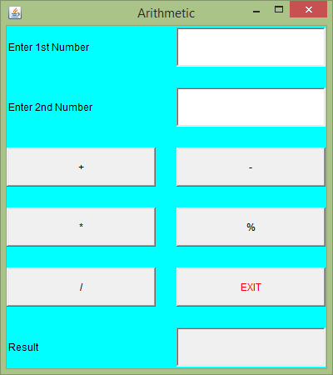
GUI Basics and Programs
Simple Calculator with Frame:

Slide 64
GUI Basics and Programs
Adapter Class:
An adapter class provides an empty implementation of all methods in an event listener interface.
Adapter classes are useful when you want to receive and process only some of the events that are handled by a particular event listener interface.
You can define a new class to act as an event listener by extending one of the adapter classes and implementing only those events in which you are interested.
For example, the MouseMotionAdapter class has two methods, mouseDragged( ) and mouseMoved( ), which are the methods defined by the MouseMotionListener interface. If you were interested in only mouse drag events, then you could simply extend MouseMotionAdapter and override mouseDragged( ). The empty implementation of mouseMoved( ) would handle the mouse motion events for you.

Slide 65
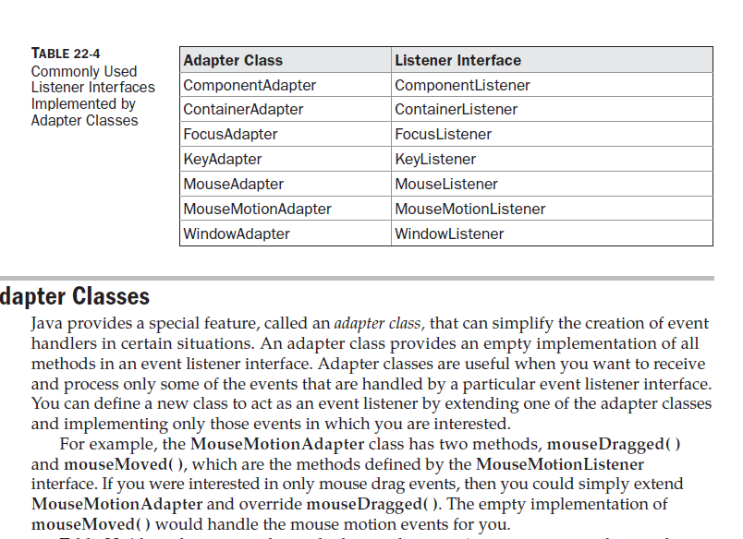
GUI Basics and Programs
List of Adapter Classes :

Slide 66
GUI Basics and Programs
Adapter Class:
// Demonstrate an adapter.
import java.awt.*;
import java.awt.event.*;
import java.applet.*;
/*
<applet code="AdapterDemo" width=300 height=100>
</applet>
*/
public class AdapterDemo extends Applet {
public void init() {
addMouseListener(new MyMouseAdapter(this));
addMouseMotionListener(new MyMouseMotionAdapter(this));
}
}

Slide 67
GUI Basics and Programs
Adapter Class:
class MyMouseAdapter extends MouseAdapter {
AdapterDemo adapterDemo;
public MyMouseAdapter(AdapterDemo adapterDemo) {
this.adapterDemo = adapterDemo;
}
// Handle mouse clicked.
public void mouseClicked(MouseEvent me) {
adapterDemo.showStatus("Mouse clicked");
}
}

Slide 68
GUI Basics and Programs
Adapter Class:
class MyMouseMotionAdapter extends MouseMotionAdapter {
AdapterDemo adapterDemo;
public MyMouseMotionAdapter(AdapterDemo adapterDemo) {
this.adapterDemo = adapterDemo;
}
// Handle mouse dragged.
public void mouseDragged(MouseEvent me) {
adapterDemo.showStatus("Mouse dragged");
} }

Slide 69
GUI Basics and Programs
Adapter Class:WindowAdapter Example
import java.awt.Frame;
import java.awt.event.*;
public class MyFrameWindowCloseAdapter extends Frame
{
MyFrameWindowCloseAdapter(String title)
{
//super(title);
//Register the Listeners
addWindowListener(new MyWindowAdapter(this));
//set window title using setTitle method
this.setTitle(title);
setSize(300,300);
//Newly created window will not be displayed until we call setVisible(true)
this.setVisible(true);
}

Slide 70
GUI Basics and Programs
Adapter Class:WindowAdapter Example
public static void main(String args[])
{
MyFrameWindowCloseAdapter window = new MyFrameWindowCloseAdapter("My First Frame");
}
} // MyFrameWindowCloseAdapter class ends
class MyWindowAdapter extends WindowAdapter
{
MyFrameWindowCloseAdapter mfca;
MyWindowAdapter(MyFrameWindowCloseAdapter mfca)
{
this.mfca = mfca;
}

Slide 71
GUI Basics and Programs
Adapter Class:WindowAdapter Example
public void windowClosing(WindowEvent e)
{
//hide the window when window's close button is clicked
mfca.setVisible(false);
mfca.dispose();
//System.exit(0);
}
} // MyAdapterAdapter class ends

Slide 72
GUI Basics and Programs
Layout Managers
A layout manager automatically arranges your controls within a window by using some type of algorithm
All of the components that we have shown so far have been positioned by the default layout manager (Flow Layout)
We will not want lay out the controls by hand because we have to position each control manually which is tedious process
Each Container object has a layout manager associated with it.
The layout manager is set by the setLayout( ) method.
If no call to setLayout( ) is made, then the default layout
manager is used. Whenever a container is resized (or sized for the first time), the layout manager is used to position each of the components within it.

Slide 73
GUI Basics and Programs
Layout Managers
The setLayout( ) method has the following general form:
void setLayout(LayoutManager layoutObj)
Here, layoutObj is a reference to the desired layout manager.
If you wish to disable the layout manager and position components manually, pass null for layoutObj.
If you do this, you will need to determine the shape and position of each component manually, using the setBounds( ) method defined by Component.

Slide 74
GUI Basics and Programs
Layout Managers: Flow Layout
FlowLayout is the default layout manager.
FlowLayout implements a simple layout style, which is similar to
how words flow in a text editor. The direction of the layout is governed by the container’s component orientation property, which, by default, is left to right, top to bottom.
Components are laid out line-by-line beginning at the upper-left corner. In all cases, when a line is filled, layout advances to the next line. A small space is left between each component, above and below, as well as left and right.
Here are the constructors for
FlowLayout( )
FlowLayout(int how)
FlowLayout(int how, int horz, int vert)

Slide 75
GUI Basics and Programs
Layout Managers: Flow Layout
The first form creates the default layout, which centers components and leaves five pixels of space between each component.
The second form lets you specify how each line is aligned. Valid values for how are as follows:
FlowLayout.LEFT
FlowLayout.CENTER
FlowLayout.RIGHT
FlowLayout.LEADING
FlowLayout.TRAILING
These values specify left, center, right, leading edge, and trailing edge alignment, respectively
The third constructor allows you to specify the horizontal and vertical space left between components in horz and vert, respectively.

Slide 76
GUI Basics and Programs
Layout Managers: Flow Layout
The first form creates the default layout, which centers components and leaves five pixels of space between each component.
The second form lets you specify how each line is aligned. Valid values for how are as follows:
FlowLayout.LEFT
FlowLayout.CENTER
FlowLayout.RIGHT
FlowLayout.LEADING
FlowLayout.TRAILING
These values specify left, center, right, leading edge, and trailing edge alignment, respectively
The third constructor allows you to specify the horizontal and vertical space left between components in horz and vert, respectively.

Slide 77
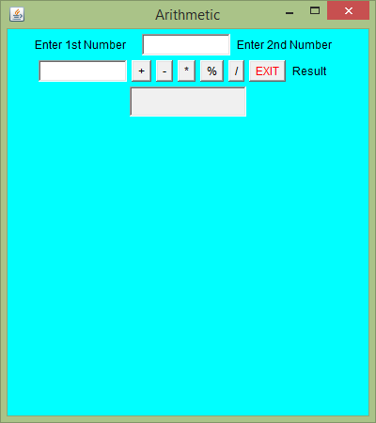
GUI Basics and Programs
Layout Managers: Flow Layout with CENTER alignment

Slide 78
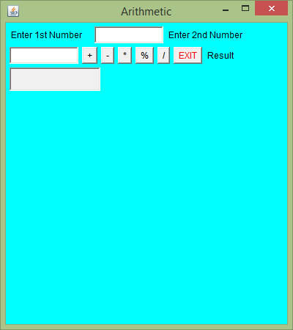
GUI Basics and Programs
Layout Managers: Flow Layout with LEFT alignment

Slide 79
GUI Basics and Programs
Layout Managers: BorderLayout
The BorderLayout class implements a common layout
style for top-level windows.
It has four narrow, fixed-width components at the edges and one large area in the center.
The four sides are referred to as north, south, east, and west. The middle area is called the center.
Here are the constructors defined by BorderLayout:
BorderLayout( )
BorderLayout(int horz, int vert)
The first form creates a default border layout. The second allows you to specify the horizontal and vertical space left between components in horz and vert, respectively.

Slide 80
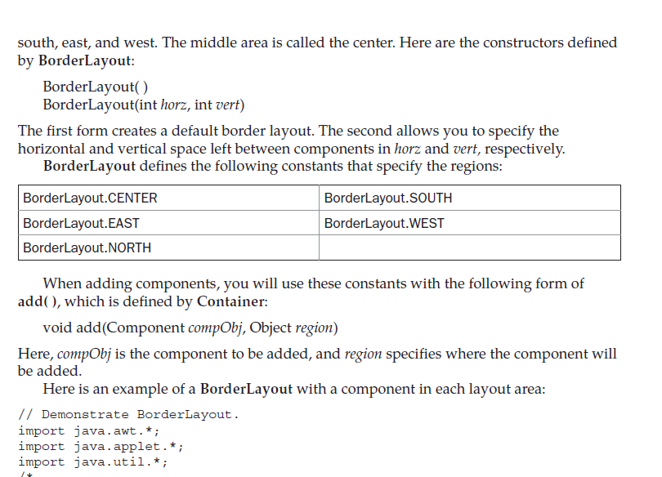
GUI Basics and Programs
Layout Managers: BorderLayout
When adding components, you will use these constants with the following form of add( ), which is defined by Container:
void add(Component compObj, Object region)
Here, compObj is the component to be added, and region specifies where the component will be added.

Slide 81
GUI Basics and Programs
Layout Managers: BorderLayout
// Demonstrate BorderLayout.
import java.awt.*;
import java.applet.*;
import java.util.*;
/*
<applet code="BorderLayoutDemo" width=400 height=200>
</applet>
*/
public class BorderLayoutDemo extends Applet {
public void init() {
setLayout(new BorderLayout());
add(new Button("This is across the top."), BorderLayout.NORTH);
add(new Label("The footer message might go here."),
BorderLayout.SOUTH);
add(new Button("Right"), BorderLayout.EAST);
add(new Button("Left"), BorderLayout.WEST);

Slide 82
GUI Basics and Programs
Layout Managers: BorderLayout
String msg = "The reasonable man adapts " +
"himself to the world;\n" +
"the unreasonable one persists in " +
"trying to adapt the world to himself.\n" +
"Therefore all progress depends " +
"on the unreasonable man.\n\n" +
" - George Bernard Shaw\n\n";
add(new TextArea(msg), BorderLayout.CENTER);
}
}

Slide 83
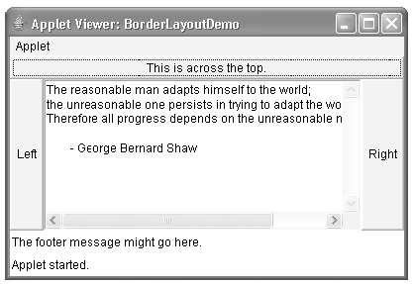
GUI Basics and Programs
Layout Managers: BorderLayout

Slide 84
GUI Basics and Programs
Layout Managers: GridLayout
GridLayout lays out components in a two-dimensional grid.
When you instantiate a GridLayout, you define the number of rows and columns.
The constructors supported by GridLayout are shown here:
GridLayout( )
GridLayout(int numRows, int numColumns)
GridLayout(int numRows, int numColumns, int horz, int vert)

Slide 85
GUI Basics and Programs
Layout Managers: GridLayout
import java.awt.*;
import java.applet.*;
/*
<applet code="GridLayoutDemo" width=300 height=200>
</applet>
*/
public class GridLayoutDemo extends Applet {
static final int n = 4;
public void init() {
setLayout(new GridLayout(n, n));
setFont(new Font("SansSerif", Font.BOLD, 24));
for(int i = 0; i < n; i++) {
for(int j = 0; j < n; j++) {
int k = i * n + j;
if(k > 0)
add(new Button("" + k)); } } } }

Slide 86
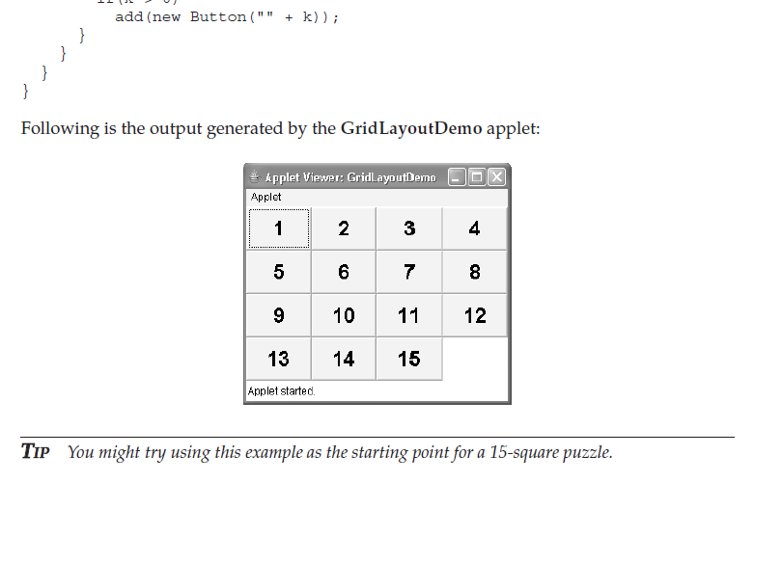
GUI Basics and Programs
Layout Managers: GridLayout

Slide 87
GUI Basics and Programs
Layout Managers: GridLayout
In the ArithmeticFrame program we can write as follows:
setLayout(new GridLayout(6, 2, 25, 25));

Slide 88
GUI Basics and Programs
Layout Managers: null Layout
If we want to set layout manually, we have to use null layout
We have to pass the null value in the setLayout() method
setLayout(null);
We can align each control at our desired position by considering top- left corner as an origin (0,0)
To achieve this , we have to use setBounds() method:
public void setBounds(int x, int y, int width, int height)
This puts the upper left corner of the given control at location (x, y) with specified width and height

Slide 89
GUI Basics and Programs
Layout Managers: null Layout
import java.awt.*;
import java.awt.event.*;
public class ManualLayout extends Frame {
Label lbl1,lbl2,lbl3;
public ManualLayout ( ) {
setLayout(null);
setBackground(Color.cyan);
lbl1= new Label("Label1:");
lbl2= new Label("Label2:");
lbl3= new Label("Label3:");
lbl1.setBounds(100,100,40,10);
lbl2.setBounds(200,200,40,10);
lbl3.setBounds(300,300,40,10);

Slide 90
GUI Basics and Programs
Layout Managers: null Layout
add(lbl1);
add(lbl2);
add(lbl3);
setTitle("Null Layout Demo");
setSize(400,450);
setVisible(true);
}
public static void main(String[] args)
{
new ManualLayout();
}
} // End of class

Slide 91
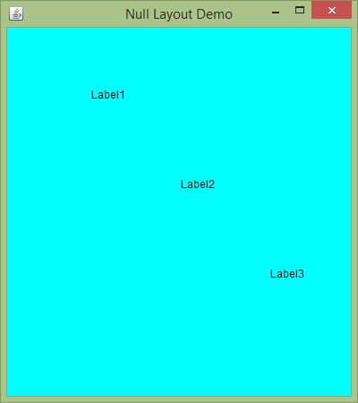
GUI Basics and Programs
Layout Managers: null Layout

Slide 92
GUI Basics and Programs
Checkbox:
A check box is a control that is used to turn an option on or off
It consists of a small box that can either contain a check mark or not.
There is a label associated with each check box that describes what option the box represents.
We can change the state of a check box by clicking on it. Check boxes can be used individually or as part of a group.
Check boxes are objects of the Checkbox class.
constructors:
Checkbox( ) throws HeadlessException
Checkbox(String str) throws HeadlessException
Checkbox(String str, boolean on) throws HeadlessException
Checkbox(String str, boolean on, CheckboxGroup cbGroup) throws HeadlessException
Checkbox(String str, CheckboxGroup cbGroup, boolean on) throws HeadlessException

Slide 93
GUI Basics and Programs
Checkbox:
The first form creates a check box whose label is initially blank. The state of the check box is unchecked.
The second form creates a check box whose label is specified by str. The state of the check box is unchecked.
The third form allows you to set the initial state of the check
box. If on is true, the check box is initially checked; otherwise, it is cleared.
The fourth and fifth forms create a check box whose label is specified by str and whose group is specified by cbGroup. If this check box is not part of a group, then cbGroup must be null.

Slide 94
GUI Basics and Programs
Checkbox:
To retrieve the current state of a check box, call getState( ). To set its state, call setState( ).
You can obtain the current label associated with a check box by calling getLabel( ). To set the label, call setLabel( ).
These methods are as follows:
boolean getState( )
void setState(boolean on)
String getLabel( )
void setLabel(String str)
Here, if on is true, the box is checked. If it is false, the box is cleared. The string passed in str becomes the new label associated with the invoking check box.

Slide 95
GUI Basics and Programs
Checkbox:
// Demonstrate check boxes.
import java.awt.*;
import java.awt.event.*;
import java.applet.*;
/*
<applet code="CheckboxDemo" width=250 height=200>
</applet>
*/
public class CheckboxDemo extends Applet implements ItemListener {
String msg = "";
Checkbox winXP, winVista, solaris, mac;
public void init() {
winXP = new Checkbox("Windows XP", null, true);
winVista = new Checkbox("Windows Vista");
solaris = new Checkbox("Solaris");
mac = new Checkbox("Mac OS");

Slide 96
GUI Basics and Programs
Checkbox:
add(winXP);
add(winVista);
add(solaris);
add(mac);
winXP.addItemListener(this);
winVista.addItemListener(this);
solaris.addItemListener(this);
mac.addItemListener(this);
}
public void itemStateChanged(ItemEvent ie) {
repaint();
}

Slide 97
GUI Basics and Programs
Checkbox:
// Display current state of the check boxes.
public void paint(Graphics g) {
msg = "Current state: ";
g.drawString(msg, 6, 80);
msg = " Windows XP: " + winXP.getState();
g.drawString(msg, 6, 100);
msg = " Windows Vista: " + winVista.getState();
g.drawString(msg, 6, 120);
msg = " Solaris: " + solaris.getState();
g.drawString(msg, 6, 140);
msg = " Mac OS: " + mac.getState();
g.drawString(msg, 6, 160);
}
}

Slide 98
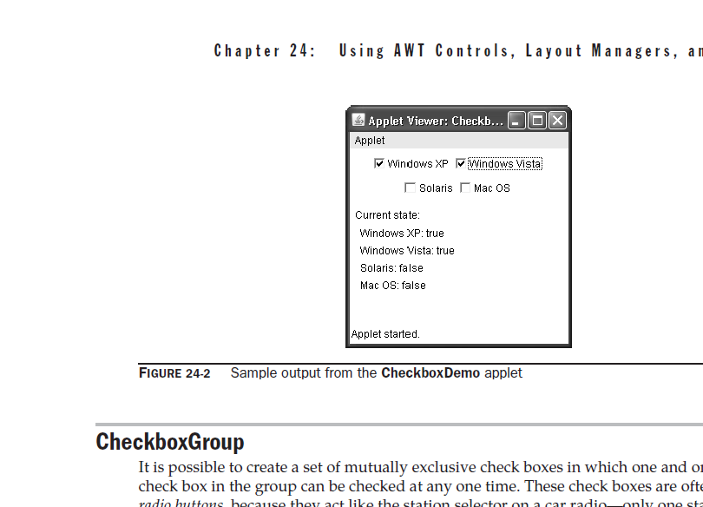
GUI Basics and Programs
Checkbox:

Slide 99
GUI Basics and Programs
Option Buttons(Radio Buttons):
Check box groups are objects of type CheckboxGroup. Only the default constructor is defined, which creates an empty group.
You can determine which check box in a group is currently selected by calling getSelectedCheckbox( )
You can set a check box by calling setSelectedCheckbox( ).
These methods are as follows:
Checkbox getSelectedCheckbox( )
void setSelectedCheckbox(Checkbox which)
Here, which is the check box that you want to be selected. The previously selected check box
will be turned off.

Slide 100
GUI Basics and Programs
Option Buttons(Radio Buttons):
In the previous program, we can add the following code:
CheckboxGroup cbg;
public void init() {
cbg = new CheckboxGroup();
winXP = new Checkbox("Windows XP", cbg, true);
winVista = new Checkbox("Windows Vista", cbg, false);
solaris = new Checkbox("Solaris", cbg, false);
mac = new Checkbox("Mac OS", cbg, false);
/* Other Lines*/
}
public void paint(Graphics g) {
msg = "Current selection: ";
msg += cbg.getSelectedCheckbox().getLabel();
g.drawString(msg, 6, 100);
}

Slide 101
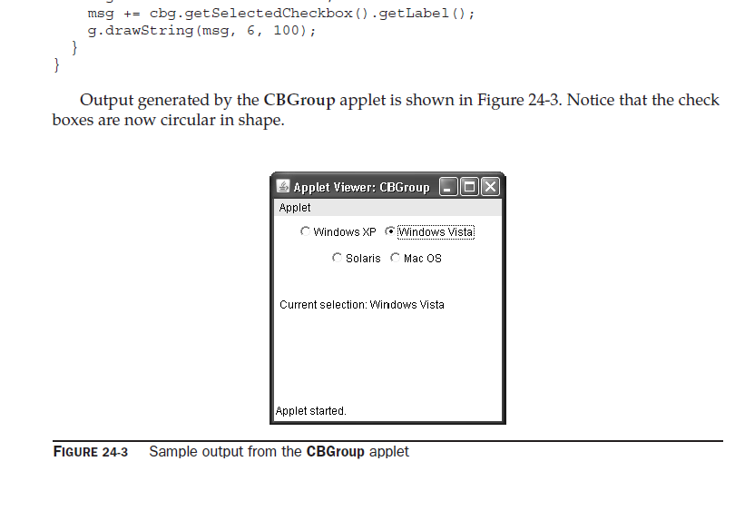
GUI Basics and Programs
Option Buttons(Radio Buttons):

Slide 102
GUI Basics and Programs
Choice Controls(Combobox):
The Choice class is used to create a pop-up list of items from which the user may choose one option. (Combobox)
A Choice control is a form of menu. When inactive, a Choice component takes up only enough space to show the currently selected item. When the user clicks on it, the whole list of choices pops up, and a new selection can be made.
Each item in the list is a string that appears as a left-justified label in the order it is added to the Choice object.
Choice only defines the default constructor, which creates an empty list.
Choice( )
To add a selection to the list, call add( ). It has this general form:
void add(String name)
Here, name is the name of the item being added. Items are added to the list in the order in which calls to add( ) occur.

Slide 103
GUI Basics and Programs
Choice Controls(Combobox):
To determine which item is currently selected, you may call either getSelectedItem( ) or getSelectedIndex( ). These methods are shown here:
String getSelectedItem( )
int getSelectedIndex( )
To obtain the number of items in the list, call getItemCount( ). You can set the currently selected item using the select( ) method with either a zero-based integer index or a string that will match a name in the list. These methods are shown here:
int getItemCount( )
void select(int index)
void select(String name)
Given an index, you can obtain the name associated with the item at that index by calling getItem( ), which has this general form:
String getItem(int index)
Here, index specifies the index of the desired item

Slide 104
GUI Basics and Programs
Choice Controls(Combobox):
// Demonstrate Choice lists.
import java.awt.*;
import java.awt.event.*;
import java.applet.*;
/*
<applet code="ChoiceDemo" width=300 height=180>
</applet>
*/
public class ChoiceDemo extends Applet implements ItemListener {
Choice os, browser;
String msg = "";
public void init() {
os = new Choice();
browser = new Choice();
// add items to os list
os.add("Windows XP");
os.add("Windows Vista");
os.add("Solaris");
os.add("Mac OS");

Slide 105
GUI Basics and Programs
Choice Controls(Combobox):
// add items to browser list
browser.add("Internet Explorer");
browser.add("Firefox");
browser.add("Opera");
// add choice lists to window
add(os);
add(browser);
// register to receive item events
os.addItemListener(this);
browser.addItemListener(this);
}

Slide 106
GUI Basics and Programs
Choice Controls(Combobox):
public void itemStateChanged(ItemEvent ie) {
repaint();
}
// Display current selections.
public void paint(Graphics g) {
msg = "Current OS: ";
msg += os.getSelectedItem();
g.drawString(msg, 6, 120);
msg = "Current Browser: ";
msg += browser.getSelectedItem();
g.drawString(msg, 6, 140);
}
}

Slide 107
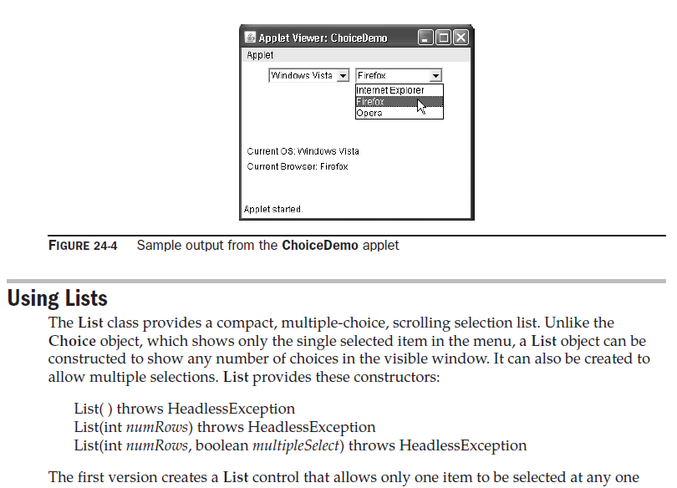
GUI Basics and Programs
Choice Controls(Combobox):

Slide 108
GUI Basics and Programs
Listbox :
The List class provides a compact, multiple-choice, scrolling selection list.
Unlike the Choice object, which shows only the single selected item in the menu, a List object can be constructed to show any number of choices in the visible window.
It can also be created to allow multiple selections.
List provides these constructors:
List( ) throws HeadlessException
List(int numRows) throws HeadlessException
List(int numRows, boolean multipleSelect) throws HeadlessException
The first version creates a List control that allows only one item to be selected at any one time. In the second form, the value of numRows specifies the number of entries in the list that will always be visible (others can be scrolled into view as needed). In the third form, if multipleSelect is true, then the user may select two or more items at a time. If it is false, then only one item may be selected.

Slide 109
GUI Basics and Programs
Listbox :
To add a selection to the list, call add( ). It has the following two forms:
void add(String name)
void add(String name, int index)
For lists that allow only single selection, you can determine which item is currently selected by calling either getSelectedItem( ) or getSelectedIndex( ).
String getSelectedItem( )
int getSelectedIndex( )
The getSelectedItem( ) method returns a string containing the name of the item. If more than one item is selected, or if no selection has yet been made, null is returned. getSelectedIndex( ) returns the index of the item. The first item is at index 0. If more than one item is selected, or if no selection has yet been made, –1 is returned.

Slide 110
GUI Basics and Programs
Listbox :
For lists that allow multiple selection, you must use either getSelectedItems( ) or getSelectedIndexes( ), shown here, to determine the current selections:
String[ ] getSelectedItems( )
int[ ] getSelectedIndexes( )
To obtain the number of items in the list, call getItemCount( ). You can set the currently selected item by using the select( ) method with a zero-based integer index.
int getItemCount( )
void select(int index)
Given an index, you can obtain the name associated with the item at that index by calling getItem( ), which has this general form:
String getItem(int index)
Here, index specifies the index of the desired item.

Slide 111
GUI Basics and Programs
Listbox :
// Demonstrate Lists.
import java.awt.*;
import java.awt.event.*;
import java.applet.*;
/*
<applet code="ListDemo" width=300 height=180>
</applet>
*/
public class ListDemo extends Applet implements ActionListener {
List os, browser;
String msg = "";
public void init() {
os = new List(4, true);
browser = new List(4, false);

Slide 112
GUI Basics and Programs
Listbox :
// add items to os list
os.add("Windows XP");
os.add("Windows Vista");
os.add("Solaris");
os.add("Mac OS");
// add items to browser list
browser.add("Internet Explorer");
browser.add("Firefox");
browser.add("Opera");
browser.select(1);
// add lists to window
add(os);
add(browser);
// register to receive action events
os.addActionListener(this);
browser.addActionListener(this);
}

Slide 113
GUI Basics and Programs
Listbox :
public void actionPerformed(ActionEvent ae) {
repaint();
}
// Display current selections.
public void paint(Graphics g) {
int idx[];
msg = "Current OS: ";
idx = os.getSelectedIndexes();
for(int i=0; i<idx.length; i++)
msg += os.getItem(idx[i]) + " ";
g.drawString(msg, 6, 120);
msg = "Current Browser: ";
msg += browser.getSelectedItem();
g.drawString(msg, 6, 140);
}
}

Slide 114
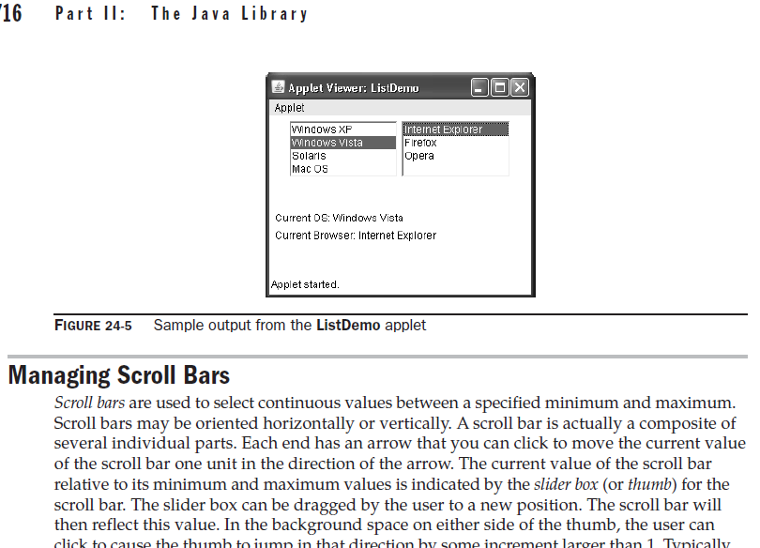
GUI Basics and Programs
Listbox :

