Slide 1
Introduction to Java Programming Language
Course: Programming In Java (PRJ190901)
Lory Al Moakar
Modified By: Manishkumar R Solanki

Slide 2
Topic Outcomes
Students will be able to:
State the history of Java
Discuss the importance of Bytecode
Describe the Buzzwords of Java
Download, Install and Configure Java
Write, Compile and Execute a “Hello World” Java Program

Slide 3
Outline
History of Java
Magic of “Bytecode”
Java Buzzwords
Downloading, Installing and Configuring Java
Writing, Compiling and Executing Hello World Program

Slide 4
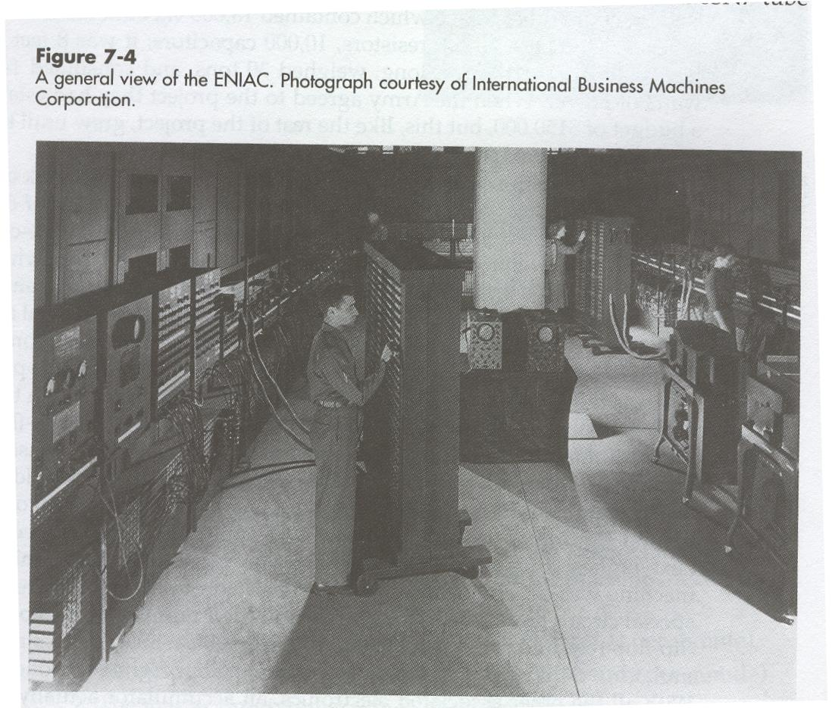
Java History
Computers of the past

Slide 5
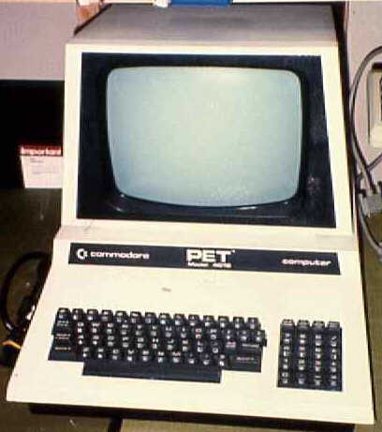
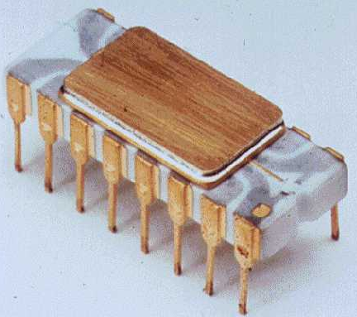
Java History
The invention of the microprocessor revolutionized computers
Intel microprocessor
Commodore Pet microcomputer

Slide 6
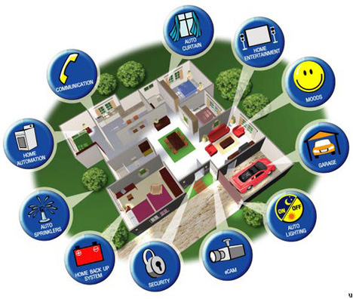
Java History
It was believed that the logical next step for microprocessors was to have them run intelligent consumer electronics

Slide 7
Java History
A platform-independent language that could be used to create software to be embedded in various consumer electronic devices, such as microwave ovens and remote controls
C and C++ is that they are designed to be compiled for a specific target
A full C++ compiler targeted for a particular CPU was required
The compilers are expensive and time-consuming to create
An easier—and more cost-efficient—solution was needed.
Gosling and others began work on a portable, platform-independent language that could be used to produce code that would run on a variety of CPUs under differing environments.
This effort ultimately led to the creation of Java

Slide 8
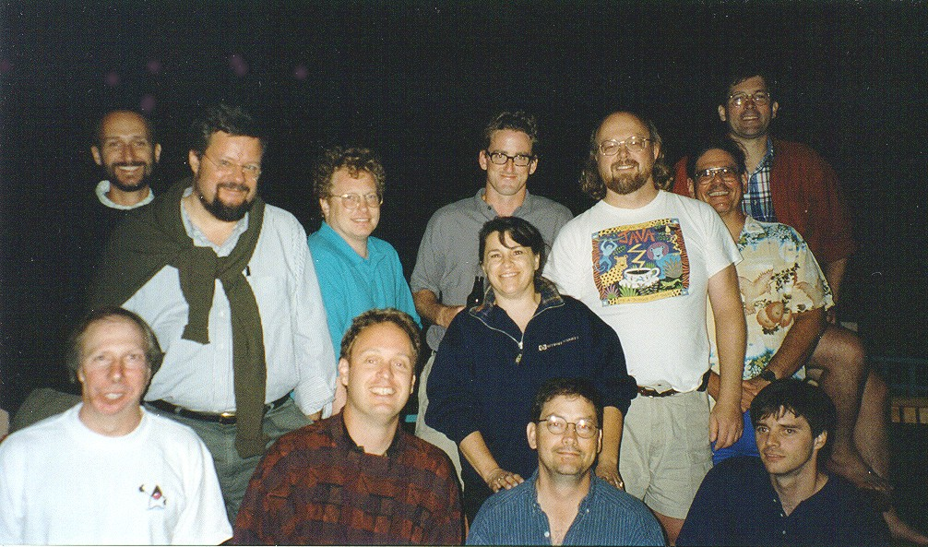
Java History
Sun Microsystems funded an internal research project “Green” to investigate opportunity to create general language for Embedded Systems in 1991
Result: After 18 months, first working version - “Oak”

Slide 9
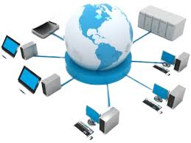

Java History(Twist)
With the advent of the Internet and the Web, the problem of portability returned.
The Internet consists of a diverse, distributed universe populated with various types of computers, operating systems, and CPUs.
Even though many kinds of platforms are attached to the Internet, users would like them all to be able to run the same program.
What was once an irritating but low priority problem had become a high-profile necessity.

Slide 10
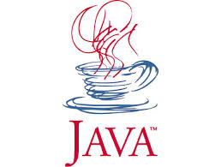
Java History(Twist)
In 1993, this realization caused the focus of Java to switch from consumer electronics to Internet programming
In 1995, the team gathered to choose a new name.
The suggested words were "dynamic", "revolutionary", "Silk", "jolt", "DNA" etc.
They wanted something that reflected the essence of the technology: revolutionary, dynamic, lively, cool, unique, and easy to spell and fun to say.
Final decision was : “Java”
Java is an island of Indonesia where first coffee was produced (called java coffee)

Slide 11
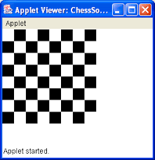
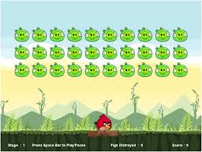
How Java Changed Internet?
Java Applets:
An applet is a special kind of Java program that is designed to be transmitted over the Internet (downloaded) at client side and automatically executed by a Java-compatible web browser.
They are typically used to display data provided by the server, handle user input, or provide simple functions, such as a loan calculator, that execute locally, rather than on the server

Slide 12
Outline
History of Java
Magic of “Bytecode”
Java Buzzwords
Downloading, Installing and Configuring Java
Writing, Compiling and Executing Hello World Program

Slide 13
Java’s Magic: The Bytecode
The output of a Java compiler is not executable code but a bytecode i.e. .class file.
Bytecode is a highly optimized set of instructions designed to be executed by the Java run-time system, which is called the Java Virtual Machine (JVM)
The original JVM was designed as an interpreter for bytecode.
Translating a Java program into bytecode makes it executable on a wide variety of environments. (only the JVM needs to be implemented for each platform.)

Slide 14
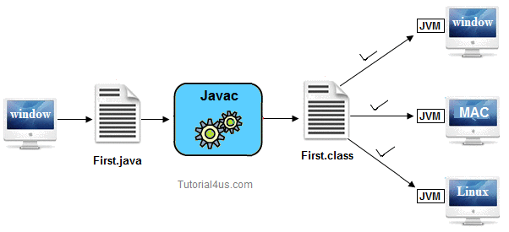
Java’s Magic: The Bytecode

Slide 15
Java’s Magic: The Bytecode
Although the details of the JVM will differ from platform to platform(OS specific), all understand the same Java bytecode
If a Java program were compiled to native code, then different versions of the same program would have to exist for each type of CPU connected to the Internet
When a program is compiled to an intermediate form and then interpreted by a virtual machine, it runs slower than it would run if compiled to executable code
Because bytecode has been highly optimized, the use of bytecode enables the JVM to execute programs much faster

Slide 16
Outline
History of Java
Magic of “Bytecode”
Java Buzzwords
Downloading, Installing and Configuring Java
Writing, Compiling and Executing Hello World Program

Slide 17
Java Buzzwords
Simple
Object-oriented
Robust
Portable
Secure
Architecture-neutral
Multithreaded
Interpreted & High performance
Distributed
Dynamic

Slide 18
Java Buzzwords
Simple:
If you have some programming experience, you will not find Java hard to master
If you are an experienced C++ programmer, moving to Java will require very little effort.
Because Java inherits the C/C++ syntax and many of the object oriented features of C++, most programmers have little trouble learning Java.

Slide 19
Java Buzzwords
Object Oriented:
Encapsulation
Abstraction
Inheritance
Polymorphism

Slide 20
Java Buzzwords
Robust:
Java is a strictly typed language, it checks your code at compile time as well at run time.
Memory management can be a difficult, tedious task in traditional programming environments.
For example, in C/C++, the programmer will often manually allocate and free all dynamic memory. This sometimes leads to problems, if programmer forgets to free memory that has been previously allocated.
Deallocation is completely automatic, because Java provides garbage collection for unused objects.
Java provides object-oriented exception handling.

Slide 21
Java Buzzwords
Portability:
Portability refers to the ability to run a program on different machines.
The Java program is getting compiled into bytecode which is platform independent.
For example, the same applet must can be downloaded and executed by the wide variety of CPUs, operating systems, and browsers connected to the Internet.
There is no need to keep different versions of the applet for different computers. The same code must run on all computers.

Slide 22

Java Buzzwords
Security:
Downloading Internet resources are prone to virus, Trojan horse, or other harmful code.
Java applets are confined to the Java execution environment and are not allowed to access to other parts of the computer i.e. partitions of the disk.
Java doesn’t support Pointers.

Slide 23
Java Buzzwords
Multithreaded:
Multithreading means dividing a program into executable sub programs(threads) which can run concurrently. (parallelly)
Examples:
On a mobile home screen : wall paper, battery level, signal strength, location, time, etc.
In a browser window: different tabs
In a word document: writing process, printing process, spell check process, etc.
Applications: Gaming, Animation, Networking programs
The Java run-time system provides an elegant yet sophisticated solution for multi threading synchronization to develop interactive applications.

Slide 24
Java Buzzwords
Architecture-Neutral:
Operating system upgrades, processor upgrades, and changes in core system resources do not affect the Java program execution.
The goal in the development of Java and JVM was “write once; run anywhere, any time, forever.”

Slide 25
Java Buzzwords
Distributed:
Java is designed for the distributed environment of the Internet because it handles TCP/IP protocols. Accessing a resource using a URL is not much different from accessing a file.
Java also supports Remote Method Invocation (RMI). This feature enables a program to invoke methods across a network.

Slide 26
Java Buzzwords
Dynamic:
It supports dynamic loading of classes.(classes are loaded on demand.)
Java programs carry with them substantial amounts of run-time type information that is used to verify and resolve accesses to objects at run time.
It also supports functions from its native languages, i.e., C and C++.

Slide 27
Outline
History of Java
Magic of “Bytecode”
Java Buzzwords
Downloading, Installing and Configuring Java
Writing, Compiling and Executing Hello World Program

Slide 28
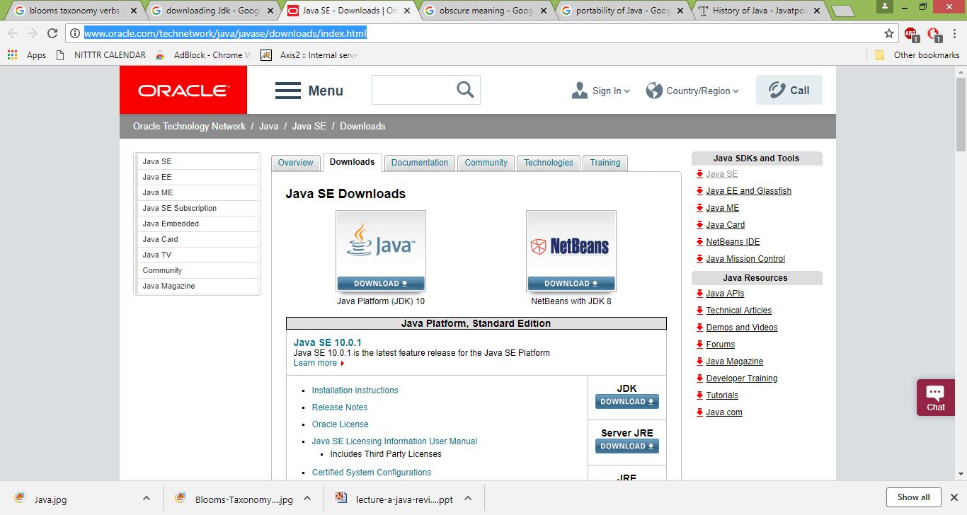
Downloading Java
URL: : http://www.oracle.com/technetwork/java/javase/downloads/index.html

Slide 29
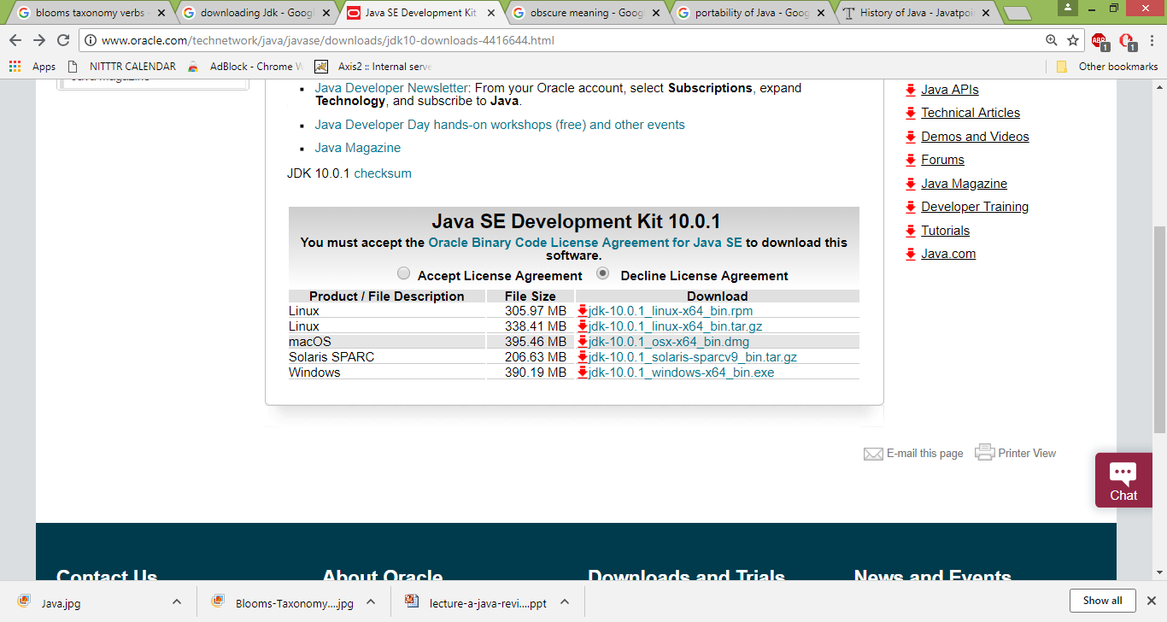
Downloading Java

Slide 30
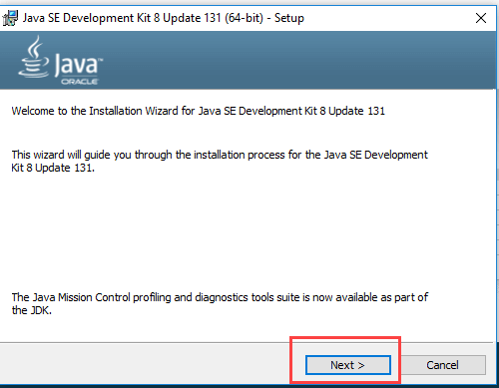
Installing Java

Slide 31
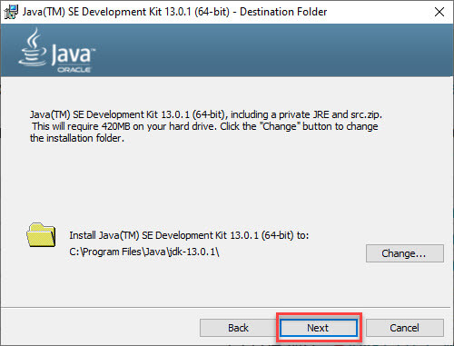
Installing Java
https://www.guru99.com/install-java.html

Slide 32
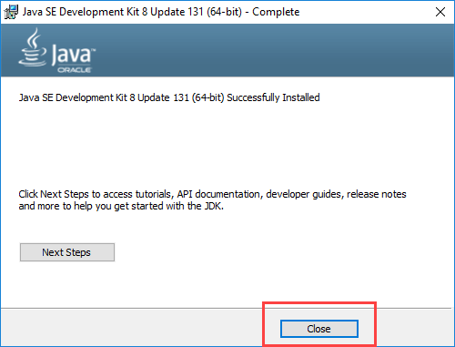
Installing Java

Slide 33
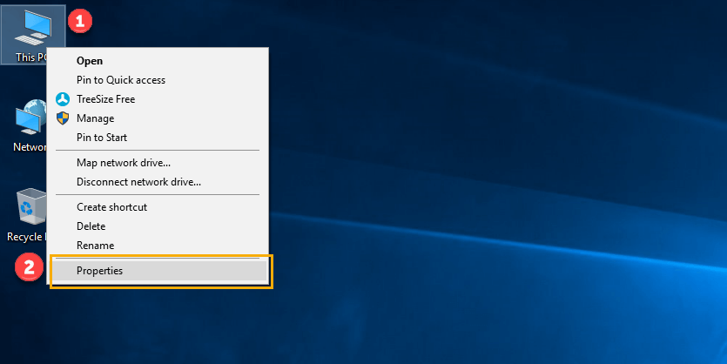
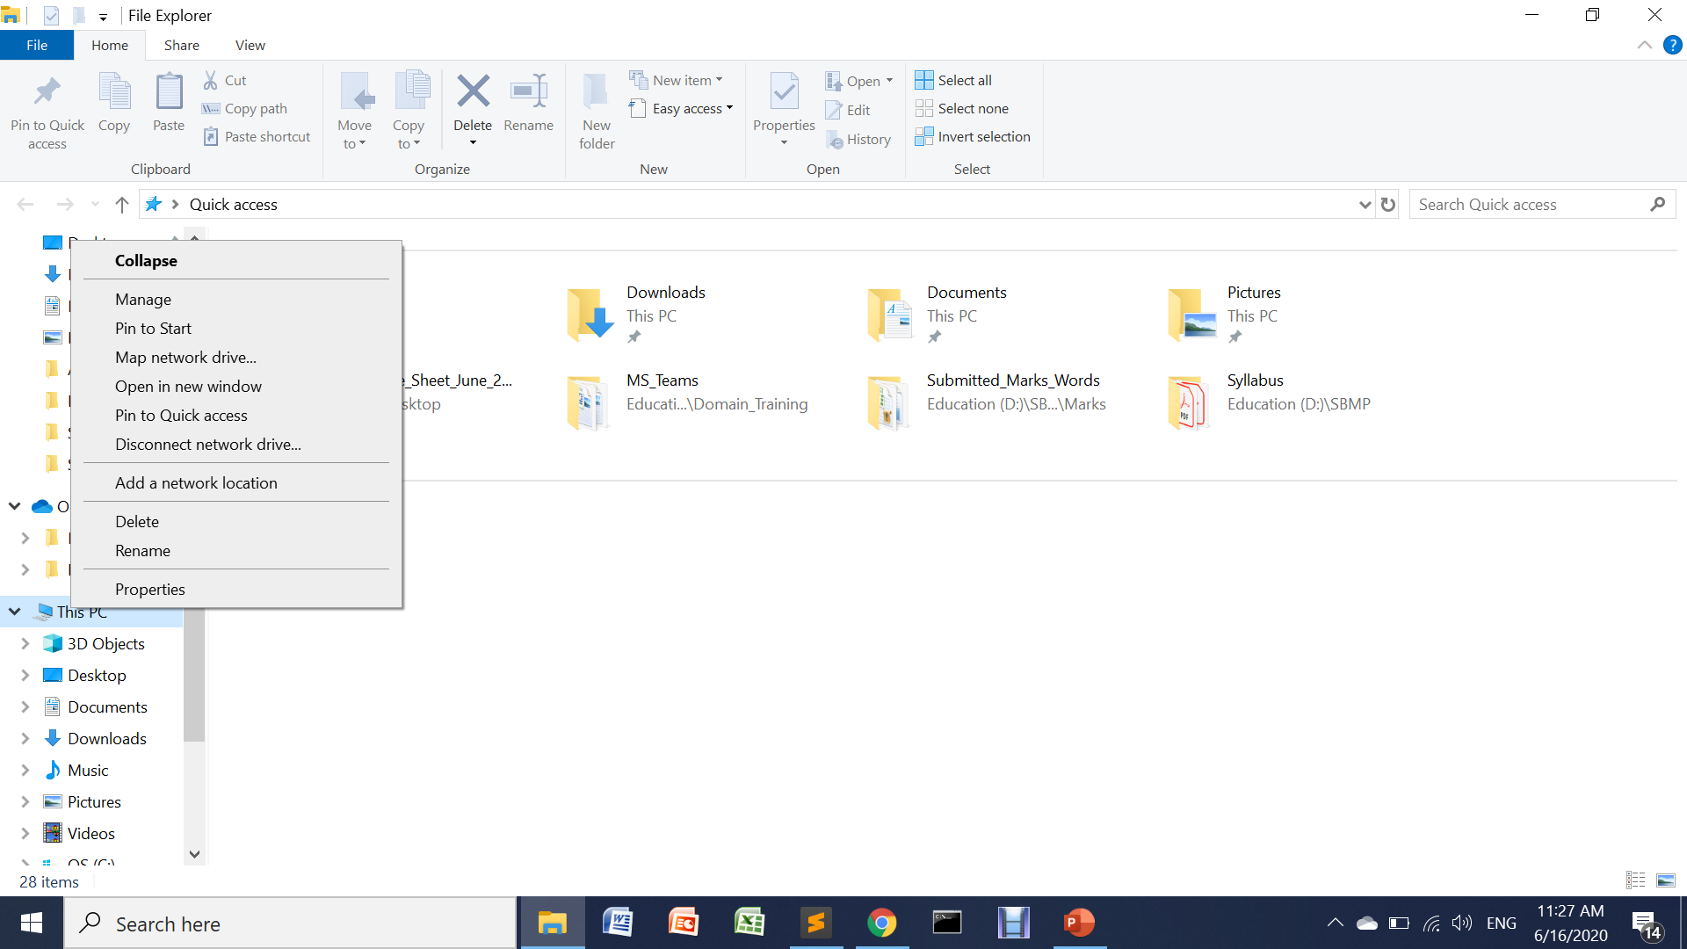
Configuring Java [Setting PATH]
Step 1) Right Click on the My Computer and Select the properties

Slide 34
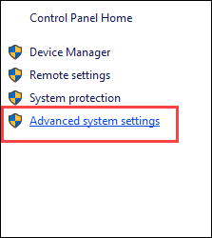
Configuring Java [Setting PATH]
Step 2) Click on advanced system settings

Slide 35
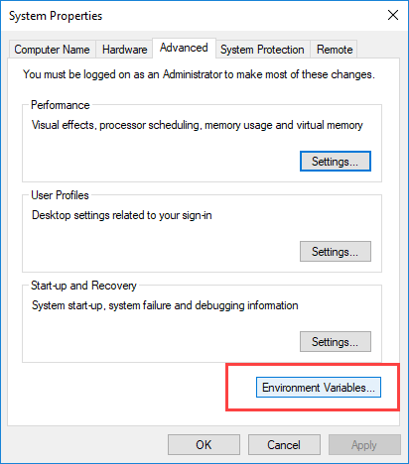
Configuring Java [Setting PATH]
Step 3) Click on Environment Variables

Slide 36
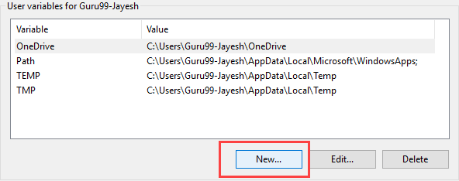
Configuring Java [Setting PATH]
Step 4) Click on new Button of User variables

Slide 37
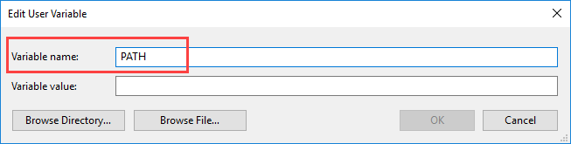
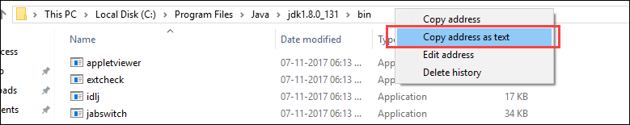
Configuring Java [Setting PATH]
Step 5) Type PATH in the Variable name
Step 6) Copy the path of bin folder which is installed in JDK folder.

Slide 38
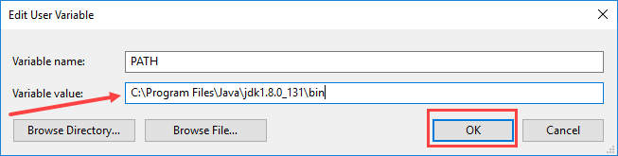
Configuring Java [Setting PATH]
Step 7) Paste Path of bin folder in Variable value and click on OK Button.

Slide 39
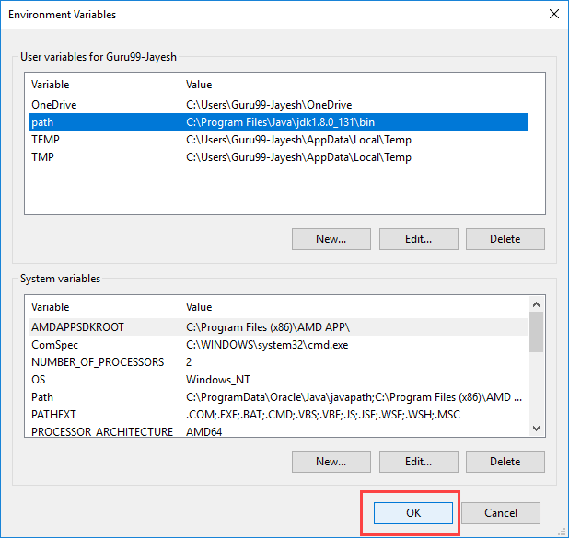
Configuring Java [Setting PATH]
Step 8) Click on OK button

Slide 40
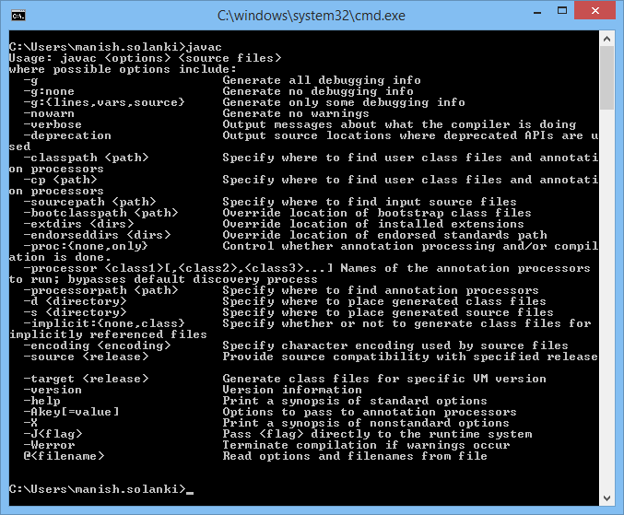
Configuring Java [Setting PATH]
Step 9) Go to command prompt and type javac commands.
If you see a screen like below, Java is installed and PATH is set

Slide 41
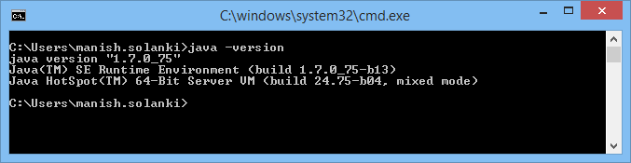
Configuring Java
To see the version of Java installed : java -version

Slide 42
Outline
History of Java
Magic of “Bytecode”
Java Buzzwords
Downloading, Installing and Configuring Java
Writing, Compiling and Executing Hello World Program

Slide 43
Java Program Structure
In the Java programming language:
A program is made up of one or more classes
A class contains one or more methods(functions)
A method contains program statements
A Java application always contains a method called main()
A Java Applet doesn’t contain main()

Slide 44
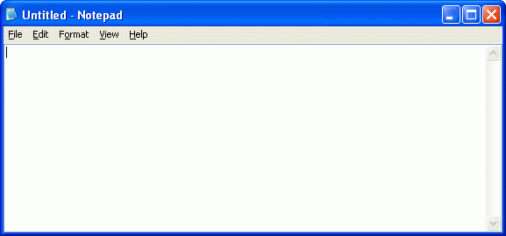
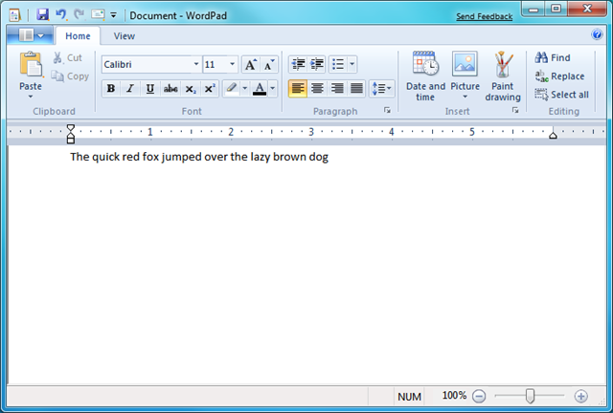
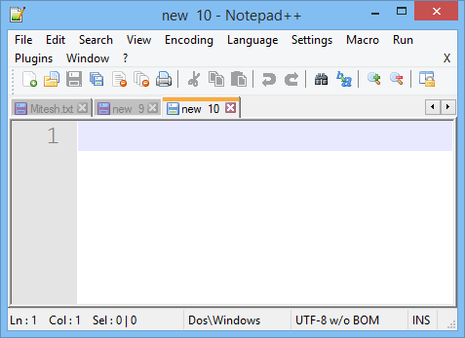
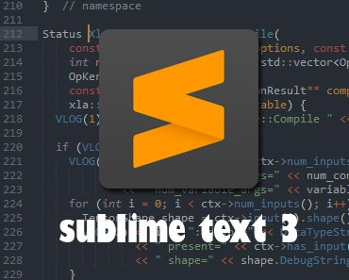
Text Editors to write a Java Program

Slide 45
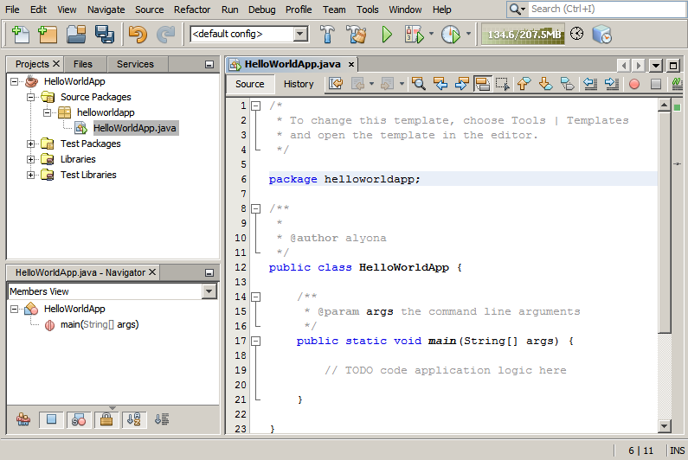
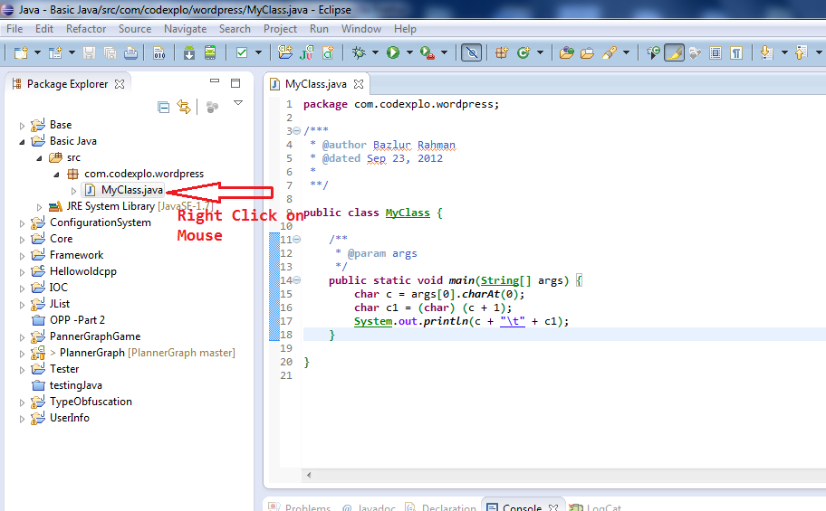
IDEs to write a Java Program

Slide 46
Writing “Hello World” Java Program
HelloWorld.java
class HelloWorld
{
public static void `(String args[])
{
System.out.println (“Hello World");
}
}
Note: Save the file with the name of class inside which main( ) resides

Slide 47
Java Program Structure
// comments about the class
class HelloWorld
{
}
class header
class body
Comments can be placed almost anywhere

Slide 48
Java Program Structure
class HelloWorld
{
}
// comments about the method
public static void main (String args[])
{
}
method header
method body

Slide 49
Comments
Comments in a program are called inline documentation
They should be included to explain the purpose of the program and describe processing steps
They do not affect how a program works
Java comments can take three forms:
// this comment runs to the end of the line
/* this comment runs to the terminating
symbol, even across line breaks */
/** this is a javadoc comment */

Slide 50
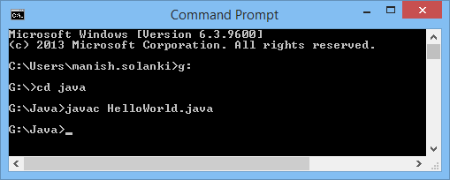
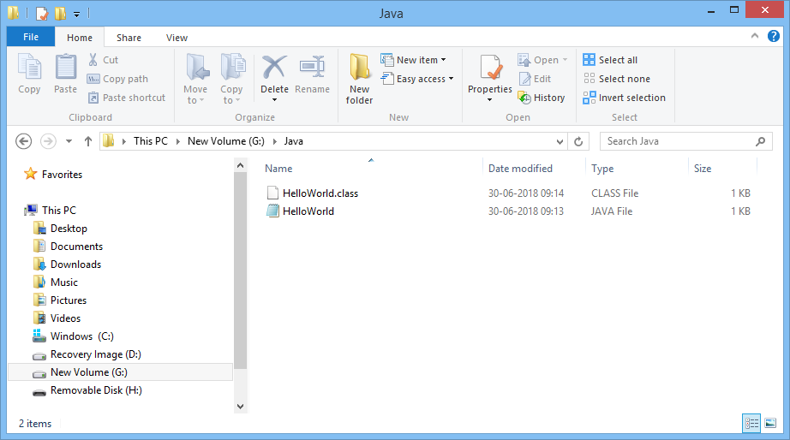
Compiling “Hello World” Java Program
Open Command Prompt
Make a directory (inside which java programs are residing) as working/present directory
Compile the program with javac program.java

Slide 51
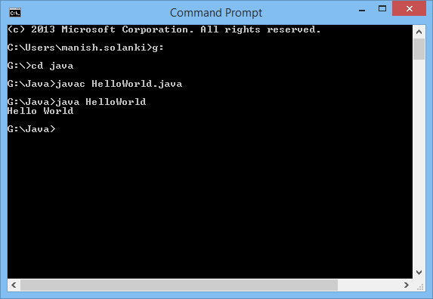
Executing “Hello World” Java Program
After successfully compilation of program .class file (bytecode) is generated
To execute, we have to write : java filename command

Slide 52
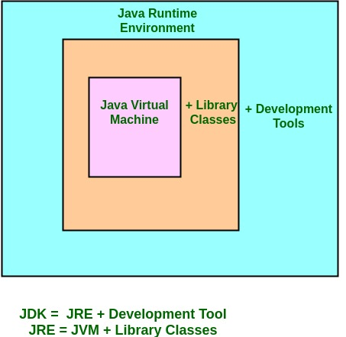
Java Ecosystem
https://www.geeksforgeeks.org/differences-jdk-jre-jvm/

Slide 53
JVM
JVM (Java Virtual Machine) is an abstract machine. It is called virtual machine because it doesn't physically exist.
It is a specification that provides runtime environment in which java bytecode can be executed
JVMs are available for many hardware and software platforms. JVM, JRE and JDK are platform dependent because configuration of each OS are different from each other
Functions of JVM:
Loads code
Verifies code
Executes code
Provides runtime environment

Slide 54
JRE
JRE is an acronym for Java Runtime Environment
It is also written as Java RTE.
The Java Runtime Environment is a set of software tools which are used for developing java applications
It is used to provide runtime environment. It is the implementation of JVM
It physically exists.
It contains set of libraries + other files that JVM uses at runtime

Slide 55
JDK
The Java Development Kit (JDK) is a software development environment which is used to develop java applications and applets.
It physically exists.
It contains JRE + development tools(i.e. javac,java,jar,etc.)
JDK is an implementation of any one of the below given Java Platforms released by Oracle corporation:
Standard Edition Java Platform
Enterprise Edition Java Platform
Micro Edition Java Platform

Slide 56
Credits
Lory Al Moakar,2004 Pearson Addison-Wesley.
https://specialties.bayt.com/en/specialties/q/223774/why-java-is-considered-dynamic/

Slide 57

You can find me at:
manish_ratilal2002@yahoo.com

