Slide 1
Principles of Object Oriented Programming in Java

Slide 2
Mr. M.R. Solanki
Sr. Lecturer, Information Technology,
manish_ratilal2002@yahoo.com
SBMP

Slide 3
Learning Outcomes
Students will be able to:
Describe types of programming Languages
Explain the difference between SOP and OOP
Define class, objects, abstraction, encapsulation, inheritance and polymorphism
Write a sample C++ Program

Slide 4
Programming Languages
Types of Programming Languages:
Low (Binary or / Machine ) Level Language:
0’s and 1’s
Input and output are in binary form
Efficient performance as Processor knows binary
Difficult to learn (Only scientists and researchers could work with it)

Slide 5
Programming Languages
Types of Programming Languages:
2. Assembly Level Language:
Hexadecimal Number System (0-F)
Easy to learn so user friendly than binary
Not efficient as binary because of Assembler required to translate code into binary and extra cost for the assembler software

Slide 6
Programming Languages
Types of Programming Languages:
3. Higher Level Language:
Decimal Number System (0-9)
Most user friendly because of fully English like structure
Performance is worse because Compiler or Interpreter is required for translation from higher level to lower level
Easy to learn compared to other languages

Slide 7
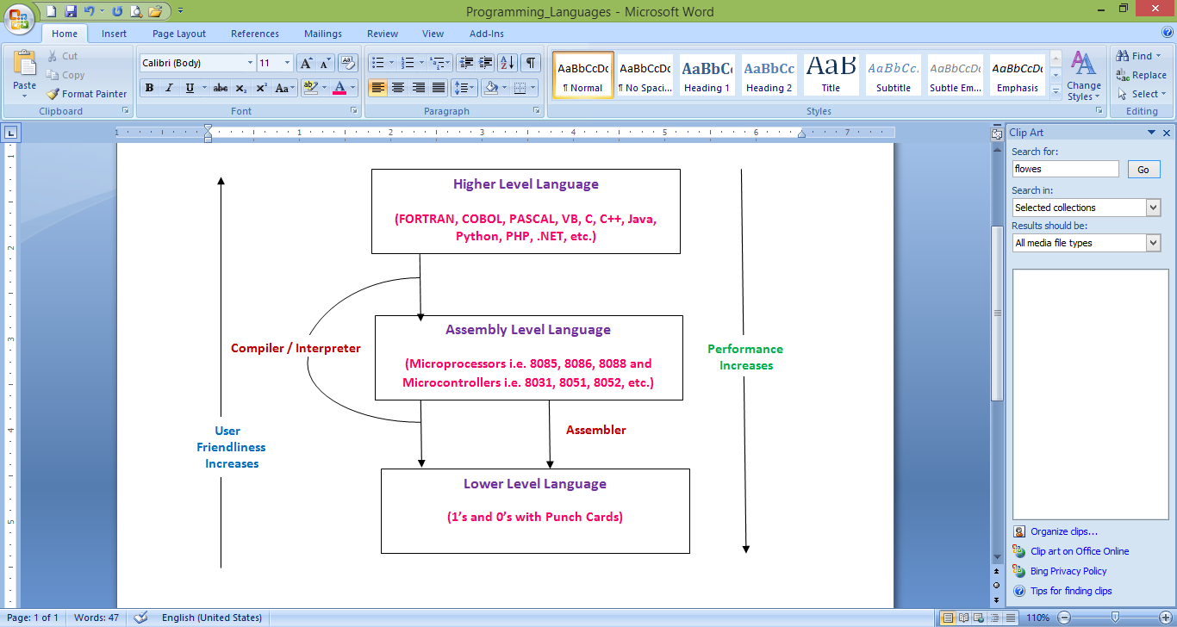
Programming Languages
Types of Programming Languages:

Slide 8
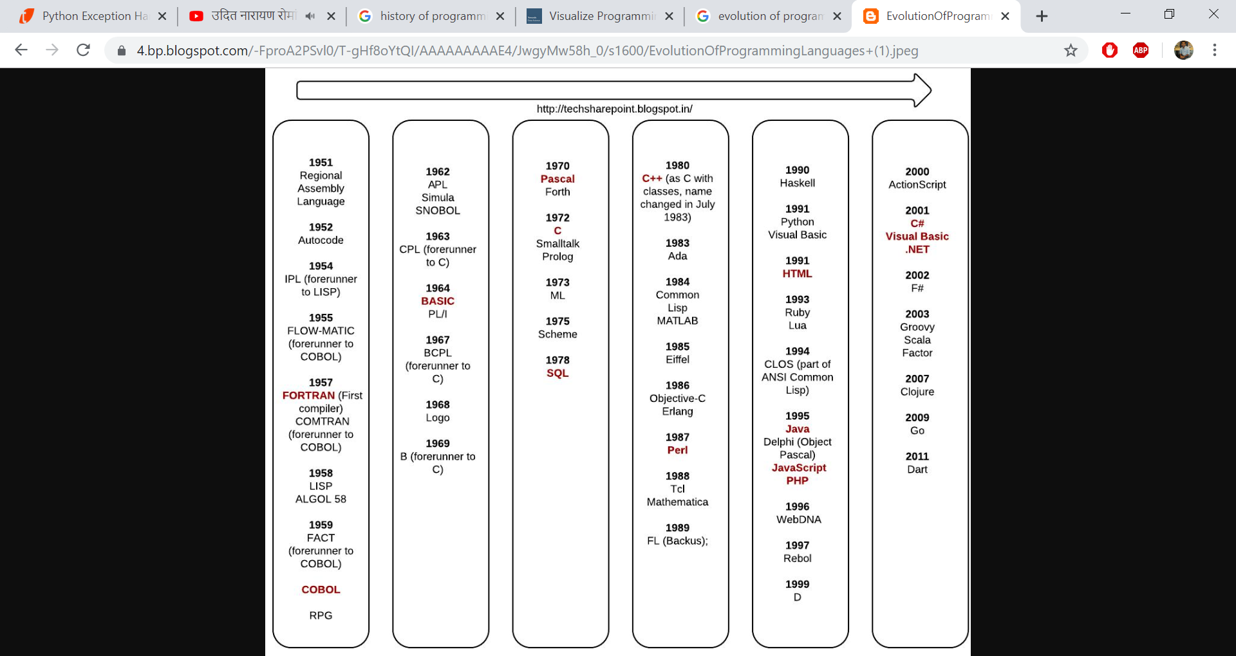
Timeline of HLLs

Slide 9
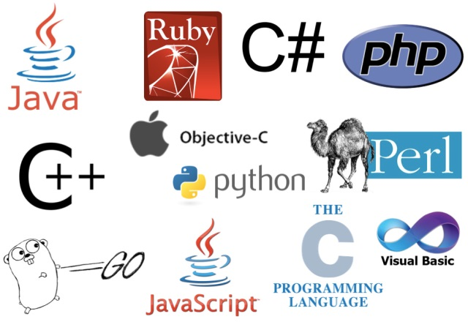
Some Popular HLLs

Slide 10
Structured v/s Object Oriented Programming Language

Slide 11
Procedure Oriented Program
Procedure-Oriented programming basically consists of writing a list of instructions (or actions) for the computer to follow, and organizing these instructions into groups known as functions.
While we concentrate on the development of functions, very little attention is given to the data t hat are being used by various functions.
What happens to the data? How are they affected by the functions that work on them?
In a multi function program, many important data items are placed as global so that they may be accessed by all the functions
Global data are more vulnerable to an accidental change by a function

Slide 12
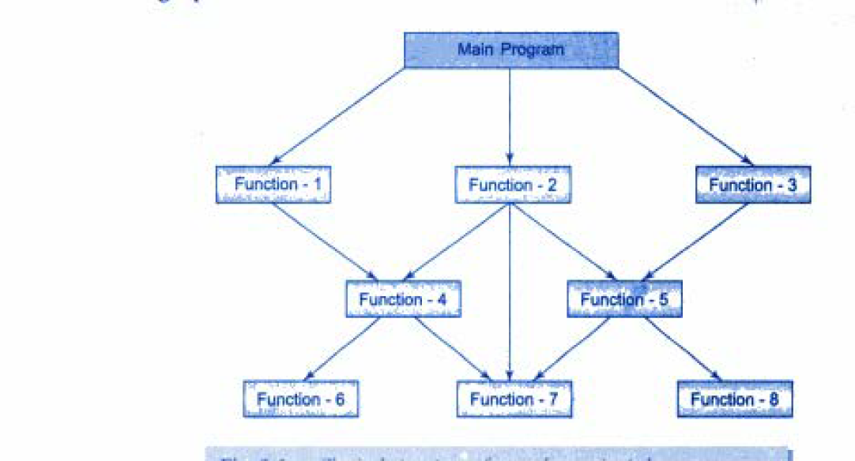
Procedure Oriented Program
Typical Structure of Procedure Oriented Program

Slide 13
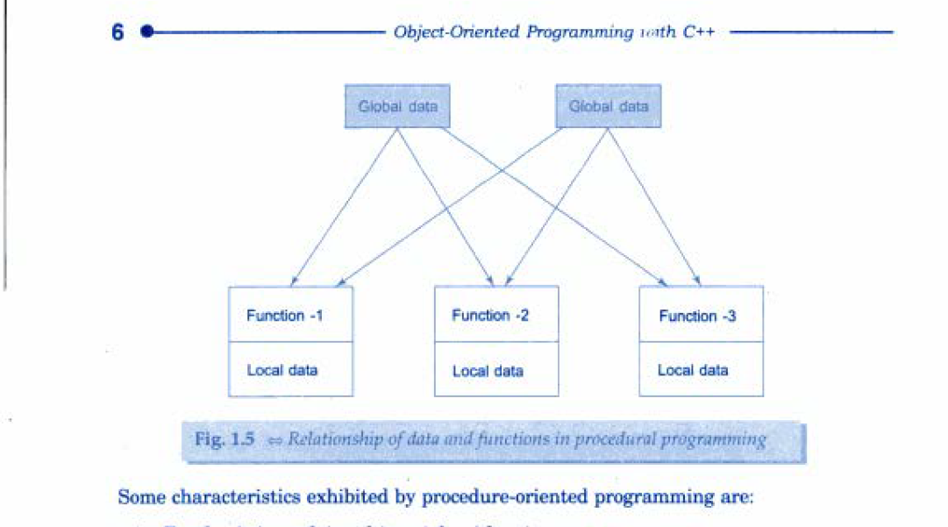
Procedure Oriented Program
Data and Functions in SOP

Slide 14
Object Oriented Program
The major motivating factor in the invention of object oriented approach is to remove some of the flaws encountered in the procedural approach.
OOP treats data as a critical element in the program development and does not allow it to flow freely around the system.
It ties data more closely to the function that operate on it, and protects it from accidental modification from outside functions.
OOP allows decomposition of a problem into a number of entities called objects and then builds data and functions around these objects.
The data of an object can be accessed only by the functions associated with that object.

Slide 15
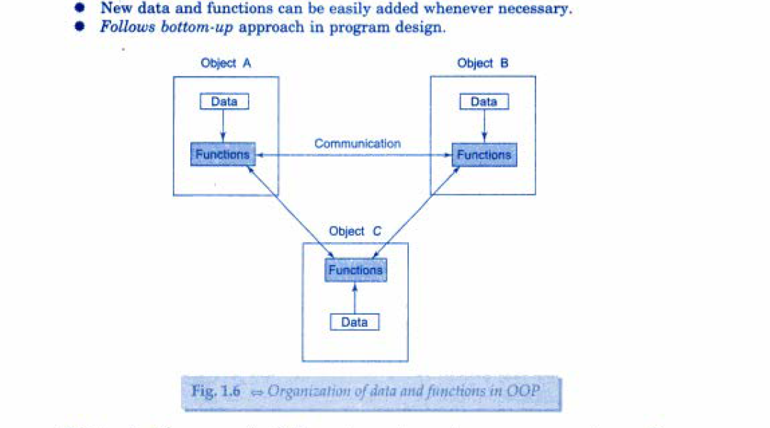
Object Oriented Program
Organization of Data in OOP

Slide 16
SOP v/s OOP
Sr. No | Structured Programming Language (SOP) | Object Oriented Programming Language(OOP)
1 | It is designed to focus on process/ logical structure and then data required for that process. | It is designed to focus on data.
2 | Follows top-down approach. | Follows bottom-up approach.
3 | Also known as Modular Programming and a subset of procedural programming language. | Supports inheritance, encapsulation, abstraction, polymorphism, etc.
4 | Programs are divided into small self-contained functions. | Programs are divided into small entities called objects.
5 | Function transform data from one form to another | Functions that operate on data of an object are tied together in a data structure

Slide 17
SOP v/s OOP
6 | Less secure as there is no way of data hiding. (most of the functions share global data) | More secure as having data hiding feature through access specifiers/modifiers i.e. private and protected
7 | Can solve moderately complex programs. | Can solve any complex programs.
8 | Provides less reusability, more function dependency. | Provides more reusability (due to inheritance), less function dependency.
9 | Less abstraction and less flexibility. | More abstraction and more flexibility( new data can functions can be added easily whenever required)
10 | Examples: FORTRAN, C, BASIC, PASCAL, etc. | Examples: C++, Java, PHP, .Net, Python, etc.

Slide 18
OOP Principles

Slide 19

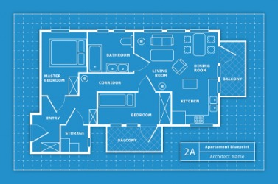
class
We can create a user defined data type in Java using class.
A class can be considered as a “Template” or “Blue Print” or “Dye” which declares data and code(function) inside it.
A class is a logical reality from which we can create n no. of instances i.e. from a dye, we can create so many idols, from a blue print (plan/design/pattern), we can construct so many buildings physically, etc. Thus a class is a collection of objects of similar types.

Slide 20

object
Basic run time entities in OOP i.e. a person, a bank, an employee, a student, etc.
Are variables of type class
Is a physical reality
Each object contains data and code(function) to manipulate data
Objects interact with each other by sending messages. i.e. a customer object can request an account object for the bank balance.

Slide 21
Data Encapsulation
The wrapping up of data and functions into a single unit (class) is known as Encapsulation
Only functions declared inside the class can access the data. (outside interference is restricted – security)
Also called as “Data Hiding” or “Information Hiding”
The functions provide an interface between an object’s data and the program.
Encapsulation is achieved trough access modifiers private and protected in Java.

Slide 22
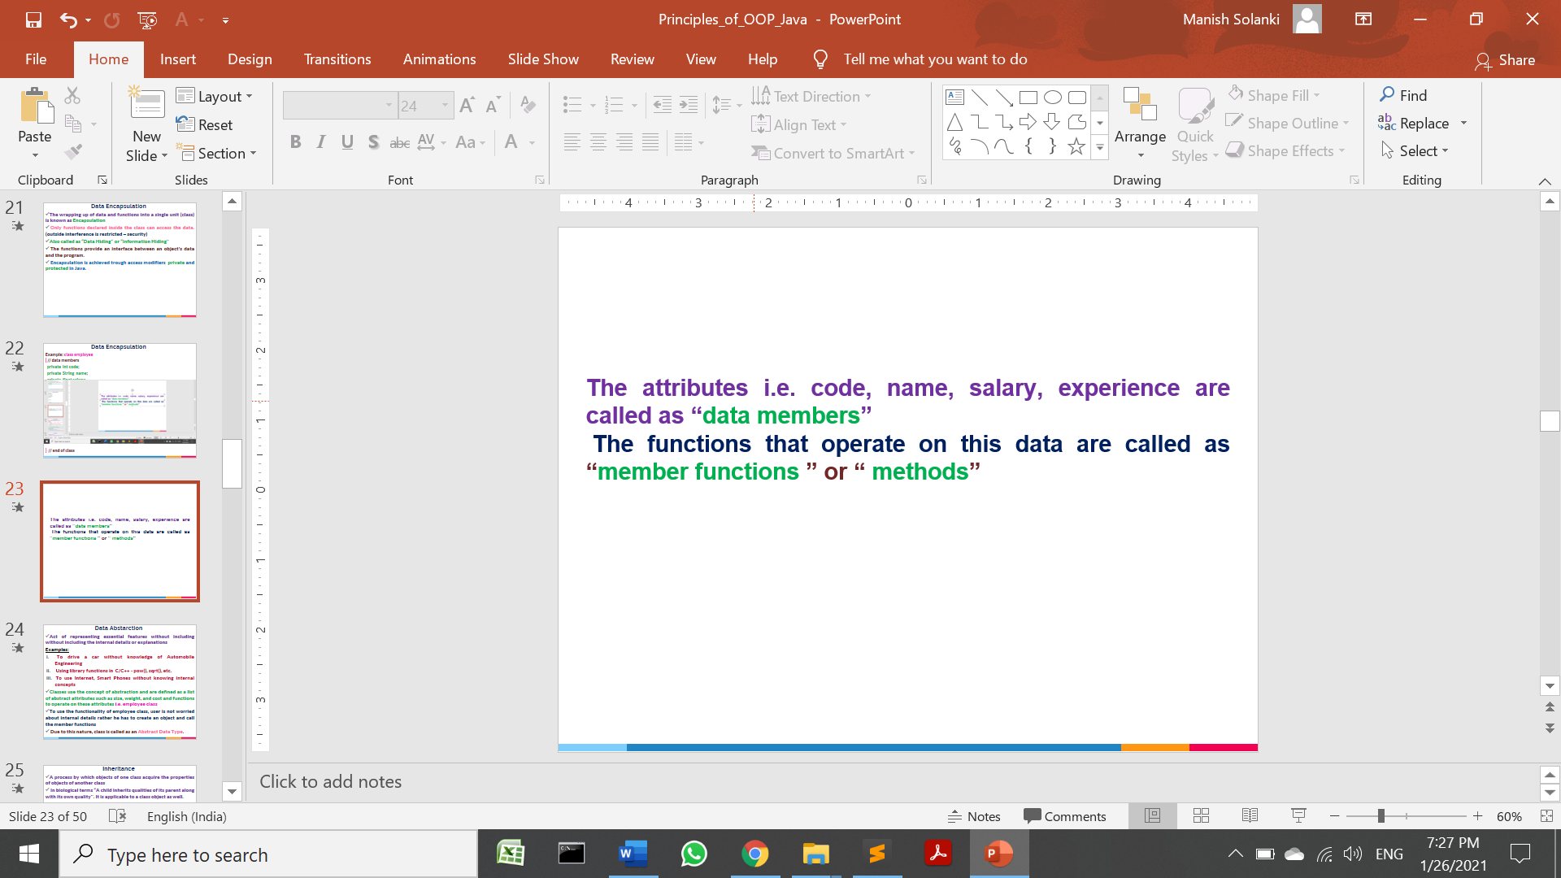
Data Encapsulation
Example: class Employee
{ // data members
private int code;
private String name;
private float salary;
private int experience;
// member methods
void setEmp()
{
// data input
}
void getEmp()
{
// data output
}
} // end of class

Slide 23
Data Encapsulation
class EmployeeMain
{
public static void main(String args[])
{
Employee e=new Employee();
e.code=1; // error becuase of private access specifier
}
}

Slide 24
Data Abstarction
Act of representing essential features without including the internal details or explanations.
Examples:
To drive a car without knowledge of Automobile Engineering
Using library functions in C/C++/Java - pow(), sqrt(), etc.
To use Internet, Smart Phones without knowing internal technicalities.
Classes use the concept of abstraction and are defined as a list of abstract attributes such as size, weight, and cost. Functions to operate on these attributes i.e. employee class
To use the functionality of employee class, user is not worried about internal details rather he has to create an object and call the member functions.
Due to this nature, class is called as an Abstract Data Type.

Slide 25
Data Abstraction
Example: class Employee
{ // data members
private int code;
private String name;
private float salary;
private int experience;
// member methods
void setEmp()
{
// data input
}
void getEmp()
{
// data output
}
} // end of class

Slide 26
Thanks!
Any questions?
You can find me at:
manish_ratilal2002@yahoo.com

Slide 27
Credits
Object oriented programming with C++, E Balagurusamy, Tata McGraw-Hill Publishing Company Limited, New Delhi

