Slide 1
Java class fundamentals

Slide 2
Mr. M.R. Solanki
Sr. Lecturer, Information Technology,
manish_ratilal2002@yahoo.com
SBMP

Slide 3
Learning Outcomes
Students will be able to:
Write a class in Java
Instantiate object in Java
Add member methods in a class
Introduce constructors in Java
Describe Garbage Collection process

Slide 4
Defining a class in Java

Slide 5
class syntax
A class is declared by use of the class keyword.
class classname {
type instance-variable1;
type instance-variable2;
type instance-variableN;
type methodname1(parameter-list) {
// body of method
}
type methodname2(parameter-list) {
// body of method
}
type methodnameN(parameter-list) {
// body of method
}
} //end of class

Slide 6
Java classes do not need to have a main( ) method
You only specify one if that class is the starting point for your program
applets, don’t require a main( ) method at all

Slide 7
class syntax
A class example
class Box
{
double width;
double height;
double depth;
}

Slide 8
Instantiating an object in Java

Slide 9
Creating Objects
Obtaining objects of a class is a two-step process:
Declare a variable of the class type i.e. reference
This variable does not define an object.
It is simply a variable that can refer to an object
We can not apply mathematical operators i.e. + and – on reference (as allowed in case of pointer in C/C++)
We can assign one reference to other reference variable
Syntax: classname ref;
Example: Box mybox;

Slide 10
Creating Objects
2. Acquire an actual, physical copy of the object and assign it to that variable:
It is performed using new operator.
The new operator dynamically allocates (at run time) memory
for an object and returns its reference.
This reference is the address of the object allocated by new in the memory (RAM).
This reference is then stored in the variable
Syntax: ref = new classname();
Example: mybox = new Box();

Slide 11
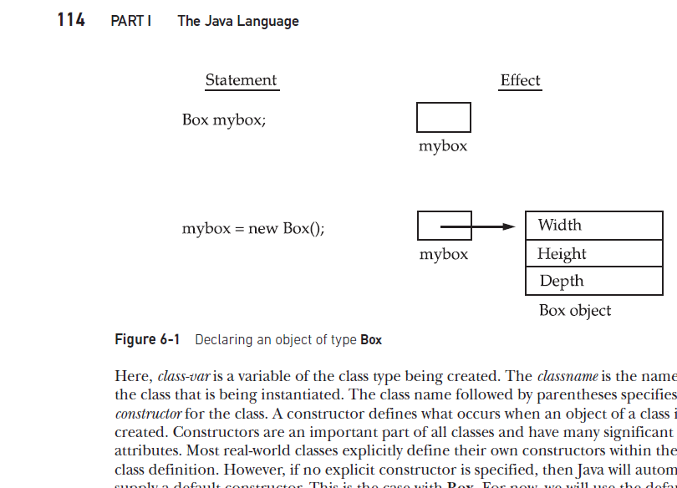
Creating Objects
RAM

Slide 12
Creating Objects

Slide 13
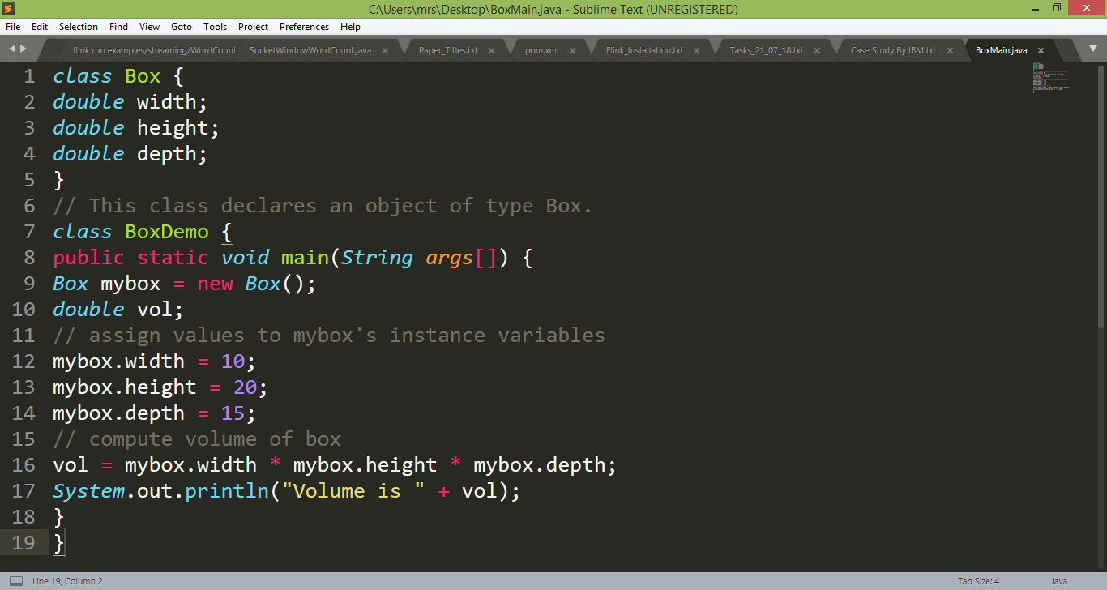
class example with Object declaration

Slide 14
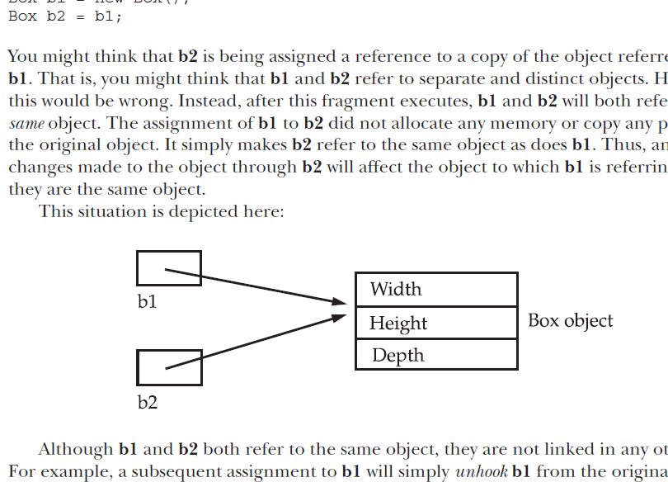
Assigning Object Reference Variables
We can assign one reference to other reference as below:
Box b1 = new Box();
Box b2 = b1;
b1 and b2 will both refer to the same object.
The assignment of b1 to b2 did not allocate any memory or copy any part of the original object.
It simply makes b2 refer to the same object as does b1
Thus, any changes made to the object through b2 will affect the object to which b1 is referring, since they are the same object

Slide 15
Although b1 and b2 both refer to the same object, they are not linked in any other way.
For example, If we assign b1 with other object reference or with null value, it will unhook itself from original object without affecting the original object or b2.
Box b1 = new Box();
Box b2 = b1;
// ...
b1 = null;
Here, b1 has been set to null, but b2 still points to the original object.

Slide 16
Adding method in a class

Slide 17
Adding Methods
type name(parameter-list) {
// body of method
}
(i) type : type of data returned by the method.
This can be any valid type
If the method does not return a value, its return type must be void.
(ii) name : name of the method is specified by name.
This can be any legal identifier other than those already used by other items within the current scope.

Slide 18
Adding Methods
type name(parameter-list) {
// body of method
}
(iii) parameter-list: is a sequence of type and identifier pairs separated by commas
Parameters are essentially variables that receive the value of the arguments passed to the method when it is called
If the method has no parameters, then the parameter list will be empty.
Methods that have a return type other than void return a value to the calling routine using the following form of the return statement:
return value;
Here, value is the value returned.

Slide 19
Adding Methods
Methods that have a return type other than void return a value to the calling routine using the following form of the return statement:
return value;
Here, value is the value to be returned.

Slide 20
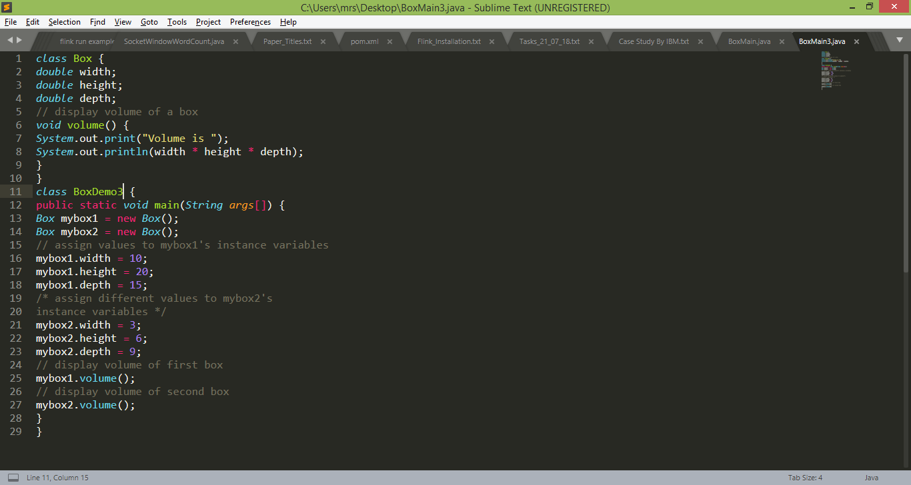
Adding a Method in Box class

Slide 21
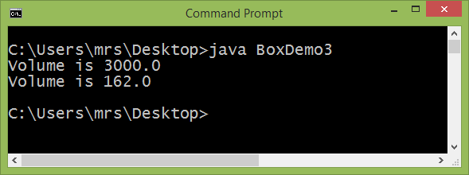
Adding a Method in Box class

Slide 22
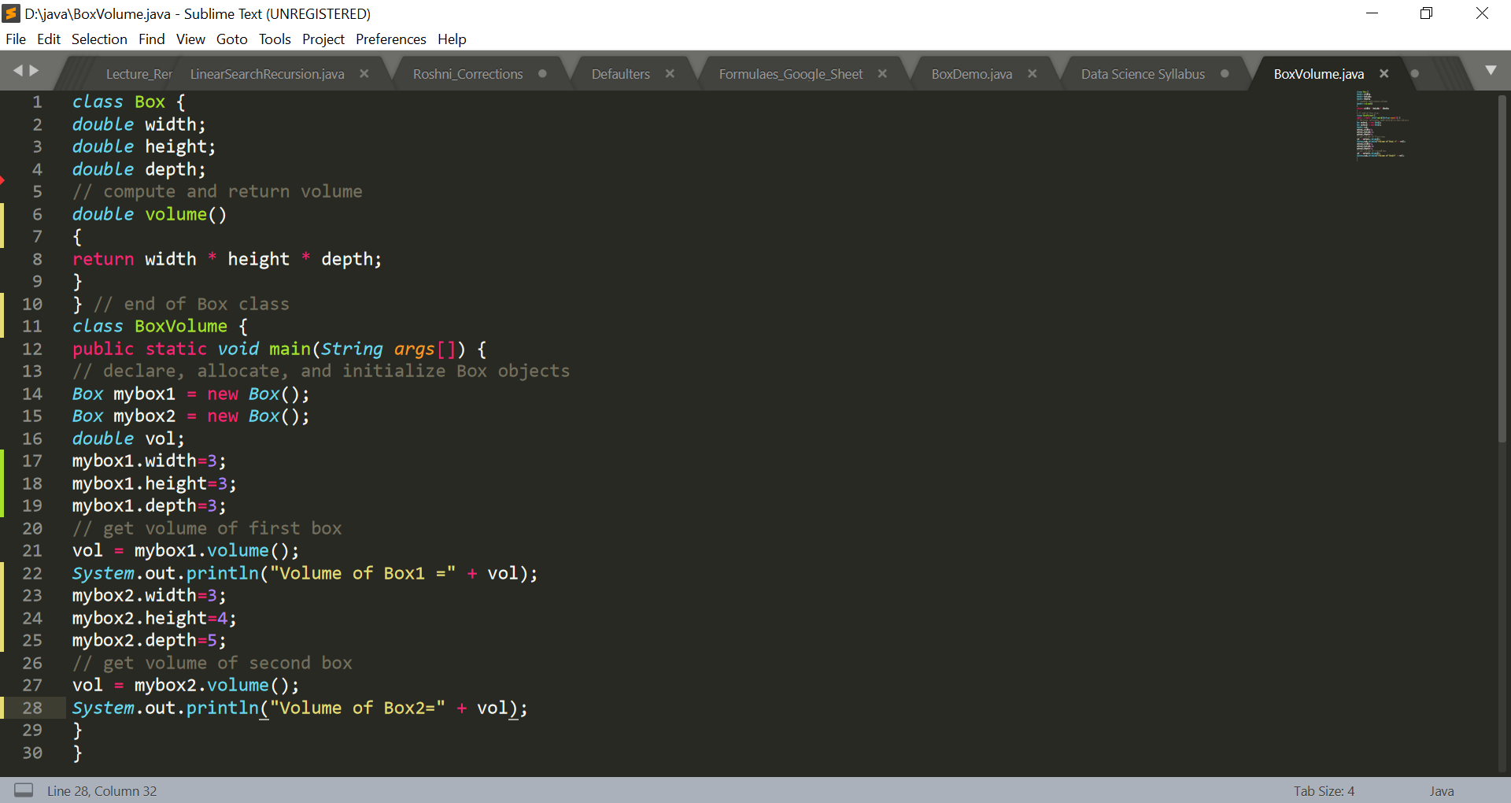
A member method with return statement

Slide 23
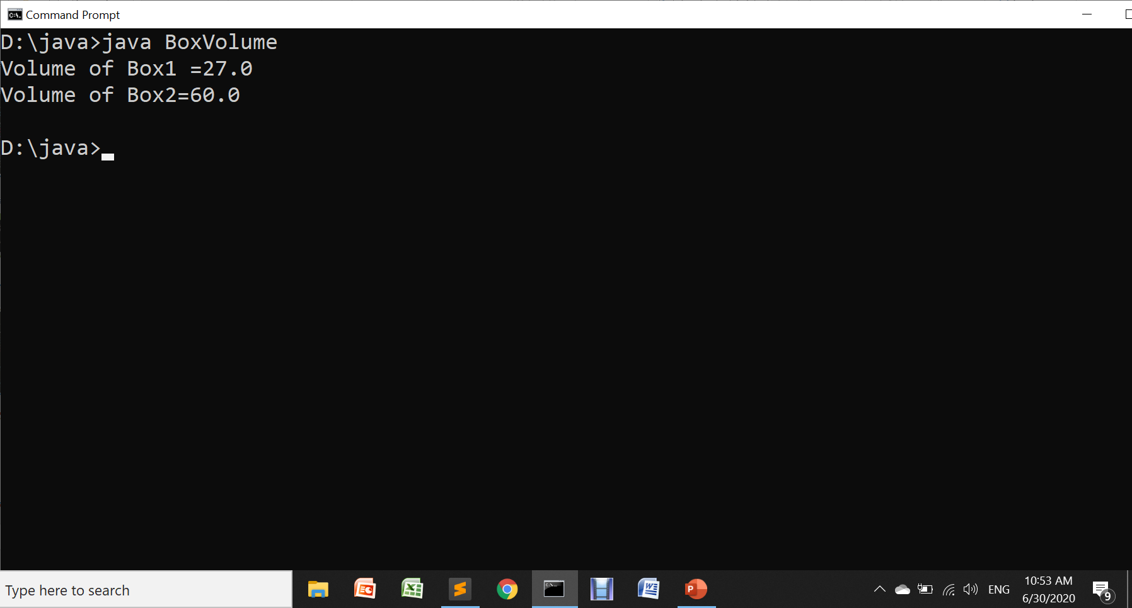
A member method with return statement

Slide 24
There are two important things to understand about returning values:
The type of data returned by a method must be compatible with the return type specified by the method. For example, if the return type of some method is boolean, you could not return an integer.
The variable receiving the value returned by a method (i.e. vol, in this case) must also be compatible with the return type specified for the method.

Slide 25
While initializing data members in main(), creates 2 problems:
It is clumsy and error prone.
Example, It would be easy to forget to set a dimension.
In well-designed Java programs, instance variables should be accessed only through methods defined by their class. (Encapsulation)

Slide 26
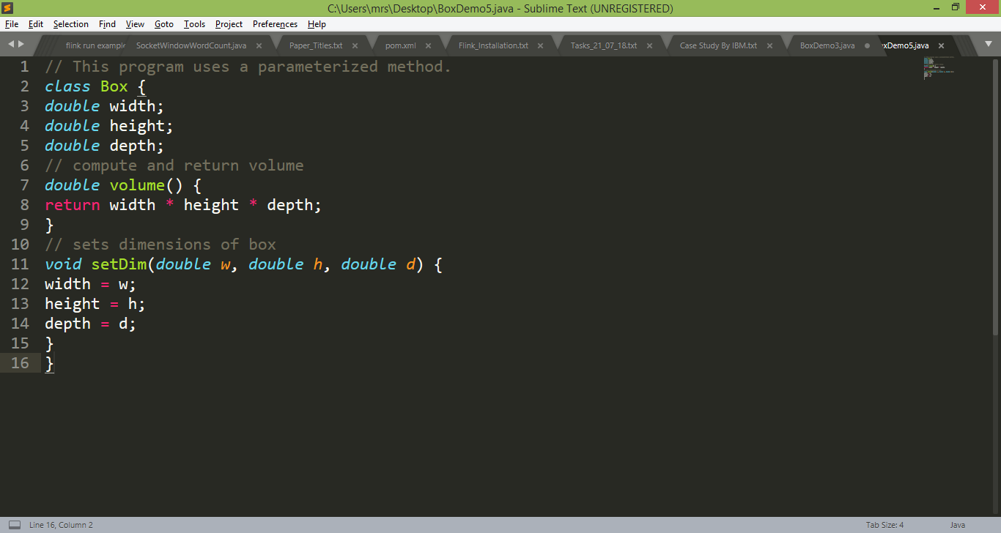
Initializing instance members using setter method
We can use setter method in Java to initialize the instance data members of a class:

Slide 27
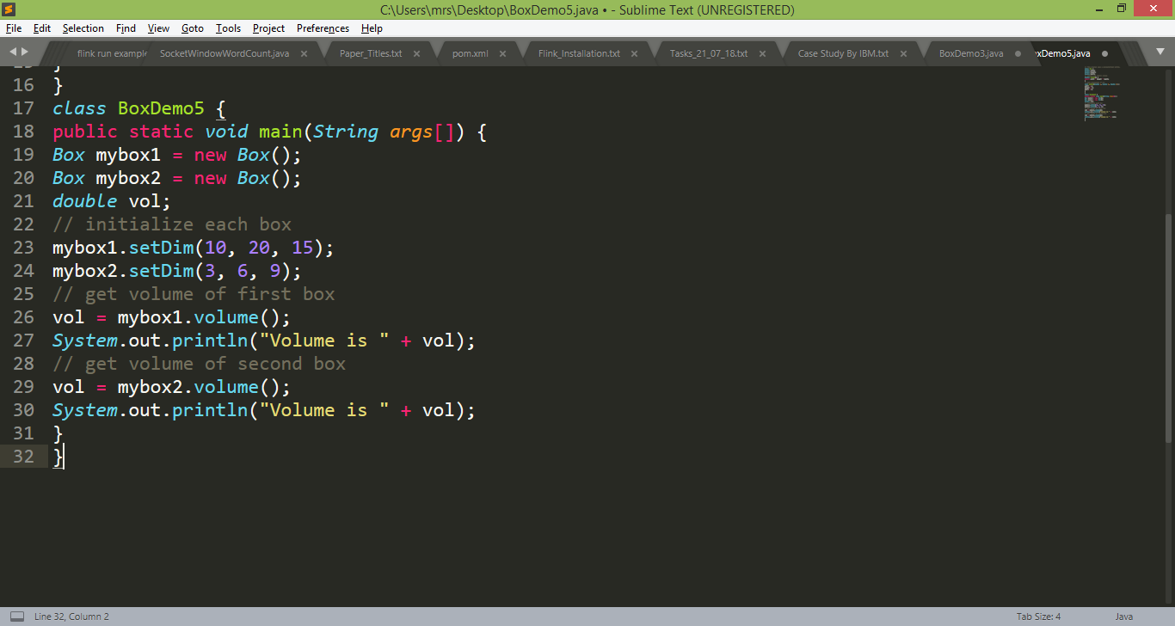
Initializing instance members using setter method

Slide 28
Exercise
Write the previous program by taking user input from key board using Scanner class.

Slide 29
Introducing Constructor in Java

Slide 30
Introducing Constructors
Setter methods are to be called explicitly to initialize instance data members of an object.
Java allows objects to initialize themselves when they are created.
This automatic initialization is performed through the use of a
constructor.

Slide 31
Constructor Properties
A constructor initializes an object immediately upon creation.
It has the same name as the class in which it resides and is syntactically similar to a method.
Once defined, the constructor is automatically called when the object is created, before the new operator completes.
Constructors don’t have return type, not even void (the implicit return type of a class’ constructor is the class type itself).
It is the constructor’s job to initialize the internal state of an object so that the code creating an instance will have a fully initialized, usable object immediately.

Slide 32
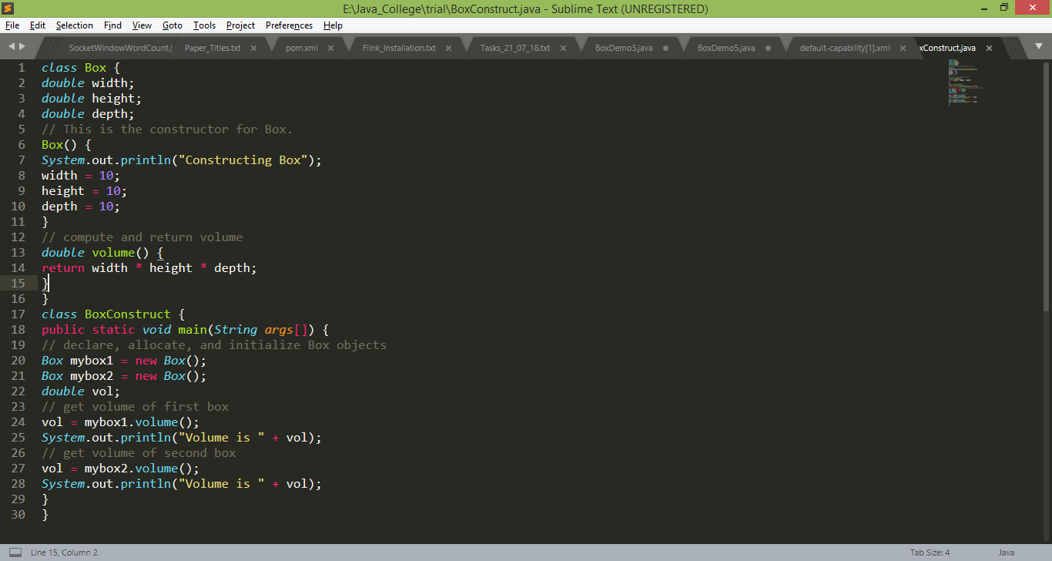
Introducing Constructors

Slide 33
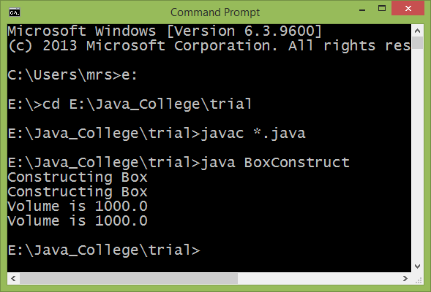
Introducing Constructors

Slide 34
Note: (i) If we don’t provide a constructor, Java provides an automatic constructor (same as C++)
(ii) The default values assigned to data members of a class as per data type are as below:
integer group -> 0
floating point group -> 0.0
boolean -> false
char-> space
reference variable -> null

Slide 35
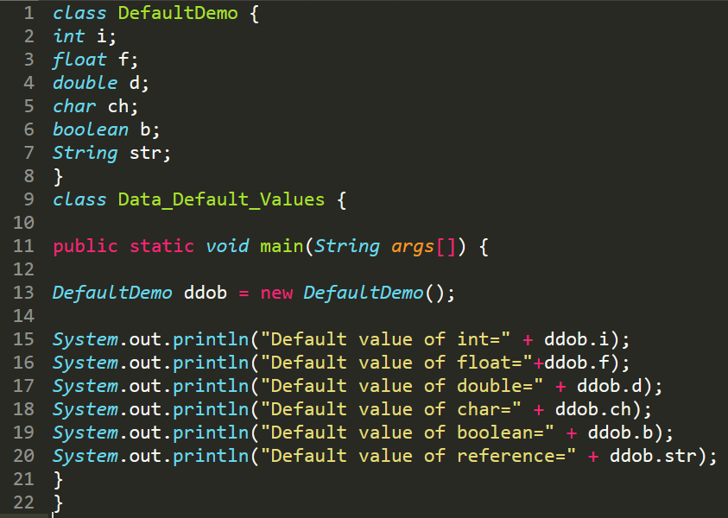
Introducing Constructors

Slide 36
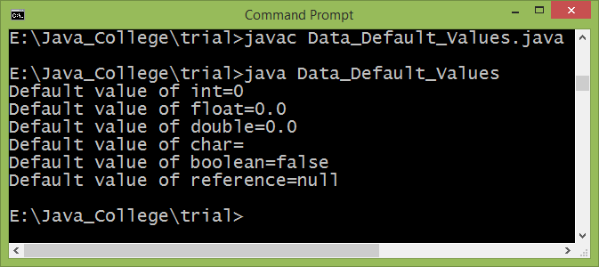
Introducing Constructors

Slide 37
Parameterized Constructors
Initialization of data members in parameter less constructor is not effective way.
In this case, every object’s data is initialized with the same values.
The easy solution is to add parameters to the constructor (same as C++)
It is similar to passing parameters to a method.

Slide 38
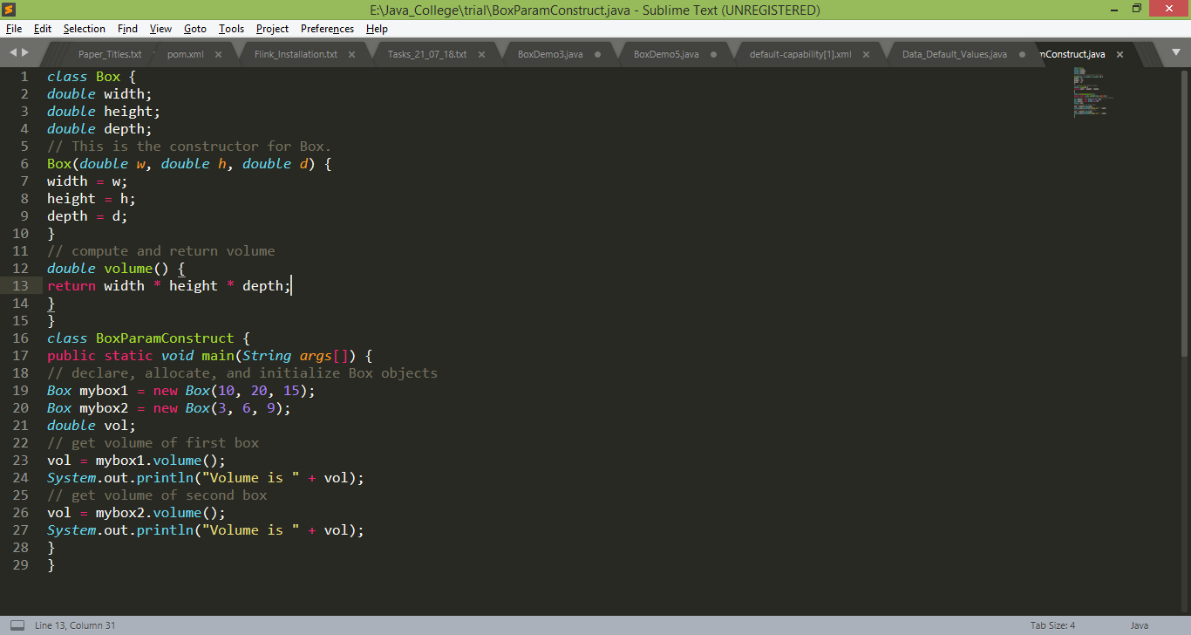
Parameterized Constructors

Slide 39
The this keyword
Sometimes a method will need to refer to the object that invoked it.
To allow this, Java defines this keyword.
this can be used inside any method to refer to the current object
this stores a reference to the object who has invoked the method presently.
// A redundant use of this
Box(double w, double h, double d)
{
this.width = w;
this.height = h;
this.depth = d;
}

Slide 40
Instance variable Hiding
We can have local variables, i.e. formal parameters to methods, which overlap with the names of the class’ instance variables.
When a local variable has the same name as an instance variable, the local variable hides the instance variable (local wins)
This is why width, height, and depth were not used as the names of the parameters to the Box( ) constructor inside the Box class.
Solution:
// Use this to resolve name-space collisions.
Box(double width, double height, double depth) {
this.width = width;
this.height = height;
this.depth = depth;
}

Slide 41
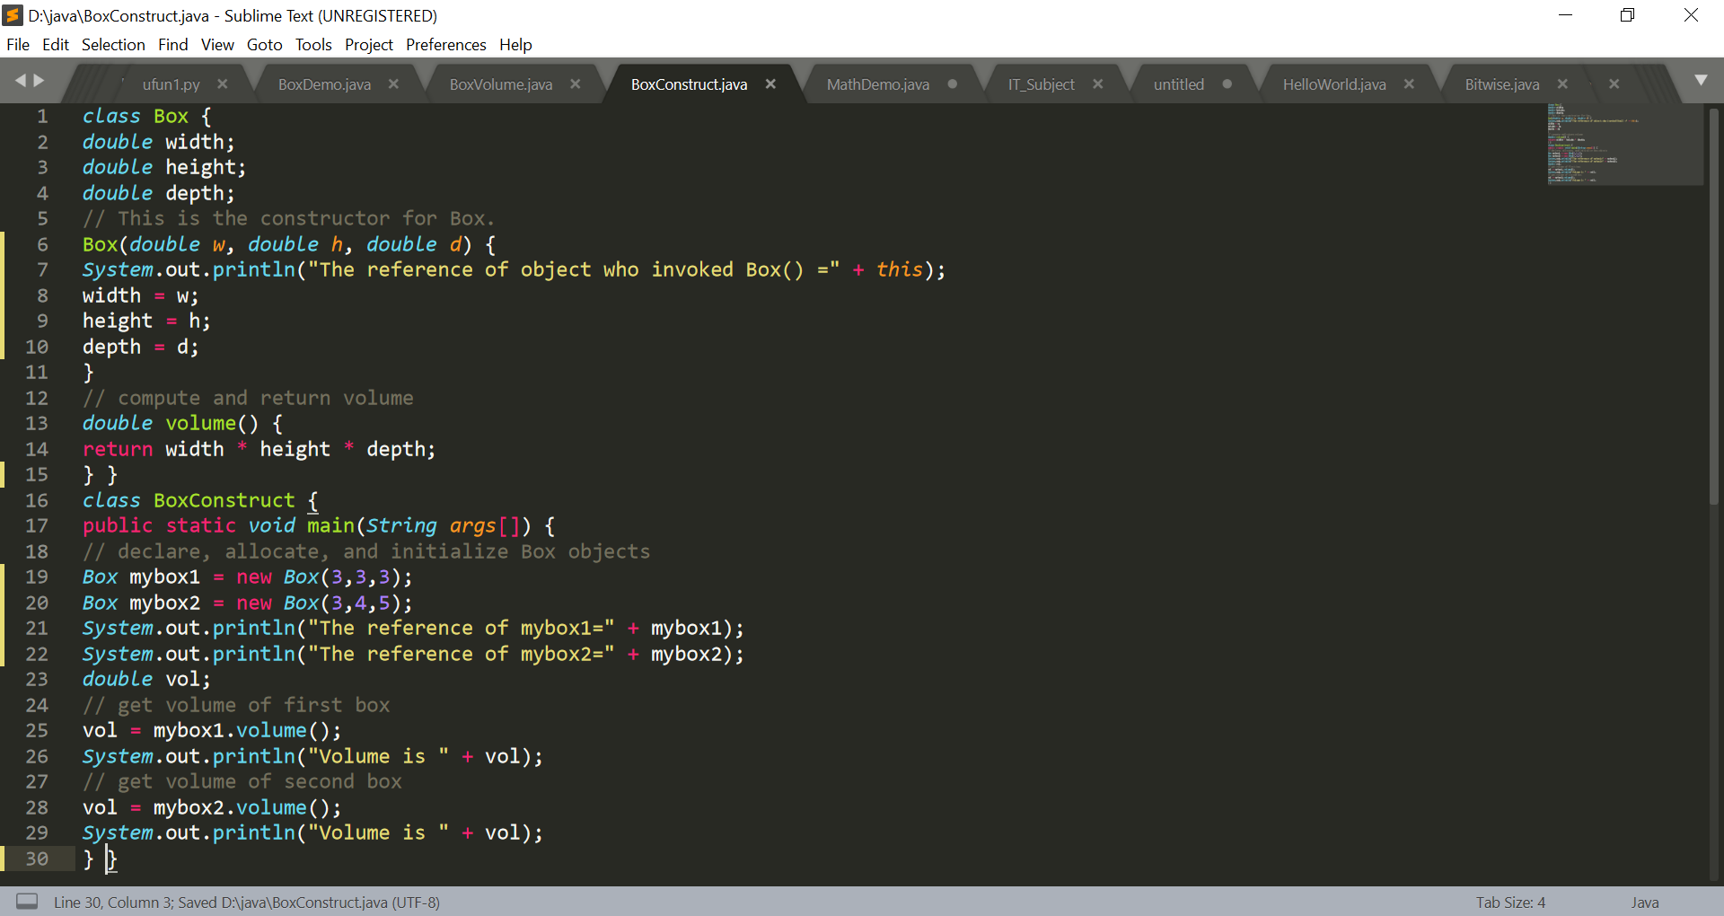
Working of this

Slide 42
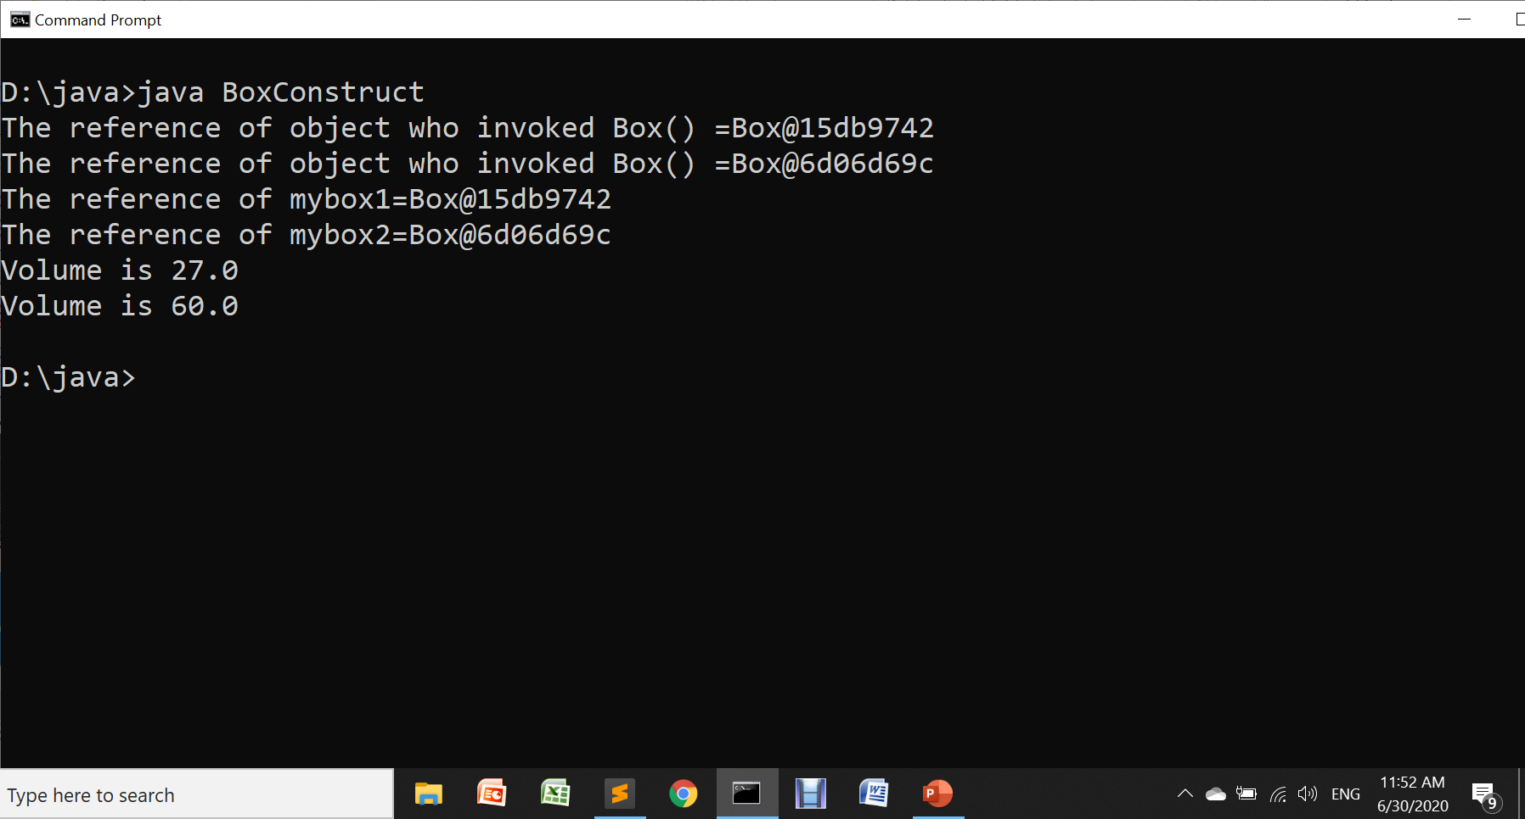
Working of this

Slide 43
Garbage Collection

Slide 44
Garbage Collection
In some languages, such as C++, dynamically allocated objects must be manually released by use of a delete operator.
Java takes a different approach; it handles deallocation for you automatically.
The technique that accomplishes this is called garbage collection.

Slide 45
Garbage Collection
Working:
When no references to an object exist, that object is assumed to be no longer needed, and the memory occupied by the object can be reclaimed.
There is no explicit need to destroy objects as in C++. Garbage collection only occurs sporadically (if at all) during the execution of your program
It will not occur simply because one or more objects exist that are no longer used

Slide 46
Thanks!
Any questions?
You can find me at:
manish_ratilal2002@yahoo.com

Slide 47
Credits
Java The Complete Reference, Ninth Edition, Herbert Schildt

