Slide 1

File Handling in Python

Slide 2

Manishkumar R Solanki
Sr. Lecturer, Information Technology,
manish_ratilal2002@yahoo.com
SBMP.

Slide 3
Students will be able to:
Read the data from the disk file.
Write and append data to the disk file.
Write file handling operations in Python.

Slide 4
Let’s begin with File Handling

Slide 5
Need of File Handling
We handle a lot of data daily. And this data could be from multiple sources like from databases, from Excel to flat files, from public websites.
The data could be in any file format like .csv, .Jason,.txt, .parquet, etc.
To make sense of data, we will need to know the basic three things: how to open, read and write data into flat files so that you can then perform analyses on them.

Slide 6
Working with Files
The io module is the default module for accessing files without even importing it.
Before we read, write, or manipulate the file, we need to make use of the module open(filename, access_mode) which returns a file object called "handle".
We can simply use this handle to read from or write to a file.
An IOError exception is raised if, while opening the file, the operation fails

Slide 7
Text files have an End-Of-Line (EOL) character to indicate each line's termination. In Python, the new line character (\n) is the default EOL terminator.
There is no EOL character in the binary files. This file type returns bytes. This file is used when dealing with non-text files such as images, videos, audio ,.exe, or .pyc.

Slide 8
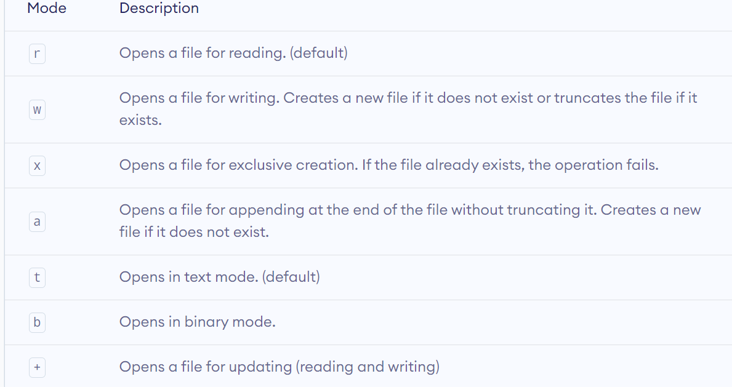
Opening a File in Python
Python has a built-in open() function to open a file.
Syntax: open(filepath, access_mode)

Slide 9
Exclusive mode ‘x’
It can not be used with "r/w/a"
"x" is only writeable. "x+" can write and read
The file must not exist before open
The file will be created after open
So, "x" is similar to "w". But for "x", if the file exists, raise FileExistsError. For "w", it will simply create a new file / truncate the existed file.

Slide 10
Opening a File in Python
Python has a built-in open() function to open a file.
Syntax: open(filepath, access_mode)
Examples:
f = open(“file1.txt") # equivalent to 'r' or 'rt'
f = open(“file2.txt",'w') # write in text mode
f = open("img.bmp",'r+b') # read and write in binary mode
f=open("D://test.txt") # File is stored in d drive.

Slide 11
Opening a File in Python
The character a does not imply the number 97 until it is encoded using ASCII (or other equivalent encodings).
The default encoding is platform dependent. In windows, it is cp1252 but utf-8 in Linux.
So, while working with files in text mode, it is highly recommended to specify the encoding type.
f = open("test.txt", mode='r', encoding='utf-8')

Slide 12
Closing File in Python
When we are done with performing operations on the file, we need to properly close the file.
Closing a file will free up the resources that were tied with the file. It is done using the close() method available in Python.
f = open("test.txt", encoding = 'utf-8')
# perform file operations
f.close()

Slide 13
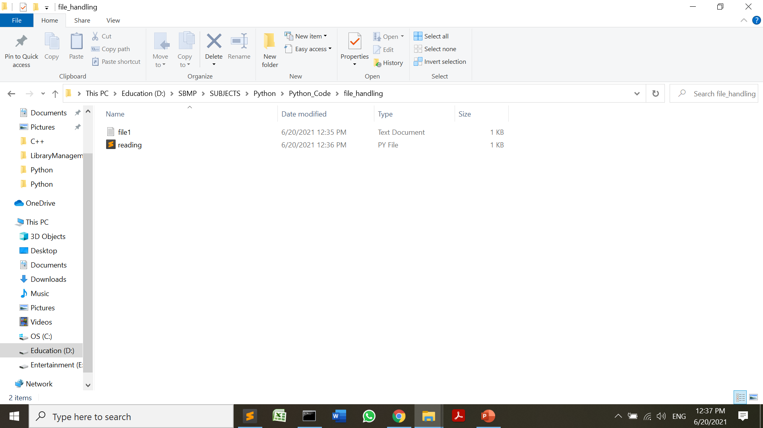
Python Script to read data from a File
try:
file = open('file1.txt', 'r')
for line in file:
print (line,end='')
except:
print("File Error")
finally:
if file:
file.close()
Hello,Python Programmers!!!.
I welcome you all in the session of File Handling.
This is first script to read file content.

Slide 14
Python Script to read data from a File
file = open('file1.txt', "r")
print (file.read())
#print (file.read(5)) # Reads first 5 characters
file.close()
Hello,Python Programmers!!!.
I welcome you all in the session of File Handling.
This is first script to read file content.

Slide 15
readline(n) and readlines()
Reads n bytes of a single line of a file. It does not read more than one line.
file=open("file1.txt","r")
#Reads first line
print(file.readline())
# Reads the first two characters of next line
print(file.readline(2))
# Reads all lines
print(file.readlines())
Hello,Python Programmers!!!.
I
['welcome you all in the session of File Handling.\n', 'This is first script to read file content.with']

Slide 17
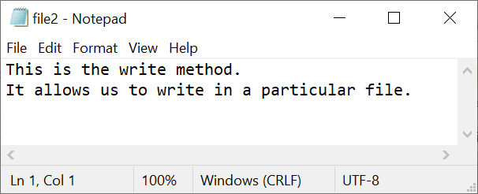
Python Script to write data to a File
# Python code to create a file
try:
file = open('file2.txt','w')
file.write("This is the write method.\n")
file.write("It allows us to write in a particular file.\n")
print("Data successfully written!!!")
except:
print("File Error")
finally:
if file:
file.close()
Data successfully written!!!

Slide 18
write(byte_str)
write(byte_str) is used to write byte (binary) data into a binary file
bytes = b"0x410x420x43"
f = open("sample.bin", "wb")
f.write(bytes)
f.close()

Slide 19
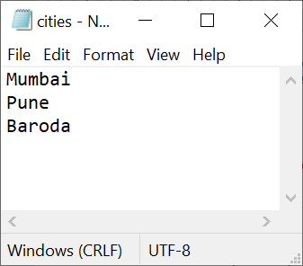
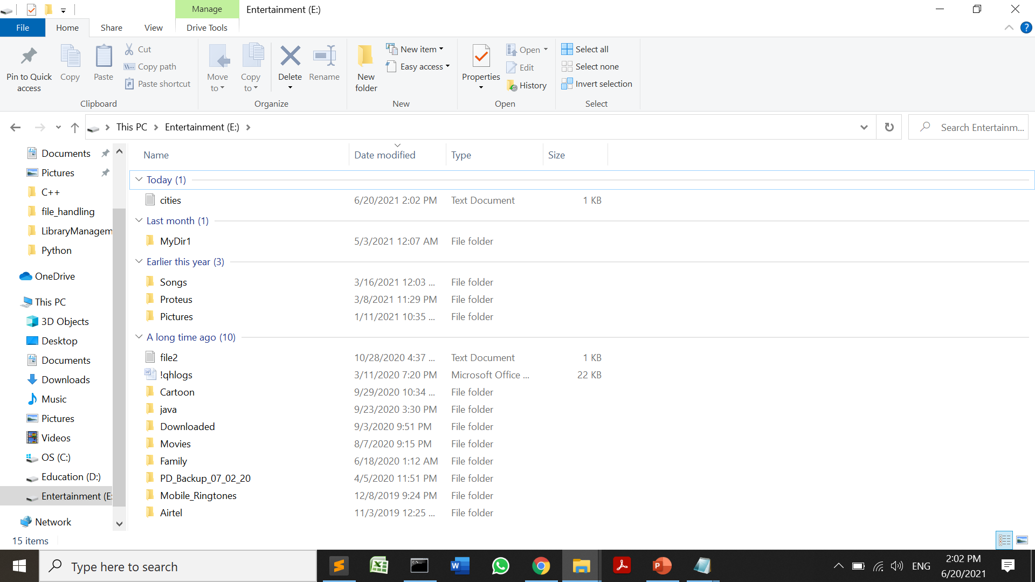
writelines(list)
cities=["Mumbai\n","Pune\n","Baroda\n"]
file=open("e://cities.txt",mode="a+",encoding="utf-8")
file.writelines(cities)
for city in file:
print(city)
file.close()

Slide 20
Append Operation
file = open(‘file2.txt','a')
file.write("This line would be appended at the last.")
file.close()

Slide 21
Using write along with with() function
with open("file1.txt", "a") as f:
f.write("with")
# Python code to illustrate split() function
with open("file1.txt", "r") as file:
data = file.readlines()
for line in data:
word = line.split()
print (word)
['Hello,Python', 'Programmers!!!.']
['I', 'welcome', 'you', 'all', 'in', 'the', 'session', 'of', 'File', 'Handling.']
['This', 'is', 'first', 'script', 'to', 'read', 'file', 'content.with']

Slide 22
Random Access
Sometimes you need to read from the record in the middle of the file at that time you can use the seek(offset, from_what) method. This function moves the file pointer from its current position to a specific position.
The offset is the number of characters from the from_what parameter which has three possible values:
0 – indicates the beginning of the file (default)
1 – indicates the current pointer position
2 – indicates the end of the file

Slide 23
Using tell() and seek()
The tell() method of a file object tells at which byte the file cursor is located.
In seek(offset,reference_point), the reference points are 0 (the beginning of the file and is the default), 1 (the current position of file), and 2 (the end of the file).
cars=["Audi\n","Bentley\n","i10\n","BMW\n"]
new_file=open("newfile.txt",mode="w+",encoding="utf-8")
for car in cars:
new_file.write(car)
print("Tell the byte at which the file cursor is:",new_file.tell())
new_file.seek(0)
for line in new_file:
print(line)
#Set the pointer at the beginning and read chars from index 1
new_file.seek(1,0)
print(new_file.readline())
new_file.close()
Tell the byte at which the file cursor is: 25
Audi
Bentley
i10
BMW
udi

Slide 24
myfile.txt
ABCDEFGHIJKLMNOPQRSTUVWXYZ
f = open('myfile.txt', 'rb+')
# go to the 7th character and read one character
f.seek(6)
print(f.read(1))
# Prints G
# go to the 3rd character from current position (letter G)
f.seek(3, 1)
print(f.read(1))
# Prints K
# go to the 3rd character before the end
f.seek(-3, 2)
print(f.read(1))
# Prints X

Slide 25
f = open('myfile.txt')
# initial position
print(f.tell())
# Prints 0
# after reading 5 characters
f.read(5)
print(f.tell())
# Prints 5
https://www.learnbyexample.org/python-file-handling/

Slide 26
Exercise
Write a Python script to copy content of one file(text/binary) to another file.

Slide 27
References
https://stackoverflow.com/questions/29295654/what-does-python3-open-x-mode-do
https://www.geeksforgeeks.org/file-handling-python/
https://www.datacamp.com/community/tutorials/reading-writing-files-python
https://www.kite.com/python/answers/how-to-write-bytes-to-a-file-in-python

