Slide 1

Exception Handling

Slide 2

Manishkumar R Solanki
Sr. Lecturer, Information Technology,
manish_ratilal2002@yahoo.com
SBMP

Slide 3
Students will be able to:
Handle the exceptions
Write user defined exceptions
Write multithreading programs

Slide 4
Working with Exception Handling

Slide 5
Exception
An exception is an abnormal condition that arises in a code sequence at run time. (run time error)
A Python exception is an object that describes an exceptional condition that has occurred in a piece of code.
When an exceptional condition arises, an object representing that exception is created and thrown in the method that caused the error.

Slide 6
Exception
Common Exceptions:
Python provides the number of built-in exceptions. A list of common exceptions that can be thrown from a standard Python program is given below.
ZeroDivisionError: Occurs when a number is divided by zero.
NameError: It occurs when a name is not found. It may be local or global.
IndentationError: If incorrect indentation is given.
IOError: It occurs when Input Output operation fails.
EOFError: It occurs when the end of the file is reached, and yet operations are being performed.

Slide 7
Exception
If we do not handle the exception, the interpreter doesn't execute the code that exists after the exception.
a = int(input("Enter a:"))
b = int(input("Enter b:"))
c = a/b
print("a/b = %d" %c)
print("End of program")
Enter a:3
Enter b:5
a/b = 0
End of program
Enter a:5
Enter b:0
Traceback (most recent call last):
File "D:\SBMP\SUBJECTS\Python\Python_Code\OOP\exceptions\demo1.py", line 3, in <module>
c = a/b
ZeroDivisionError: division by zero

Slide 8
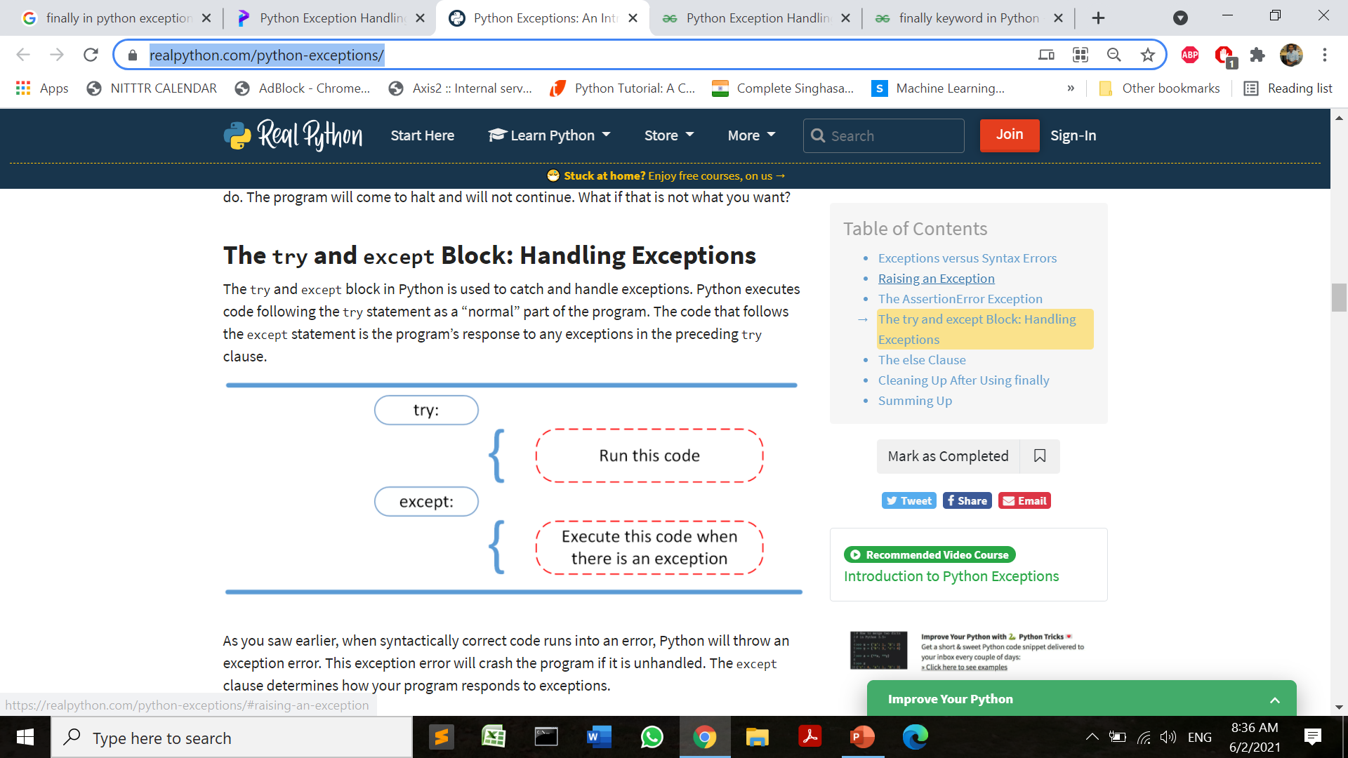
Handling Exception in Python
To handle exception we have to use try and except keywords as follows:
try :
#statements in try block
except :
#executed when exception occurs in try block

Slide 9
Handling Exception in Python
To handle exception we have to use try and except keywords as follows:
try:
a = int(input("Enter a:"))
b = int(input("Enter b:"))
c = a/b
except:
print("Divisor can not be zero")
print("End of Program")
Enter a:5
Enter b:0
Divisor can not be zero
End of Program

Slide 10
Handling Exception in Python
To handle exception we have to use try and except keywords with Exception description as follows:
Enter a:5
Enter b:0
Divisor can not be zero
<class 'Exception'>
End of Program
try:
a = int(input("Enter a:"))
b = int(input("Enter b:"))
c = a/b
except Exception:
print("Divisor can not be zero")
print(Exception)
print("End of Program")
Enter a:2
Enter b:5
End of Program

Slide 11
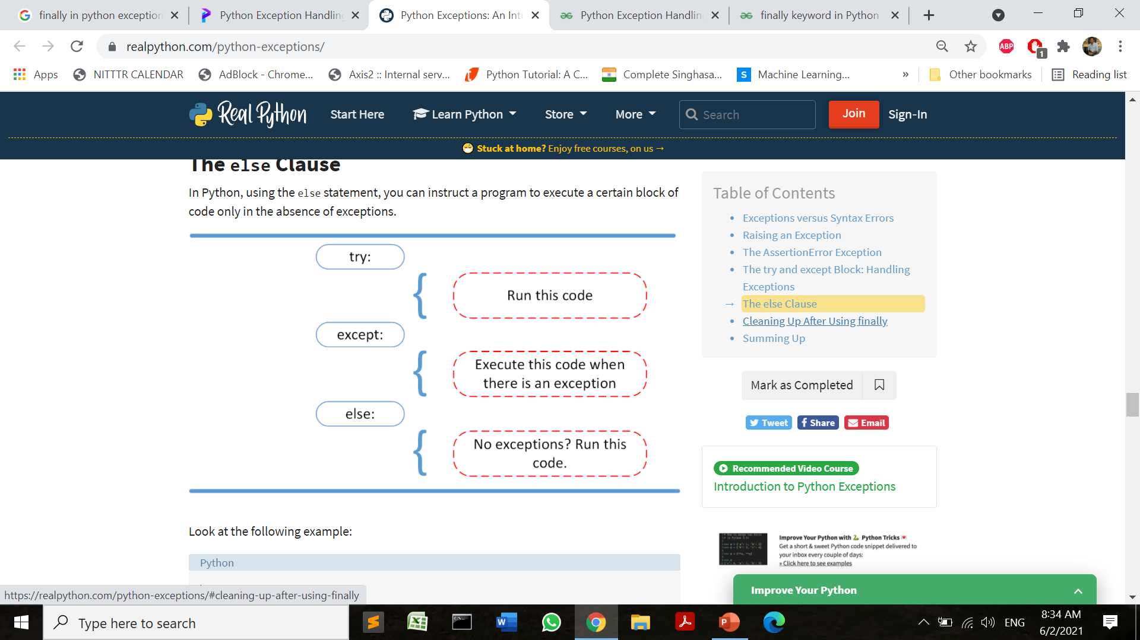
Handling Exception in Python
The except statement using with exception variable
Enter a:3
Enter b:4
Exception Not Generated
End of Program
try:
a = int(input("Enter a:"))
b = int(input("Enter b:"))
c = a/b
except Exception as e:
print("Divisor can not be zero")
print(e)
else:
print("Exception Not Generated")
print("End of Program")
Enter a:6
Enter b:0
Divisor can not be zero
division by zero
End of Program

Slide 12
Handling Multiple Exceptions in Python
File not found
OR
try:
#this will throw an exception if the file doesn’t #exist.
fileptr = open("file1.txt","r")
a=5/0
except ArithmeticError:
print("Division By Zero")
except IOError:
print("File not found")
else:
print("The file opened successfully")
fileptr.close()
Division By Zero

Slide 13
Declaring Multiple Exceptions in Python
try:
#block of code
except (<Exception 1>,<Exception 2>,<Exception 3>,...<Exception n>)
#block of code
else:
#block of code

Slide 14
Declaring Multiple Exceptions in Python
try:
#a=10/0;
fileptr = open("file1.txt","r")
except (ArithmeticError, IOError) as e:
print(type(e),e)
else:
print("Successfully Done")
<class 'FileNotFoundError'> [Errno 2] No such file or directory: 'file1.txt'

Slide 15
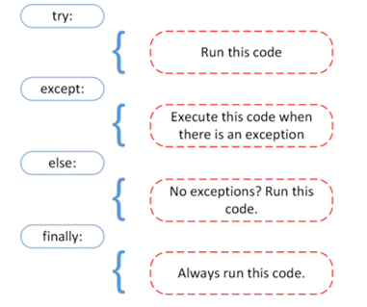
Using finally
The try statement in Python can have an optional finally clause. This clause is executed whether the exception is generated or not.
Generally used to release external resources i.e. database connection, files, and network sockets.

Slide 16
Using finally
try:
ans = 15//0
print(ans)
except ZeroDivisionError:
print("Denominator must not be zero")
finally:
print("finally block executed")
Denominator must not be zero
finally block executed

Slide 17
Using finally
f=None
try:
f = open("fil.txt",encoding = 'utf-8')
# perform file operations
except:
print("You are trying to open non existing file")
finally:
if f:
f.close()
print("File closed successfully")
print("All resources released....")
You are trying to open non existing file
All resources released....
File closed successfully
All resources released....

Slide 18
Creating Custom(User Defined Exception) class
To create a custom exception class, we have to inherit an Exception class in Python.
The constructor of Exception class displays the description message of the exception which has been raised. So we have to invoke base class constructor with custom message.
When the condition is violating, we have to raise the exception explicitly as per below syntax:
raise ExceptionClassName(arg)

Slide 19
Creating Custom(User Defined Exception) class
class SalaryNotInRangeError(Exception):
"""Exception raised for errors in the input salary.
Attributes:
salary -- input salary which caused the error
message -- explanation of the error
"""
def __init__(self, salary, message="Salary is not in (5000, 15000) range"):
self.salary = salary
self.message = message
super().__init__(self.message)
salary = int(input("Enter salary amount: "))
if not 5000 < salary < 15000:
raise SalaryNotInRangeError(salary)

Slide 20
Creating Custom(User Defined Exception) class
Enter salary amount: 3400
Traceback (most recent call last):
File "D:\SBMP\SUBJECTS\Python\Python_Code\OOP\exceptions\UDE1_Sal.py", line 17, in <module>
raise SalaryNotInRangeError(salary)
__main__.SalaryNotInRangeError: Salary is not in (5000, 15000) range
Note: The Constructor of the Exception class is called with self.message

Slide 21
Creating Custom(User Defined Exception) class
The custom self.salary attribute is defined to display the salary which caused the exception.
The inherited __str__ method of the Exception class is then used to display the corresponding message when SalaryNotInRangeError is raised.
We can also customize the __str__ method itself by overriding it.

Slide 22
Creating Custom(User Defined Exception) class
class SalaryNotInRangeError(Exception):
def __init__(self, salary, message="Salary is not in (5000, 15000) range"):
self.salary = salary
self.message = message
super().__init__(self.message)
def __str__(self):
return f'{self.salary} -> {self.message}'
salary = int(input("Enter salary amount: "))
if not 5000 < salary < 15000:
raise SalaryNotInRangeError(salary)

Slide 23
Creating Custom(User Defined Exception) class
Enter salary amount: 4999
Traceback (most recent call last):
File "D:\SBMP\SUBJECTS\Python\Python_Code\OOP\exceptions\UDE2_Sal_Str.py", line 12, in <module>
raise SalaryNotInRangeError(salary)
__main__.SalaryNotInRangeError: 4999 -> Salary is not in (5000, 15000) range

Slide 24
Number Guessing Game
# define Python user-defined exceptions
class Error(Exception):
"""Base class for other exceptions"""
pass
class ValueTooSmallError(Error):
"""Raised when the input value is too small"""
pass
class ValueTooLargeError(Error):
"""Raised when the input value is too large"""
pass

Slide 25
Number Guessing Game
# you need to guess this number
number = 10
# user guesses a number until he/she gets it right
while True:
try:
i_num = int(input("Enter a number: "))
if i_num < number:
raise ValueTooSmallError
elif i_num > number:
raise ValueTooLargeError
break
except ValueTooSmallError:
print("This value is too small, try again!")
print()
except ValueTooLargeError:
print("This value is too large, try again!")
print()
print("Congratulations! You guessed it correctly.")

Slide 26
Number Guessing Game
Enter a number: 2
This value is too small, try again!
Enter a number: 5
This value is too small, try again!
Enter a number: 11
This value is too large, try again!
Enter a number: 10
Congratulations! You guessed it correctly.

Slide 27
One can use finally just after try without using except block, but no exception is handled in that case.

Slide 28
References
https://www.javatpoint.com/python-exception-handling
https://www.datacamp.com/community/tutorials/exception-handling-python
https://realpython.com/python-exceptions/
https://www.programiz.com/python-programming/user-defined-exception

Slide 29
By the end of this tutorial you will be able to:
Define what is a class
Describe how to create a class
Define what is a method
Describe how to do object instantiation
Describe how to create instance attributes in Python

Slide 30
THANKS!
Any questions?
You can find me at
manish_ratilal2002@yahoo.com

