Slide 1

switcher statement
The switch…case is not available in Python as C/C++/JAVA
We have to define a function to provide switcher as shown below:
Example:
def week(i):
switcher={
0:'Sunday',
1:'Monday',
2:'Tuesday',
3:'Wednesday',
4:'Thursday',
5:'Friday',
6:'Saturday'
}
return switcher.get(i,"Invalid day of week")
print(week(7))
Invalid day of week
If we provide value of i from 0 to 6, it will display valid Week Day.

Slide 2
Arithmetic Operations using switcher
import sys
def addition(num1, num2):
num1 += num2
return num1
def subtraction(num1, num2):
num1 -= num2
return num1
def multiplication(num1, num2):
num1 *= num2
return num1
def division(num1, num2):
num1 /= num2
return num1
def module(num1, num2):
num1 %= num2
return num1

Slide 3
Arithmetic Operations using switcher
switcher = {
1:addition,
2:subtraction,
3:multiplication,
4:division,
5:module
}
def switch (operation, num1, num2) :
return switcher.get(operation)(num1,num2)

Slide 4
Arithmetic Operations using switcher
print("""You can perform operation:
1:Addition
2:Subtraction
3:Multiplication
4:Division
5:Module
""")
choice = int(input("Select operation: "))
if choice <0 or choice > 5:
print("Invalid Operation")
sys.exit(0)
num1 = float(input("Enter first number: "))
num2 = float(input("Enter second number: "))
print(switch(choice,num1,num2))

Slide 5
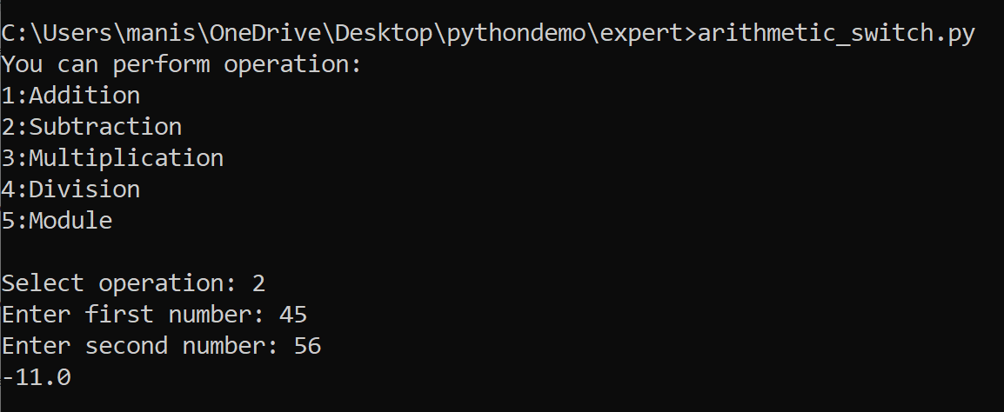
Arithmetic Operations using switcher

Slide 6
Arithmetic operation using Lambda function
def calculate(n1, n2, operator):
switcher ={
'+': lambda n1,n2: n1+n2,
'-': lambda n1,n2: n1-n2,
'*': lambda n1,n2: n1*n2,
'/': lambda n1,n2: n1/n2,
}
return switcher.get(operator)(n1,n2)
print( calculate(10,20,'+'))
print( calculate(10,20,'-'))
print( calculate(10,20,'*'))
print( calculate(10,20,'/'))
30
-10
200
0.5
[Finished in 126ms]

Slide 7
Another Example
def calSal(grade):
switcher ={
'A':5000,
'B':4000,
'C':3000,
'D':2000
}
return switcher.get(grade,"Invalid Grade")
grade='A'
perks=calSal(grade)
print(perks)
5000
[Finished in 126ms]

Slide 8
def calSal(grade):
switcher ={
'A':5000,
'B':4000,
'C':3000,
'D':2000
}
return switcher.get(grade,"Invalid Grade")
grade='b'
perks=calSal(grade)
print(perks)
Invalid Grade
[Finished in 125ms]

