Slide 1

EAST POINT COLLEGE OF ENGINEERING & TECHNOLOGY
Department of Computer Science and Engineering (IoT&CSBT)
BIC685 - Project Presentation
Project Title: Smart Glove for Sign Language Translation and Gesture-controlled Home automation.
“SignRythm”
Under the guidance of
Prof Jay Prakash Malviya, Assistant Prof, Dept of CSE(IoT&CSBT)
Project Committee
Dr. Komala C R, Professor, Dept. of CSE (IoT&CSBT)
Dr. Nanda Ashwin, Prof & HOD, Dept. of CSE (IoT&CSBT)
By
Jayalaxmi - 1EP22IC024
Pavan Kumar H M - 1EP22IC039
Tanaya S - 1EP22IC055
Vaishnavi - 1EP22IC058

Slide 2
Presentation Outline
Abstract
Objectives
Introduction
Problem Statement
Scope of the Project
Existing System
Proposed System
Literature Survey
Project Schedules/Gantt Chart
Requirements Specification
Methodology
Expected Results
Query Handling
Conclusion
References
Dept. of CSE (IoT&CSBT), EPCET BIC685 - Project Presentation 2

Slide 3
Abstract
This project presents a wearable smart glove capable of translating sign language gestures into text/speech and enabling gesture-based home automation. Using ADXL345 Accelerometer , an IMU, and a microcontroller with Bluetooth, the glove enhances communication accessibility and provides a novel human–machine interaction interface.
Dept. of CSE (IoT&CSBT), EPCET BIC685 - Project Presentation 3

Slide 4
Objectives
To design a glove that translates sign language gestures into text and speech.
To implement gesture recognition for home automation.
To ensure real-time processing with high accuracy.
To create a low-cost, portable, and user-friendly wearable system.
Dept. of CSE (IoT&CSBT), EPCET BIC685 - Project Presentation 4

Slide 5
Introduction
Communication barriers exist for individuals with hearing and speech impairments. Sign language is an effective mode of communication but not universally understood. A smart glove that translates signs into text/speech can bridge this gap. Moreover, gesture recognition can also provide intuitive human–machine interaction, such as controlling home automation without physical buttons.
Dept. of CSE (IoT&CSBT), EPCET BIC685 - Project Presentation 5

Slide 6
Problem Statement
Hearing- and speech-impaired individuals face challenges in communicating with non-sign language users. Similarly, conventional home automation methods require manual interaction, which may not be convenient. There is a need for a low-cost, portable device that can recognize hand gestures and translate them into meaningful outputs.
Dept. of CSE (IoT&CSBT), EPCET BIC685 - Project Presentation 6

Slide 7
Scope of the project
Translation of basic sign language gestures into text/speech.
Gesture-based home authomation (ON, OFF).
Real-time processing using sensors and microcontroller.
Optional enhancements: integration with smartphones, machine learning for dynamic gestures, multilingual support.
Dept. of CSE (IoT&CSBT), EPCET BIC685 - Project Presentation 7

Slide 8
Existing System
Current systems use camera-based sign recognition or static gesture detection.
They suffer from limitations such as high computational cost, poor performance in low-light,
or lack of portability.
Dept. of CSE (IoT&CSBT), EPCET BIC685 - Project Presentation 8

Slide 9
Proposed System
The proposed system introduces a smart glove-based solution that helps differently-abled individuals communicate and control home appliances through simple hand gestures. The glove uses an ADXL345 accelerometer to detect hand movements and sends the data to an Arduino for processing. Each gesture is mapped to a specific sign language message or home automation command. The interpreted message is displayed on an LCD screen and played as audio using a DFPlayer Mini module. For appliance control, the system operates relays to switch lights and fans ON or OFF. This low-cost, portable system enhances independence and supports daily living for users with communication or mobility challenges.
Dept. of CSE (IoT&CSBT), EPCET BIC685 - Project Presentation 9

Slide 10
Literature Survey
Prior studies have developed sign language recognition using computer vision, but accuracy depends on environmental conditions.
Sensor-based gloves (e.g., CyberGlove) exist but are expensive.
Recent works integrate Arduino and flex sensors for static gesture recognition.
Few projects combine sign language translation with gesture-based device control, making this system unique.
Dept. of CSE (IoT&CSBT), EPCET BIC685 - Project Presentation 10

Slide 11
Project Schedules / Gantt Chart
- Phase 1:Requirement gathering.
- Phase 2: Hardware procurement.
- Phase 3: Testing & Feedback.
- Phase 4: Finalization & Deployment.
- Phase 5: Documentation.
Dept. of CSE (IoT&CSBT), EPCET BIC685 - Project Presentation 11

Slide 12
Requirements Specification
Components Used:
Arduino UNO – Main microcontroller.
ADXL345 Accelerometer – Detects hand gestures by measuring acceleration along X, Y, Z axes.
Relay Module (2-Channel) – Controls fan and light.
DFPlayer Mini MP3 Module + Speaker – Provides audio feedback/voice alerts.
LCD (I2C 16x2) – Displays status messages.
Dept. of CSE (IoT&CSBT), EPCET BIC685 - Project Presentation 12

Slide 13
Technology stack
Sensor data acquisition (ADXL345 Accelerometer + IMU).
Signal preprocessing and calibration.
Mapping gestures to sign language alphabets and home automation commands.
Data transmission via Bluetooth.
Output generation: text-to-speech/sign display and music player control.
Dept. of CSE (IoT&CSBT), EPCET BIC685 - Project Presentation 13

Slide 14
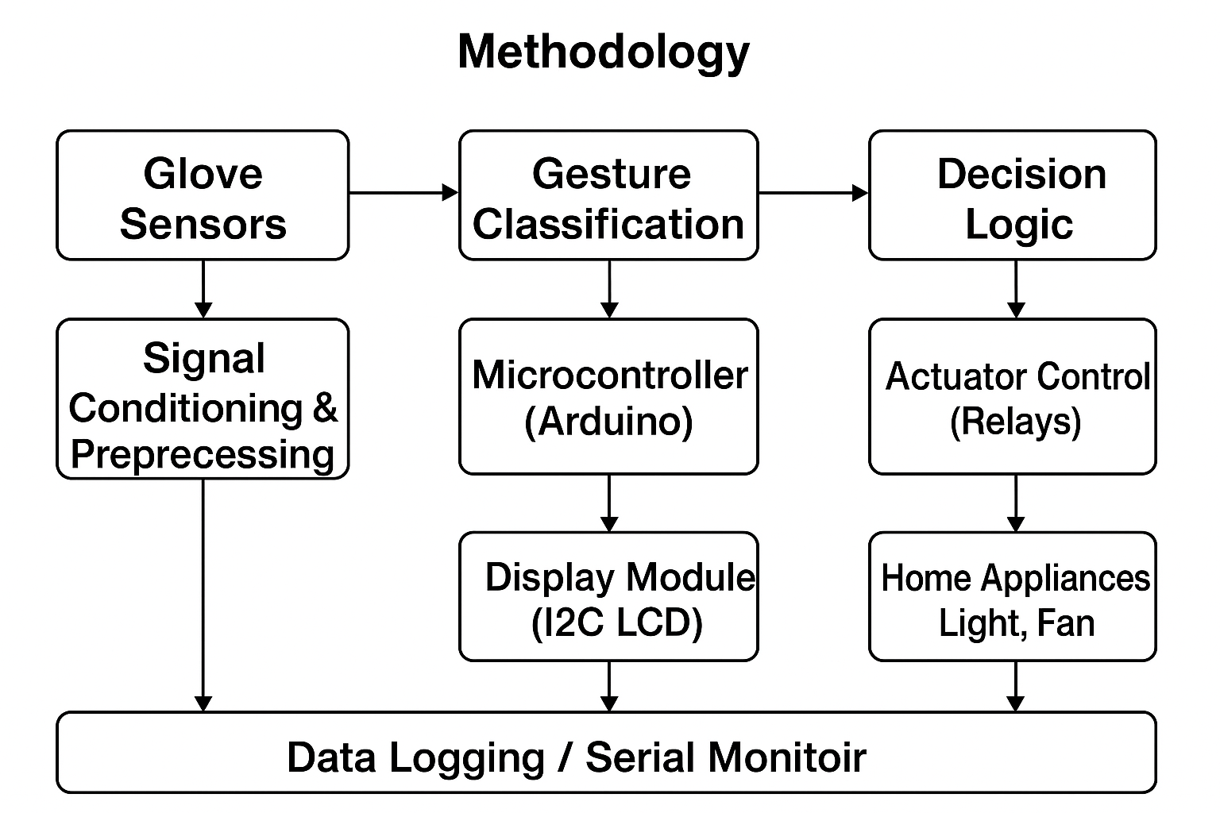
Methodology
Dept. of CSE (IoT&CSBT), EPCET BIC685 - Project Presentation 14

Slide 15
Expected Results
Accurate recognition of predefined sign language gestures.
Smooth control of home automation with intuitive hand movements.
A lightweight, portable, and cost-effective wearable system.
Dept. of CSE (IoT&CSBT), EPCET BIC685 - Project Presentation 15

Slide 16
Challenges & Risks
Gesture Variability
Sensor Calibration
Real-Time Processing
Battery Efficiency
Data Mapping Complexity
Hardware Damage
Accuracy Risks
Overfitting in ML Models
Dept. of CSE (IoT&CSBT), EPCET BIC685 - Project Presentation 16

Slide 17
Conclusion
The smart glove bridges the communication gap for differently-abled individuals while introducing an innovative application for gesture-controlled devices. This project contributes to accessibility, IoT-based wearables, and human–machine interaction.
Dept. of CSE (IoT&CSBT), EPCET BIC685 - Project Presentation 17

Slide 18
References
M. A. Fok et al., “A data glove for sign language recognition,” IEEE Sensors Journal, 2020.
C. Chen et al., “Wearable sensor-based sign language translation,” ACM IMWUT, 2019.
Arduino Documentation – www.arduino.cc
Espressif ESP32 Documentation – www.espressif.com
Dept. of CSE (IoT&CSBT), EPCET BIC685 - Project Presentation 18

Slide 19
Thank You!

