Slide 1

EAST POINT COLLEGE OF ENGINEERING & TECHNOLOGY
Department of Computer Science and Engineering (IoT&CSBT)
BIC685 - Project Presentation
Project Title: Smart Glove for Sign Language Translation and Gesture-Controlled Home Automation
“SignRythm”
By
Jayalaxmi - 1EP22IC024
Pavan Kumar H M - 1EP22IC039
Tanaya S - 1EP22IC055
Vaishnavi - 1EP22IC058
Under the guidance of:
Jay Prakash Malviya, Assistant Prof, Dept of CSE(IoT&CSBT)
Project Committee:
Dr. Komala C R, Professor, Dept. of CSE (IoT&CSBT)
Dr. Nanda Ashwin, Prof & HOD, Dept. of CSE (IoT&CSBT)

Slide 2
Presentation Outline
System Architecture and Identification of System Components.
Demonstration of Prototype/Problems Encountered/Solutions.
Expected Outcome.
Presentation & Query Handling.
Conclusion & References.
Phase l Project Report.
Dept. of CSE (IoT&CSBT), EPCET BIC685 - Project Presentation 2

Slide 3
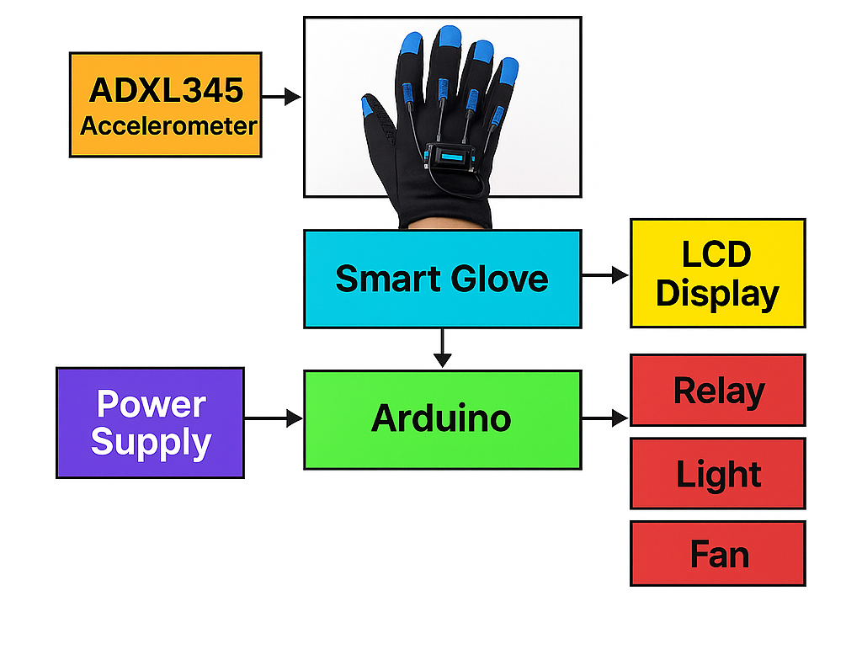

System Architecture and Identification of System Components
Dept. of CSE (IoT&CSBT), EPCET BIC685 - Project Presentation 3

Slide 4
Identification of system components:
ADXL345 Accelerometer: Detects hand gestures.
Arduino Board: Processes sensor values and controls outputs.
LCD Display: Shows gesture messages.
DFPlayer Mini: Plays voice messages.
Relay Modules: Control light and fan.
Smart Glove: Holds sensors and allows gesture input.
Power Supply: Provides power to all components.
Dept. of CSE (IoT&CSBT), EPCET BIC685 - Project Presentation 4

Slide 5
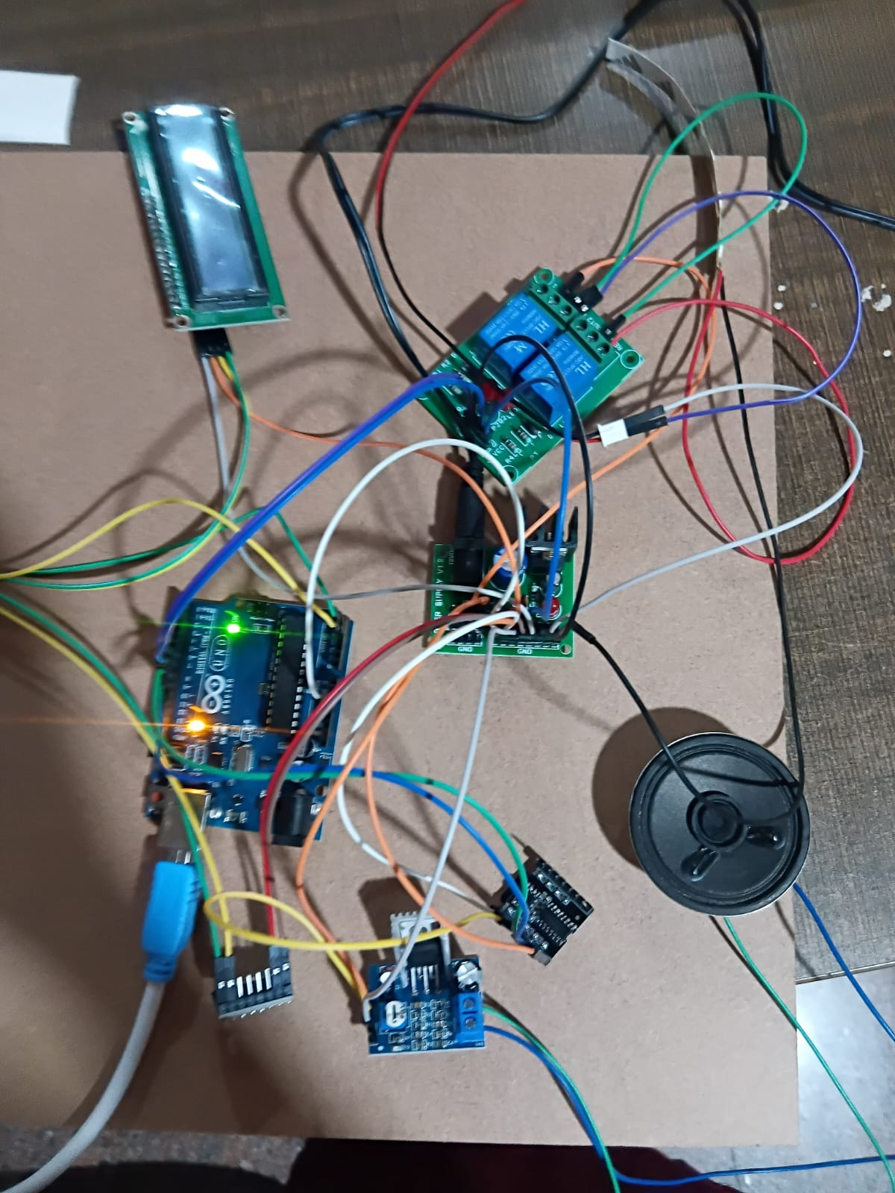
Demonstration of Prototype
Dept. of CSE (IoT&CSBT), EPCET BIC685 - Project Presentation 5

Slide 6
Problems Encountered
Sensor noise affected gesture accuracy.
Unstable accelerometer readings due to hand vibrations.
Difficulty setting correct gesture thresholds for X-axis values.
Voice module delays during audio playback.
Loose wiring caused inconsistent relay activation.
Power fluctuations affected LCD brightness and audio output.
Dept. of CSE (IoT&CSBT), EPCET BIC685 - Project Presentation 6

Slide 7
Solutions Implemention
Calibrated the ADXL345 sensor to reduce noise and improve accuracy.
Adjusted gesture threshold ranges for more reliable detection.
Added delays and filtering to avoid false gesture triggers.
Improved wiring connections for stable relay operation.
Optimized DFPlayer initialization to reduce audio delay.
Provided separate power lines for LCD, Arduino, and relays to prevent voltage drops.
Tested gestures multiple times to fine-tune system response.
Dept. of CSE (IoT&CSBT), EPCET BIC685 - Project Presentation 7

Slide 8
Expected Outcome
Real-time translation of sign language.
Seamless music control via gestures.
Assistive tool for differently-abled individuals.
Dept. of CSE (IoT&CSBT), EPCET BIC685 - Project Presentation 8

Slide 9
Conclusion
The smart glove successfully translates hand gestures into text, audio, and appliance control.
It provides an effective communication tool for speech-impaired users.
Gesture-based automation increases independence and ease of use.
The system is low-cost, portable, and performs with good accuracy.
The project demonstrates strong potential for future enhancements like wireless control and more gesture support.
Dept. of CSE (IoT&CSBT), EPCET BIC685 - Project Presentation 9

Slide 10
References
R. Kadam, P. Pansare, P. Gawali, and S. Bhosale, “Smart Glove for Sign Language Recognition,” International Journal of Advanced Research in Computer and Communication Engineering, vol. 6, no. 4, pp. 388–392, 2017.
A. S. Jadhav, V. H. Patil, and S. R. Khot, “Hand Gesture Recognition Based on Flex Sensors for Sign Language Translation,” International Journal of Engineering Research & Technology (IJERT), vol. 9, no. 6, 2020.
J. Liu, Y. Jiang, and L. Zhang, “Real-Time Continuous Gesture Recognition for Natural Human-Computer Interaction,” IEEE Transactions on Multimedia, vol. 16, no. 8, pp. 2281–2291, Dec. 2014.
S. R. Kamat and A. S. Shinde, Embedded Systems and Robotics with Open-Source Tools, CRC Press, 2021 – (for ESP32/Arduino integration and embedded systems design).
DFRobot, DFPlayer Mini MP3 Module Wiki and Documentation, Available online: https://wiki.dfrobot.com/DFPlayer_Mini_SKU_DFR0299.
Dept. of CSE (IoT&CSBT), EPCET BIC685 - Project Presentation 10

Slide 11
Phase 1 Project Report
Planning Phase
Identified the communication challenges of speech- and hearing-impaired individuals.
Defined project objectives: gesture translation, appliance control.
Conducted feasibility study (technical, economic, and operational).
Design Phase
Designed system architecture with sensors, microcontroller, and output modules.
Created hardware circuit design and component layout.
Planned software logic for gesture mapping and communication.
Dept. of CSE (IoT&CSBT), EPCET BIC685 - Project Presentation 11

Slide 12
Development Phase
Procured and assembled hardware components on the glove.
Programmed ESP32/Arduino using Arduino IDE.
Implemented gesture recognition, relay control, and audio playback features.
Testing Phase
Performed unit testing of each module (gesture, relay, LCD, audio).
Conducted integration testing for combined hardware and software.
Validated system accuracy and usability with real-time gestures.
Deployment Phase
Deployed prototype for demonstration and user trials.
Configured Arduino code and Bluetooth connectivity.
Maintenance & Evaluation
Recalibrated sensors and ensured power management.
Planned future enhancements like ML and IoT integration.
Dept. of CSE (IoT&CSBT), EPCET BIC685 - Project Presentation 12

Slide 13
Thank You!

