Slide 1

EAST POINT COLLEGE OF ENGINEERING & TECHNOLOGY
Department of Computer Science and Engineering (IoT&CSBT)
BIC786 - Project Presentation
Project Title: Smart Glove for Sign Language Translation and Gesture-Controlled Home Automation
“SignRythm”
By
Jayalaxmi - 1EP22IC024
Pavan Kumar H M - 1EP22IC039
Tanaya S - 1EP22IC055
Vaishnavi - 1EP22IC058
Under the guidance of
Prof Jay Prakash Malviya, Assistant Prof, Dept of CSE(IoT&CSBT)
Project Committee
Dr. Komala C R, Professor, Dept. of CSE (IoT&CSBT)
Dr. Nanda Ashwin, Prof & HOD, Dept. of CSE (IoT&CSBT)

Slide 2
Presentation Outline
Design and Methodology.
Implementation of algorithm/techniques on project.
Integrity and ethical and legal implications and regulations.
Dept. of CSE (IoT&CSBT), EPCET BIC786 - Project Presentation

Slide 3
Design and methodology
System Design
Gesture and sign language recognition system using sensors, microcontroller, and output modules.
Data flow: Hand gesture → Sensor input → Microcontroller processing → Output (text, speech, or device control).
2. Hardware Design
Accelerometer/gyroscope for hand orientation and motion.
Microcontroller (Arduino/ESP32) for processing data.
Output devices: LCD display, speaker, and relays for fan, light.
Dept. of CSE (IoT&CSBT), EPCET BIC786 - Project Presentation 3

Slide 4
Design and methodology
3. Software Design
Sensor calibration to map gestures accurately.
Microcontroller programming for gesture recognition and command mapping.
Output control algorithms for text/speech display and appliance operation.
Optional: Mobile app or PC interface for enhanced visualization.
Dept. of CSE (IoT&CSBT), EPCET BIC786 - Project Presentation 4

Slide 5
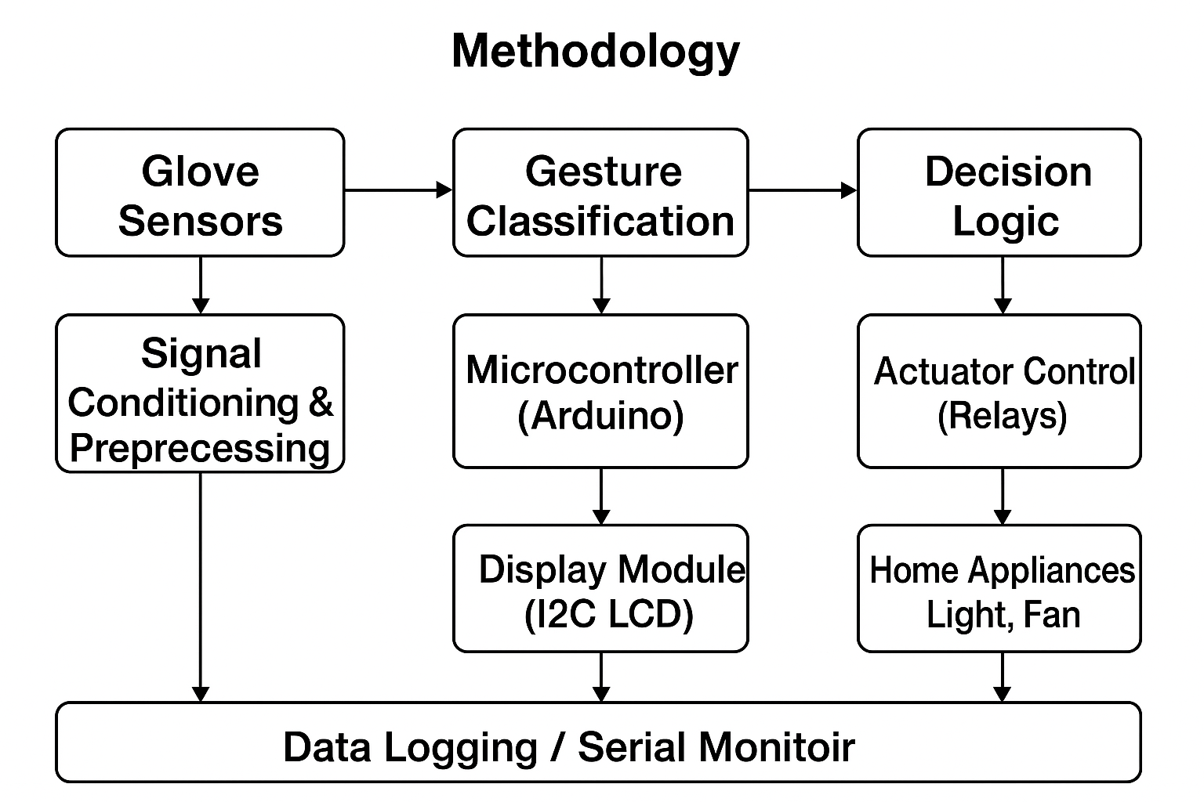
Methodology
Dept. of CSE (IoT&CSBT), EPCET BIC786 - Project Presentation 5

Slide 6
Methodology
Step Description
Gesture Input – User performs a hand/gesture captured by sensors.
Signal Processing – Raw signals are filtered and converted into usable data.
Gesture Classification – Data is analyzed and matched with predefined gestures.
Output – Classified gesture is used either for Text-to-Speech (sign translation) or Home Automation (ON,OFF).
Dept. of CSE (IoT&CSBT), EPCET BIC786 - Project Presentation 6

Slide 7
Methodology
Workflow Summary
The workflow of the proposed system begins with the smart glove’s ADXL345 sensor capturing hand gestures and sending the raw motion data to the Arduino microcontroller. The controller preprocesses the incoming values and classifies the gesture into a specific command. The decision logic then interprets whether the gesture corresponds to a communication message or a home automation function. If it is a communication gesture, the system displays the message on the LCD and plays the corresponding audio through the DFPlayer Mini. If it is a control gesture, the Arduino activates the relay modules to operate home appliances such as lights and fans.
Dept. of CSE (IoT&CSBT), EPCET BIC786 - Project Presentation 7

Slide 8
Implementation technique
Sensor-Based Gesture Detection.
Microcontroller-Based Decision Processing.
Relay-Driven Appliance Control.
Voice Feedback Implementation.
LCD Status Display Integration
Power Management and Safety Measures
System Testing and Calibration.
Dept. of CSE (IoT&CSBT), EPCET BIC786 - Project Presentation 8

Slide 9
Integrity and ethical and legal implications and regulations
Integrity Considerations:
Ensure accurate gesture detection and reliable appliance control.
Maintain data integrity and truthful reporting of system performance.
Prioritize user safety with proper isolation and regulated power supply.
Ethical Implications:
User-centered design for accessibility and independence.
Inclusive approach with audio/visual feedback for all users.
Transparency, safety, and informed use to prevent misuse or harm.
Dept. of CSE (IoT&CSBT), EPCET BIC786 - Project Presentation 9

Slide 10

Legal and Regulatory Considerations:
Follow electrical safety standards (IEC/BIS) and proper insulation.
Obtain necessary certifications (CE, ISI, RoHS) for commercialization.
Respect data privacy, IP rights, and assistive technology regulations.
Responsible Use:
Add fail-safes to prevent accidental switching.
Provide clear, accessible user instructions.
Test thoroughly before real-world deployment.
Dept. of CSE (IoT&CSBT), EPCET BIC786 - Project Presentation 10

Slide 11
Thank You!

