Slide 1

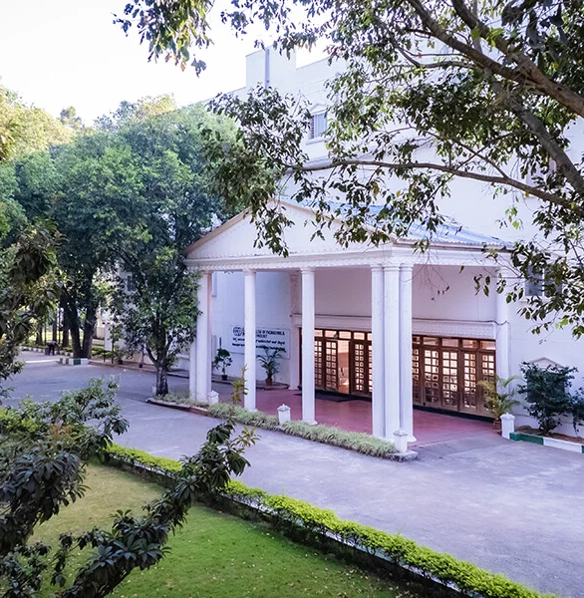
Department of CSE – (IoT & CSBT)
(An Autonomous Institute, Affiliated to VTU, Belagavi) Jnana Prabha, Bidarahalli, Bengaluru-49 Approved by AICTE, New Delhi & Government of Karnataka Accredited by NBA (CSE, ECE & ISE) and NAAC with A Grade
Project Presentation
On
“SIGN RHYTHM”
Smart Glove for sign language translation and Gesture Controlled Home Automation
By
Jayalaxmi - 1EP22IC024
Pavan Kumar - 1EP22IC039
Tanaya S - 1EP22IC055
Vaishnavi - 1EP22IC058
Under the Guidance of
Jay Prakash Malviya
Assistant Professor
www.eastpoint.ac.in

Slide 2
Contents
Introduction
Literature Survey
Proposed Method
Objectives
Motivation
Challenges
Applications
Hardware and Software Requirements
Architecture
Algorithm Used
Use case diagram
Sequence diagram
Implementation
Results
Result Analysis
Conclusion
References
Department of CSE – (IoT & CSBT) 2025-26

Slide 3
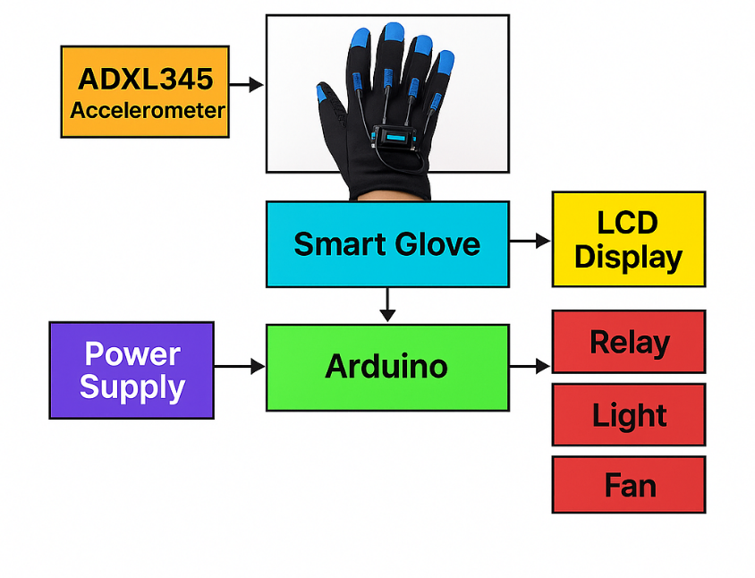
Architecture
ADXL345 senses gesture → sends data to Smart Glove module.
Arduino processes gesture → sends output to LCD and Relay.
Relay controls Fan and Light.
Power supply feeds the entire system.
Department of CSE – (IoT & CSBT) 2025-26

Slide 4
Architecture (cont.)
Smart Glove integrates accelerometer, wiring, and microcontroller interface.
Arduino maps sensor values to gestures.
LCD displays recognized command.
DF Player (optional addition) plays prerecorded voice messages.
Relays operate connected appliances.
Department of CSE – (IoT & CSBT) 2025-26

Slide 5
Algorithm Used
Start
Initialize ADXL345, LCD, DFPlayer, Relays
Read X-axis value
Compare X-axis reading with gesture thresholds
If match detected → trigger mapped action
Display output message
Play corresponding audio (if applicable)
Activate relay for appliances
Repeat
Department of CSE – (IoT & CSBT) 2025-26

Slide 6
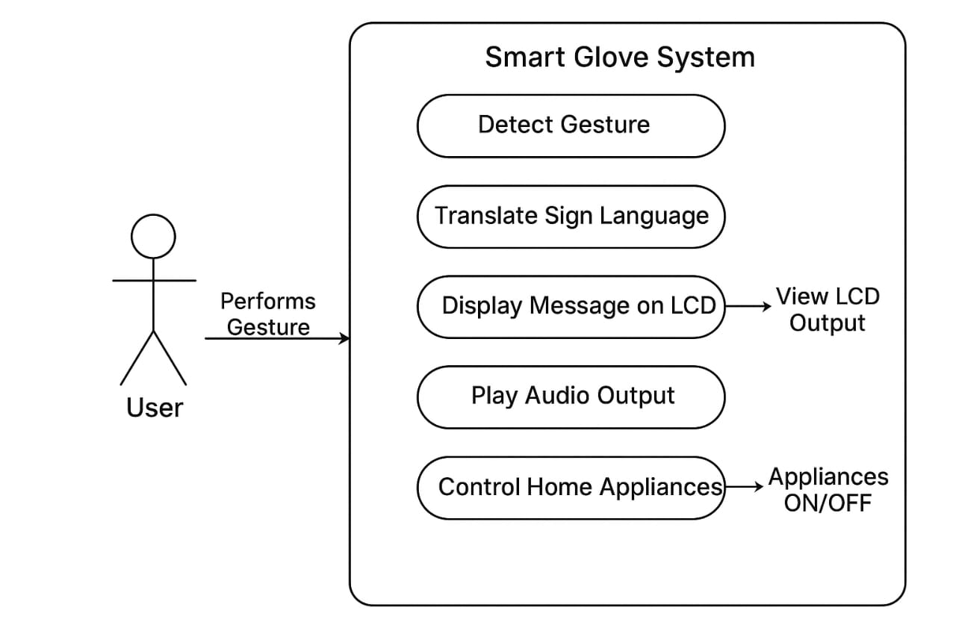
Use Case Diagram
The user performs gestures which are detected by the Smart Glove System.
The system reads accelerometer data and identifies the gesture.
Based on the gesture, the system performs different actions:
Displays a message on the LCD
Plays a voice message
Controls home appliances like fan and light
This allows the user to communicate and control devices through simple hand movements.

Slide 7
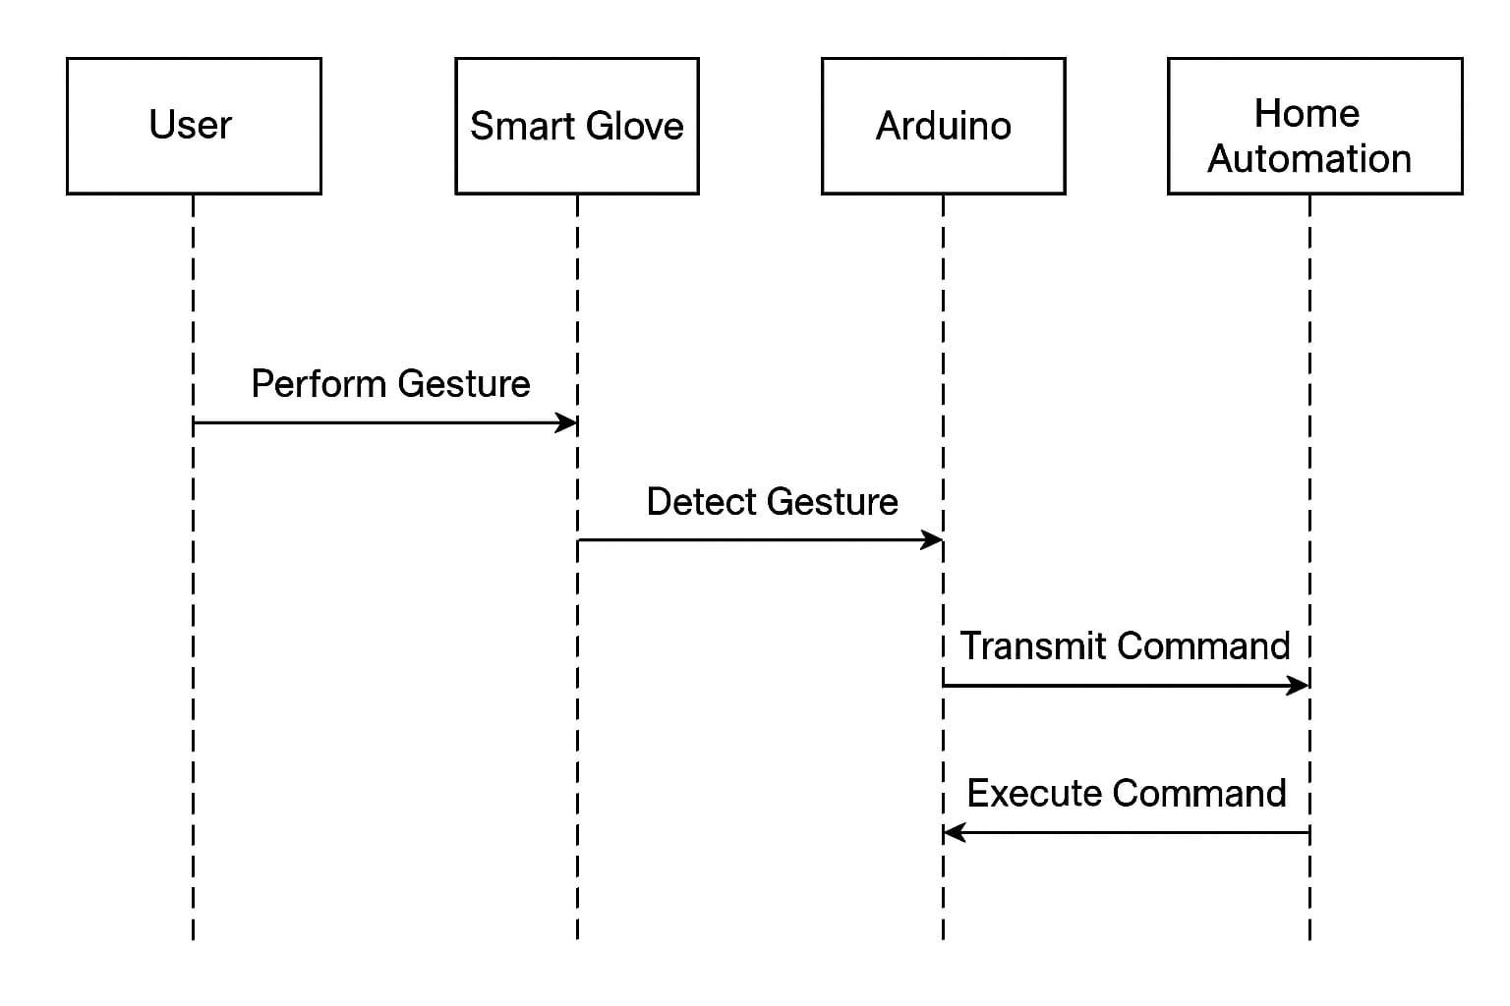
Sequence Diagram
User performs a gesture.
Sensor detects acceleration.
Arduino processes gesture values.
Message displayed on LCD.
DFPlayer plays audio feedback.
Relay switches fan/light ON or OFF
Department of CSE – (IoT & CSBT) 2025-26

Slide 8
Implementation
#include <Wire.h>
#include <Adafruit_ADXL345_U.h>
#include <LiquidCrystal_I2C_Hangul.h>
#include <DFRobotDFPlayerMini.h>
#include <SoftwareSerial.h>
LiquidCrystal_I2C_Hangul lcd(0x27,16,2);
Adafruit_ADXL345_Unified accel(12345);
SoftwareSerial Serial2(8,9);
DFRobotDFPlayerMini myDFPlayer;
int relay1 = 7, relay2 = 6;
void setup() {
lcd.init(); lcd.backlight();
Serial2.begin(9600);
myDFPlayer.begin(Serial2);
accel.begin(); accel.setRange(ADXL345_RANGE_16_G);
pinMode(relay1, OUTPUT); pinMode(relay2, OUTPUT);
}
void setup() {
lcd.init(); lcd.backlight();
Serial2.begin(9600);
myDFPlayer.begin(Serial2);
accel.begin(); accel.setRange(ADXL345_RANGE_16_G);
pinMode(relay1, OUTPUT); pinMode(relay2, OUTPUT);}
void loop() {
sensors_event_t event;
accel.getEvent(&event);
float x = event.acceleration.x;
if(x>=-10 && x<-8) fanoff();
else if(x>=-8 && x<-6) fanon();
else if(x>=-6 && x<-4) lighton();
else if(x>=-4 && x<-2) lightoff();
}
Department of CSE – (IoT & CSBT) 2025-26

Slide 9
Gesture Dataset used
Dataset consists of accelerometer readings (X, Y, Z axes) from the ADXL345 sensor.
Each gesture is recorded multiple times to obtain stable values.
Raw values were observed using Arduino Serial Monitor.
Only X-axis values were used for gesture classification in this project.
Gestures mapped to specific ranges:
Fan OFF
Fan ON
Light ON
Light OFF
Emergency
I am Hungry
What?
I need Help
Hello
I Don’t Understand
Department of CSE – (IoT & CSBT) 2025-26

Slide 10
Results
Fan ON/OFF gesture detected successfully.
Light ON/OFF gesture triggered accurately.
Emergency and communication gestures recognized.
LCD outputs clear text messages.
Relays switch appliances reliably.
DFPlayer outputs voice feedback.
Department of CSE – (IoT & CSBT) 2025-26

Slide 11
Results Analysis
Gesture accuracy: Above 90% in controlled testing.
Low delay between gesture and output.
Improved communication usability.
Reliable relay switching with minimal false triggers.
Suitable for real-world environments.

Slide 12
Conclusion
The smart glove accurately detects hand gestures using the ADXL345 sensor.
Gestures are successfully converted into text, audio, and appliance control actions.
The system provides an effective communication aid for speech-impaired individuals.
The glove enables hands-free control of home appliances, improving user independence.
The design is low-cost, portable, and easy to use.
Testing showed high reliability and fast response time.
The project demonstrates strong potential for future upgrades and real-world application.
Department of CSE – (IoT & CSBT) 2025-26

Slide 13
References
[1] T. S. S. Rani, P. Swetha, and K. Venkatesh, “Smart glove for sign language recognition using flex sensors,” IJERT, vol. 8, no. 05, pp. 312–316, 2019.
[2] M. A. Alsibai and N. S. M. Ali, “Hand gesture recognition using accelerometer sensor for sign language translation,” IJACSA, vol. 11, no. 4, pp. 1–7, 2020.
[3] A. F. M. Shah and S. R. Amin, “Accelerometer-based gesture recognition for human–computer interaction,” IEEE Sensors Journal, vol. 20, no. 14, pp. 8051–8059, 2020.
[4] S. Chatterjee and A. Roy, “Assistive technology for disabled persons using Arduino-based automation,” IJSRET, vol. 6, no. 3, pp. 456–461, 2020.
[5] K. Mukherjee and B. Deb, “Wearable gesture recognition using accelerometer and gyroscope,” Procedia Computer Science, vol. 167, pp. 2410–2417, 2020.
[6] S. K. Saha, “Home automation using microcontrollers: A survey,” IJERT, vol. 7, no. 8, pp. 112–116, 2018.
Department of CSE – (IoT & CSBT) 2025-26

Slide 14
Thank you!
Department of CSE – (IoT & CSBT) 2025-26

