Slide 1



ChatBot for College Website
Aldel Education Trust’s
St. John College of Engineering and Management, Palghar
NAAC Accredited with Grade A (2017-2022)
DEPARTMENT OF COMPUTER ENGINEERING
Tanaya Dasharath Patil | B | 43 | EU1192008
Vaishnavi Nanasaheb Jadhav | B | 20 | EU1192032
Priti Prem Ghodke | B | 13 | EU1192025
Anushka Vilas Wagh | A | 71 | EU1192007
Mrs. Prachi Gurav | Assistant Professor
April 28, 2022

Slide 2
Contents
Introduction
Motivation
Problem Statement
Objectives
Scope
Review of Existing Literature
Proposed System
Block diagram of Proposed System
Implementation
Algorithm/Flowchart
Technologies Used
Results and Discussion
Conclusion and Future Work
References
Department of Computer Engineering | SJCEM

Slide 3
Introduction
What is chatbot?
Chatbots are meant to answer the queries
Chatbot will aid to ease the query process.
Chatbot uses ML and NLP for processing the input.
Chatbot integrated with web will be more convenient and user friendly
Department of Computer Engineering | SJCEM

Slide 4
Problem Statement
To create an interactive chat-bot that efficiently responds to the user's query and replies with appropriate answers using machine learning and natural language processing techniques.

Slide 5
Motivation
The era of automation
Existing system is time consuming
To find the quick solution rather than going through tedious process.

Slide 6
Objectives
To implement a bot frame work that helps the users to get the college related data from any place with a web application
To lessen the task at hand of college organization.
To automate traditional human-to-human interaction.
To save time of students as well as organization required in traditional process.

Slide 7
Scope
Human Computer Interaction.
Every business are now making use chatbots
Automation.

Slide 8
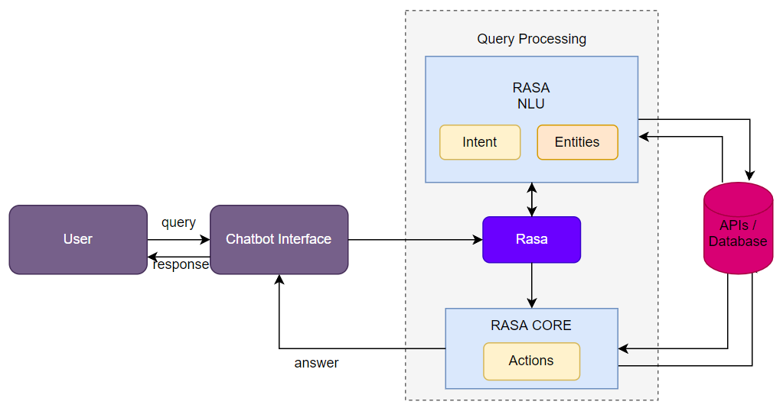
Proposed System
Chatbot processing in Rasa Framework:
Fig. 1: Block diagram of the proposed system
Department of Computer Engineering | SJCEM

Slide 9
Review of Existing Literature
[4] Chatbot for university related FAQs: Chatbots are meant to interact with humans using natural language. Student can get the answers of their queries and at any time with the help of such chatbot.
[8] Chatbot for College enquiry: Through this application users can raise any college connected activities through the system.
[6] A Tool of Conversation: Chatbot: Chatbot is widely popular now-a-days and new technology. In this application can be seen in various field in the future.
Department of Computer Engineering | SJCEM

Slide 10
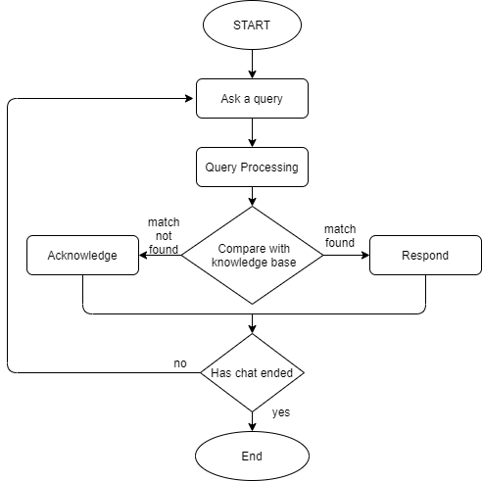
Implementation
Flow chart of the proposed system
Department of Computer Engineering | SJCEM

Slide 11
Implementation
DIET Algorithm:
Stands for Dual Intent Entity Tramsformer.
Input is breaken into list of tokens
Tokens then follow two path
Pretrained path
Sparse feature and feed forward
The output vectors are then feeded to transformer and then to the CRF( conditional random field )
Special tokens are class and mask
Total loss = Entity loss + Intent loss + Mask loss

Slide 12
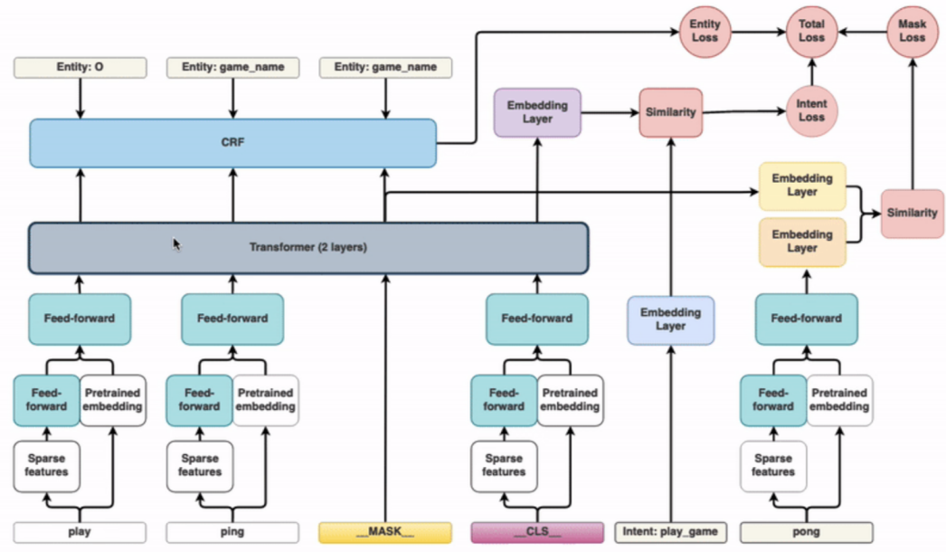

Slide 13
Technologies Used
Hardware Requirement
RAM | 4GB (8 GB recommended)
Processor | i3 , i5 or similar
Mouse | Dell
Software Requirement
Programming Language | Python, Python Libraries: Tensorflow | 3.7 or Above
Other Softwares | Anaconda | 4.9.2
 | Visual Studio | 16.9.3
Department of Computer Engineering | SJCEM

Slide 14
Machine Learning:
As Rasa Framework is ML based the data is fed to the bot and it is trained.
Natural Language processing:
The NLP is used to understand what is the query of user and accordingly responses are given by chatbot.

Slide 15
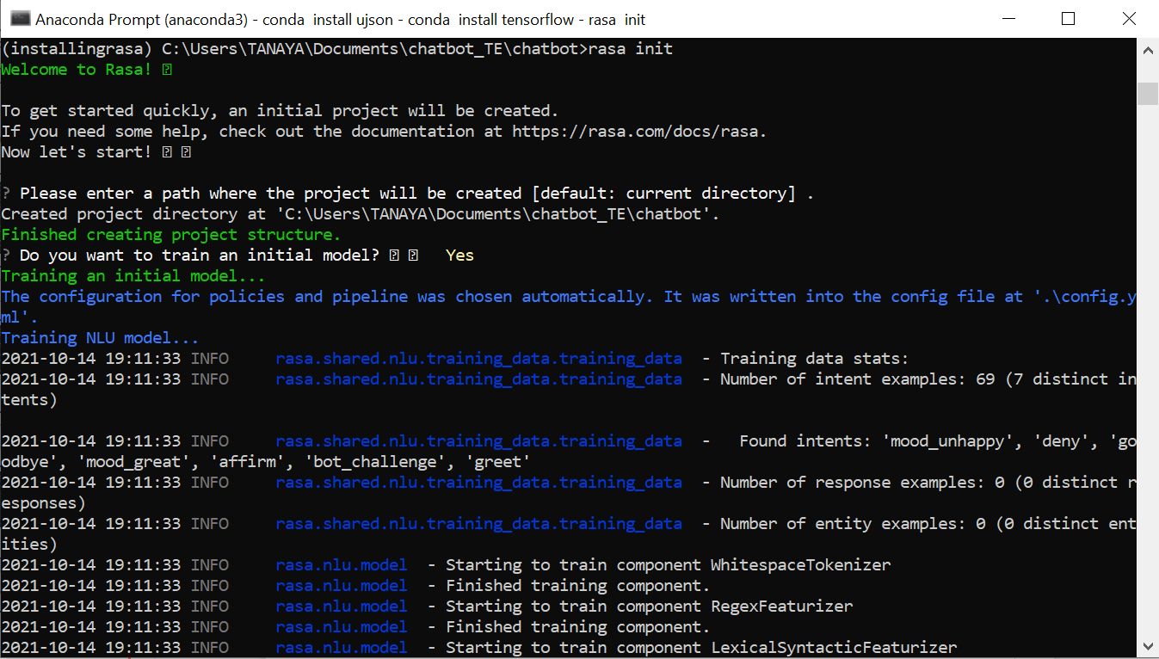
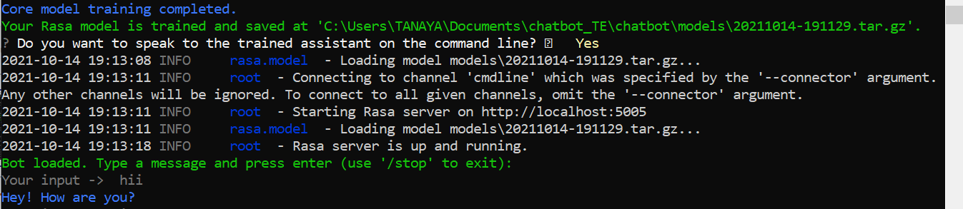
Results and Discussion
Department of Computer Engineering | SJCEM

Slide 16
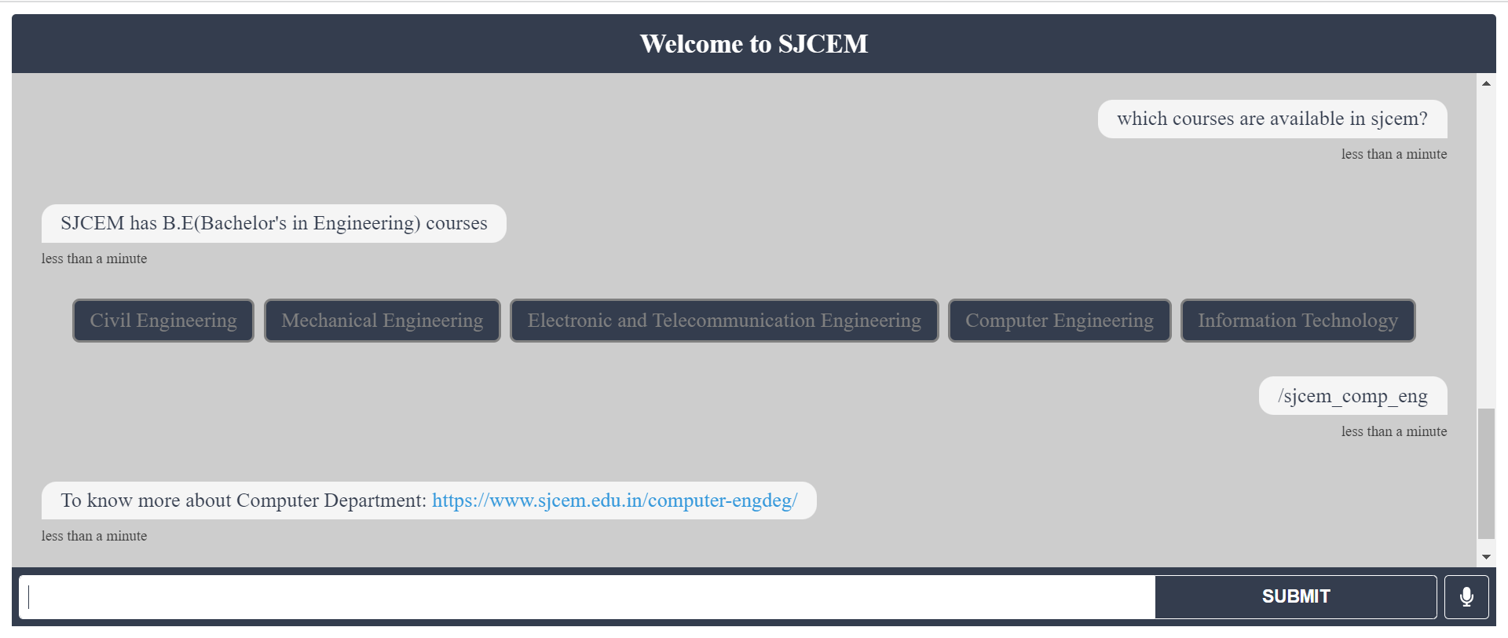
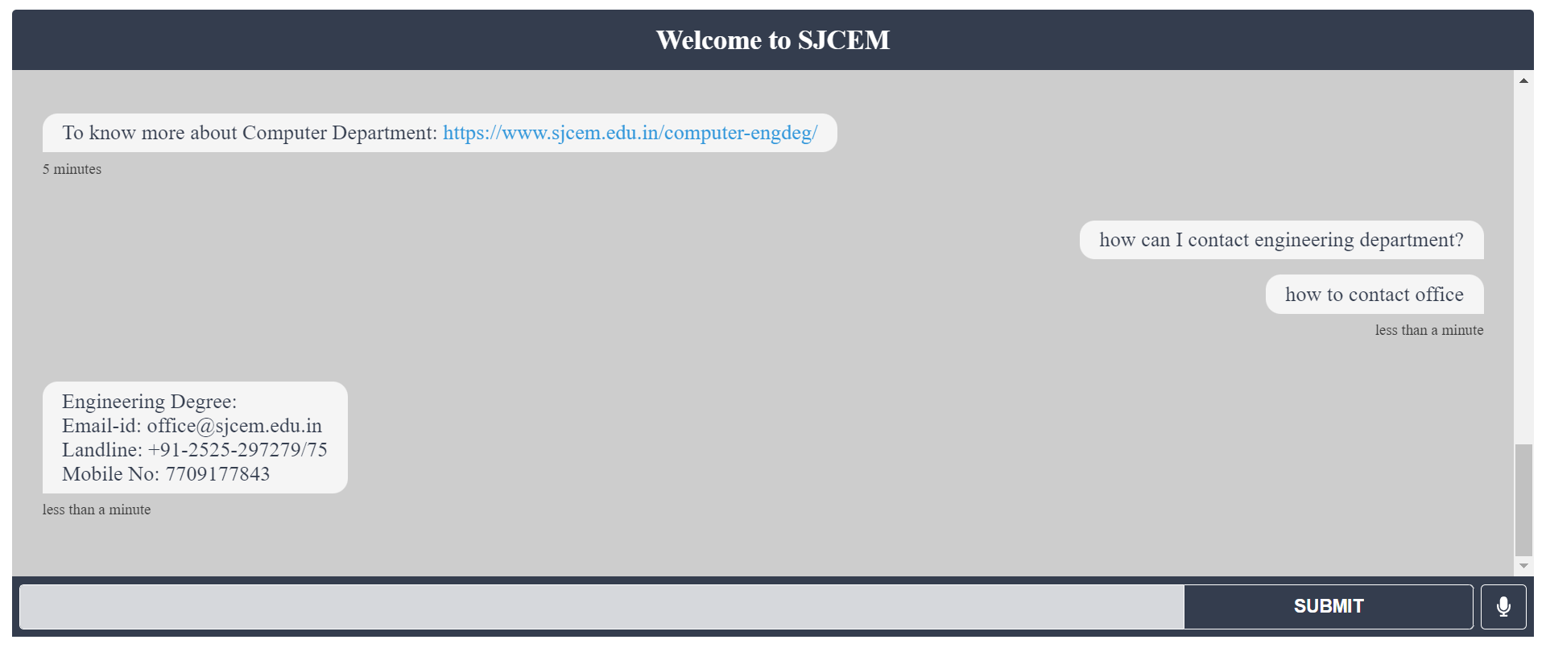
Results and Discussion

Slide 17
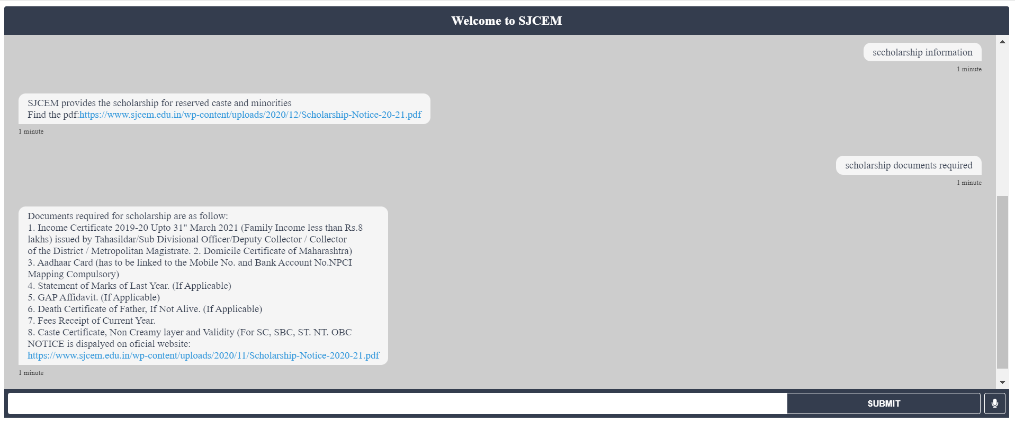
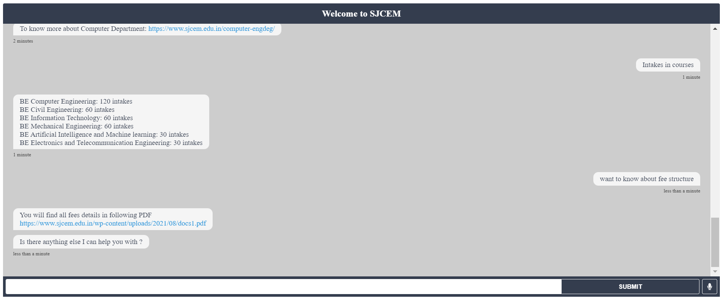
Results and Discussion

Slide 18
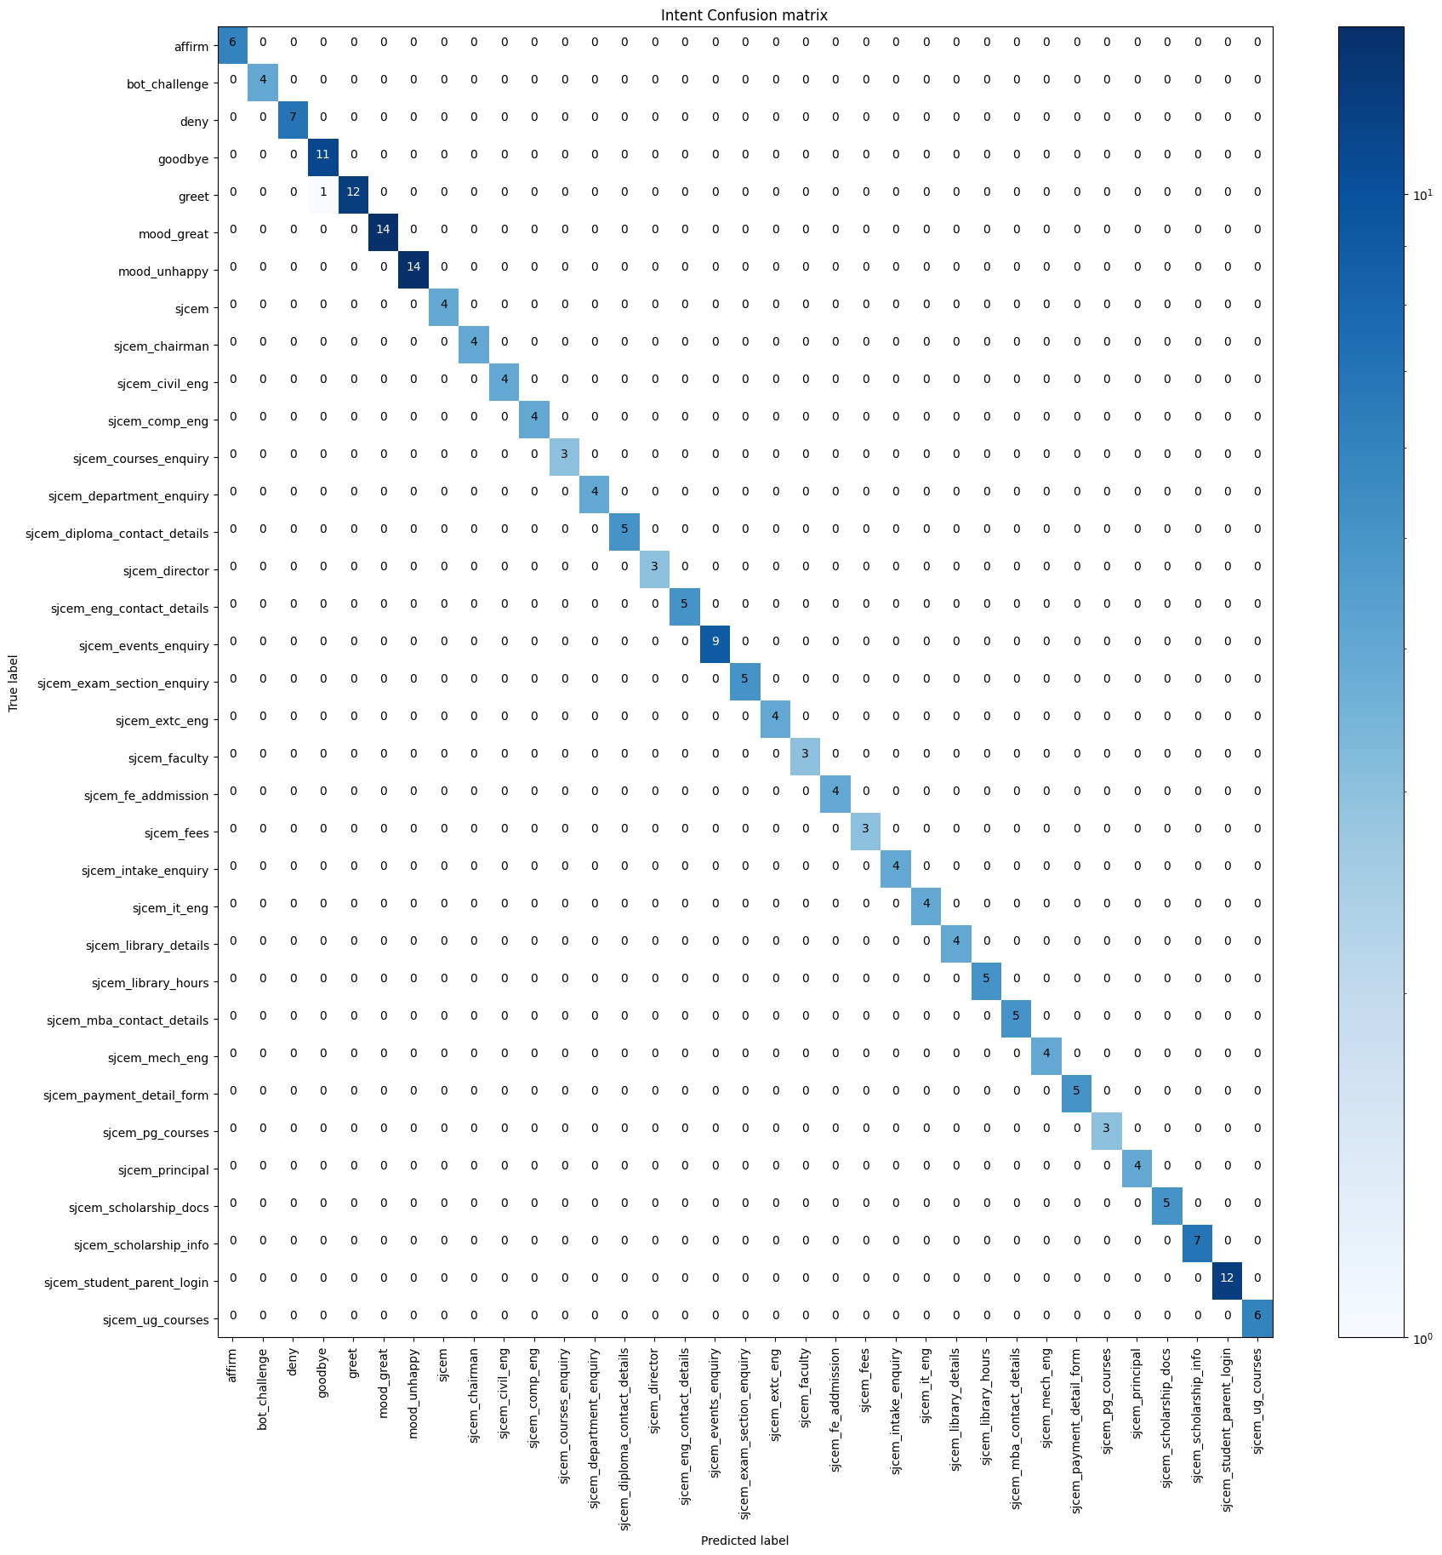
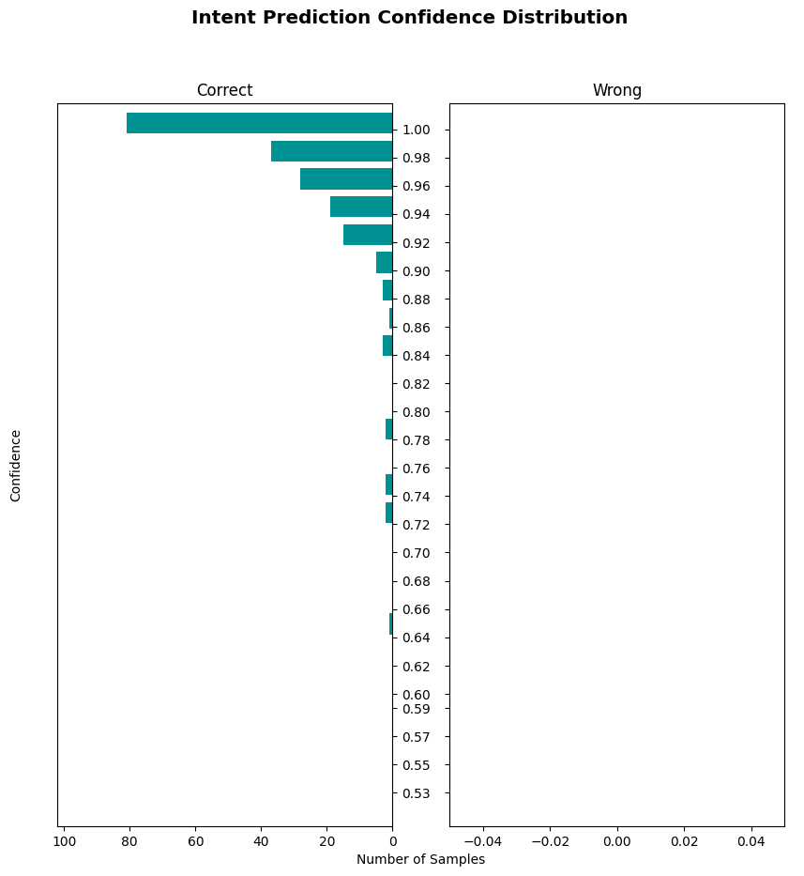
Results and Discussion
Confusion Matrix
Histogram

Slide 19
Demo

Slide 20
Future Work
Increasing efficiency
Make to learn the pattern on its own.
Add Role Based Access
Add more intents and entities
Department of Computer Engineering | SJCEM

Slide 21
References
[1]G. S. Ramesh, G. Nagaraju, Vemula Harish, and P. Kumaraswamy "Chatbot for College Website" Proceedings of International Conference on Advances in Computer Engineering and Communication Systems ICACECS (2020)
[2]Ms.Ch.Lavanya Susanna, R.Pratyusha, P.Swathi, P.Rishi Krishna, V.Sai Pradeep "COLLEGE ENQUIRY CHATBOT" International Research Journal of Engineering and Technology (IRJET) Volume: 07 Issue: 3 | Mar 2020
[3]Ram Manoj Sharma “Chatbot based College Information System” Research Review International Journal of Multidisciplinary Vol 4 Issue 3 March (2019)
[4]B. R. Ranoliya, N. Raghuwanshi and S. Singh, "Chatbot for university related FAQs," 2017 International Conference on Advances in Computing, Communications and Informatics (ICACCI), Udupi, 2017, pp. 1525-1530. doi: 10.1109/ICACCI.2017.8126057
[5]Punith S, Chaitra B , Veeranna Kotagi , Chethana R M “Research Paper on Chatbot for Student Admission Enquiry” Journal of Advancement in Software Engineering and Testing HBRP publication Volume 3 Issue 1 (2020)
[6]M. Dahiya “A Tool of Conversation: Chatbot” International Journal of Computer Sciences and Engineering Volume 5 Issue 5 E-ISSN: 2347-2693 May (2017)
Department of Computer Engineering | SJCEM

Slide 22
[7]Gadhave Ganesh D., Patil Rajnandini R., Hambre Pankaj S., Pawar Komal D. “Web Based College Enquiry Chatbot with Results” Resincap Journal of Science and Engineering Volume 4, Issue 2, February 2020 ISSN: 2456-9976
[8]Emil Babu, Geethu Wilson “CHATBOT FOR COLLEGE ENQUIRY” International Journal of Creative Research Thoughts (IJCRT) Volume 9, Issue 3 March 2021 | ISSN: 2320-2882
[9] Rasa blogs: https://rasa.com/blog/intents-entities-understanding-the-rasa-nlu-pipeline/
https://rasa.com/blog/introducing-dual-intent-and-entity-transformer-diet-state-of-the-art-performance-on-a-lightweight-architecture/
[10] https://medium.com/the-research-nest/using-the-diet-classifier-for-intent-classification-in-dialogue-489c76e62804

Slide 23
Thank You !!!
Department of Computer Engineering | SJCEM

Slide 24
Q & A
Department of Computer Engineering | SJCEM

