Slide 1
Novel AI Input Support Tool
新たな入力支援ツールが登場！
[Novel AI Input Support Tool]
Novel AI Input Support Tool

Slide 2
Abstract
What is this?
Function introduction
Image Tab.
Text Tab.
Tree Tab.
Enjoy!

Slide 3
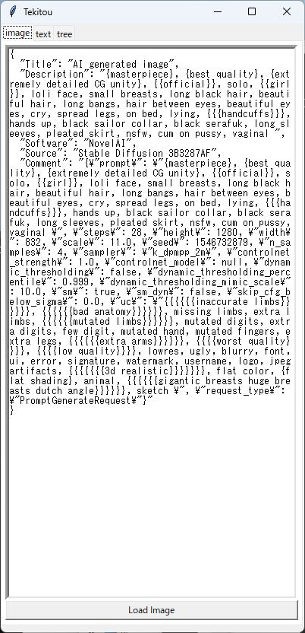

What is this? (1/2)
② Analyzed Image Header
① Load Image

Slide 4
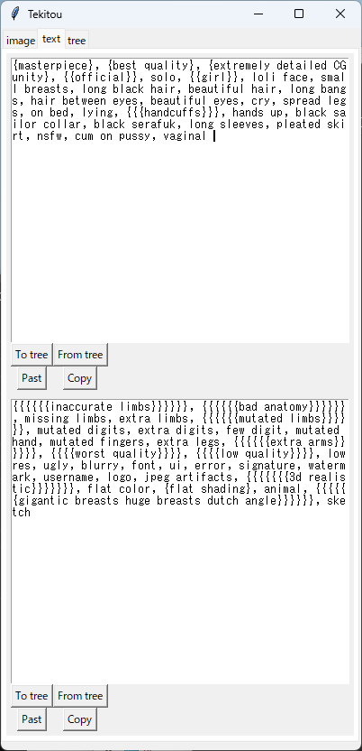
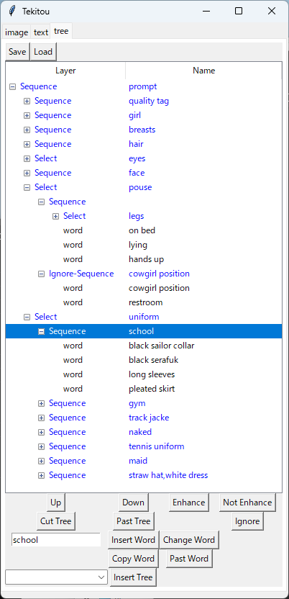
What is this? (2/2)
⑤ Manipulate the prompt using a tree structure
③ Create prompt.
④ Create uc.

Slide 5
Function introduction/ Image Tab
① Load Image

Slide 6

Function introduction/ Text Tab
send text to tree tub
get text from tree tub
Past To Novel AI !
Copy form clipboard
Past to clipboard

Slide 7
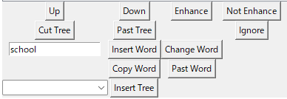
Function introduction/ Tree Tab
UP / Down
Enhance / Not Enhance
Cut Tree / Past Tree
Insert Word / Change Word
Copy Word / Past Word
Insert Tree

Slide 8
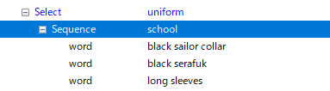
Tree Tab / Up / Down
Up
Down

Slide 9
Tree Tab / Enhance / Not Enhance
{{{NSFW}}}
NSFW
[[[NSFW]]]
Enhance
Not Enhance

Slide 10
Tree Tab / Cut Tree / Past Tree
Cut / Past

Slide 11
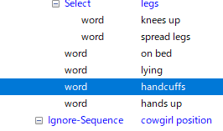
Tree Tab / Insert Word / Change Word
Insert / Cange

Slide 12
Tree Tab / Copy Word / Past Word
Copy form clipboard
Past from clipboard

Slide 13
Tree Tab / Insert Tree
Behavior when sending to text tab
Sequence
Select
Select
- Sequence
- aaa
- bbb
- ccc
- Sequence
- aaa
- bbb
- ccc
- Sequence
- aaa
- bbb
- ccc
Send only one with equal probability
Send only one with first probability
Send all
Text Tab
Text Tab
Text Tab
aaa, bbb, ccc
bbb
aaa

Slide 14
Enjoy!
・To be continued.
ポイント
そのとき、ふとひらめいた！
この経験は〇〇な画像の作成に活かせるかもしれない。

