Slide 1
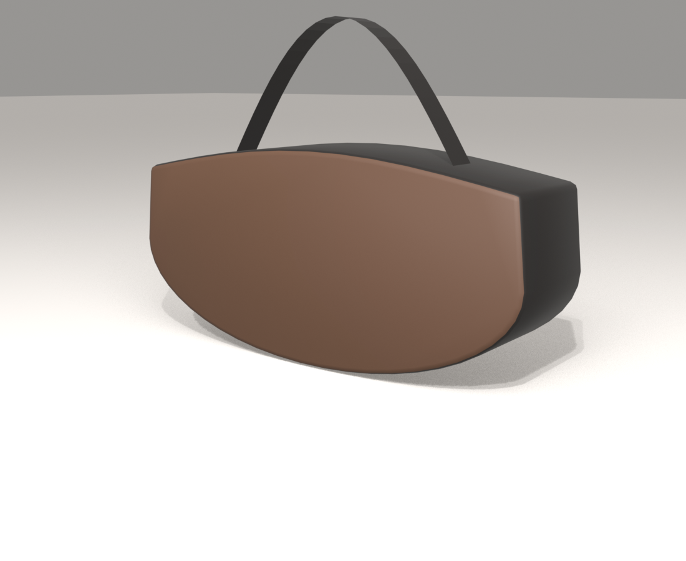
3D-FABRIC PIPELINE · CONCEPT TEST
Crescent
A curved-bottom shoulder bag, taken from reference photo to 3D concept, sewing pattern, cut files, and cost — in one afternoon.
DRAFT — NOTHING VERIFIED YET
Prepared by Richard · July 26, 2026

Slide 2
What it is
11.4″
6.7″
3.0″
wide
tall
deep
Top-zip crescent body with a wraparound gusset band
Short shoulder strap + long crossbody strap
6 cut pieces, 10 mm seam allowance everywhere
290 × 170 × 75 mm parametric model — every dimension is a slider
Original silhouette study inspired by a classic crescent shoulder bag. No third-party branding, prints, or hardware — this shape is yours to make 1-of-1.

Slide 3
Photo to factory-ready, automatically
1
Concept
2
3D model
3
Pattern
A photo or sketch of the shape you want
Parametric Blender build — spin it, resize it, re-render it
Auto-unfolded to flat pieces, seams at panel edges
4
Nest
5
Cost
6
Hand-off
Pieces packed onto a 54″ fabric roll
Yardage and dollars per bag, instantly
SVG + DXF cut paths + tech pack for the sample maker
This bag: mesh → tech pack in 5.8 seconds · 60 automated tests green · every artifact stamped DRAFT until a human seals it

Slide 4
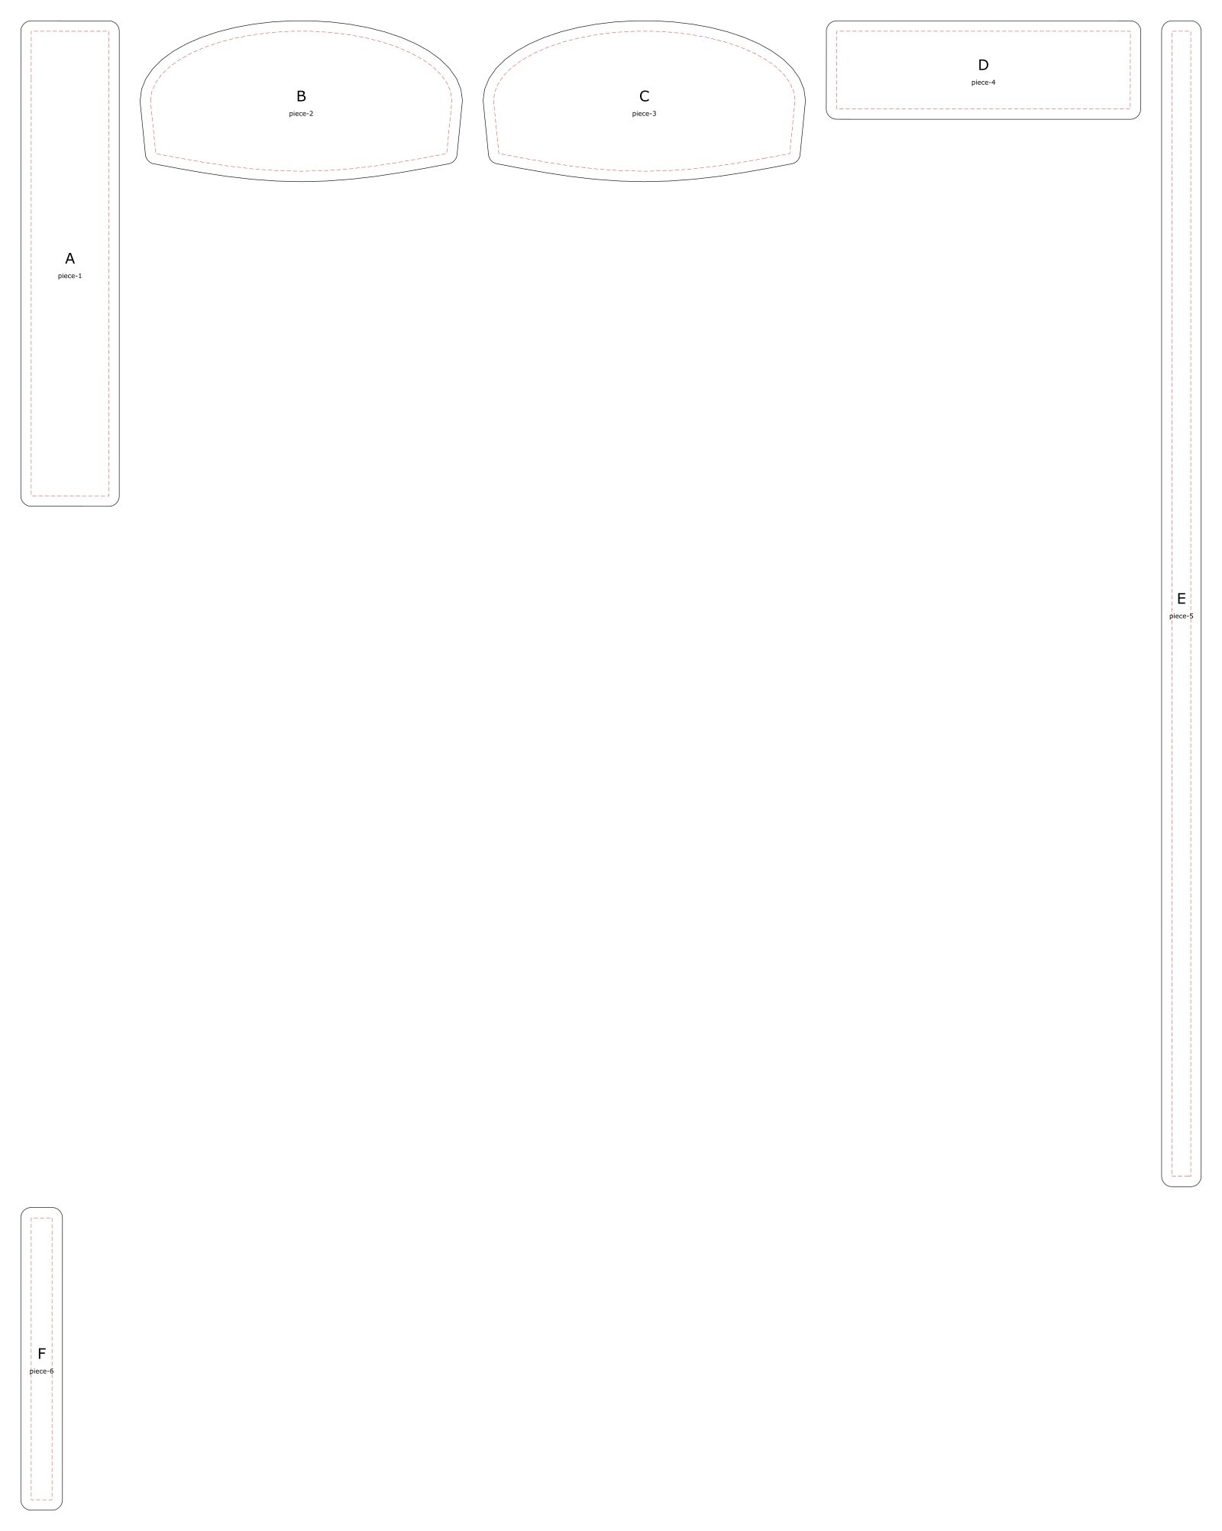
The pattern — six pieces
A
Gusset band (sides + top)
95 × 466 mm
B
Front panel
310 × 155 mm
C
Back panel
310 × 155 mm
D
Bottom band
302 × 95 mm
E
Crossbody strap
38 × 1120 mm
F
Shoulder strap
40 × 291 mm
Solid line = cut (includes 10 mm seam allowance) · dashed red = stitch line

Slide 5
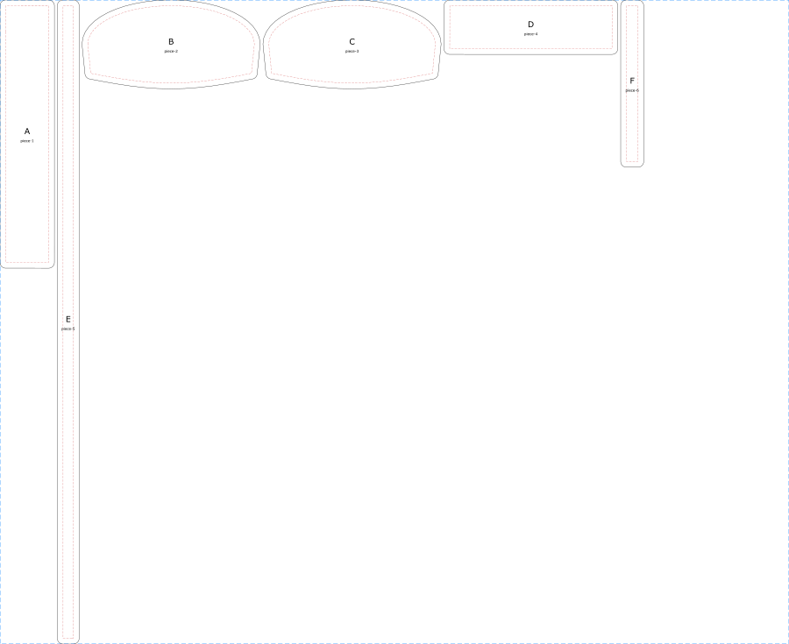
Cut files any shop can run
DXF for AutoCAD, Illustrator, and laser cutters
Layered file: CUT (solid), STITCH (dashed), LABEL (piece names) — millimeter units
Nested marker: 54″ roll, 44.1″ used per bag → 1.35 yd
Same geometry also ships as SVG for Ponoko’s upload flow
Honest number: a single bag packs this marker at only 13% — the two long straps dominate. Cutting several bags per marker (or straps from strap stock) tightens this dramatically.
Files: CrescentDemo_cutpaths.dxf · CrescentDemo_pattern.dxf · nested_54in.svg

Slide 6
What one costs — draft numbers
$24.25
$160
$15–25
CANVAS, PER BAG
LEATHER, PER BAG
HARDWARE, EST.
1.35 yd @ $18/yd placeholder pricing, 10% waste factor included
1 full hide by the tool’s flagged approximation — real usage is a fraction of a side once bags are batched
Zipper, D-rings, chain accent, magnetic snap — stub BOM, needs real quotes
Getting to a physical bag
Felt fit-check (Ponoko): tens of dollars — proves shape and proportions
Laser-cut leather panels: low hundreds — real material, our assembly
Professionally sewn sample (ISAIC, Detroit): by quote — small batch is their mission
Every number on this slide is a placeholder in materials.yaml until quoted.

Slide 7
Three ways to make it
1
Felt fit-check
2
Leather panels
3
Sewn sample
Upload the DXF to Ponoko. Cheap felt, no minimums. Hold the shape in your hands before spending on leather.
Laser-cut full-grain panels from the same file — printable with artwork. We assemble and finish locally.
ISAIC in Detroit takes the pattern + tech pack and returns a production-grade sample. Ten minutes from home.
W1
W2
W3
W4
Direction: pick silhouettes + materials mood
Select the hero bag, order the felt cut
Felt arrives — adjust, revise same day, order leather
Real sample in progress, shoot content

Slide 8
How it sells — 1-of-1 by design
Numbered drops: every bag is a 1-of-1 — the brand promise and the manufacturing model are the same sentence
Commissions: a client sketch becomes a render in minutes, a pattern the same evening
Each bag ships with its story: the render, the pattern, its number
Content is in-house: the 3D renders ARE the launch imagery
Example unit economics (draft)
Leather (batched, realistic)
$40
Hardware
$20
Sewing / assembly
$90
Cost of goods
$150
Retail at 3×
$450
Gross per bag
$300
Draft math with placeholder costs — the pipeline recomputes this per design the moment a real quote lands.

Slide 9
The machine works.
Now it’s taste.
Pick three real silhouettes worth making
Order the first felt fit-check from the DXF on this deck
Replace draft prices with real quotes — the costs recompute themselves
3D-Fabric pipeline · all artifacts DRAFT — AI drafts, engineers seal

