Slide 1
SK SET · CONCEPT PARTIS · REV 0.1 · AUG 2026
A-FRAME HYBRID
NORTHERN MICHIGAN
LAKEHOUSE
A-frame + 2-car under · lakeside deck · 20-ft container pool · one 3D-printed curved element
CONCEPT ONLY — NOT FOR CONSTRUCTION
Notes:
Three partis, same program: A-frame with a 2-car under part of it, lakeside deck, 20-ft container pool, and one 3D-printed curved element. Target: inland lake, northern Michigan.

Slide 2
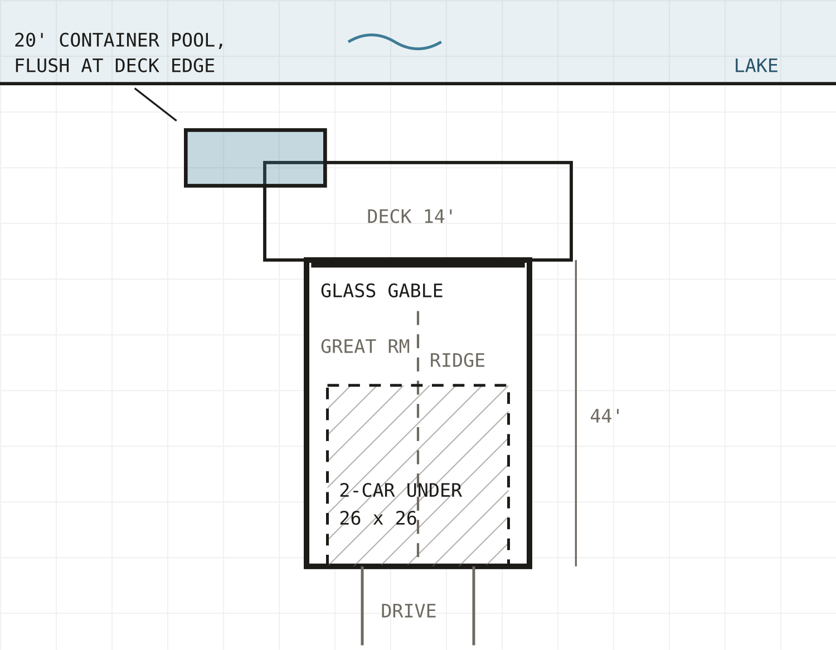
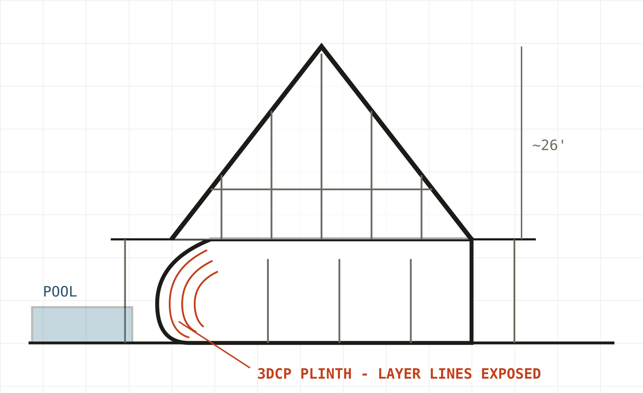
SK-1
STACKED CHALET
NTS
Full A-frame riding on a walkout plinth — garage buried in the plinth on the road side, glass gable to the water. The plinth itself is the printed piece.
PROGRAM
Plinth: 2-car + mud/mech, lakeside walkout guest. Main: great room at the gable, kitchen mid, primary rear. Loft: 2 beds + bath. ≈2,300 sf living.
POOL
Parallel to shore, flush at the deck edge, on its own helical piles.
LAKE ELEVATION
PRINTED PIECE
WATCH-OUT
3DCP plinth — printed concrete, curved entry corner, layer lines left exposed.
PARTI PLAN — LAKE UP
Needs 8–10 ft of grade fall to the water or the walkout dies. Buy the slope before you buy the scheme.
CEDAR
BRONZE SEAM
BLACK RAIL
PRINTED CONC.
RL LAKEHOUSE · SK-1 · REV 0.1 · 2026-08-14
Notes:
The first reference photo done as a bank house. Best fit for a sloped lot; the printed concrete plinth is the 3DP move.

Slide 3
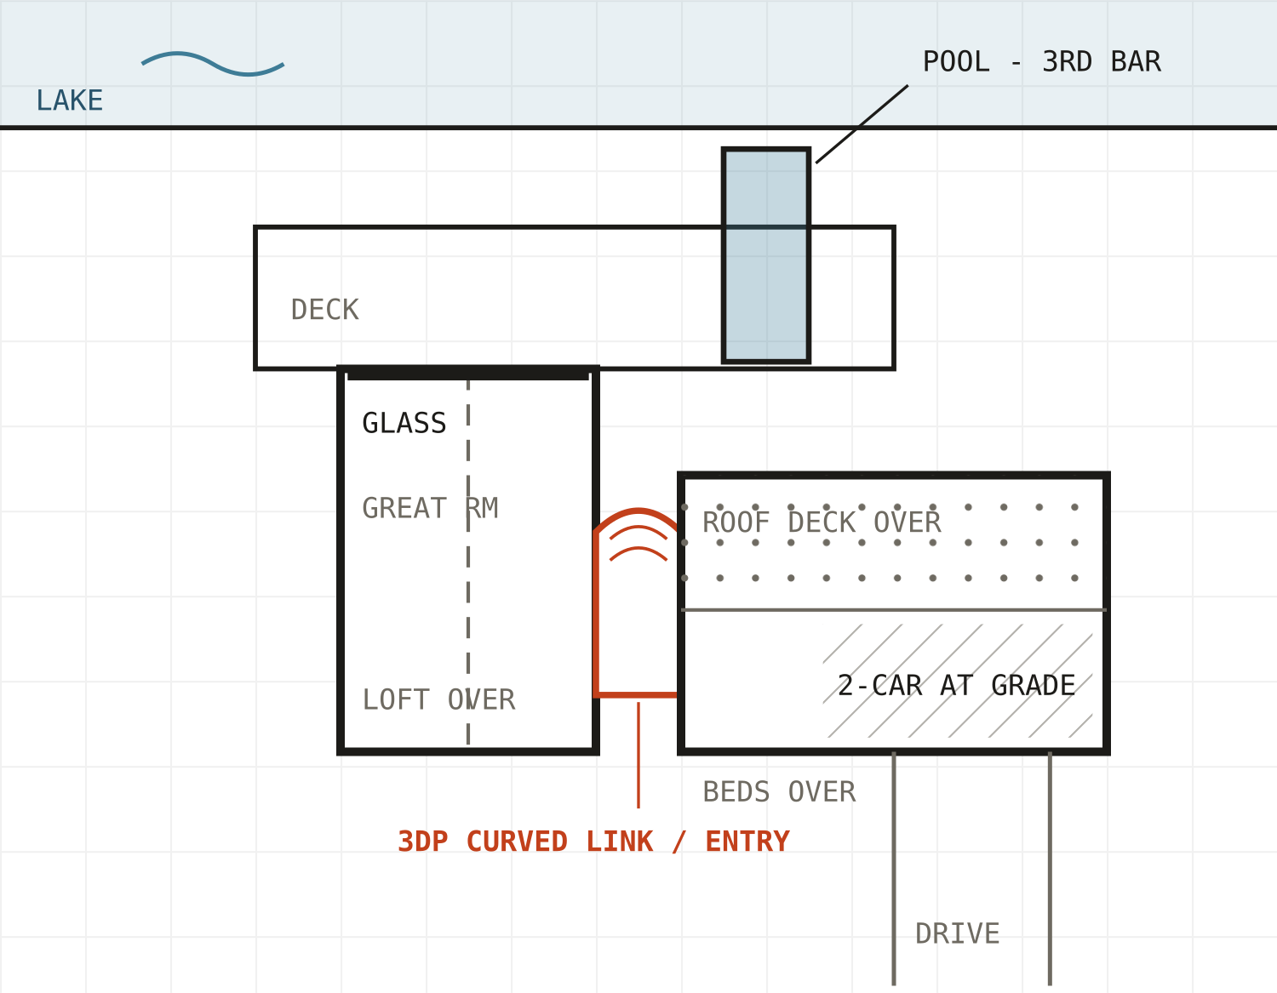
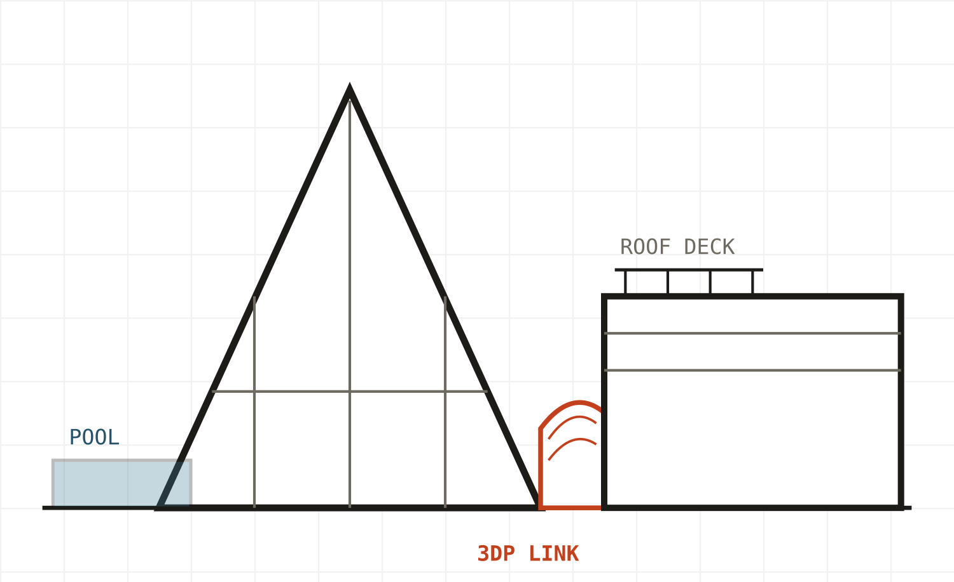
SK-2
A + BAR
NTS
Pure A-frame kept sacred — great room and loft only — beside a flat-roof bar carrying garage, beds, and a roof deck. The curved printed link is the hinge between the two languages.
PROGRAM
A-volume: double-height great room, loft primary. Bar: 2-car + entry at grade; 2 beds + bath over; roof deck on the lake end. ≈2,400 sf living.
POOL
Perpendicular to shore, in line with the bar — a third module. A MOONDOCK unit in residential trim.
LAKE ELEVATION
PRINTED PIECE
WATCH-OUT
Curved entry link — printed-mold GFRC panels or LFAM polymer rainscreen.
PARTI PLAN — LAKE UP
Keep the bar clear of the A's snow-shed zone — the gap is avalanche avoidance, not just composition. Size the link roof for slide load.
MATTE BLACK
TORREFIED ASH
WOOD SOFFIT
GFRC LINK
RL LAKEHOUSE · SK-2 · REV 0.1 · 2026-08-14
Notes:
The AKAY container-hybrid parti from the second reference. Container pool reads as a third module of the same family.

Slide 4
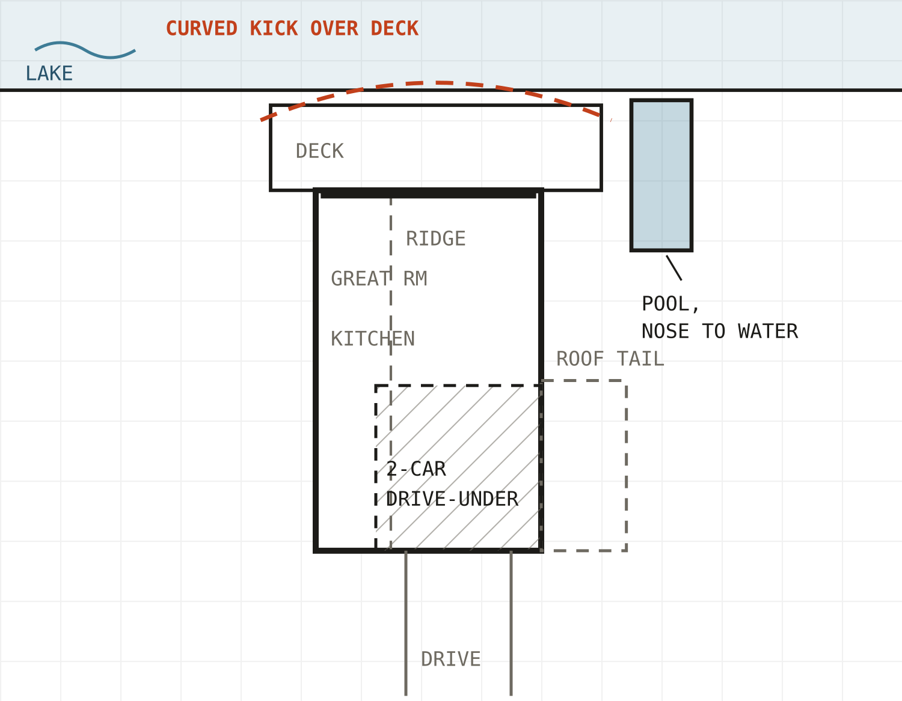
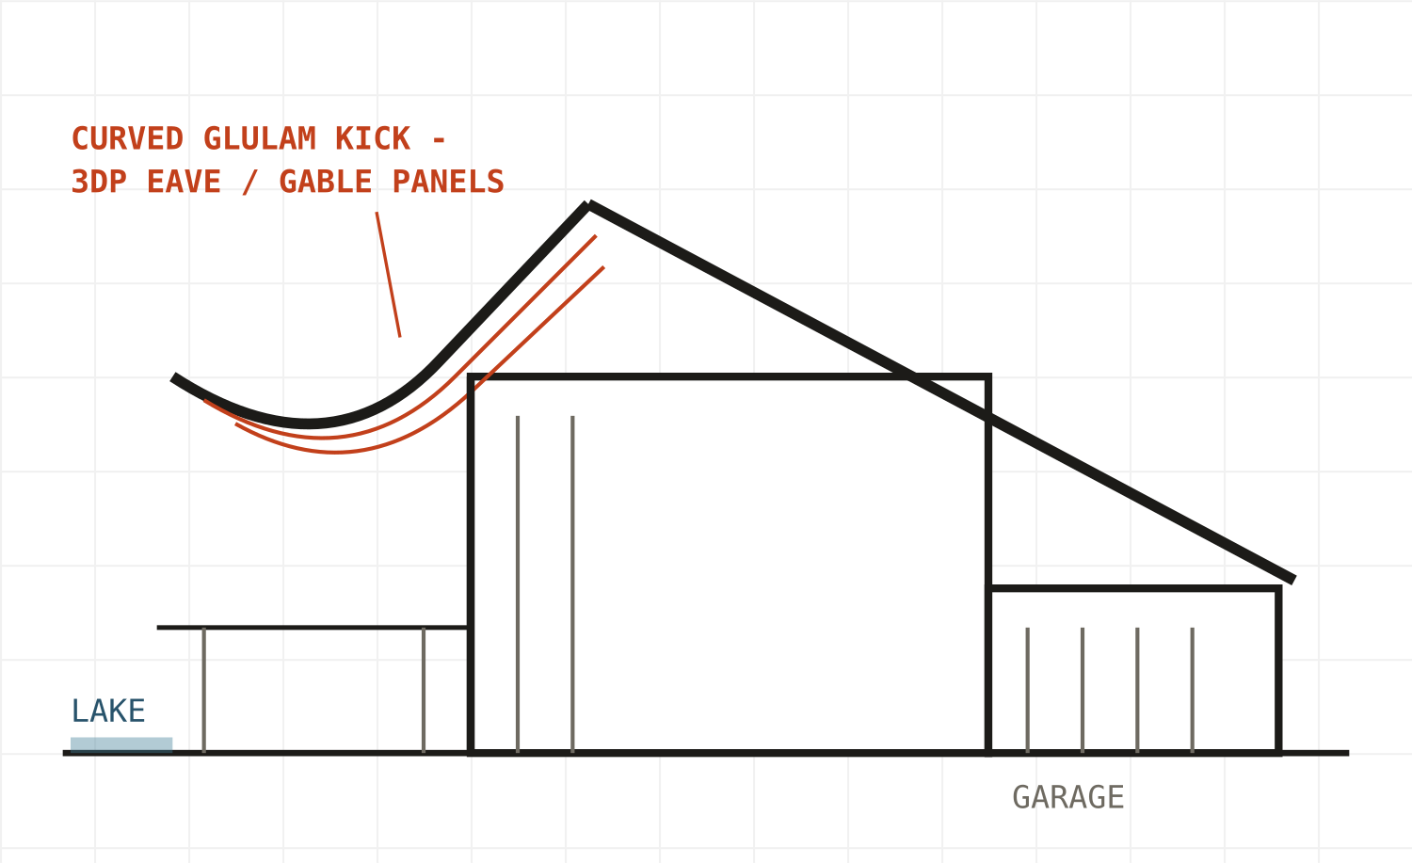
SK-3
KICKED RIDGE
NTS
Asymmetric A — one roof plane runs long over a drive-under garage; the lake-end eave kicks up in a curved glulam sweep over the deck. The curvature is real structure, not applied.
PROGRAM
Grade: garage + entry under the tail. Main: great room to the lake gable, kitchen/dining mid. Loft: primary + bunk. ≈2,200 sf living.
POOL
Perpendicular off the deck corner, nose toward the water.
SIDE ELEVATION — LAKE AT LEFT
PRINTED PIECE
WATCH-OUT
Curved gable-end + eave fascia panels following the glulam sweep — printed molds to GFRC, or LFAM polymer.
PARTI PLAN — LAKE UP
The premium option — curved glulams + curved panels mean the longest fab lead times. Lock roof geometry early; everything references it.
ZINC ROOF
LARCH
BLK STEEL
GFRC PANELS
RL LAKEHOUSE · SK-3 · REV 0.1 · 2026-08-14
Notes:
Closest to the last two references. Most sculptural, most fab-intensive; the curve is structural glulam with printed panels following it.

Slide 5
NORTHERN MICHIGAN · 45TH PARALLEL
REALITY CHECKS
60–70+ psf
≈50,000 lb
SNOW
POOL STRUCTURE
Ground snow up north. A-frames shed to the two long sides — decks, walks, garage doors, and the pool stay at the gable ends. All three partis are drawn that way.
A 20-ft container pool, full. Never on deck framing — own helical piles with a flush-deck surround. Insulate + heat pump for May–Oct; drain down after.
40–75 ft
R302.6
SITE + ZONING
GARAGE UNDER
Typical inland-lake OHWM setbacks, township-specific; pools usually count as structures. Frost footings 42–60 in. Septic + well drive siting as much as the view.
Dwelling separation at the garage lid and shared walls per the Michigan Residential Code. Cheap now, annoying in a retrofit.
RL LAKEHOUSE · NOTES · REV 0.1
Notes:
Numbers are concept-level; confirm ground snow, setbacks, and frost depth with the specific township once the parcel is real.

Slide 6
THREE BUILDABLE ROUTES
THE PRINTED PIECE
A
B
C
3DCP PLINTH / SITE WALLS
PRINTED MOLDS → GFRC
LFAM POLYMER RAINSCREEN
Printed concrete, on-site or precast. Citizen Robotics in Detroit is the obvious first call — keep the fab local.
Print the formwork, cast glass-fiber-reinforced concrete panels. The most freeze-thaw-proven route to curved facade geometry.
Large-format printed panels hung on conventional framing. Lightest and fastest to iterate — verify UV + thermal-cycling specs first.
BEST FIT: SK-1
BEST FIT: SK-2 / SK-3
FASTEST TO PROTOTYPE
RL LAKEHOUSE · NOTES · REV 0.1
Notes:
One curved element, three fab paths. GFRC from printed molds is the safest bet for a four-season lakefront; 3DCP is the boldest if the plinth is the move.

Slide 7
CONCEPT TO NATIVE RVT + FAB EXPORT
PATH TO REVIT
1
2
3
4
FORMA
CONCEPTUAL MASS
ADAPTIVE COMPONENT
STEP / OBJ OUT
Drop the actual parcel in — massing, sun, wind + snow, and view corridors before committing to a parti.
Winning parti into Revit; generate walls, floors, and roofs by face.
The printed element stays parametric — adaptive family or Dynamo-driven surface.
Fab geometry exports straight to the printer; everything else stays native RVT.
FORMA MASSING FIRST — THE PARCEL PICKS THE PARTI BEFORE TASTE DOES.
RL LAKEHOUSE · WORKFLOW · REV 0.1
Notes:
Same discipline as the TEG pipelines: parametric where it pays, native everywhere else.

Slide 8
NEXT REV
PICK A PARTI.
Rev 0.2 develops the winner: plans, sections, and a Forma-ready massing brief.
SK-1 lives or dies on 8–10 ft of grade fall to the water — let the lot vote before taste does.
CONCEPT ONLY — NOT FOR CONSTRUCTION
Notes:
If the parcel isn't locked yet, run all three partis through Forma on the shortlist lots — slope and shore orientation will eliminate at least one for free.

