Slide 1


NETMIRROR
Content Analysis Dashboard
An end-to-end Power BI solution analysing the Netflix Movies & TV Shows catalog
Power BI • DAX • Power Query • Media Analytics
Notes:
Title slide.

Slide 2

Team Members :
The people behind NetMirror
M1
M2
M3
Tandrima Nandy
Sumanta Kolley
Rudranil Das
Data Cleaning & Preparation
Data Modelling & DAX
Dashboard Design
NetMirror Content Analysis | 2

Slide 3
Project Overview :
A single-page executive summary of a streaming catalog
1
2
Movies vs TV Shows
Geographic reach
Full workflow
How is the catalog split between formats?
Which countries produce the most content?
Data audit
Cleaning & preprocessing
Data modelling
DAX measures
Interactive report
3
4
Audience segments
Growth over time
Which age ratings dominate the catalog?
How has production changed by release year?
NetMirror Content Analysis | 3

Slide 4
Problem Statement :
A large streaming catalog is hard to understand when the data is messy and scattered across raw columns.
~30%
~9%
1
of titles had no director listed
had missing cast or country
column shift: durations stored in rating
Key question: How can a non-technical viewer quickly see the catalog mix, geographic reach, audience ratings and release trends without wrestling with raw, inconsistent data?

Slide 5
Business Strategy :
How the catalog insights translate into decisions (recommendations drawn from the dashboard)
1
2
3
4
Expand globally
Balance audiences
Invest in growth
Decide with data
US, India and UK lead. Grow under-represented regions and pursue local licensing.
Compare mature (TV-MA, R) with family-friendly ratings to fill audience gaps.
Production accelerates after 2010. Plan acquisitions around this trend.
Replace guesswork with one interactive view that leadership can explore.
Goal: turn catalog data into clear, repeatable content decisions
NetMirror Content Analysis | 5

Slide 6
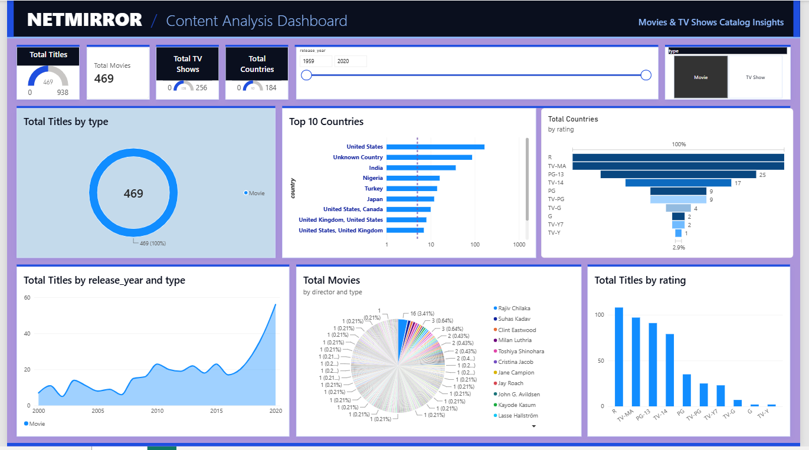
Dashboard Preview :
Interactive filter state: Movie segment selected
Overview
Single 1920 x 1080 page for full-screen viewing.
Cross-filtering
Selecting "Movie" updates every visual instantly.
Slicers
Release year range and content type.
NetMirror Content Analysis | 6

Slide 7
What This Dashboard Actually Does :
The work delivered, from raw file to interactive report
4
10
2
1
DAX measures
visuals
slicers
page, 1920 x 1080
1
3
5
Audit
2
Model
4
Visualise
Found missing values, shifted columns and type issues
Clean
One flat table for fast cross-filtering
Measure
Donut, bar, funnel, area, pie, column, KPIs
Imputed, trimmed, converted dates, split duration
Titles, Movies, TV Shows, Countries in DAX
NetMirror Content Analysis | 7

Slide 8
Data Architecture :
One flat, denormalised table prepared in Power Query
Original columns
Engineered fields
Why a single table?
show_id, type, title, director, cast, country, date_added, release_year, rating, duration, listed_in, description
year_added
Year title joined the catalog
Reduces model overhead and avoids unnecessary relationships.
Keeps cross-filtering fast and predictable for every visual on the page.
Simple for non-technical viewers to explore.
month_added
Month name added
duration_value
Numeric part of duration
duration_unit
min / Season / Seasons
NetMirror Content Analysis | 8

Slide 9
Data Cleaning Methodology :
Four data-quality problems resolved before modelling
1
2
3
4
Column shift
High missingness
Minor missingness
Inconsistent types
Durations (e.g. "74 min") stored in rating: moved to duration, rating cleared for imputation
Director ~30%, cast ~9%, country ~9%: imputed "Unknown" to avoid losing 30%+ of rows
Rating (<0.1%) filled with mode TV-MA; rows lacking date_added (<0.2%) removed
Trimmed whitespace, ISO 8601 dates, regex split of duration into value and unit
Additional checks: whitespace trimming on all text columns, uniqueness of show_id, duplicate validation on (title, type, release_year)
NetMirror Content Analysis | 9

Slide 10
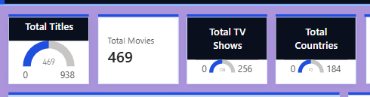
KPI Trackers and Catalog Mix :
Headline numbers and format split
What it tells us
Total Titles, Total Movies, Total TV Shows and Total Countries give an at-a-glance view of catalog size and reach.
The donut chart shows the share of Movies versus TV Shows, and updates when a segment is selected.
Gauges
Titles, TV, Countries
Card
Total Movies
DAX
4 core measures
NetMirror Content Analysis | 10

Slide 11
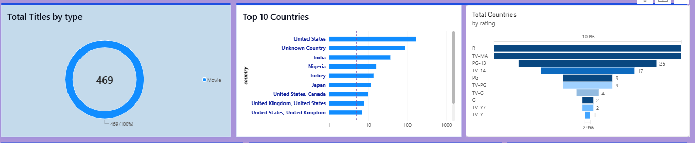
Geographic Footprint and Audience Mix :
Where content comes from and who it is for
Top countries
United States, India and the United Kingdom lead, pointing to global expansion and local licensing needs.
Audience classification
Funnel and column charts show titles by age rating (TV-MA, TV-14, R, PG-13), comparing mature content with family-friendly programming.
Unknown Country
Imputed values remain visible so data gaps are transparent.
NetMirror Content Analysis | 11

Slide 12
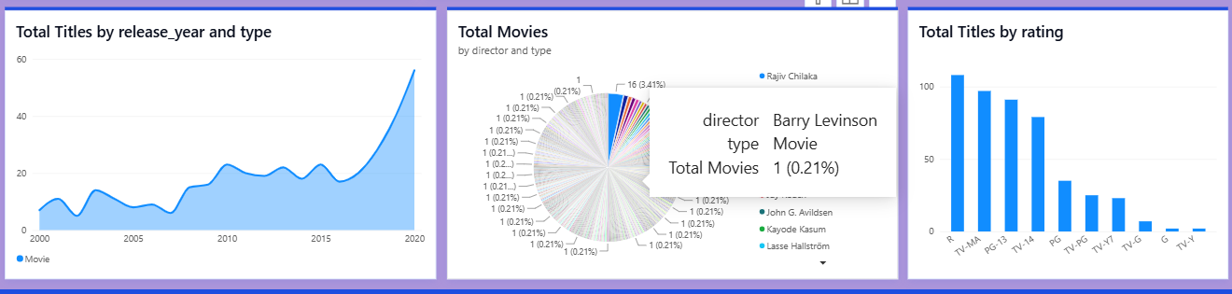
Temporal Trend and Production Concentration :
Release-year growth and director distribution
Temporal trajectory
Area chart of titles by release year and type shows production accelerating after 2010.
Production concentration
Pie chart of titles per director, including titles with no director listed, shows a long tail of one-title directors.
Rating distribution
Column chart ranks the catalog by rating for a quick audience comparison.
NetMirror Content Analysis | 12

Slide 13
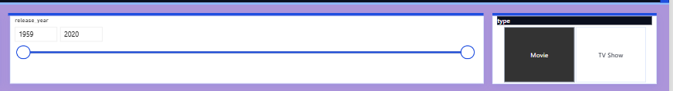
Technical Implementation :
Tools and design decisions
Power Query
Cleaning, type conversion and null handling
1
Data model
Single denormalised table, no cross-filter latency
Slicers: release year range and content type
2
Layout
1920 x 1080 single page
full-screen viewing
DAX measures
Total Titles, Movies, TV Shows, Countries
3
Interactivity
Slicers for type and release year, click-to-cross-filter
4
NetMirror Content Analysis | 13

Slide 14
Solutions Delivered :
Each problem mapped to its fix
Shifted duration values in rating
Detected "min" in rating, moved to duration
High missing director, cast, country
Imputed "Unknown" to keep 30%+ of rows
Text dates and mixed durations
ISO 8601 dates, regex split into value and unit
Hard to read raw catalog
Single-page interactive dashboard
Slow, unclear filtering
Slicers and cross-filtering on a flat model
NetMirror Content Analysis | 14

Slide 15
Future Scope :
Where this project can grow next
Near term
Mid term
Long term
Quick wins
Deeper analytics
Intelligent insights
Genre analysis from listed_in
Add country split for multi-country titles
Top cast and director leaderboards
Multi-page report with drill-through
Publish to Power BI Service with scheduled refresh
Forecast release and addition trends
Add viewership and engagement data
NLP on descriptions for themes and sentiment
Content recommendation and gap analysis
NetMirror Content Analysis | 15

Slide 16
Conclusion :
Clean data, clear story
Global, mature-skewed catalog
Systematic cleaning kept over 30% of records that deletion would have lost.
US, India and UK lead; TV-MA and TV-14 dominate ratings.
Accelerating production
Decision-ready
Output grows sharply after 2010.
Interactive slicers let non-technical users explore instantly.
Thank you

