Slide 1

Writing My Name’s Initials with a Two-Arm-Robot

Slide 2
Function of my name’s initial was created.
A initial position for two robot arms and the relationship between the angles was decided.
Using Newton’s iterative method created function was solved.

Slide 3
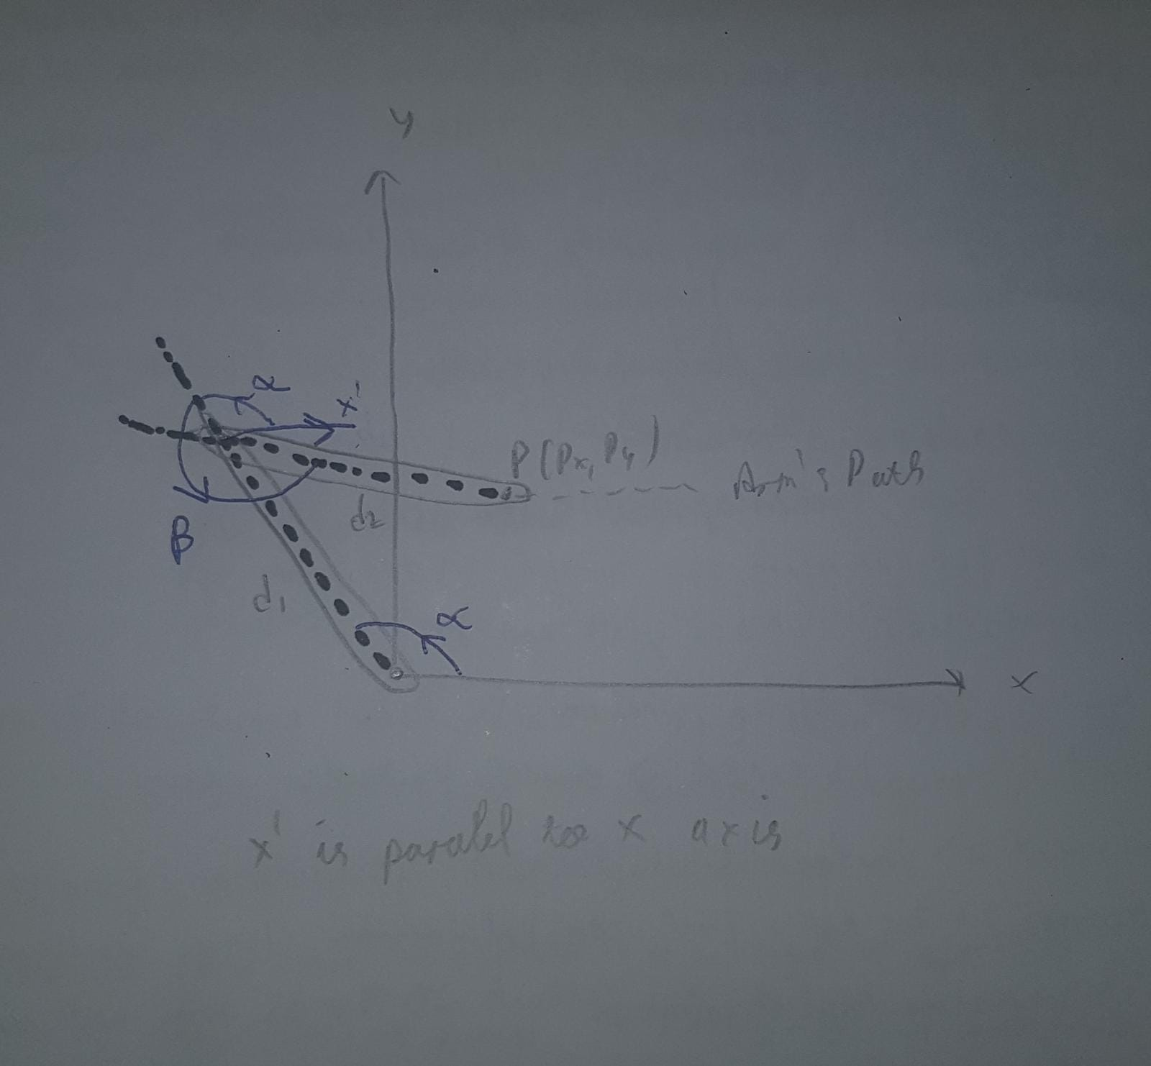
Hand Drawn initial position and the angle relations

Slide 4
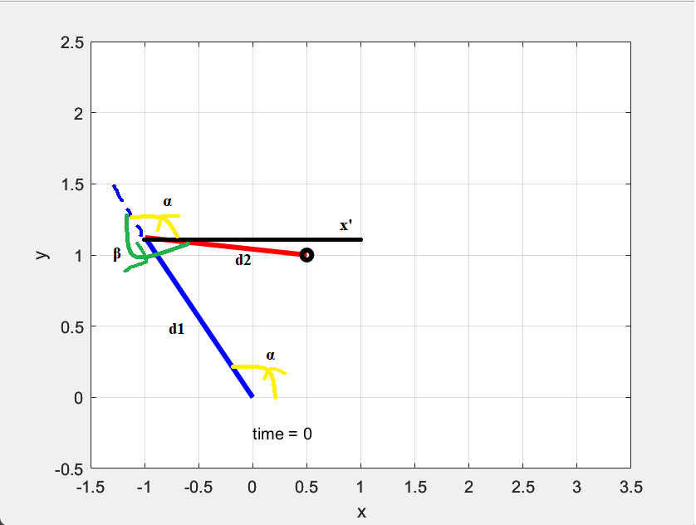
Digital version of initial position and the angle relations

Slide 5
The Animation

Slide 6


Slide 7
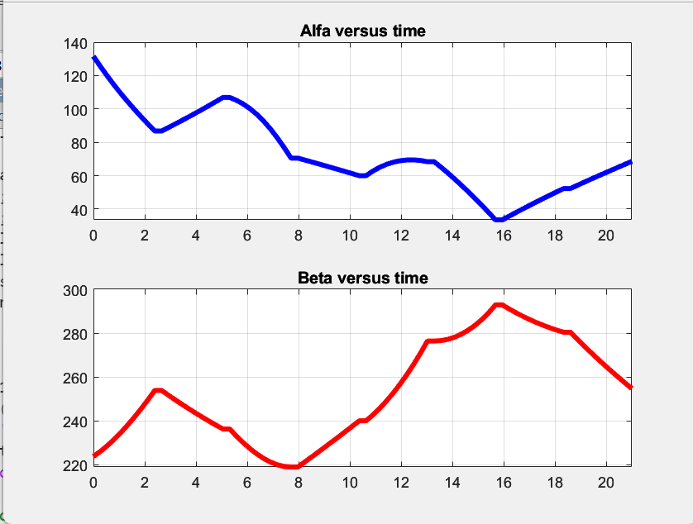
Angles of the arms vs Time.

