Slide 1
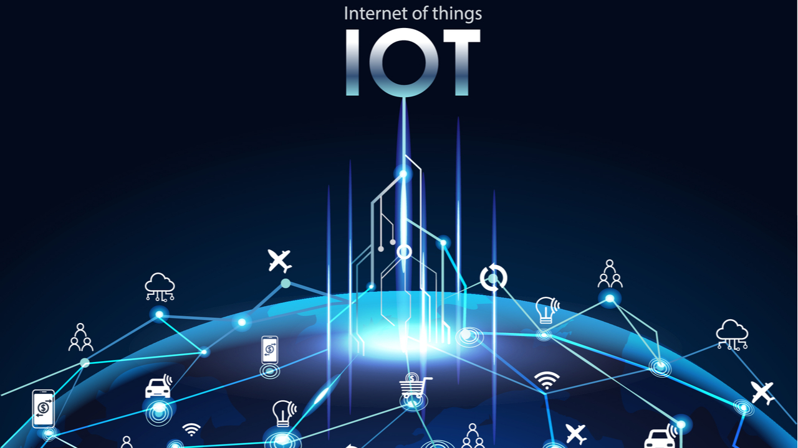
JEREMY B GAMBOA

Slide 2
WHAT IS INTERNET OF THINGS(IoT)
The Internet of Things (IoT) is the network of physical objects or "things" embedded with electronics, software, sensors, and network connectivity, which enables these objects to collect and exchange data
A “Thing” in the context of the Internet of things (IoT), is an entity or physical object that has a Unique identifier, an embedded system and the ability to transfer data over a network. • Heart monitoring implants • Biochip transponders on farm animals • Automobiles with built-in sensors • DNA analysis devices & Other Wearbles etc. These devices collect useful data with the help of various existing technologies and then autonomously flow the data between other devices.

Slide 3
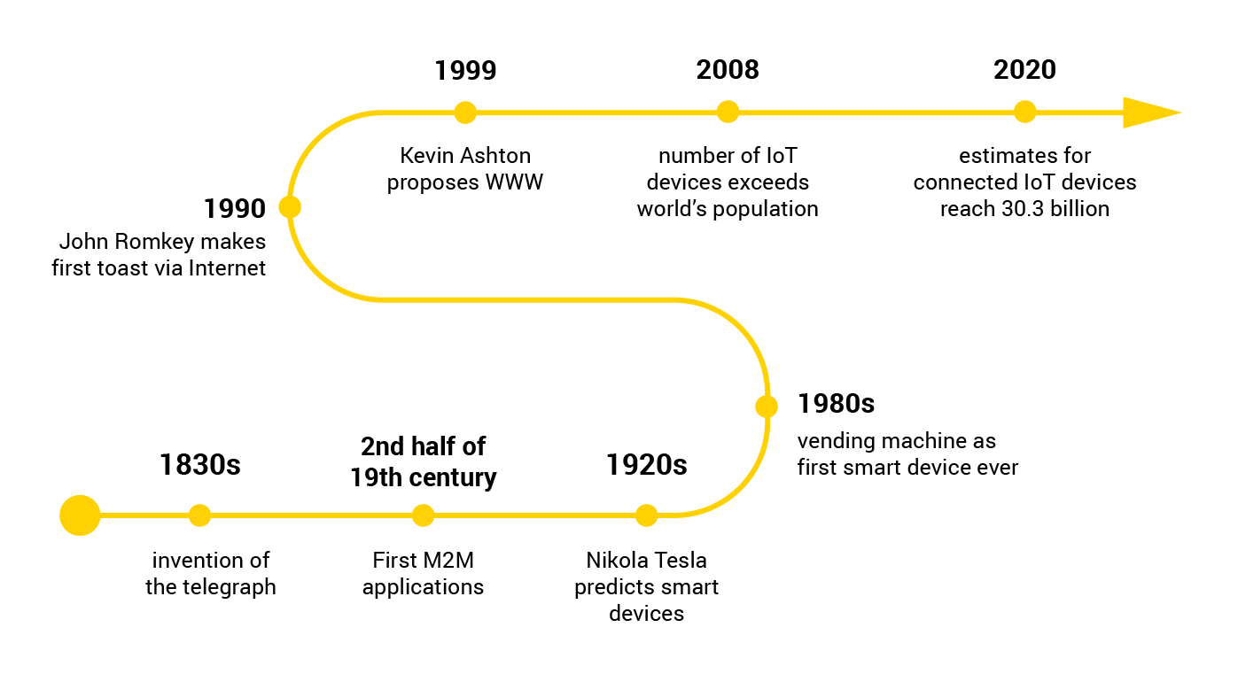
HISTORY OF IOT

Slide 4
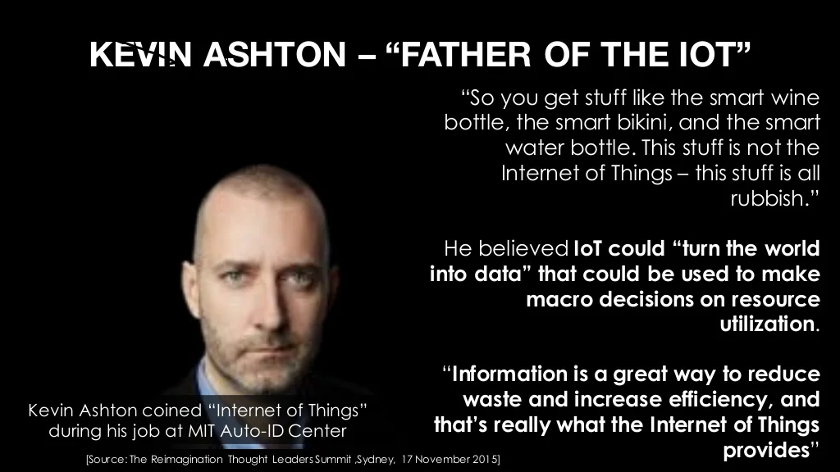
HISTORY OF IOT

Slide 5
HOW IOT WORKS
The Internet of Things (IoT), also sometimes referred to as the Internet of Everything (IoE), consists of all the web-enabled devices that collect, send and act on data they acquire from their surrounding environments using embedded sensors, processors and communication hardware. These devices, often called "connected" or "smart" devices, can sometimes talk to other related devices, a process called machine-to-machine (M2M) communication, and act on the information they get from one another. Humans can interact with the gadgets to set them up, give them instructions or access the data, but the devices do most of the work on their own without human intervention. Their existence has been made possible by all the tiny mobile components that are available these days, as well as the always- online nature of our home and business networks. 7

Slide 6
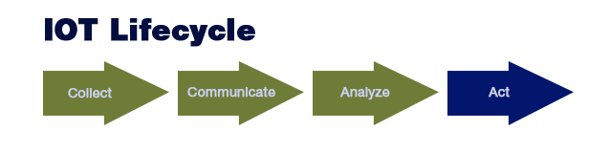

Slide 7
Few Applications of IoT
✓Building and Home automation
✓Manufacturing ✓
Medical and Healthcare systems
✓Media ✓
Environmental monitoring
✓Infrastructure management
✓Energy management
Transportation
✓Better quality of life for elderly
✓... ... ... You name it, and you will have it in IoT!

Slide 8
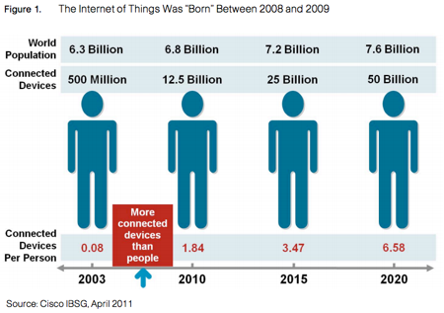
CURRENT STATUS & FUTURE PROSPECT OF IOT

Slide 9
TECHNOLOGICAL CHALLENGES OF IoT
At present IoT is faced with many challenges, such as:
▪ Scalability ▪
Technological Standardization
▪ Inter operability
▪ Discovery
▪ Software complexity
▪ Data volumes and interpretation
▪ Power Supply
▪ Interaction and short range communication
▪ Wireless communication ▪
Fault tolerance

Slide 10
Criticisms and Controversies of IoT
Scholars and social observers and pessimists have doubts about the promises of the ubiquitous computing revolution, in the areas as:
▪ Privacy
▪ Security
▪ Autonomy and Control
▪ Social control
▪ Political manipulation
▪ Design
▪ Environmental impact
▪ Influences human moral decision making

