Slide 1

Sastho Seba
Projects Proposal
27.02.23

Slide 2
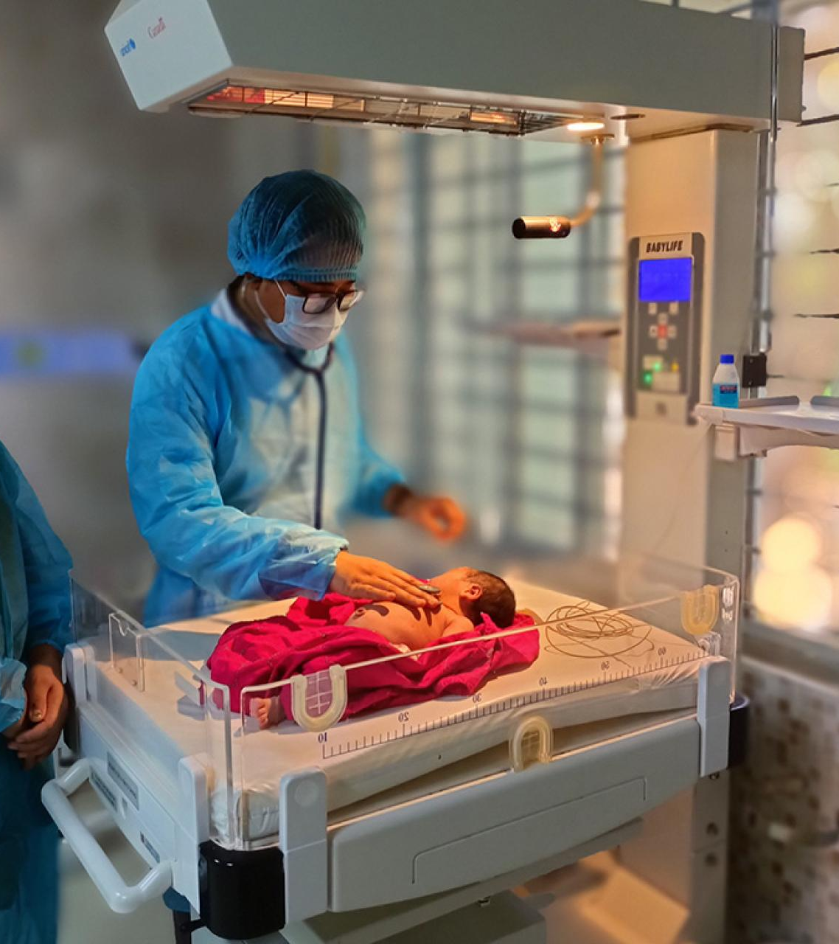
Sastho Seba
TEAM MEMBERS:
Taneem Ahmed (2013102042)
Siddhartha Sankar Saha (2011567042)
Mahbub Morshed Rifat (2011415042)

Slide 3
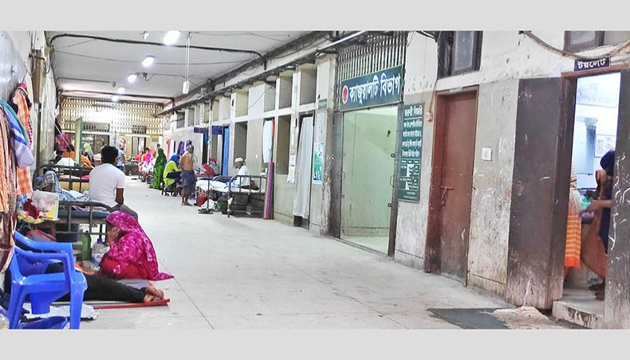
Agenda
Introduction
Motivation And Aim
Some HMS Vs Our Ideas
Tools
Some Diagrams
Timeline
Closing

Slide 4

INTRODUCTION
WHAT IS OUR IDEA?
SASTO SEBA REFERS TO THE PLATFORM TO COLLAB ALL THE MEDICAL FIELDS TOGETHER AND HASSLE FREE .

Slide 5

motivation AND AIM
TO CENTRALIZE THE MASSIVE MEDICAL SYSTEM ALL OVER THE COUNTRY.
RECORD ALL THE REPORTS BELONGING TO A PATIENT.
PREVENTING CORRUPTION

Slide 6
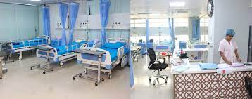
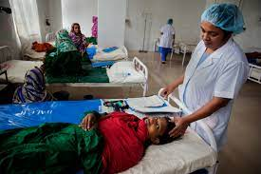
Some HMS Vs Our Ideas
OTHER HMS
SASTHO SEBA
MOST HMS PROVIDE THE CONNECTION INSIDE A HOSPITAL.
MANAGE THE DOCTORS, PATHOLOGY, AND PAYMENT-BILLING SYSTEM.
LEAST AMOUNT OF RECORD-SAVING TECH.
CENTRALIZED THE HOSPITAL SYSTEM INTO ONE UMBRELLA.
ALL DATA WILL BE COLLECTED FOR PATIENTS THROUGHOUT THEIR LIFESPAN.
IT WILL PROVIDE A ADVANTAGE TO COLLECTING HUGE MEDICAL HISTORY.

Slide 7
tools
JAVA SCRIPTS
MERN (a Node.js framework)
Express.js
Xampp SQL
Postman

Slide 8

What’s next
LOOKING AHEAD

Slide 9
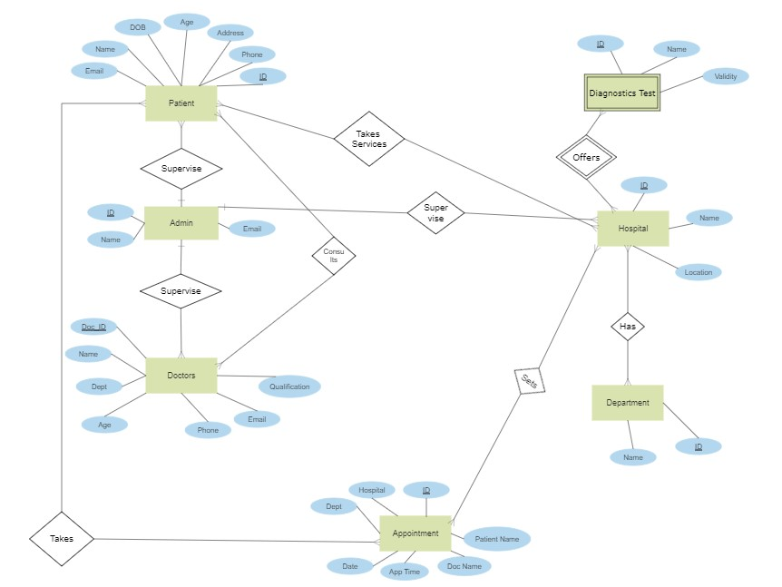
Diagrams

Slide 10
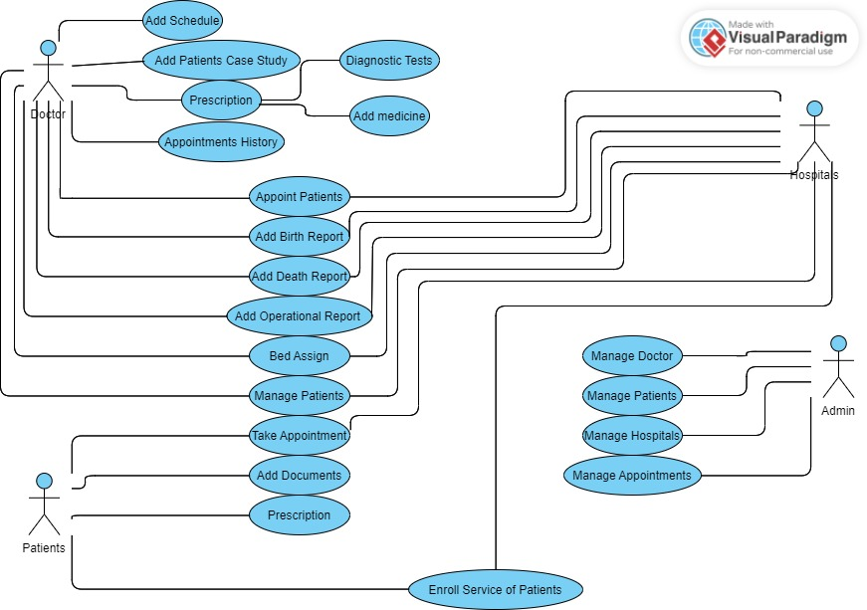
Diagrams

Slide 11

SUMMARY
COUNTRY LIKE BANGLADESH FACES MEDICAL UNITY AS THE MOST IMPORTANT.
APPROPRIATE TREATMENT IS ENSURED FOR ALL TYPES OF PEOPLE.
IT SHOULD BE IMPLEMENTED ALL OVER THE WORLD.

Slide 12



THANK YOU
SASTO SEBA
0179725603
NORTH-SOUTH.EDU

