Slide 1

Professor Hala Own
Web Programming CST8285_312
March 31,2024
Zhonghan Tang
Azadeh Sadeghtehrani
Yuchen Wang

Slide 2
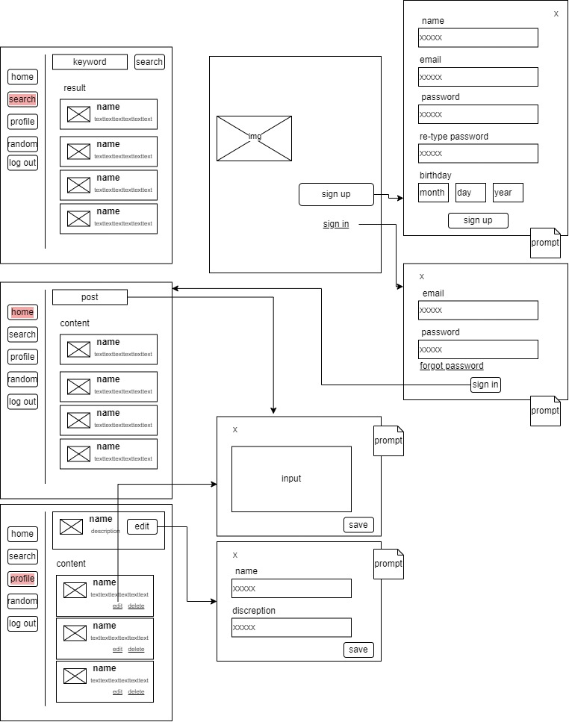
Web Map, WireFrame

Slide 3

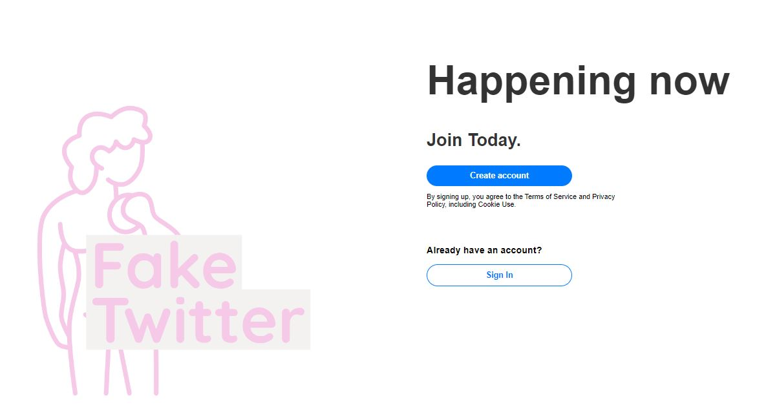
Fake Twitter
Address Sites
http://localhost/raw_twitter/pages/index.php
Create account
Sign In

Slide 4
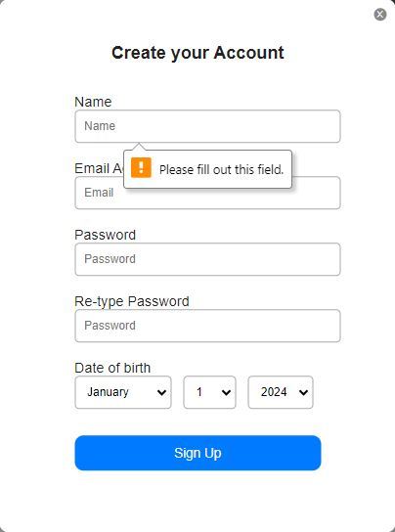
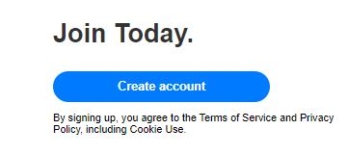
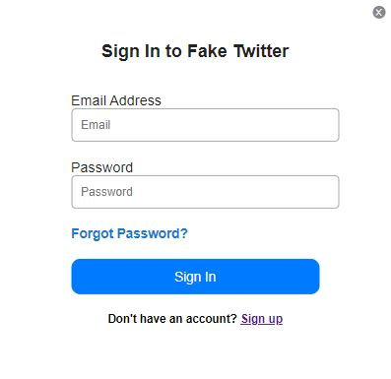
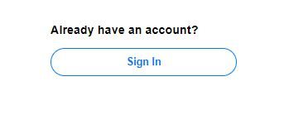
Sign-In & Sign-Up Form
Find sign-out option
Click "Create account"
Fill all the fields that required
Click sign-out
Access account
Go to login page
Enter Email and Password
Click "Sign In"
Access account

Slide 5
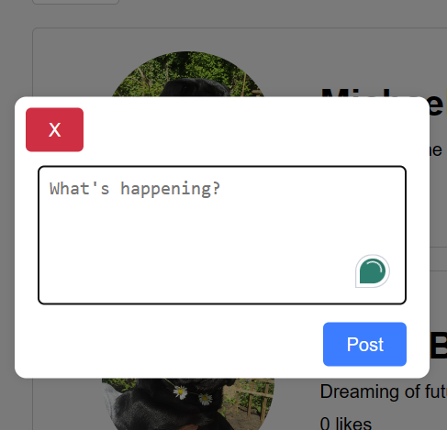
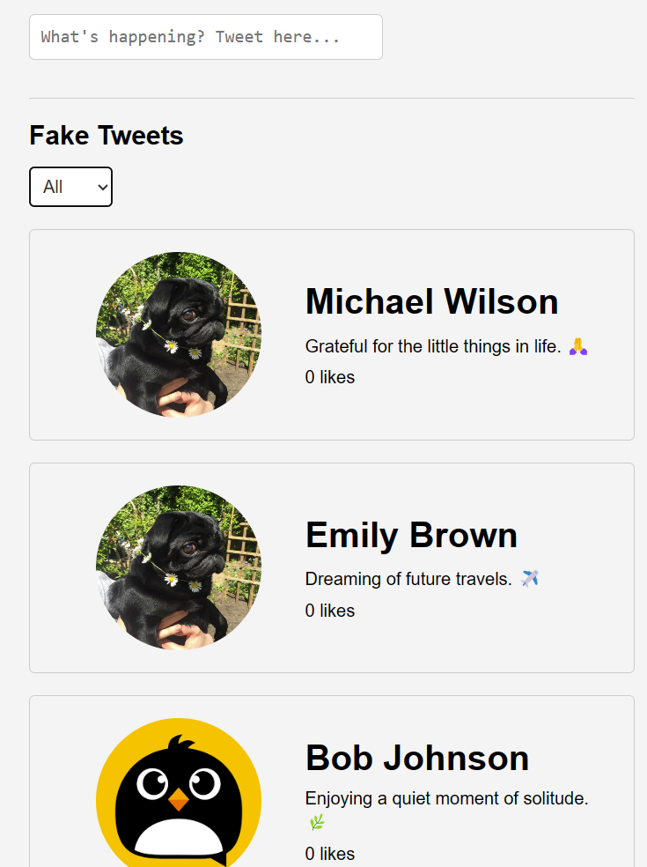
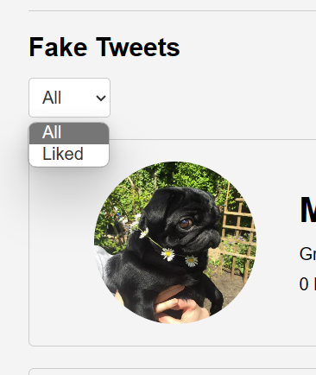
Home page
Users can post something at the top area
“click post" the content will be fill into database
filter that allows users to choose to see all tweets or tweets which has likes

Slide 6
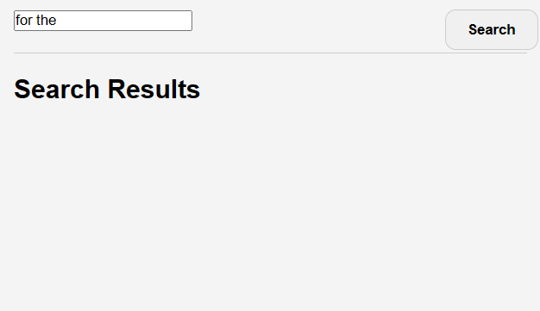
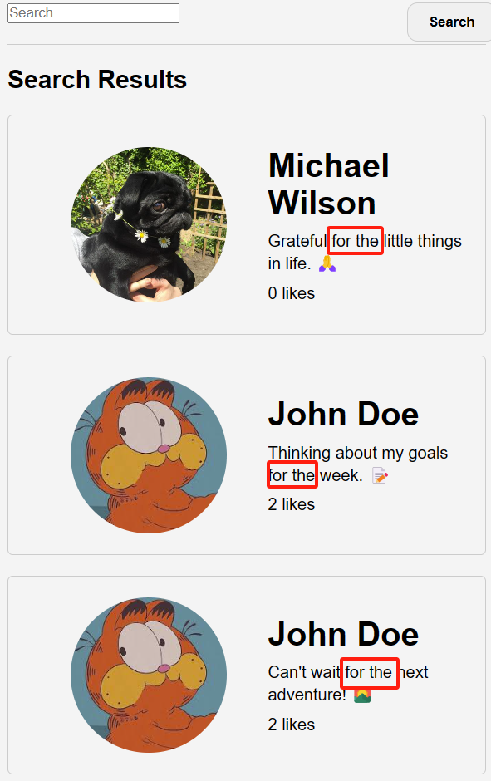
Search page
The content section is empty by default
User can fill keywords
Click search
The content with the keywords will be shown at the main area

Slide 7
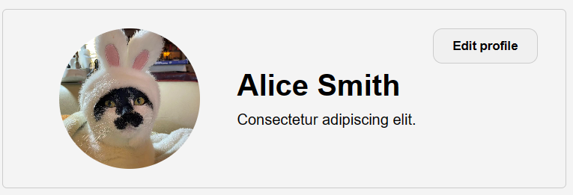
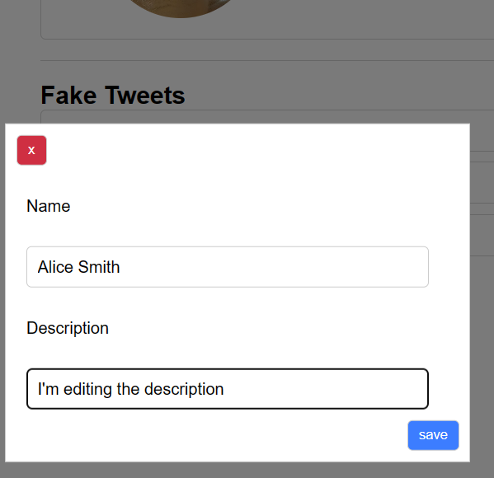
Profile & edit
The user’s information will be shown
Click “edit profile"
User information will be passed to the pop-up window
User and edit name and description
Click “save”
Pass to the database and displayed on the page

Slide 8
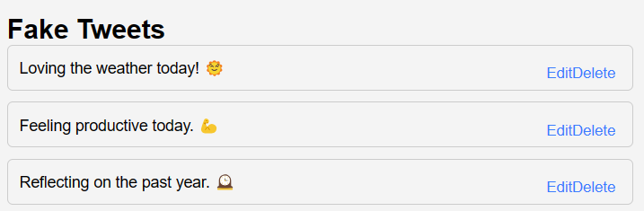
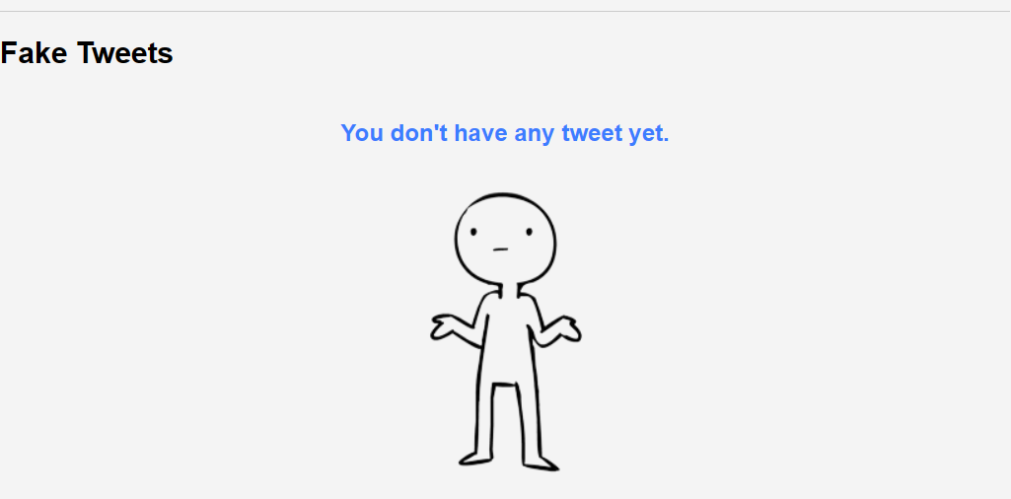
Tweets & edit
The tweet of this user will be shown at profile page
Click “edit profile"
Specific will be passed to the pop-up window
User and edit this tweet
Click submit
Pass to the database and displayed on the page
Users can also choose to delete the tweet

Slide 9
Thank you

