Slide 1


进度汇报
导师：史本云
汇报人：唐爱彬
2022/8

Slide 2
群体VS个人

Slide 3
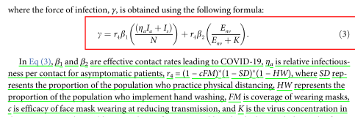
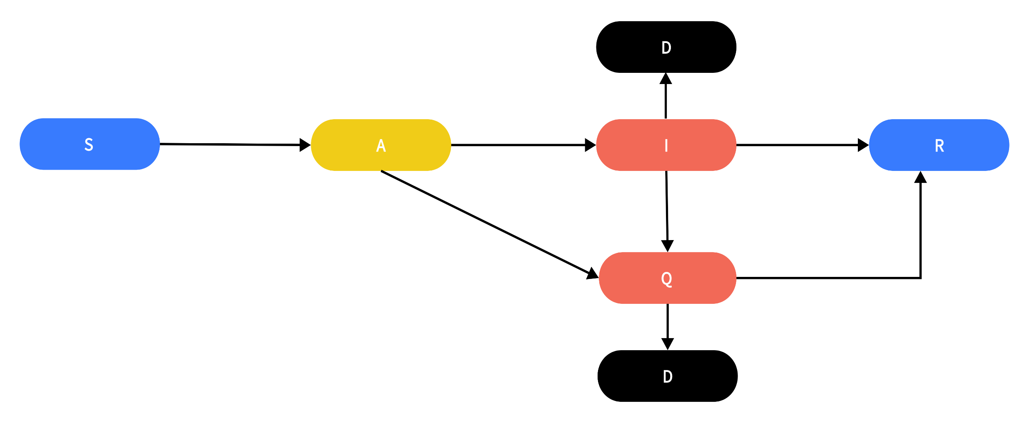












模型
$$r=(1−C_{FM})(1−C_{OL})$$
$$\frac{β\left(1−p\right)I}{N}r+\frac{\hat{β}pI}{N}r$$
$$α$$
$$σ$$
$$γ$$
$$ε_{1}ρ$$
$$ρ$$
$$γ$$
$$ε_{2}α$$
$$ρ$$
Testing rate
$$ε_{1}$$
detected rate
$$q$$
密接隔离

Slide 4






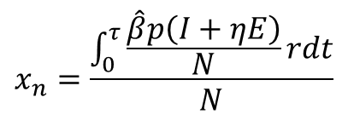

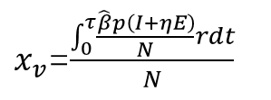
Individual payoff
$P_{v}=−x_{v}C_{iv}−C_{v}−C_{qi}$+incent
$$C_{v}$$
打疫苗的cost
$$P_{n}=−x_{n}C_{in}−C_{qi}$$
$$C_{iv}$$
打疫苗感染的cost
$$C_{in}$$
不打打疫苗感染的cost
$x_{v}$=$\frac{\int_{0}^{τ}{\frac{\hat{β}p\left(I+ηE\right)}{N}rdt}}{N}$
最终被感染的人/可以被感染的人
$$C_{qi}$$
个人隔离的cost(损失创造个人经济/个人支出）
$$x_{n}=\frac{\int_{0}^{τ}{\frac{\hat{β}p\left(I+ηE\right)}{N}rdt}}{N}$$

Slide 5
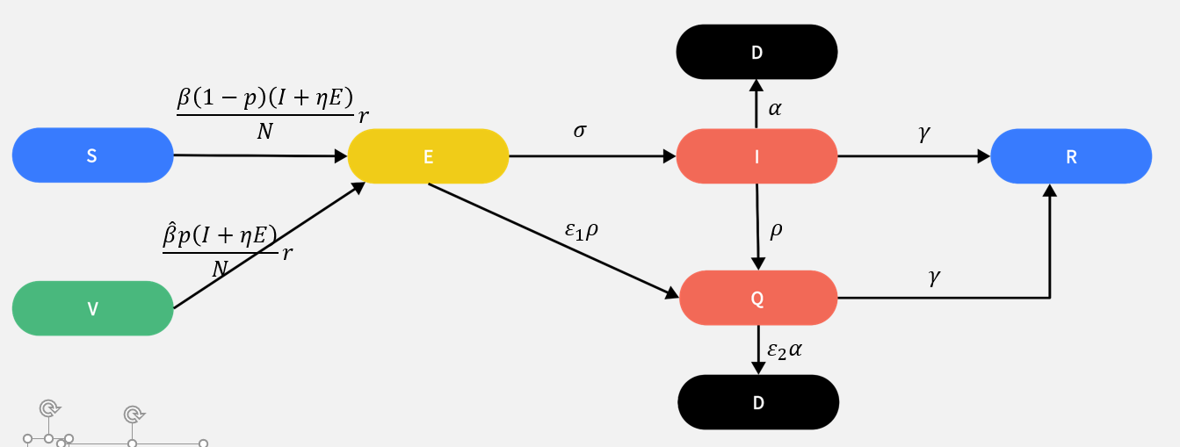
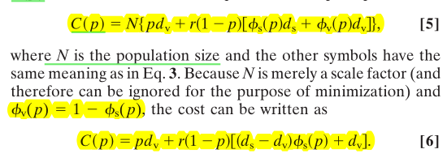

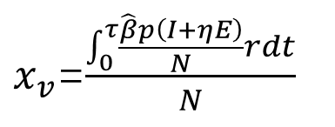

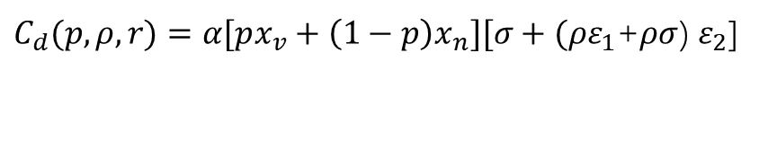



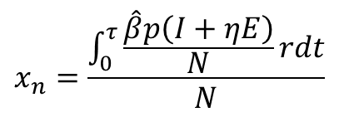
Group loss
Group loss
$C_{d}(p,ρ,r)=α[px_{v}+\left(1−p\right)x_{n}][σ+(ρε_{1}$+$ρσ$) $ε_{2}$]
$C_{q}(p,ρ,r)=[px_{v}+\left(1−p\right)x_{n}](ρε_{1}$+$ρσ$)
$C(p,ρ,r)=$ ${mC}_{d}$+ $C_{q}$
$ΔC$=$\frac{{C−C}_{standard}}{C_{standard}}$
$m$ default as 1000
$x_{v}$=$\frac{\int_{0}^{τ}{\frac{\hat{β}p\left(I+ηE\right)}{N}rdt}}{N}$
where r is the risk of attack
$$x_{n}=\frac{\int_{0}^{τ}{\frac{\hat{β}p\left(I+ηE\right)}{N}rdt}}{N}$$
$$r=(1−C_{FM})(1−C_{OL})$$

Slide 6







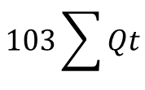

investment
$ΔC$=$\frac{{C−C}_{standard}}{C_{standard}}$
口罩
$$0.3Nt$$
$ΔC$=$\frac{C}{C_{standard}}$
疫苗
$$500pN$$
检测
$$3ρNt$$
$$103\sum{Qt}$$
隔离

