Slide 1
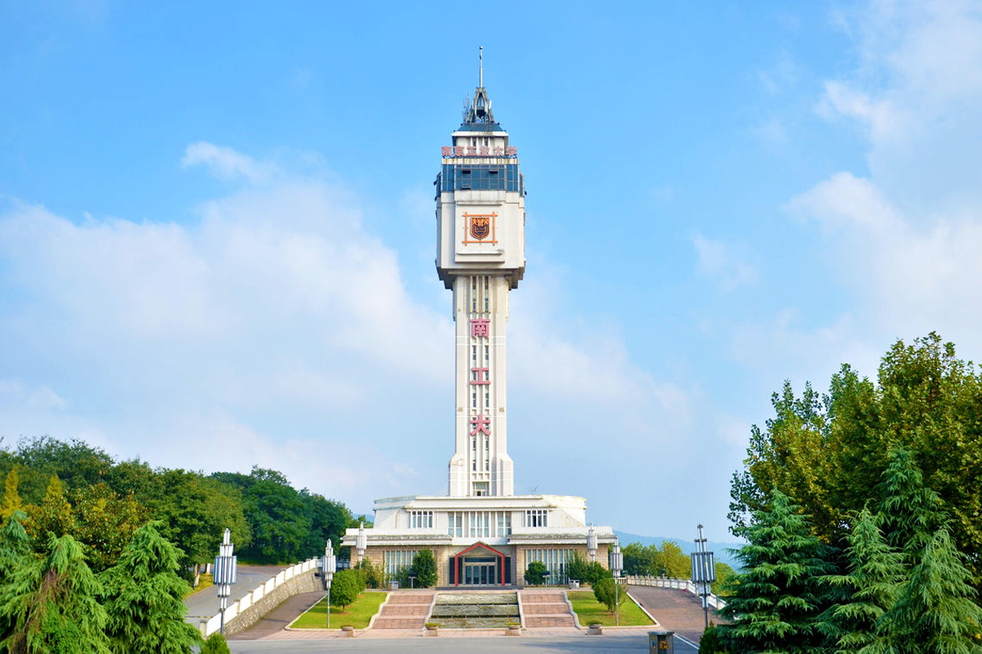

进度汇报
导师：史本云
汇报人：唐爱彬

Slide 2
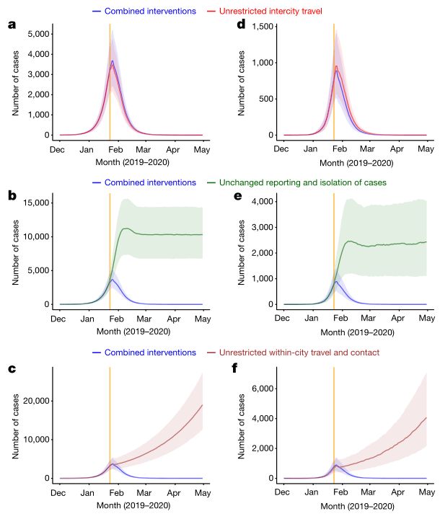
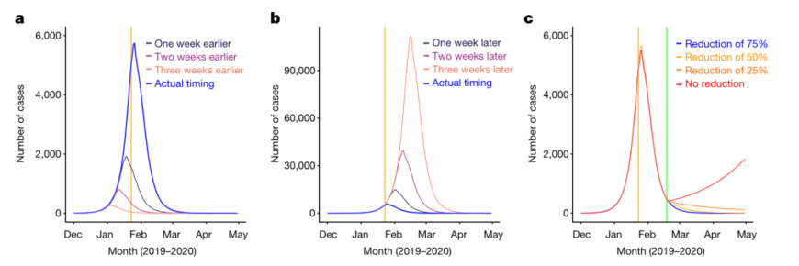
非药物干预
Lai, S., N. W. Ruktanonchai, L. Zhou, O. Prosper, W. Luo, J. R. Floyd, A. Wesolowski, M. Santillana, C. Zhang, X. Du, H. Yu & A. J. Tatem (2020) Effect of non-pharmaceutical interventions to contain COVID-19 in China. Nature, 585, 410-413
采取了城际旅行限制措施
重视早期发现和隔离病例
限制接触和保持社交距离

Slide 3
Changing pattern of travel and contact across mainland China under the COVID-19 outbreak and interventions in 2020, compared to normal travel patterns during CNY holiday in 2014
Date | Percentage of travel and contact | Standard deviation | Note
Before 2020-1-23 | 100% as normal | NA
2020/1/23 | 90.40% | 10.40%
2020/1/24 | 88.20% | 12.60%
2020/1/25 | 82.30% | 17.30%
2020/1/26 | 86.60% | 19.70%
2020/1/27 | 75.40% | 26.60%
2020/1/28 | 64.70% | 28.80%
2020/1/29 | 53.60% | 27.50%
2020/1/30 | 46.90% | 25.10%
2020/1/31 | 33.70% | 17.20%
2020/2/1 | 29.00% | 14.10%
2020/2/2 | 35.80% | 18.00%

Slide 4
The average days from illness onset to report of the first case reported by each county in mainland China
Date | Median (days) | Inter-quatile range (days)
 |  | q1 | q3
Before 2020-1-16 | Using values on January 16, 2020
2020/1/16 | 11 | 10 | 15
2020/1/17 | 11 | 9 | 13
2020/1/18 | 11 | 8 | 12
2020/1/19 | 10 | 8 | 11
2020/1/20 | 9 | 7 | 10
2020/1/21 | 8 | 6.75 | 9.25
2020/1/22 | 7 | 5 | 9
2020/1/23 | 6 | 5 | 8
2020/1/24 | 5 | 3 | 7
2020/1/25 | 5 | 4 | 6
2020/1/26 | 4 | 3 | 5
2020/1/27 | 3 | 2 | 4
2020/1/28 | 2 | 1 | 4
2020/1/29 | 2 | 1 | 3.5
2020/1/30 | 2 | 1 | 3
2020/1/31 | 2 | 1 | 3
Since 2020-2-1 | Using values on January 31, 2020

Slide 5
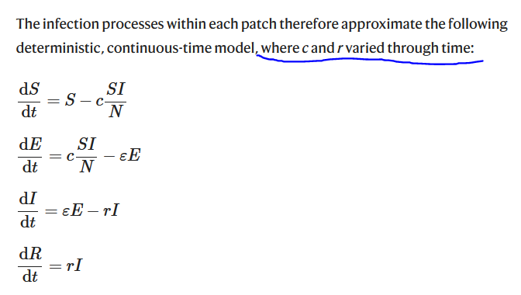

Slide 6
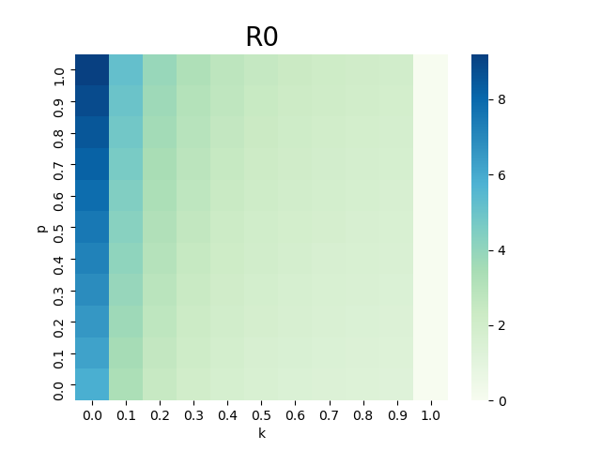
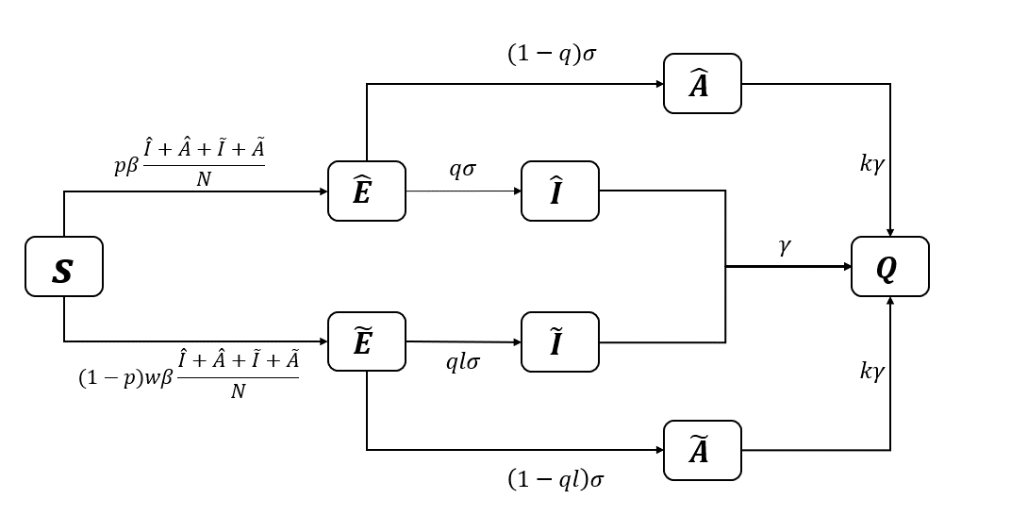
早期的隔离干预

Slide 7
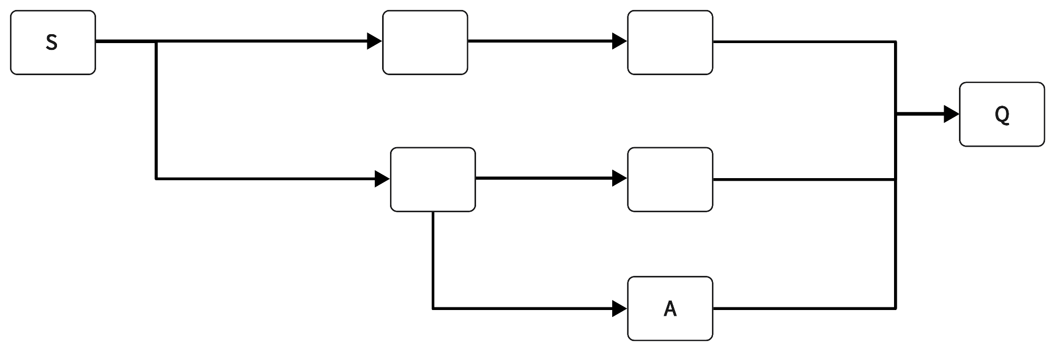












1
$$pβS\frac{\hat{I}+\tilde{I}+A}{N}$$
$$σ$$
$$γ$$
$$\hat{E}$$
$$\hat{I}$$
$$\left(1−p\right)wβS\frac{\hat{I}+\tilde{I}+A}{N}$$
$$lσ$$
$$γ$$
$$\tilde{E}$$
$$\tilde{I}$$
$$\left(1−l\right)σ$$
$$kγ$$

Slide 8
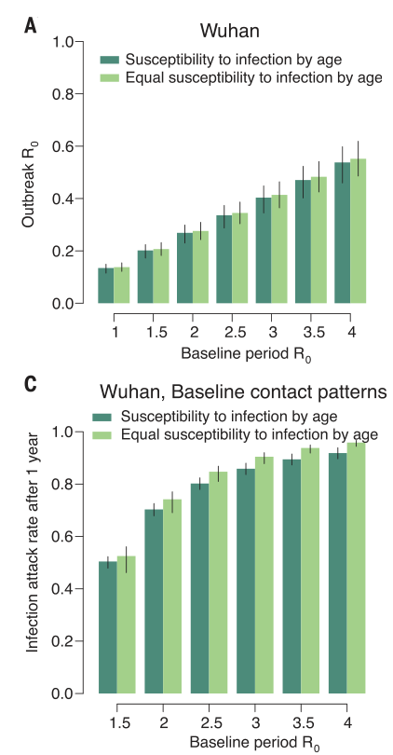
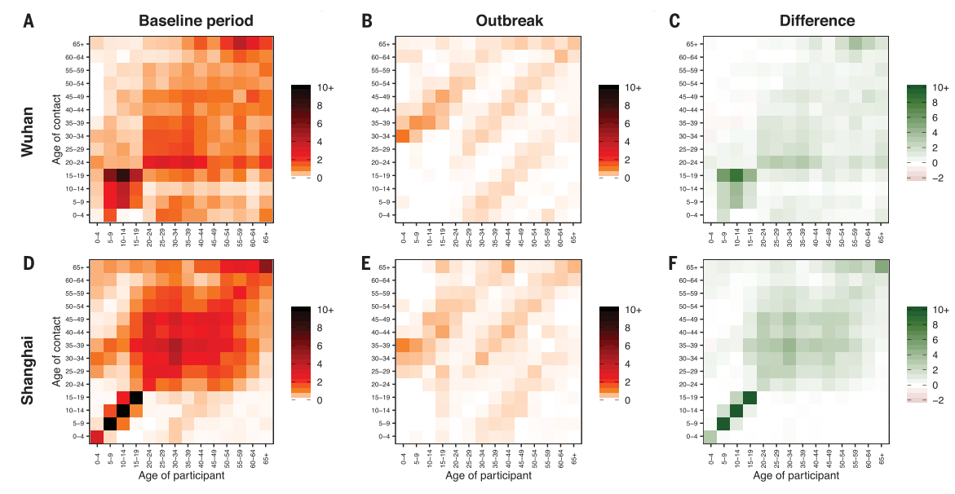
隔离ganyu
Zhang, J., M. Litvinova, Y. Liang, Y. Wang & H. Yu (2020) Changes in contact patterns shape the dynamics of the COVID-19 outbreak in China. Science, 368, eabb8001.
学校关闭，工作限制

Slide 9
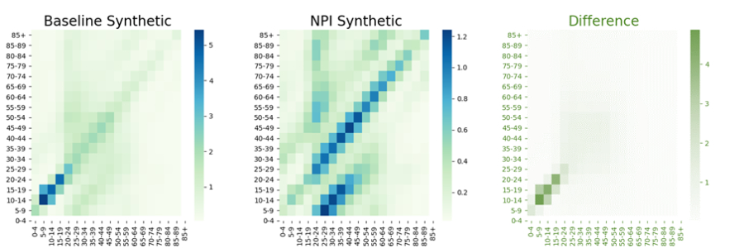
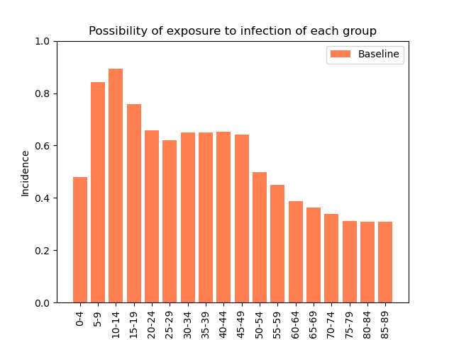
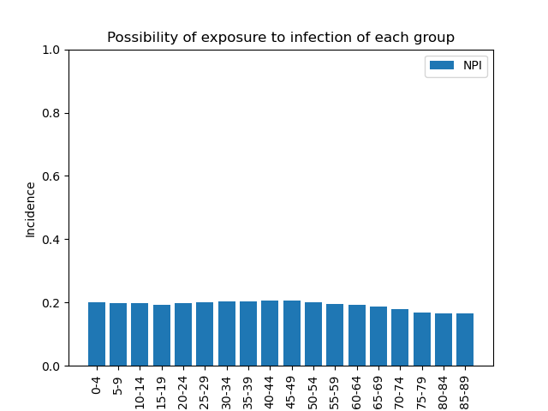

Slide 10
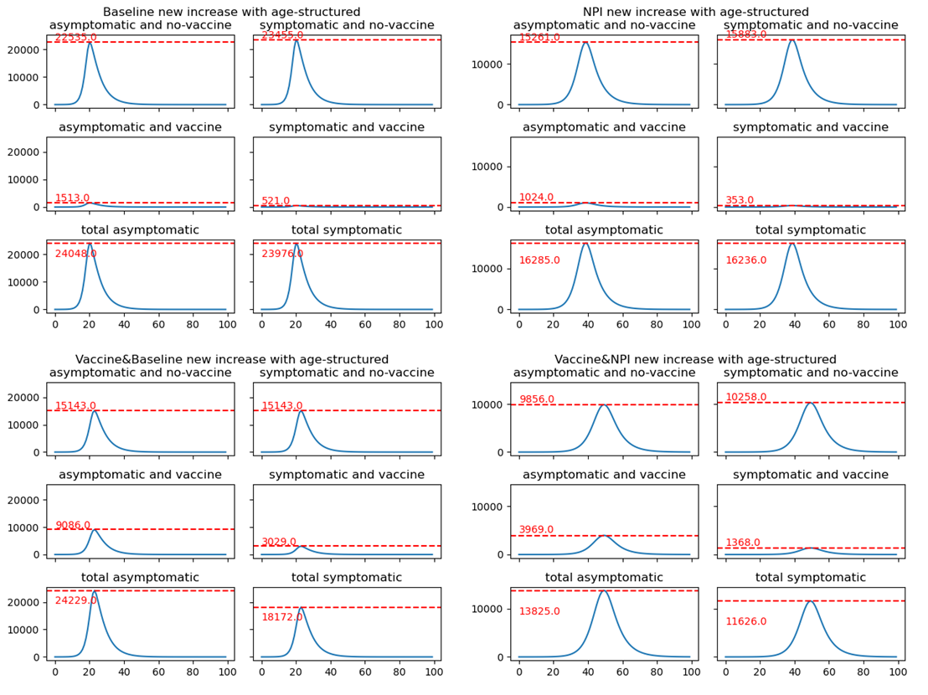

Slide 11
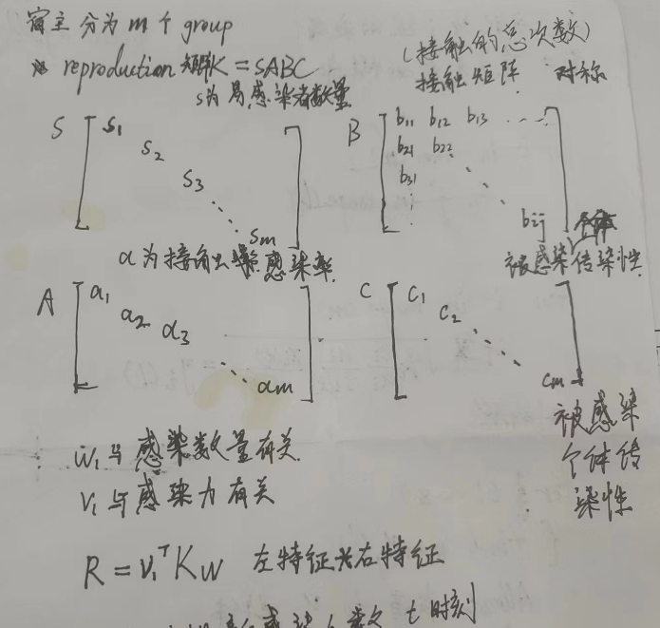
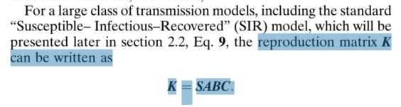
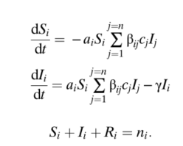
疫苗分配

Slide 12



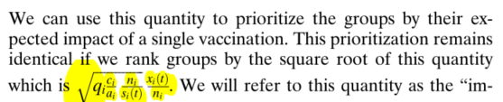
接种对繁殖矩阵的扰动

Slide 13
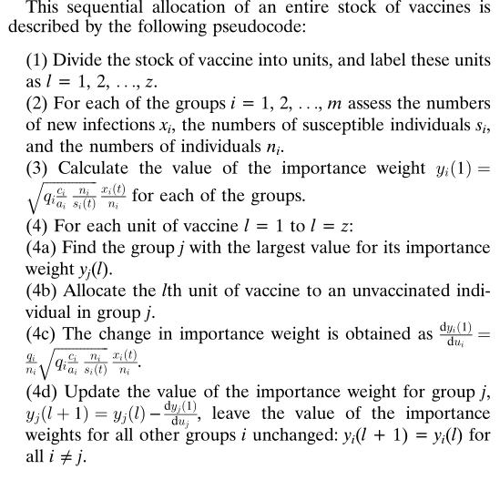
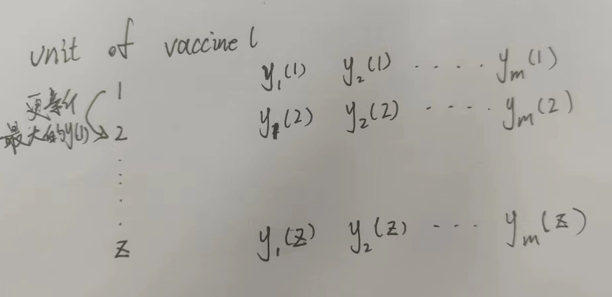
疫苗分配

Slide 14
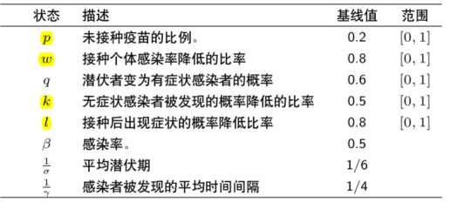
模型

Slide 15
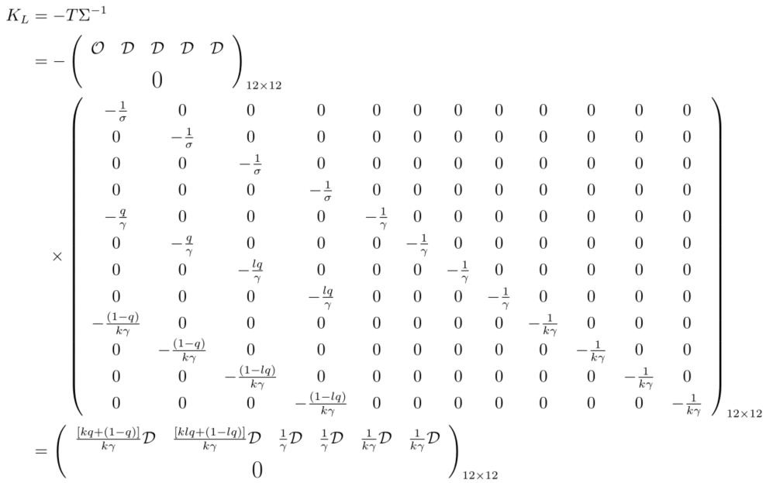
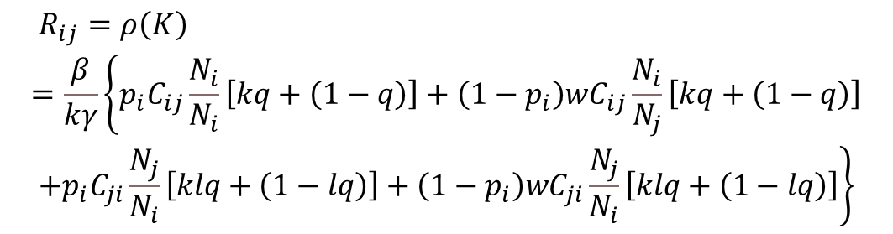
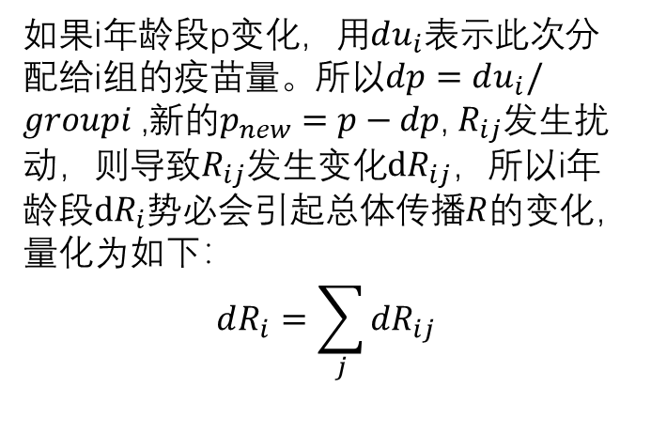
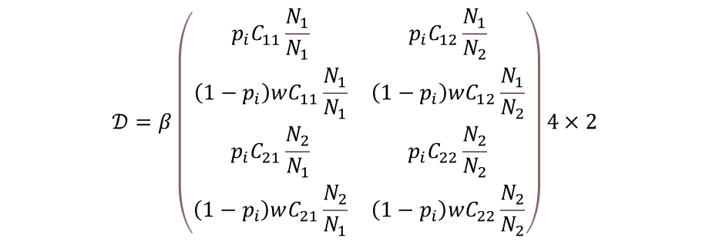
$$T={\left(\begin{matrix}𝒪 & 𝒟 & 𝒟 & 𝒟 & 𝒟 \\ & & 0 & & \end{matrix}\right)}_{12×12}$$
$$𝒟=β\left(\begin{matrix}p_{i}C_{11}\frac{N_{1}}{N_{1}} & p_{i}C_{12}\frac{N_{1}}{N_{2}} \\ \left(1−p_{i}\right)wC_{11}\frac{N_{1}}{N_{1}} & \left(1−p_{i}\right)wC_{12}\frac{N_{1}}{N_{2}} \\ p_{i}C_{21}\frac{N_{2}}{N_{1}} & p_{i}C_{22}\frac{N_{2}}{N_{2}} \\ \left(1−p_{i}\right)wC_{21}\frac{N_{2}}{N_{1}} & \left(1−p_{i}\right)wC_{22}\frac{N_{2}}{N_{2}}\end{matrix}\right)4×2$$
如果i年龄段p变化，用$du_{i}$表示此次分配给i组的疫苗量。所以$dp=du_{i}/groupi$ ,新的$p_{new}=p−dp$, $R_{ij}$发生扰动，则导致$R_{ij}$发生变化$dR_{ij}$，所以i年龄段$dR_{i}$势必会引起总体传播$R$的变化，量化为如下：
$$dR_{i}=\sum_{j}{{dR}_{ij}}$$
$$\begin{aligned}&R_{ij}=ρ\left(K\right) \\ =\frac{β}{kγ}\left\{p_{i}C_{ij}\frac{N_{i}}{N_{i}}\left[kq+\left(1−q\right)\right]+\left(1−p_{i}\right)wC_{ij}\frac{N_{i}}{N_{j}}\left[kq+\left(1−q\right)\right]\right. \\ &\left.+p_{i}C_{ji}\frac{N_{j}}{N_{i}}\left[klq+\left(1−lq\right)\right]+\left(1−p_{i}\right)wC_{ji}\frac{N_{j}}{N_{i}}\left[klq+\left(1−lq\right)\right]\right\}\end{aligned}$$

Slide 16
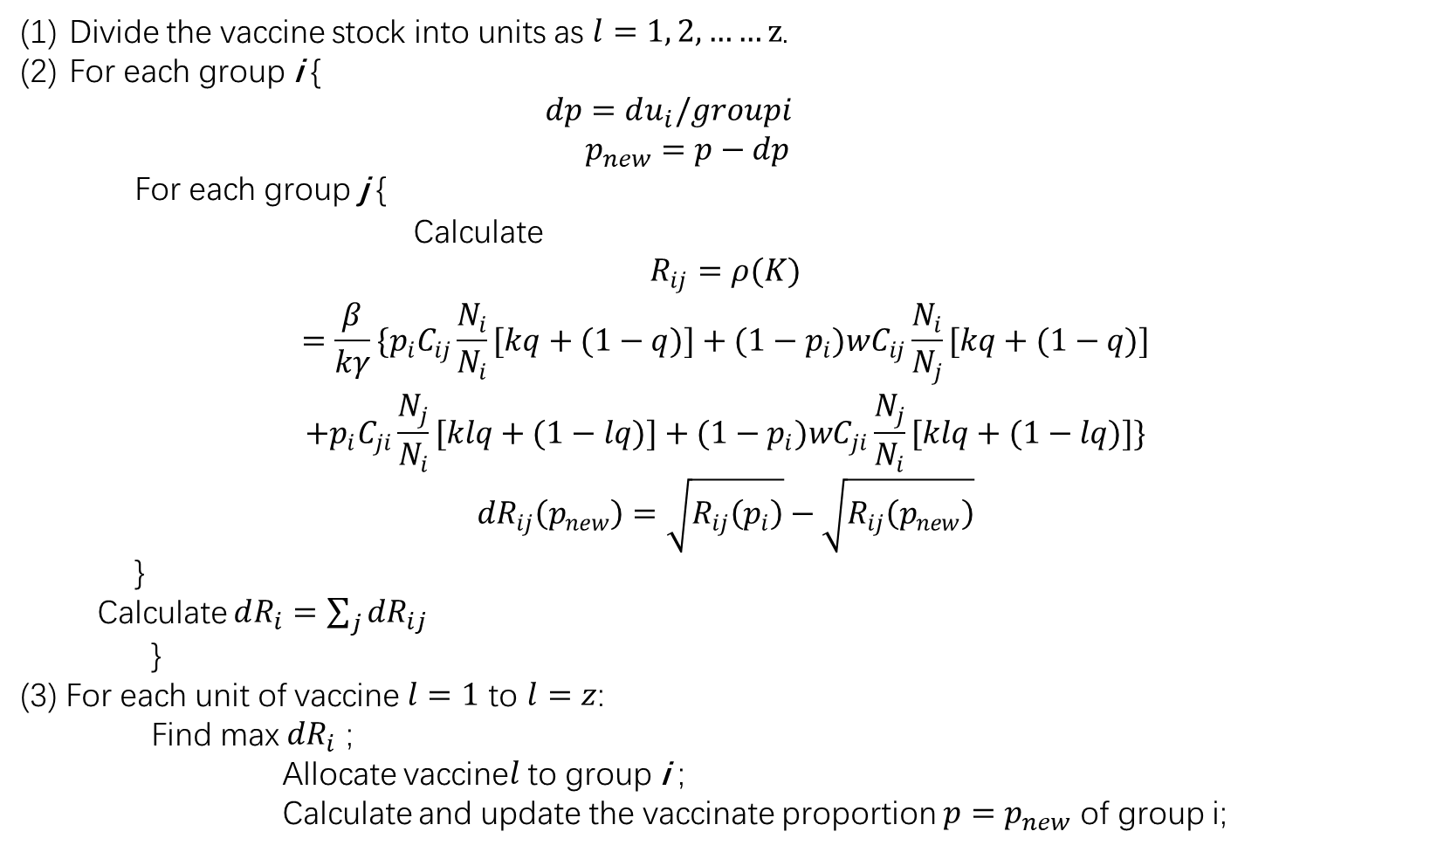
疫苗分配算法
Divide the vaccine stock into units as $l=1, 2,……z$.
For each group i {
$$dp=du_{i}/groupi$$
$$p_{new}=p−dp$$
For each group j {
Calculate
$$\begin{aligned}R_{ij}=ρ(K) \\ =\frac{β}{kγ}\{p_{i}C_{ij}\frac{N_{i}}{N_{i}}[kq+(1−q)]+(1−p_{i})wC_{ij}\frac{N_{i}}{N_{j}}[kq+(1−q)] \\ +p_{i}C_{ji}\frac{N_{j}}{N_{i}}[klq+(1−lq)]+(1−p_{i})wC_{ji}\frac{N_{j}}{N_{i}}[klq+(1−lq)]\}\end{aligned}$$
$${dR}_{ij}\left(p_{new}\right)=\sqrt{R_{ij}\left(p_{i}\right)}−\sqrt{R_{ij}\left(p_{new}\right)}$$
}
Calculate $dR_{i}=\sum_{j}{{dR}_{ij}}$
}
(3) For each unit of vaccine $l=1$ to $l=z$:
Find max ${dR}_{i}$ ;
Allocate vaccine$l$ to group i ;
Calculate and update the vaccinate proportion $p=p_{new}$ of group i;

Slide 17
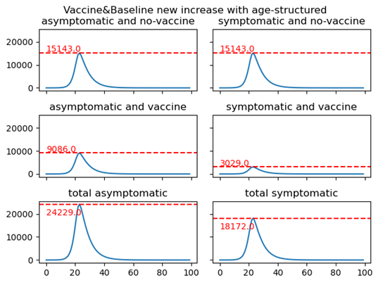
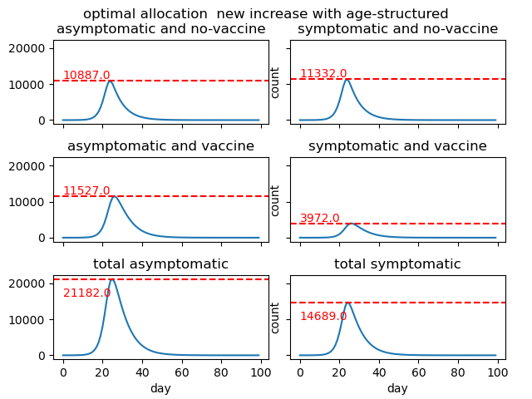

Slide 18
