Slide 1
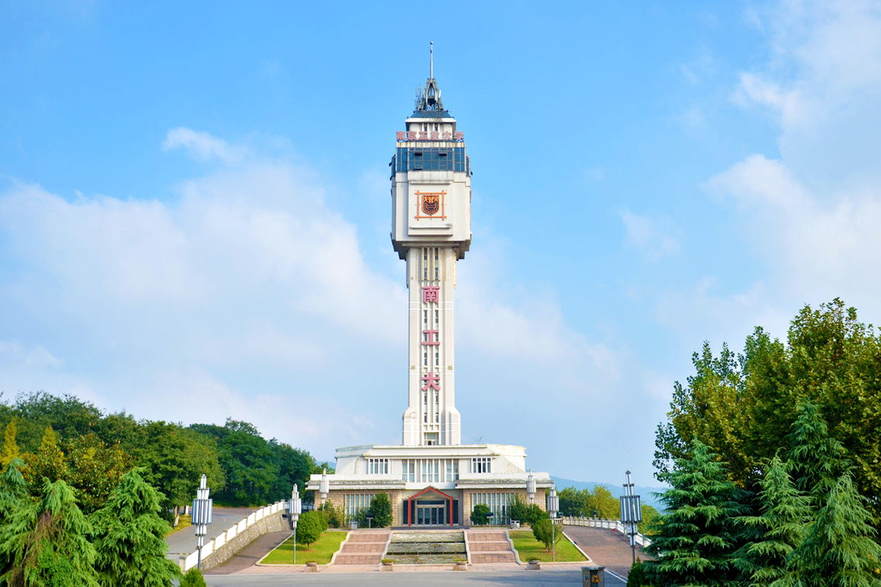

进度汇报
导师：史本云
汇报人：唐爱彬

Slide 2
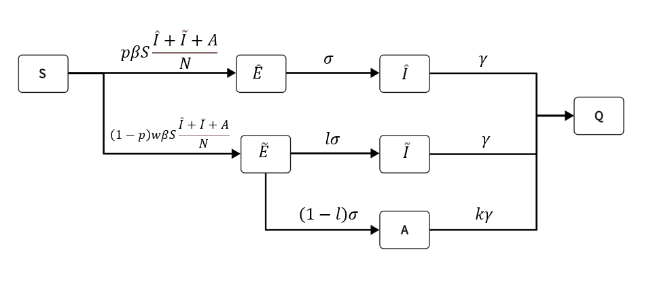
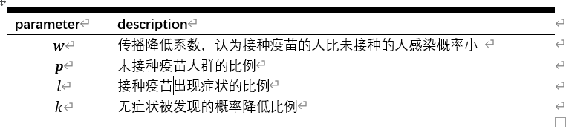
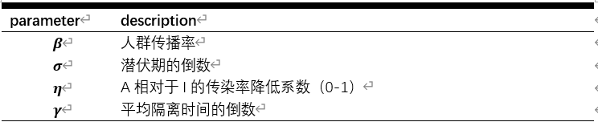
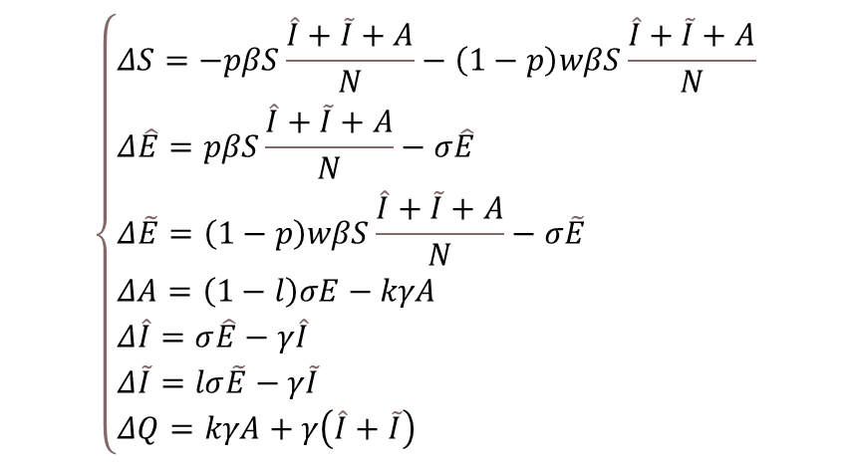
模型
$$\left\{\begin{aligned}&ΔS=−pβS\frac{\hat{I}+\tilde{I}+A}{N}−\left(1−p\right)wβS\frac{\hat{I}+\tilde{I}+A}{N} \\ &Δ\hat{E}=pβS\frac{\hat{I}+\tilde{I}+A}{N}−σ\hat{E} \\ &Δ\tilde{E}=\left(1−p\right)wβS\frac{\hat{I}+\tilde{I}+A}{N}−σ\tilde{E} \\ &ΔA=\left(1−l\right)σE−kγA \\ &Δ\hat{I}=σ\hat{E}−γ\hat{I} \\ &Δ\tilde{I}=lσ\tilde{E}−γ\tilde{I} \\ &ΔQ=kγA+γ\left(\hat{I}+\tilde{I}\right)\end{aligned}\right.$$
ˆ·表示未接种，˜·表示已接种,S为易感者，E为暴露这，I为感染则，A为无症状感染者，Q是被隔离者

Slide 3
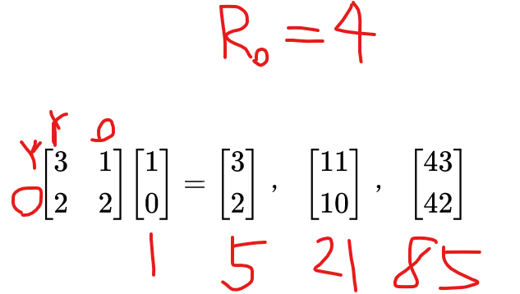

基本再生数
R0在数学上的特征是将感染传播视为一个“人口统计学过程”，在这个过程中，生产后代不被视为人口统计学意义上的生育，而是通过传播引起新的感染(我们将其称为“流行病学出生”)。
$$R0=ρ\left(K\right)=\frac{β}{kγ}\left\{pk+\left(1−p\right)w\left[\left(1−l\right)+kl\right]\right\}$$
Diekmann O, Heesterbeek J A P, Roberts M G. The construction of next-generation matrices for compartmental epidemic models[J]. Journal of the royal society interface, 2010, 7(47): 873-885.

Slide 4
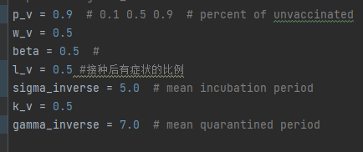
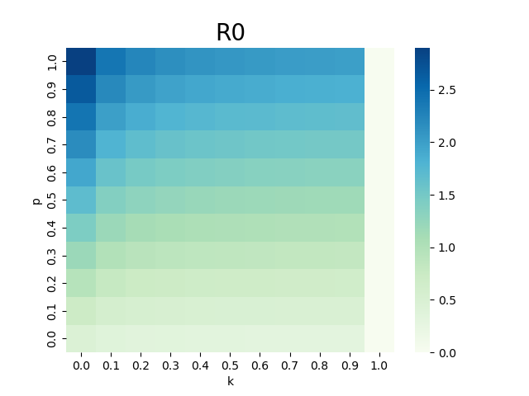
Sinovac疫苗：一项在巴西进行的III期临床试验表明，Sinovac疫苗的总有效性为50.38%，对轻度症状的病例保护效果为78%（Wu et al., 2021）。
Wu, Z., Hu, Y., Xu, M., Chen, Z., Yang, W., Jiang, Z., ... & Jin, R. (2021). Efficacy and safety of a COVID-19 inactivated vaccine in healthcare professionals in Brazil: The PROFISCOV Study. Research Square.
临床试验数据显示，中国的新冠疫苗，如灭活疫苗和重组蛋白疫苗，对预防COVID-19感染和减少疾病严重程度具有一定的保护作用。例如，一项在巴西进行的试验表明，接种中国的冠状病毒灭活疫苗后，感染新冠病毒的风险降低了50.7%（Vaccari et al., 2021）
Vaccari, M., Luque, R., Gomez, C. E., Cahn, P., Rolón, M. J., Pérez, M. J., ... & SARS-CoV-2 Vaccine Study Group (2021). A Randomized, Double-Blind, Placebo-Controlled Phase 3 Study with a 2: 1 Randomization of a COVID-19 Vaccine Candidate, BBV152 (COVAXIN™),
一项在巴基斯坦进行的研究表明，接种中国国药集团的疫苗后，感染新冠病毒后出现症状的风险降低了93.4%（Baden et al., 2021）。此外，一些研究也表明，接种中国疫苗后可以显著降低感染后出现重症和死亡的风险。例如，一项在智利进行的研究表明，接种中国国药集团的疫苗后，感染新冠病毒后死亡的风险降低了80%（Krause et al., 2021）。
Baden, L. R., El Sahly, H. M., Essink, B., Kotloff, K., Frey, S., Novak, R., ... & Follmann, D. (2021). Efficacy and Safety of the mRNA-1273 SARS-CoV-2 Vaccine. New England Journal of Medicine, 384(5), 403-416. Krause, P. R., Fleming, T. R., Peto, R., Longini, I. M., Figueroa, J. P., Sterne, J. A. C., & Cravioto, A. (2021). Considerations in boosting COVID-19 vaccine immune responses. The Lancet, 398(10298), 1377-1380.
，COVID-19的潜伏期平均为5.1天，中位数为4.8天，95%置信区间为2.1到11.1天（Lauer et al., 2020）。
Lauer, S. A., Grantz, K. H., Bi, Q., Jones, F. K., Zheng, Q., Meredith, H. R., ... & Lessler, J. (2020). The incubation period of coronavirus disease 2019 (COVID-19) from publicly reported confirmed cases: estimation and application. Annals of internal medicine, 172(9), 577-582

Slide 5
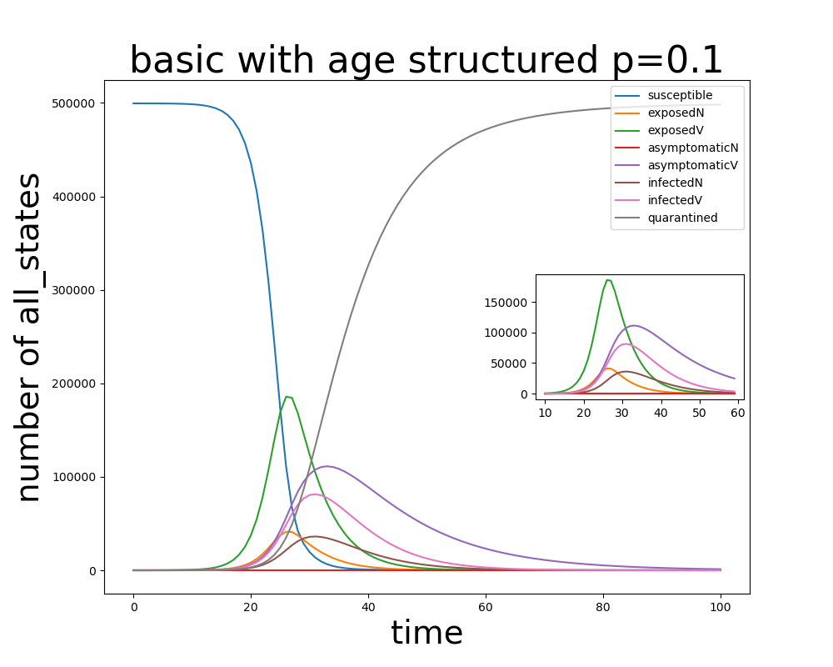
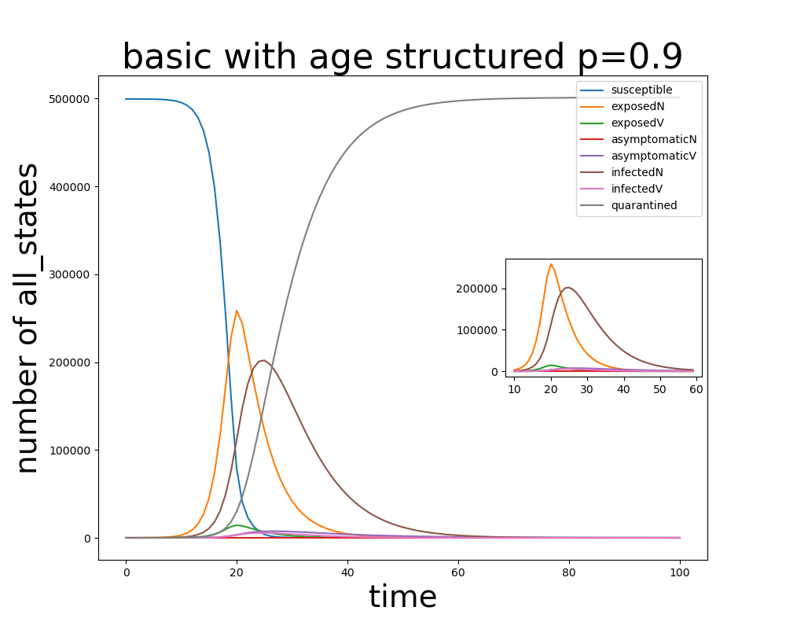

Slide 6
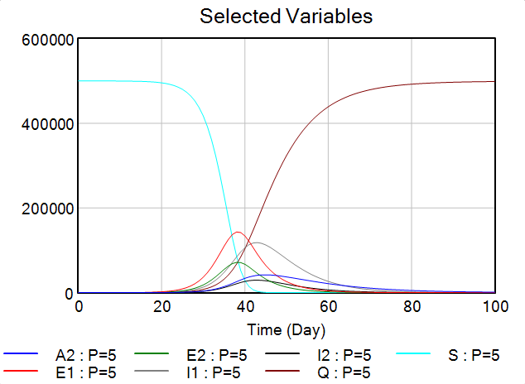
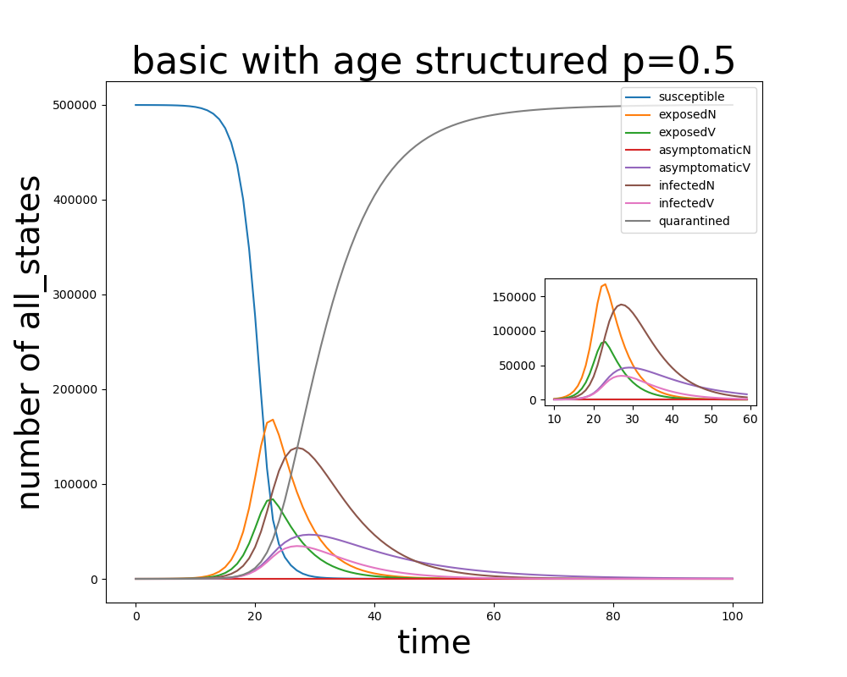

Slide 7
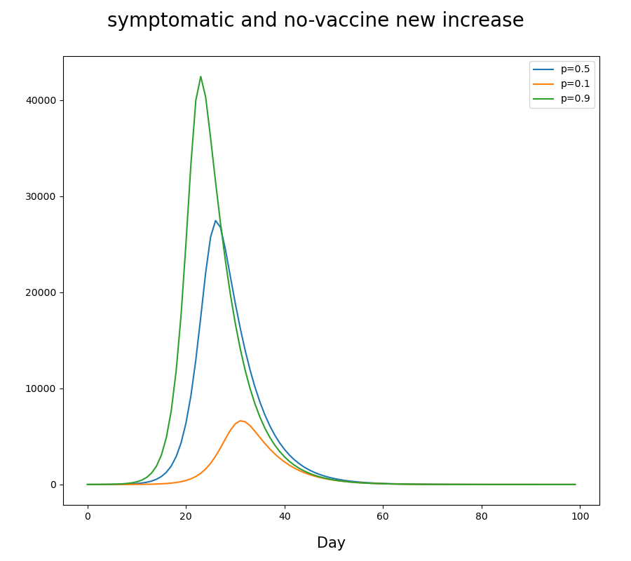
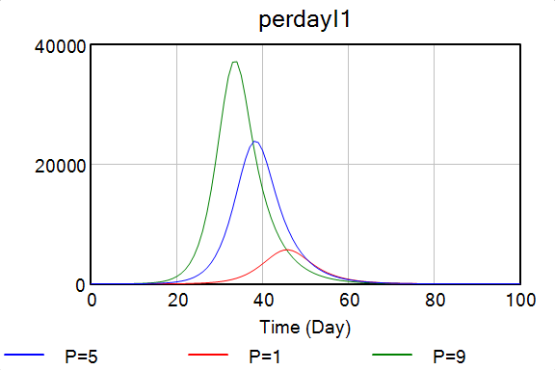

Slide 8
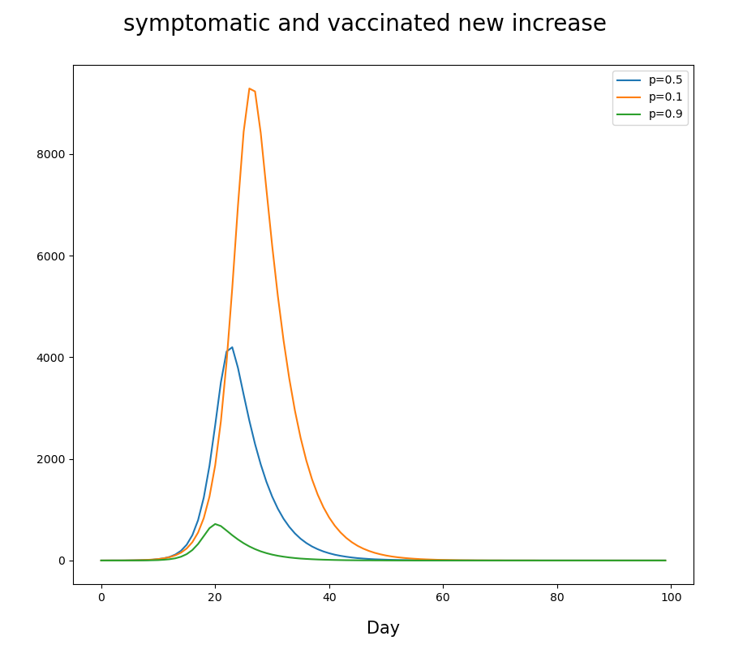
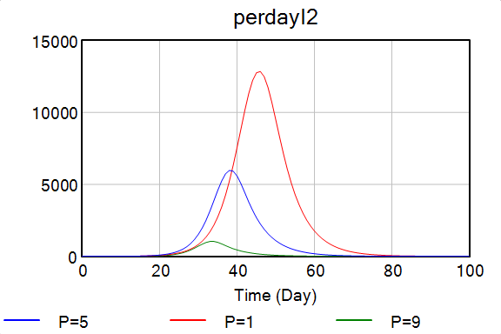

Slide 9
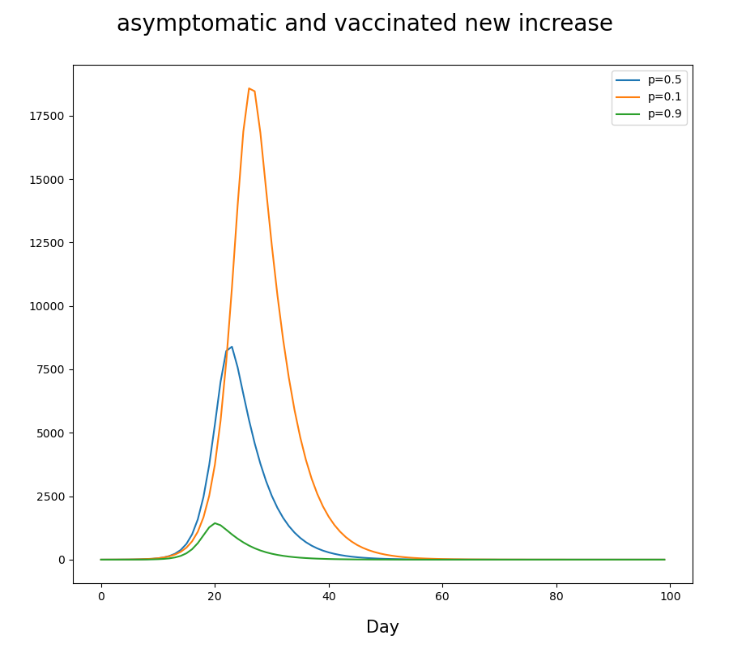
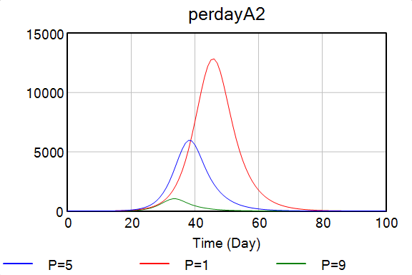

Slide 10
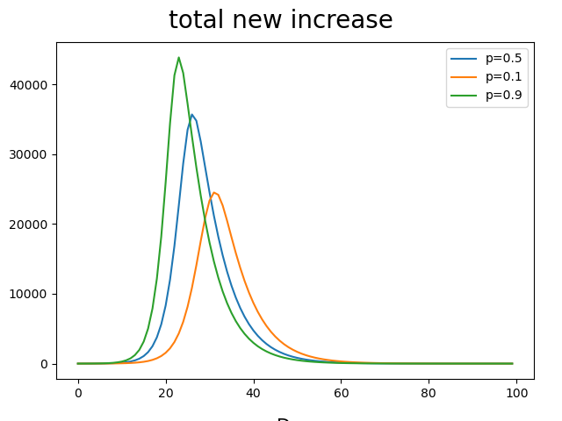
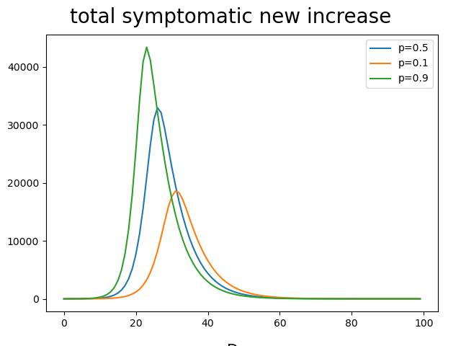

Slide 11
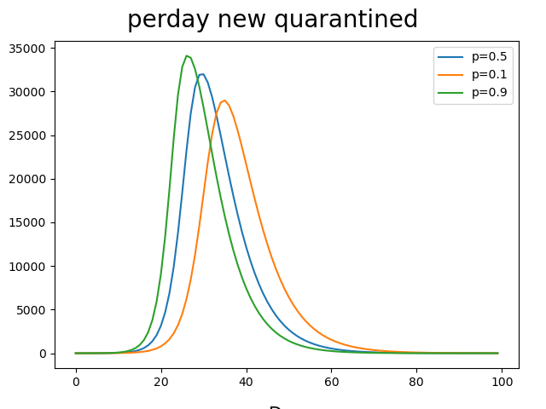

Slide 12
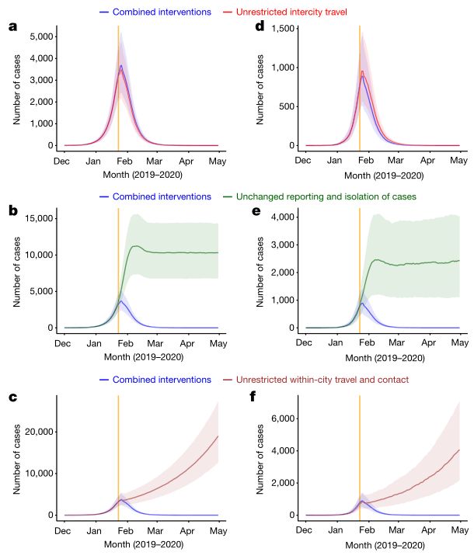
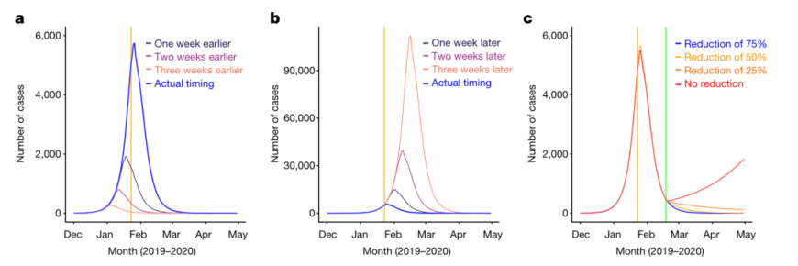
非药物干预
Lai, S., N. W. Ruktanonchai, L. Zhou, O. Prosper, W. Luo, J. R. Floyd, A. Wesolowski, M. Santillana, C. Zhang, X. Du, H. Yu & A. J. Tatem (2020) Effect of non-pharmaceutical interventions to contain COVID-19 in China. Nature, 585, 410-413
采取了城际旅行限制措施
重视早期发现和隔离病例
限制接触和保持社交距离

Slide 13
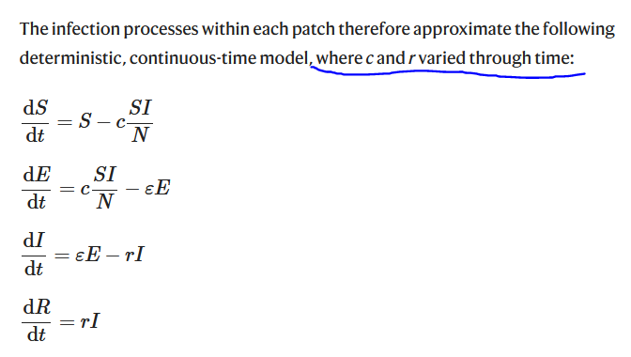

Slide 14
Changing pattern of travel and contact across mainland China under the COVID-19 outbreak and interventions in 2020, compared to normal travel patterns during CNY holiday in 2014
Date | Percentage of travel and contact | Standard deviation | Note
Before 2020-1-23 | 100% as normal | NA
2020/1/23 | 90.40% | 10.40%
2020/1/24 | 88.20% | 12.60%
2020/1/25 | 82.30% | 17.30%
2020/1/26 | 86.60% | 19.70%
2020/1/27 | 75.40% | 26.60%
2020/1/28 | 64.70% | 28.80%
2020/1/29 | 53.60% | 27.50%
2020/1/30 | 46.90% | 25.10%
2020/1/31 | 33.70% | 17.20%
2020/2/1 | 29.00% | 14.10%
2020/2/2 | 35.80% | 18.00%

Slide 15
The average days from illness onset to report of the first case reported by each county in mainland China
Date | Median (days) | Inter-quatile range (days)
 |  | q1 | q3
Before 2020-1-16 | Using values on January 16, 2020
2020/1/16 | 11 | 10 | 15
2020/1/17 | 11 | 9 | 13
2020/1/18 | 11 | 8 | 12
2020/1/19 | 10 | 8 | 11
2020/1/20 | 9 | 7 | 10
2020/1/21 | 8 | 6.75 | 9.25
2020/1/22 | 7 | 5 | 9
2020/1/23 | 6 | 5 | 8
2020/1/24 | 5 | 3 | 7
2020/1/25 | 5 | 4 | 6
2020/1/26 | 4 | 3 | 5
2020/1/27 | 3 | 2 | 4
2020/1/28 | 2 | 1 | 4
2020/1/29 | 2 | 1 | 3.5
2020/1/30 | 2 | 1 | 3
2020/1/31 | 2 | 1 | 3
Since 2020-2-1 | Using values on January 31, 2020

Slide 16
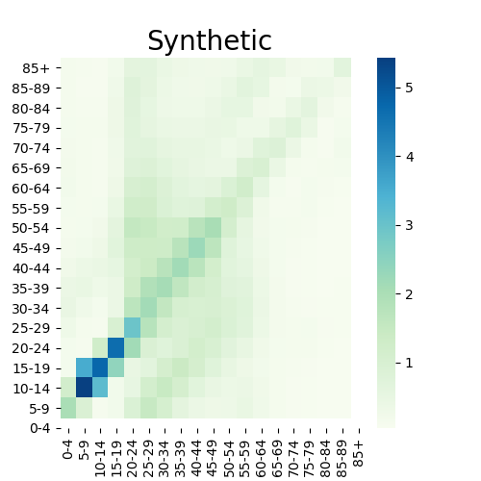
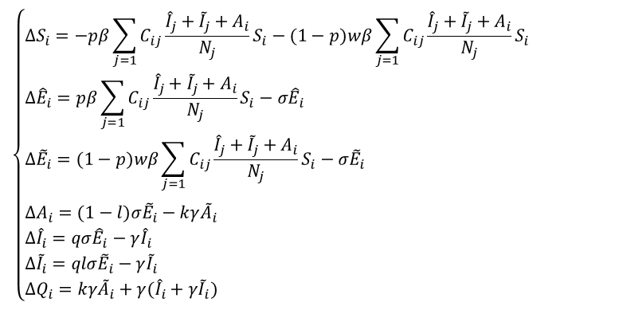
$$\left\{\begin{aligned}&ΔS_{i}=−pβ\sum_{j=1}{C_{ij}}\frac{{\hat{I}}_{j}+{\tilde{I}}_{j}+A_{i}}{N_{j}}S_{i}−(1−p)wβ\sum_{j=1}{C_{ij}}\frac{{\hat{I}}_{j}+{\tilde{I}}_{j}+A_{i}}{N_{j}}S_{i} \\ &Δ{\hat{E}}_{i}=pβ\sum_{j=1}{C_{ij}}\frac{{\hat{I}}_{j}+{\tilde{I}}_{j}+A_{i}}{N_{j}}S_{i}−σ{\hat{E}}_{i} \\ &Δ{\tilde{E}}_{i}=(1−p)wβ\sum_{j=1}{C_{ij}}\frac{{\hat{I}}_{j}+{\tilde{I}}_{j}+A_{i}}{N_{j}}S_{i}−σ{\tilde{E}}_{i} \\ & \\ &ΔA_{i}=(1−l)σ{\tilde{E}}_{i}−kγ{\tilde{A}}_{i} \\ &Δ{\hat{I}}_{i}=qσ{\hat{E}}_{i}−γ{\hat{I}}_{i} \\ &Δ{\tilde{I}}_{i}=qlσ{\tilde{E}}_{i}−γ{\tilde{I}}_{i} \\ &ΔQ_{i}=kγ{\tilde{A}}_{i}+γ({\hat{I}}_{i}+γ{\tilde{I}}_{i})\end{aligned}\right.$$

Slide 17
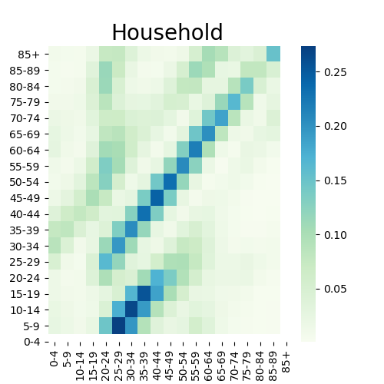
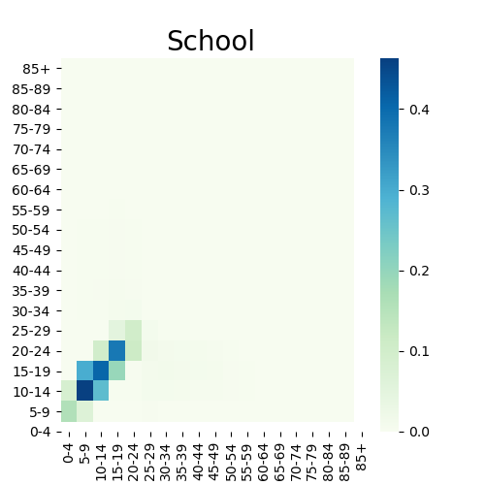
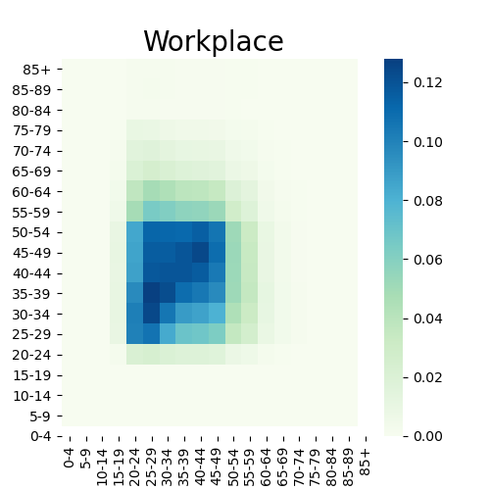
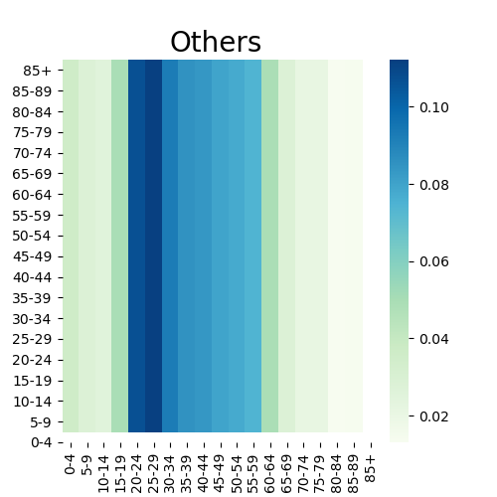
weights = {'household': 4.11, 'school': 11.41, 'workplace': 8.07, 'community': 2.79}
Mistry D, Litvinova M, Pastore y Piontti A, et al. Inferring high-resolution human mixing patterns for disease modeling[J]. Nature communications, 2021, 12(1): 323.

Slide 18
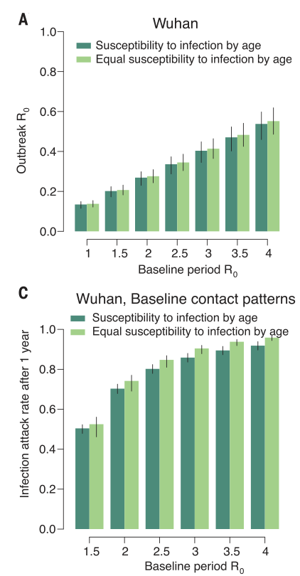
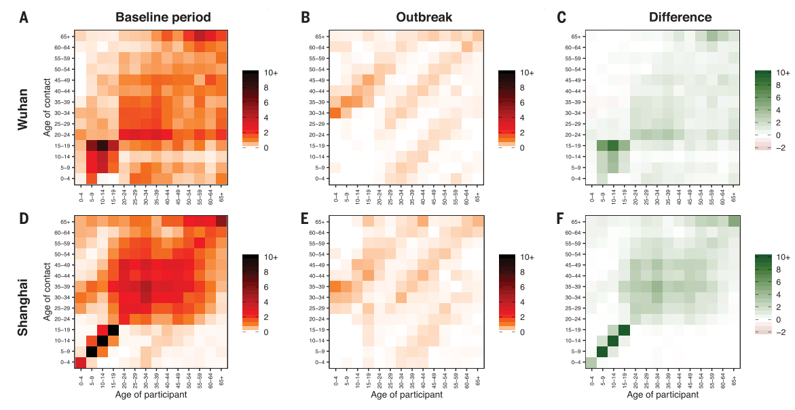
隔离ganyu
Zhang, J., M. Litvinova, Y. Liang, Y. Wang & H. Yu (2020) Changes in contact patterns shape the dynamics of the COVID-19 outbreak in China. Science, 368, eabb8001.
学校关闭，工作限制

Slide 19
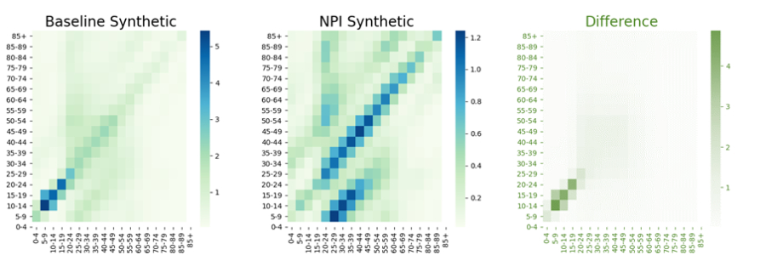
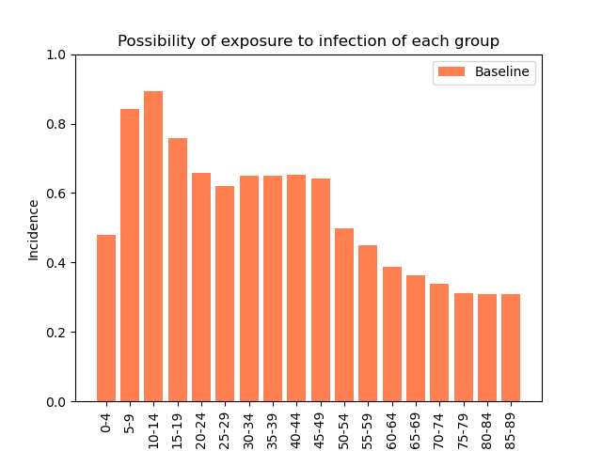
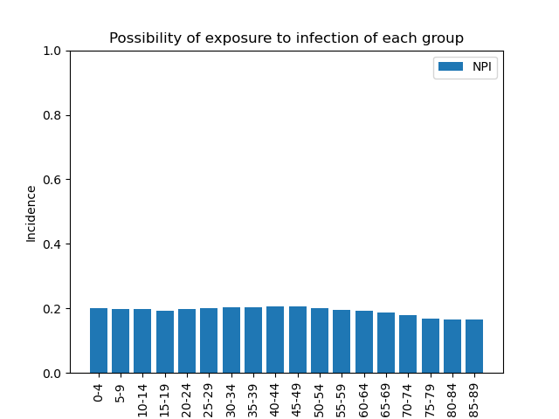

Slide 20
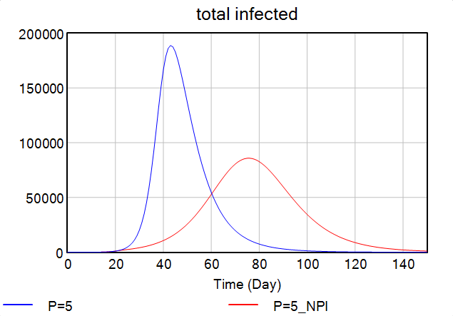
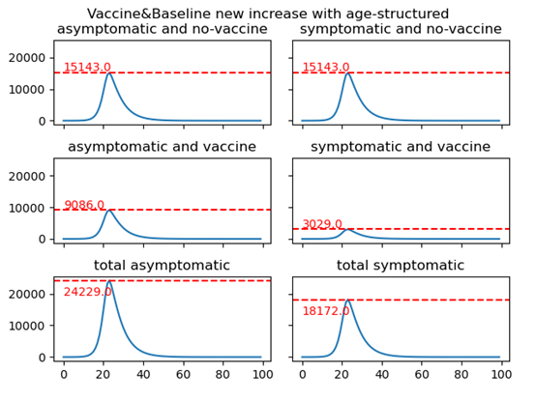
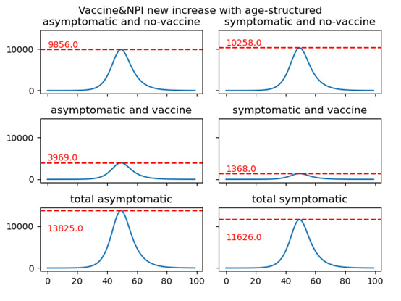
对比

Slide 21
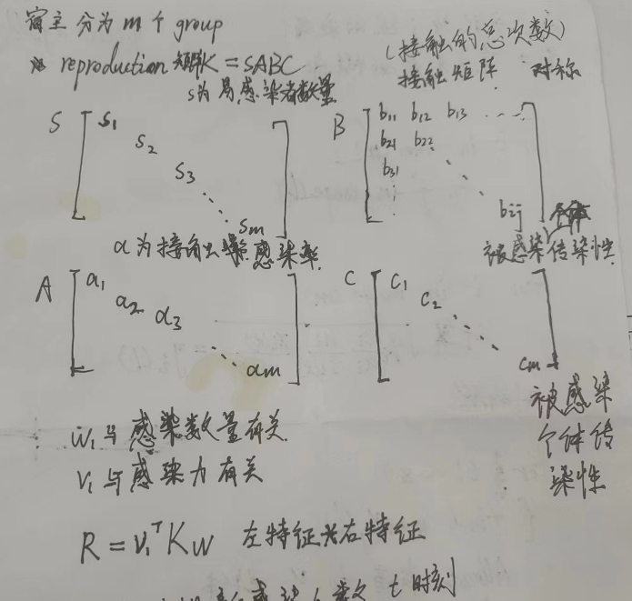
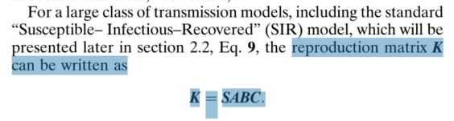
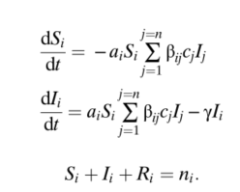
疫苗分配
Wallinga J, van Boven M, Lipsitch M. Optimizing infectious disease interventions during an emerging epidemic[J]. Proceedings of the National Academy of Sciences, 2010, 107(2): 923-928.

Slide 22



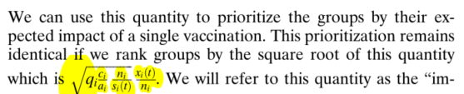
接种对繁殖矩阵的扰动

Slide 23
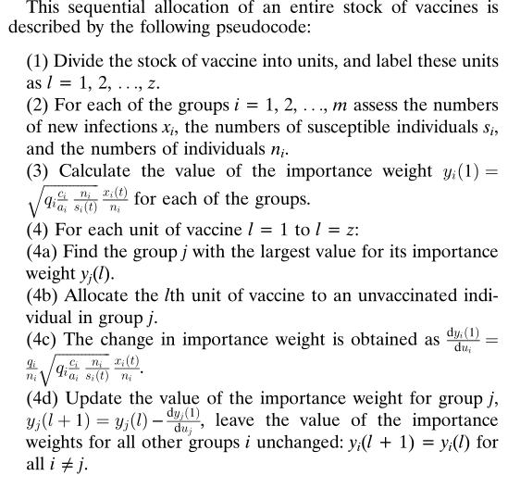
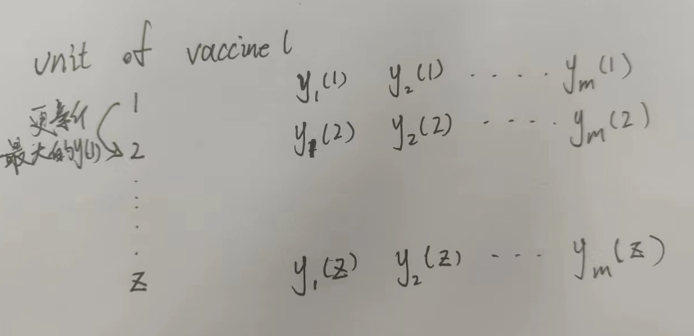
疫苗分配

Slide 24
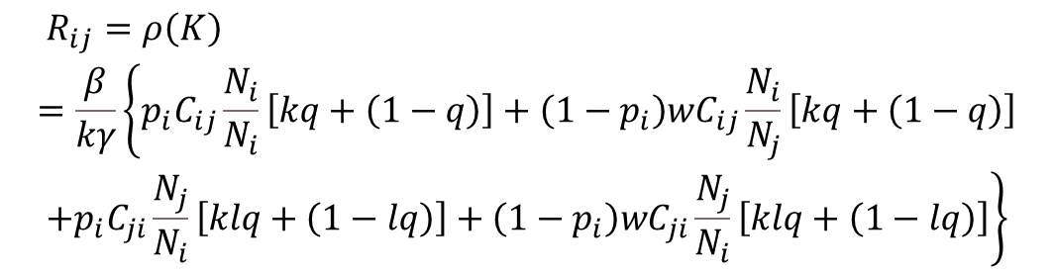
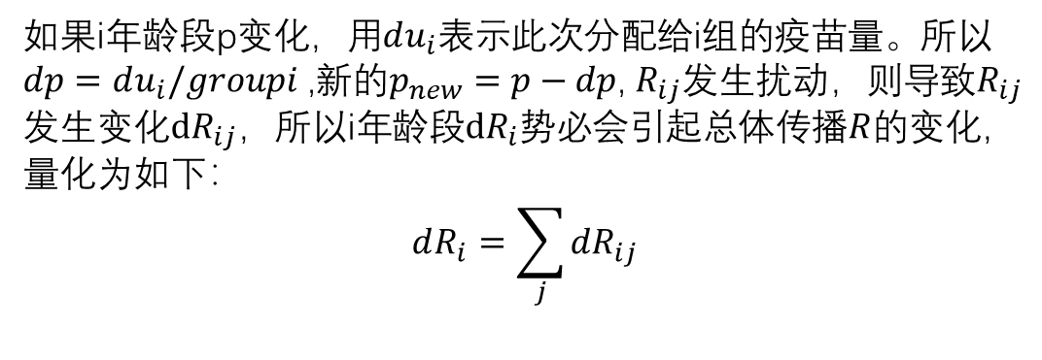
Gaddis M D, Manoranjan V S. Modeling the spread of COVID-19 in enclosed spaces[J]. Mathematical and Computational Applications, 2021, 26(4): 79.
如果i年龄段p变化，用$du_{i}$表示此次分配给i组的疫苗量。所以$dp=du_{i}/groupi$ ,新的$p_{new}=p−dp$, $R_{ij}$发生扰动，则导致$R_{ij}$发生变化$dR_{ij}$，所以i年龄段$dR_{i}$势必会引起总体传播$R$的变化，量化为如下：
$$dR_{i}=\sum_{j}{{dR}_{ij}}$$
$$\begin{aligned}&R_{ij}=ρ\left(K\right) \\ =\frac{β}{kγ}\left\{p_{i}C_{ij}\frac{N_{i}}{N_{i}}\left[kq+\left(1−q\right)\right]+\left(1−p_{i}\right)wC_{ij}\frac{N_{i}}{N_{j}}\left[kq+\left(1−q\right)\right]\right. \\ &\left.+p_{i}C_{ji}\frac{N_{j}}{N_{i}}\left[klq+\left(1−lq\right)\right]+\left(1−p_{i}\right)wC_{ji}\frac{N_{j}}{N_{i}}\left[klq+\left(1−lq\right)\right]\right\}\end{aligned}$$

Slide 25
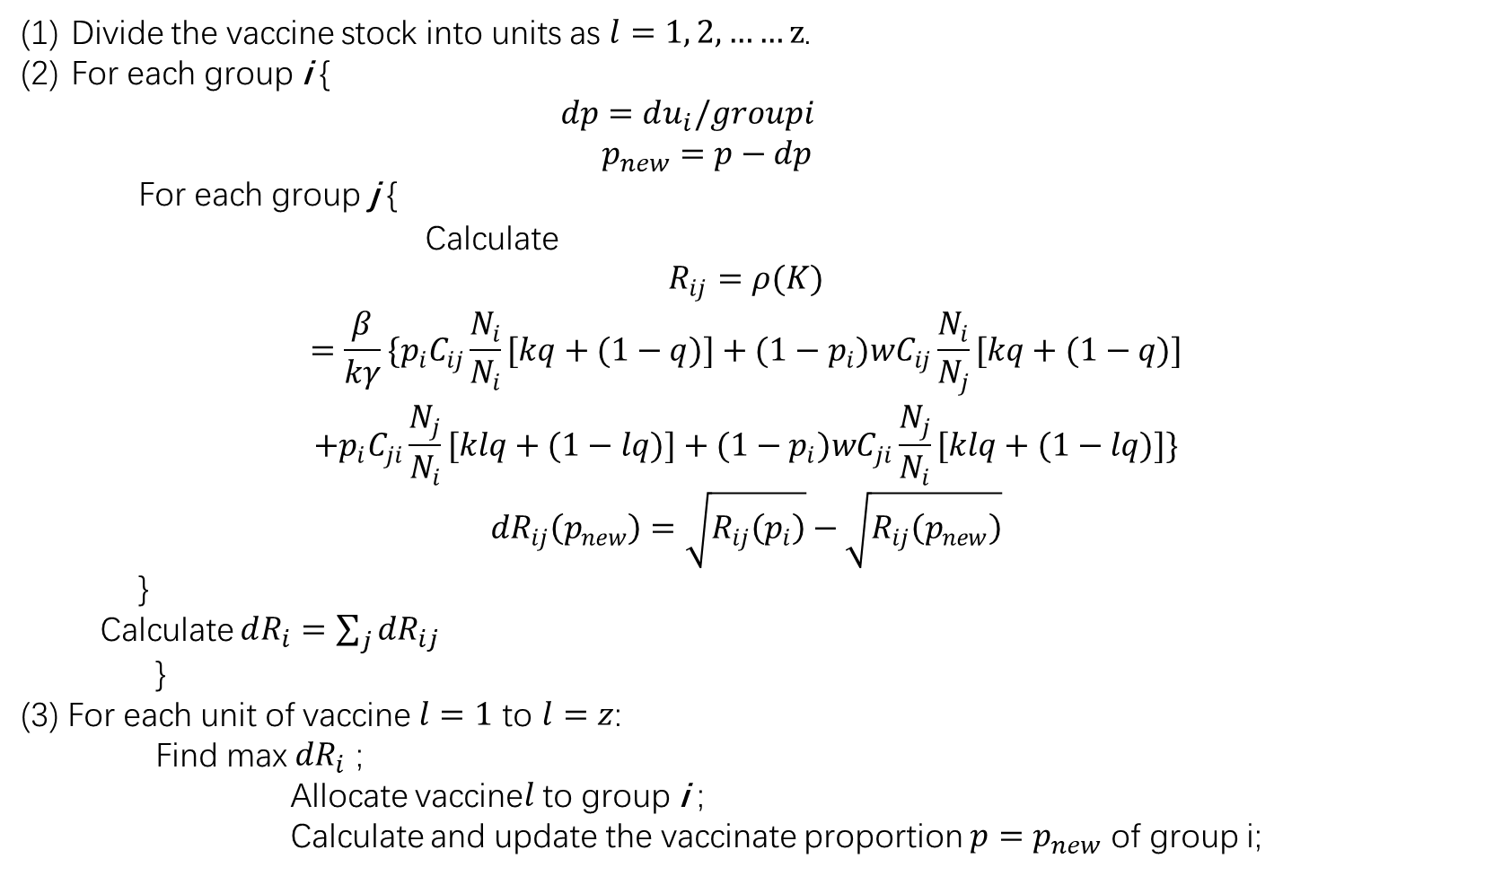
疫苗分配算法
Divide the vaccine stock into units as $l=1, 2,……z$.
For each group i {
$$dp=du_{i}/groupi$$
$$p_{new}=p−dp$$
For each group j {
Calculate
$$\begin{aligned}R_{ij}=ρ(K) \\ =\frac{β}{kγ}\{p_{i}C_{ij}\frac{N_{i}}{N_{i}}[kq+(1−q)]+(1−p_{i})wC_{ij}\frac{N_{i}}{N_{j}}[kq+(1−q)] \\ +p_{i}C_{ji}\frac{N_{j}}{N_{i}}[klq+(1−lq)]+(1−p_{i})wC_{ji}\frac{N_{j}}{N_{i}}[klq+(1−lq)]\}\end{aligned}$$
$${dR}_{ij}\left(p_{new}\right)=\sqrt{R_{ij}\left(p_{i}\right)}−\sqrt{R_{ij}\left(p_{new}\right)}$$
}
Calculate $dR_{i}=\sum_{j}{{dR}_{ij}}$
}
(3) For each unit of vaccine $l=1$ to $l=z$:
Find max ${dR}_{i}$ ;
Allocate vaccine$l$ to group i ;
Calculate and update the vaccinate proportion $p=p_{new}$ of group i;

Slide 26
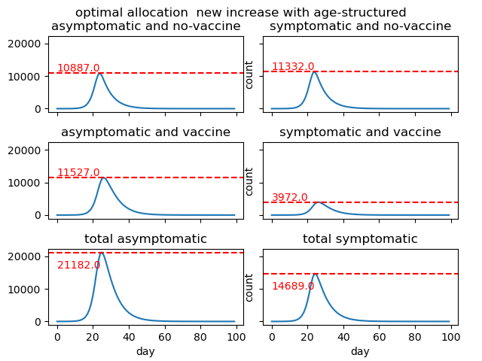

Slide 27
