Slide 1


进度汇报
导师：史本云
汇报人：唐爱彬

Slide 2
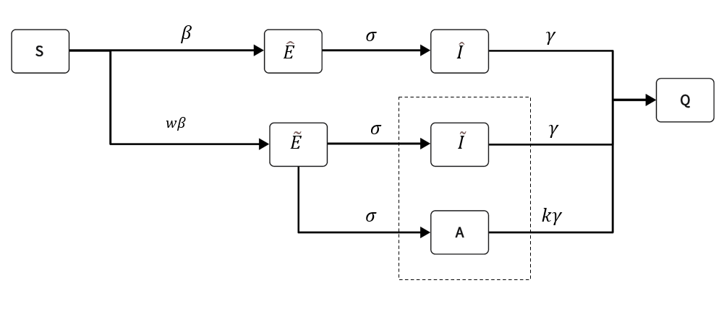
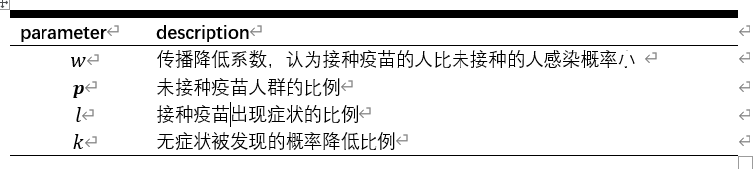
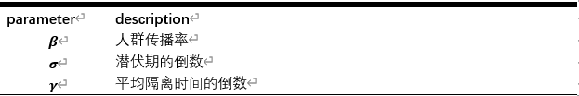
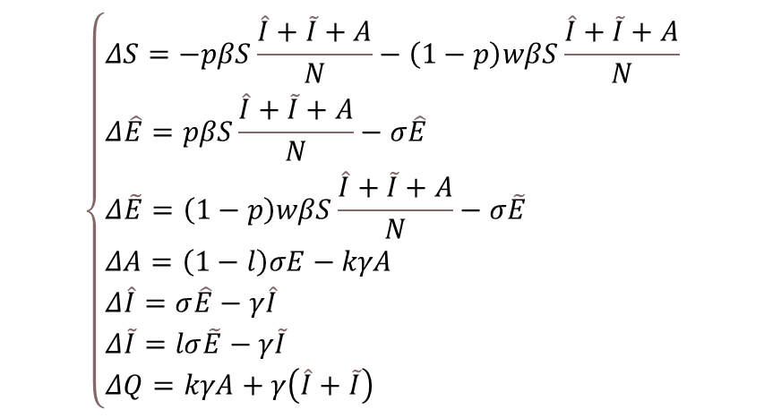
模型
$$\left\{\begin{aligned}&ΔS=−pβS\frac{\hat{I}+\tilde{I}+A}{N}−\left(1−p\right)wβS\frac{\hat{I}+\tilde{I}+A}{N} \\ &Δ\hat{E}=pβS\frac{\hat{I}+\tilde{I}+A}{N}−σ\hat{E} \\ &Δ\tilde{E}=\left(1−p\right)wβS\frac{\hat{I}+\tilde{I}+A}{N}−σ\tilde{E} \\ &ΔA=\left(1−l\right)σE−kγA \\ &Δ\hat{I}=σ\hat{E}−γ\hat{I} \\ &Δ\tilde{I}=lσ\tilde{E}−γ\tilde{I} \\ &ΔQ=kγA+γ\left(\hat{I}+\tilde{I}\right)\end{aligned}\right.$$
ˆ·表示未接种，˜·表示已接种,S为易感者，E为暴露这，I为感染则，A为无症状感染者，Q是被隔离者

Slide 3
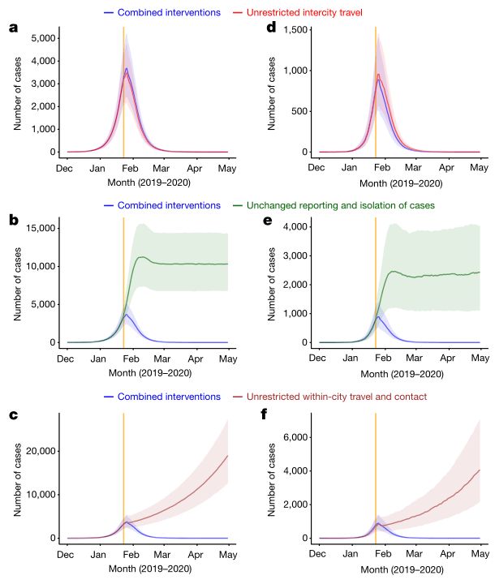
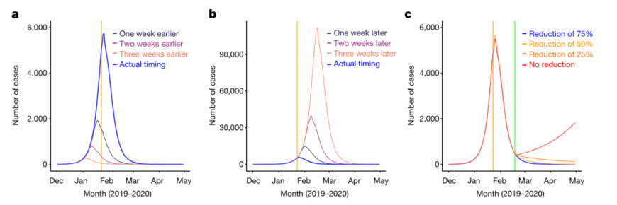
非药物干预
Lai, S., N. W. Ruktanonchai, L. Zhou, O. Prosper, W. Luo, J. R. Floyd, A. Wesolowski, M. Santillana, C. Zhang, X. Du, H. Yu & A. J. Tatem (2020) Effect of non-pharmaceutical interventions to contain COVID-19 in China. Nature, 585, 410-413
采取了城际旅行限制措施
重视早期发现和隔离病例
限制接触和保持社交距离

Slide 4
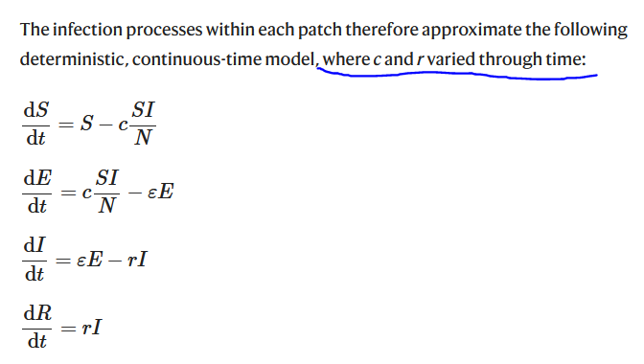

Slide 5
Changing pattern of travel and contact across mainland China under the COVID-19 outbreak and interventions in 2020, compared to normal travel patterns during CNY holiday in 2014c
Date | Percentage of travel and contact | Standard deviation | Note
Before 2020-1-23 | 100% as normal | NA
2020/1/23 | 90.40% | 10.40%
2020/1/24 | 88.20% | 12.60%
2020/1/25 | 82.30% | 17.30%
2020/1/26 | 86.60% | 19.70%
2020/1/27 | 75.40% | 26.60%
2020/1/28 | 64.70% | 28.80%
2020/1/29 | 53.60% | 27.50%
2020/1/30 | 46.90% | 25.10%
2020/1/31 | 33.70% | 17.20%
2020/2/1 | 29.00% | 14.10%
2020/2/2 | 35.80% | 18.00%

Slide 6
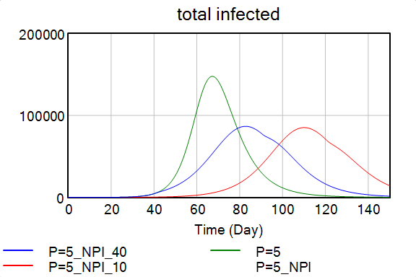
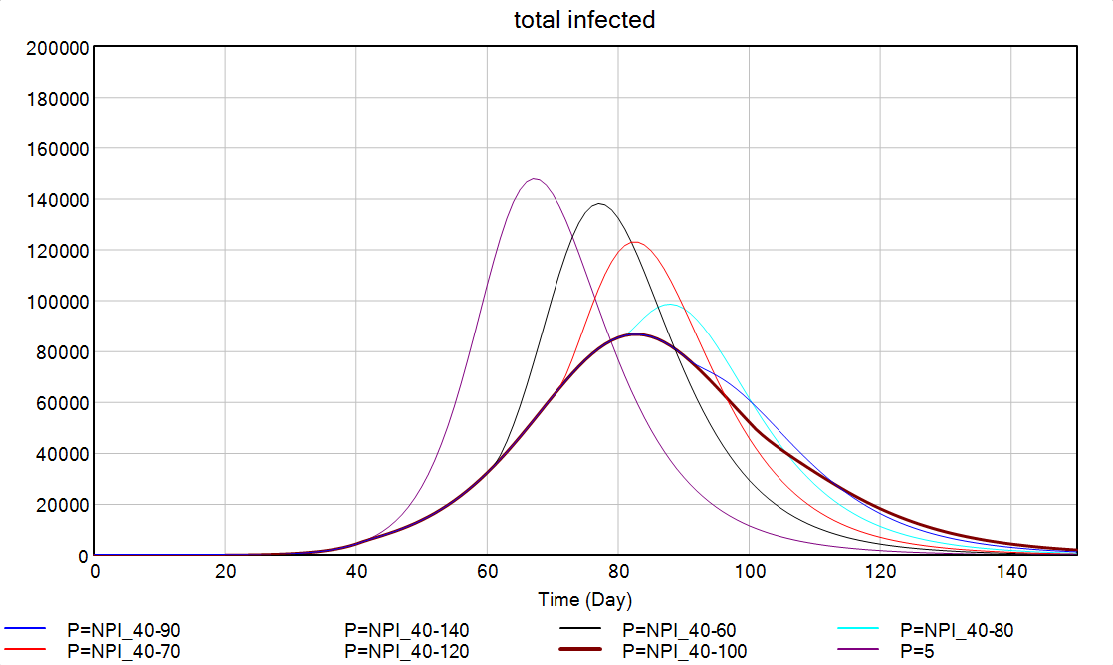

Slide 7
The average days from illness onset to report of the first case reported by each county in mainland China
Date | Median (days) | Inter-quatile range (days)
 |  | q1 | q3
Before 2020-1-16 | Using values on January 16, 2020
2020/1/16 | 11 | 10 | 15
2020/1/17 | 11 | 9 | 13
2020/1/18 | 11 | 8 | 12
2020/1/19 | 10 | 8 | 11
2020/1/20 | 9 | 7 | 10
2020/1/21 | 8 | 6.75 | 9.25
2020/1/22 | 7 | 5 | 9
2020/1/23 | 6 | 5 | 8
2020/1/24 | 5 | 3 | 7
2020/1/25 | 5 | 4 | 6
2020/1/26 | 4 | 3 | 5
2020/1/27 | 3 | 2 | 4
2020/1/28 | 2 | 1 | 4
2020/1/29 | 2 | 1 | 3.5
2020/1/30 | 2 | 1 | 3
2020/1/31 | 2 | 1 | 3
Since 2020-2-1 | Using values on January 31, 2020

Slide 8
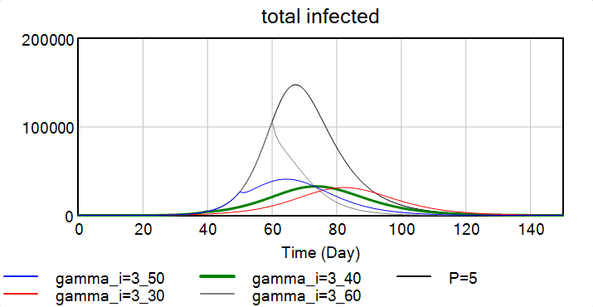
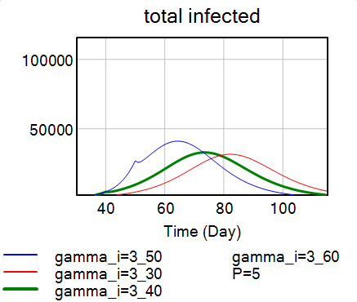
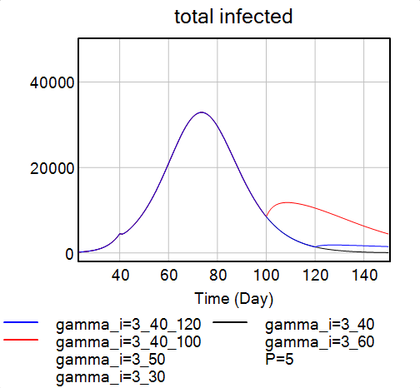
隔离

Slide 9
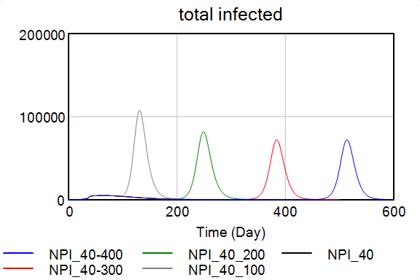
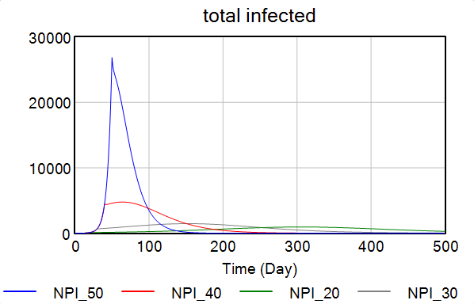
联合NPI

Slide 10
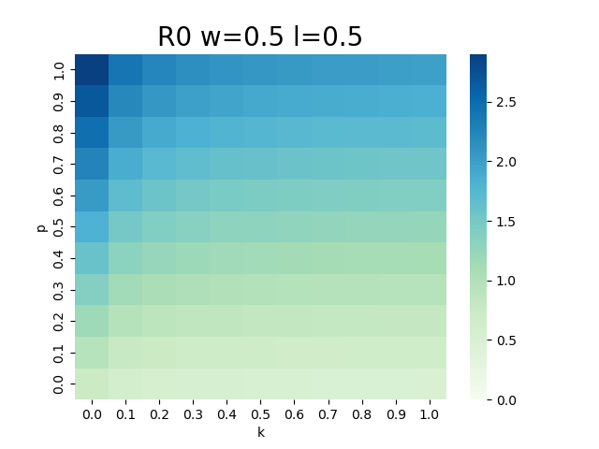
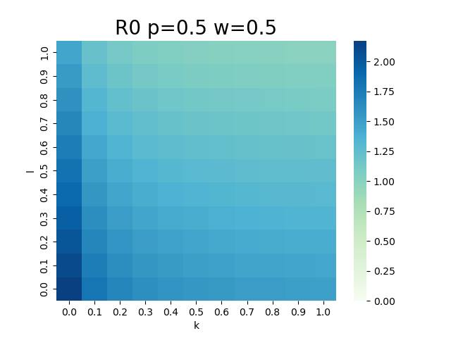

k-w+wl-wkl
$$R0=ρ\left(K\right)=\frac{β}{kγ}\left\{pk+\left(1−p\right)w\left[\left(1−l\right)+kl\right]\right\}$$

Slide 11
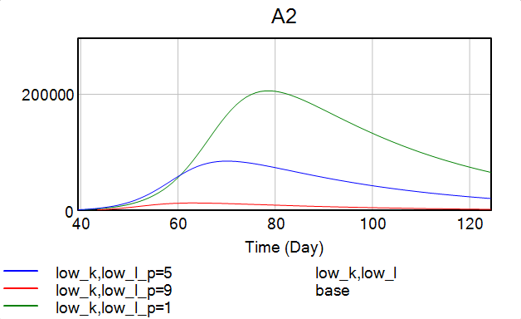
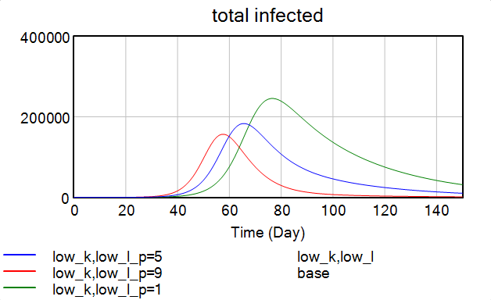

Slide 12
