Slide 1


进度汇报
导师：史本云
汇报人：唐爱彬

Slide 2
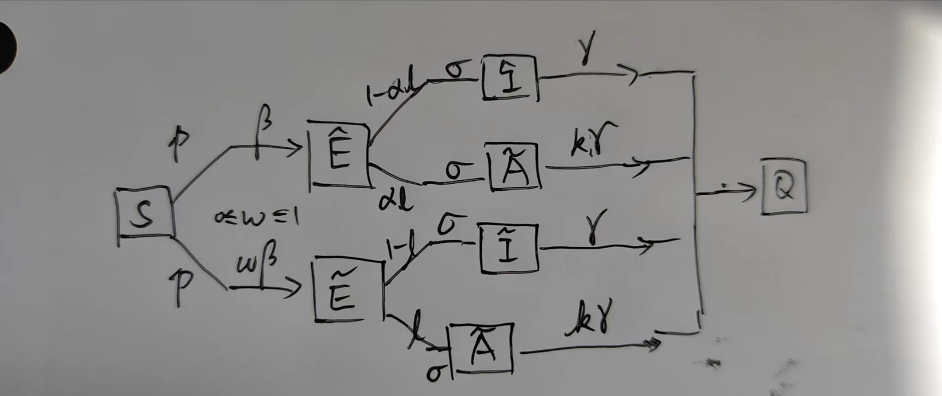
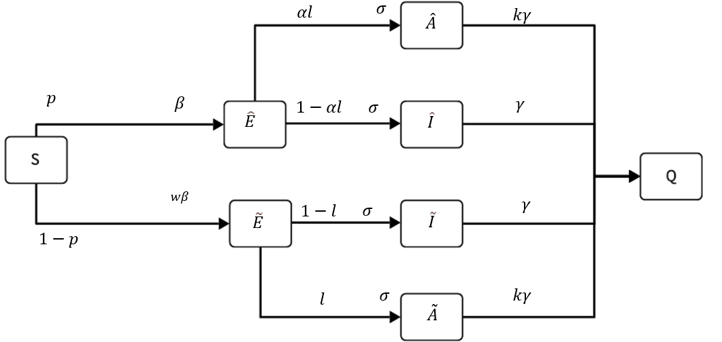
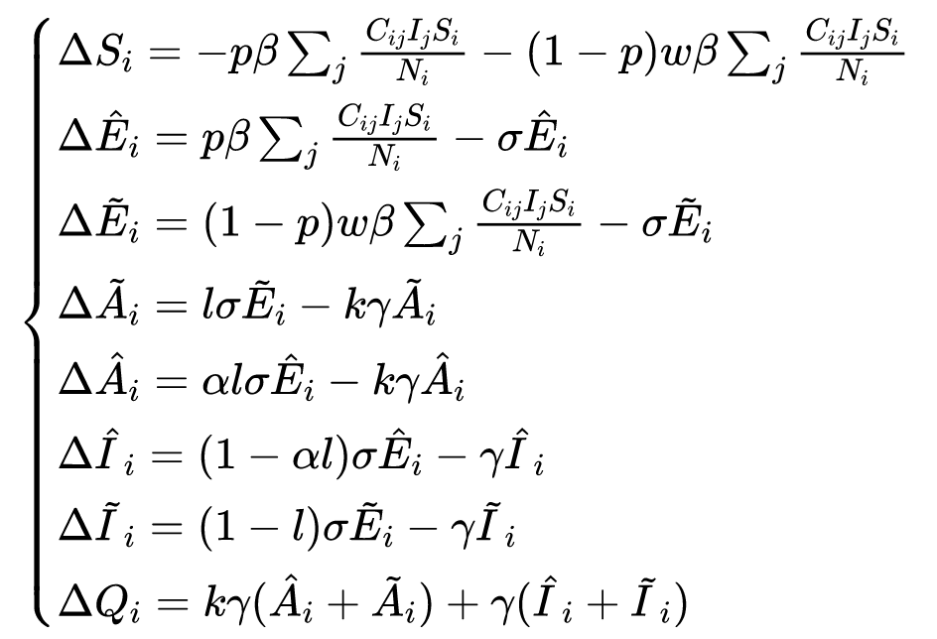
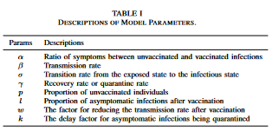

Slide 3
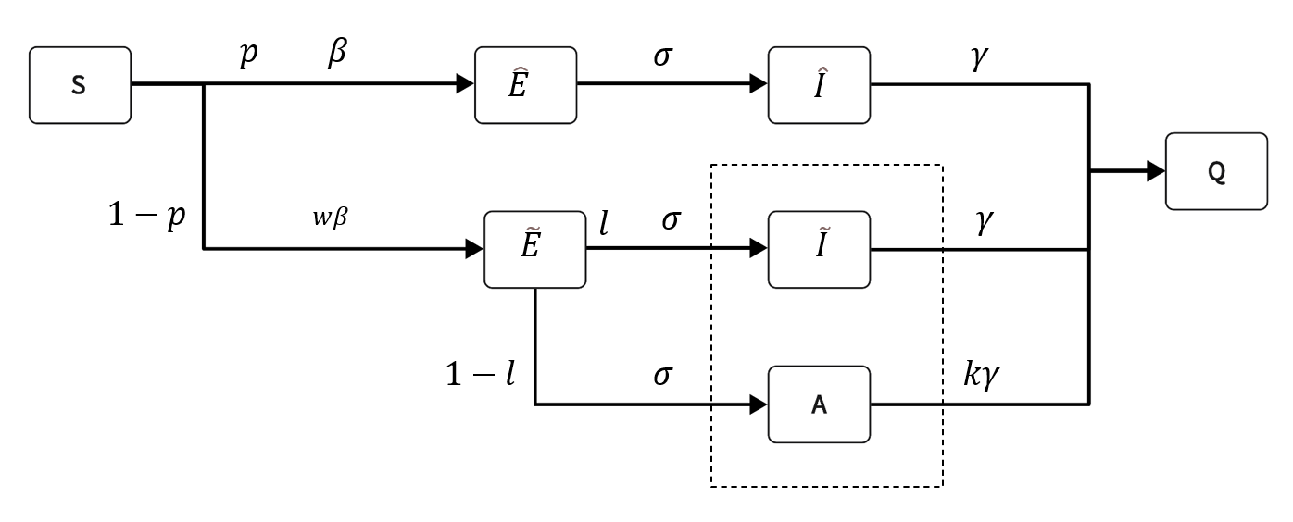
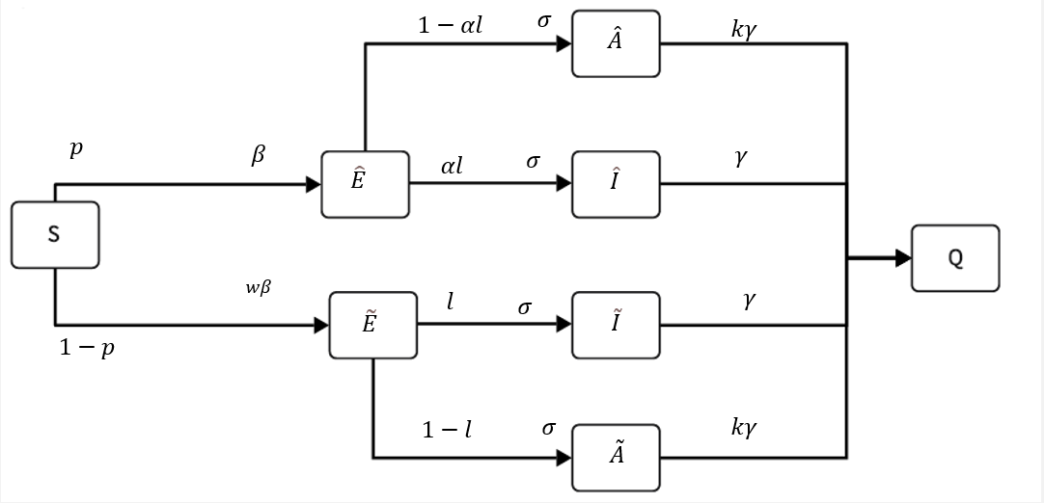
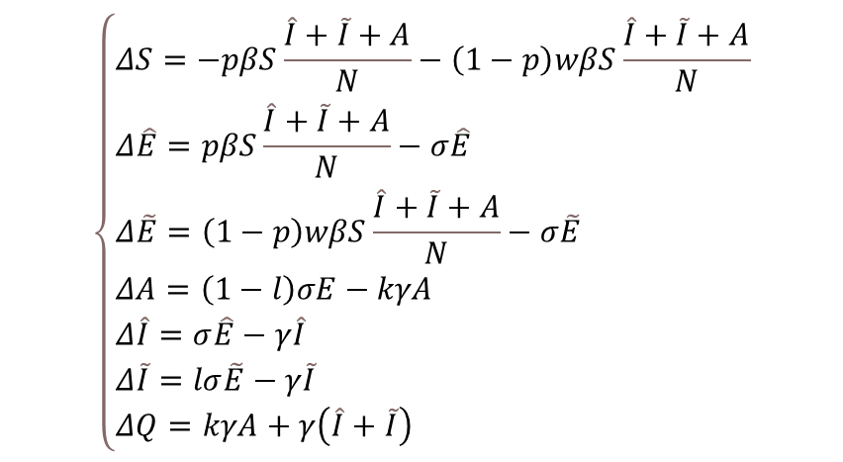
$$\left\{\begin{aligned}&ΔS=−pβS\frac{\hat{I}+\tilde{I}+A}{N}−\left(1−p\right)wβS\frac{\hat{I}+\tilde{I}+A}{N} \\ &Δ\hat{E}=pβS\frac{\hat{I}+\tilde{I}+A}{N}−σ\hat{E} \\ &Δ\tilde{E}=\left(1−p\right)wβS\frac{\hat{I}+\tilde{I}+A}{N}−σ\tilde{E} \\ &ΔA=\left(1−l\right)σE−kγA \\ &Δ\hat{I}=σ\hat{E}−γ\hat{I} \\ &Δ\tilde{I}=lσ\tilde{E}−γ\tilde{I} \\ &ΔQ=kγA+γ\left(\hat{I}+\tilde{I}\right)\end{aligned}\right.$$

Slide 4
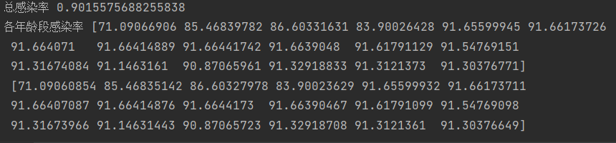
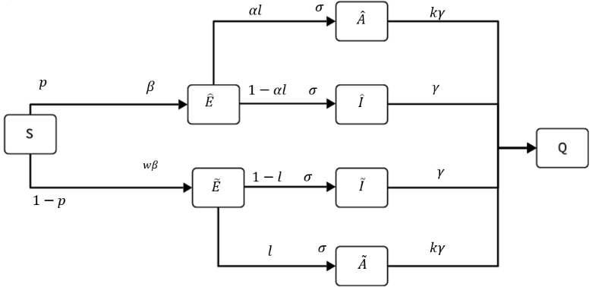
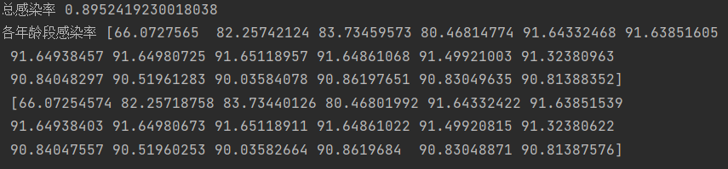
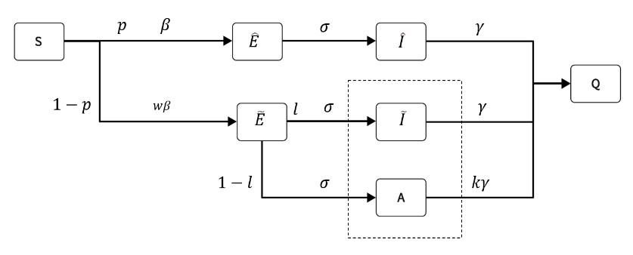
0.5
|
0

Slide 5
