Slide 1
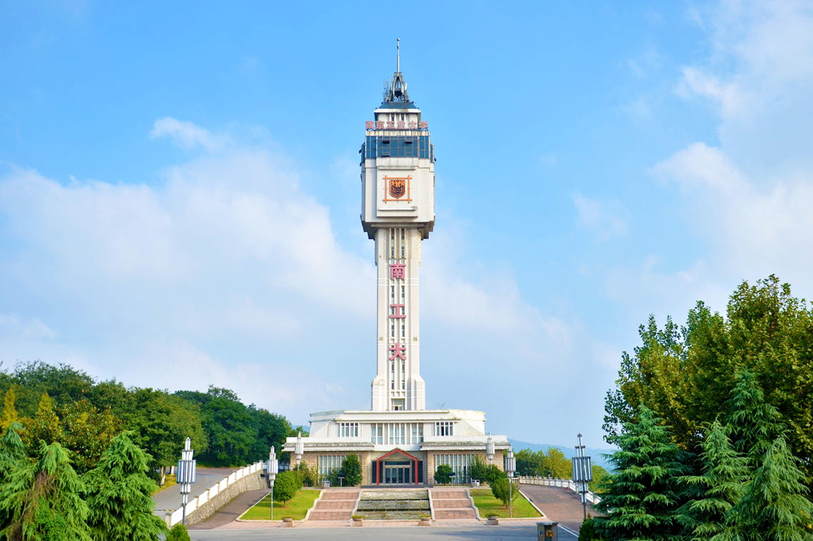

进度汇报
导师：史本云
汇报人：唐爱彬

Slide 2
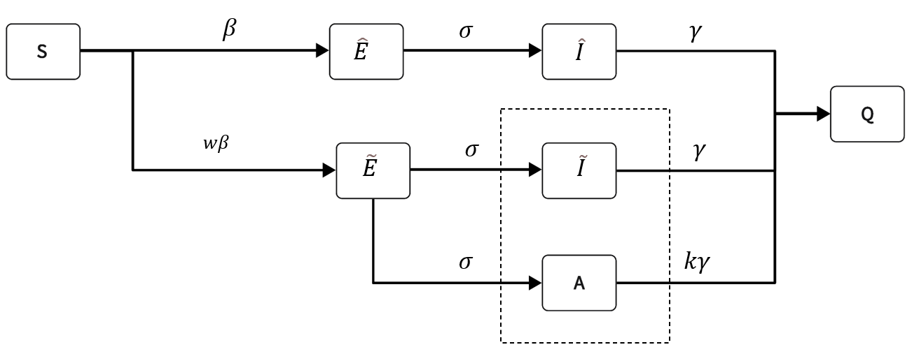
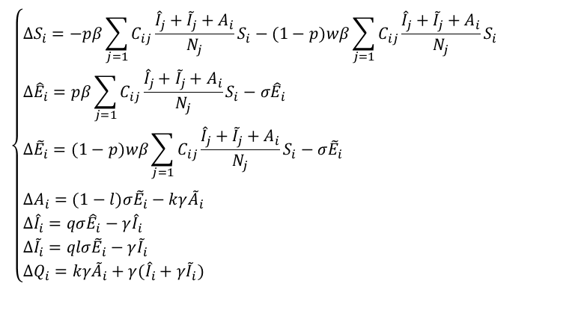
$$\left\{\begin{aligned}&ΔS_{i}=−pβ\sum_{j=1}{C_{ij}}\frac{{\hat{I}}_{j}+{\tilde{I}}_{j}+A_{i}}{N_{j}}S_{i}−(1−p)wβ\sum_{j=1}{C_{ij}}\frac{{\hat{I}}_{j}+{\tilde{I}}_{j}+A_{i}}{N_{j}}S_{i} \\ &Δ{\hat{E}}_{i}=pβ\sum_{j=1}{C_{ij}}\frac{{\hat{I}}_{j}+{\tilde{I}}_{j}+A_{i}}{N_{j}}S_{i}−σ{\hat{E}}_{i} \\ &Δ{\tilde{E}}_{i}=(1−p)wβ\sum_{j=1}{C_{ij}}\frac{{\hat{I}}_{j}+{\tilde{I}}_{j}+A_{i}}{N_{j}}S_{i}−σ{\tilde{E}}_{i} \\ & \\ &ΔA_{i}=(1−l)σ{\tilde{E}}_{i}−kγ{\tilde{A}}_{i} \\ &Δ{\hat{I}}_{i}=qσ{\hat{E}}_{i}−γ{\hat{I}}_{i} \\ &Δ{\tilde{I}}_{i}=qlσ{\tilde{E}}_{i}−γ{\tilde{I}}_{i} \\ &ΔQ_{i}=kγ{\tilde{A}}_{i}+γ({\hat{I}}_{i}+γ{\tilde{I}}_{i})\end{aligned}\right.$$

Slide 3
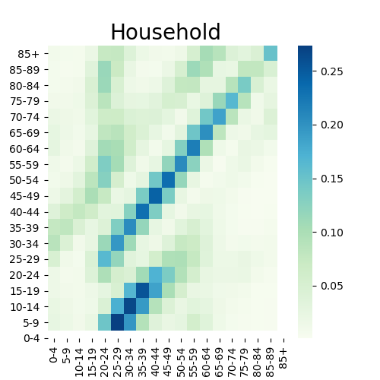
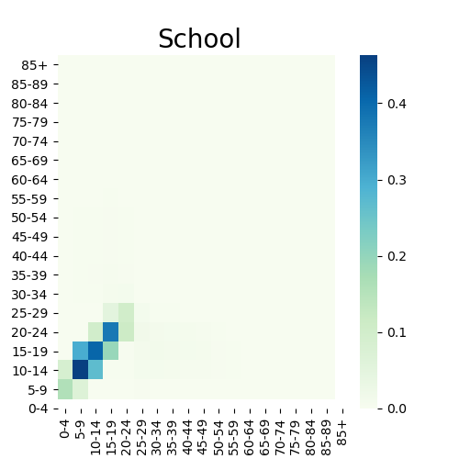
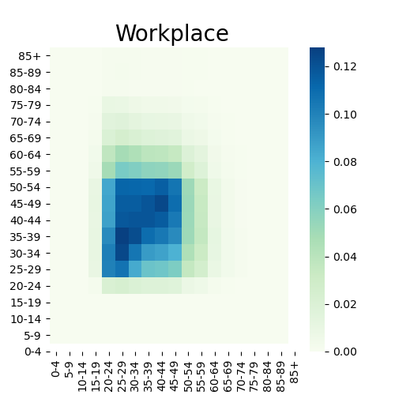
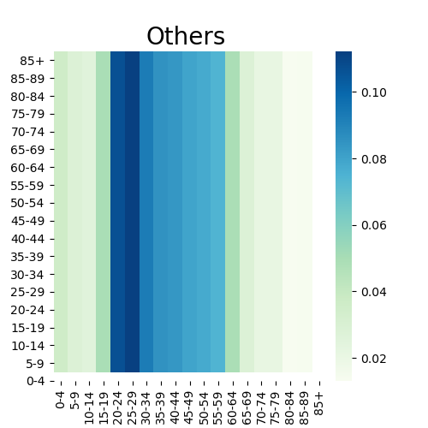
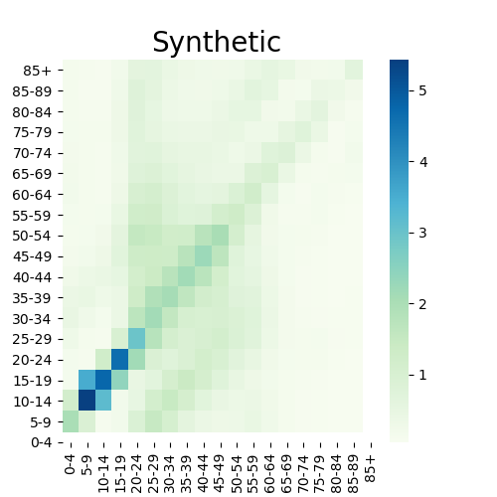
weights = {'household': 4.11, 'school': 11.41, 'workplace': 8.07, 'community': 2.79}
Mistry D, Litvinova M, Pastore y Piontti A, et al. Inferring high-resolution human mixing patterns for disease modeling[J]. Nature communications, 2021, 12(1): 323.

Slide 4
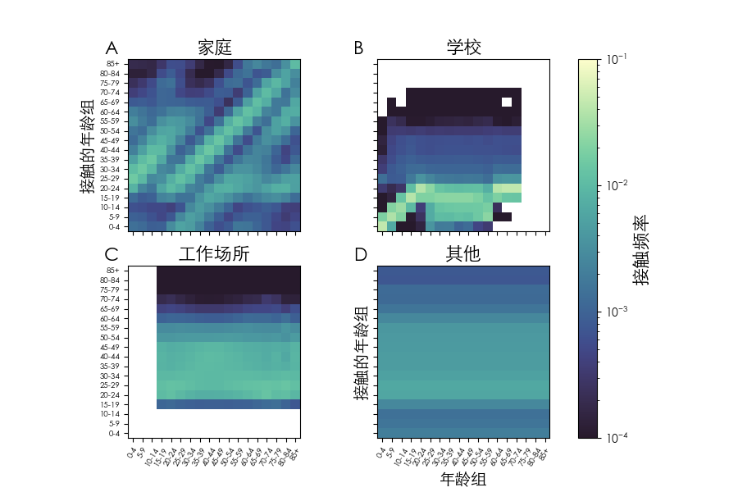
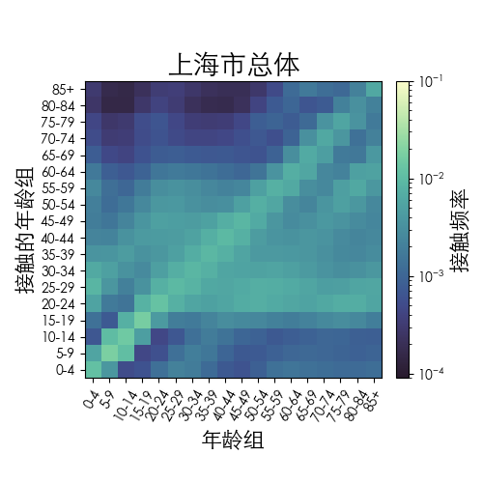

Slide 5
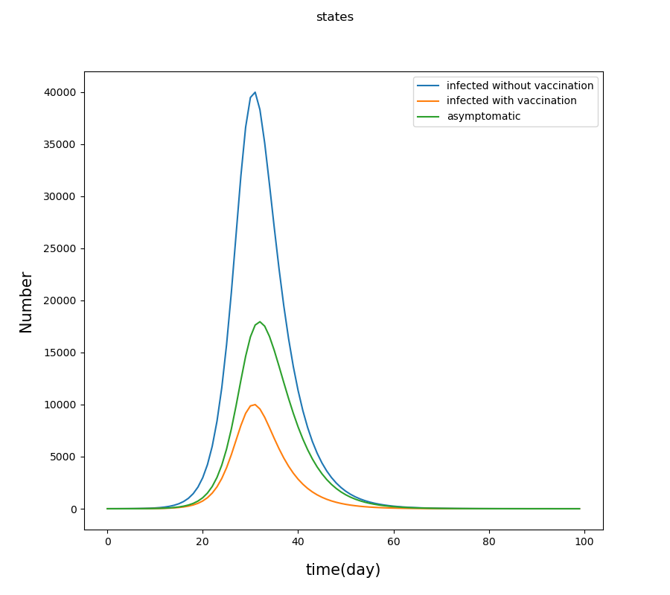

Slide 6
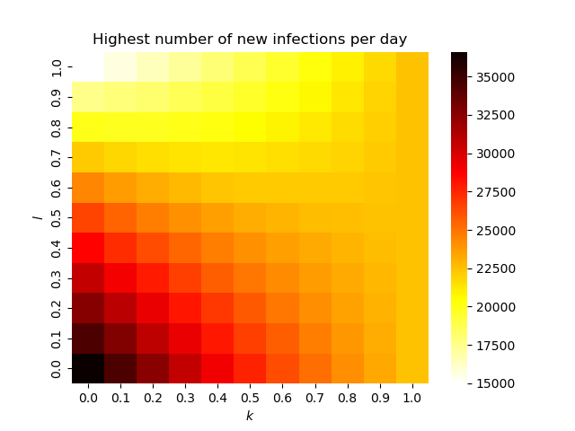
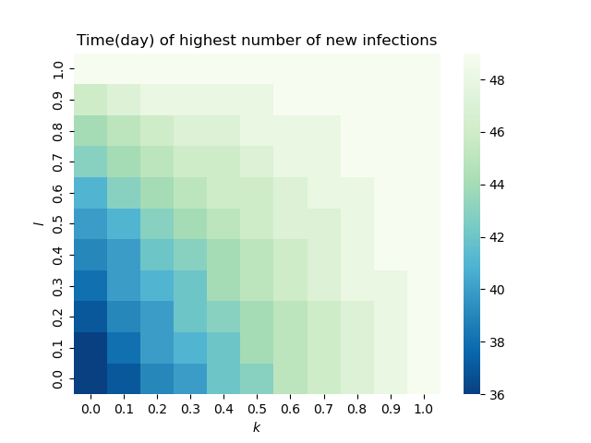

Slide 7
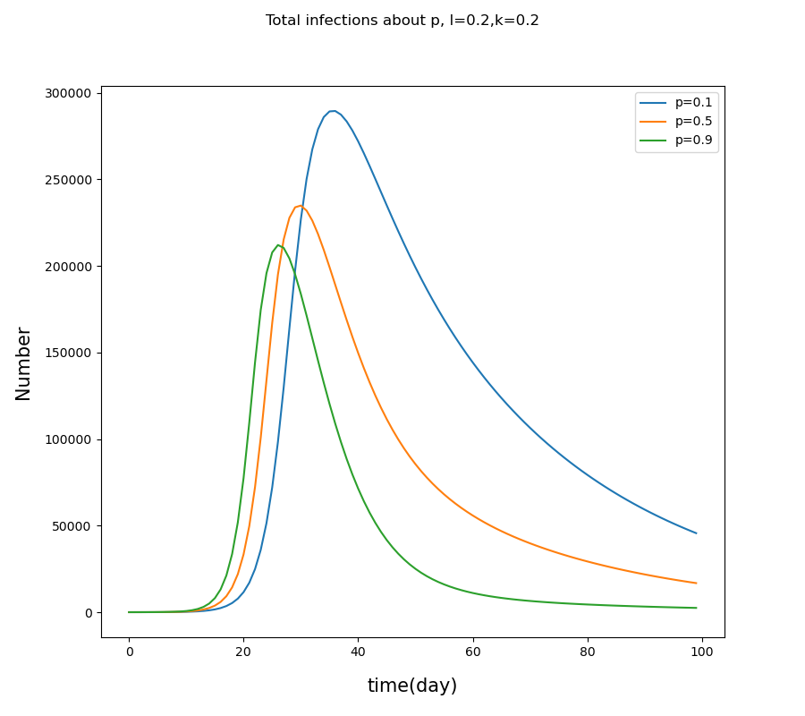
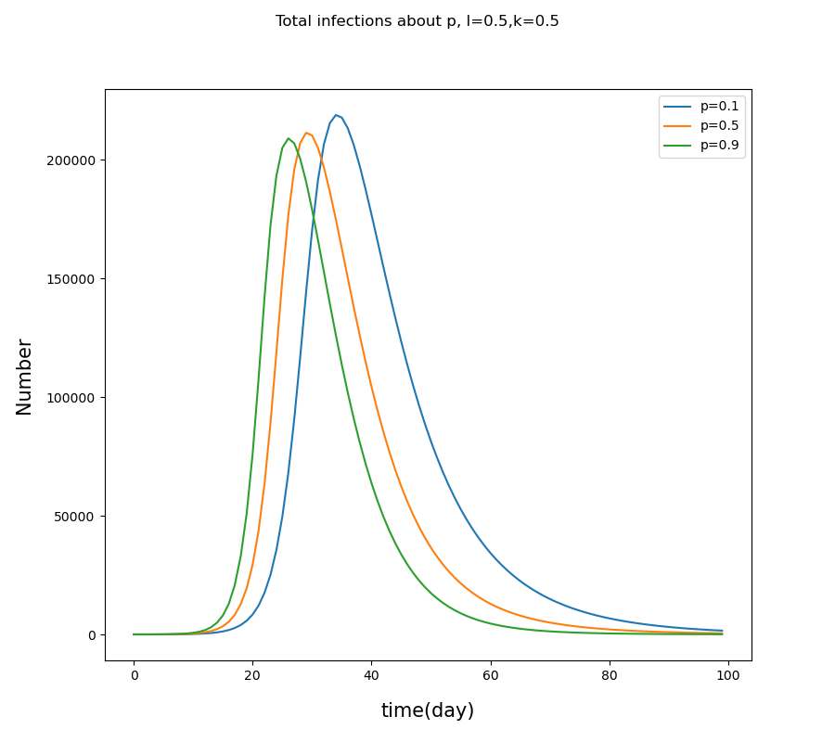
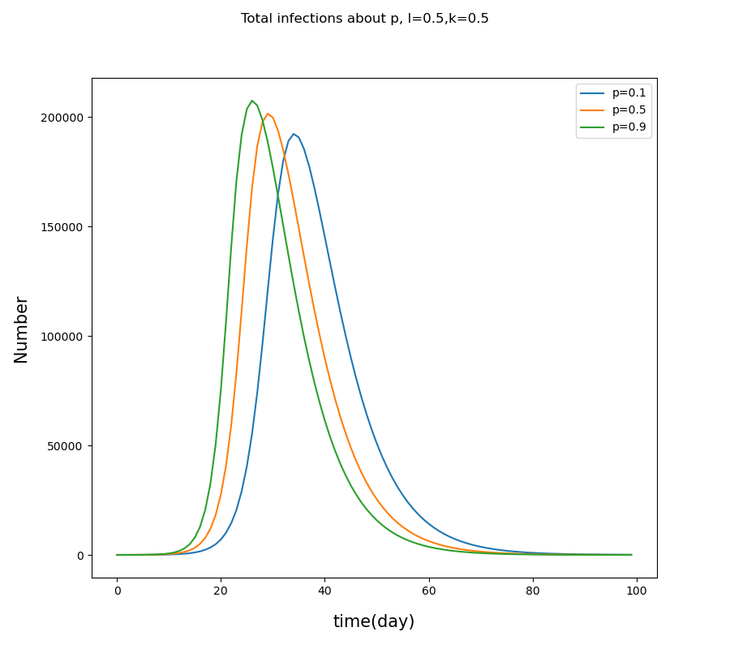
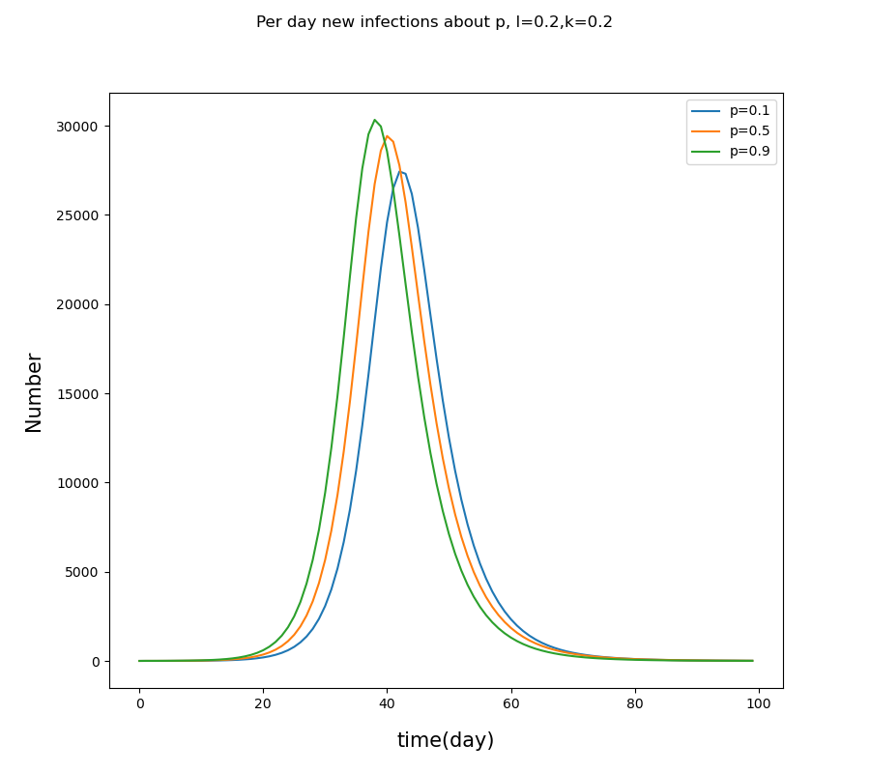
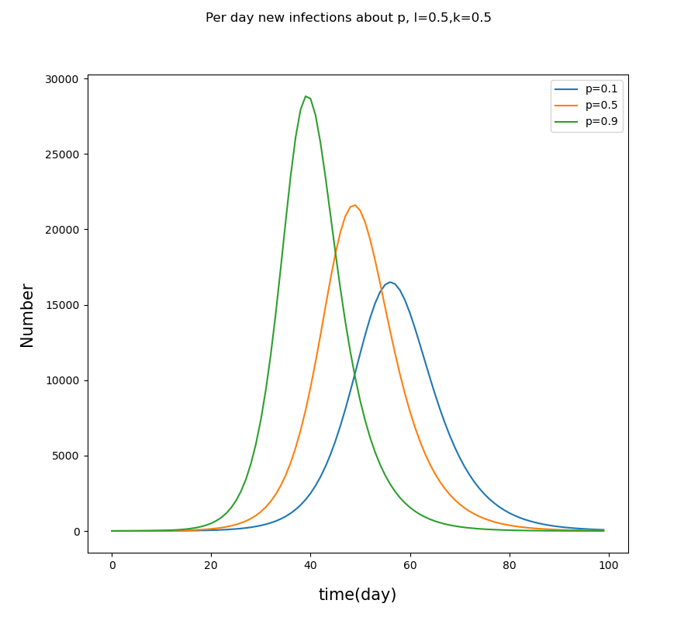
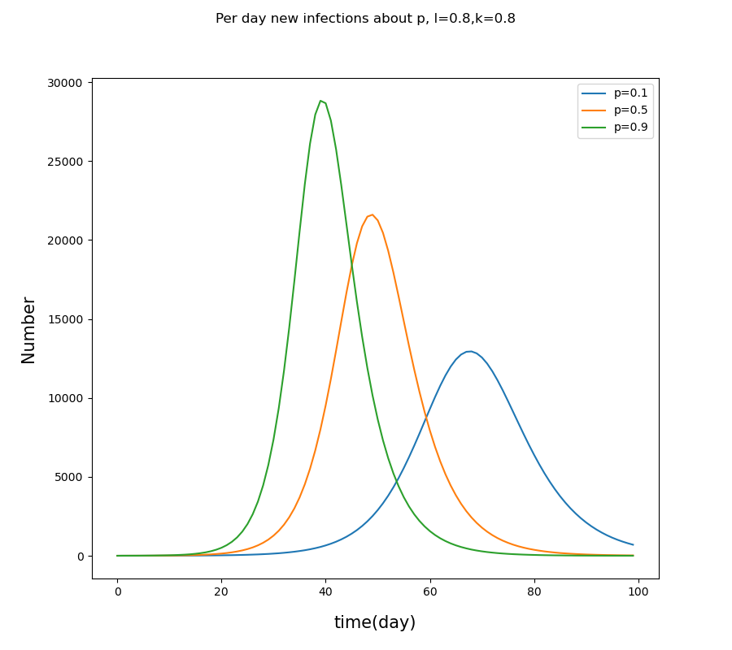

Slide 8
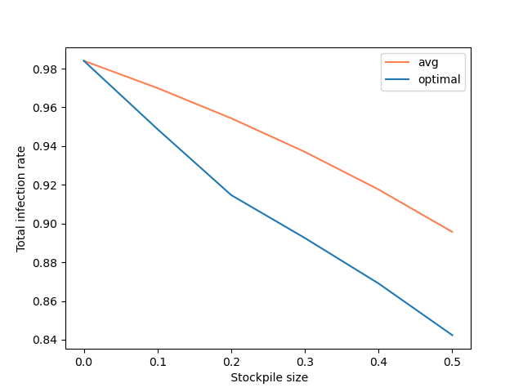
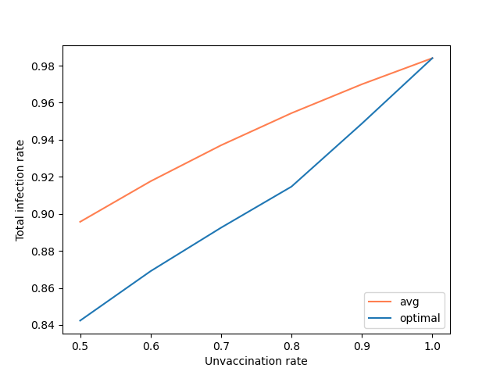

Slide 9
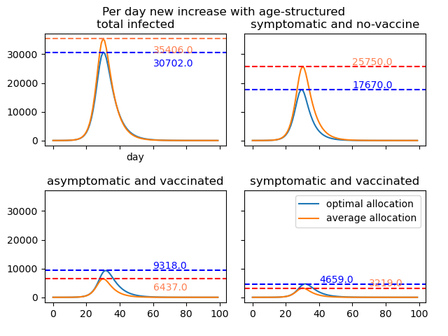
疫苗分配 p=0.5 ,k=0.5,l=0.5

Slide 10
