Slide 1
Deepfake Video Detection
Frame-Level CNN Classifier
Coco Yav · Student ID: 21396816
BSc (Hons) Software Engineering
Manchester Metropolitan University
Supervisor: Dr Nicholas Costen · 2025–2026

Slide 2
Problem & Motivation
What are deepfakes?
Synthetically manipulated videos in which a subject's face is replaced or altered using generative AI, typically undetectable by an untrained observer.
Why detection matters
Deepfake content poses measurable risks to public trust, journalistic integrity, and personal identity — several high-profile cases have already driven regulatory attention.
Project aim
Build a frame-level binary classifier that scores each sampled face crop as REAL or FAKE, aggregating scores to produce a video-level verdict.

Slide 3
Background & Related Work
Key datasets
FaceForensics++ (Rössler et al., 2019) and the DeepFake Detection Challenge (Dolhansky et al., 2020) are the standard benchmarks for this task.
Detection strategies
Frame-level classifiers (this project) treat each face crop independently. Temporal models — 3D CNNs or LSTMs over frame embeddings — exploit inter-frame inconsistency but require greater computational resource.
Common backbones in the literature
XceptionNet (Rössler et al.), EfficientNet, and ResNet variants are frequently compared. ResNet18 provides a compact, well-understood baseline suitable for a time-bounded undergraduate project.

Slide 4
System Architecture
MP4 video input
OpenCV: sample 1 frame per 30
MTCNN: detect & crop face → 224×224
ImageNet normalisation
ResNet18 (transfer-learned)
Softmax → P(fake) / P(real) per frame
Mean across frames → video-level verdict

Slide 5
Dataset & Ethics
Source
Kaggle — mafiosoquasar/deepfake-faces (DFDC-derived face crops): 86,655 real images and 120,769 fake images.
Sampling & split
5,000 images per class sampled with fixed seed 42; split 70 / 15 / 15 → 7,000 train · 1,500 val · 1,500 test. Split manifest: data/working/manifest.csv.
Ethics
Supervisor sign-off: Dr Nicholas Costen (EAN.txt). No children present; no re-identification attempted; no raw face data redistributed in the submission archive.

Slide 6
Implementation — Training
Backbone
ResNet18, ImageNet-pretrained (ResNet18_Weights.IMAGENET1K_V1). Final fully-connected layer replaced with nn.Linear(512, 2). 11,177,538 total parameters; all trainable.
Optimiser & schedule
AdamW, learning rate 1e-4, weight decay 1e-4. Cross-entropy loss applied to raw logits (no softmax in the model). 5 epochs; best checkpoint selected on validation accuracy.
Hardware & reproducibility
Trained on Apple M4 (MPS backend) in under 10 minutes. Seed 42 applied across Python, NumPy, and PyTorch. Minor MPS non-determinism noted; CPU runs are fully deterministic.

Slide 7
Training Curves
Validation loss diverges from training loss after epoch 3 — best-model checkpointing on val accuracy mitigated overfitting.

Slide 8
Evaluation — Headline Metrics
Metric | Value
Accuracy | 0.9247
Weighted F1 | 0.9246
AUC | 0.9814
Test samples | 1,500
Held-out test set: 750 real + 750 fake face crops.

Slide 9
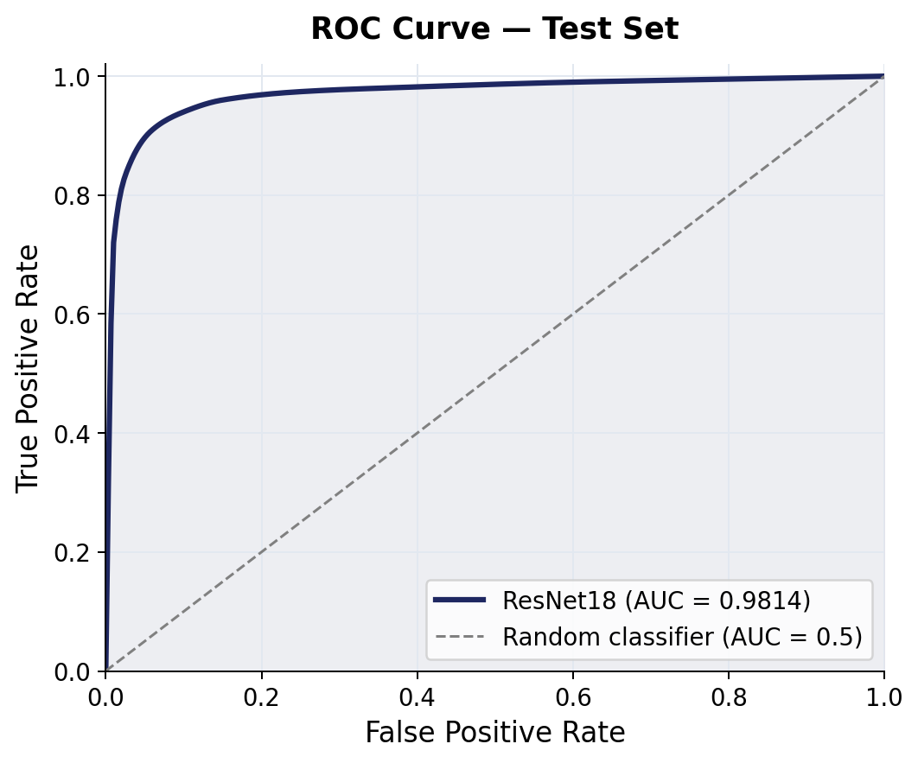
ROC Curve
AUC = 0.9814 — strong threshold-independent discrimination between real and fake face crops.

Slide 10
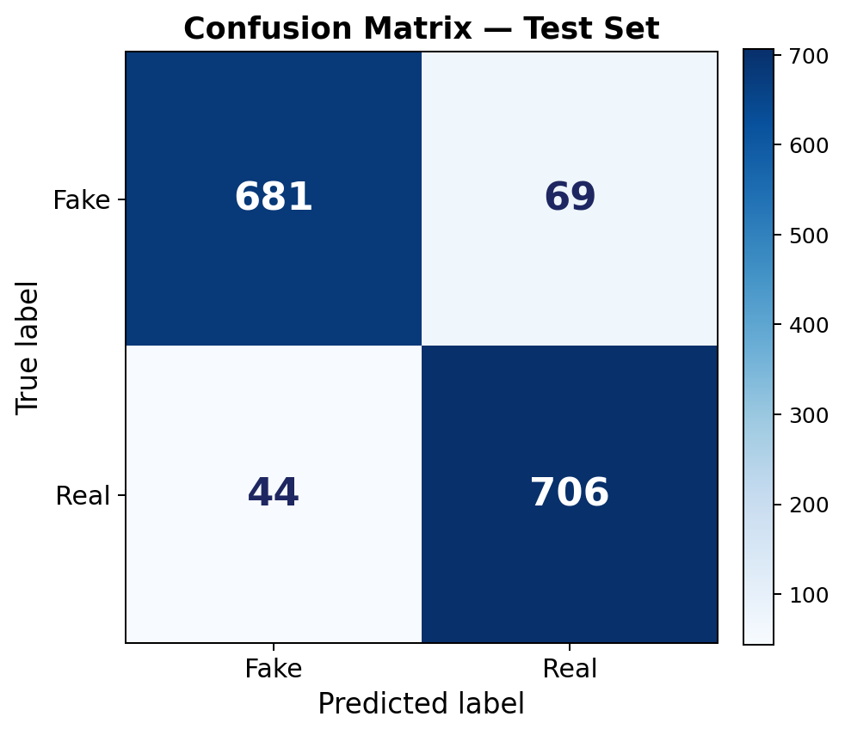
Confusion Matrix
Model exhibits a slight false-positive bias — recall on fake class = 0.908.

Slide 11
Limitations & Design Choices
Domain shift
The model is trained on DFDC-derived face crops. Out-of-distribution clips (e.g. webcam selfies) produced P(fake) = 0.510 — borderline confidence suggesting reduced generalisation.
Single-architecture comparison
Only ResNet18 was evaluated within the project timeline. ResNet50 and Xception comparisons are natural next steps and would strengthen ablation evidence.
No temporal modelling
Frame scores are aggregated by arithmetic mean, discarding inter-frame consistency entirely. A 3D CNN or LSTM over frame embeddings would likely improve performance on longer clips.

Slide 12
Conclusions & Future Work
Achieved 92.47% accuracy / AUC 0.981
Transfer-learned ResNet18 baseline on a held-out test set of 1,500 balanced face crops — strong performance for a frame-level classifier within the project scope.
Natural next steps
Cross-dataset evaluation on FaceForensics++ (to assess cross-generator generalisation), temporal modelling (3D CNN or LSTM), and threshold calibration for in-the-wild deployment.
Fully reproducible pipeline
prepare_data.py → train.py → evaluate.py reproduces headline numbers from a cold checkout. Seed 42 applied throughout; manifest.csv provides a cast-iron split record.
Student ID: 21396816

