Slide 1
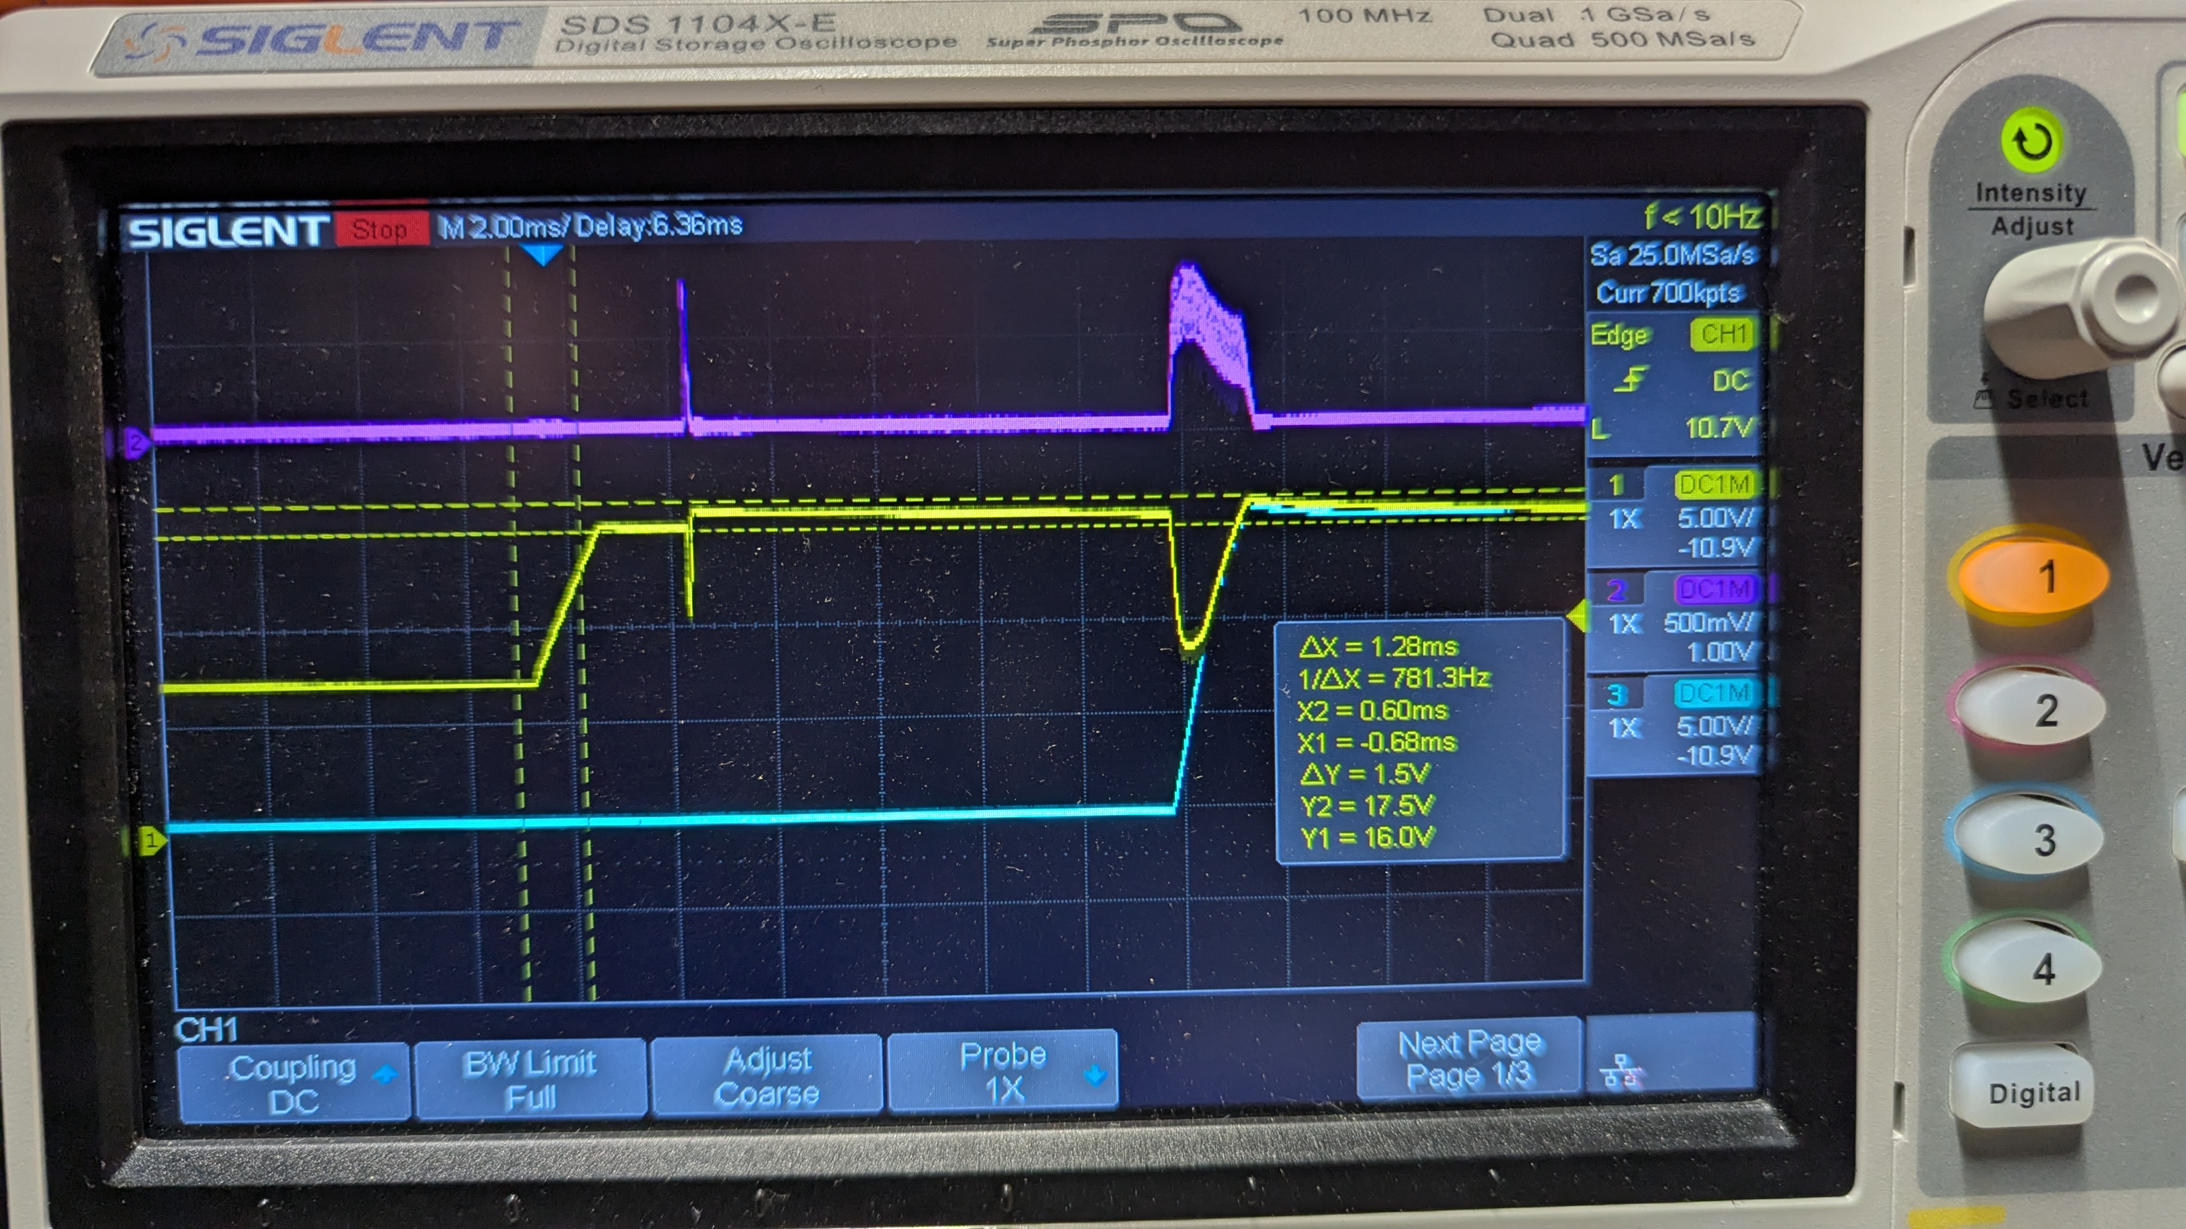
RT1987 Soft-Start Bodge
Boost bring-up debug round · 2026-07-31 → 08-03
Symptom (non-destructive, repeatable): ~80 % of State-98 “G” bus bring-ups latch 0x8004 = FAULT_OV_BUS on a current-limited bench supply; ~20 % come up clean.
Mechanism: connecting a running boost to the discharged bus through the RT1987 dumps a load-step into the boost; the recovery overshoot (17.2–17.5 V) is then peak-held on the bus by the ideal diode — a boost cannot sink, so the ADC samples the parked peak, not the 16.0 V regulation point.
Capture 5 (before): Vout (yellow), V-MOT (cyan), I_BAT (purple), 2 ms/div — the failing bus connect.
80 %
17.4 V
7 A
Hypotheses killed on the way: missing RD1 bodge (boosts regulate 15.9 V standalone) · logic-rail load step · RT1987 bias brownout · half-rectified ring (capture 6) · scope common-mode artifact (capture 7). Survivor: VIN-UVLO abort + ideal-diode peak-hold.
of bring-ups tripped
FAULT_OV_BUS
cursor park vs then-armed
17.0 V limit (now 17.5 V)
connect inrush vs the
~5.3 A RT1987 limit
Sources: docs/boost-bringup-debug.md · RT1987 DS §17.1–17.6 · captures 5–9
Notes:
Round trigger: after the 16 V retune, ~80% of G bring-ups latched FAULT_OV_BUS. First theory (missing RD1 bodge) refuted same day — both boosts regulate 15.9 V standalone. Real mechanism: load-dump overshoot peak-held by the RT1987 ideal diode.

Slide 2
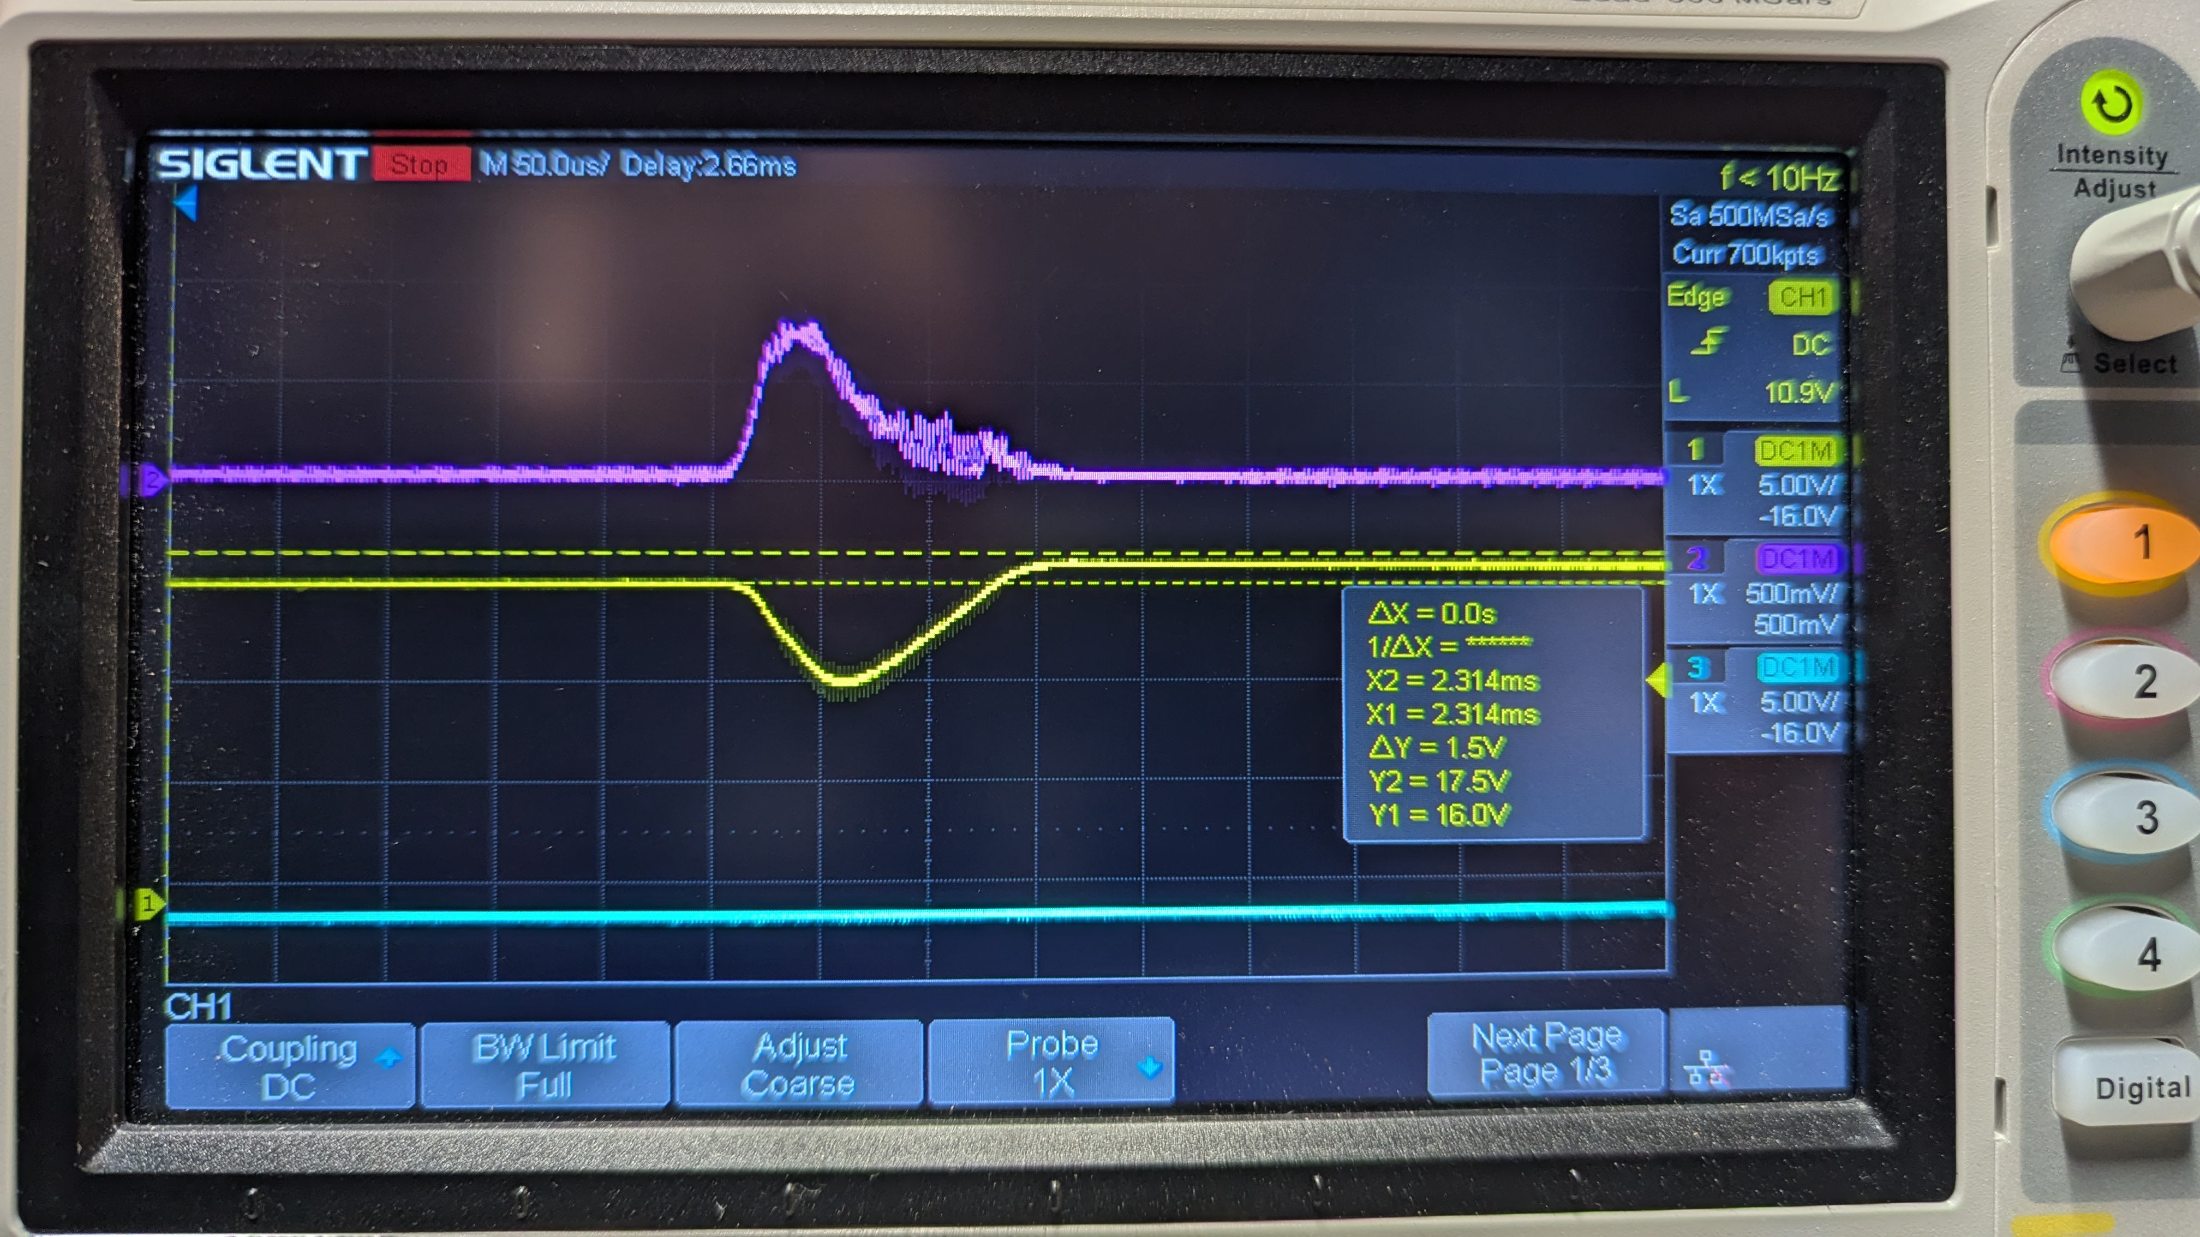
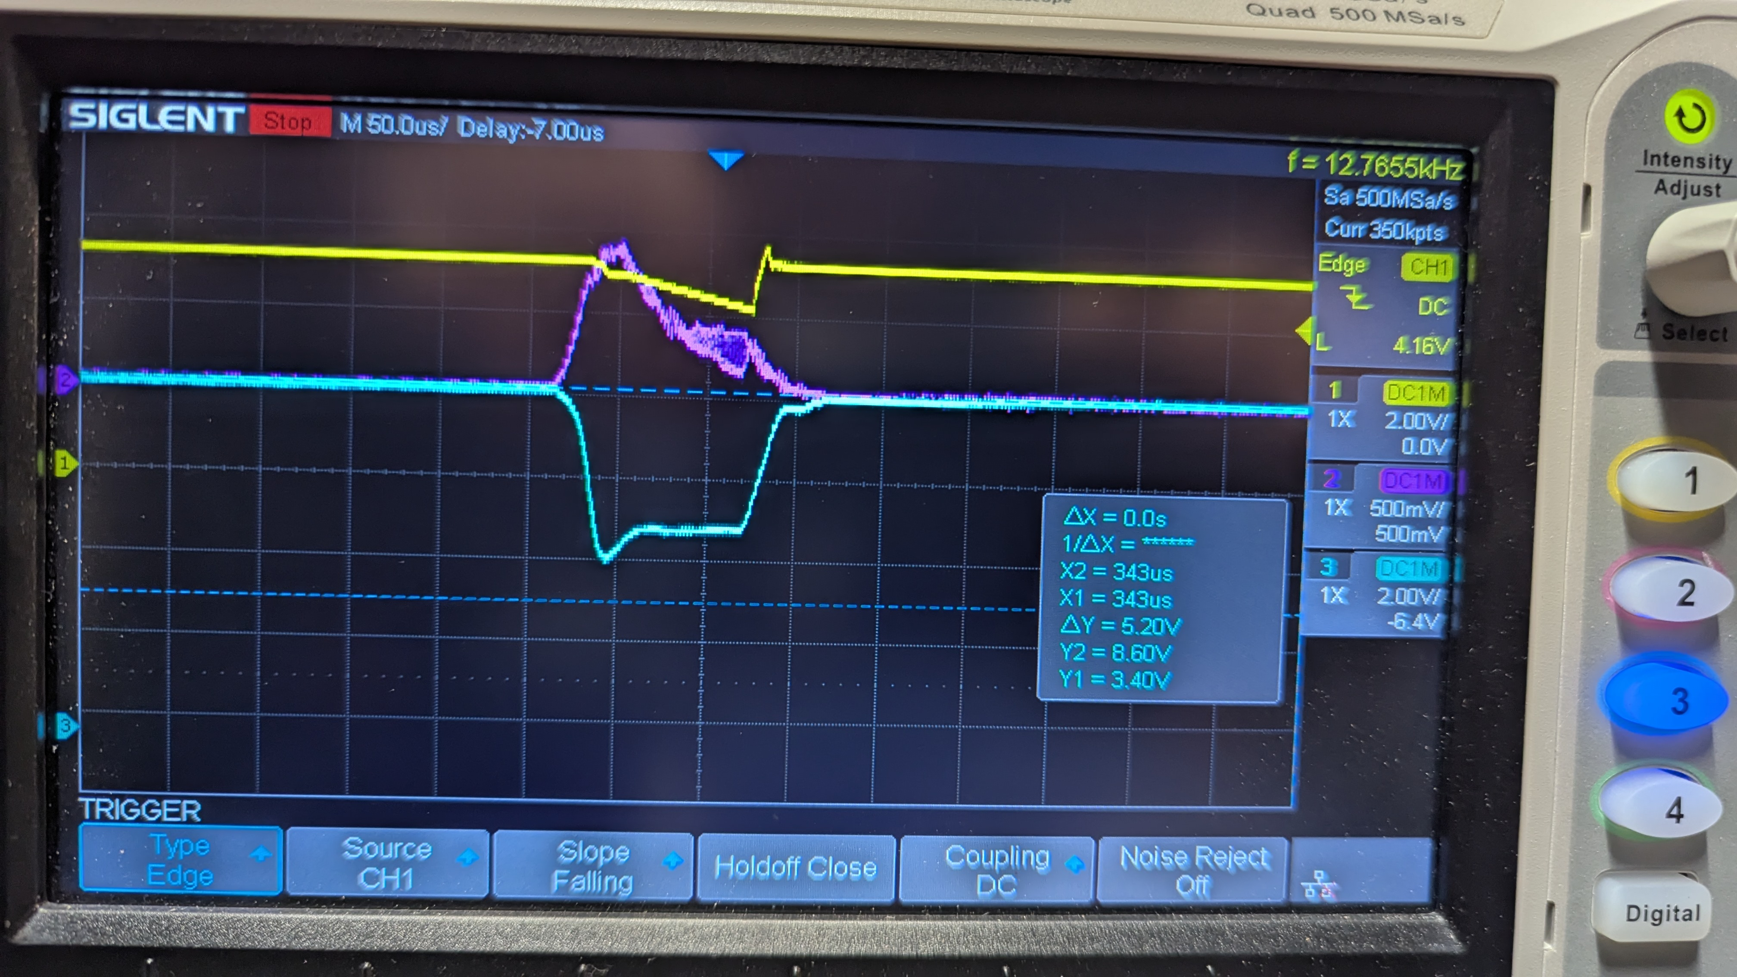
Before (CSS = 5.6 nF): anatomy of a failed connect
Dip #1 — VIN-UVLO abort (identified). A smooth unipolar ~7 A / ~100 µs inrush lobe (capture 6, 500 MSa/s — kills the ring/artifact theories). Capture 7 shows why it stops: the inrush collapses the current-limited source, VBT 8.6 → 3.4 V, RT1987 VIN (~2.9 V) crosses falling UVLO (~2.93 V) → documented abort (DS §17.1), then re-enable ≈ tD_ON 8 ms later.
Deep dip — the real charge event. 6–8 A for 1.77 ms (7.1× the 250 µs SCP timer, no cut), ∫I dt ≈ 7.4 mC ≈ 470 µF × 16 V — the motor-node charge through the full chain. Probe-node correction: the cyan CH3 trace in captures 5/6/8/9 was V-MOT, not VBUS (VBUS was never scoped); V-MOT climbs 0.91 → 16.85 V while VOUT sags to a 9.68 V floor.
The OV trip. Release overshoot ≈ 0.21 V/A of dump current parks the bus at 17.2–17.5 V — over the 17.0 V limit. Firmware timing bug confirmed: tD_ON = 8 ms > BUS_SETTLE_MS = 5 ms, so the pre-charge sequencing never ran; every connect was a full-ΔV (~16 V) connect.
Capture 5 · 2 ms/div — dip #1 needle,
then the 1.77 ms deep dip and 17.5 V park
Capture 6 · 50 µs/div, 500 MSa/s — dip #1:
smooth 6.9 A lobe, V-MOT flat
Capture 7 · 50 µs/div — VBT collapses
8.6 → 3.4 V; 5 V logic rail sags ~1 V
Notes:
Hypotheses killed in order: RD1 bodge missing; logic load step; RT1987 bias brownout; half-rectified ring (capture 6); CH2 common-mode artifact (capture 7). Winner: VIN-UVLO abort, which also dissolves the anomalous ~9.5 ms 'silent retry'.

Slide 3
The fix: CSS 5.6 nF → 100 nF on D-BT-EN
RT1987 DS §17.3: tON = VIN/35 × (CSS/0.0023 − 100) µs (10–90 % ramp; connect demand I = 0.8·C·VIN/tON)
Before — CSS = 5.6 nF
After — CSS = 100 nF
tON(16 V) ≈ 1.07 ms — far too fast for the node
Connect demand for the ~590 µF node ≈ 7 A, vs the ~5.3 A foldback limit at ΔV = 16 V — protection-marginal
Inrush collapses the source → UVLO abort → retry loop; release at ~7 A parks the bus +1.5 V over setpoint
tON(16 V) = 19.8 ms (full ramp 24.8 ms); predicted demand 0.65 A per mF (tON and ISCP are typ-only)
Gentle-ramp prediction FALSIFIED by capture 8: the connect is two-phase — onset dumps ~2/3 of the node charge at foldback-class ~7 A in ≲1 ms; only the top ~5 V rides the gate ramp at ~0.4 A
CSS bounds the duration / handoff point, not the onset current — inrush too brief to collapse the source, so no UVLO retry
Single-variable test: 100 nF fitted on D-BT-EN only; D-MT-EN left at 5.6 nF. Ordering consequence: this bodge must precede the ADC-gated settle — at 5.6 nF the Death-5 low-voltage pre-charge is functionally impossible on a current-limited supply (bus parks at ~400 mV). Interim firmware mitigation already in: LIMIT_V_BUS_MAX 17.0 → 17.5 V.
Notes:
Rationale chain: bound the dump current → bound the park (ΔV ≈ 0.21 V/A × I_dump) → stay under LIMIT_V_BUS_MAX and far under 19 V OVP / 20 V abs-max; and make the inrush too small to trigger the UVLO-abort retry loop.

Slide 4
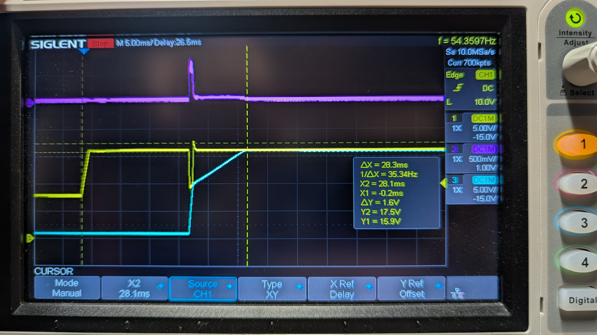
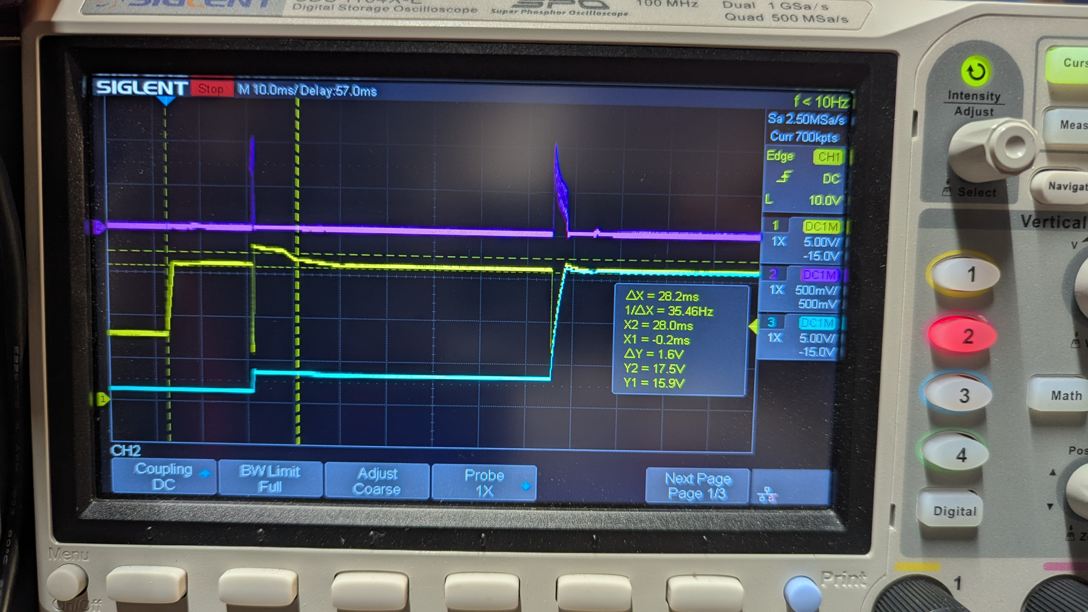
Verified results — and the limit of the fix
Capture 8 (after, no VESC) · 5 ms/div — one event, V-MOT ramps ~0.6 V/ms to ~16.2 V.
Capture 9 (after, VESC attached) · 10 ms/div — SCP cut, 65 ms retry gap, then success.
✓ Timing formula validated: ΔX = 28.3 ms measured vs tD_ON 8 ms + tON 19.8 ms = 27.8 ms predicted — a 1.8 % match. ✓ Retry loop gone, park reduced: single connect event; the scope-window ~17.0 V was a slowly-decaying park — DMM confirms VOUT regulates 15.9 V steady-state. ✓ Pass criterion met: no FAULT_OV_BUS, >4 consecutive clean “G” bring-ups (2026-08-03).
△ Big node still cuts: first clean SCP-cut/retry fingerprint — ~10 A abort, dead gap ~65 ms ≈ tSCP_RST 64 ms typ; retry completes, no OV trip. △ 0.21 V/A coefficient confirmed: 15.9 V + 10 A × 0.21 V/A = 18.0 V — matches the observed ~18 V peak. ⚠ Protection gap: the 18 V excursion lives behind the cut diode (the probed ~3.9 V node was V-MOT, not VBUS). Firmware sees taper-parks — the historic trips — but is blind to cut-release parks. Next: 100 nF on D-MT-EN, ADC-gated settle (≥ ~28–33 ms). 470 µF location RESOLVED: on V-MOT, downstream of D-MT-EN.
Notes:
Fix validated for the no-VESC config; with the VESC the connect still SCP-cuts but recovers cleanly on the documented 64 ms retry. The 18 V boost-local peak is invisible to firmware — only hardware (CSS, bodge caps) protects. Overshoot mechanism (linear vs EA-slew) remains OPEN — both models over-predict vs the empirical 0.10–0.21 V/A.

