Slide 1
DROOP CHAIN — PER CHANNEL
Each block sets one constant in the droop model
I_{out}
INA253A1 shunt amp
K_{sns} = 0.1 V/A
Sense gain. A1 fitted, not the A3 (0.4 V/A) intended.
V_{droop}
AD5443 MDAC, 12-bit
g ∈ [0, 1]
The only control input. Sets droop strength per channel.
g·V_{droop}
OPA197 non-inverting
A_{v} = 1 + 40.2k/10k = 5.02
Fixed gain. 5 V rail sets the output ceiling.
V_{op}
R_{inj} = 53.6k into FB
R_{D1}/R_{inj} = 215k/53.6k = 4.01
Injection attenuation.
V_{FB}
TPS61288 servos FB → V_{ref}
V_{ref} = 0.6 V
Closes the loop. Turns injected current into output volts.
Each channel is a Thevenin source with a programmable output resistance
V_{out} = V₀ − R_{e}(g)·I_{out}
R_{e}(g) = K_{sns}·A_{v}·(R_{D1}/R_{inj})·g = 2.014·g Ω V₀ = V_{ref}(1 + R_{D1}/R_{D2} + R_{D1}/R_{inj}) = 15.91 V
The MDAC is the only thing that moves. Everything upstream and downstream is a fixed constant, so 12 bits of g buy 0.49 mΩ of droop resolution from 0 to 2.014 Ω.
Notes:
Per channel: the INA253 senses the boost's own output current at 0.1 V per amp. That goes through a 12-bit MDAC, which is the only variable in the chain. The OPA197 scales it by 5.02, and it is injected into the boost feedback node through 53.6k, which the 215k feedback resistor attenuates by 4.01. The boost servos its FB node to 0.6 V, so the injected current comes back out as a drop in output voltage. Multiply the four constants and you get a Thevenin source with output resistance 2.014 times g, and a no-load voltage of 15.91 V. Note the injection ratio: the firmware mapping had omitted it, so both MDACs were sitting clamped at full scale.

Slide 2
POWER SHARE — THE MODEL
Two programmable sources in parallel give the share
Both sources feed VBUS through RT1987 ideal diodes (≈ 0 Ω on):
What the equation says
V_{bus} = V_{0F} − R_{F}·I_{F} = V_{0B} − R_{B}·I_{B} , I_{F} + I_{B} = I_{tot}
Gain is 1
Command the two resistances as a ratio r:
α = r exactly, when the two no-load voltages match.
R_{F} = k_{d}/r , R_{B} = k_{d}/(1−r) ⇒ R_{F} ∥ R_{B} = k_{d} , independent of r
Mismatch is a DC disturbance
α = I_{F} / I_{tot} = r + ΔV₀·r(1−r) / (k_{d}·I_{tot})
ΔV₀ ≈ ±0.4 V ⇒ d ≈ 0.17 share at 2 A. Worst at r = 0.5 and light load. Needs integral action.
Actuator limit: g ≤ 1 bounds k_{d} ≤ R_{e,max}·r_{min}. Chose k_{d} = 0.30 Ω over r ∈ [0.15, 0.85], leaving max g = 0.993.
Mismatch also moves the gain
∂α/∂r = 1 + ΔV₀(1−2r)/(k_{d}·I_{tot}) ⇒ K ∈ [0.55, 1.45].
Dynamics: the statics are instantaneous
With ΔV₀ = 0 both currents carry the same (V₀ − V_{bus}) factor, so α = G_{F}/(G_{F}+G_{B}) = r at every instant — bus transient or not. The bus pole only reaches the share through the mismatch term. What is left is the 1 kHz digital loop:
Corner | K | T_{d} | τ_{r} | τ_{f}
Range | 0.55 – 1.45 | 0.5 – 2 ms | 20 – 300 µs | 0 / 0.8 ms
G_{P}(s) = K · e^(−T_{d}·s) / [(τ_{r}·s + 1)(τ_{f}·s + 1)]
Delay-dominated, near-unity gain. 60 corners swept in synthesis.
T_{d} = 1 ms (ZOH + latch) · τ_{r} = 100 µs (converter lag) · τ_{f} = 0.8 ms (200 Hz prefilter)
Notes:
Two of those Thevenin sources in parallel, through ideal diodes that are near zero ohms when on. Solve the two-source network for the fuel-cell current, and then pick the mapping: resistance k_d over r on one channel, k_d over one-minus-r on the other. That mapping is the trick — the parallel combination stays k_d whatever r is, and the share collapses to alpha equals r, plus one term driven by the mismatch in the two no-load voltages. So nominal gain is exactly one. The mismatch term is the disturbance: about 0.17 share at 2 amps for a 0.4 volt mismatch, and it also perturbs the gain, which is where the uncertainty range comes from. Dynamically there is almost nothing in the hardware: with matched voltages both currents share the same driving factor, so the split is instantaneous regardless of what the bus is doing. The plant is essentially the 1 kHz loop delay.

Slide 3
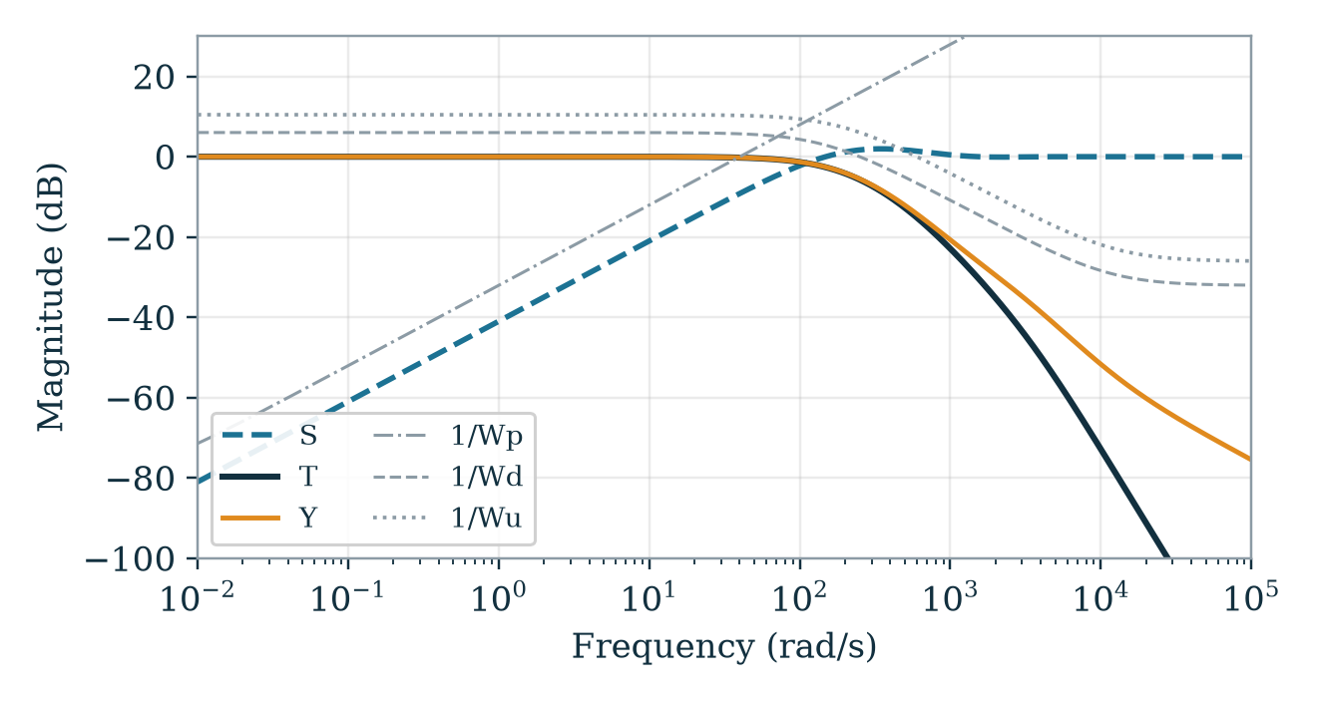
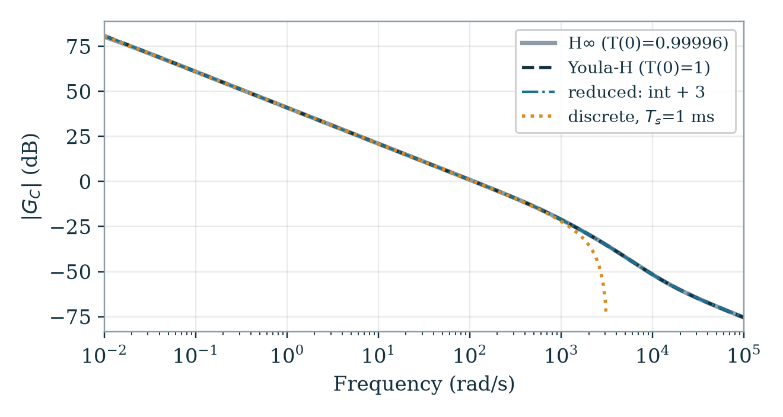
RESULT — H∞ / YOULA-H
Youla-H controller: exact DC, delay-tolerant
M₂ = 0.80
0.59 – 0.95
11.7 ms
T(0) = 1
nominal plant · peak S 1.25 · PM 73.9°
M₂ over 60 corners, median 0.83 · all stable
delay margin, ≈ 6× the worst modelled T_{d}
exact, to machine precision
How M₂ moves: gain and delay carry it. Mean M₂ falls 0.89 → 0.74 across K = 0.55 → 1.45, and 0.87 → 0.74 across T_{d} = 0.5 → 2 ms. The prefilter costs a little (0.84 → 0.78). τ_{r} does almost nothing (0.82 vs 0.80 over 20 → 300 µs) — the converter lag is 2.5 decades out of band, which is why lumping it is safe. 54 of 60 corners stay above 0.70; the 0.59 worst case stacks all four extremes at once.
Closed loop: S, T and Y sit under their inverse weights. γ = 0.653, crossover 110 rad/s.
Controller: the integrator is the diverging low-frequency branch. Reduction and discretisation track it.
Independent check: an 11-state TPS61288 model over 432 operating points, 432/432 stable, worst ‖S‖∞ 1.24. Next: bench-calibrate ΔV₀, T_{d}, τ_{r}, k_{d} and regenerate.
Notes:
At the nominal plant M2 is 0.80 — sensitivity peak 1.25, phase margin 74 degrees at 110 rad/s. Across the 60 corners it ranges 0.59 to 0.95, median 0.83, everything stable. What moves it is gain and delay: mean M2 drops from 0.89 to 0.74 as K goes 0.55 to 1.45, and the same drop again from half a millisecond of delay to two. The measurement prefilter costs a bit. Tau_r does essentially nothing — 0.82 versus 0.80 over the whole 20 to 300 microsecond range, which is the numerical version of the time-scale-separation argument: the converter loop is two and a half decades out of band, so lumping it as one pole is safe. The worst corner, 0.59, needs all four extremes at once, and even that is above my 0.5 target. Delay margin 11.7 ms is the one to watch — it is what covers me until T_d is measured.

Slide 4
IMPLEMENTATION — C++
Two parallel paths, four float states
teensy_controller/share_controller.h — shareControllerStep()
The split is the design, not a choice
G_{C,YH} factors as k_{I}/s + R(s), so the code is that sum: u = 0.5 + R(z)·e + I(z)·e, both paths driven by the same error. The 0.5 is only the zero-state output, not a linearisation point — the integrator carries the setpoint, settling at α_{req} − 0.5. Keeping it exact and separate makes T(0) = 1 structural; R(z) is the phase lead that pays for the 1 ms delay.
// R(z): cascade of DF2T biquads
float x = e;
for (int i = 0; i < SHARE_CTRL_NSOS; i++) {
const float *c = SHARE_CTRL_SOS[i]; // b0 b1 b2 a1 a2
float y = c[0]*x + state[i][0];
state[i][0] = c[1]*x - c[3]*y + state[i][1];
state[i][1] = c[2]*x - c[4]*y;
x = y;
}
// I(z): trapezoidal integrator
float integNew = integ + KI * Ts * 0.5f * (e + eprev);
float u = 0.5f + x + integNew;
// back-calculation anti-windup on the clamp
if (u > rmax) { integNew -= (u - rmax); u = rmax; }
else if (u < rmin) { integNew += (rmin - u); u = rmin; }
integ = integNew; eprev = e;
return u; // droop ratio r
Trapezoidal, because R(z) is Tustin
The integrator must use the same s→z map as the sections, or the two paths' phase disagrees and their sum is no longer the G_{C}(z) that was validated. Tustin also maps the LHP inside the unit disc, so stability survives, and at 1 kHz against a 17.5 Hz crossover the warping is nil.
Sections, because of one pole
R(z) is 3rd order. In a single direct form every coefficient's rounding is shared across all three poles; sections localise it. That matters here: one section carries z = 0.999996 — 4·10⁻⁶ from the unit circle, ~30× float32 eps. It is the W_{p} weight pole surviving near-cancellation, and it survives because it owns a section.
Transposed, because of that pole too
In DF2T every state is an accumulator sum, the same order of magnitude as the output; DF-II's intermediate node is what loses precision on a near-unit-circle pole. It is also what scipy's sosfilt does, so the Python reference and the C++ run the same recurrence.
Coefficients generated by synthesize_controller.py · the wrapper gates this step to 1 ms on micros() and holds the output between ticks — that ZOH is in the design plant · replay-tested against the Python reference, tol 5·10⁻⁴.
Where they meet: the clamp
R(z) is stable and cannot wind up, so back-calculation touches the integrator only — it absorbs the clamp excess, and r leaves the rail the tick after the error reverses.
Notes:
The shape of this code is inherited, not invented. The controller factors as an integrator plus a stable remainder, so the code is that sum: nought point five, plus the remainder path, plus the integrator path, both fed the same error. If someone asks about that 0.5 — it is not a linearisation point and it does not track the EMS command. It is simply what the controller outputs when every state is zero, a balanced fifty-fifty split at reset, in the middle of the 0.15 to 0.85 authority band. The setpoint is carried by the integrator: in steady state the error goes to zero, so the integrator state settles at the requested share minus 0.5. Any constant would give the same steady state. Why keep the two paths apart? Three reasons. First, the integrator is the thing Youla-H bought me — if I fold it into the sections it becomes a pole near z equals one that is only approximately at one, and exact DC tracking stops being structural and starts depending on rounding. Second, the integrator is trapezoidal specifically because the sections are Tustin — same s-to-z map, or the two paths' phase disagrees and their sum is not the controller I validated. Third, anti-windup needs one well-defined state to push on. Why sections rather than one direct form: one of these poles sits at 0.999996, four parts per million from the unit circle, about thirty times float32 epsilon — that is the sensitivity weight's pole surviving near-cancellation, and in a lumped third-order polynomial it would drown in coefficient rounding. Giving it its own section keeps it. Transposed form for the same reason: its states are accumulator sums that stay the same size as the output, where direct form two's intermediate node is exactly what loses precision on a pole that close to one. It also matches scipy's sosfilt, so the Python reference and the firmware run the same recurrence and the replay test is comparing like with like. And at the clamp the split pays off again: the remainder is stable and cannot wind up, so back-calculation only ever touches the integrator.

Slide 5
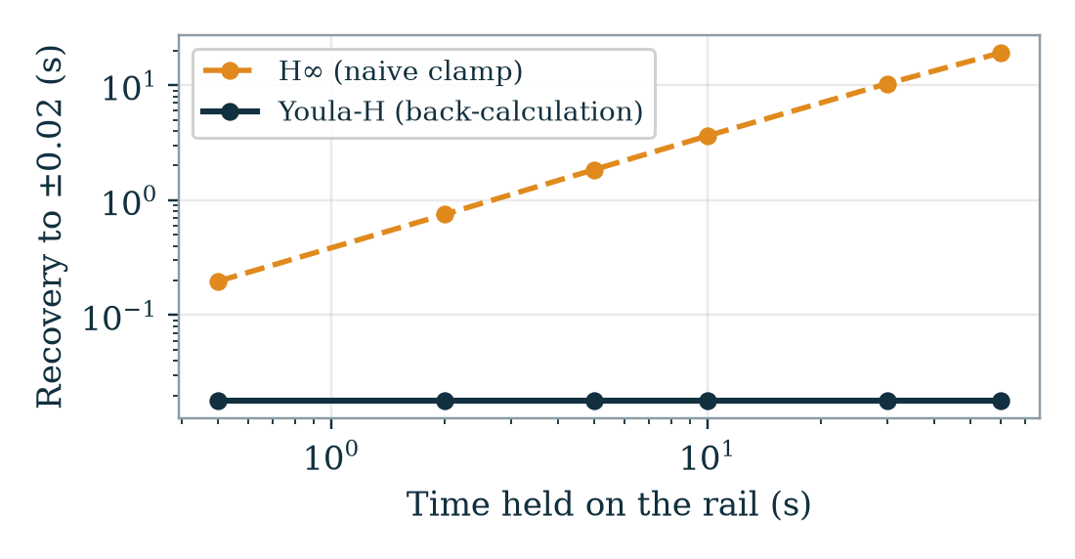
WHY BOTHER WITH THE CORRECTION
The same γ, but only one of them is implementable cheaply
Youla-H (shipped)
Uncorrected H∞
Pole at the origin
yes — 5.6·10⁻⁹, planted by the gain step
none. Slowest pole −4·10⁻³ (τ = 250 s)
Integrator split
k_{I} = 111.9 + stable remainder
asserts: no near-origin pole found
Ships as
integrator + 3 sections, 4 states
7th order → 6 sections; truncates to 3–4 at ~0.8 % — a wash
Anti-windup
back-calculation on one state: 2 lines
no integrator state to unwind. Naive clamp, or add conditioning / observer-form AW
T(0)
1, exactly
0.99996
The cost lands on windup
r is clamped to [0.15, 0.85], so saturation is routine, not an edge case. Hold the reference against the rail, then release:
Youla-H: the integrator absorbs the clamp excess. r leaves the rail in one tick and recovers in 18 ms — and that number does not move, however long it sat there.
Uncorrected H∞: the DC action is a 250 s mode buried in the cascade. A naive clamp lets it charge, so recovery scales with the abuse — 0.5 s on the rail → 0.2 s, 10 s → 3.6 s, 60 s → 19 s.
Fair caveat: a general LTI controller can be given proper anti-windup (Hanus conditioning, observer-form AW) — but that is another design step, with its own validation. Youla-H makes two lines enough.
Notes:
This is the practical argument for the correction, and it is not the one people expect. It is not order — the H-infinity controller balance-truncates to three or four states just as well, that is a wash. And the DC error, 0.99996 versus 1, is real but tiny. The bite is anti-windup. My controller output is clamped to the 0.15 to 0.85 authority band, so saturation is a normal event, not an edge case. With Youla-H the integrator is an explicit state, so back-calculation is two lines: it absorbs exactly the clamp excess, and the ratio leaves the rail one tick after the error reverses — 18 milliseconds recovery, and critically that number does not depend on how long it was saturated. The uncorrected H-infinity controller has no integrator state to unwind. Its DC action is a mode with a 250 second time constant buried inside the cascade, and a naive clamp lets that mode keep charging while the output is stuck. I simulated it: half a second on the rail costs 0.2 seconds of recovery, ten seconds costs 3.6, a minute costs nineteen. The recovery scales with the abuse. To fix that you would add conditioning or observer-form anti-windup — doable, but that is another design step with its own validation. The Youla step makes two lines sufficient.

Slide 6
SIDE BY SIDE — C++
The same loop, the code you would actually write
Youla-H — share_controller.h (shipped)
Uncorrected H∞ — what it would take
#define SHARE_CTRL_NSOS 3
static const float SOS[3][5] = { ... }; // 15 coeffs
static const float KI = 111.929630f; // + 1
static float st[3][2], integ, eprev; // 8 floats
float step(float e, float rmin, float rmax) {
float x = e;
for (int i = 0; i < 3; i++) { /* DF2T */ } // R(z)
// exact integrator, its own state
float iN = integ + KI*Ts*0.5f*(e + eprev);
float u = 0.5f + x + iN;
// BACK-CALCULATION: hand the excess to the integrator
if (u > rmax) { iN -= (u - rmax); u = rmax; }
else if (u < rmin) { iN += (rmin - u); u = rmin; }
integ = iN; eprev = e;
return u;
}
#define HINF_NSOS 6
static const float SOS[6][5] = { // 30 coeffs
{ 2.917e-2f, 1.667e-2f, 4.168e-3f, 5.911e-1f, 1.406e-1f},
{ 1.0f, 1.0f, 0.0f, -0.999996f, 0.0f}, // <- DC
... 4 more ... }; // no KI to declare
static float st[6][2]; // 12 floats
float step(float e, float rmin, float rmax) {
float x = e;
for (int i = 0; i < 6; i++) { /* DF2T */ } // ALL of Gc
// no integrator term: the DC action is st[1][0],
// buried mid-cascade. Nothing to hand an excess to.
float u = 0.5f + x;
// NAIVE CLAMP: states keep charging while railed
if (u > rmax) u = rmax;
else if (u < rmin) u = rmin;
return u;
}
Order 4 vs 7 3 sections + an explicit integrator, against a 6-section cascade. 16 coefficients vs 30, 8 state floats vs 12.
The integrator is right there in the H∞ code — it just leaks Section 1 is b = {1, 1, 0}, a₁ = −0.999996. At a₁ = −1.0 exactly it would be a trapezoidal integrator. That 4·10⁻⁶ of leak is T(0) = 0.99996, and it carries the loop's whole DC gain (G_{C}(1) = 27952).
Which is why the clamp has nothing to grab Back-calculation needs a scalar that owns DC. Here it is st[1][0], mid-cascade, inseparable from the sections after it. Clamping the output alone lets it charge — recovery then scales with rail time. Doing it properly means Hanus conditioning or an observer form: another realisation, another validation pass.
Notes:
Same plant, same weights, same gamma — this is only the last step, and this is the code it changes. On the left, what ships. On the right, what the uncorrected H-infinity controller would force: six sections instead of three, thirty coefficients instead of sixteen, and no integrator to declare. Look at section one on the right: b equals one, one, zero, and a-one equals minus 0.999996. If that coefficient were exactly minus one, that line would be a trapezoidal integrator — the very thing the left-hand code has explicitly. It is not exactly minus one. It leaks by four parts per million per tick, and that leak is precisely T of zero being 0.99996 instead of one. So the integrator is present in both; the difference is that H-infinity leaves it buried mid-cascade and slightly wrong, and Youla-H hands it to you exactly and separately. That is what the clamp needs. Back-calculation wants one scalar that owns the DC action so it can give the excess back. On the right that scalar is a state inside the cascade with five more sections downstream of it — there is nothing to correct — so you clamp the output and let it charge, and pay for it on release.

