Slide 1

Bench Bring-Up Session Results
SCALED FCHEV TEST PLATFORM
Hydrogen purge characterisation, drive-cycle fault diagnosis, two software defects, and the governor load threshold
Siddhesh Yadav
Prof. Francis Assadian
20 October 2026
Teensy firmware v30 · ROS 2 Jazzy · Future Mobility Lab
Notes:
One bench session. Four separate problems were tangled together: the fuel cell purge, two defects in the Pi-side software, and a governor threshold. Each is separated here with the measurement that identified it.

Slide 2
Summary of Findings
PHYSICAL
BENCH ARTEFACT
H-20 hydrogen purge
Drive-cycle faults were the supply
Measured at 100 ms every 10.34 s, V_fc to 1.75 V. Previously inferred from the brochure, never characterised.
The DC supply sagged 1.14 V on load steps. The real LiPo sags essentially nothing.
SOFTWARE
CONTROL
Two Pi-side defects
Closed-loop entry gate
A ROS parameter type error killed the sweep node at startup; a fault gate reset the sweep clock at every purge.
Operating at 0.300 A against a 0.30 A gate. Raising load restored tracking; the purge was not the cause.
All figures from rosbag2 telemetry, 20 October 2026 bench session
Notes:
Three of these four looked like each other. The purge was blamed for the tracking problem; the bench supply was blamed on the fuel cell; and a node that silently died looked like a firmware fault. Each needed its own measurement to separate.

Slide 3
H-20 Purge Characterisation
Eight consecutive events captured in rosbag_sweep_2026-10-20_06-40-47. The ~10 s period was previously an inference from the brochure; it is now measured.
Quantity | Measured | Previously assumed
Interval | 10.340 s (10.320–10.360) | ~10.4 s, inferred
Duration | 100 ms mean, 120 ms max | 200–300 ms
V_fc floor | 1.754 V | "near 0 V"
V_fc healthy, loaded | 10.151 V median | 7.8–8.2 V (bench source)
Interval jitter | ±20 ms across 8 events | unknown
Jitter of 40 ms across eight events indicates a scheduled timer rather than a reactive protection trip. The duration is two to three times shorter than the firmware design note assumed.
Source: /vehicle_state at 50 Hz, fault_flags transitions
Notes:
This is the most useful measurement of the session. Every TODO(calibrate) in firmware v30 was waiting on these numbers. The healthy loaded V_fc of 10.15 V also reconciles with the earlier problem note, which described the bus as running at about 10.7 V — that node was the FC rail all along.

Slide 4
Bus Voltage During Purge
V_bus across all eight purges
Purge share of run time
15.67–15.94 V
~1%
A 264 mV range, and 11.7 V above the 4 V design floor. The battery absorbed every event.
1.2 s of disturbance in a 128 s run — too little to account for a tracking problem.
Consequence: hold-up capacitor sizing drops by a factor of 20
The original 0.1 F estimate assumed the fuel cell was the only source, so the bus was the FC rail and it collapsed. With the battery in parallel on a 15.7 V bus, the battery is the hold-up. If capacitance is still wanted as insurance, the figure is approximately 5–10 mF, which also removes the inrush-limiter requirement.
C = 2·P·dt / (V_high² − V_low²) at 15.7 V, ~6 W estimated load, 120 ms
Notes:
The one configuration where the purge is genuinely dangerous is FC-only, with the battery off the bus. At the firmware's figure of 2.57 V per millisecond the bus would fall from 15.67 V to 4 V in about 4.5 ms, faster than the RT1987 can close. That is why v30 adds a 30-second FC-only lockout. Note the 6 W load figure is an estimate.

Slide 5
UDDS Drive-Cycle Faults
Two consecutive drive-cycle runs on DC supplies ended in different faults. The first hypothesis — that arming BENCH_TEST 0 simply exposed excursions that had always been present — was refuted by the archived bags.
Run 1 · UV_BATT
Run 2 · OC_FC
Prior clean runs
Ran a few seconds. V_batt transient floor 6.902 V against a 6.2 V limit.
Ran longer. I_fc spiked to 1.25 A against a 1.4 A limit.
I_fc peaked at only 0.45 A — a threefold margin, nothing near tripping.
The earlier runs were genuinely clean, not merely unmonitored. Arming the checks was therefore not what changed — something else had.
Comparison: rosbag 2026-09-07 and 2026-09-10 against the 2026-10-20 runs
Notes:
Worth stating plainly: the first explanation offered for these faults was wrong, and the data that refuted it already existed in the lab's own bag archive. Checking the old runs took five minutes and prevented a wrong fix.

Slide 6
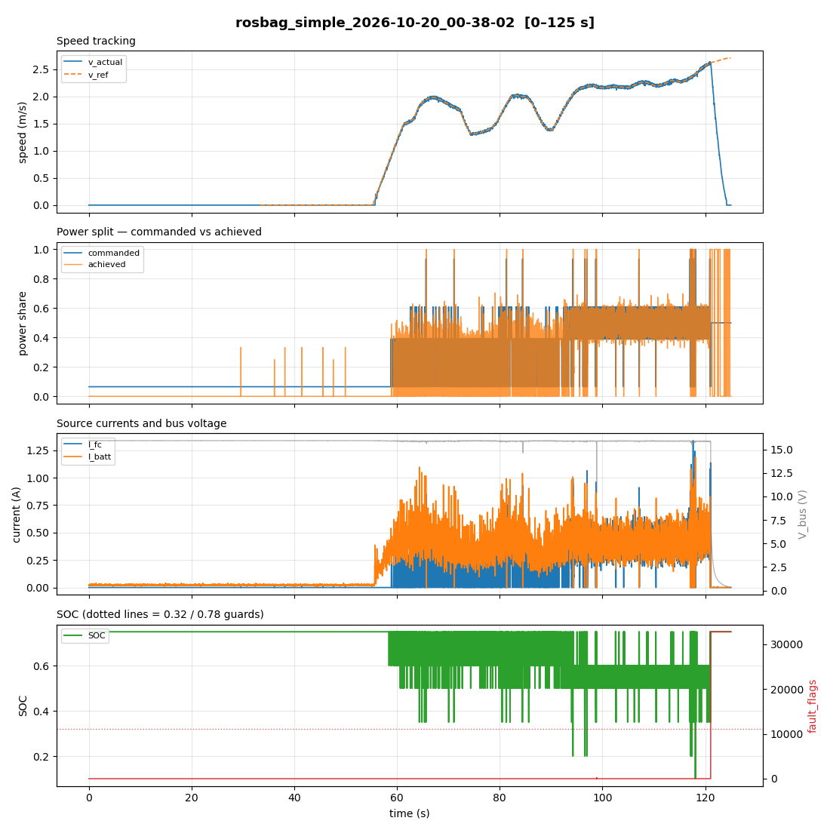
Faulted UDDS Run, First 125 s
Simple EMS on DC supplies. Latch at t ≈ 121 s.
Panel 2: commanded share jumps from 0.065 to ~0.6 at t = 57 s and chatters to 1.0.
Panel 3: I_fc spikes to 1.25 A at t ≈ 118 s, two seconds before the latch.
Panel 4: SOC snapping between 0.75 and 0.20 — the discrete values of the lookup table, not a physical quantity.
rosbag_simple_2026-10-20_00-38-02 · plotted with fchev_plot.py
Notes:
Peak speed here is 2.6 m/s, essentially the same as the clean 9-07 run at 2.7 m/s. Same speeds, same battery current envelope — so the difference was not how far into the cycle the run got.

Slide 7
Root Cause: Bench Supply Transient Response
V_batt behaviour | DC supply | Real 2S LiPo
Idle / resting | 8.037 V | 8.1 V
Loaded mean | 7.914 V | —
Transient floor | 6.902 V | 8.099 V
Sag under load step | 1.14 V | essentially none
Static drop is normal
Transient drop is not
ADC is accurate
123 mV loaded — about 0.12 Ω at 1 A, typical for bench leads.
1.135 V — nine times the static drop. A supply loop failing to follow a step load.
8.037 V measured against 8.09 V set — 53 mV. Not a calibration error.
A real pack at 20–50 mΩ responds immediately; the supply's transient impedance behaved like roughly 1 Ω. Every SOC-derived result from the DC-source bench is therefore an artefact of supply voltage and lead impedance.
Idle baseline from the 55 s stationary segment at the start of each run
Notes:
The static drop, the transient drop and the ADC each have a different signature, and the 55 seconds of idle at the start of every drive-cycle run provides a free zero-current baseline that distinguishes them.

Slide 8
SOC Estimation Path
The Teensy firmware contains no SOC at all. It is synthesised on the Pi in teensy_bridge_node as a nine-step lookup on instantaneous V_batt — unfiltered, evaluated every packet at 50 Hz — so a transient sag becomes a step change in commanded share.
if v >= 7.80: return 0.75
if v >= 7.60: return 0.60
if v >= 7.40: return 0.50
if v >= 7.20: return 0.35
if v >= 7.00: return 0.20
At the measured 6.90 V floor the table returns SOC 0.20, and the Simple EMS rule gives:
share = 1 − (0.20 − 0.32)/0.46
= 1.26 → clipped to 1.00
Every deep transient commanded the entire load onto the fuel cell — producing the I_fc spike to 1.25 A and the OC_FC latch.
Sample distribution: SOC 0.75 at 78.0% · 0.60 at 16.2% · 0.50 at 5.2% · 0.35 at 0.5% · 0.20 at 0.1%
Notes:
A 2S LiPo cannot change state of charge by half in 20 ms. The SOC trace snapping between 0.75, 0.60, 0.50, 0.35 and 0.20 is the literal table, not a noisy estimate of anything. Recommended fix: low-pass before the lookup, interpolate instead of stepping, and IR-compensate using V_batt + I_batt·R_int.

Slide 9
Sweep EMS Defect 1: Parameter Type
The node exited at startup on every launch. The visible symptom was the Teensy remaining in State 1 (Idle), which sent the investigation to the firmware.
BEFORE
AFTER
-p period_s:=20
-p period_s:=20.000
ROS 2 infers int64 from the spelling. The parameter is declared double, so declare_parameter() raises InvalidParameterTypeException and the process exits.
The launcher now routes every numeric prompt through a decimal formatter and rejects non-numeric input rather than passing it into the launch line.
No /ems_command publisher ever existed, so the Teensy never received a mode and never left Idle. The firmware was correct throughout — it was waiting for a command that was never sent.
fchev_run.sh · sweep_ems_node declares period_s and v_hold as doubles
Notes:
The launcher's own default was the integer 20, so the failure was both fully reproducible and invisible — the pane scrolled the traceback away before anyone looked at it.

Slide 10
Sweep EMS Defect 2: Fault Gate
Since firmware v30 four faults set their bit as a non-latching transient indication while a dwell filter decides. The Pi gated on any nonzero value, so every 100 ms purge commanded SAFE.
1 · Purge
2 · Firmware
3 · Pi
4 · Teensy
5 · Sweep
V_fc falls to 1.75 V
sets 0x0040, no latch
flags != 0 → mode 4
Run → Finish → Idle
clock resets to zero
Predicted ceiling
The correction
(10.34 − 3.0 settle) / 10 s ramp
→ 0.15 + 0.70 × 0.734 = 0.664
if flags & FAULT_ERROR:
→ SAFE
Observed peak: ~0.65. The sweep was structurally unable to command higher.
Only 0x8000 means stop. Transient bits are decoded and logged, not acted on.
Also explains the deep speed dips — the old SAFE branch published v_setpoint = 0.0
Notes:
This was the wrong architectural layer. The Teensy is Layer 1 — safety, full loop rate, direct ADC access, its own dwell filters. The Pi is Layer 3 — supervisory, 50 Hz decimated telemetry over UDP. The Pi was duplicating a protection function it is not responsible for, with worse information and no filtering.

Slide 11
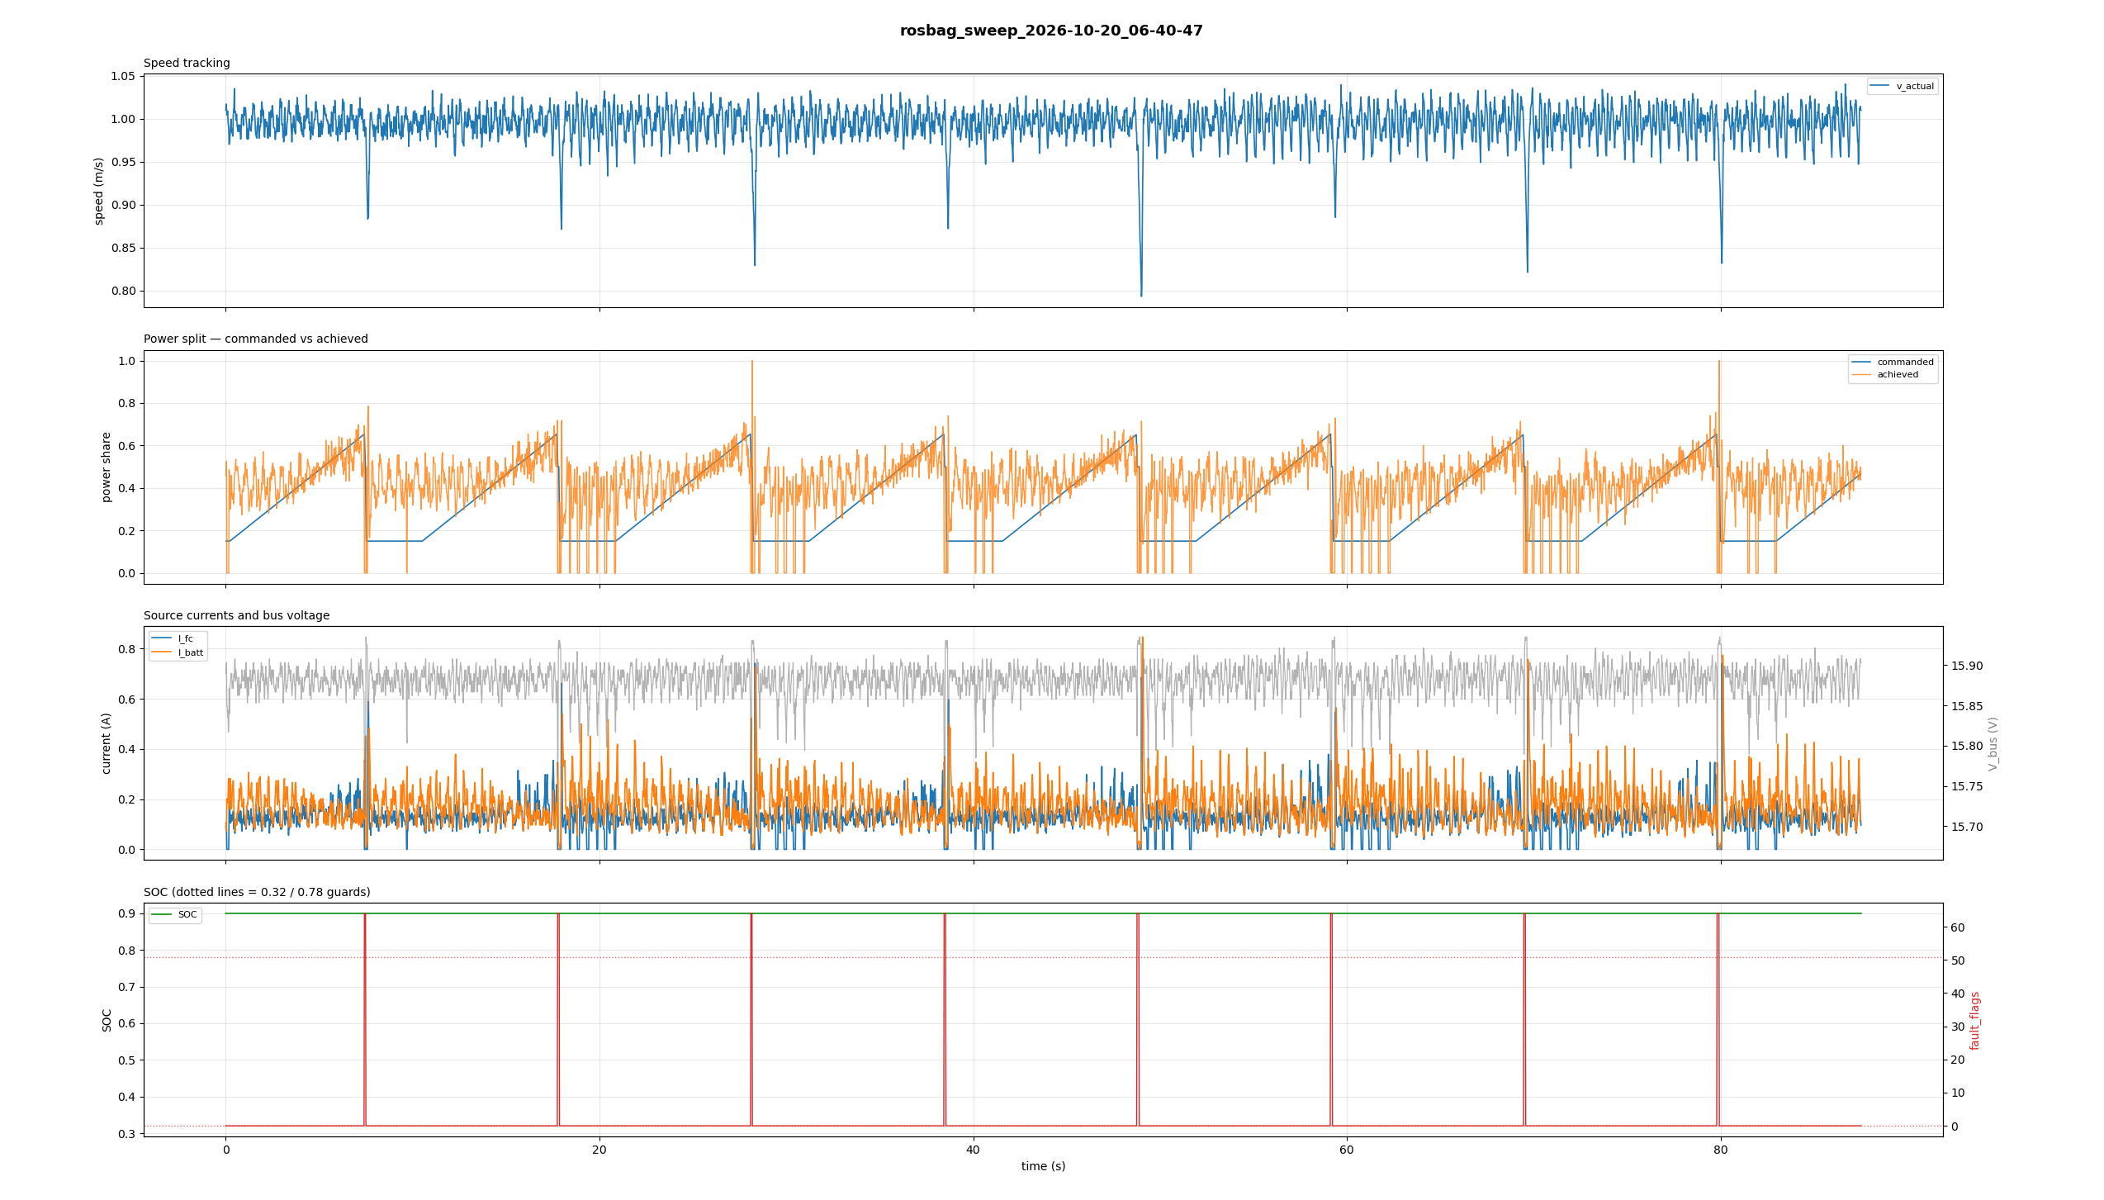
Sweep Clock Reset by Each Purge
Panel 2
Panel 4
Panel 1
A sawtooth, not a triangle. Each ramp stops at ~0.65 and restarts after the 3 s settle hold.
fault_flags pulses to 64 (0x0040, UV_FC) at every reset — the purge and the reset coincide exactly.
Speed dips to 0.80 m/s — mostly self-inflicted, since SAFE published v_setpoint = 0.
rosbag_sweep_2026-10-20_06-40-47 · real H-20 and 2S LiPo, pre-fix
Notes:
After the fix the residual speed dip is only to about 0.94 m/s. Most of the apparent purge disturbance in this plot was the EMS commanding the car to stop for 100 ms, not the fuel cell.

Slide 12
Governor Closed-Loop Entry Gate
Closed-loop entry threshold
Measured I_total at 1.0 m/s
0.30 A
0.300 A
= 2 × SHARE_MINORITY_I_MIN_A (0.15 A), strict greater-than test
mean — only 47.0% of samples above the gate
Below the gate the governor holds — it does not track
From the firmware: "Below 2·SHARE_MINORITY_I_MIN_A the band is empty (lo > hi): no split is feasible, so the reference is HELD at the ratio physically on the MDACs and nothing moves."
Approximately half of the achieved-share trace was therefore not tracking error. It was the governor frozen while the command moved away, then catching up — mode chatter, not controller performance.
Constants per fw v27 rev 2; the 0.30 A minority floor was rev 1 and is superseded
Notes:
Data taken at this operating point is a half-and-half mixture of two different actuation modes and should not be presented as closed-loop share tracking.

Slide 13
Load Sweep: Gate Crossing and Tracking
Same stack, same purge cadence, same firmware. Only the hold speed changed. If the purge were the cause of poor tracking, raising the load would not have helped.
Measure | 1.0 m/s | 1.5 m/s | UDDS sweep
I_total mean | 0.300 A | 0.454 A | 0.578 A
Above 0.30 A gate | 47.0% | 89.8% | 89.0%
Tracking RMS error | ragged | 0.0679 | 0.0667
Tracking bias | — | +0.0094 | −0.0009
Purge cadence | 10.3 s | 10.3 s | 10.3 s
Purges held constant, load raised 50%, tracking restored. A hold-up capacitor would not have produced this result. The purge remains worth addressing on its own merits, but it was not what was costing tracking quality.
Tracking error = achieved − commanded share, zero-order hold aligned, 4833 samples at 1.5 m/s
Notes:
The arithmetic that settled it beforehand: twelve purges at 100 ms is about 1.2 s in a 128 s run, under 1 percent duty cycle. But 53 percent of samples were below the gate. Removing the purges entirely could only have recovered that 1 percent.

Slide 14
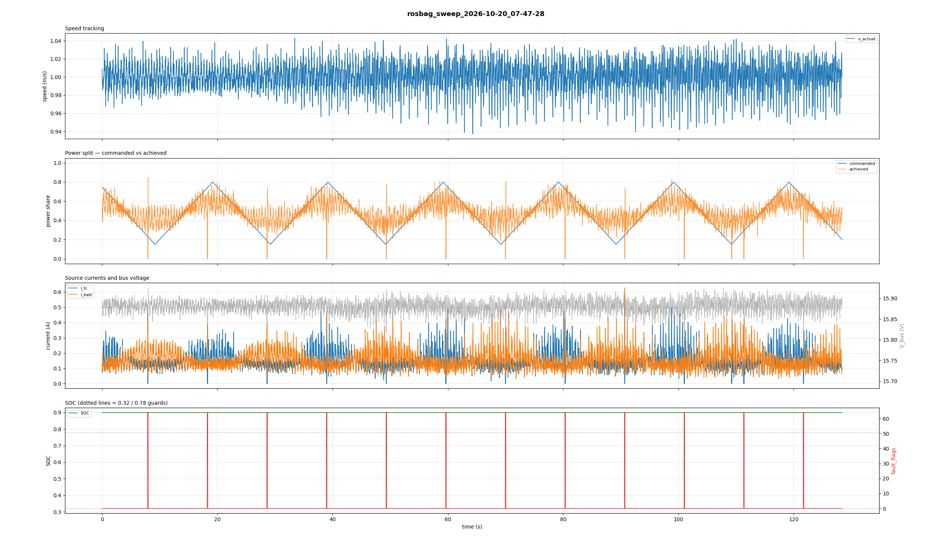
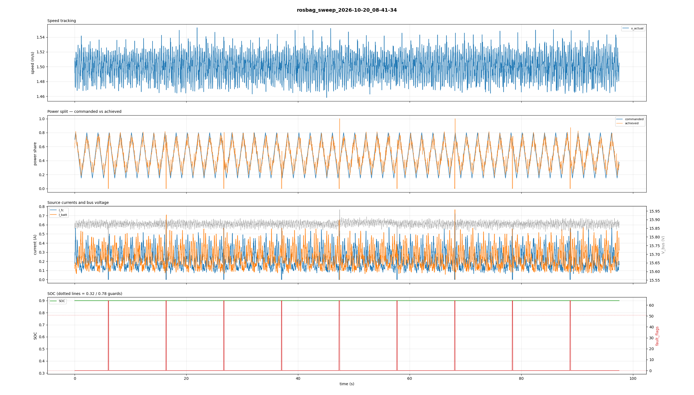
Tracking at 1.0 m/s and 1.5 m/s
1.0 m/s — 47.0% above gate
1.5 m/s — 89.8% above gate
Full triangles after the fault-gate fix, but a wide achieved band — the governor entering and leaving closed loop as total current crosses the gate.
Achieved follows commanded across the full 0.15–0.80 range. RMS error 0.0679, bias +0.0094 over 4833 samples.
rosbag_sweep_2026-10-20_07-47-28 (20 s period) and 08-41-34 (2 s period)
Notes:
Note the right-hand run uses a 2 second sweep period against 20 seconds on the left, so it is also a harder test. Achieved share spans 0.018 to 0.873 there, exceeding the commanded range at both ends, which rules out slew-ceiling clipping.

Slide 15
Firmware v30 Constant Changes
Design rule stated in the firmware: the discriminator is duration, not threshold. A purge reaches ~1 V, so no trip limit can separate a purge from a depleted stack — only a dwell filter can.
Constant | Was | Now | Rationale
UV_FC_DWELL_LATCH_MS | 20 ms | 1000 ms | A purge credits at most 120 ms of dwell
LIMIT_V_FC_MIN | 6.0 V | 4.5 V | Below the 7.8 V loaded knee
UV_FC_PURGE_LOCKOUT_MS | — | 30 s | Refuses FC-only after a purge-class dip
LIMIT_V_BATT_MIN | 6.2 V | 7.4 V | Pack-floor ruling, now dwell-filtered
LIMIT_V_BATT_MAX | 10.0 V | 8.5 V | OV_BATT was inoperative — above the 8.646 V ADC ceiling
Operational constraint: the FC-only lockout refuses a >= 0.85 command while armed — and at 10.34 s purge spacing against a 30 s window it is permanently armed. Sweep share_max must stay below 0.85; we now run 0.80.
Also fixed on flash: a missing forward declaration for busBringupFail (Arduino prototype ordering)
Notes:
The OV_BATT finding is worth calling out separately — the limit was set above what the ADC can report, so battery overvoltage protection did not exist at all until v30. That is independent of the purge work.

Slide 16
v30 Validation Against Measurement
Quantity | Measured | v30 constant | Margin
Purge duration | 120 ms max | 1000 ms latch | 8.3×
Purge interval | 10.340 s | 2.52 s break-even | 4.1×
V_fc floor | 1.754 V | 4.5 V trip | crosses, by design
V_fc healthy | 10.151 V | 7.0 V arm | 3.15 V
V_batt floor, real LiPo | 8.099 V | 7.4 V limit | 0.70 V
No ratcheting
Confirmed in service
Still unverified
A 120 ms dip decays in 2.4 s of over-time at the 0.05 leak. With 10.34 s between events, every purge starts from zero.
88 s and eight purges with the bit set each time and no latch. The dwell filter rejected every one.
LIMIT_I_FC_MAX at 1.4 A remains TODO(verify) against the physical cell.
The firmware's working figure was 100–200 ms; the measurement came in at 100 ms mean
Notes:
The header's assumptions were conservative in the right direction. The one number still resting on inference is the FC current limit, which was corrected from 3.5 A to 1.4 A on reasoning alone and has never been checked against the stack.

Slide 17
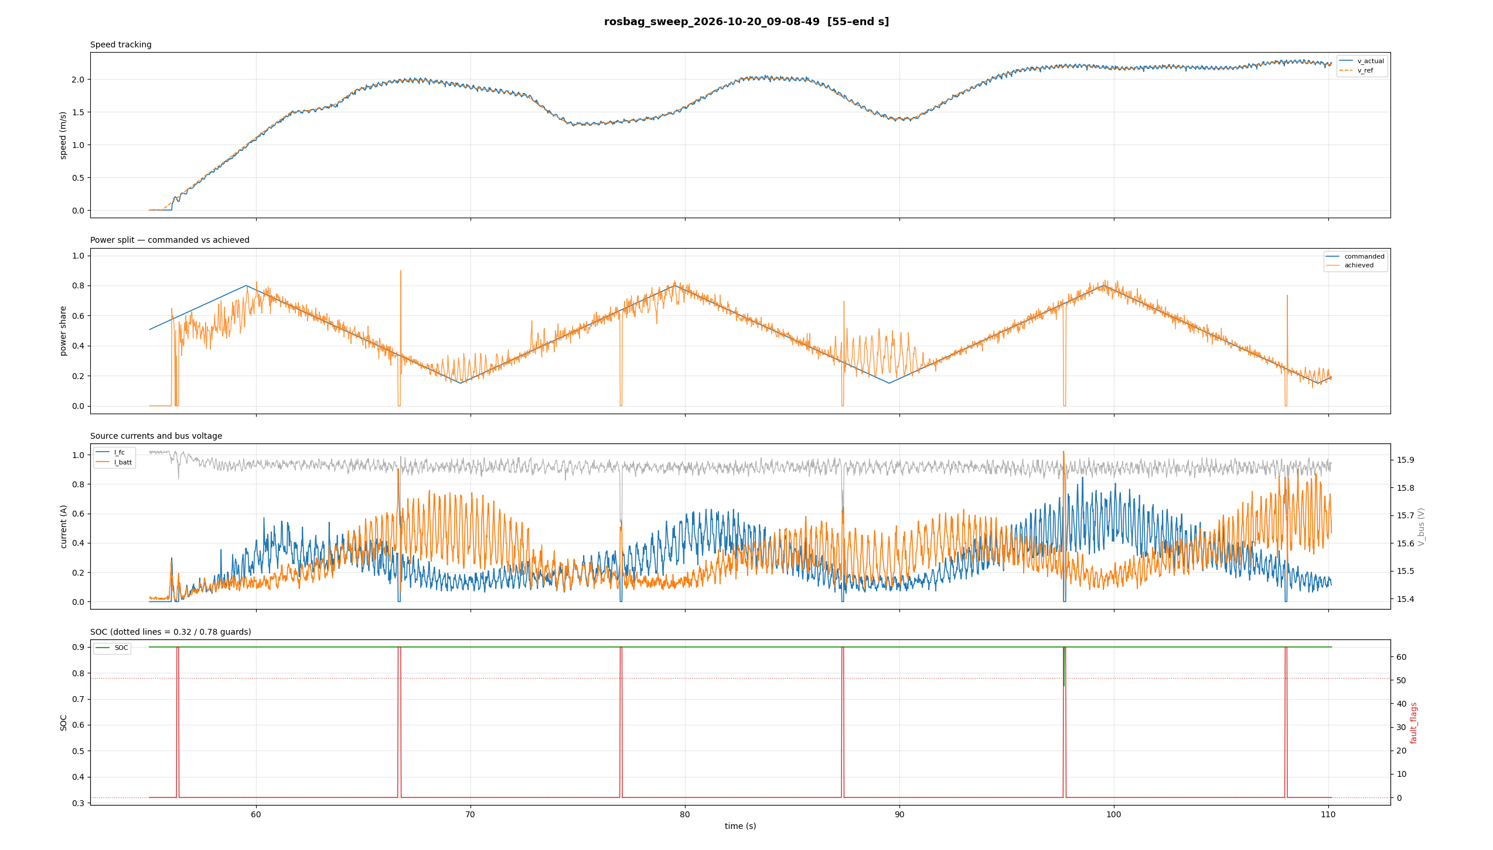
Working Result: UDDS with Sweep EMS
Real H-20 and 2S LiPo, firmware v30, through a purge every 10 s. No latch, no state cycling.
Tracking RMS
Tracking bias
0.067
−0.001
I_fc peak
I_batt peak
60%
34%
Tracking is load-invariant. RMS 0.0667 under a varying drive cycle against 0.0679 at constant speed — the governor tracks the same whether demand is steady or sweeping.
rosbag_sweep_2026-10-20_09-08-49 · v max 2.30 m/s · V_batt min 8.099 V · no latch
Notes:
This is the first dataset from the platform that measures what it claims to measure. The DC-source runs characterised a bench supply; the pre-fix FC runs characterised two software defects. This one characterises the governor.

Slide 18
Open Items
Full UDDS requires a lower share_max
Revise the SOC estimation path
We reached 2.30 m/s; the cycle peaks at 5.0. Linear scaling puts I_fc near 1.9 A at share 0.80, above the limit. Use approximately 0.45, or step up and measure the exponent.
Low-pass before the lookup, interpolate instead of stepping, IR-compensate. Incorrect regardless of what supplies the rail.
sdp_ems_node still on pre-v4 indices
Verify LIMIT_I_FC_MAX
Reads V_batt as SOC and V_rgn as fault flags. Runs without erroring and optimises against the wrong signals. Blocks any SDP experiment.
1.4 A was derived by reasoning after 3.5 A was found unprotective. Never checked against the stack.
Encoder scaling discrepancy
Is purging consumption-based?
Firmware reports 180 counts/rev; the governor document states 240. A 1.33× error in v_actual if the model follows the document.
If the interval shortens with current, disturbance rate couples to the control input — a feedback path worth addressing in the paper.
Gold = blocks the next run · Blue = blocks publishable results
Notes:
The capacitor remains worth fitting: it removes the V_fc collapse, the UV_FC transients and the residual speed dips. It is simply not on the critical path for tracking data, and the sizing is now 5–10 mF rather than 0.1 F.

