Slide 1
VMs vs Docker: Workflow & Architecture Comparison
Detailed Workflow Diagrams, Architecture Layers & Performance Analysis

Slide 2
1. Overview
Both Virtual Machines (VMs) and Docker Containers provide application isolation.
- **VMs:** Full hardware-level virtualization for running multiple OS instances.
- **Docker:** Lightweight, container-based virtualization sharing the same OS kernel.
This presentation details their workflows, architectures, and performance differences.

Slide 3
2. Virtual Machine Workflow
1️⃣ **Infrastructure Layer:** Physical hardware providing compute, storage, and network.
2️⃣ **Hypervisor:** Virtualization layer (e.g., VMware, Hyper-V) enabling multiple VMs.
3️⃣ **Guest OS:** Each VM runs its own OS instance.
4️⃣ **Application Layer:** Applications run inside isolated VMs.
5️⃣ **Network & Storage:** Managed through virtualized interfaces.

Slide 4
3. Docker Workflow
1️⃣ **Infrastructure Layer:** Underlying hardware and OS.
2️⃣ **Docker Engine:** Core component managing containers.
3️⃣ **Container Layer:** Runs applications in isolated environments.
4️⃣ **Docker Registry:** Repository storing and distributing container images.
5️⃣ **CI/CD Integration:** Enables automated build, deploy, and scale workflows.

Slide 5
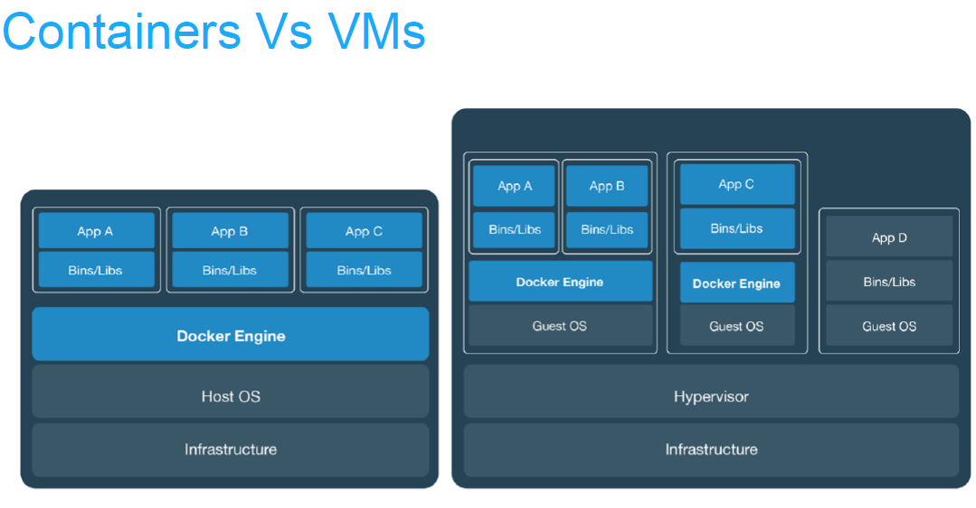
4. Containers vs VMs: Architecture Comparison (Visual)

Slide 6
5. Workflow Block Diagram: VM vs Docker
Virtual Machine Workflow:
Infrastructure → Hypervisor → Guest OS → App
Docker Workflow:
Infrastructure → Host OS → Docker Engine → Container → App

Slide 7
6. Detailed Feature Comparison Table
Feature | Virtual Machine | Docker Container
Architecture | Full OS via Hypervisor | Shared Host OS via Docker Engine
Boot Time | Minutes | Seconds
Resource Usage | High (Each VM has OS) | Low (Shared OS kernel)
Isolation | Hardware-level | Process-level
Performance | Moderate (overhead from OS) | Near-native performance
Portability | Hypervisor dependent | Cross-platform portability
Workflow Integration | Limited automation | Seamless CI/CD integration

Slide 8
7. Performance Comparison Chart

Slide 9
8. Key Takeaways
✅ **Virtual Machines** → Ideal for multi-OS, legacy, and secure workloads.
✅ **Docker Containers** → Best for CI/CD, scalability, and modern DevOps workflows.
➡ **In summary:** Docker provides speed and portability, while VMs offer stronger isolation and flexibility.

