Slide 1
MyScholarship
SSE Scholarship Maganement System
1851343 Xiaoyi Ji
1850250 Ximing Zhao
1852137 Yiteng Zhang
1853829 Yuchen Yang
Notes:
Hello, our project name is MyScholarship, as the name suggests, it is a scholarship management system.

Slide 2
Content
1
2
3
4
Background
Architecture
Function
Presentation
Notes:
Hello, our project name is MyScholarship, as the name suggests, it is a scholarship management system.

Slide 3
Background
Lack of such a system
Cumbersome of manual
data processing
Notes:
Every year, our college will issue scholarships to outstanding students to commend their efforts in the previous academic year. However, due to the large number of applicantions, the method of manual sorting of materials by counselors is not only cumbersome, but also prone to some omissions. Based on this background, we thought that we could build a scholarship management platform, so that counselors and teachers could publish scholarship selection announcements, collect and automatically organize the information of students on this platform, and screen out suitable candidates faster and more accurately; at the same time, students can also get the scholarship selection notice in time on this platform, prepare the application materials before the deadline, and check the scholarship application progress in real time.

Slide 4



Architecture
Front-end architecture
Use npm to implement dependency package management
Use the progressive framework Vue.js user interface
Use vue-cli-based Vue .js for rapid development
Create a single-page app using routed Vue Router
Use Axios as an HTTP request tool
Use the Element UI desktop component library

Slide 5



Architecture
Back-end architecture
Use Spring boot as a background development framework
Use Mysql as a database management system
Use Mybatis for data persistence
Notes:
Firstly, we used spring boot as our backend development framework. The hierarchical framework can simplify our project setup and development process, and make our development more concise.
Then,, we used mysql as our database to store the data of our system, including 4 tables that are user, scholarship, application and announcement.
Finally instead of the native JDBC, we apply Mybatis for our data persistence framework.
MyBatis can eliminate almost all of the JDBC code and the work of setting parameters and getting the result sets. MyBatis can be configured and mapped with simple XML files or annotations to primitive types, interfaces, and Java Pojos (Plain Old Java Objects) The Java Pojos can be created as records in a database.

Slide 6
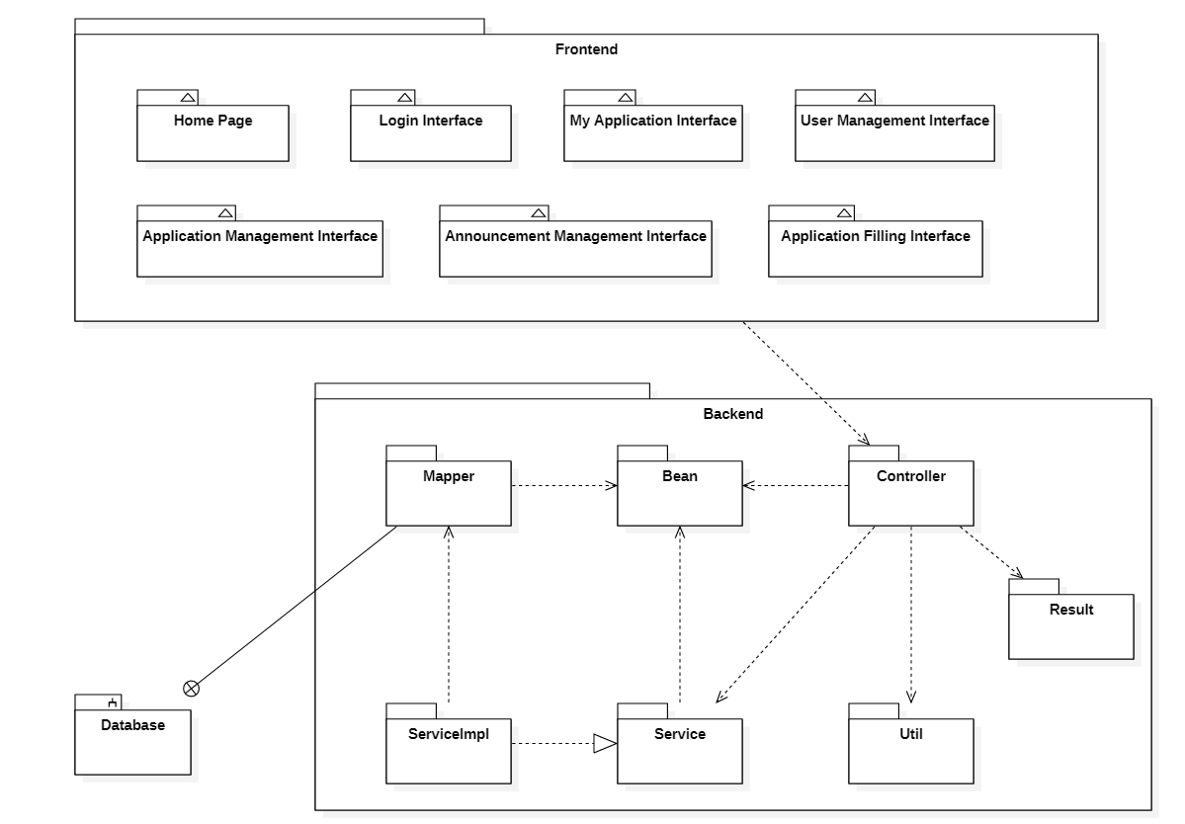
Back-end Architecture
Hierarchical structure
Controller Layer
Service Layer
Mapper Layer
Notes:
Next, I will focus on the hierarchy of Springboot. which is divided into Mapper layer, controller layer and service layer.
Mapper layer is mainly responsible for the interaction with database information, which is implemented by using Mabatis.
The Service layer is responsible for the business logic processing to provide various services.
The Controller layer interacts directly with the front end to respond to the needs of the front end users. They can use the value of the annotation @RequestMapping and the
@PostMapping in the control layer as the URL path to access.
At each level we have four modules based on the tables in the tables of database. They mainly provide adding, deleting, modifying and checking of each table. Our query database is more complex, with a single table query only calling the Search interface, but it can receive different parameter queries.
In addition, there are other modules at the back end to assist in development. The Result module
encapsulates a unified data format for front-end and back-end interaction. The Util module encapsulates
the tools needed for the service logic, such as the method to upload a file, the method to generate token, and
so on.

Slide 7


Function
Apply for
Scholarship
User
management
View the
Results
Announcement

Slide 8
Presentation

Slide 9
Thank you！

