Slide 1

MyClub
Tongji University Club Management Center
1951708 Xie Yuxiang
1952350 Liu Hongbo
1952292 Meng Junjie

Slide 2
Content
1
Background
2
Architecture
3
Function
4
Innovation
5
Presentation

Slide 3
01
Background
1
2
3
Lack
Need
convenient
We don’t have such a club management system in our school.
Club management has always been a difficult part for managers to deal with.
It is convenient for storing data and information into our system compare with manual.

Slide 4



02
Architecture
Use npm to implement dependency package management
Use the progressive framework Vue.js user interface
Use vue-cli-based Vue .js for rapid development
Create a single-page app using routed Vue Router
Use Axios as an HTTP request tool
Use the Element UI desktop component library

Slide 5



02
Architecture
Use Spring boot as a background development framework
Use Mysql as a database management system
Use Hibernate for data persistence

Slide 6
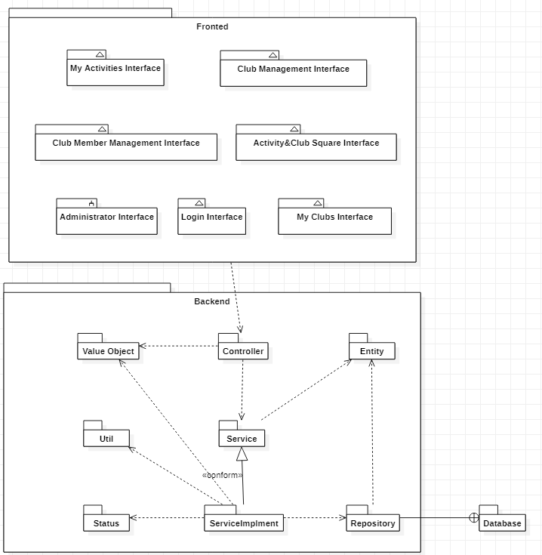
02
Architecture

Slide 7
finish
03
Function
04
Step
Core Domain
Create Clubs/Activities Join in Clubs/Activities
Member Management
General Domain
Login & Logout & Signup
Change Personal Details of Users
Fundamental Domain
Sendding Login Verification Code
Retrieve password

Slide 8
04
Innovation
Innovation Design
E-mail System
SaResult and Status
Double encryption
We aggregate send e-mail function
Encapsulate the return data of all controller interfaces, Use status instead of boolean
We use AES and MD5 to encrypt our data in http and database.

Slide 9
Presentation
延时符

