Slide 1
Severity of road accidents in Belgium Prediction using machine learning
08/11/2020
Tanguy Timmermans

Slide 2
Predicting accident severity can be useful
In the short run
Help road users identify dangerous conditions or situation
Help emergency services react more appropriately
Send the right team when being notified of an accident
Size the response teams and set up planning the have the right persons available at the right time
Help safety agencies design road safety awareness campaigns
In the long run
Improve road infrastructure to protect most vulnerable persons
Improve vehicles safety features

Slide 3
Data acquisition
Data from the government website : data.gov.be
All accidents between 2005 – 2019 involving casualties:
Slightly injured victim
Severely injured victim
Deathly accident
In total 734 301 training example with 42 columns
Duplicated columns (translation) and correlated data were dropped
In total 10 features were retained
Example classified in 3 classes – dataset largely imbalanced:
0 = only slightly injured people (89.3%)
1 = at least severely injured person but no death (9.2%)
2 = at least 1 death (1.5%)

Slide 4
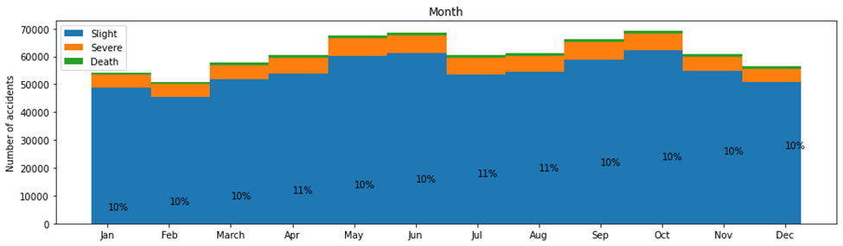
Feature analysis: Month
The percentage represent the proportion of “severe” + “deathly” accidents.
No significant influence of month (or season) on severity

Slide 5
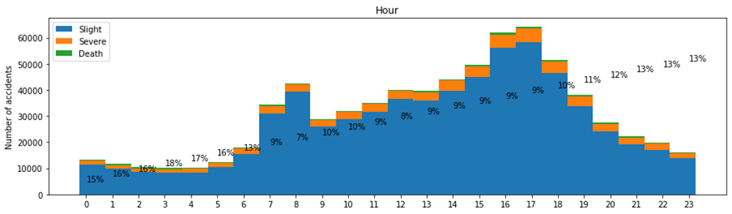
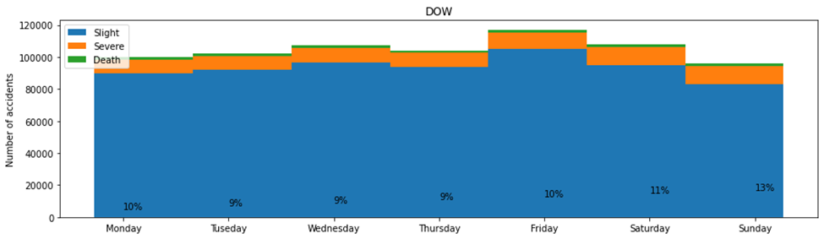
Feature analysis: Time of the accident
Midnight – 5am is the worst period
More accidents on Friday but Accidents on Sunday are a bit more severe

Slide 6
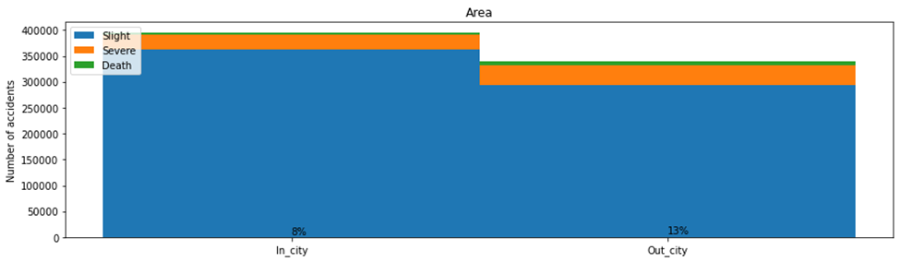
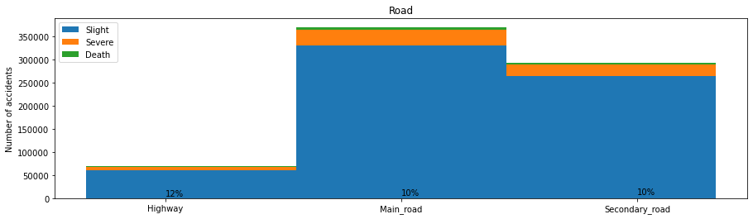
Feature analysis: Location of the accident
More accidents inside cities
Accidents on outside the cities (on hihgways) are a bit more severe

Slide 7
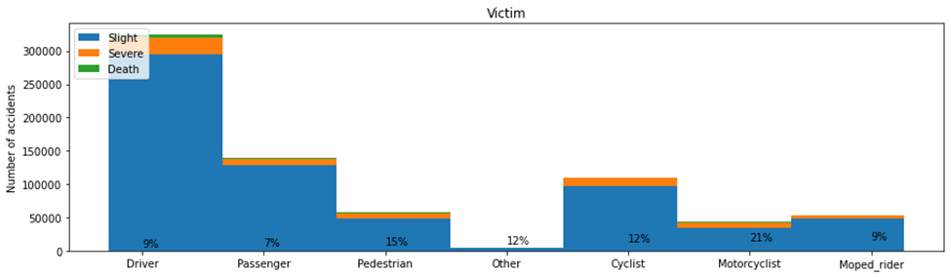
Feature analysis: Victim type
Most victims are drivers, but likely because they are the most common road users
21% of the time a motorcyclist is the victim, he is severely injured or dies
Pedestrian are also ignorantly more injured by accidents than other users

Slide 8
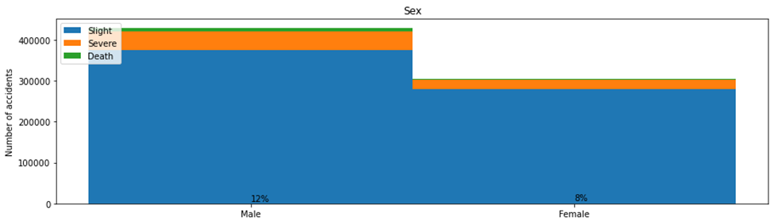
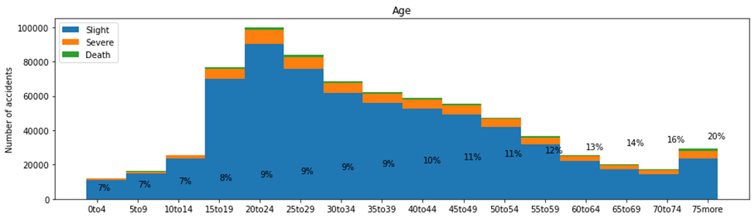
Feature analysis: Victim gender and age
Male are both the most frequent and the most severe victims of road accidents
The older you get, the more severe the consequences of accidents are

Slide 9
Data preparation
Scaling of the data using standard scaler
Under sampling: remove example of overly represented classes (0 & 1):
Avoid issues related to training on imbalanced dataset
Reduce size of the dataset to speed calculation
Performed in 2 step:
Random under sampling: 734 301 → 22140 examples
Cluster centroid sampling: 22140 → 6861 examples
Split the remaining dataset:
Training set (80% of the data)
Test set (20% of the data)
Two different classification problems
3-classes: Slight vs Sever vs Death
2-classes: Slight or Sever vs Death

Slide 10
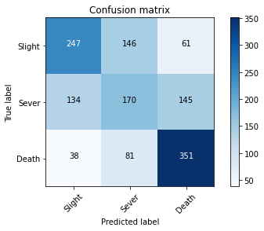
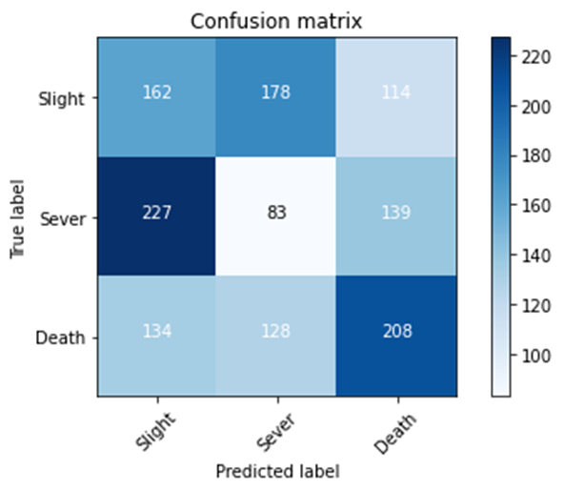
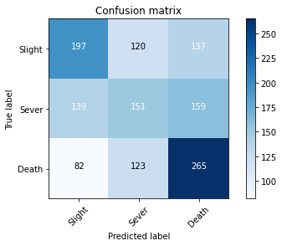
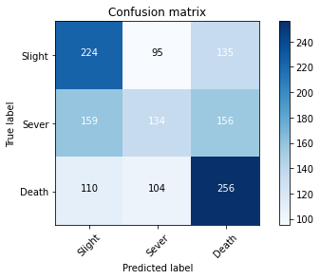
Modelling: 3-classes
Relatively low accuracy for the different algorithms
Decision tree | K nearest neighbour | SVM | Logistic regression
14 layers deep Gini impurity | 4 neighbours Uniform distance weigh Manhattan distance | Regularization : 0.1 RBF kernel | Regularization : 0.1 Newton-cg solver Multinomial method
F1-score = 55% | F1-score = 33% | F1-score = 44% | F1-score = 44%

Slide 11
Modelling: 2-classes
Bundling slight and sever classes makes it easier to predict
Decision starts to have quite good accuracy
 | F1-score (training set) | F1-score (test set)
Decision tree | 87% | 87%
K nearest neighbours | 60% | 60%
Support vector machine | 66% | 67%
Logistic regression | 65% | 66%

Slide 12
Conclusion
Built model to predict accident severity
Predict deathly vs rest is easier than 3-classes classification
Decision is quite good to predict deathly accident (up to 87% accuracy)
Potential improvement
No need for additional example
Additional feature seems the best way forward
Weather information
Involvement of drugs or alcohol
Speeding or reckless behaviour
Discussion with domain expert
Police
Emergency services
…

