Slide 1


Cache and Data Coherency
Tony He
2021-10

Slide 2

What is cache？
Cache problems
目 录
CONTENTS
Cache maintenance

Slide 3


01
What is cache?

Slide 4
Cache Memory
CPU
CACHE
MAIN MEMORY
Word transfer
Block transfer
Cache的主要构成
Cache 存储体
地址转换单元
替换单元

Slide 5
Cortex A53 Cluster
Core 1
Core 2
Core 3
Core 4
L1 caches
L1 caches
L1 caches
L1 caches
Snoop Control Unit
Level 2 Cache
AMBA4 ACE MasterBus Interface

Slide 6
New data generated
Got new data
Got new data
New data generated
Core
Core
Peripheral
Peripheral
L1/L2 caches
L1/L2 caches
Coherence
DMA
Coherence
DMA
Clean
Invalidate
Carry
Carry
External memory
External memory
0xffff_1234
0xffff_1234

Slide 7
The observer and sharing region with coherence
The observer with non-coherence
P0
Pn
E0
En
Cortex-A
Cortex-A
Cortex-A
Cortex-M
Cortex-M
BUS

Slide 8
New data generated
New data generated
Core 1
Core 2
x
y
Register
Register
Cache Line
Cache Line
x
y
External Memory

Slide 9
TTBR
Virtual Address
ASID
Page table base address
tag
index
offset
ways
TLB Way
New data generated
Got new data
ASID | AP | D | nG | V | tag | PFN
Core
ASID | AP | D | nG | V | tag | PFN
Peripheral
ASID | AP | D | nG | V | tag | PFN
L1/L2 caches
…
Coherence
DMA
ASID | AP | D | nG | V | tag | PFN
Clean
Carry
External memory
0xffff_1234
Physical address

Slide 10
Process Perspective
Process 1
Process 2
Kernel
Kernel Space
Kernel Space
Kernel Space
User Space
User Space
0x8000
Got new data
Coherence
Peripheral
Clean
CPU Perspective
Carry
0x8000
TLB
Cache
K
1
2
K
P1
TTBRx_EL1
63
48 47
0
P2
ASID
Page table base address

Slide 11
TTBRx_EL1
48 47
0
ASID
Page table base address
Process Perspective
Process 1
Process 2
Kernel
Kernel Space
Kernel Space
Kernel Space
User Space
User Space
0x8000
CPU1 Perspective
CPU2 Perspective
0x8000
TLB 1
0x8000
TLB 2
K
K
1
K
2
K
P2
P2
Cache
Cache

Slide 12
TTBRx_EL1
48 47
0
ASID
Page table base address
Process 1
0x8000
The SoC is powered and begins execution at the reset vector. Loads the First stage bootloader from the boot device into internal SoC memory and passes ctrl to it.
Bootloader
SoC ROM Bootloader
Bootloader
ROM bootloader decides boot device order based on hardware pin settings.
SoC ROM Bootloader
First Stage Bootloader
Secure ROM
Public ROM
The first stage bootloader copies the second stage bootloader into external RAM, and reads its config settings. Finds and loads the Linux kernel and DTB into RAM.
First Stage Bootloader
Second Stage Bootloader
Second Stage Bootloader
Kernel
Linux Kernel Device Tree File
Using the Boot Args, the kernel locates and mounts the root filesystem, then runs the Init process(PID 0) to start user space.
User
Root Filesystem and Init Process

Slide 13
Are Functional Safety Packages All the Same?
Arm IP - Safety Element out of Context
Source code
Functional Safety is IP specific
No generic documents
IP integrators responsible for system design
Detail depends on the expected application safety requirements
Fault detection and control scope
Only features within Arm IP considered
IP specific Safety Manual and FMEA Reports
System or software level mechanisms defined by IP integrator
Functional safety support from Arm
Arm compiler
Software
Functional safety support from Arm
Arm IP
RAM
ROM
Logic
Analog

Slide 14
Cache Terminology
Hit vs Miss.
Eviction vs Linefill.
Clean vs Dirty.
Cacheability attributes.
Non-cacheable.
Write-back cacheable.
Write-through cacheable.
Cache allocation hints.
Read-Allocate, Transient Read-Allocate, or no Read-Allocate.
Write-Allocate, Transient Write-Allocate, or no Write-Allocate.
Read allocate mode.
i.e. memset().

Slide 15
Associative Mapped Cache（全相联）
Memory
所有内存块都能映射进任意的缓存块。
命中率较高，缓存存储空间利用效率高。
速度低，成本高。
B0
B1
……
Cache
L0
L1
L2
L3
Tag, Valid, Data
Bn-1
Address
Tag
Offset

Slide 16
Direct Mapped Cache（直相联）
Memory
所有主存块只能存入缓存中特定的位置（块号相同）。
硬件实现简单，成本低。
替换操作频繁，命中率低。
B0
B1
Group0
B2
B3
Cache
B4
L0
B5
Group1
L1
B6
L2
B7
L3
B8
Tag, Valid, Data
B9
Group2
B10
B11
B12
B13
Group3
B14
B15
Address
Tag
Index
Offset

Slide 17
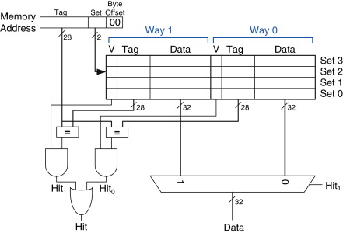
组相联）
Memory
B0
组间直相联，组内全相联。
组号相等。
组内各块任意存放。
块的冲突概率比较低，块利用率大幅度提高，块失效率明显降低。
实现难度和成本较高。
B1
B2
Cache
B3
B4
L0
B5
S0
B6
L1
L2
B7
S1
B8
L3
2-way set assoc. cache
B9
B10
B11
B12
B13
B14
B15
Address
Tag
Set
Offset
From internet

Slide 18
Typical Arm CPU Cache Info.
CPU | LSZ (Byte) | L1I | L1D | L2
A9 | 32 | 4-way set assoc. | 4-way set assoc. | 8/16-way set assoc.
A53 | 64 | 2-way set assoc. | 4-way set assoc. | 16-way set assoc. up to 2MB
M55 | 32 | 2-way set assoc. | 4-way set alloc | O
Instruction cache
Read-Allocate.
Data cache and unified cache
Read-Allocate, Write-Allocate.
Write-Back, Write-Through.
Transient hints.

Slide 19

02
Cache problems

Slide 20
Coherency Problems Caused by Cache
An update to a memory location by a CPU that accesses a cache might not be visible to other observers that can access memory.
Updates to memory locations by other observers that can access memory might not be visible to a CPU that accesses a cache.
Explicit cache maintenance is required to overcome the cache coherency problems above.

Slide 21
Example scenarios for Cache Maintenance
Memory accessed by CPU and non-coherent DMA.
Self-modifying software.
Asymmetric shared memory.
Sec vs NS, cacheable vs non-cacheable.
Changing security attribution of an address.
CPU
Input
CACHE
Input
MAIN MEMORY
Input
Driver
Output
Output
Output

Slide 22

03
Cache maintenance

Slide 23
Cache Maintenance
Operations (by set/way/VA)
Point of operation
Use of Memory Barriers
Clean
Invalidate
Clean and invalidate (flush)
Point of Unification (PoU).
Coherent at CPU level, i.e., icache, dcache, TLB
Point of Coherency (PoC).
Coherent at system level.
DMB
DSB
ISB
- Risk of stall data!?
- Risk of data loss!?

Slide 24
Operations by VA
Clean/invalidate/flush(va, len).
start = ROUND_DOWN(va, LSZ).
end = ROUND_UP(va + len, LSZ).
LSZ
target memory
len
va
operating memory
range
start
end

Slide 25
Cache Maintenance – Full lines
Input Memory
Output Memory
Inout Memory
write(va, len)
clean(va, len)
consume(va, len)
produce(va, len)
invalidate(va, len)
read(va, len)
write(va, len)
clean(va, len)
con_and_prod(va, len)
invalidate(va, len)
read(va, len)
LSZ
va
len

Slide 26
Cache Maintenance – Incomplete lines
Input Memory
Output Memory
Inout Memory
Seqs
write(va, len)
clean(va, len)
consume(va, len)
Risks
Data loss risk if oth portion is used by other observers in parallel.
Seqs
flush(va, len)
produce(va, len)
invalidate(va, len) or flush(va, len)
read(va, len)
Risks
What if CPU modifying oth after step#1?
Stall data if use flush in step#3, or data loss if invalidate.
Seqs
write(va, len)
flush(va, len)
con_and_prod(va, len)
invalidate(va, len) or flush(va, len)
read(va, len)
Risks
See input and output memory cases.
oth
oth
len
va

Slide 27
Data Coherency Issue – Mitigations
Not cache line aligned cases
va
len
Assumption.
Incomplete cache line appears at the header and/or tail of the buffer only.
Copy input data from incomplete blocks to intermediate buffer.
Each intermediate buffer shall occupy one complete cache line, i.e., obtained via osal_malloc_aligned().
Skip copying if output buffer.
Produce output data to intermediate buffer plus provided complete block buffers.
Copy output data from intermediate buffer to incomplete blocks.
oth
I1
I2
I3
oth
Copy-in
I1
I2
I3
Produce
O1
O2
O3
Copy-out
oth
O1
O2
O3
oth
len
va

Slide 28
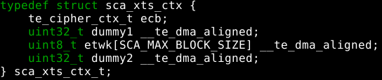
Scenario: use stack/struct memory for DMA output
The output buffer MUST exclusively occupy one or more cache lines.
merak_driver/cipher/xts.c
merak_driver/drv/drv_hash.c
ce_lite/src/ce_hash.c

Slide 29
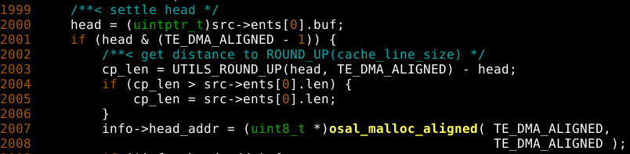

Scenario: use scatter gather DMA buffer
Driver just needs to handle the start and end mis-aligned cases for memory coherency consideration, while assuming the middle entries shall be full page or exclusive buffer.
ofs
len₀
len_{n}
Blk₀
…
Blk_{n-1}
Blk_{n}
page
page
page
page

