Slide 1
Real World Business Analysis – Capstone Project
Tanya Deep

Slide 2
Agenda
Project Overview
Business Problem & Objectives
Datasets & Methodology
Data Cleaning, EDA, Advanced Analysis
Key Visual Insights (add notebook images)
Recommendations, Roadmap, Risks, Conclusion

Slide 3
Project Overview
End-to-end data analytics project using real-world datasets
Datasets: Sales Data, Customer Churn Data, House Prices Data
Goal: Convert raw data into actionable business insights
Deliverables: Analysis notebooks, reports, and business presentation

Slide 4
Business Problem
Organizations generate large datasets but struggle to extract actionable insights
Need to understand drivers of sales performance and customer churn
Identify patterns and relationships to guide data-driven decisions
Translate analysis into practical business strategy

Slide 5
Project Objectives
Build a complete data analysis workflow from raw data to recommendations
Apply data cleaning, EDA, and advanced analytical techniques
Create professional visualizations to communicate findings
Provide actionable recommendations and an implementation plan

Slide 6
Datasets Used
Sales Data: transaction-level pricing and performance metrics
Customer Churn Data: customer attributes and churn indicator
House Prices Data: numerical and categorical housing features
All datasets cleaned and standardized before analysis

Slide 7
Analysis Workflow
Raw Data → Data Cleaning → Exploratory Data Analysis (EDA)
Advanced Analysis → Insights → Recommendations → Implementation
Notebooks: 1_data_cleaning.ipynb, 2_eda.ipynb, 3_advanced_analysis.ipynb, capstone_analysis.ipynb
Modular structure supports reproducibility and clarity

Slide 8
Data Cleaning & Preparation
Checked data types, structure, and missing values
Handled missing values (median for numeric, mode for categorical)
Removed duplicates and validated data consistency
Feature engineering performed (e.g., Total_Sales)

Slide 9
EDA Overview
Distribution analysis to understand data behavior
Outlier detection using boxplots
Correlation analysis using heatmaps
Trend and relationship analysis using line and scatter plots

Slide 10
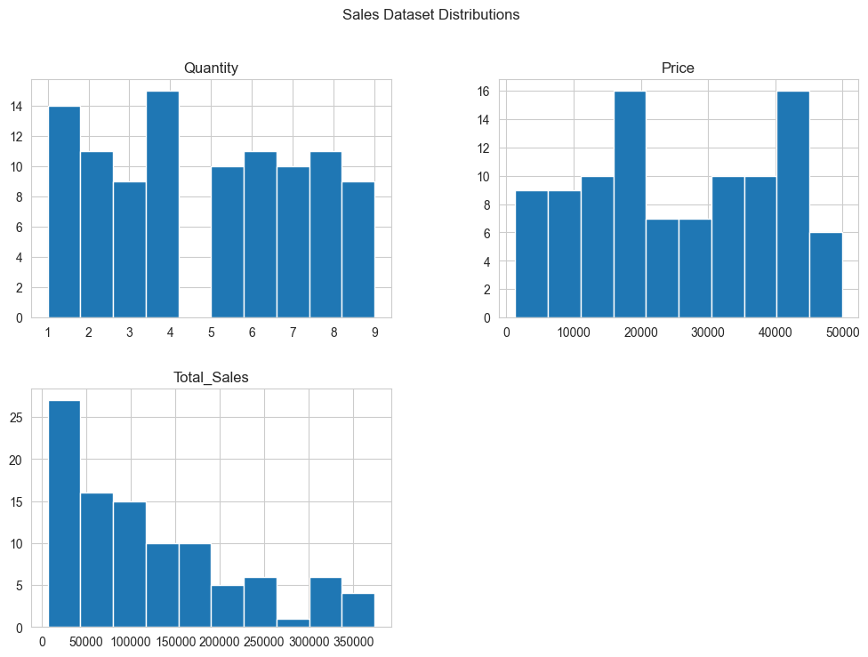

Slide 11
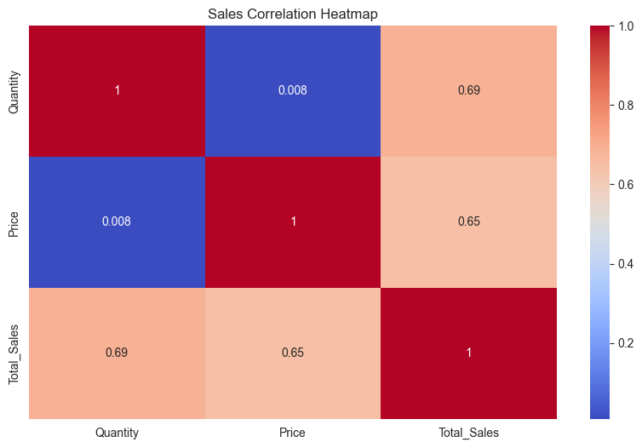
Key Visualization: Correlation Heatmap
Shows relationships between numerical variables
Helps identify key drivers influencing outcomes
Example insight: pricing-related features correlate with sales

Slide 12
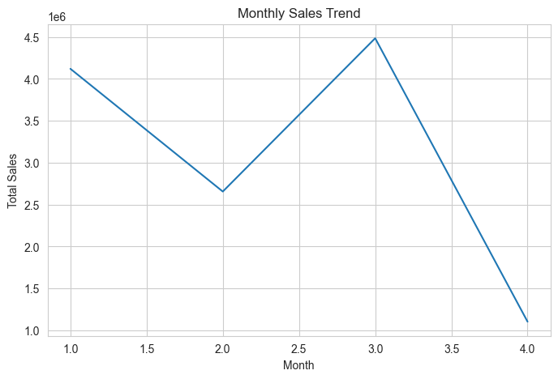
Sales Trend Analysis
Monthly/periodic trends observed in sales performance
Identifies high-performing periods and potential seasonality
Business use: timing promotions and resource allocation

Slide 13
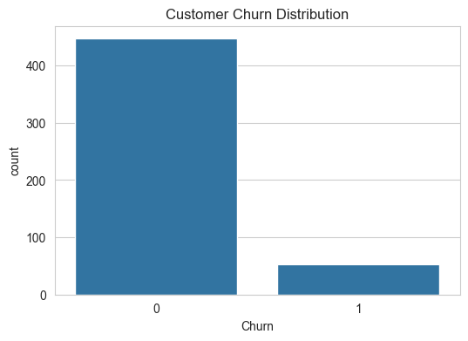
Customer Churn Analysis
Analyzed churn vs non-churn distribution
Detected potential high-risk customer segments
Retention strategies can reduce revenue loss

Slide 14
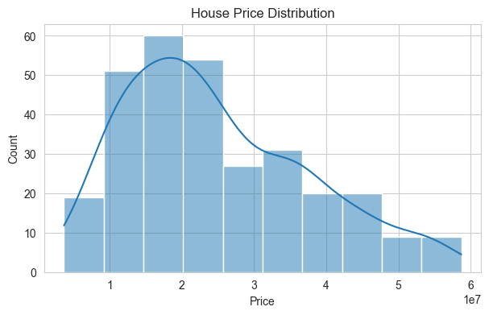
House Price Analysis
Explored distribution and variability in house prices
Identified possible segmentation opportunities
Insights support pricing and positioning decisions

Slide 15
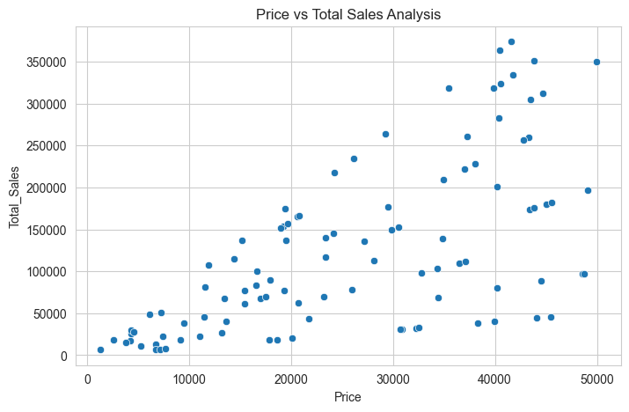
Advanced Analysis & KPIs
KPIs: Total Revenue, Average Sales, Max Sale, Churn Rate, Average Price
Statistical validation and segment analysis performed
Relationships between features analyzed to support decision-making

Slide 16
Key Insights (Summary)
Pricing strongly influences revenue outcomes
Customer churn patterns are identifiable and actionable
Correlations reveal influential business variables
Segment differences highlight targeted optimization opportunities

Slide 17
Business Recommendations
Optimize pricing strategy based on analysis findings
Launch targeted customer retention programs
Focus investment on high-performing segments and periods
Monitor KPIs regularly and adjust strategies iteratively

Slide 18
Implementation Roadmap
Month 1: Deploy pricing changes and KPI tracking
Month 2: Execute retention initiatives and monitor metrics
Month 3: Evaluate impact and refine strategy
Ongoing: Continuous monitoring and data-driven improvements

Slide 19
Risks & Limitations
Results depend on available dataset features and quality
External factors not included may influence outcomes
Further predictive modeling could improve forecasting
Recommendations should be validated with real business data

Slide 20
Business Impact
Improved decision-making through data-driven insights
Potential revenue optimization via pricing strategy
Reduced churn through targeted retention actions
Structured workflow enables repeatable analytics process

Slide 21
Conclusion
Completed an end-to-end business analysis workflow
Combined technical analysis with business storytelling
Generated actionable recommendations from real data
Project demonstrates portfolio-ready analytics skills

Slide 22
Thank you

