Slide 1


DAA projects Topic: “ Sudoku Solver”
Student Names & Enrolment No.:
Aaditya Sharma (09817711622)
Tanishq Rawat (11217711622)
Branch& Section: AIML-B

Slide 2
Table of Content
Introduction & Motivation
Problem Statement
Implementing Backtracking Algo
Technology Stack Result
Enhancing the User Experience
User Interface
Result
Conclusion and Future Improvements
Learning Outcomes

Slide 3
1. Introduction & Motivation
Sudoku is a popular logic-based number puzzle game originating in the late 1970s but inspired by earlier number placement puzzles. The classic version of Sudoku consists of a 9x9 grid divided into nine 3x3 sub-grids. The objective is to fill in all 81 cells with digits from 1 to 9 so that each row, each column, and each 3x3 sub-grid contains every digit from 1 to 9 exactly once.
Number Placement
The goal is to fill a 9x9 grid with digits from 1 to 9.
Unique Values
Each row, column, and 3x3 subgrid must contain all digits without repetition.
Logic and Deduction
Players use logic and deduction to determine the correct placement of numbers.

Slide 4
2. Problem Statement
The problem statement for a Sudoku solver is to create a program that can efficiently determine the correct placement of numbers in a partially filled Sudoku grid to satisfy all the rules of the game.
RULES
1. Row Constraint
Each row must contain all the digits from 1 to 9, without any repetition.
2. Column Constraint
Similarly, each column must also contain all the digits from 1 to 9, with no repetitions.
3. Subgrid Constraint
Each 3x3 subgrid, within the larger 9x9 grid, must have all the digits from 1 to 9, without repetition.

Slide 5
3. Implementing Backtracking Algo
.
1. Find Empty Cell The algorithm begins by finding an empty cell in the grid.
2. Try Possible Values For each empty cell, the algorithm iterates through possible values (1 to 9).
3. Check Validity The algorithm checks if the candidate value is valid based on Sudoku rules.
4. Recursive Call If valid, the algorithm recursively calls itself to solve the rest of the puzzle.
5. Backtrack If no valid value is found, the algorithm backtracks and tries another value.

Slide 6
4. Tech Stack
JavaScript
The primary programming language for implementing the Sudoku solver logic and user interface.
HTML
Used for structuring the web page and defining elements like the Sudoku grid, buttons, and input fields..
CSS
For styling the user interface, ensuring a visually appealing and user-friendly experience.

Slide 7
5. Enhancing the User Experience
Difficulty Levels
Allow users to select from different difficulty levels, ranging from easy to expert, providing a tailored experience.
Hints
Implement a hint feature that provides a suggestion for an empty cell, helping users progress when stuck.
Timer
Include a timer to track the user's solving time, adding a competitive element to the game.

Slide 8
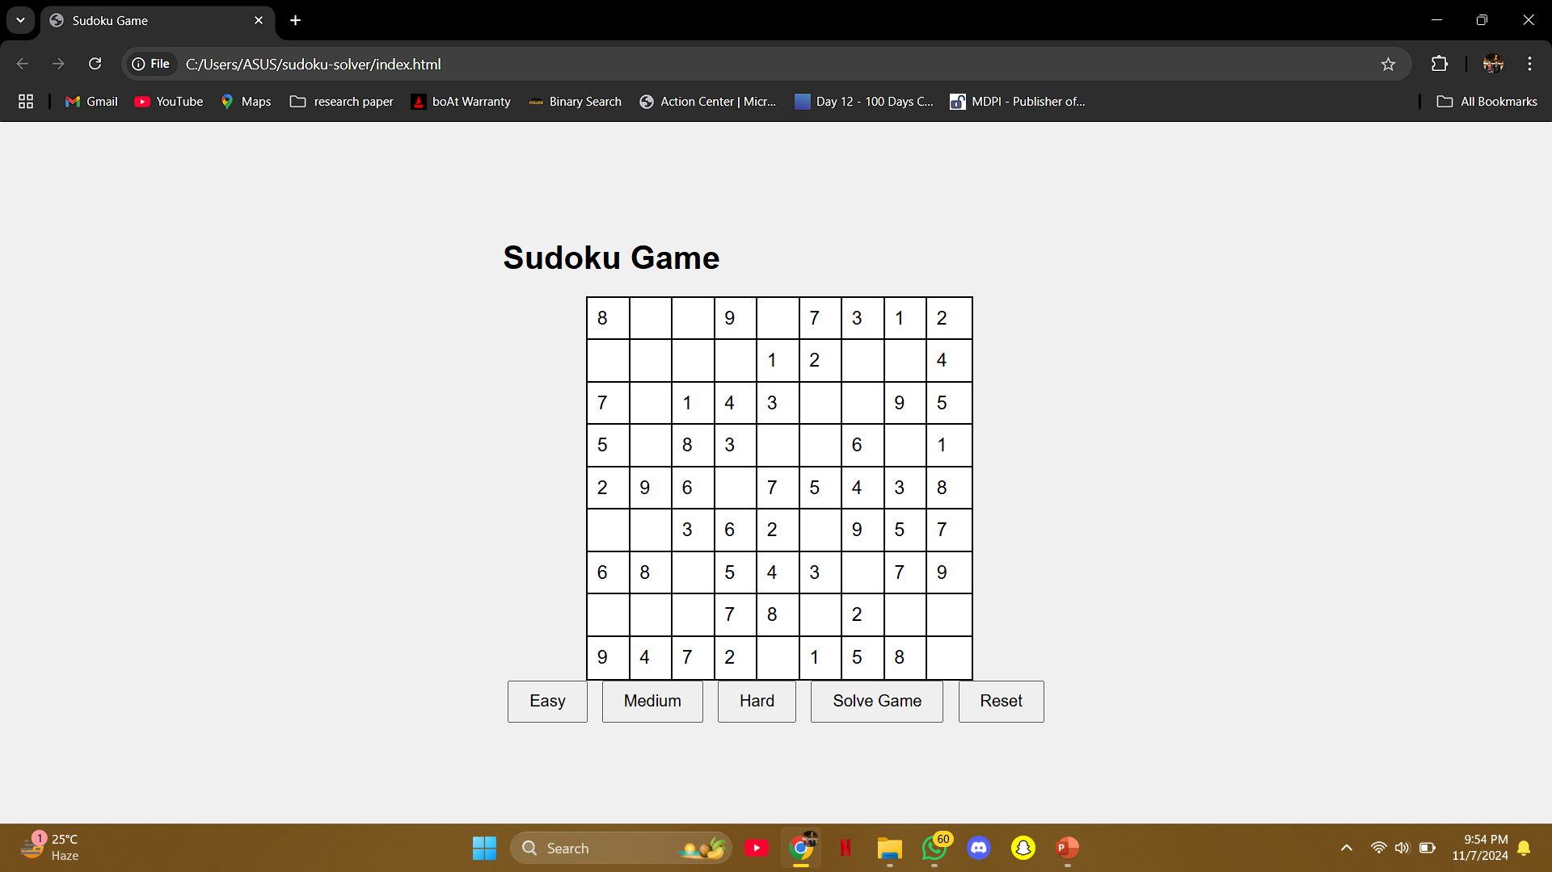

6. User Interface

Slide 9

7. Result

Slide 10
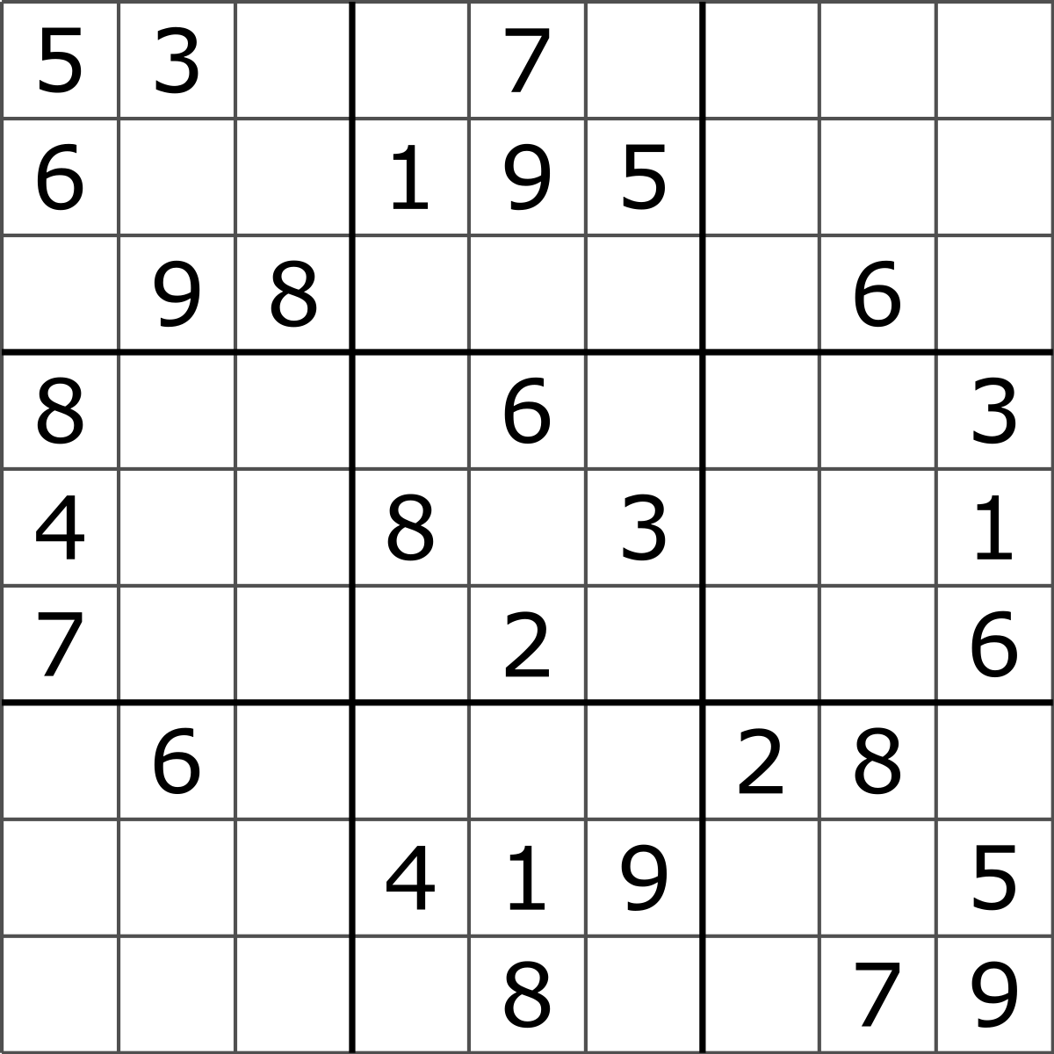
8. Conclusion and Future Improvements
Project Summary
This project demonstrates the development of a Sudoku solver using JavaScript, encompassing logic implementation, user interface design, and user experience enhancements
Future Scope
Future improvements could include exploring different solving algorithms, optimizing the performance for larger grids, and incorporating additional game features
This Photo by Unknown Author is licensed under CC BY-SA

Slide 11
9. Learning Outcomes
JavaScript Programming
It reinforces JavaScript programming skills through its implementation, encompassing user interface development and logical problem solving.
Problem-Solving
Solving Sudoku puzzles using JavaScript cultivates logical reasoning, problem-solving, and critical thinking skills.
Algorithm Design
This project provides practical experience in designing and implementing algorithms, specifically a backtracking algorithm for Sudoku solving.

