Slide 1
GRAPH THEORY DE BRUIJN SEQUENCE, ORIENTATIONS AND TOURNAMENTS
Submitted by :
Shubham Sharma(58)
Tania Aggarwal (60)
Vandana Yadav (61)
Varun (62)
Submitted To:-
Ms. Dipti Jain

Slide 2
De Bruijn sequence
Definition: Given an integer n and a set of characters A of size k, find a string S such that every possible string on A of length n appears exactly once as a substring in S. Such a string is called de Bruijn sequence.
OR
Given an alphabet with k elements, a de Bruijn sequence of order n is a sequence in which every possible string of length n from this alphabet appears exactly once.

Slide 3
Example
Input: n = 3, k = 2, A = {0, 1)
Output: 0011101000
All possible strings of length three (000, 001, 010, 011, 100, 101, 110 and 111) appear exactly once as sub-strings in A.
Input: n = 2, k = 2, A = {0, 1)
Output: 01100
All possible strings of length two (00, 01, 10, 11) appear exactly once as sub-strings in A.

Slide 4
How to solve?
We can solve this problem by constructing a directed graph with k^{n-1} nodes
with each node having k outgoing edges.
Each node corresponds to a string of size n-1.
Every edge corresponds to one of the k characters in A and adds that character to the starting string.

Slide 5
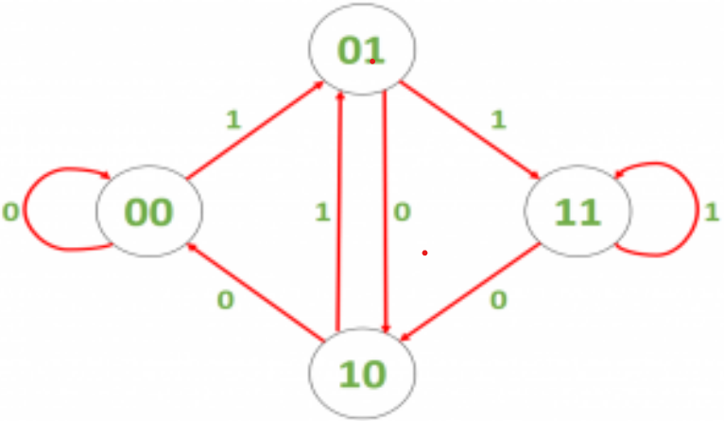
For example, if n=3 and k=2, then we construct the following graph:
We can solve this problem by constructing a directed graph with k^{n-1} nodes
with each node having k outgoing edges.
Each node corresponds to a string of size n-1.
Every edge corresponds to one of the k characters in A and adds that character to the starting string.
Source: De Bruijn sequence | Set 1 - GeeksforGeeks

Slide 6
Interpretation of Graph
The node ’01’ is connected to node ’11’ through edge ‘1’, as adding ‘1’ to ’01’ (and removing the first character) gives us ’11’.
We can observe that every node in this graph has equal in-degree and out-degree, which means that a Eulerian circuit exists in this graph.
The Eulerian circuit will correspond to a de Bruijn sequence as every combination of a node and an outgoing edge represents a unique string of length n.
The de Bruijn sequence will contain the characters of the starting node and the characters of all the edges in the order they are traversed in.

Slide 7
Generating de Bruijn Sequences
We start by generating a set of nodes. If we’re working with a de Bruijn sequence of order k then each node contains a unique string of length k-1 from our alphabet.
For example, given our alphabet of binary digits and a de Bruijn sequence of order 3, we would generate every unique string of length 2: 00, 01, 10, 11.
Having done this, we can then build a directed graph. Every node has an edge leaving it that joins it to the node that would be next in the de Bruijn sequence. For example, node “01” would join to “10” using an edge of “0”, and to “11” using an edge of “1”.

Slide 8
Generating de Bruijn Sequences (contd.)
By definition, every one of our nodes will have one edge leaving it for every symbol in our alphabet, and an equally will have one edge entering it for every symbol in our alphabet. This means that we will always have an even number of edges for every node. This in turn means that we always have an Euler Path in our graph.
We can then make use of this to generate our de Bruijn sequence. We pick a node as our start, then follow the Euler Path throughout the entire graph, adding the appropriate symbol from that edge. Once we’ve traced the entire path we will have our de Bruijn sequence.

Slide 9
Example
For example, if we start at node “00” and follow edges “0”, “1”, “0”, “1”, “1”, “1”, “0”, “0” then we will have generated our sequence:
Source: The de Bruijn Sequence | Baeldung on Computer Science

Slide 10
Orientation
Let G be an undirected graph. An Orientation of G is a directed graph obtained by assigning a direction to each edge of G.
A Directed Graph is called an Oriented Graph if none of its pairs of vertices is linked by two symmetric edges.
That is at most one of (x,y) and (y,x) may be arrows of the graph.

Slide 11
For Example,
Consider a Graph G:
Y
Y
Y
X
Z
X
Z
X
Z

Slide 12
Strong Orientation
A strong orientation is an orientation that results in a strongly connected graph.
Totally cyclic Orientations
The closely related totally cyclic orientations are orientations in which every edge belongs to at least one simple cycle.
An orientation of an undirected graph G is totally cyclic if and only if it is a strong orientation of every connected component of G.

Slide 13
Acyclic Orientation
An acyclic orientation is an orientation that results in a directed acyclic graph. Every graph has an acyclic orientation.
Eulerian orientation
An Eulerian orientation of an undirected graph is an orientation in which each vertex has equal in-degree and out-degree.

Slide 14
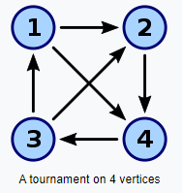
Tournament
A tournament on n vertices is an orientation of a complete graph on n vertices.
A tournament is a directed graph with exactly one arc between each pair of vertices.
A tournament graph represents the outcome of a round robin tournament ,where each arc goes from winner to a loser.

Slide 15
How many tournament on N vertices
We can select any two vertices which consist of an edge between them , so total possible edges will be ^{N}C₂.
Now as we can assign direction from u to v or v to u where u and v are vertices, so there are two possible direction for each edge.
Hence total tournaments possible with n vertices will be 2^{(nC2).}

Slide 16
Transitive Tournament
A tournament T is transitive if whenever (u,v) and (v,w) are arcs of T ,then (u,w) is also an arc of T.
Note :- A tournament is transitive if it has no cycles.

Slide 17
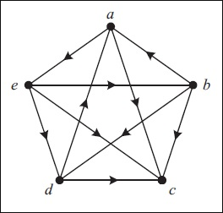
Hamiltonian Tournament
A Hamiltonian path is a path that visits every vertex.
A Hamiltonian cycle is a cycle that visits every vertex.
Theorem :- Every tournament has at least one Hamiltonian path.

Slide 18
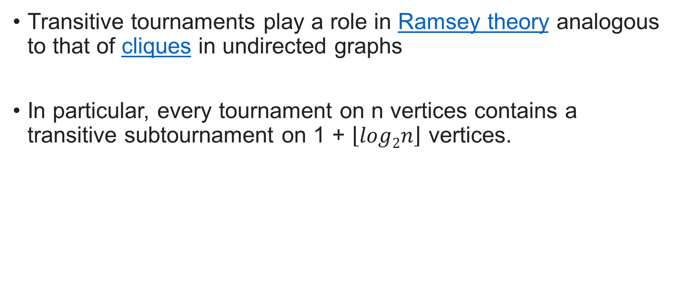
Ramsey Theory
Transitive tournaments play a role in Ramsey theory analogous to that of cliques in undirected graphs
In particular, every tournament on n vertices contains a transitive subtournament on 1 + $\left\lfloor log2n\right\rfloor$ vertices.

