Slide 1
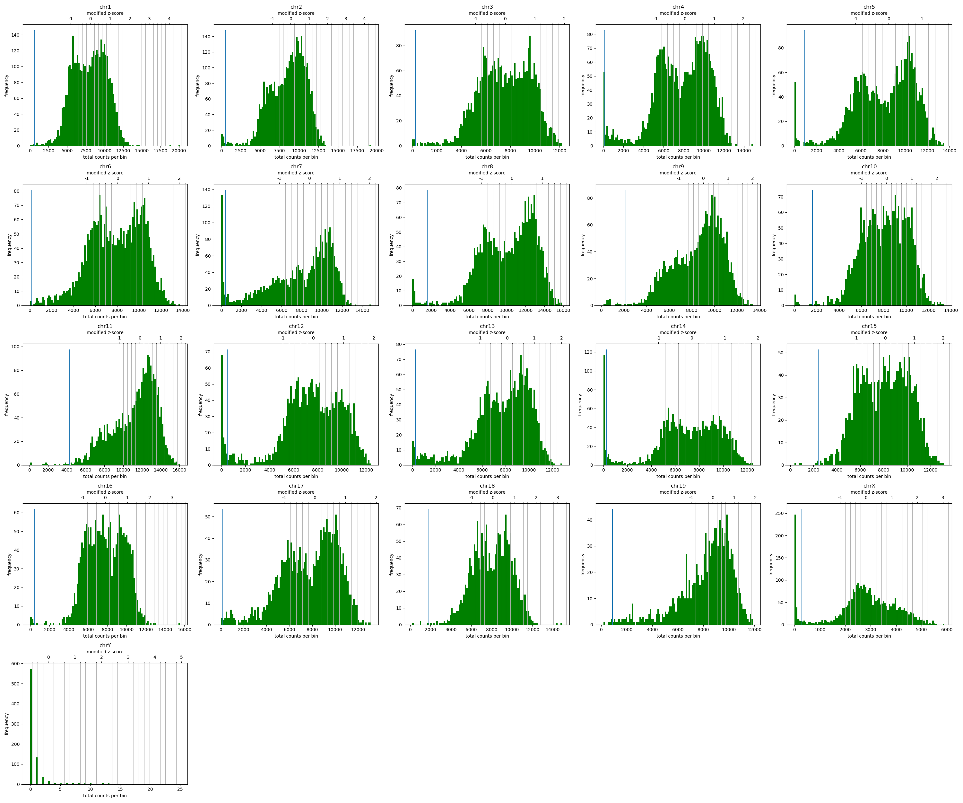
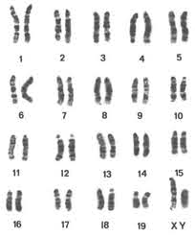
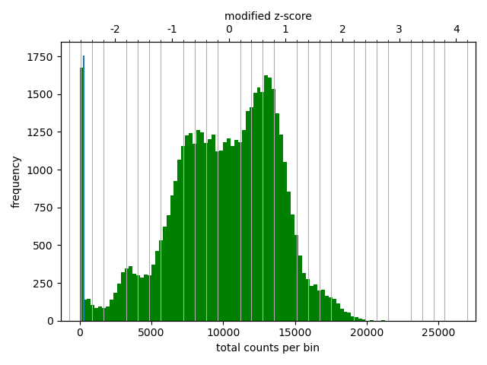
Group5
HiCExplorer: diagnostic plot
Informatics.jax.org
mus musculus has 19+X+Y haploid chromosomes

Slide 2
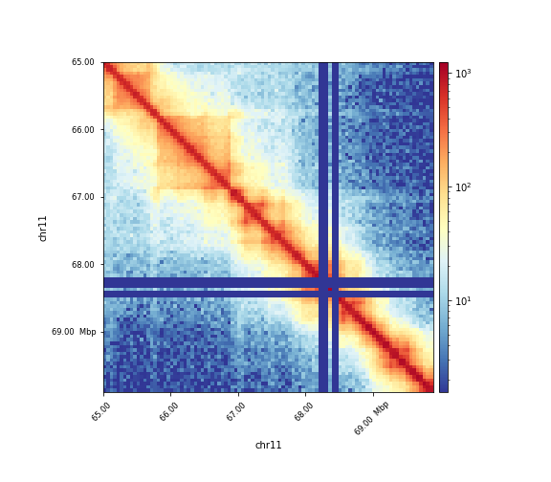
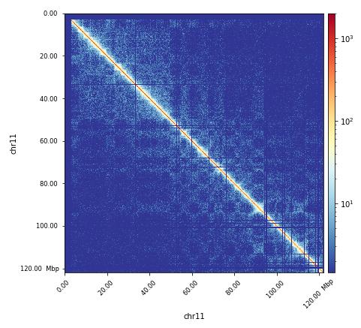
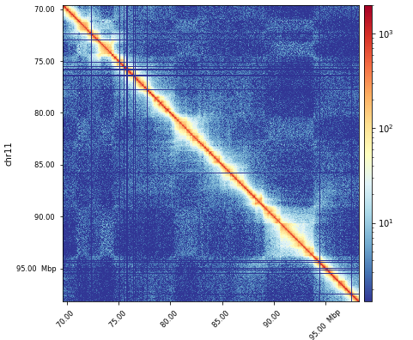
Group 5: HiCExplorer
Corrected matrix, plotting regions of interest
The entire chr 11
p53: chr11, 69,580,359 - 69,591,873
p53 chr11 69,580,359 - 69,591,873
NF1: chr11 79,339,693 - 79,581,612
CDK12: chr11
98,203,059 - 98,278,504
CDK12: chr11 98,203,059 - 98,278,504

Slide 3
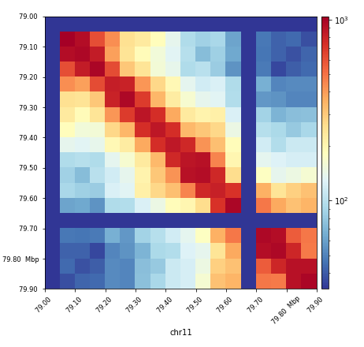
… zooming more in… choice of a bin size
NF1: chr11 79,339,693 - 79,581,612

Slide 4
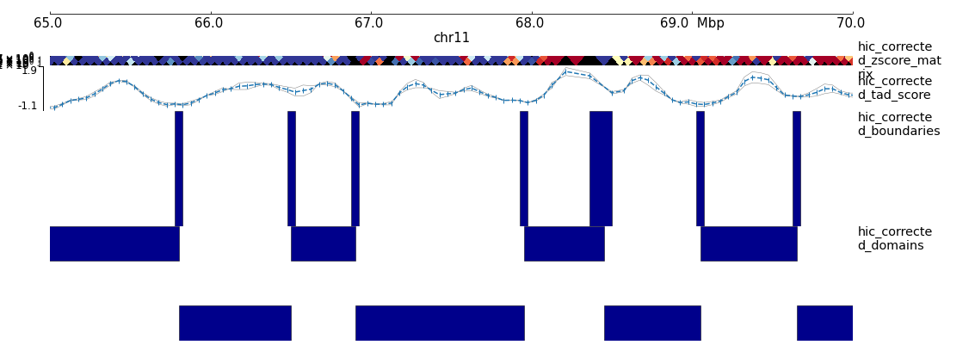
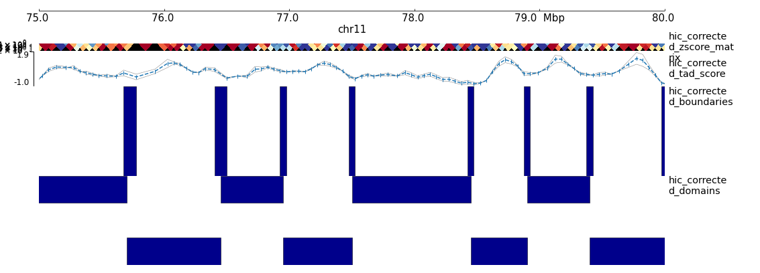
Detecting TADs with HiCExplorer Group 5
11: 65000000-70000000
11: 79000000-79900000
TAD-separation scores are based on a z-score matrix for all bins
P-values assigned based on comparing local min scores with those in surroundings
The bins more likely to be TAD boundaries are selected with FDR cutoff
NF1 (11:79,339,693 - 79,581,612)
p53 chr11 69,580,359 - 69,591,873
Note: bedgraph file with the TAD-score can be visualized in a genome browser.

Slide 5
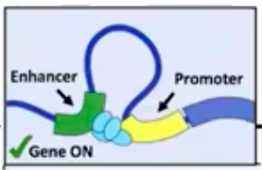
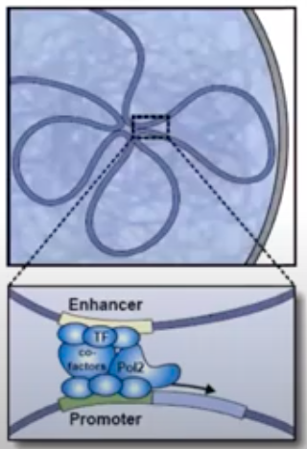
Detecting and plotting Hi-C contact enriched loops
Enriched interaction regions (peaks/loops) based on negative binomial distributions, Wilcoxon rank-sum test, and strict candidate selection.
From Sissa Medialab and David Gorkin

Slide 6
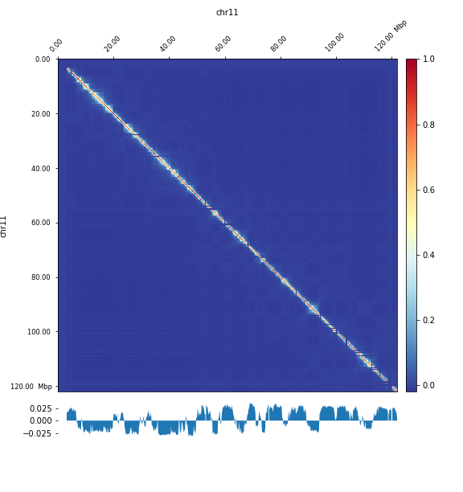
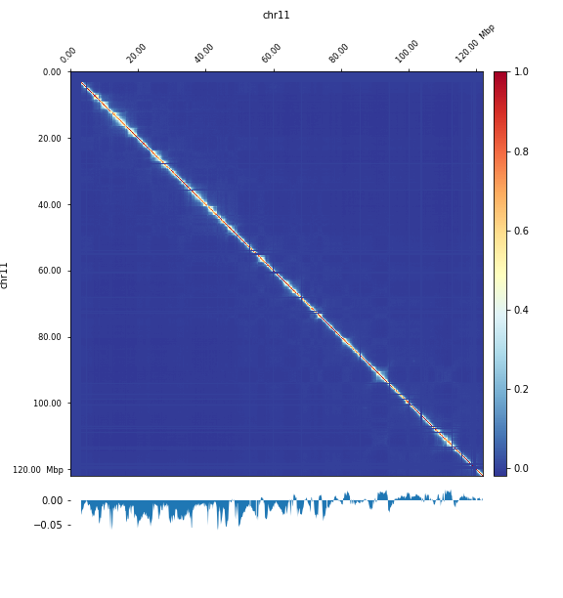
A/B compartment analysis (Pearson correlation -> covariance matrix -> Eigen v. computed(PCA)-> PCA1 and 2 plotted)
PCA 1 plot
PCA 1 plot

Slide 7
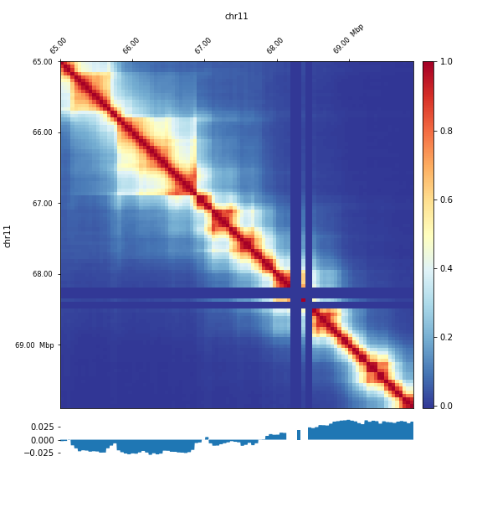
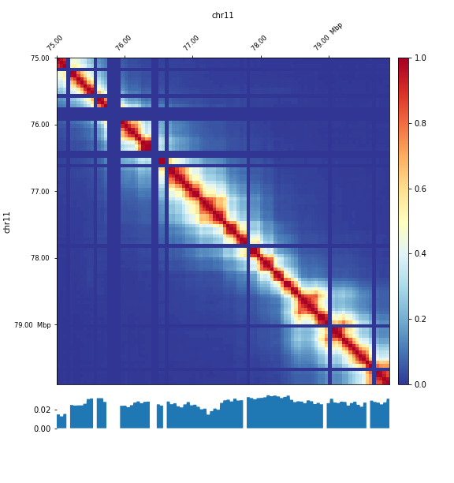
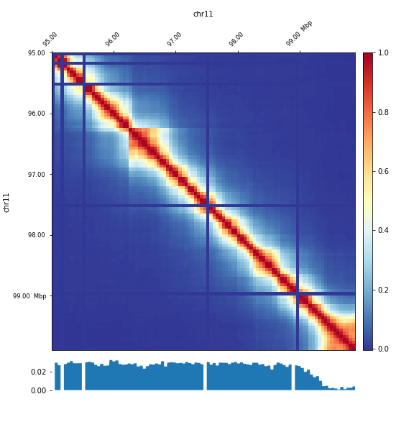
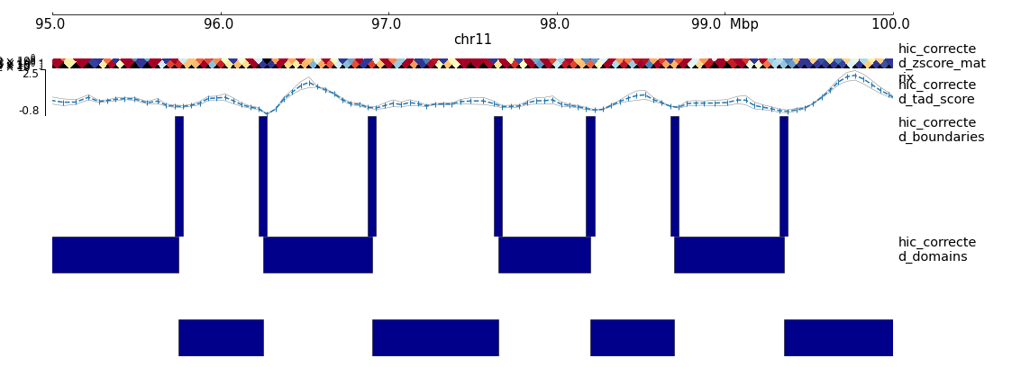
PCA1 , TADs
11: 65 000 000 – 70 000 000
PCA1 , TADs
11: 75 000 000 – 80 000 000
PCA1 , TADs
11: 95 000 000 – 100 000 000

