Slide 1

Library Management System
By - Tania Khatun

Slide 2
Project Overview
Objective
To build an efficient and user-friendly system to manage books, authors, members, and borrowing records using a MySQL database and Python interface.

Slide 3
Tools & Technologies
Component | Technology
Backend Database | MySQL
Programming | Python
DB Connector | MySQL-connector-python
IDE | VS Code / MySQL workbench
ER Diagram | Draw.io

Slide 4
Database Design
Tables
Authors (AuthorID, Name, Country)
Books (BookID, Title, AuthorID, Category, Price)
Members (MemberID, Name, JoinDate)
Borrowing (BorrowID, MemberID, BookID, BorrowDate, ReturnDate, Fine)

Slide 5
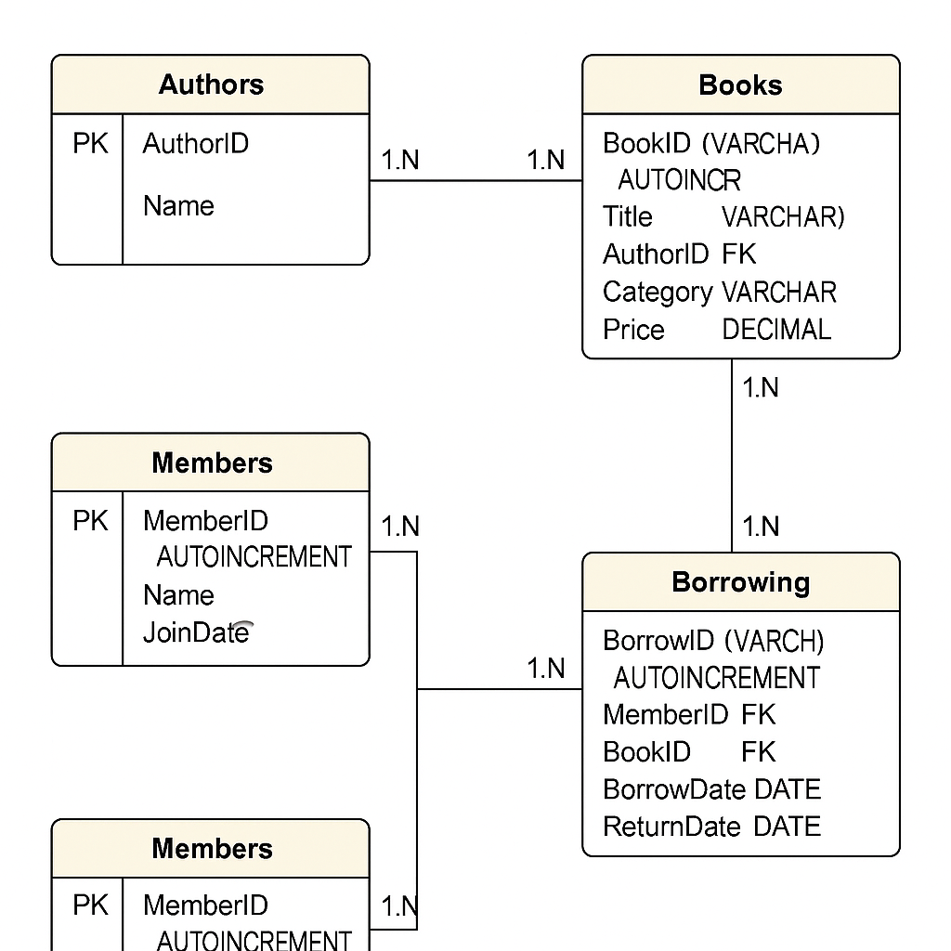
ER Diagram

Slide 6
Python Integration
Implemented Functionalities
Add/Update/Delete Books, Authors, Members
Borrow books
View borrowed records
Fine calculation via trigger
Menu-driven interface

Slide 7
SQL Features Used
Joins (Books + Authors, Members + Borrowing)
Views (BorrowedBooksView)
Stored Procedure (GetBooksByCategory)
Function (Calculate fine)
Trigger (Auto-update fine on return)
Indexing (AuthorID, BookID)

Slide 8
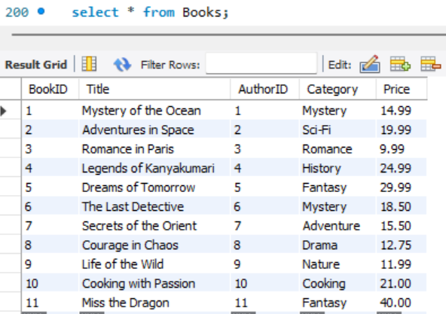
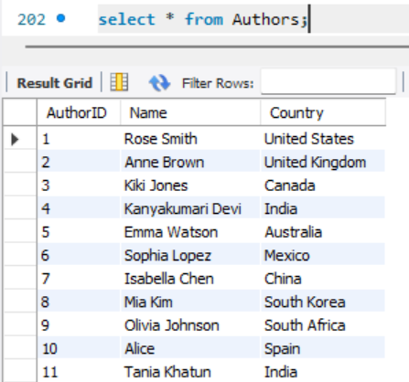
Outputs

Slide 9
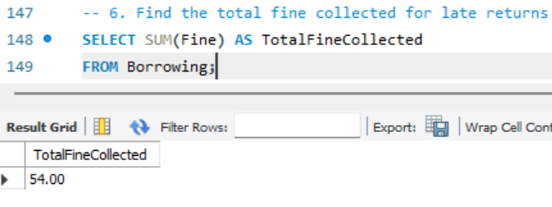
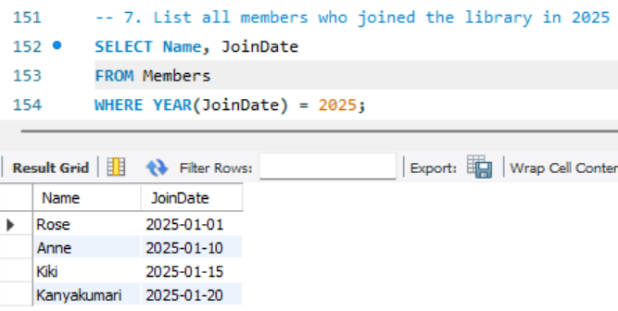
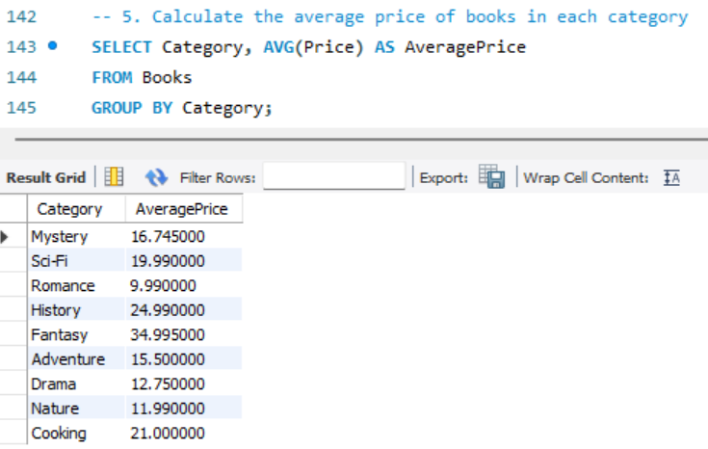
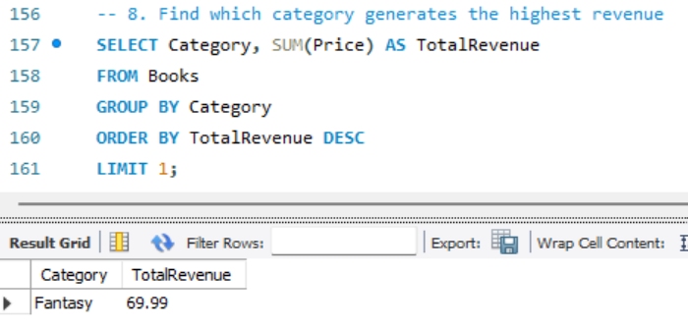
Queries & Reports

Slide 10
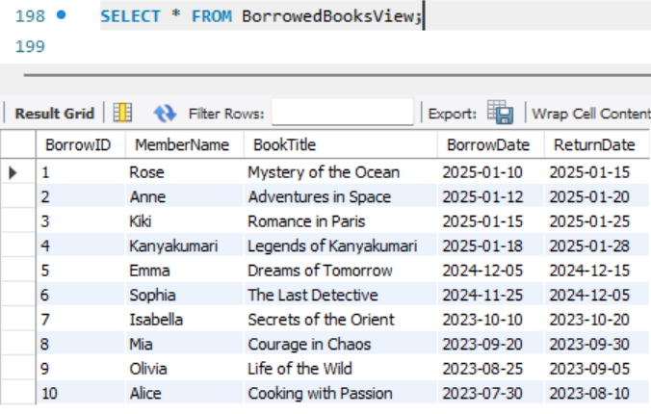
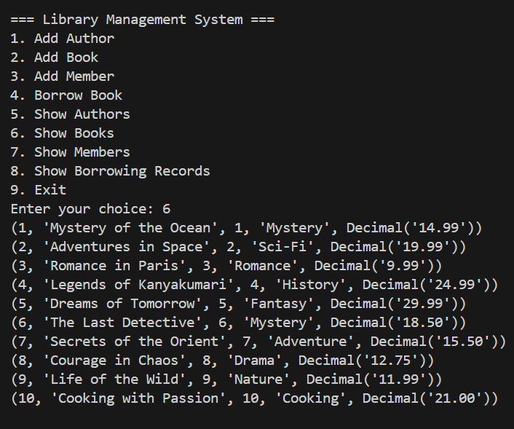
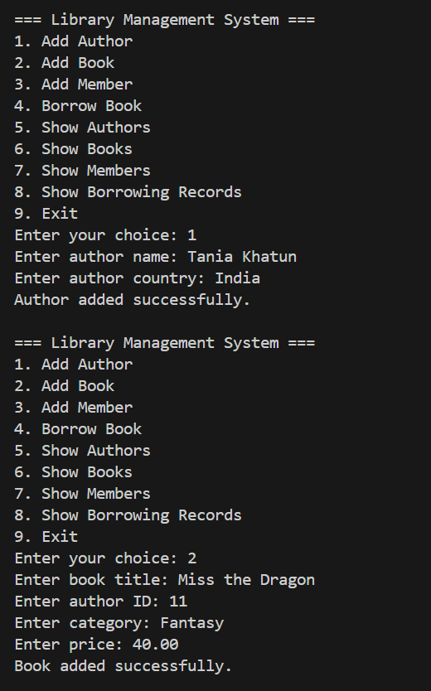
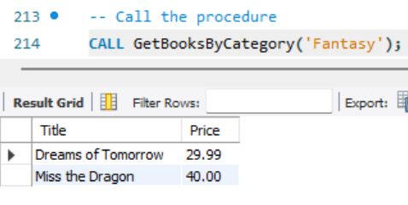
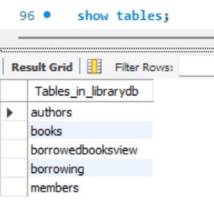
Screenshots

Slide 11
Challenges & Learnings
Challenges
Designing database relationships
Writing complex SQL logic
Connecting Python to MySQL securely
Learnings
SQL joins, triggers, procedures
Database normalization
Building real-world applications

Slide 12
Conclusion & Future Scope
Project successfully integrates MySQL and Python
Automation of fine, borrowing, and records
Future Scope: GUI using Tkinter or web interface with Streamlit/Flask

