Slide 1
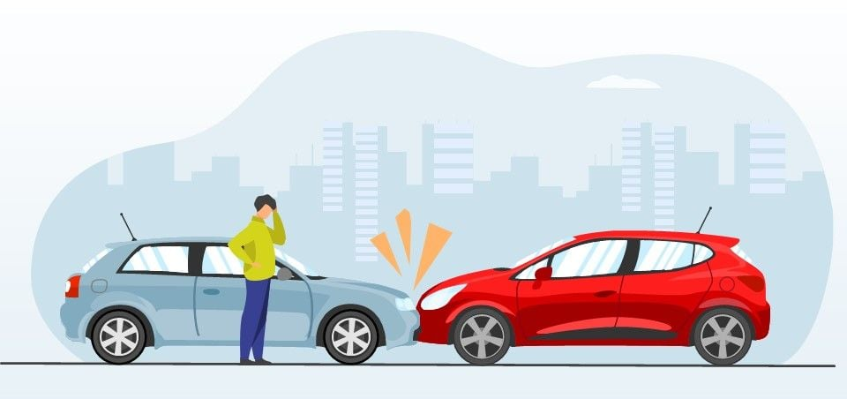
Road Accident Analysis Dashboard (Power BI)
Exploring data-driven insights to improve road safety
Presented by Tania Khatun | April 2025

Slide 2

Problem Statement
Rising road accidents
Increasing fatalities and injuries impact communities
Lack of visual insights
Traditional reports fail to capture dynamic data
Reporting challenges
Static formats limit stakeholder understanding

Slide 3
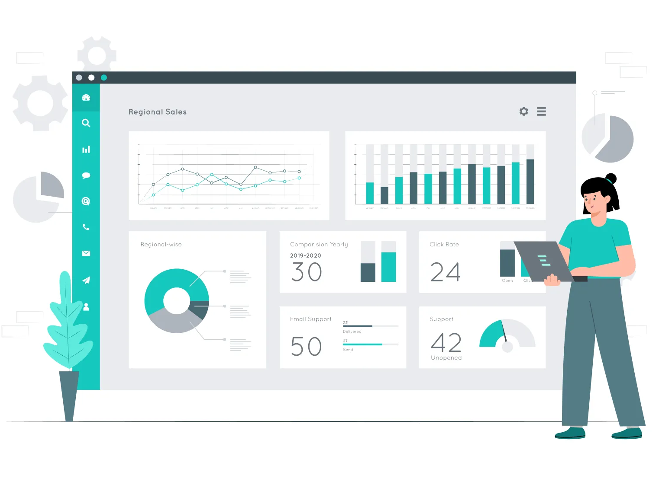
Proposed Solution: Power BI Dashboard
Dynamic visualizations
Data-based decisions
Interactive charts & maps for real-time insights
Enabling proactive safety measures and policies
Ease of use
Accessible for analysts, decision-makers, and road safety pros

Slide 4
UML/ER Diagram Overview
Vehicle Entity
Captures vehicle details contributing to accidents
Accident Entity
Describes incident specifics and severity
Location Entity
State-level geography of accident occurrences
Year Entity
Temporal context for accident trends analysis

Slide 5




Technology Stack & Dataset
Dataset
Cleaned_VehicleRoadAccident.csv providing accurate data
Power BI
Visualization & dashboard development tool
Excel
Data cleaning and preprocessing support

Slide 6
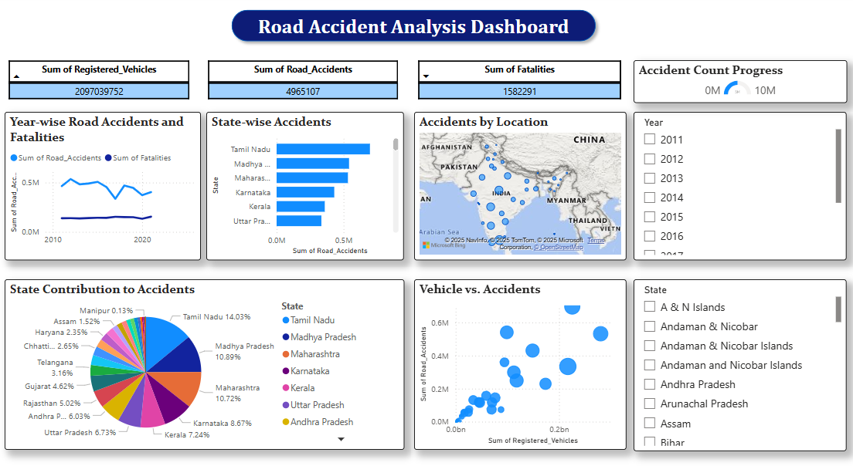
Dashboard Features
KPI cards highlighting key metrics
Year-wise Line Chart for trend analysis
State Bar Chart comparing accident counts
Interactive Map for geographical distribution
Pie Chart for accident type breakdown
Scatter Plot showing vehicle-accident correlation
Filters and Gauge Chart for progress tracking

Slide 7
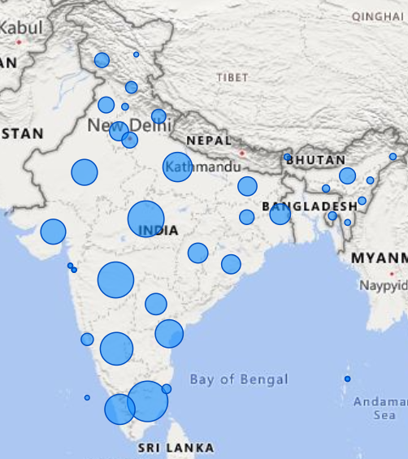
Results & Insights
Key Findings
Accident Hotspots
Identified accident peaks and risk factors
State-level clusters with high incident frequency
Vehicle-Accident Correlation
Patterns between vehicle types and accident severity

Slide 8

Data Limitations
Geographic Scope
Historical Data
Only state-level data available, no city granularity
Limited to past years, no real-time updates
Data Completeness
Potential gaps in accident reporting consistency

Slide 9

Future Scope
Real-time Data Feeds
Enable up-to-date accident monitoring
City-level Analytics
Deeper insights for urban traffic management
Predictive Analytics
Forecast trends & prevent accidents proactively
Mobile Dashboard Versions
Accessibility on-the-go for decision-makers

