Slide 1

Hospital Readmission-Case Study Analysis
by Tania Laha

Slide 2
Problem Statement
Impact of Medication for Lifestyle Diseases on Hospital Readmission: –
Management of lifestyle diseases in hospitalized patients has a significant bearing on outcome, in terms of both morbidity and mortality.
Objective:-
The main objective for this problem is to predict whether a patient is likely to be readmitted to hospital based on the previous details of the patient.
Target Variable Description:-
‘readmitted’ is the target variable with two labels ‘0’ and ‘1’ which denotes ‘not readmitted’ and ‘readmitted’ respectively.

Slide 3
Business Understanding
This case study helps to understand the reasons behind frequent hospital readmission and how to get rid of the problem at earliest.
From the outcome of predictive model, stakeholders will be able to get an idea which all factors are influencing the readmission cases more.
The solution will also stimulate the reduction of the expenses and time of hospital management spent on each readmission case.
It will also enhance the trust and faith of customers on hospitals regarding their quick recovery.

Slide 4
Data Understanding
There are total 66587 rows and 49 columns within the data.
There are total 12 integer , 1 float and 36 object columns.
Types of columns:
Continuous - 'index', 'encounter_id', 'patient_id','num_lab_procedures','num_medications’, 'number_outpatient', 'number_emergency', 'diag_5’.
Categorical - 'race', 'gender', 'age', 'time_in_hospital','number_inpatient','number_diagnoses','diag_1', 'diag_2', 'diag_3', 'diag_4', 'X1', 'X2', 'X3', 'X4', 'X5', 'X6', 'X7', 'X8', 'X9', 'X10', 'X11', 'X12', 'X13', 'X14', 'X15', 'X16', 'X17', 'X18', 'X19', 'X20', 'X21', 'X22', 'X23', 'X24', 'X25', 'change', 'diabetesMed’.
Target variable is mostly having uniform distribution within categories. It contains 54% ‘0’ and 46% of ‘1’ values and a classification model needs to be built to solve the problem.

Slide 5
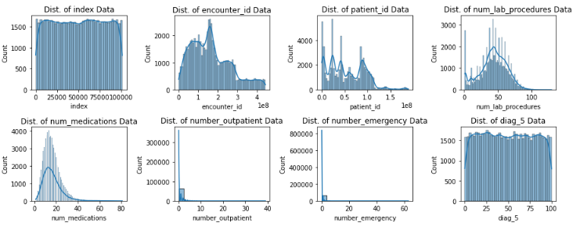
Exploratory data analysis on continuous columns
Missing value removal and imputation :
The dataset contains missing values for below columns :
‘race’, ‘weight’,’medical_specialty’, ‘diag_1’,’diag_2’ , ‘diag_3’ , ‘diag_4’
There are more than 30% missing values within ‘weight’ and ‘medical_specialty’ columns so dropped off those from dataset
Replaced missing values of other four columns by ‘NA’
Univariate Analysis :
From given histogram plot, it is quite evident that encounter_id', 'patient_id', 'num_lab_procedures', 'num_medications', 'number_outpatient', 'number_emergency’ are highly skewed continuous columns hence they need skewness treatment.

Slide 6
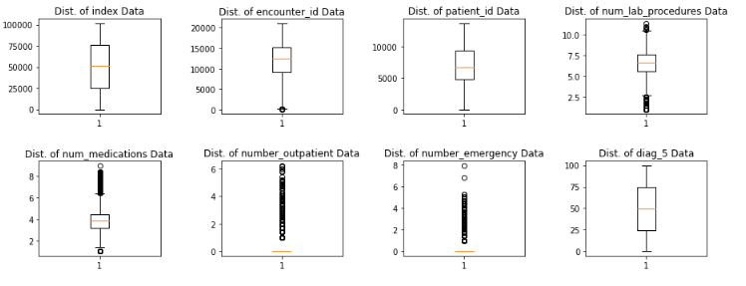
It is clearly visible from box-plots that some columns need to be treated to remove such large number of outliers.
Outliers are replaced by 90% of respective upper and lower bound values.
From histogram and box-plot, it can be inferred that both ‘number_outpatient’ and ‘number_emergency’ columns are immensely impacted by outliers and cannot be completely treated hence need to be permanently removed.
Also, the variance of these two specific columns seem to be lower (close to 0) so they are not much capable of extracting any meaningful insight out of data.

Slide 7
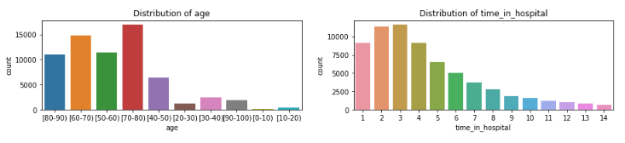
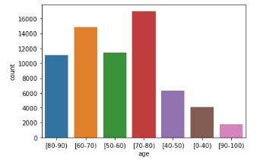
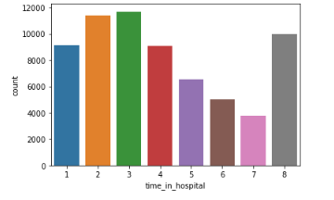
Exploratory data analysis on categorical columns
‘age’ column is having very minor contribution for 0 to 40 range so it is merged into one group i.e. [0-40)
Similarly, ‘time_in_hospital’ has been reduced to eight categories
The above method is followed for two other columns i.e. ‘number_inpatient’ and ‘number_diagnoses’

Slide 8
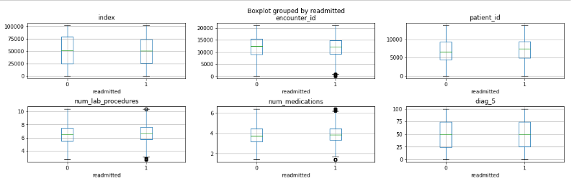
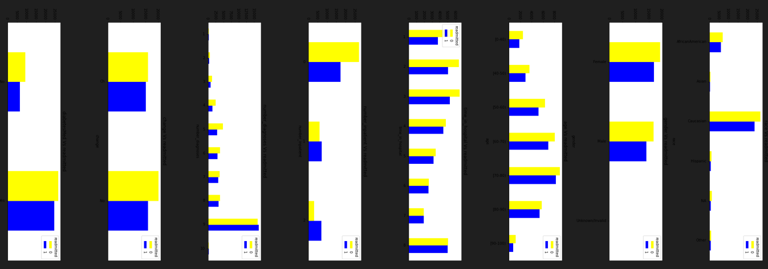
Bivariate Analysis
The box-plots help to investigate the dependency of target variable on continuous predictors
To validate the exploration from visualization, ‘Anova test’ has been performed and final predictors has been selected based on p-value.
Grouped bar-plots are used to visualize relationship between categorical predictors and categorical target variables.
‘Chi-square test’ has been performed to validate this relationship and selection of final predictors.

Slide 9
Feature Engineering and Feature Selection
To remove redundancy within data ‘diag_4’ column has been dropped as it is just a duplicate of ‘diag_3’.
‘diag_12’,’diag_23’ and ‘diag_34’ are created using ‘diag_1’,’diag_2’ and ‘diag_3’ to get more clarity on type of diseases diagnosed.
A new column ‘dosechange’ has been created using X1-X25 columns to check how many time doses of medicines has been changed.
Binary nominal columns has been mapped to numerics to make it useful for model building.
Final selected predictors for model are:
'index', 'encounter_id', 'patient_id', 'race', 'gender', 'age', ‘ ‘time_in_hospital’, 'num_lab_procedures’, 'num_procedures', 'num_medications', 'number_inpatient', 'diag_5’, 'number_diagnoses’,'change', 'diabetesMed', 'diag_12', 'diag_23', 'diag_34', 'dosechange'

Slide 10
Interpretation of predictive model’s output
A ‘Logistic regression’ model has been created to predict the output of given data.
After analysis of the final outcome, it has been observed this model has a training score of 0.624 and test score of 0.622 which is quite lower in range. Hence this can be considered as an ‘underfit’ model (both bias and variance are high).
Final average accuracy of model using F1-score and 10 fold cross validation is 0.62.
From ROC-AUC curve , it can be inferred that with an auc score of 0.66 this predictive model is having moderate predictive power and its True positive rate is also quite low.
Overall, this predictive model is an average performer and needs more improvement in future.

Slide 11
THANK YOU

